Slide 1
An open rainfall-runoff measurement database
Jan Devátý¹, Hana Beitlerová² & Jonas Lenz³
¹ Czech Technical University in Prague, Faculty of Civil Engineering; ² Research institute for soil and water conservation; ³ Technische Universität Bergakademie Freiberg

Slide 2
Introduction & motivation
every team and person has its unique way to record the data collected during experimental campaigns
the data are further processed and much of the important information can get lost during the processing and during the time that passed since the experiment
the effort to compose a consistent output of many series’ of measurement (especially if taken and processed over long timespan by many different workers) can be enormous

Slide 3
Conceptual layout
every datapoint is a part of dataset record
every record is a part of measurement
records can be edited, processed and combined
every measurement is a part of an experiment
every experiment is a part of experimental setup
every experimental setup is a part of the environment
All of the above needs to be stored in a comprehensive way and well documented by metadata.
The desired state is where every record has metadata included and is back-trackable to the original source field record regardless if it was written on paper or recorded by digital logger.

Slide 4
FAIR principles
The runoffDB follows the principles stated by www.go-fair.org
Findable
Metadata and data should be easy to find for both humans and computers. Machine-readable metadata are essential for automatic discovery of datasets and services
Accessible
The protocol is open, free, and universally implementable, the protocol allows for an authentication and authorisation procedure, where necessary
Interoperable
(Meta)data use a formal, accessible, shared, and broadly applicable language for knowledge representation., (Meta)data include qualified references to other (meta)data
Reusable
metadata and data are well-described so that they can be replicated and/or combined in different settings.

Slide 5
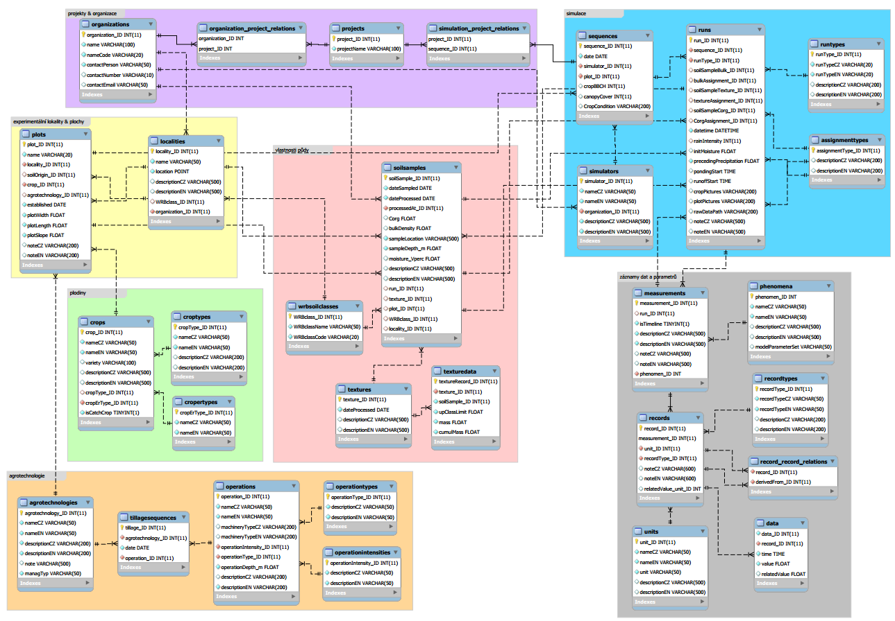
Implementation
the relational database is coded in MySQL
metadata are stored in Czech and English language
so far it’s being tested on the rainfall simulator experiments data from the teams of the authors (CTU, VUMOP, TUBAF: over 1000 data records of over 300 experiments)
the DB includes rainfall simulation specific data structures but can be used by many other experimental setups
the graphical user interface and the documentation will be available at runoffdb.fsv.cvut.cz

Slide 6
User access control
several levels of user access are provided
a public web user interface for low-level access to the data (tables and charts)
private web interface provides logged-in users the rights to add, delete and alter data
high level access by direct querying the DB is available for trusted users who are familiar with MySQL language and so are capable of creating their own complex queries
querying the database is possible via any programing language with appropriate libraries

Slide 7
Feeding and mining the database
any consistent record form can be parsed by a script and thus easily transcribed into the DB’s data structure ... any inconsistent records can be transcribed manualy ☺
the data and their derivatives can be programmatically output into new data structures, e.g. datasheets for models calibration – the datasheets can be instantly re-generated on demand and used for fresh batch of calibrations runs once the DB is updated
the data can be re-structured for utilization in another environment (e.g. GIS softwares)
metadata regarding the source of the data, authors and funding providers are bound to the data and are available for the exports
“Those who share will benefit from sharing of others”

Slide 8
Want to participate?
Contact me on jan.devaty@fsv.cvut.cz and bring in any ideas that might help extend the usability of the database.
Does your team use some standard record sheet that can parsed?
send it in and I can code a script to store the data into the runoffDB
Do you need a calibration sheet for your runoff/soil erosion model?
contact me and we can find a way for its automatic generation together
Thank you for your time!

