Slide 1
On Space Weather Data Assimilation
Mihail Codrescu¹, Stefan Codrescu^{1,2}, Mariangel Fedrizzi^{1,2}, and Claudia Borries³
¹Space Weather Prediction Center, Boulder, United States of America (mihail.codrescu@noaa.gov)
²Cooperative Institute for Research in Environmental Sciences, University of Colorado, Boulder, USA
³Deutsches Zentrum für Luft- und Raumfahrt, Neustrelitz, Germany

Slide 2
Abstract
Most if not all terrestrial weather prediction services today are based on data assimilation and numerical weather prediction models. Space Weather services are expected to follow a similar path towards data assimilation. However, the application of data assimilation in Space Weather requires a different implementation compared to terrestrial weather because space systems tend to be strongly forced and because the amount of data available for assimilation is critically small. In this paper we review the implementation of an ensemble Kalman filter data assimilation system based on the Space Weather Prediction Center operational Coupled Thermosphere Ionosphere Plasmasphere Electrodynamics (CTIPe) model. We present assimilation results for neutral mass density during geomagnetically quiet and disturbed conditions and discuss the future use of data assimilation for the thermosphere ionosphere system.

Slide 3
Chaotic vs Strongly Forced Systems
Codrescu et al. 2018 https://doi.org/10.1002/2017SW001752

Slide 4
The Covariance Matrix
Set of correlations between state elements (model values at grid points)
Must reflect the uncertainty of the background model
Some state elements may not correlate with other state elements
A larger variety and volume of data is desirable to cover the state
How to calculate or estimate the covariance matrix?

Slide 5
How to Calculate or Estimate the Covariance
Most models in Space Weather are non-linear and the covariance being state dependent must be determined independently at each assimilation time step
Ways
Variational Analysis: Run the model while changing one state element at a time and recording the results
Use Monte Carlo methods to estimate the covariance

Slide 6
Thermosphere Ionosphere Data Assimilation (TIDA)
Use an ensemble of model runs
Use ensemble member statistics to infer the covariance
Questions about the ensemble:
How many members?
How to force the members?
How many elements in the state?

Slide 7
TIDA Results for 20 March 2007
Assimilated CHAMP and compared also at GRACE
Codrescu et al., 2018 https://doi.org/10.1002/2017SW001752

Slide 8
The November 18 – 21, 2003 Simulation

Slide 9
Storm Recovery November 21, 2003 TIDA Results

Slide 10
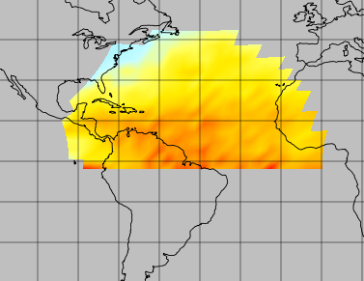
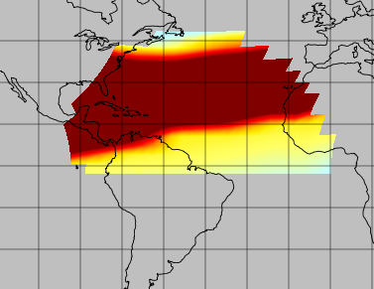
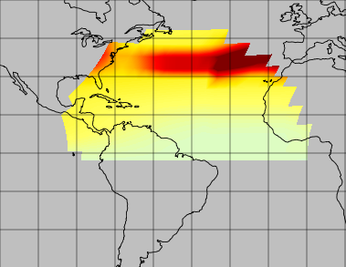
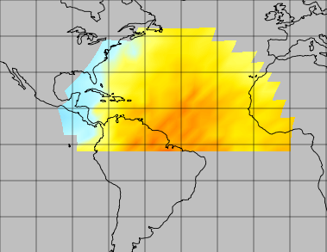
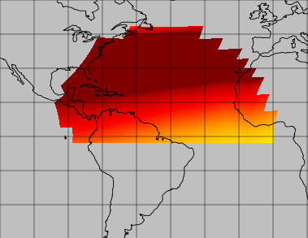
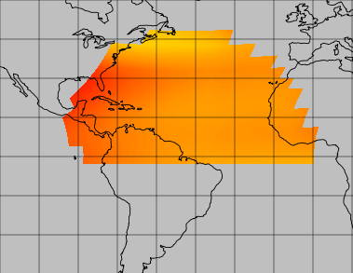
Gold Measurements, Reference, and Analysis (20x Uncertainty)
May 12 top line, May 15, 2019 bottom line

Slide 11
GOLD O/N₂ Ratio Assimilation The Importance of Measurement Uncertainty

Slide 12
Conclusions
EnKFs offer best hope for dealing with input uncertainties for strongly forced systems and even bridging input data gaps
Assimilation results depend critically on both model and data uncertainties
TIDA can assimilate neutral density and neutral composition
Assimilation of electron density and TEC on the way
Global Observations of The Limb and Disk (GOLD) measurements seem sufficient to constrain the background model on first order effects

