Slide 1
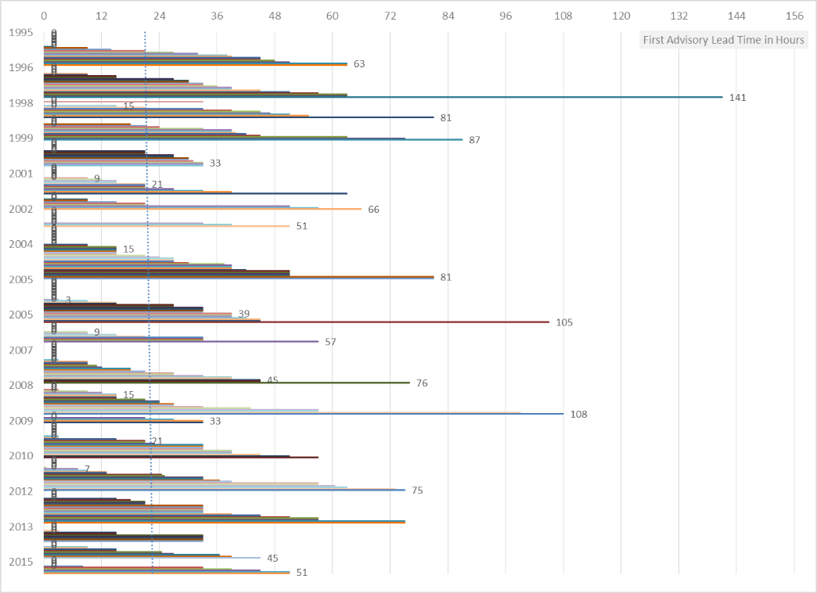
More than a Feeling: Using Climate Information to Understand and Communicate Storm Risk in Caribbean Small Islands
Denyse S. Dookie
Grantham Research Institute on Climate Change and the Environment/LSE | Profile | d.dookie@lse.ac.uk
* please click on links to access more information *
Storms a key threat in the Caribbean
Caribbean islands have historically been affected by natural hazards
Storms are most frequent & severe threat (i.e. people affected, economic damages) – Click here
Ongoing research efforts help better forecast storm track and intensity, but relatively less research/policy on improving disaster preparedness
Communicating Disaster Risk
Survey of 2016 Wet Season CariCOF participants highlighted a ‘weekend effect’ which may affect many Caribbean weather and disaster agencies – Click here
Short lead times and reduced awareness on weekends may challenge quick action
Improved institutional support to better utilise climate information, and enhanced communication and local coordination listed as main essential resources required
Insights of Climate Information
Climate Information, such as storm lead time, can help improve the context and awareness of impending threats towards enhanced disaster preparedness and resilience strategies
Research identifies range of relatively short lead times across Caribbean islands, challenges of adequate preparedness and active prioritisation of needs, given resource-related limitations
What next?
Collaboration with regional/local partners on findings, enhancing use of climate information in critical step towards disaster preparedness and resilience building
Click here
Regional average storm lead time, i.e. difference in hours between time at first-issued storm advisory and time at storm approach or landfall: 21.8 - 33.4 hours
Average storm lead-time by country varies between 9 hours (Grenada) to 31.2 hours (The Bahamas)
Highlights disparity across region, even when lead times weighted by number of storms affecting islands
Acknowledgements
Many thanks to: Dan Osgood (IRI/Columbia); Participants at 2016 Wet/Hurricane Season Caribbean Climate Outlook Forum (CariCOF), Roseau, Dominica; Cédric Van Meerbeeck (Caribbean Institute for Meteorology and Hydrology, Barbados); Glenroy Brown (Jamaica Meteorological Services); Dale Destin (Antigua & Barbuda Meteorological Services); Shem Willie (Saint Lucia Meteorological Services); Suzana Camargo and Chia-Ying Lee (Lamont/Columbia University); Carolyn Vernimen-Balk, Natalie Belew, and Claire Palandri (Data Collection).
All Rights Reserved.

Slide 2
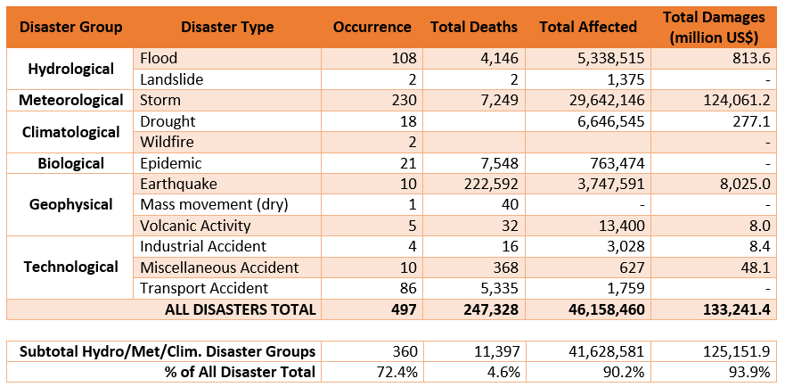
Disasters in the Caribbean (28 countries & territories), 1990-2020 [EM-DAT]
Source: EM-DAT: The Emergency Events Database - Universite catholique de Louvain (UCL) - CRED, D. Guha-Sapir - www.emdat.be, Brussels, Belgium
Last Database Update: January 30 2020
Please refer to EM-DAT database for definitions of terms used.
Return to Main Slide
EGU 2020: Denyse S. Dookie | More than a Feeling: Using Climate Information to Understand and Communicate Storm Risk in Caribbean Small Islands

Slide 3
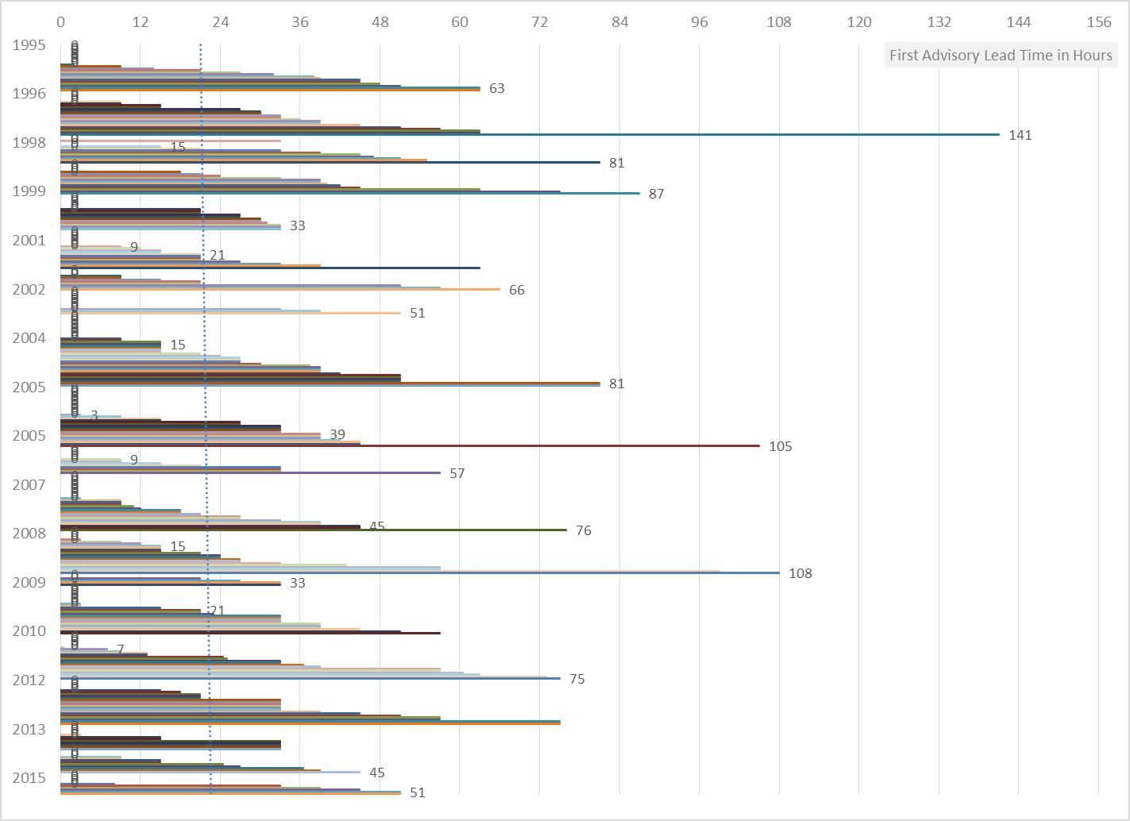
Lead Time: difference in hours between time at first issued storm advisory and time at approach or landfall
Graph constructed of 384 records, in 14 Caribbean countries, over 1995-2015
Regional Average Lead Time: 21.8 hours
Average slightly increasing over period
Click here to see country average lead times
Min. Lead Time: 0 hours (133 events)
0-hour lead time occurs if no advisory issued, but still storm approach or landfall
Click here for Graph without 0-hour lead time
Note that colours are visual aids only and do not represent further details
Return to Main Slide
EGU 2020: Denyse S. Dookie | More than a Feeling: Using Climate Information to Understand and Communicate Storm Risk in Caribbean Small Islands

Slide 4
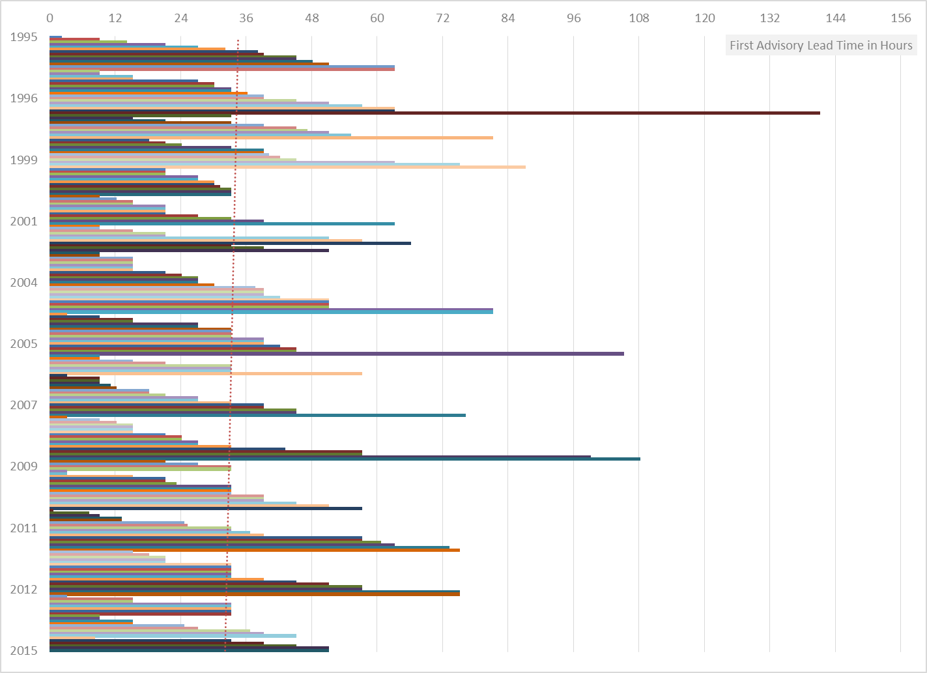
Lead Time: difference in hours between time at first issued storm advisory and time at approach or landfall
Graph constructed of 251 records, in 14 Caribbean countries, over 1995-2015
Range: 0.5 – 141 hours
No 0-hour lead time included. Note: 0-hour lead time occurs if no advisory issued, but still storm approach or landfall
Regional Average Lead Time: 33.4 hours
Average slightly decreasing over period
Note that colours are visual aids only and do not represent further details
Return to Main Slide
EGU 2020: Denyse S. Dookie | More than a Feeling: Using Climate Information to Understand and Communicate Storm Risk in Caribbean Small Islands

Slide 5
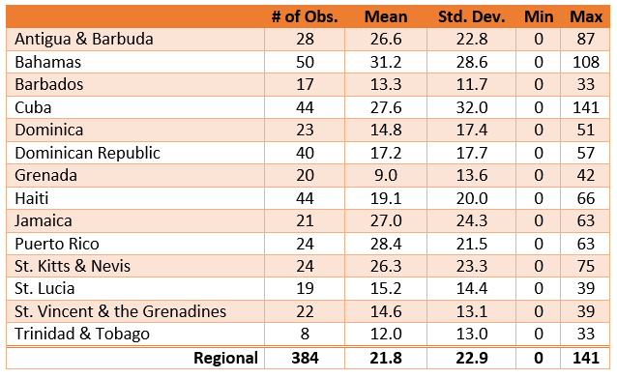
Summary Statistics of Storm Approach Lead Times, by Country (incl. 0-hr lead)
Lead Time: difference in hours between time at first issued storm advisory and time at approach/landfall
Table of 384 events, 14 selected Caribbean countries*, 1995-2015
Regional Average Lead Time: 21.8 hours
Click here for an illustration of these country differences
* Country selection based on available economic data and autonomy
Return to Main Slide
EGU 2020: Denyse S. Dookie | More than a Feeling: Using Climate Information to Understand and Communicate Storm Risk in Caribbean Small Islands

Slide 6
Storm Lead Times in the Caribbean, weighted by number of storms
Map based on weighting country-level storm lead times (in hours) by number of storms per island, in period 1995-2015
Dominican Republic Haiti, and Grenada stand out as most affected by short lead times based on number of storms (i.e. weighted storm lead times <0.5)
Bahamas, Cuba, Dominica, St. Vincent & the Grenadines also face relatively short lead times
N
Bahamas
< 0.5
0.5 – 0.75
0.75 – 1
Cuba
Turks & Caicos
Islands
> 1
Mexico
Dominican Republic
Atlantic Ocean
Cayman Islands
Jamaica
Haiti
Puerto Rico
Belize
Antigua & Barbuda
St. Kitts & Nevis
Guadeloupe
Honduras
Dominica
Caribbean Sea
Martinique
Nicaragua
St. Vincent & Grenadines
St. Lucia
Barbados
Grenada
Costa Rica
Trinidad & Tobago
Panama
Colombia
Venezuela
Return to Main Slide
EGU 2020: Denyse S. Dookie | More than a Feeling: Using Climate Information to Understand and Communicate Storm Risk in Caribbean Small Islands

Slide 7
Communicating Disaster Risk in the Caribbean
What is the most essential resource needed to assist this weak link? (Ranked)
Improved institutional support to utilise information
What is the likely weak link in communicating disaster risk?
Limited general preparation for disasters by local public (i.e. threat doesn't happen often, or won't affect them). Note: about 30% of advisories highlight storms which do not make approach or landfall
Challenges in Agency capacity to acknowledge and share initial information about disaster
Challenges in Agency capacity to follow-up information and respond to disaster
Limited awareness of impending threat by local public (i.e. not following news, away from info sources)
Communication, e.g. need better strategy or local coordination
Networking with other agencies, local and/or regional
Technical skills of responsible agency
Financial, e.g. need access to or increase in funds, either generally or within responsible agency
Human, e.g. need more capacity within responsible agency
Technical Assistance, i.e. unsure of how to fit this information into existing decision-making strategies
More data, e.g. climate information, number of people affected, most vulnerable locations
Information about disaster management/best practices/research about disasters within the region
Why are operations/response different on weekends?
Some agencies closed, or at limited capacity, offering slower response times
Communication to/within local public may be limited (cultural, recreational norms)
Certain sectors do not maintain 24-hour shift system
Challenges of mobilising volunteers
Note: Participants who responded as such more likely from English-speaking Caribbean
Note: All ranked similarly
Participants at 2016 Wet Season Caribbean Climate Outlook Forum (CariCOF) surveyed on regional use of climate information and communication of disaster risk
Participants included reps from Caribbean weather and disaster agencies, and agriculture, tourism, and water sectors
While there are many reasons for challenge of communicating risk, the key resources needed include improved institutional support and better local coordination and networking
Participants also asked if operations were different on weekends, and majority said yes
However, given short storm lead times, reduced awareness on weekends may threaten quick action by local agencies
Return to Main Slide
EGU 2020: Denyse S. Dookie | More than a Feeling: Using Climate Information to Understand and Communicate Storm Risk in Caribbean Small Islands

