Slide 1


Turbulent Mixing in the benthic biolayer of streams with bedforms
Ahmed Monofy
Supervisor: Fulvio Boano
Co-supervisor: Stanley Grant

Slide 2
Benthic Biolayer
Biological active upper (~20 cm) region within the streambed.
Stream turbulence drives the vertical transport of dissolved constituents into the streambed.
Grant et al. (under review)

Slide 3
Benthic Biolayer
Turbulent mixing in the benthic biolayer:
Bedform Pumping.
Permeability hetrogeneity.
Turbulent pumping.
Bedform turnover.
Turbulence penetration.
Grant et al. (under review)

Slide 4
Conceptual model
Average vertical flux (J, kg/m².s) of a conservative solute through a permeable sedimentbed:
x , depth below surface-water interface (m).
ϴ , streambed porosity.
C_{s} , Interstitial solute concentration (kg/m³).
D_{eff} , effictive diffusivity; moleculer diffusion(D’_{m}), dispersion (D_{d}), and turbulent diffusion (D_{t}) coefficients (m²/s).
Grant et al. (under review)

Slide 5
Conceptual model
Subistituting the average vertical flux (J) in the conservation equation:
C_{s} , Interstitial solute concentration (kg/m³).
D_{eff} (x), depth-varying effictive diffusivity coefficients (m²/s).
t , time (s).
Grant et al. (under review)

Slide 6
Conceptual model
Two profiles of D_{eff}(x) are adopted in this work:
D_{eff,0} , the effective diffusivity at the sediment-water interface.
f(x)= 1 for constant profile.
f(x)= e^{-ax} for exponential profile, a is the inverse-length scale.
Grant et al. (under review)

Slide 7
Conceptual model
Our model accounts for the two-way feedback (negative feedback) by combining the following to equation through the Duhamel’s thereom:
Water Column mass balance:
Vertical mass flux (J(x), kg/m2.s) in the sedimentbed:
Grant et al. (under review)

Slide 8
Adopted Experiments
Our conceptual model is applied on a set of bedform experiments.
List of smallscale bedforms (ripples and dunes) experiments:
Elliot and Brooks 1997
Packman et al. 2000
Packman and Mackay 2003
Ren and Packman 2004
Pachman et al. 2004
Rehg et al. 2005
Ren and Packman 2004

Slide 9
Results
The predicted sediment-water interface effective diffusivity (D_{eff0}) is plotted vs the permeability Reynold’s number (Re_{k}).
The exponential profile predicts higher effective diffusivity at the sediment-water interface, which decreases with depth by a decay factor (a).
Modeling the domain with infinite sediment bed underestimates the mixing in the bed (less D_{eff0}) compared to the confined bed assumption.

Slide 10
Results
Which Model is superior?!
Re_{k} <1
 | Constant Deff Infinite bed | Exponential Deff Infinite bed | Constant Deff Infinite bed
AICc
R²
RMSE
Re_{k} >1
AICc
R²
RMSE

Slide 11
Results
Which Model is superior?!
Re_{k} <1
 | Constant Deff Infinite bed | Exponential Deff Infinite bed | Constant Deff Infinite bed
AICc
R²
RMSE
Re_{k} >1
AICc
R²
RMSE

Slide 12
Results
Which Model is superior?!
Re_{k} <1
 | Constant Deff Infinite bed | Exponential Deff Infinite bed | Constant Deff Infinite bed
AICc
R²
RMSE
Re_{k} >1
AICc
R²
RMSE

Slide 13
Results
Which Model is superior?!
Re_{k} <1
 | Constant Deff Infinite bed | Exponential Deff Infinite bed | Constant Deff Infinite bed
AICc
R²
RMSE
Re_{k} >1
AICc
R²
RMSE

Slide 14
Comparison with previous Studies
Comparing with O’Connor and Harvey 2008.
The differences:
Using the exponential diffusivity profile in this study vs constant profile in O’Connor and Harvey’s.
O’Connor and Harvey’s Formula of estimating the D_{eff} does not account for the sediment porosity.
And most importantly, accounting for the two-way feedback in our study.

Slide 15
Comparison with previous Studies
Comparing with Grant et al. 2012.
The differences:
Using the exponential diffusivity profile in this study vs constant profile in Grant et al. 2012 study.
And most importantly, accounting for the two-way feedback in our study.

Slide 16

Sediment bed effect
How adding an impervious layer will change the predicted effective diffusivity?
Water
Water
Sediment
Sediment
X->∞
X->d_{b}
d_{b}
Impervious layer

Slide 17
Sediment bed effect
How adding and impervious layer will affect the effective diffusivity?
Certainly in some experiments, imposing a bottom boundary layer changes the effective diffusivity prediction on the sediment surface.
Assuming infinite bed for our model underestimated the effective diffusivity.

Slide 18

Sediment bed effect
How adding and impervious layer will affect the effective diffusivity?
A_{N} indicator A_{N} is proposed to see if the sediment depth will have an effect or not.
If A_{N}>1, this implies that the sediment bed will have an effect on the results.
A_{N}= $\frac{\sqrt{Deff ∗Texperiment}}{ϴ\left(porosity\right)∗db}$

Slide 19
Future work
Including different morphology types (flat bed, bedforms, pools-riffles).
Performing a meta analysis, and build a generalized predictive model that can predict the value of the effective diffusivity in different hydraulic and morphological characteristics.

Slide 20
References
Elliott, A. H., & Brooks, N. H. (1997). Transfer of nonsorbing solutes to a streambed with bed forms: Laboratory experiments. Water Resources Research, 33(1), 137-151.
Packman, A. I., Brooks, N. H., & Morgan, J. J. (2000). Kaolinite exchange between a stream and streambed: Laboratory experiments and validation of a colloid transport model. Water Resources Research, 36(8), 2363-2372.
Packman, A. I., & MacKay, J. S. (2003). Interplay of stream‐subsurface exchange, clay particle deposition, and streambed evolution. Water Resources Research, 39(4).
Ren, J., & Packman, A. I. (2004). Stream-subsurface exchange of zinc in the presence of silica and kaolinite colloids. Environmental science & technology, 38(24), 6571-6581.
Packman, A. I., Salehin, M., & Zaramella, M. (2004). Hyporheic exchange with gravel beds: basic hydrodynamic interactions and bedform-induced advective flows. Journal of Hydraulic Engineering, 130(7), 647-656.
Rehg, K. J., Packman, A. I., & Ren, J. (2005). Effects of suspended sediment characteristics and bed sediment transport on streambed clogging. Hydrological Processes: An International Journal, 19(2), 413-427.

Slide 21
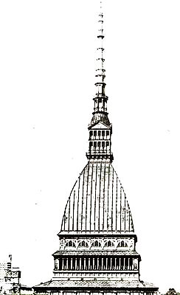
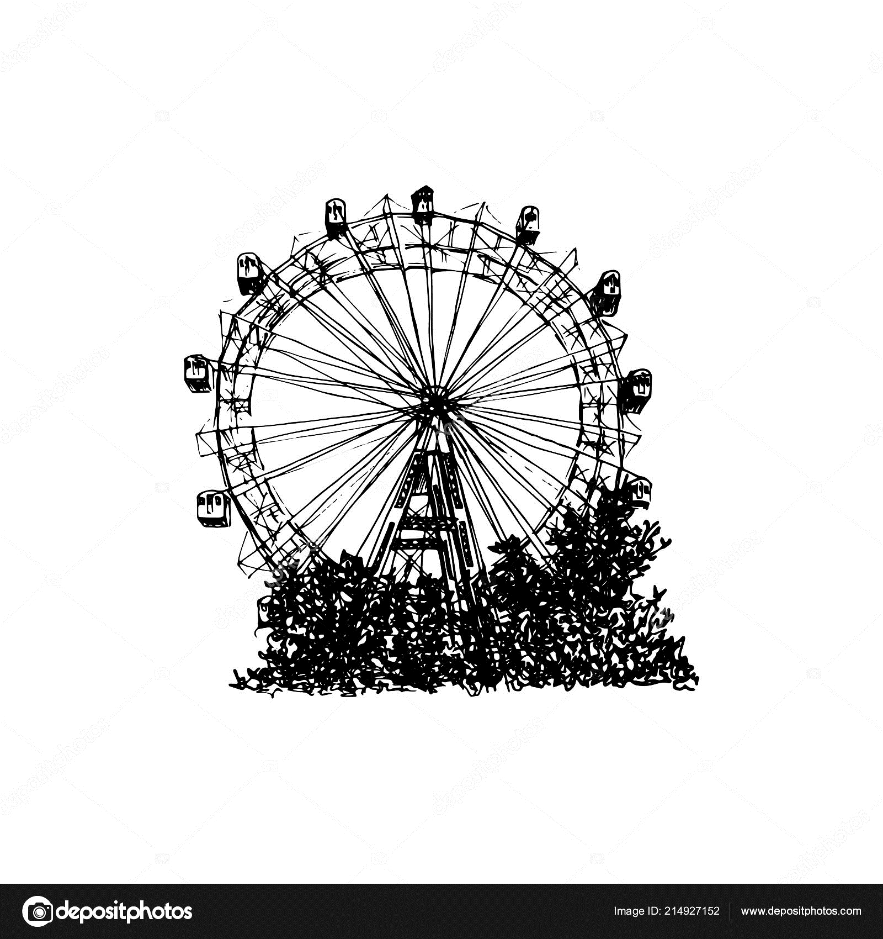
TH NK Y U
Ahmed Monofy

Slide 22

TH NK Y U
Ahmed Monofy

