Slide 1
Quantification of the dissolution kinetics of natural gypsum and particle transport processes applied to the evolution of dissolution cavities
Imen Zaier^{1,2}, Joël Billiotte¹, Arnaud Charmoille², Farid Laouafa²
¹MINES ParisTech, PSL Research University, Centre of Geosciences, Fontainebleau, France
²National Institute for Industrial Environment and Risks (Ineris), Verneuil-en-Halatte, France
Imen.zaier@mines-paristech.fr
Ineris -
[CGR]
-
454923
-
[Version (doc)]

Slide 2
Outline
1
Research framework
2
Experimental approaches
Characterization of the dissolution kinetics
Characterization of particle transport processes
3
Conclusions

Slide 3
Research framework

Slide 4
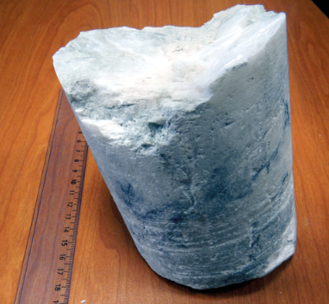
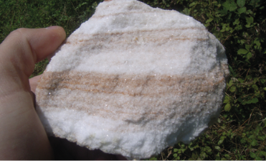
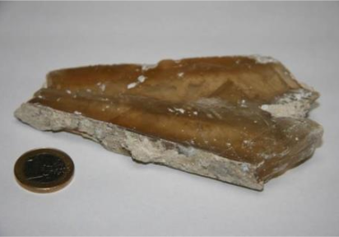
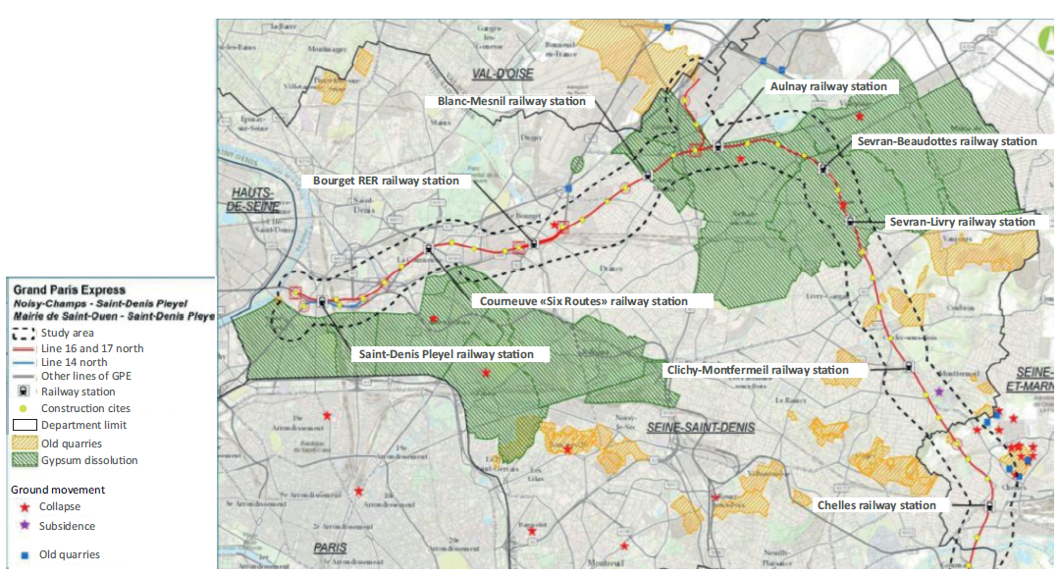
Research framework
Study location
Gypsum is a moderately soluble mineral
→ Various gypsum facies in the Paris region:
Mineral | Formula | Solubility (g/L)
Calcite | CaCO3 | 0,015 – 0,060
Gypsum | CaSO4, 2H2O | 2,5
Salt | NaCl | 360
Alabaster (M&C, IdF)
Sacharoidal (Isère)
Glassy arrowhead gypsum
Study location
Seine-St-Denis department- Grand Paris Express metro line
Mairie de Paris- IGC
http://www.enquetepubliqueuniqueligne16.fr/assets/files/Dossier_EP_Ligne16_Volet_E2.pdf
Pre-Ludian gypsum (40 MA)
Old underground quarries

Slide 5
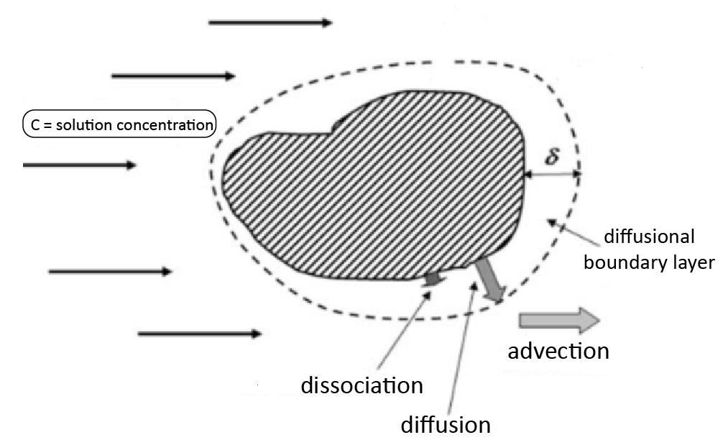
Research framework
Basic definitions
Gypsum dissolution in three main steps:
1
Kinetic model controlled by surface reaction:
$$τ_{s}=k_{s}{\left(1−{C_{s}}/{C_{ref}}\right)}^{n}$$
2
Kinetic model controlled by molecular transport:
$$τ_{t}=k_{t}(C_{s}−{\left.C_{b}\right)}/{C_{ref}}$$
$$k_{t}=\frac{D}{δ}C_{ref}$$
3
1
2
A mixed reaction-transport kinetic model:
$k_{s}$ : dissolution rate coefficient
$${τ=τ}_{s}=τ_{t}$$
n : kinetic order > 1
$C_{s}$ : concentration of the dissolved species at the surface of the mineral
$C_{ref}$: equilibrium concentration
Kinetic order >1:
$C_{b}$ : concentration of the dissolved species in the solution
$$\frac{dC}{dt}=\frac{A}{V}τ$$
$k_{t}$ : transport constant
$$C(t)=f(k,n,t)$$
$$k , n ??$$
for different varieties of natural gypsum
$$k , n??$$

Slide 6
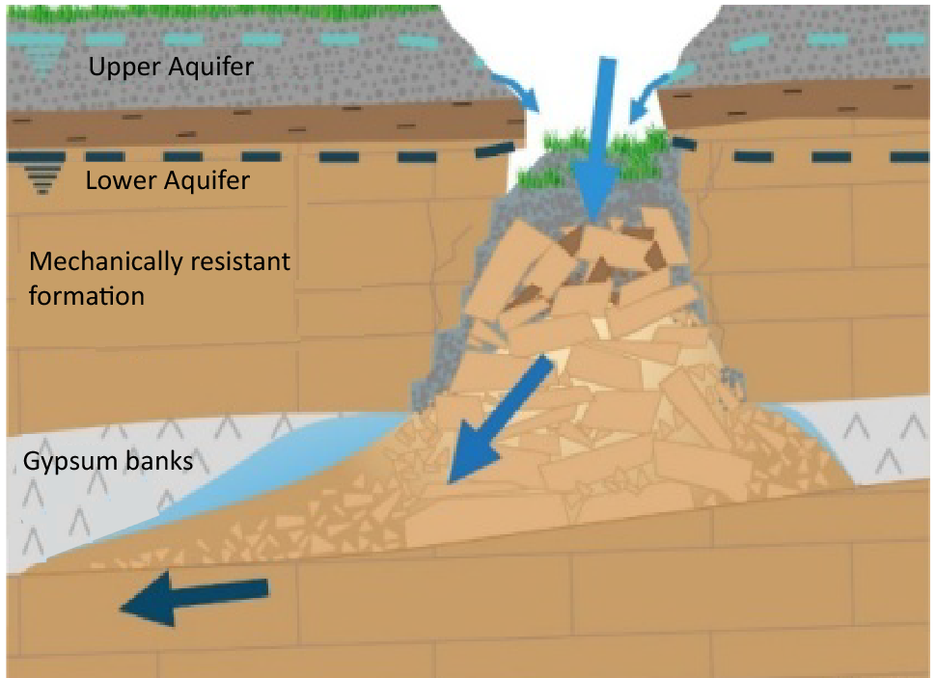
Research framework
Mechanisms responsible for the cavity formation is gypsum dissolution
Gypsum + groundwater flow: from dissolution to sinkhole subsidence
Undersaturated water in contact with gypsum
Void created by dissolution
Underground collapse
Hypothesis : Particle transport process strongly increases cavity growth
Active hydraulic disturbances:
Anthropic or hydroclimatic
Active natural dissolution:
Gypsum destructuration
Growth of the dissolved mass
Transport of gypsum grains (undissolved) by the flow
Potential increase of the cavity volume
Experimental work in progress:
Quantification of the dissolution kinetics: natural gypsum with different fabrics and insoluble contents
The impact of erosion and particle transport related to gypsum dissolution

Slide 7
Experimental approaches

Slide 8
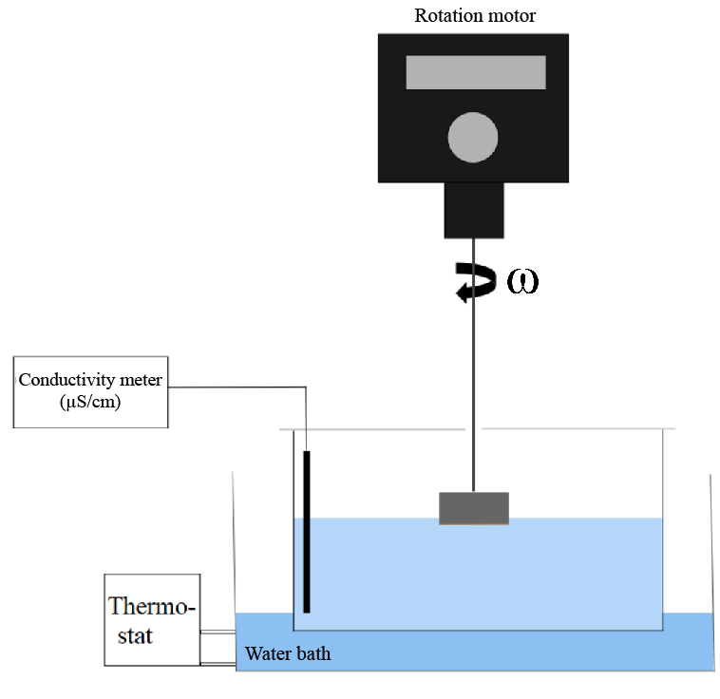
Rotating disk technique
Experimental setup
Setting rotation speed 𝜔:
50, 100 and 200 rpm
Measurement of the electrical conductivity $σ$
from $σ$ = 0 to $σ$ = equilibrium
→ variation in the boundary layer characteristics
Controlled temperature: 15 and 20°C
Rotating disk
Performing measurements under constant and uniform boundary conditions
Diffusion boundary layer $δ$ controlled by the rotation speed $ω$
Quantifying the evolution of the solution concentration from the electrical conductivity measurements
$$\frac{dσ_{rel}(t)}{dt}=τ_{0}{(1−σ_{rel}(t))}^{n}$$
$$τ_{0}=\frac{A}{V}k_{σ}=\frac{A}{V}\frac{k}{C_{ref}}$$
$$σ_{rel}=σ/{σ_{ref}}$$

Slide 9
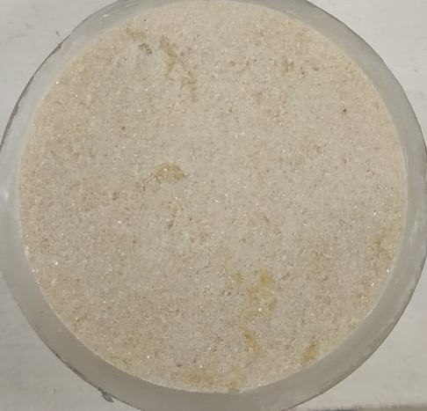
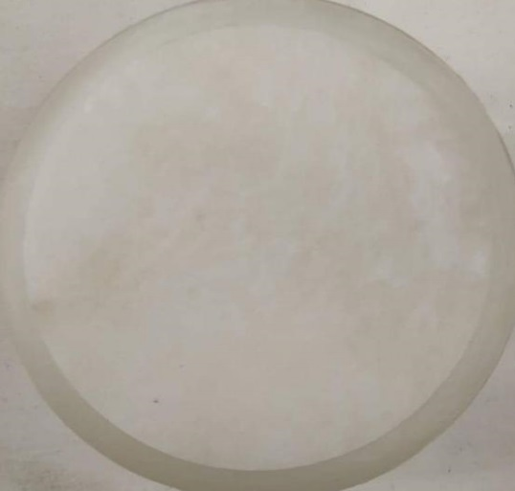
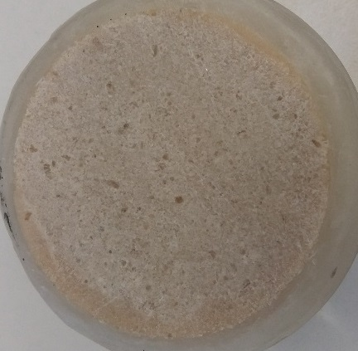
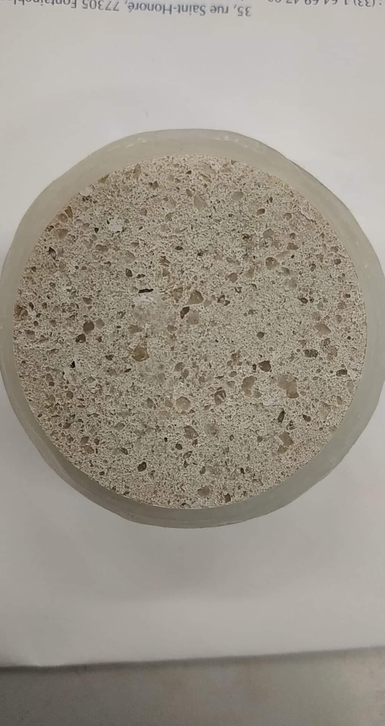
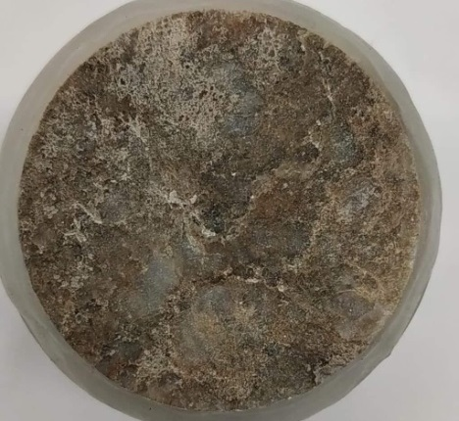
Rotating disk technique
Experimental setup
Samples: various facies of gypsum disks initially polished
From the underground quarry of Vaujours
From the exploratory drill cores of the Grand Paris Express project:
sacharoidal
alabaster
Sacharoidal
(used as reference)
matrix textured gypsum
Impure alabaster

Slide 10
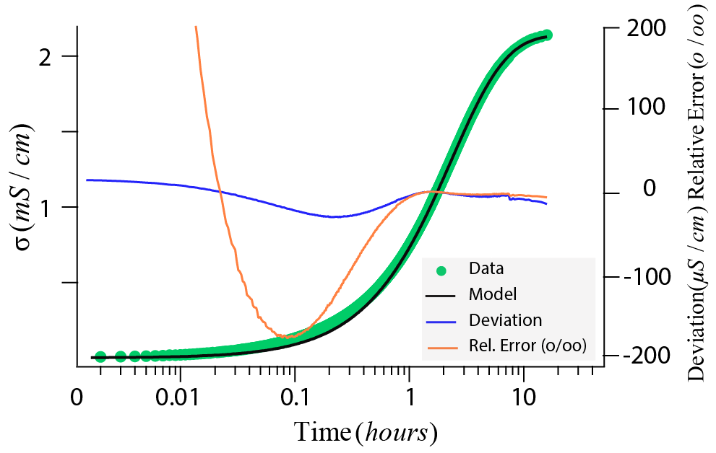
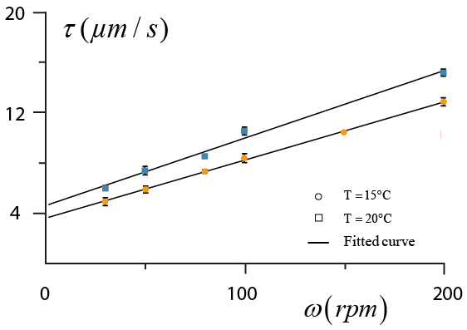
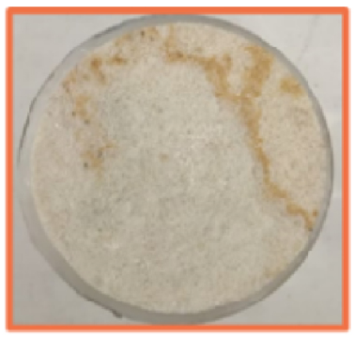
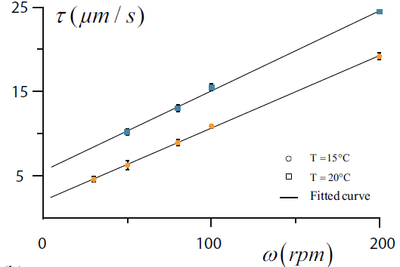
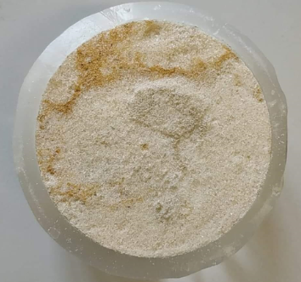
Rotating disk technique
Quantification of the dissolution kinetics
→ Interpretation by a global fit (τ₀, n, [σref])
duration: 2 days
Sacharoidal gypsum (1)
$$τ_{0}, n$$
Alabaster gypsum
Development of a macroscopic roughness during the experiment
At zero rotation speed
Gypsum sample (initially polished) | Recession rate (µm/s) T=15 °C | R²
Sacharoidal (1) | 2,09 | 0.99
alabaster | 3.58 | 0.99
Sacharoidal (2) | 1 ±2 | 0.7

Slide 11
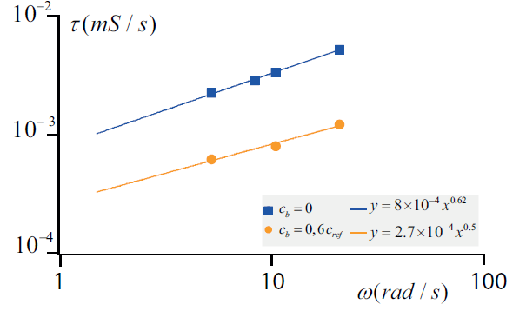
Rotating disk technique
Influence of surface roughness
Levich theory
Gypsum dissolution rate under conventional conditions
$$τ=α{ D}^{2/3}{ θ}^{−1/6}{ ω}^{β}$$
$$β=0.5$$
Comparison of rotating disk experiments under conventional/unconventional conditions
Alabaster: T=15°C
 | Conventional conditions | Unconventional conditions
$$σ_{start}$$ | $$0.6 σ_{ref}$$ | $$0$$
$$σ_{end}$$ | $σ_{start}$+ 10 µS/cm | $$σ_{ref}$$
$$β$$ | $$0.5$$ | $$>0.5$$
Gypsum disk has naturally developed a surface roughness at 0.6$σ_{ref}$
→ disturbance of the hydrodynamic conditions in fluid/gypsum interface

Slide 12
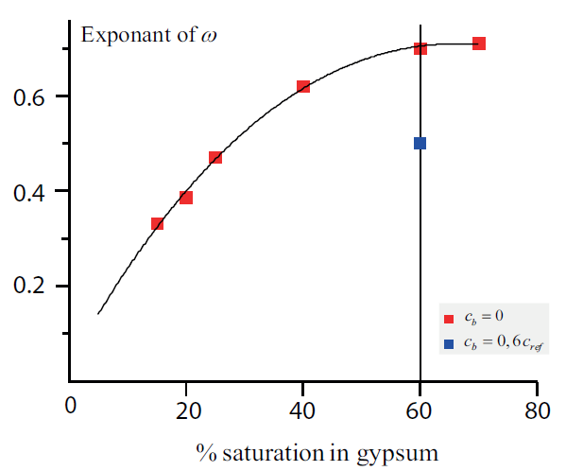
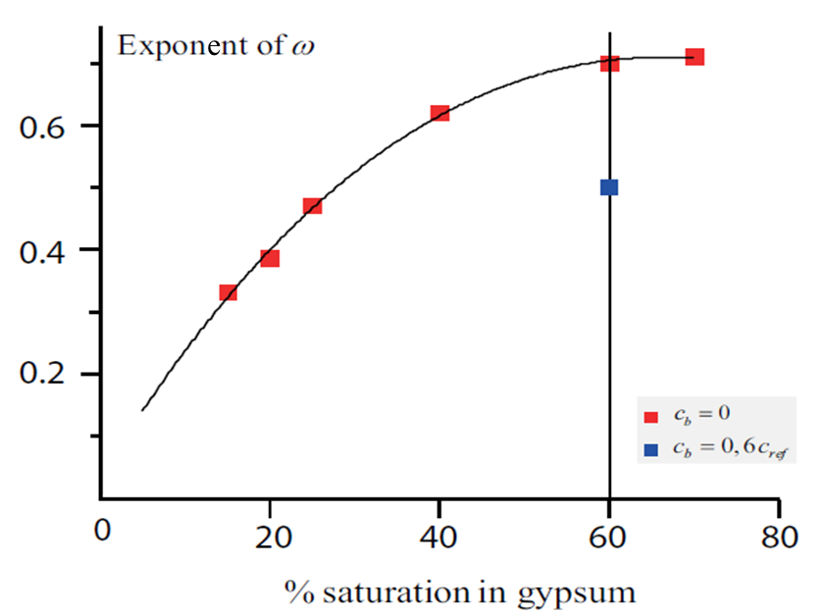
Rotating disk technique
Influence of surface roughness
Evolution of the exponent of $ω$ along the rotating disk experiment:
Determination of a local exponent based on a conductivity increment ($10 µS/cm$)
Matrix textured gypsum:
T=15°C
Large variations of the local exponent along the global curve (between 15 and 80% saturation)
The evolution of surface roughness influences the dissolution kinetics
close to roughness of in situ surfaces exposed to dissolution

Slide 13
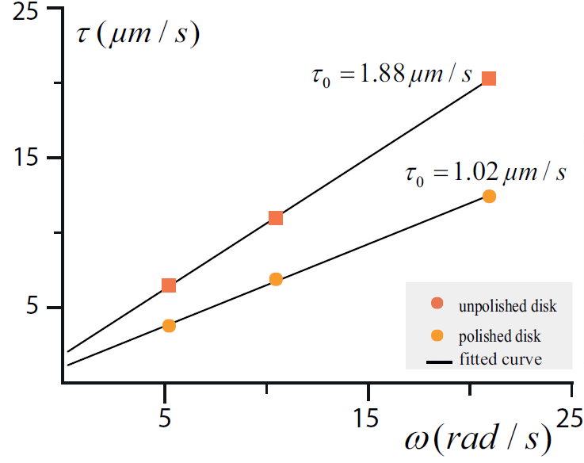
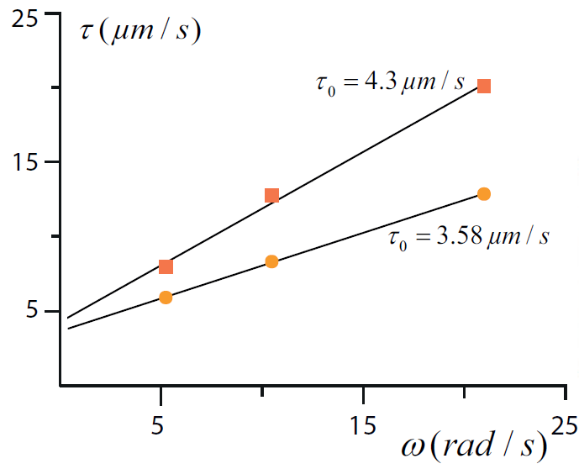
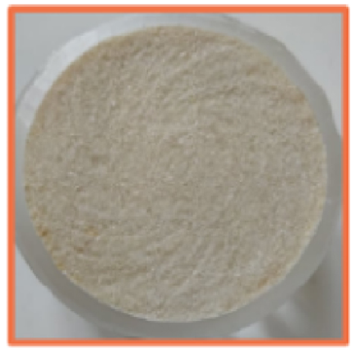
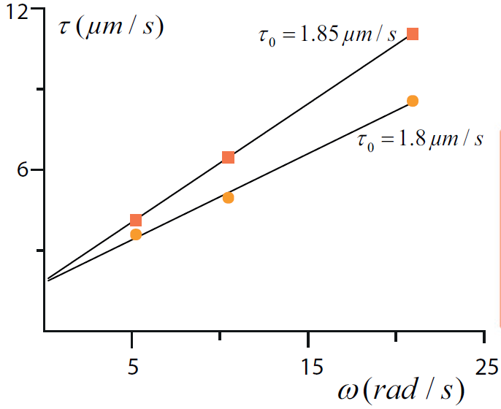
Rotating disk technique
Influence of surface roughness
Disk surface changes with dissolution: the hydrodynamic conditions are no longer stable
Using of unpolished rotating disks: comparison of the results at 15°C
Sacharoidal (Vaujours)
Sacharoidal (1)
after dissolution
Matrix textured gypsum
→ Gypsum with insoluble contents:
$ω≫0$: large differences in the recession rate
$τ$ disturbed by the flow
$ω≈0$: small difference in $τ_{0}$
$τ$ influenced only by the surface geometry

Slide 14
Rotating disk technique
Summary of the results obtained from linear regressions at T=15°C
Gypsum sample | Porosity [ %] | Initial surface | $τ_{0}$ $[µm/s$] | $$τ_{0} [mg/cm²/s\text{]}$$ | Precision $±(\%)$ | Exponent n | Precision $±(\%)$ | Roughness influence
Alabaster | <1 | polished | 2,09 | 0,55 | 7 | 1,09 | 4 | Roughness geometery
 |  | unpolished | 4,37 | 1,15 | 7 | 1,12 | 1
Impure Alabaster | 1 | polished | 3,28 | 0,74 | 9 | 1,04 | 4 | Coating effect
 |  | unpolished | 3,3 | 0,76 | 2 | 1,13 | 3
Sacharoidal (Vaujours) | 6 | polished | 1,02 | 0,22 | 11 | 1,12 | 8 | Roughness geometery
 |  | unpolished | 1,88 | 0,4 | 2 | 1,25 | 8
Sacharoidal (1) | 9 | polished | 3,58 | 0,76 | 9 | 1,13 | 8 | Roughness geometery
 |  | unpolished | 4,3 | 0,9 | 13 | 1,3 | 8
Matrix textured | 10 | polished | 1,8 | 0,37 | 3 | 1,19 | 7 | Coating effect
 |  | unpolished | 1,85 | 0,38 | 6 | 1,3 | 4
$C_{ref}=14,5±0,4 mmol/L$ very close to the reference value in literature ($C_{ref}=15 mmol/L)$
$τ_{0}≈1 to 8×{10}^{−6} mmol{ cm}^{−2}s^{−1}$ consistent with previous study for $C<C_{ref}$
$\text{Roughness} \text{influence}\text{: }\text{increase} \text{of} \text{exponent} \text{n}\text{ (1,1 }\text{to}\text{ 1,3), }\text{increase}$ of $τ_{0}$ (up to double)
but unchanged if high insoluble content (coating effect)

Slide 15
Characterization of particle transport processes
Principle
Controlled leaching tests on external surfaces
→ Evaluation of the solid flow in addition to the dissolved flow
Capture of grains released during dissolution
→ Study of the mass and nature of the collected grains (mineralogy)
Difficulties :
Controlled geometry to evaluate the dissolved flow
solvent selection: better capture of particles (insoluble)
→ Gypsum saturated solution
→ Gypsum block samples: sacharoidal (Vaujours), sacharoidal, matrix textured
6 cm
Surface covered with epoxy resin to block dissolution
V (m/s)
2,5 cm
2 cm
Released grains

Slide 16
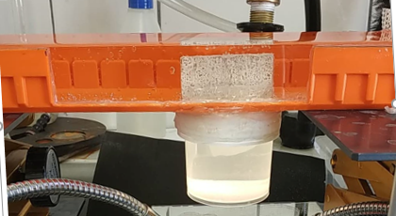
Controlled leaching tests on external surfaces
Experimental setup
Low water flow through a horizontal canal
Flow velocity ~ 10⁻³ m/s
A container to collect the detached grains
Solvent selection: gypsum-saturated solution
→ Block dissolution
Camera time lapse: 1 photo/12 hours

Slide 17
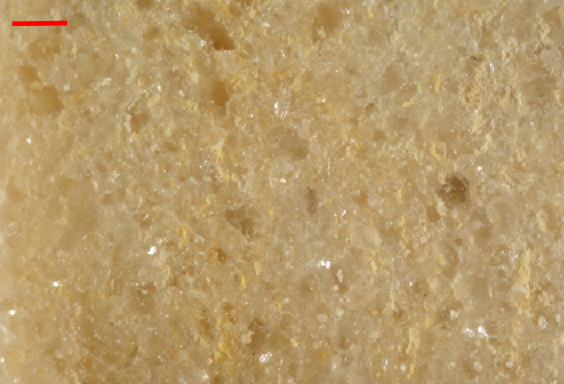
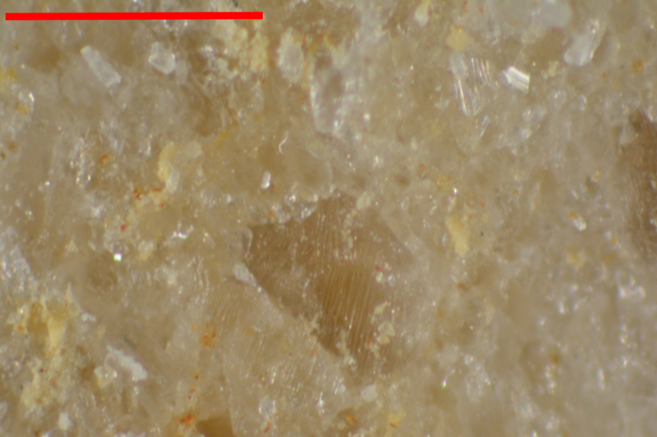
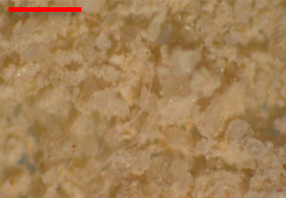
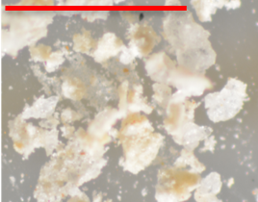
Controlled leaching tests on external surfaces
Observations
Sacharoidal gypsum (Vaujours)
Smooth surface
Duration: 5 days
Araldite epoxy resin
1 mm
Mass loss rate= 0,03 g/cm²/d
(0,0014 µm/s)
→ Observations of the collected grains (~0,1 g)
Mineralogy (XRD)
Calcite | 80%
Quartz | 8%
Calcium magnesium carbonates (Fe) | 6%
Magnesian clays and others | 6%

Slide 18
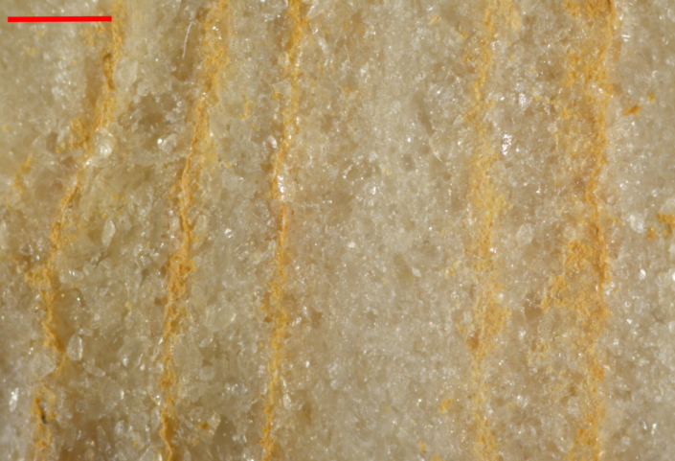
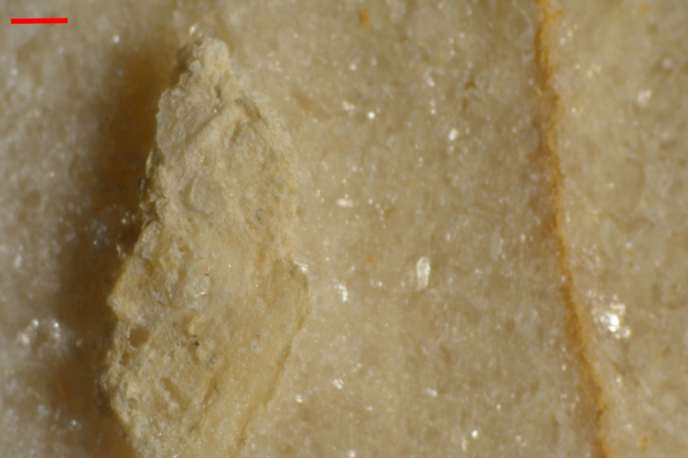
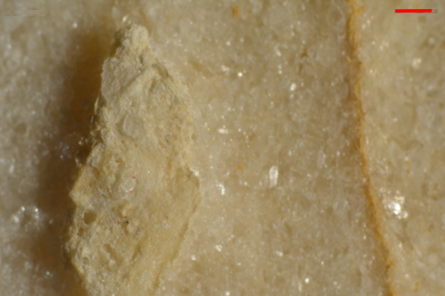
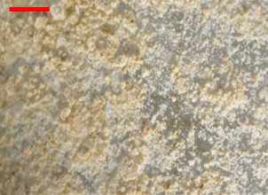
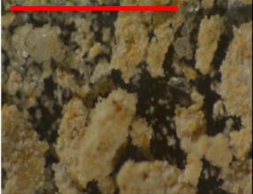
Controlled leaching tests on external surfaces
Observations
Sachaoidal gypsum
Small local ridges and reliefs
Duration: 7 days
1 mm
Mass loss rate= 0,03 g/cm²/d
(0,0014 µm/s)
→ Observations of the collected grains (~0,3 g)
Mineralogy (XRD)
Calcite | 52%
Quartz | 14%
Dolomite | 2%
Calcium magnesium carbonates (Fe) | 27%
Others | 5%

Slide 19
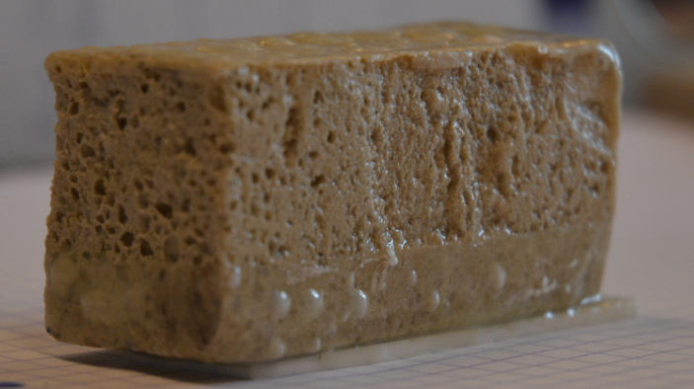
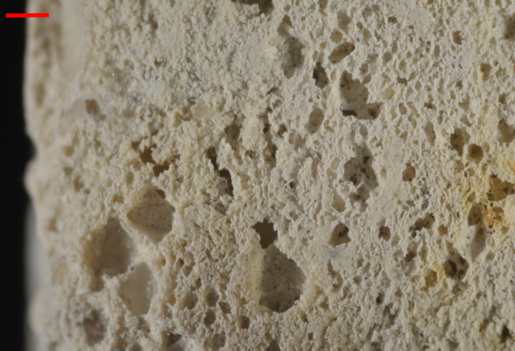
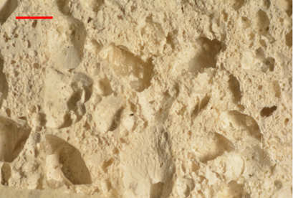
Controlled leaching tests on external surfaces
Observations
Matrix textured gypsum
Duration : 9 jours
Mass loss rate= 0,02 g/cm²/d
(0,0010 µm/s)
Collected grains ~0,5g
No erosion of matrix
Erosion of matrix
1 mm
A preferential dissolution in the coarse-grained sections of gypsum
Smooth zone along the dissolved surface
gypsum grains are protected by insolubles
→ Surface coating

Slide 20
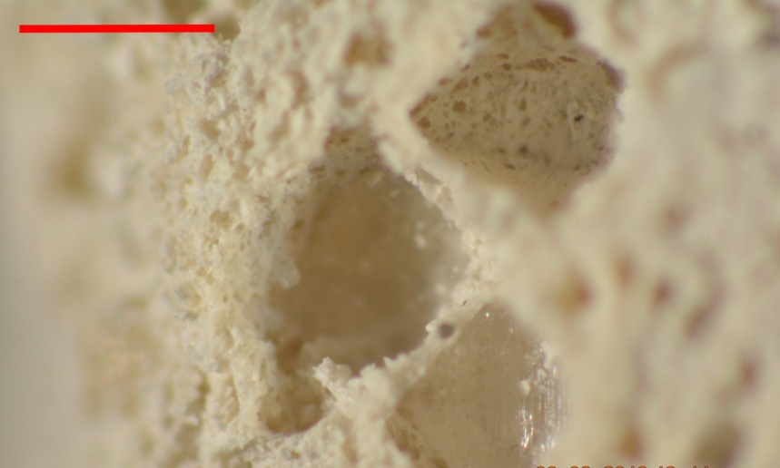
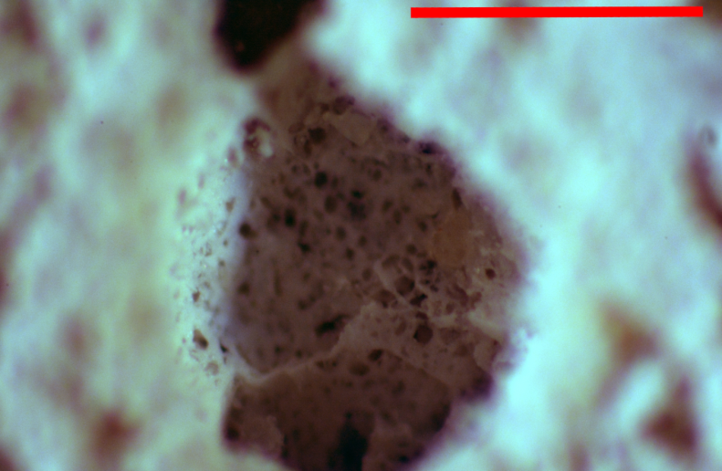
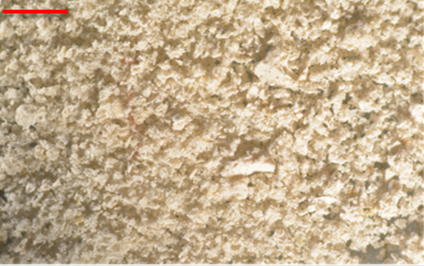
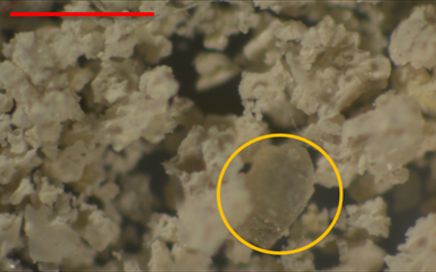
Controlled leaching tests on external surfaces
Observations of matrix textured gypsum block after dissolution
→ Observations of the pores
1 mm
Mineralogy (XRD)
→ Observations of the collected grains (~0,5g)
Calcite | 45%
Quartz | 25%
Gypsum | 5-10%
Calcium magnesium carbonates | 20%
Magnesian clays and others | 9%

Slide 21
Controlled leaching tests on external surfaces
Summary
Low particle flow :
Insolubles
Gypsum facies | Particles | Observations
Sacharoidal (Vaujours) | -
Sacharoidal | +
Matrix textured | +++
0
Stripe marks
Insoluble patch
Regressive dissolution
No erosion of the matrix
Dissolution of gypsum grains at the surface
Erosion of the matrix
Coating of grains
Dissolution of internal gypsum grains is slows down

Slide 22
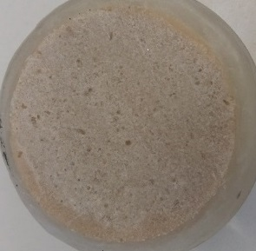
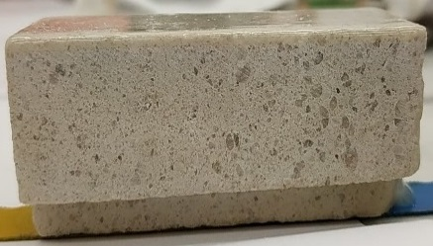
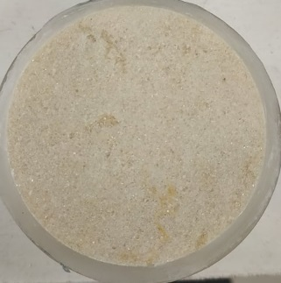
Controlled leaching tests on external surfaces
Summary
Low particle flow :
Insolubles
Gypsum block | Particles | Observations
Sacharoidal (Vaujours) | -
Sacharoidal | + | libération de quelques insolubles
Matrix textured | +++
0
Insoluble patch
Stripe marks
Regressive dissolution
Dissolution in the pores
Sacharoidal gypsum (Vaujours)
Matrix textured gypsum
1
2
before dissolution
after dissolution
Sacharoidal gypsum
before dissolution
after dissolution
1
Insoluble materials → coating effect
2
Influence on the dissolution kinetics?
1
2
3
3
before dissolution
after dissolution

Slide 23
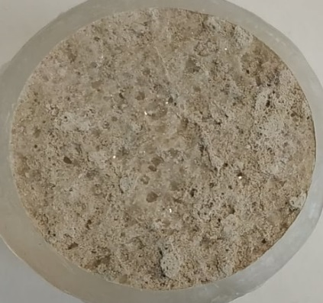
Matrix textured gypsum
Effect of insoluble materials on the dissolution kinetics
Rotating disk technique: matrix textured gypsum disks with different surface roughness
→ Gypsum disc Initially polished
$$k_{1}$$
→ Gypsum disc with deep roughness
$$k_{3}$$
→ Gypsum disc with superficial roughness
$$k_{2}$$
$${k_{2}>k}_{1}>k_{3}$$
Roughness effect
Coating of gypsum grains with insoluble materials
The insoluble materials slow down the dissolution kinetics

Slide 24
Conclusions

Slide 25
Conclusions
Rotating disk technique:
Quantification of the dissolution kinetics of different varieties of natural gypsum
Low flow velocity → no significant influence of surface roughness
High flow velocity → strong influence of surface roughness
Dissolution rates more representative of in situ conditions
Controlled leaching tests on external surfaces
Effect of insoluble materials in gypsum
Roughness-induced effect (insoluble patch)
Coating and destructuration effect (matrix textured gypsum or impure alabaster)
Determination of the impact of erosion and particle transport related to gypsum dissolution
Slow flow velocity : low mass loss rate related to insoluble content and its erosion resistance
High flow velocity : erosion effect : Leaching tests stopped by COVID-19

