Slide 1
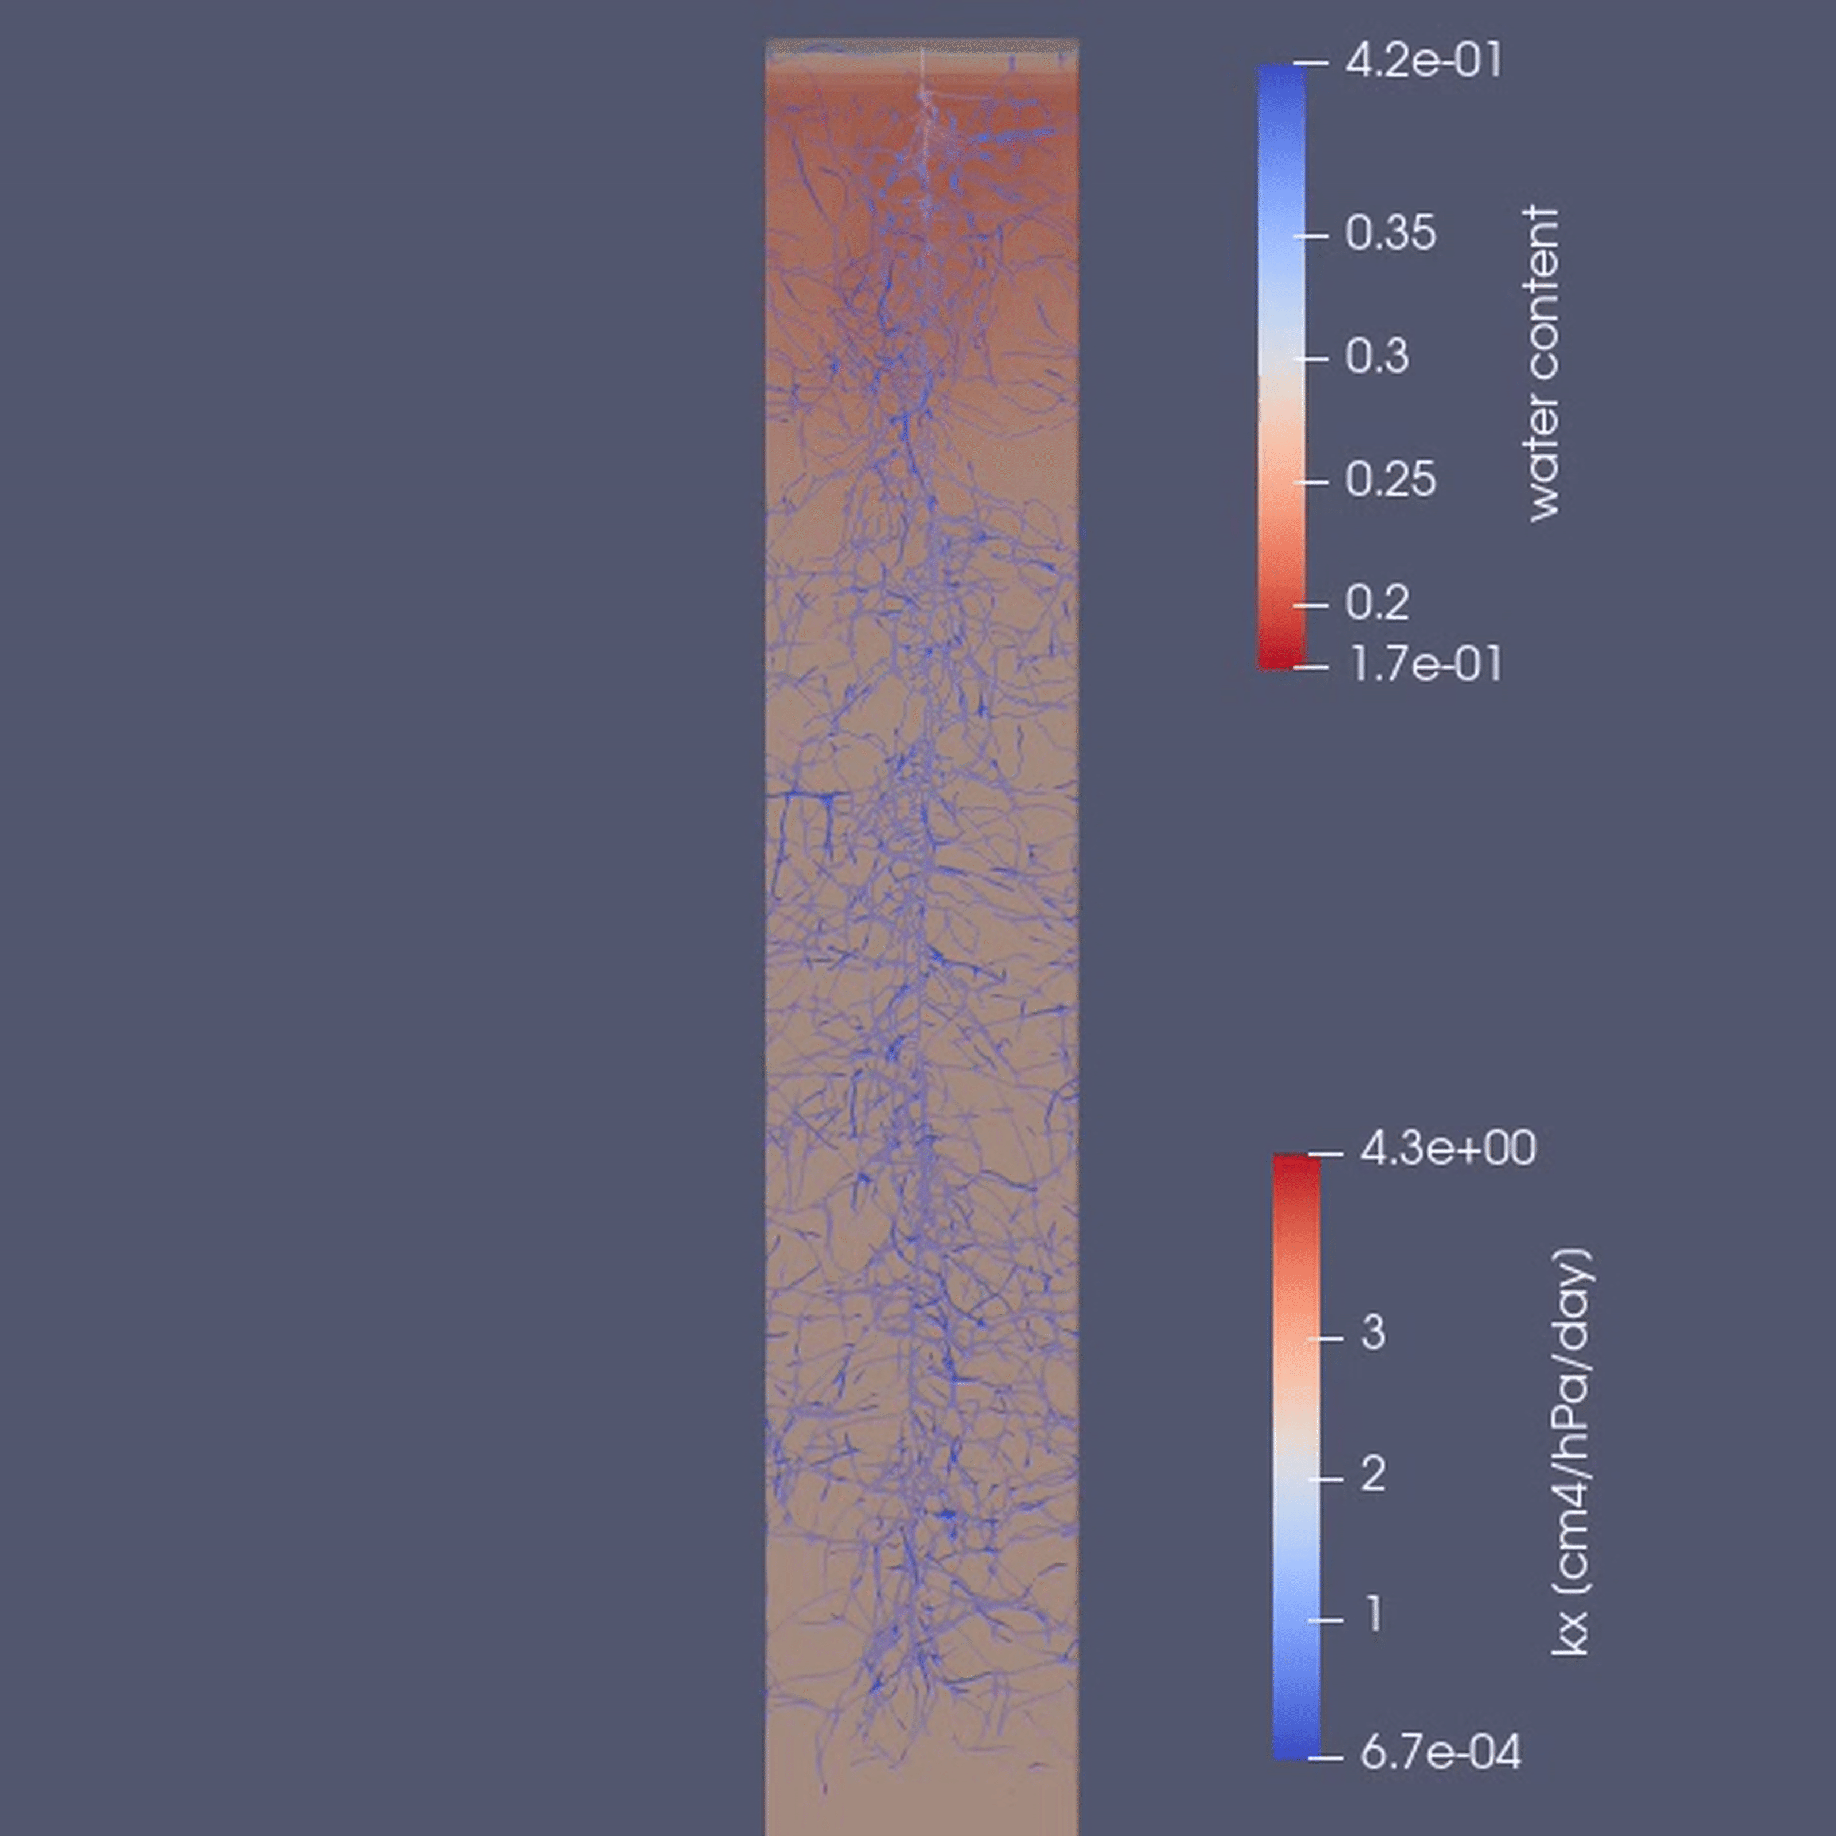
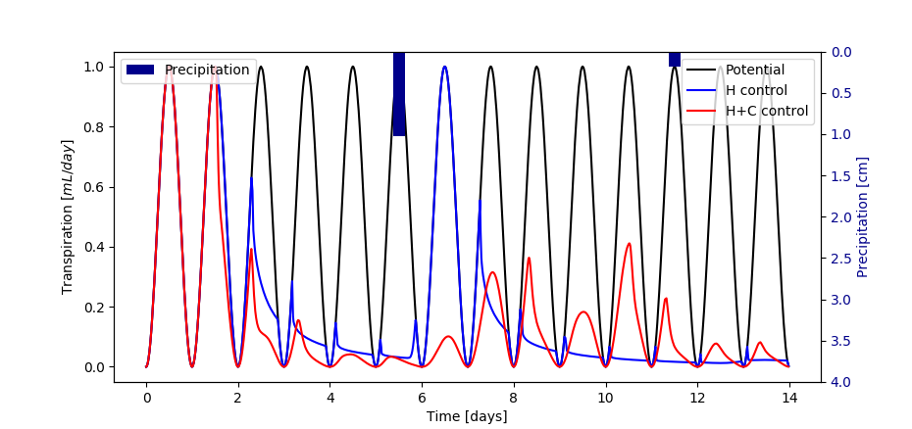
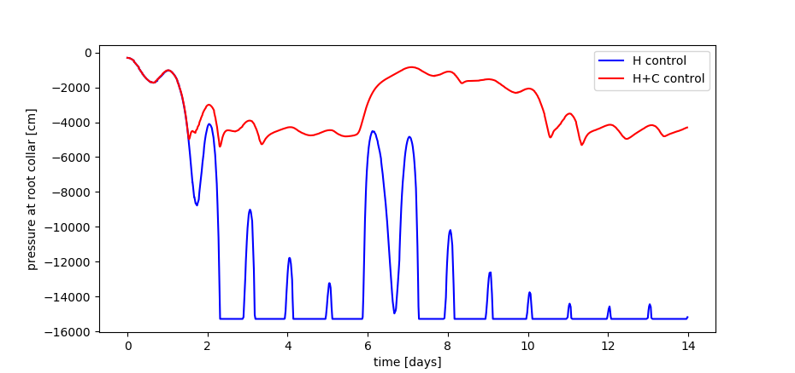
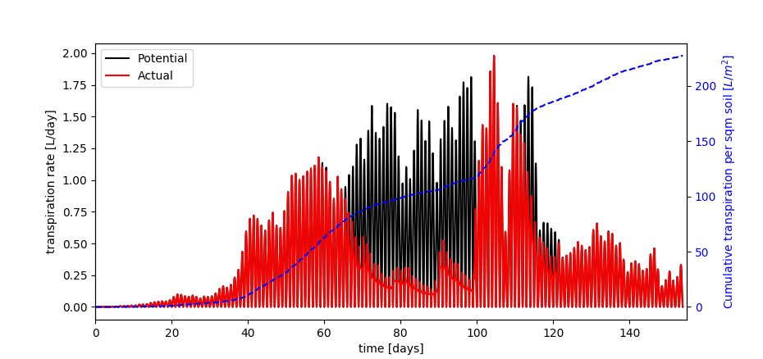
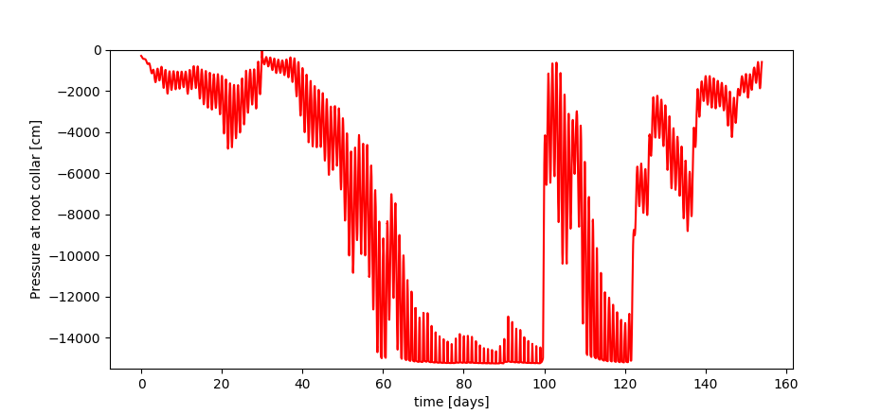
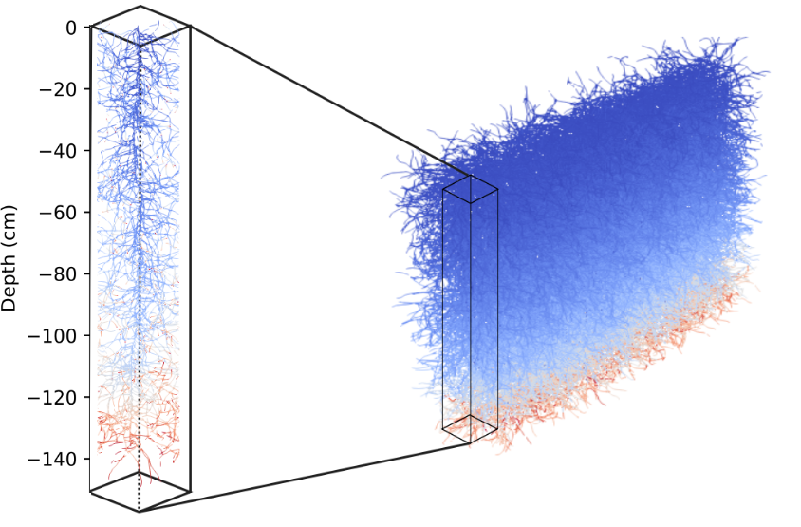
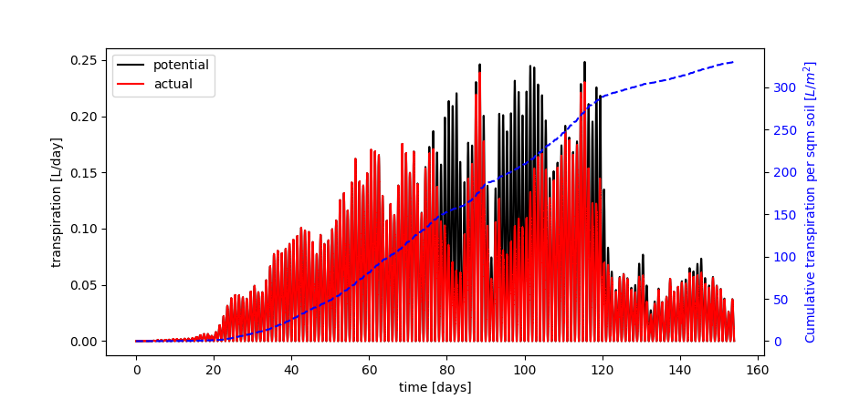
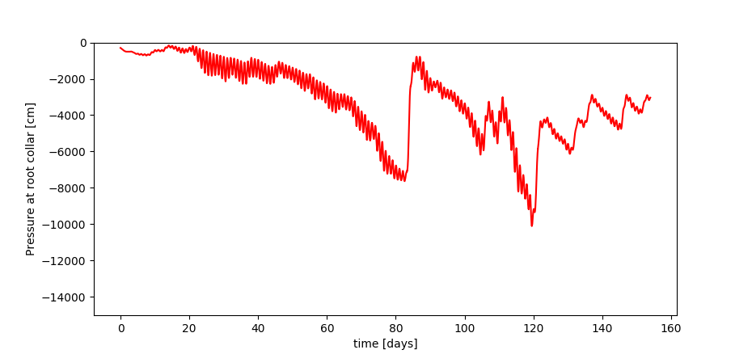
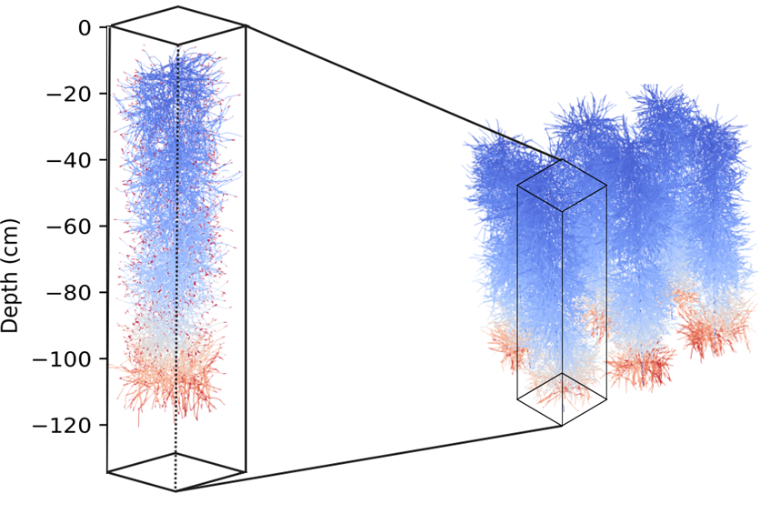
Quantifying how plants with different water-use strategies cope with drought-prone hydro-ecological conditions
D. Khare¹, G. Bodner², A. Verhoef³, M. Javaux¹, D. Leitner⁴, J. Vanderborght¹, A. Schnepf¹
¹ Institute of Bio-Geosciences (IBG-3, Agrosphere), Forschungszentrum Jülich, Jülich, Germany, d.khare@fz-juelich.de
² Institute of Agronomy, University of Natural Resources and Life Sciences, Vienna, Austria,
³ Department of Geography and Environmental Sciences, The University of Reading, UK,
⁴Simwerk, Ortmayrstraße 20, A-4060, Leonding, Austria
INTRODUCTION
SINGLEROOT SIMULATIONS
Plants have different mechanisms to control transpiration, including hydraulic and hormonal signalling.
Aim is to simulate the field conditions by:
Mimicking root growth
H/H+C signalling: single root, sunflower, and soybean
using measured soil data from Hollabrunn, Austria
using measured weather data
MODEL APPROACH
H signalling (water flow only):
p_{w} > p_{w,c}; water flux at the root collar is equal to transpiration rate (neumann boundary conditions)
p_{w} < p_{w,c}; pressure is prescribed to be equal to the threshold value (dirichlet boundary conditions)
H+C signalling (water and hormones transport): based on Huber et. al, 2014
Hormones are considered to be produced by the root tips, and then transported to the root collar which helps the plants to maintain higher leaf water potential and prevent them from reaching permanent wilting point.
We model relative stomatal conductance (ɑ= T_{act}/T_{pot}) as a function of both hormone concentration and water potential at the root collar.
SUNFLOWER SIMULATIONS (H control)
soybean
SCENARIOS
SOYBEAN SIMULATIONS (H+C control)
crop | control mechanism | sowing density | soil domain size (cm)
single root | H control | - | 1 x 1 x 15
single root | H+C control | - | 1 x 1 x 15
sunflower | H control | 6 plants/m² | 50 x 33 x 150
soybean | H+C control | 50 plants/m² | 37 x 5 x 250
sunflower
RESULTS
REFERENCES
H+C control crops show a relatively constant pressure head at the root collar, in absense of any rain events.
Rain event cause a quick increase in transpiration rate in H control crops whereas H+C control crops only gradually increase the transpiration rate depending on the hormone concentration still present in the leaves.
Sunflower reaches a period of long drought between 60 and 100 days. Cumulative transpiration per square meter of soil surface over the whole vegetation period is 222 L/m².
Soybean when under stress produces hormones which helps in maintaining higher leaf water potential with cumulative transpiration of ~310L/m².
Huber, Katrin et al. (2014). “Modelling the im pact of heterogeneous rootzone water distrib ution on the regulation of transpiration by ho rmone transport and/or hydraulic pressures”. In:Plant andSoil384(1-2), pp. 93–112.issn: 0032079X. doi: 10.1007/s11104 014-2188-4.

