Slide 1
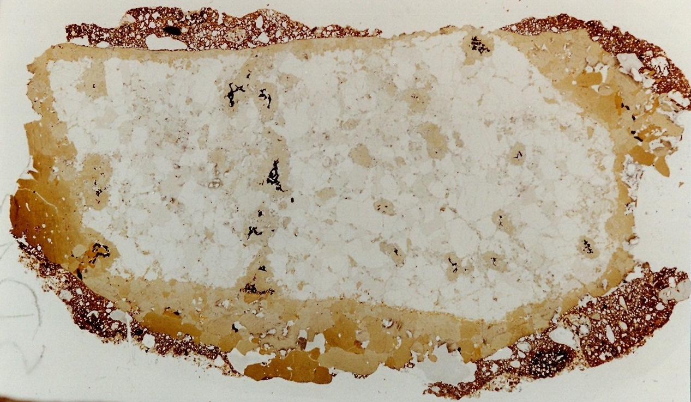
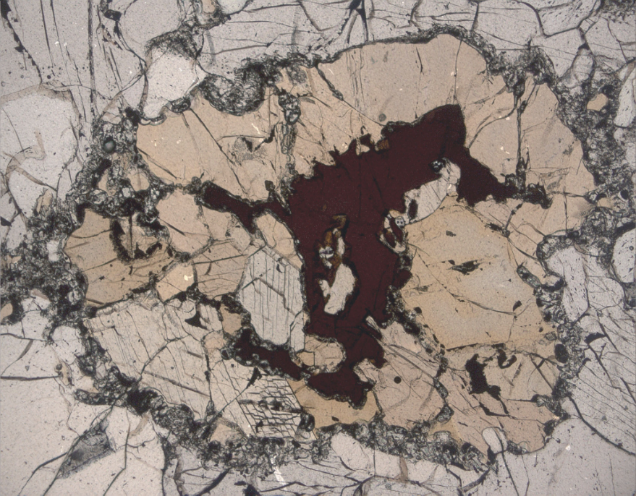
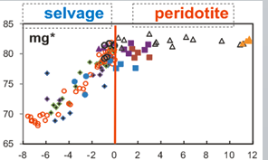
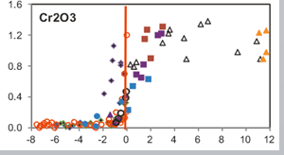
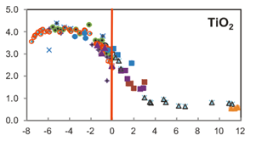
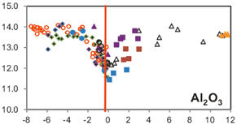
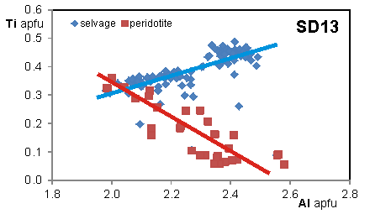
Minerals as key markers of melt/fluid percolation in the lithospheric mantle from the French Massif Central
2020
Christiane WAGNER¹, Etienne DELOULE², Marie-Lola Pascal¹, Omar Boudouma¹
¹ Sorbonne Université, CNRS, Institut des Sciences de la Terre de Paris (ISTeP), 75005 Paris, France, christiane.wagner_raffin@sorbonne-universite.fr
² CRPG, CNRS-Univ de Lorraine, F-54501 Vandoeuvre-lès-Nancy, France.
1 – AMPHIBOLE : A metasomatic phase
2 – Metasomatism and Li behavior^{[3]}
In peridotites, amphibole represents a modal imprint of the percolation of melt/fluid in the mantle.
Li and REE abundances
cpx
We report here the sample SD13, representative of the different spinel lherzolites from the Devès (French Massif Central).
Amphibole occurs as:
- disseminated crystals
- cross-cutting veinlets
- selvage
Hydrous
L50
The lherzolites have been equilibrated at 950-1050°C.
amphibole
Anhydrous
L17
anhydrous L17
Li increases in all phases of hydrous samples, e.g. up to 5.4 ppm average values in cpx from hydrous samples compared to 0.4 ppm.
Amphibole compositional variations
Implications of Ti behaviour in amphibole
The hydrous xenoliths deviate from the trend of equilibrium partitioning between phases, with a preferential Li uptake in cpx.
The amphibole composition varies from an Al-rich kaersutite in the selvage to a Cr-rich pargasite in the lherzolite.
Following Thompson’s approach^{[1]}, the amphibole composition is expressed in terms of:
anhydrous
Additive component
Pargasite
Na Ca₂ Mg₄ Al Si₆ Al₂ O₂₂ (OH) ₂
Exchange vectors
x = (Mg* Si) (⁶Al* Al)₋₁
y = (Na* Si) (Mg* ⁴Al)₋₁
z = ( ⁶Al*) (Na* Mg*)₋₁
k = (Ti O) (⁶Al* OH)₋₁
selvage lherzolite
selvage lherzolite
Metasomatism increases the Li abundances in minerals.
The Li-rich hydrous samples are LREE-enriched.
Thompson’s approach:
Li and REE were transported by the same metasomatic agent.
with Na*= R¹⁺, Mg*= R²⁺, ⁶Al*= R³⁺
The Li and REE carrier is a silicate melt, likely an alkali basalt melt.
mg* and Cr increase
The mains variations in exchange components are observed for x and k, which suggest:
Li isotopic composition
opx
ol
amp
cpx
Two different mechanisms of Ti incorporation.
Ti decreases,while Al decreases in the selvage and increases in the lherzolite.
selvage
lherzolite
The different phases of the hydrous samples show large intra-grain variations in δ⁷Li, up to 18 ‰, compared to <6 ‰ in anhydrous samples.
There is no relation between Li and δ⁷Li in ol, opx and cpx from hydrous samples,
but Li and δ⁷Li co-vary in amp.
(Ti ⁶Al ⁴Al₂ O) (Mg₂* Si₂ OH)₋₁
(Ti Mg*_{0.4} Si_{0.4} O) (⁶Al_{1.4} ⁴Al_{0.4} OH)₋₁
Ti and Al are positively correlated in the selvage and anti-correlated in the lherzolite.
The different mechanisms suggest that the formation of amphibole is related to different percolating agents.
The Li isotopic variations do not result from a mixing between different sources
but likely result from diffusion-related Li isotope fractionation.
In selvage
In lherzolite
The absence of correlation is likely due to the pervasive character of the metasomatism along grain boundaries, which allows strong Li exchanges with the lherzolite minerals.
Amphibole crystallizes from a silicate melt percolating through the mantle.
Ti and Al are both given by the melt.
Amphibole is produced by reaction of the lherzolite with a percolating fluid emanating from the silicate melt.
Al is provided by the reacting spinel, which shows a change in its composition as the amphibole developed.
The Li and Li isotopic compositions of the melt change as it interacts with the lherzolite. The amphibole records the isotopic evolution of the melt.
The preservation of the small scale δ⁷Li heterogeneities and of the Li isotope fractionation in minerals requires that the Li exchange event occurs shortly before the eruption.
[1] Thompson JB, Rev Min,10, 1982; [2] Seitz & Woodland, Chem Geol, 166, 2000; [3] Wagner & Deloule, GCA, 71, 2007.

