Slide 1
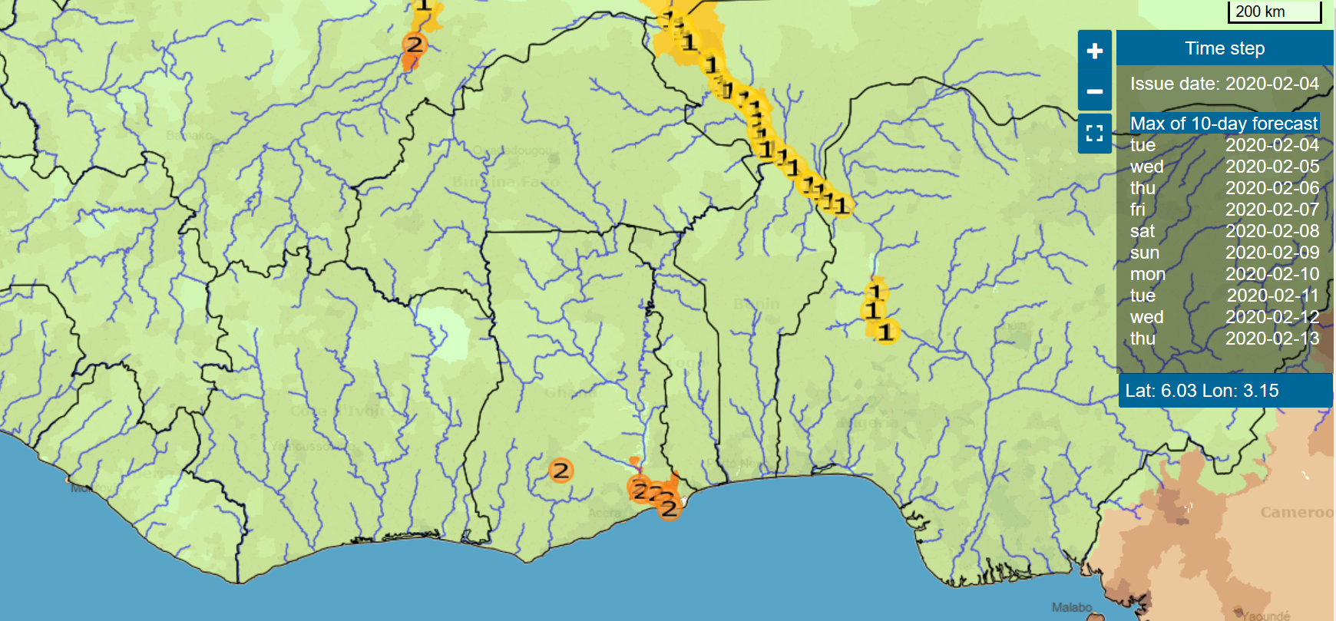
Effective Risk Communication for Early Flood Warning in West-Africa
Dr. Martijn Kuller
Co-authors:
Dr. Francisco Silva Pinto
Kevin Schönholzer
Dr. Judit Lienert

Slide 2


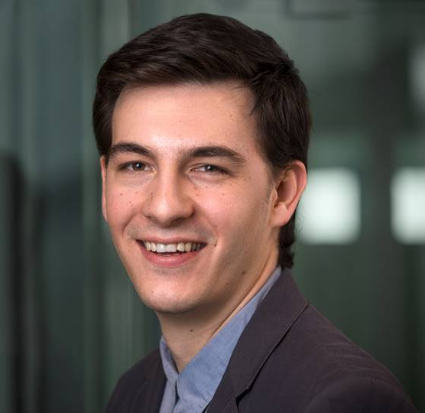
Research team at eawag
Dr. Martijn Kuller*
Dr. F. Silva Pinto
Kevin Schönholzer
Dr. Judit Lienert

Slide 3
Need for effective flood warning communication
Floods are causing more casualties and damage than any other natural hazard
1
Flood Early Warning Systems (FEWS) are effective in mitigating the negative effects of floods
2
Success of FEWS depends on effectiveness of flood risk warning communication
3
There is little systematic investigation into the question: What makes flood warning communication effective?
4

Slide 4
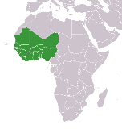


Case Study
EU project with project partners in 5 European and 2 African countries
Co-development of FANFAR with national hydrological services and emergency management services from 17 West-African countries
ReinForced cooperAtion to provide operatioNal Flood forecasting and Alerts in West AfRica
This project has received funding from the European Union’s Horizon 2020 research and innovation programme under grant agreement No 780118.

Slide 5
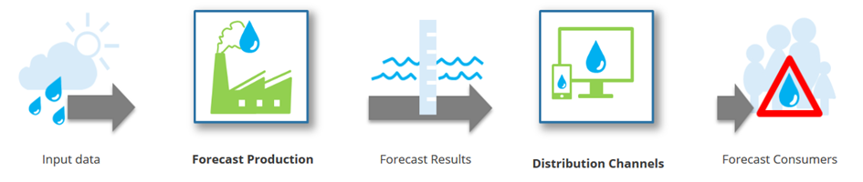
Risk warning communication in FANFAR
FANFAR flowchart
Our research focuses on communication of predicted water flows- and levels from FANFAR to emergency managers, and further to all relevant stakeholders

Slide 6
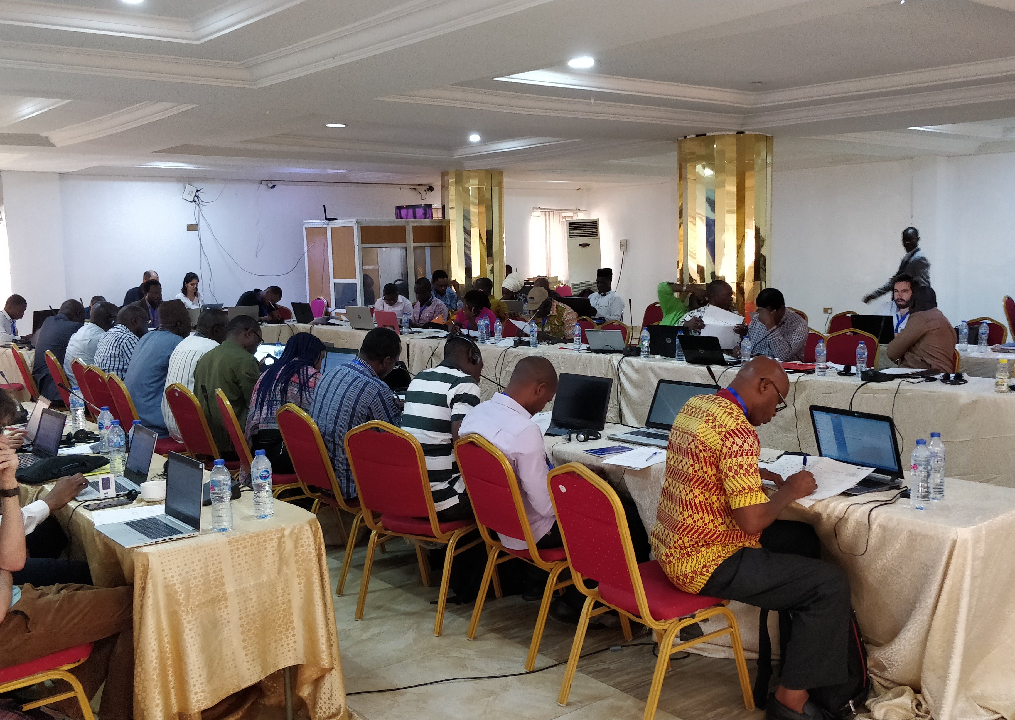
Methods
Definition aspects of risk communication
Aspects of risk communication by category
Development of forecast scenarios of varying severity, location and timing
Organisation of focus group with emergency managers from West-African countries
Emergency managers perform rating of “suitability” of each individual aspect
Rating is repeated for each scenario
Rating is done for two difference receivers of information: communication from FANFAR to emergency managers as well as from emergency managers to other stakeholders

Slide 7
Results - overview
Content
Format
Channel
No significant difference between scenarios
No significant difference between scenarios
Great variety in suitability of channels
Only few differences between receiver of information
Differences between receiver of information, especially for certain formats
Differences both between scenarios and receivers

Slide 8
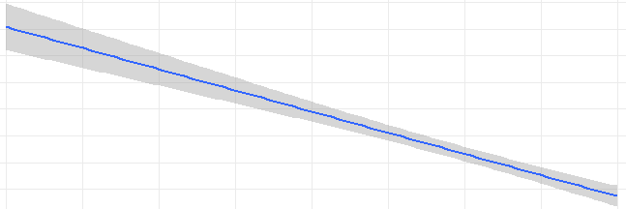



Results
Content
All scenarios and receivers
All scenarios and receivers
Location
Uncertainty
Time
Least preferred
Most preferred

Slide 9

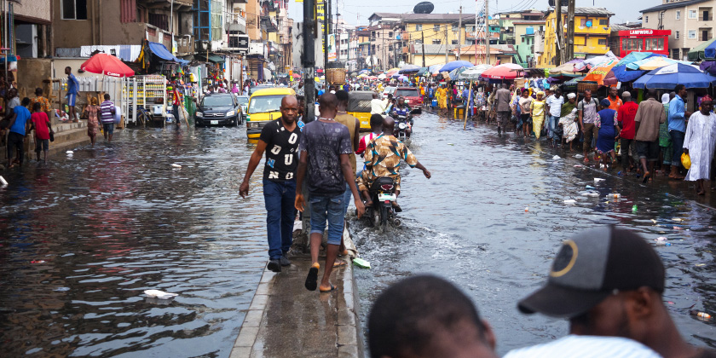
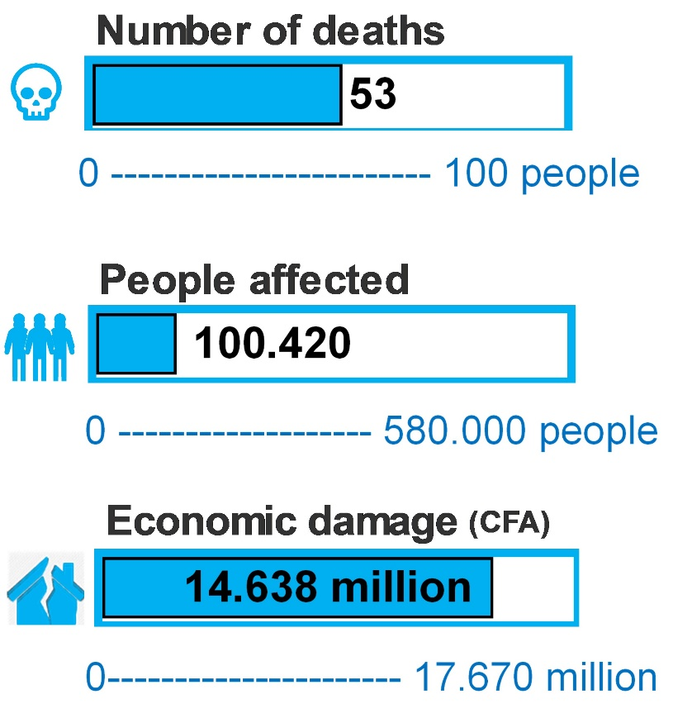
Results
Format
To emergency managers
To emergency managers
“I remember the water rose to above our doorstep and flooded our entire ground floor”
Personal accounts
Maps
To general public
To general public
“A large flood will occur in the southern part of the city tomorrow around noon”
Graphics
Text
Images
Most preferred
Least preferred

Slide 10
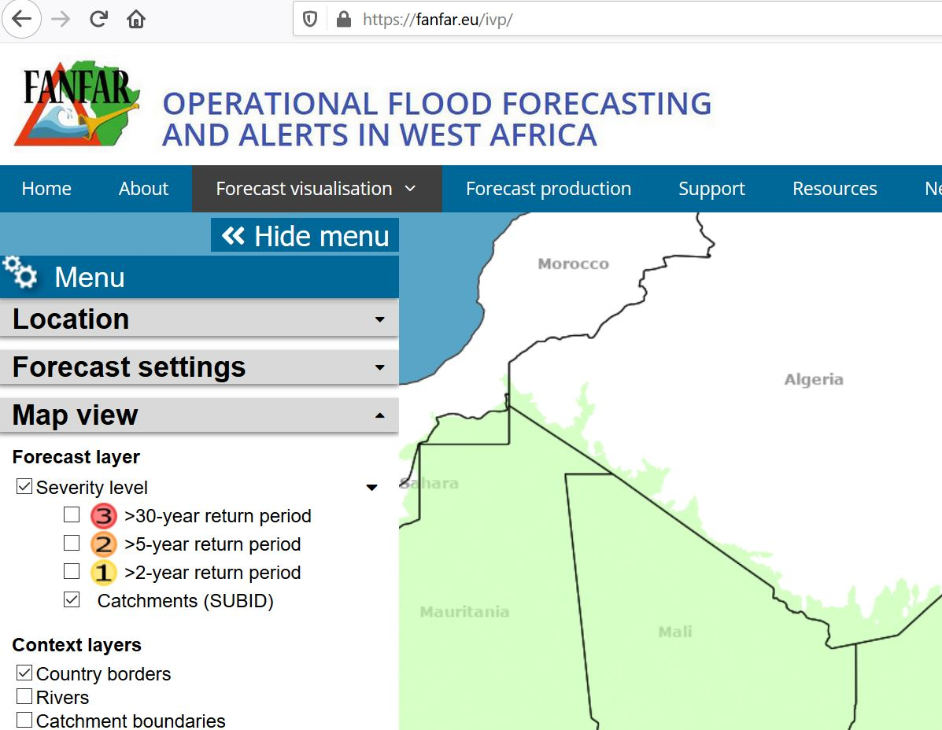
Results
Channel
To emergency managers
To emergency managers
@
Sirens
E-mail
Website
To general public
To general public
@
E-mail
Radio-TV
Sirens
Most preferred
Least preferred

