Slide 1
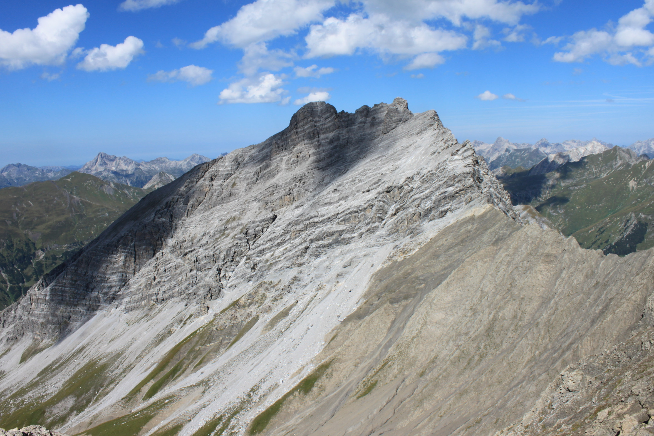

Tectonic subdivisions in thrust belts – Cleaning up the western
Northern Calcareous Alps (NCA)
H. Ortner, S. Kilian, Institute of Geology,University of Innsbruck
Proper contact between tectonic units...
Fallesin klippe
Norian dolomite
shear zone
Cenomanian shale

Slide 2
Why would anyone want to study historic tectonic subdivisions?
Many of them are still in use, but full of contradictions
Where do these contradictions come from?
Because at the time of creation of the tectonic subdivisions, the concepts that we have today did not exist
What is the general relevance of doing that?
It is a problem that exists in many thrust belts

Slide 3
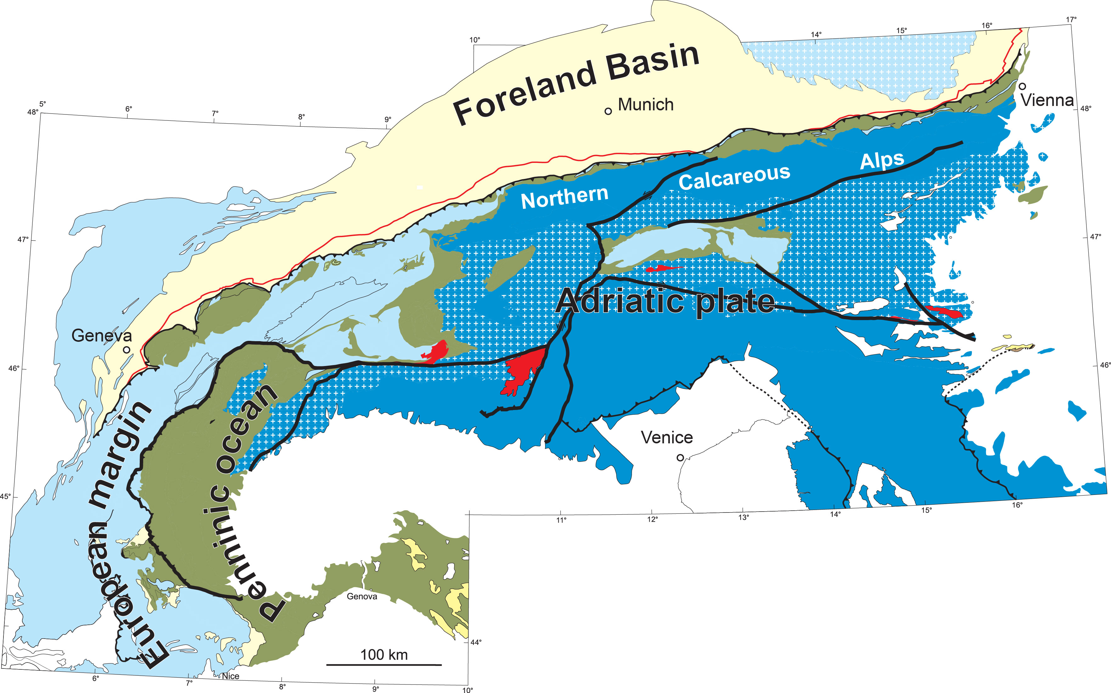
The Northern Calcareous Alps
PA
PA
PA
The Northern Calcareous Alps are the most external part of the Austroalpine unit of the Alps.
The Austroalpine unit includes all units with an Adriatic affinity north of the Periadriatic line (PA).

Slide 4
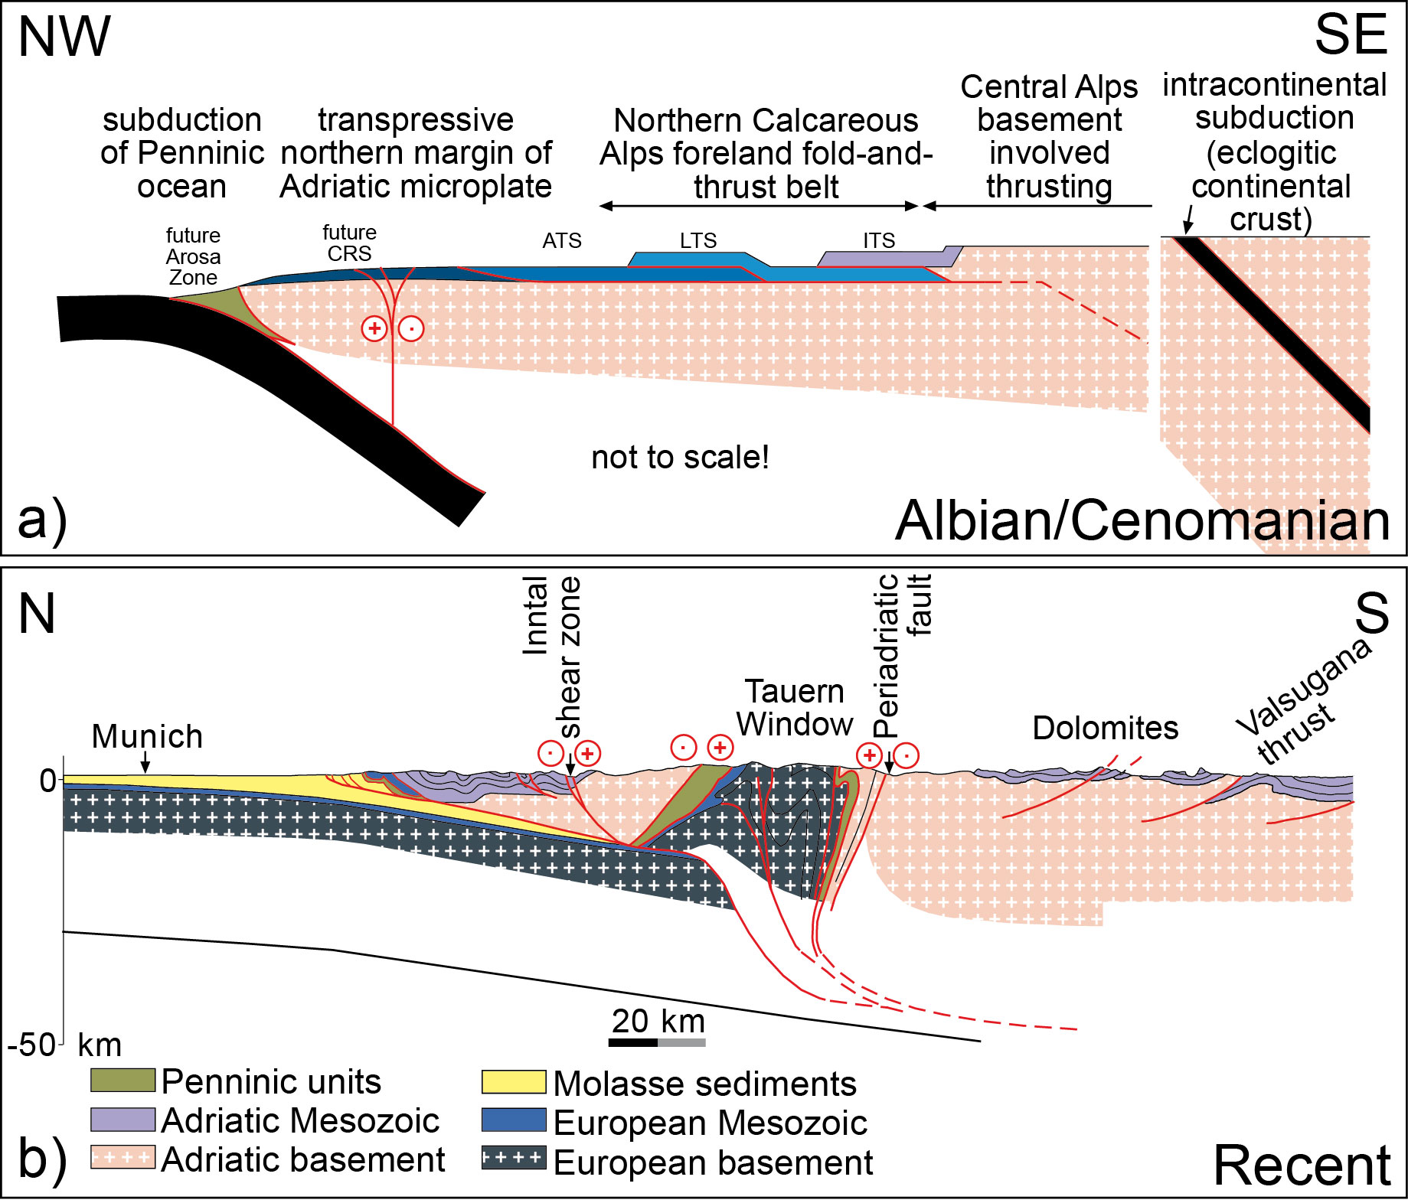
Cretaceous orogeny
Two orogenies created todays Northern Calcareous Alps.
During Cretaceous orogeny the NCA formed as a typical thin-skinned fold-and thrust belt
During Cenozoic orogeny, the NCA travelled piggy-back tectonically deeper units.
(1) Eoalpine stacking of thrust sheets
cf. Stüwe & Schuster 2010
Cenozoic
orogeny
cf. Lammerer & Weger 1998
Northern
Calcareous
Alps
(2) Mesoalpine transport of thrust sheets

Slide 5
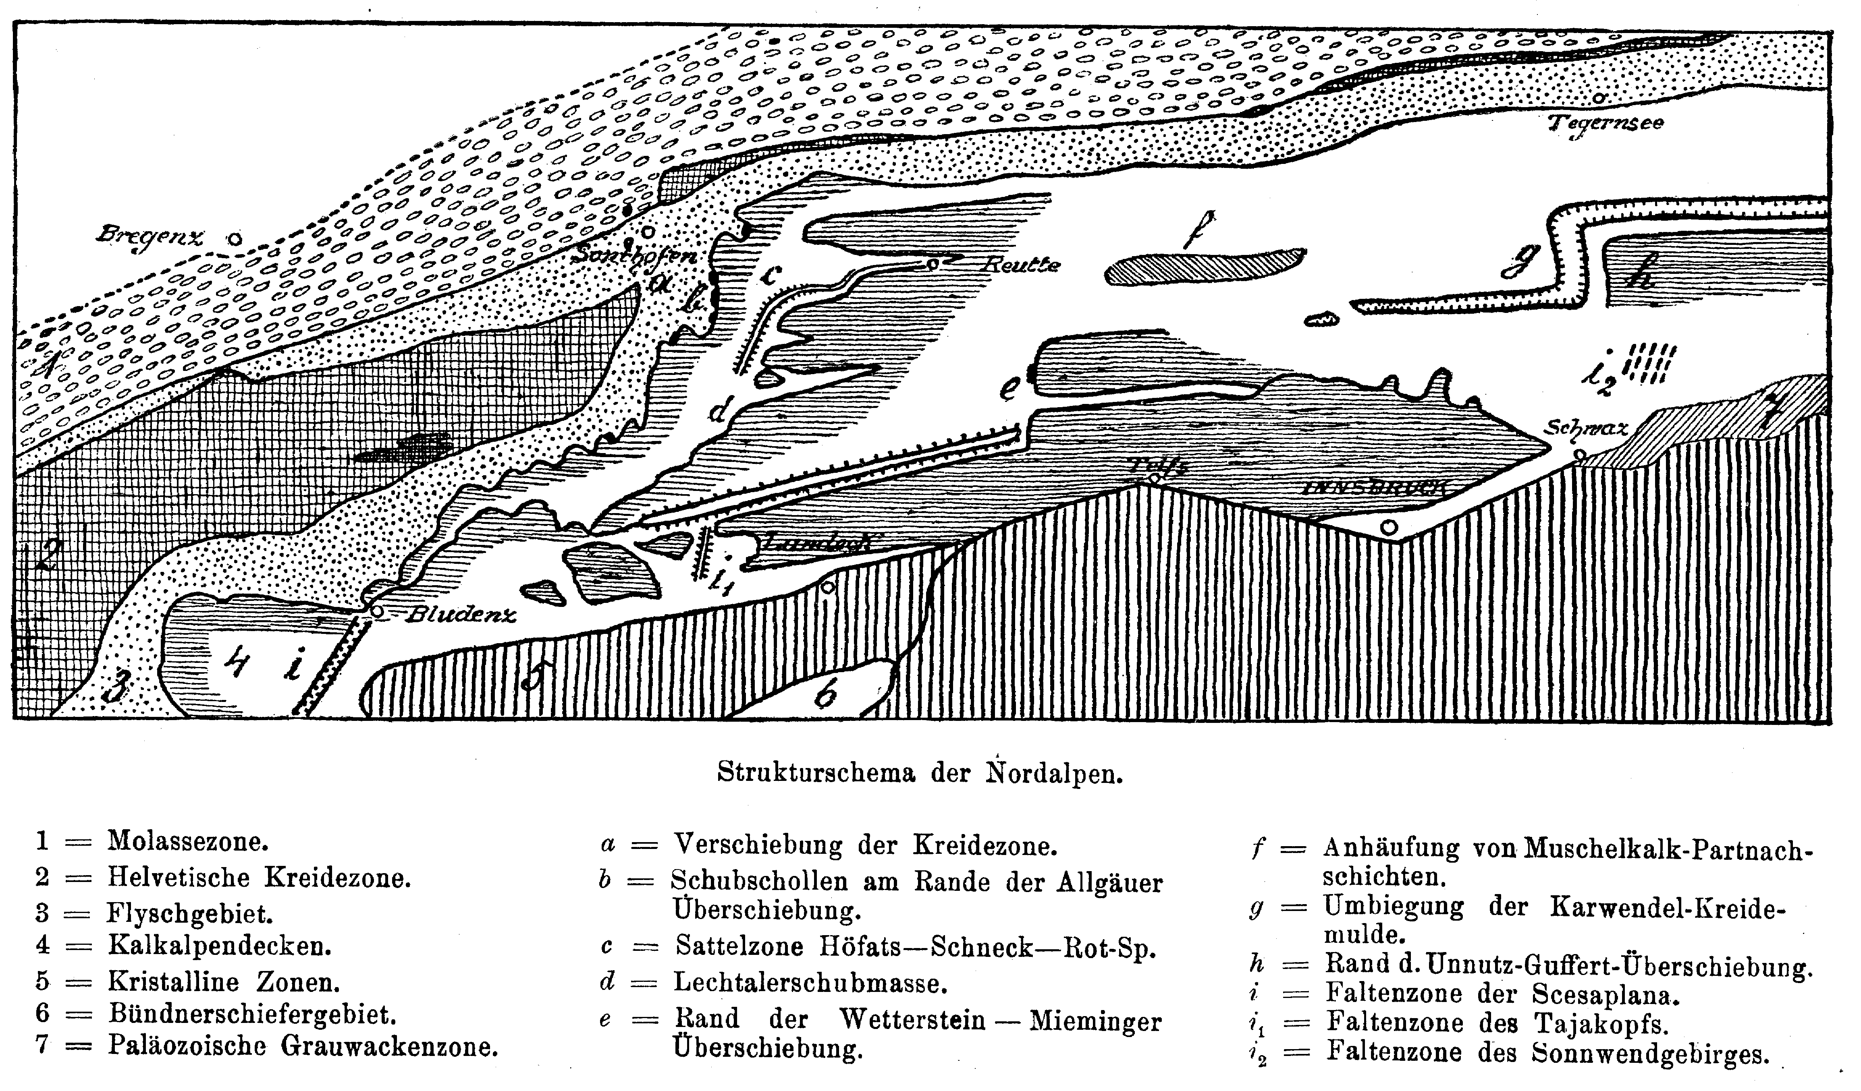
Ampferer & Hammer (1911)
*
with permission of © GBA
The tectonic subdivision of the western NCA is largely based on the work of Otto Ampferer in the early 20th century. He recognized the principal thrust north of Innsbruck in 1902 (*).

Slide 6
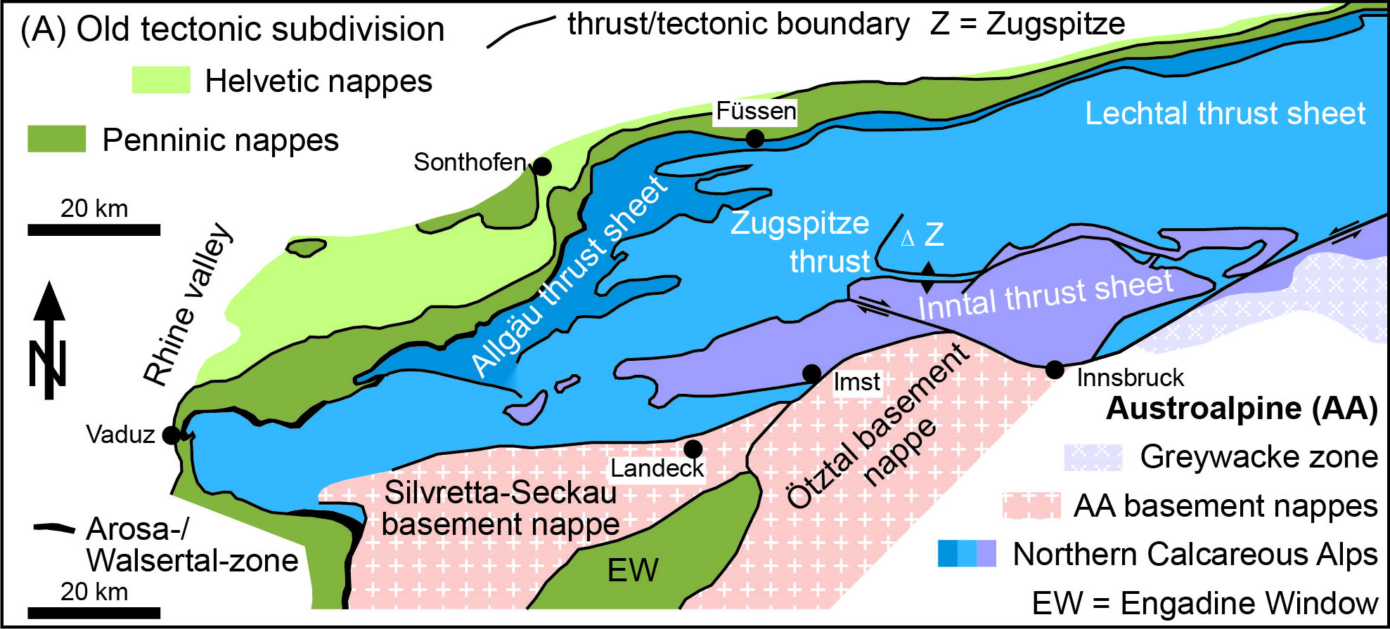
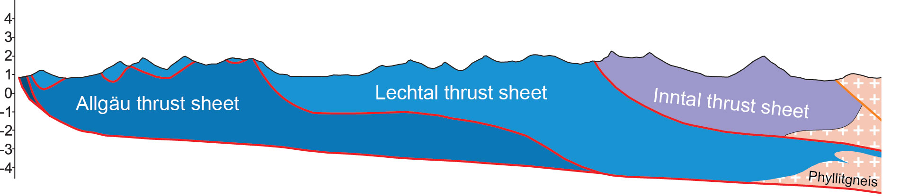
Tectonic subdivision of NCA according to Heißel 1958, Tollmann 1976 based on Ampferers work
2
Page 8
3
1
1 – 4, Page 8 = locations mentioned in this presentation
4
Shortening estimates from the study of Eisbacher et al. 1990
folding thrust distance total
Inntal thrust sheet 8 km 12 km 20 km
Lechtal thrust sheet 11 km 28 km 39 km
Allgäu thrust sheet 3 km - 3 km
NW SE
simplified from Eisbacher et al. 1990

Slide 7
Here we test the implicit assumptions underlying the tectonic subdivisions against some field observations in key outcrops. Even if is difficult to know what the early authors thought, the discussions circle around following assumptions:
Thrust transport is large and thrusts do not end laterally
Nappes are surrounded by thrusts on all sides
Thrusting should bring old on young rocks.

Slide 8
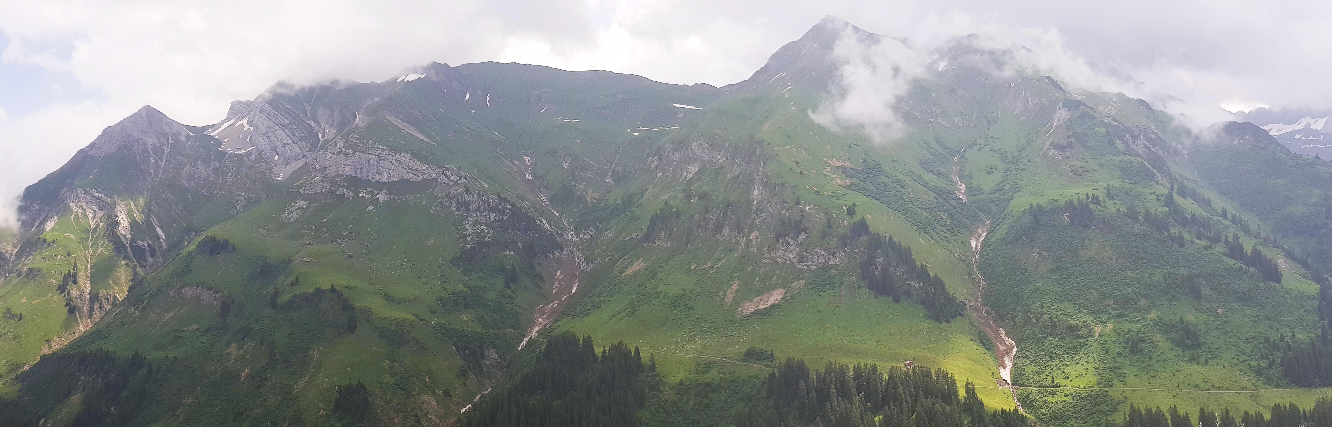
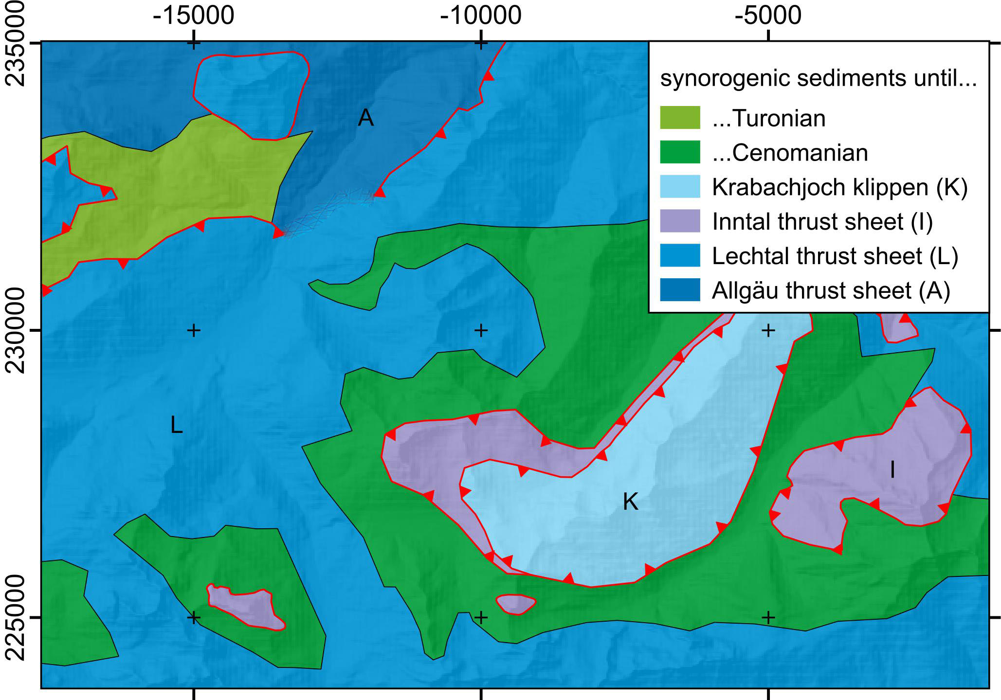
Assumption 1: Thrust transport is large and thrusts do not end laterally
Field example: view to the S of western end of Lechtal thrust in Arlberg region (see 1 of page 5 for location)
E W
Top Rhätian limestone
Top Middle Jurassic
Top Norian dolomite
Top Lower Jurassic
Top Rhätian shale
Lechtal thrust sheet
Top Lower Jurassic
end of stratigraphic separation
Allgäu thrust sheet
?
The Lechtal thrust sheet ends in a lateral hanging wall ramp, where stratigraphic offset disappears. The Lechtal thrust has an Albian age (see page 15), however in the western continuation the Lechtal thrust sheet is emplaced on Turonian deposits.
Thrust transport was not large enough to completely separate the Lechtal thrust sheet from ist footwall. In the Arlberg region, two thrusts of different age merged, but offset in this zone is still minor.
(eye symbol indicates view of photograph)

Slide 9
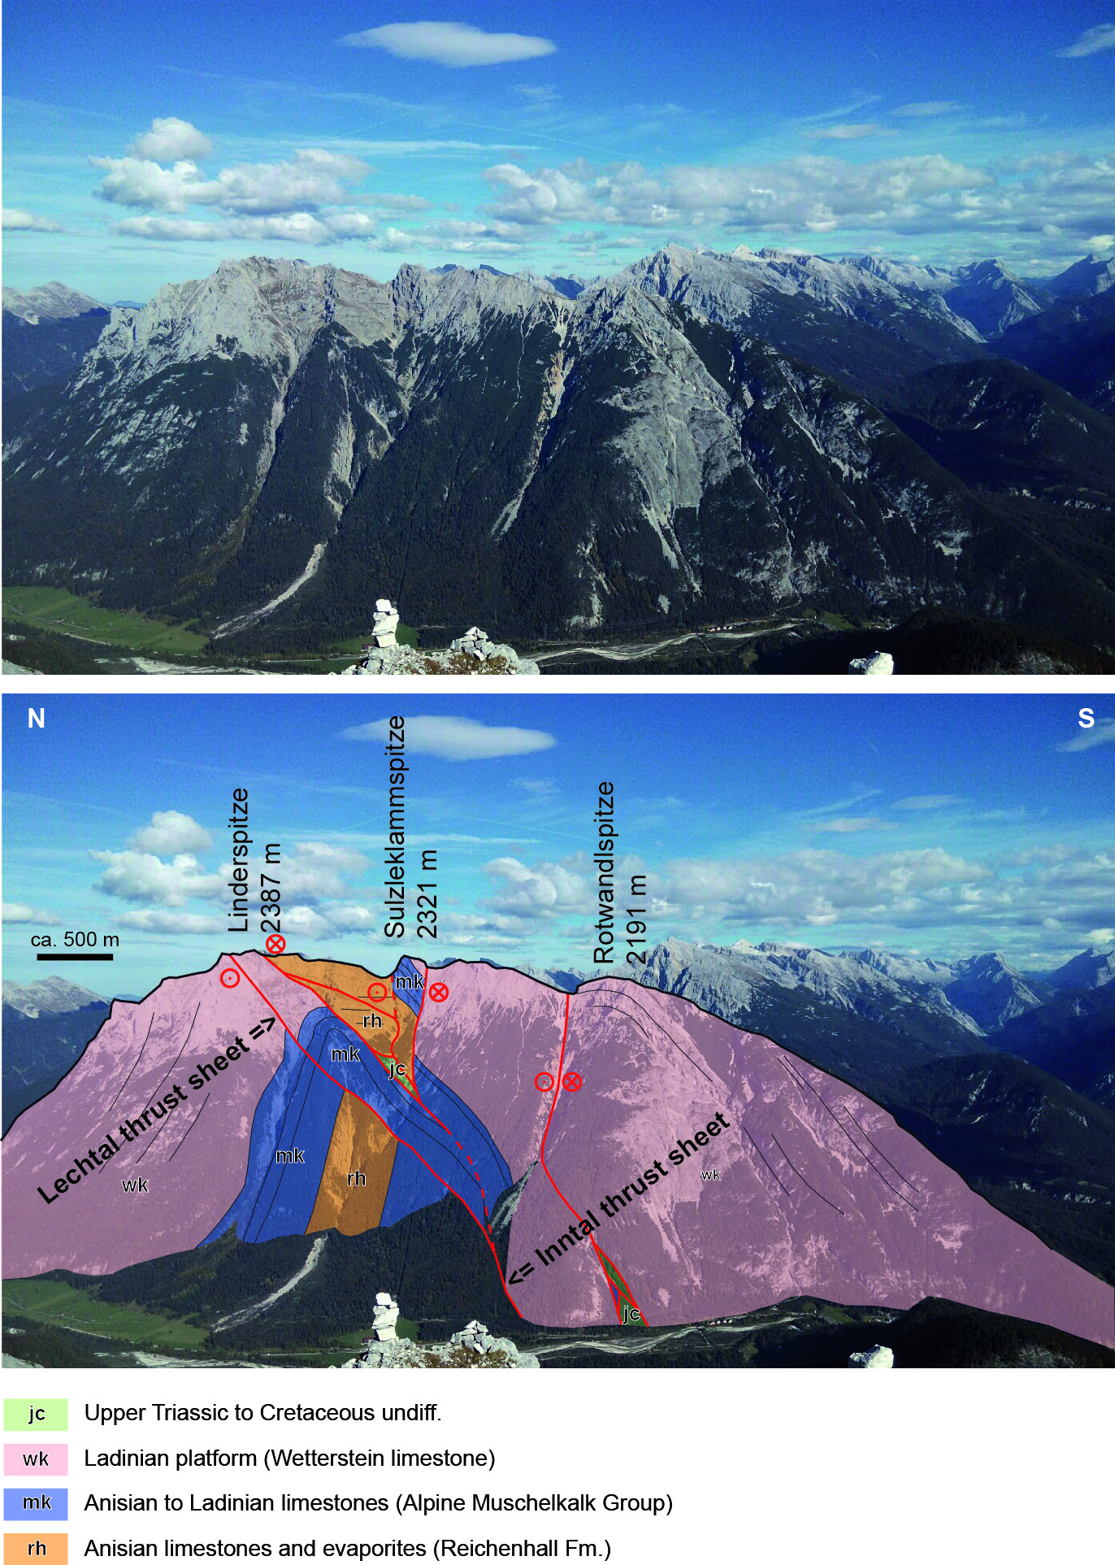
Assumption 2: Nappes are surrounded by thrusts on all sides
Field example: view to the E of western end of the Inntal thrust in the Karwendel mountains (see 2 of page 5 for location)
In this view the Inntal thrust is clearly a very oblique sinistral out-of-sequence thrust cutting across an anticline.
Slices of Upper Triassic to Cretaceous rocks (jc) found at several fault splays suggest that the fault at the base of the Inntal thrust sheet postdates nappe stacking and that these slices actually belong to the top of the underlying thrust sheet (see next page).
Previous authors used any thrust or fault to delimit a thrust sheet. These thrusts have different ages, and therefore problems arise in the definition of the allochthons (see next page).
The assumption was applied correctly, but it should have been Nappes are surrounded by thrusts of the same age and type on all sides

Slide 10
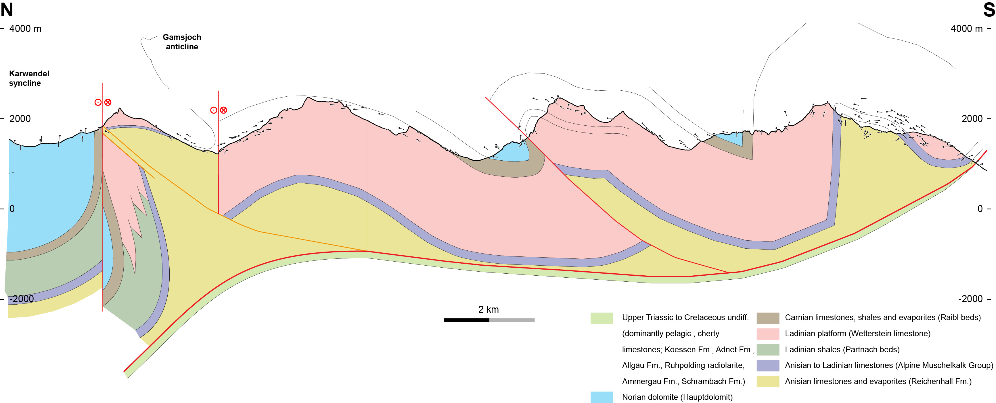
Assumption 2: Allochthons are surrounded by thrusts on all sides
Cross section based on the view of page 9 (see page 6 for location). In the backlimb of the folded principal thrust a splay originates that cuts across an anticline. This out-of-sequence splay has been interpreted to separate the Lechtal and Inntal thrust sheets. It is however, not related to Eoalpine nappe stacking, but to subsequent Mesoalpine shortening.
<= Inntal thrust sheet
Mesoalpine out-of-
sequence thrust
Lechtal thrust sheet =>
Eoalpine principal thrust

Slide 11
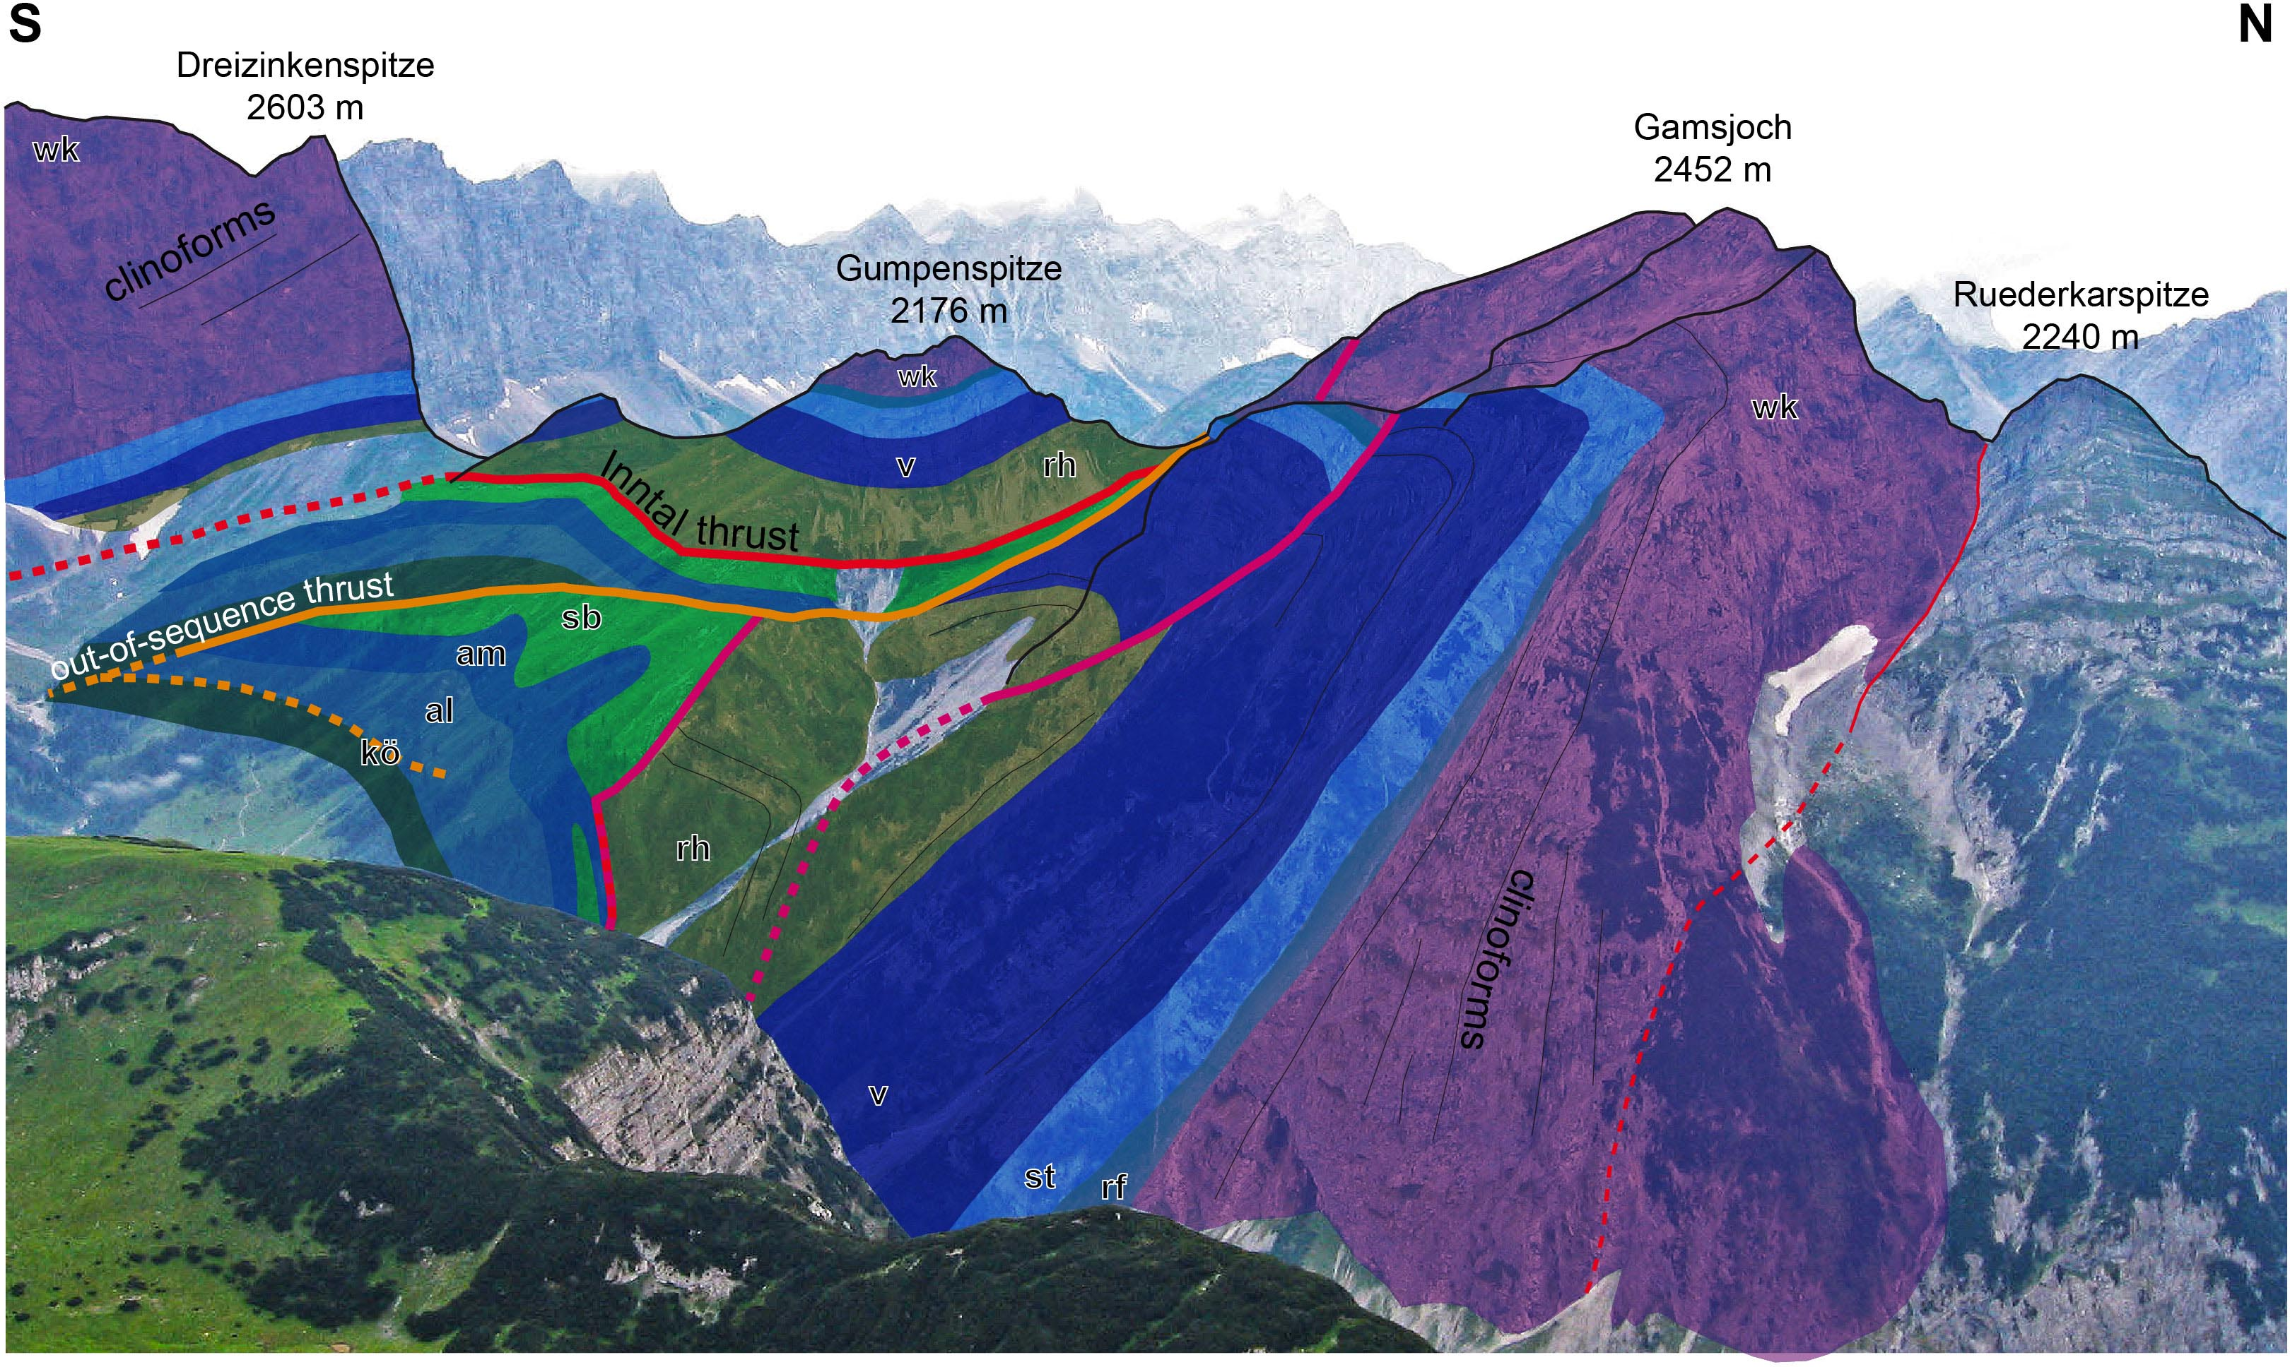
Assumption 3: Thrusting should bring old on young rocks
Out-of-sequence thrusts delimiting thrust sheets often emplace young on old rocks (see 1 of page 5 for location). These are however, not related to Eoalpine nappe stacking, but to subsequent Mesoalpine shortening.
Inntal
thrust sheet
=>
Lechtal
thrust sheet
<=
young-on-old
out-of-sequence thrust
cuts across Gamsjoch
anticline
from base to top:
al, am, sb = Jurassic-Cretaceous pelagic limestones and marls
kö = Rhätian shales
wk = Ladinian platform
v, st, rf = Anisian – Ladinan limestones
Rh = Anisian limestones and evaporites
(Kilian & Ortner 2019,
Austrian Journal of Earth Sciences)

Slide 12
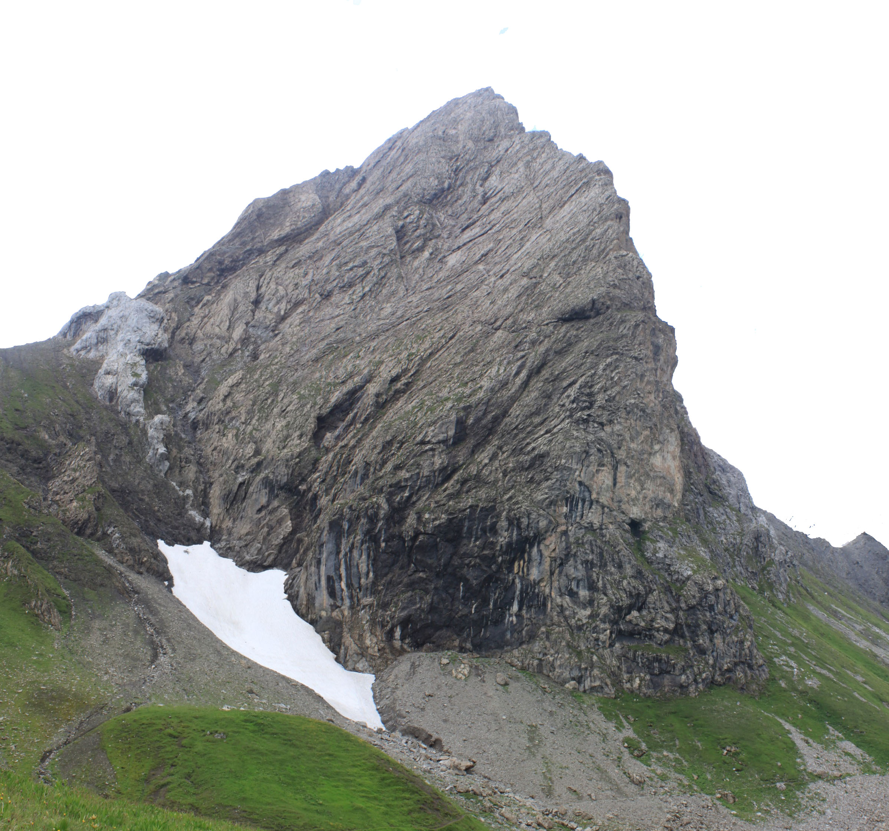
Assumption 3: Thrusting should bring old on young rocks
Mountain-size glide bocks have been interpreted as klippen. One example is the Roggspitze olistolithe (see 4 of page 6 for location). A block of Liassic breccias and pelagic limestones did slide into Cenomanian shales.
The unconformity on top of the slide block has been mapped as a thrust, creating the problem that the sedimentary succession of the footwall block lies on top of the hangingwall (young-on-old).
Roggspitze
2747 m
N S
Rhätian
limestone block =>
unconformity
Lower Jurassic
pelagic limestone
Cenomanian shale
_________
2400 m
slide plane
Roggspitze

Slide 13
As a consequence we propose a revised tectonic subdivision of the western Northern Calcareous Alps, that avoids the problems discussed here, and is entirely based on the emplacement of old-on-young rocks across thrusts
N S
Proper contact between tectonic units: bedding in footwall and hanging wall are parallel, and represents the geometry of the hanging wall flat on an upper footwall flat
Fallesin klippe
Norian dolomite
shear zone
Cenomanian shale

Slide 14
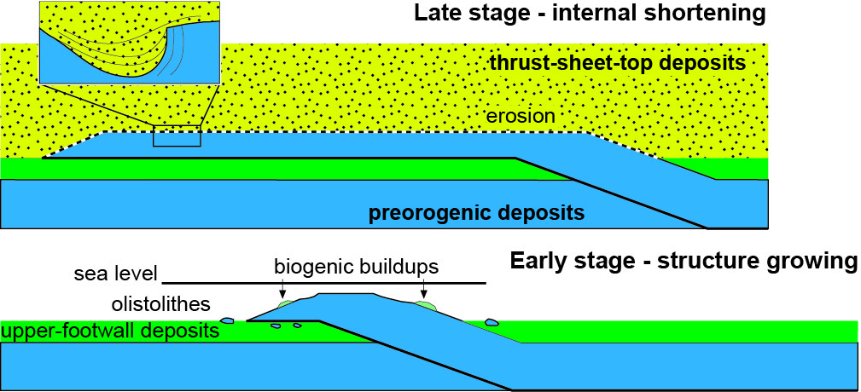
Model for stacking of thrust sheets
Late stage - progressive shortening
Unconformity at base of thrust-sheet-top deposits
hanging wall flat on an upper footwall flat
(modified from Ortner 2016, Geo.Alp)
The model only relies on
the ages of syntectonic sediments below thrust sheets, and
on the geometry of the hanging wall flat on an upper footwall flat

Slide 15
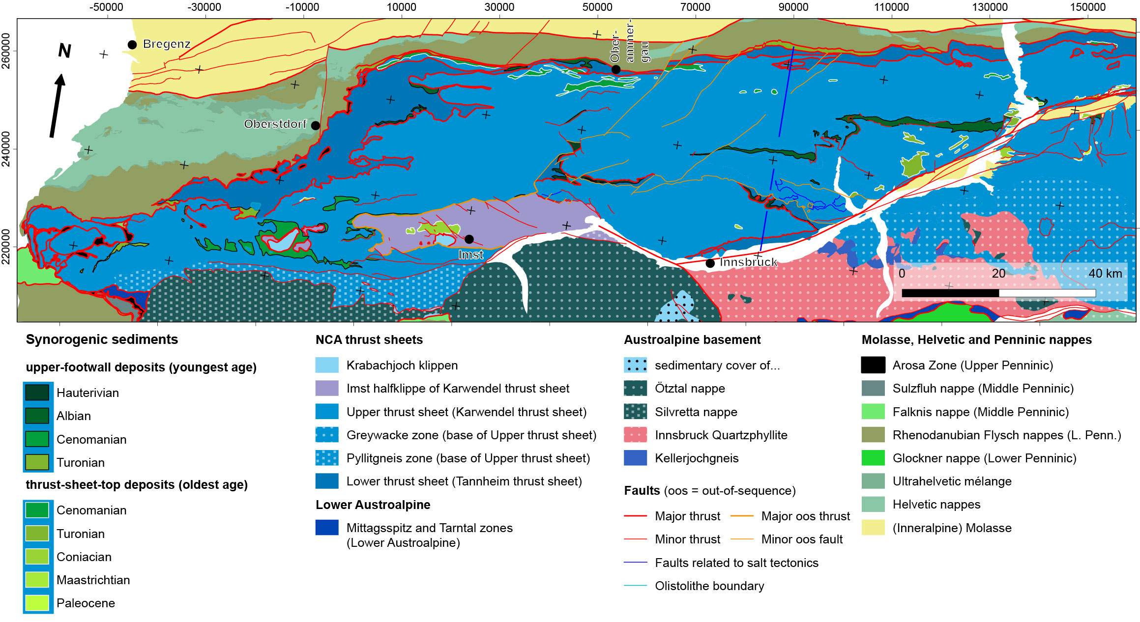
New tectonic subdivision of the western Northern Calcareous Alps:
Two avoid confusion between old and new tectonic subdivisions we introduced new names:
- the lower Tannheim thrust sheet, and the upper Karwendel thrust sheet
- the Imst half klippe is in lateral continuity with the main body of the Karwendel thrust sheet across a tear fault
see page 14 for distinction
between upper-footwall deposits
and thrust-sheet-top deposits
- different types of faults are shown separately

Slide 16
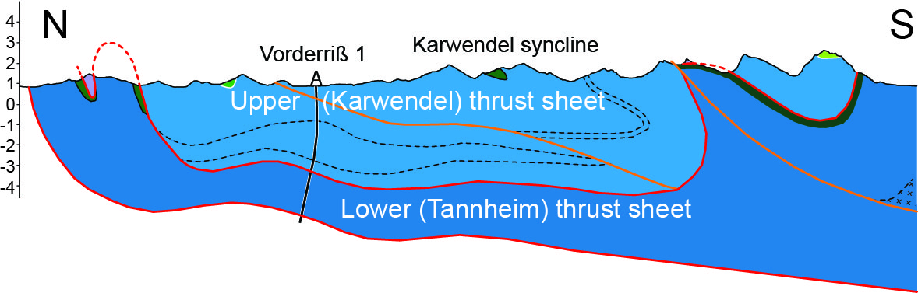
in-sequence
thrust
out-of-sequence thrust
(Kilian & Ortner 2019,
Austrian Journal of Earth Sciences)
New tectonic subdivision of the western Northern Calcareous Alps:
the Karwendel thrust sheet was emplaced between the Hauterivian (S) and Albian (N)
the Imst half klippe of the Karwendel thrust sheet formed out-of-sequence and stacked a southern part of the Karwendel thrust sheet onto a northern part
the Tannheim thrust sheet was emplaced after the Turonian onto a marginal slice.
stacking of thrust sheets is related to the Eoalpine event (pages 8, 13), out-of-sequence thrusting (pages 8, 10, 11) mostly related to Mesoalpine shortening
Thank you for your attention

Slide 17
References
Ampferer, O. (1902): Bericht über die Neuaufnahme des Karwendelgebirges.- Verh. Geol. Bundesanst., 1902: 274-276
Ampferer, O. & Hammer, W. (1911): Geologischer Querschnitt durch die Alpen vom Allgäu zum Gardasee.- Jahrbuch der k.k. Geologischen Reichsanstalt, 61: 531 - 710.
Eisbacher, G. H., Linzer, G.-H. & Meier, L. (1990): A depth extrapolated structural transect across the Northern Calcareous Alps of Western Tirol.- Eclogae Geol. Helv., 83 (3): 711 - 725.
Kilian, S. & Ortner, H. (2019): Structural evidence of in-sequence and out-of-sequence thrusting in the Karwendel mountains and the tectonic subdivision of the western Northern Calcareous Alps.- Austrian Journal of Earth Sciences, 112 (1): 62-83.
Lammerer, B. & Weger, M. (1998): Footwall uplift in an orogenic wedge: the Tauern Window in the Eastern Alps of Europe.- Tectonophysics, 285: 213 - 230.
Ortner, H. (2016): Field Trip 4: Deep water sedimentation on top of a growing orogenic wedge - interaction of thrusting, erosion and deposition in the Cretaceous Northern Calcareous Alps.- Geo.Alp, 13: 141-182.
Stüwe, K. & Schuster, R. (2010): Initiation of subduction in the Alps: Continent or ocean?- Geology, 38: 175-178.

