Slide 1
EGU General Assembly 2020, “Sharing Geoscience Online“ NH9.3 - Vulnerability, loss and damage modelling of the built environment 8 May 2020
Vulnerability of terrestrial transportation lines to natural events
U. Eidsvig¹, N. Tanasic², R. Hajdin², C. Ekeheien¹, L. Piciullo¹ 1: NGI (Norwegian Geotechnical Institute), Norway. 2: IMC (Infrastructure Management Consultants Gmbh), Switzerland

Slide 2
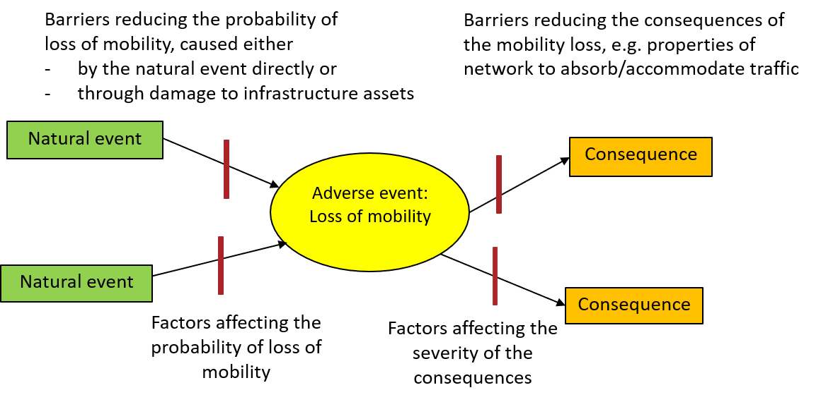
Scope
Notes:
Scope of the work is presented as bow-tie diagram with the adverse event in the middle and the causes and factors affecting the probability of the undesirable event in the left part of the diagram and consequences in the right part of the diagram. Considered triggers are natural events focusing on extreme weather events or related hazards.
The probability of the adverse event is not only dependent on the probability of the triggering event, but also encompass the structural vulnerabilty of the infrastructure assets related to e.g. robustness; condition and degree of protection
On the right side of the adverse event, the consequences are shown; here indirect consequences of the loss of mobility.

Slide 3
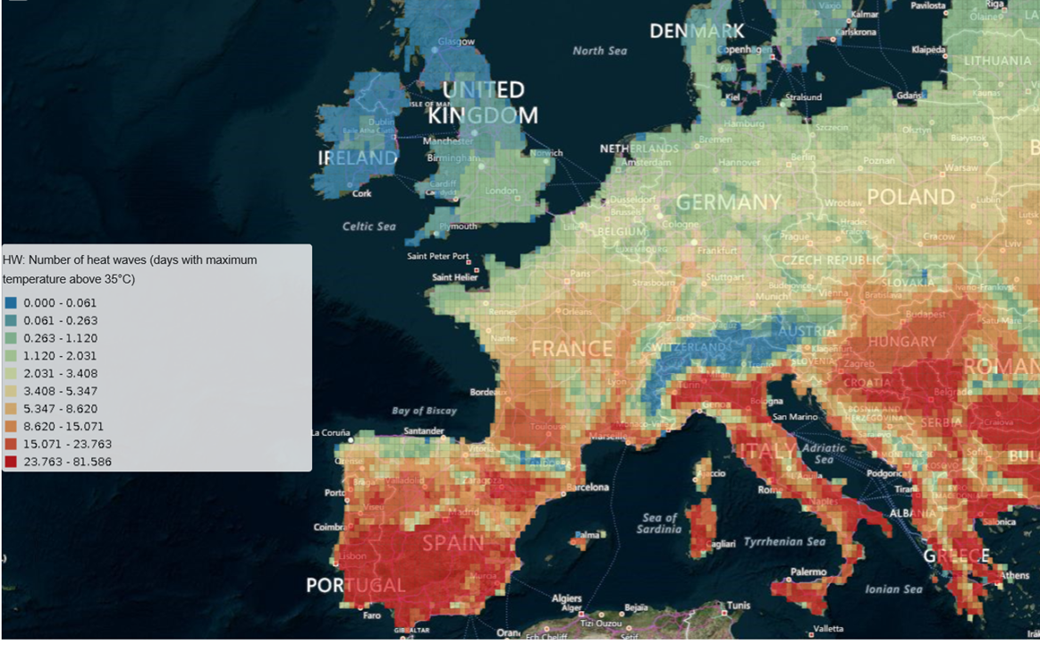
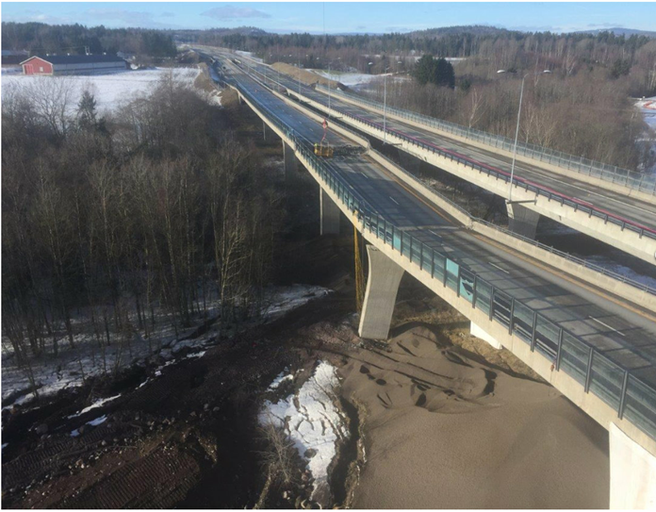
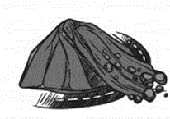
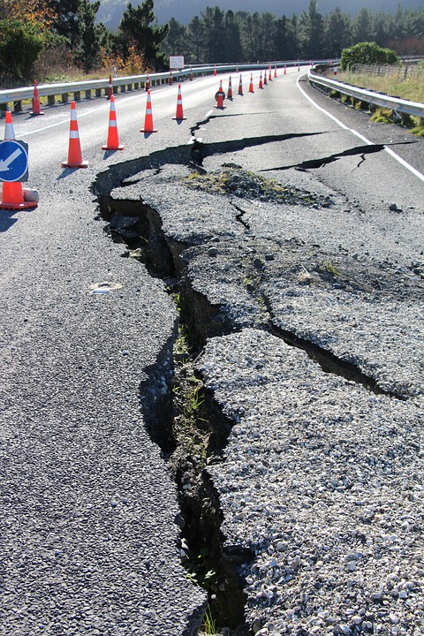
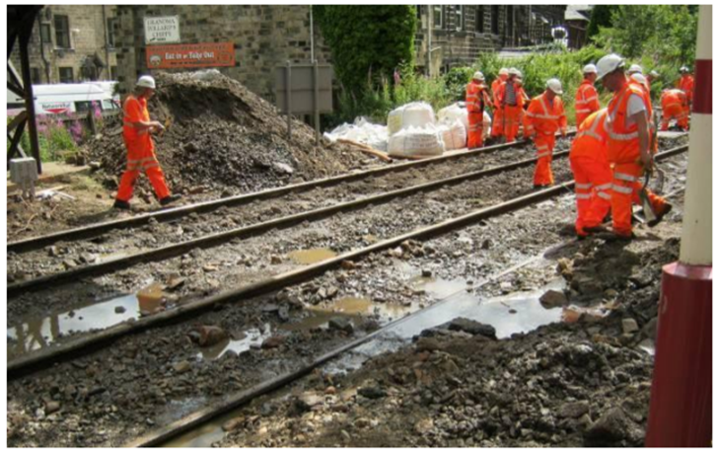
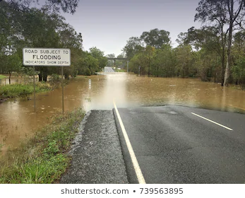
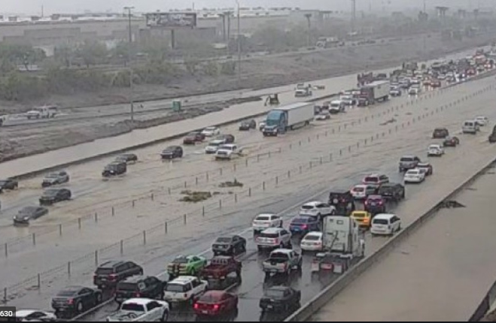
Triggers
Temporal and spatial probability
Structural
vulnerability
Damage
Delays
Risk identification
Hazard
Exposure
Vulnerability
(structural, functional)
Impacts
Failure modes
Intensity and
Duration
Infrastructure assets
Functional
Vulnerability
Detours and trip cancellations
Consequences of loss of trans-portation service
Notes:
Impact assessment encompass risk identification, considering triggers and failure modes and assessment of Hazard, exposure, vulnerability and impacts.
The vulnerability assessment will depend on the types of elements at risk, here the focus is on infrastructure assets as the scope is to analyse loss of mobility and not the safety of the users of the network.
Steps in the framework:
Risk identification: Review of previous events; both regarding predominant hazard types for different areas and failure modes/modes of malfunctioning.
Hazard: Hazard is assessed in terms of frequency and magnitude or intensity of the triggering events.
Two main ways of presenting the results:
Frequency of event for given range of intensities –or intensity for scenarios given a certain frequency or return period.
Exposure: The exposed infrastructure assets can be identified by overlapping the hazard maps with road and railway networks.
Vulnerability: Vulnerability could both be assessed at an asset level or at a network level., describing the damage to an asset or the functionality loss of the network(e.g. reduction of a traffic capacity). It could express the degree of loss of infrastructure assets, probability of damage of infrastructure assets or degree of loss of service/mobility
Impact: Impacts encompass damages, delays, detours and trip cancelletions as well as other consequences of loss of transportation service (related to the redundancy in the network as well as societal functions and economic activity served by the transportation infrastructure)

Slide 4
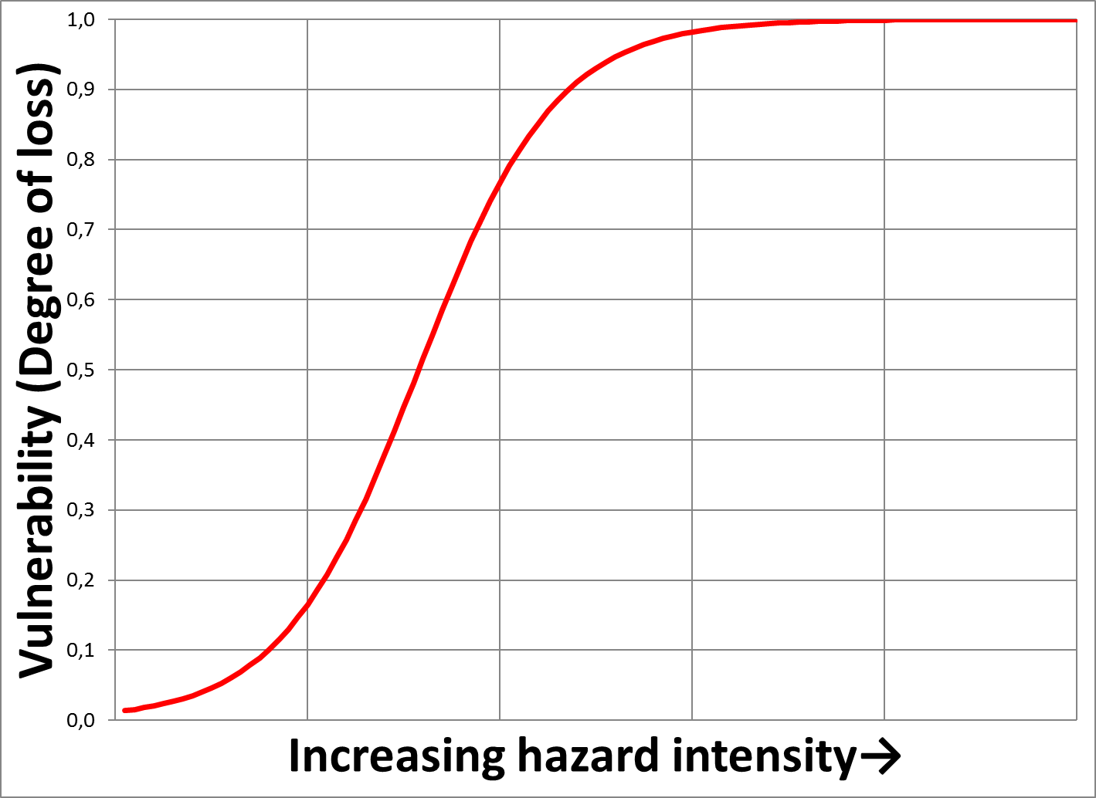
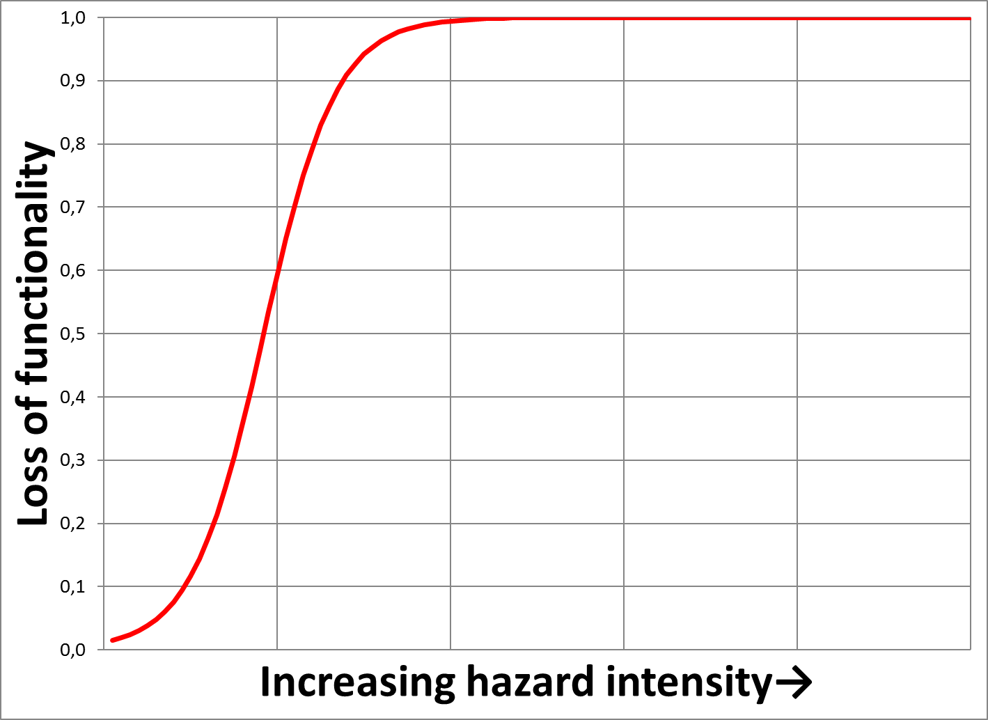
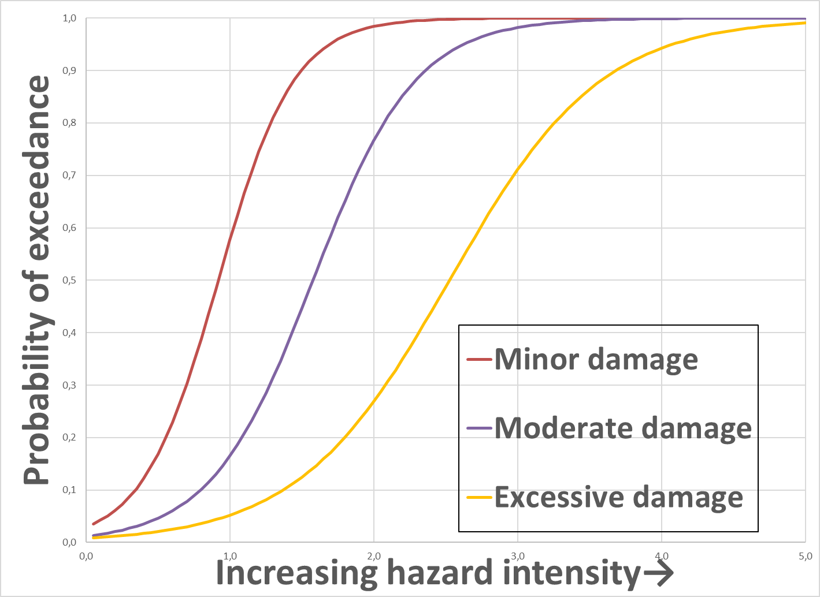
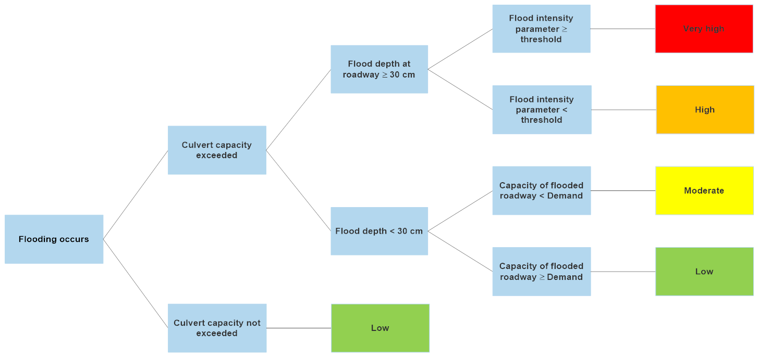
Structural asset vulnerability function - deterministic
Interruption of transportation service
Natural events leading to service interruption with damage to assets
Malfunctioning of asset due to damage
Criticality of asset for transportation service
Natural events leading directly to service interruption without material damage to assets
Functional vulnerability function
Asset fragility function -probabilistic
Assessment of relation between asset damage and service disruption
Notes:
This slide shows different scenarios leading to interruption of the transportation service – as well as tools for assessment.

Slide 5
This presentation is based on SAFEWAY deliverable 2.3: «Vulnerability and Resilience Factors», which is available at:
https://www.safeway-project.eu/en/results/d2-3

