Slide 1

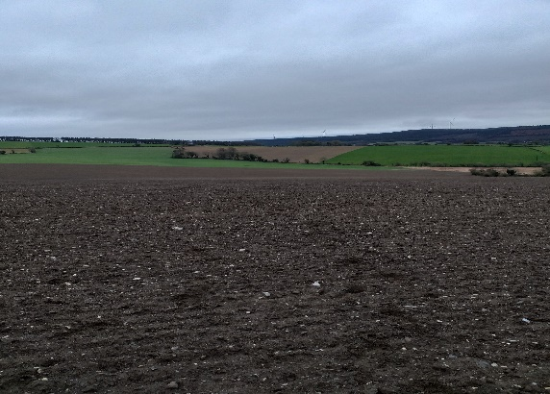
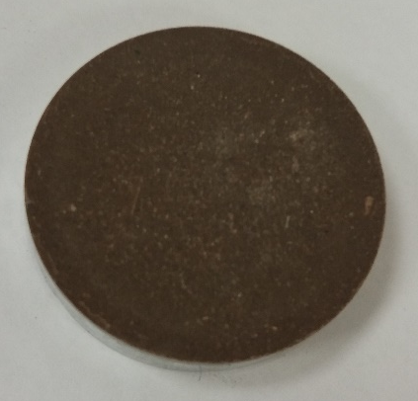
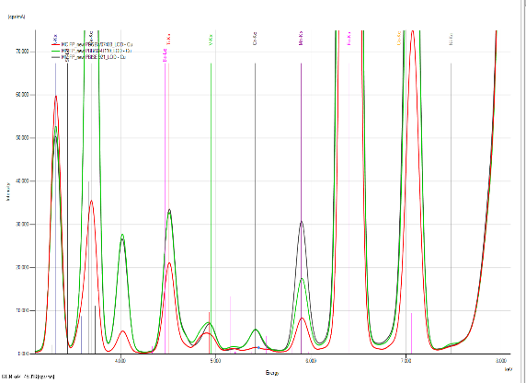
Determination of trace elements and macronutrients in agricultural soils using energy dispersive X-ray fluorescence as a rapid and precise analytical technique
Maame Croffie ^{1, 2}
(mcroffie01@qub.ac.uk)
Co-authors: Paul N. Williams ², Owen Fenton ¹, Anna Fenelon ¹, Konrad Meztger ^{1, 3}, Karen Daly ¹
1Teagasc Agriculture and Food Development Authority, Crops Environment and Land Use Department
Wexford, Y35 TC97, Ireland
2 Institute for Global Food Security, Queen’s University Belfast, Northern Ireland, BT9 5DL, UK
3 International Network for Environment and Health, NUI Galway, H91 TK33, Ireland

Slide 2
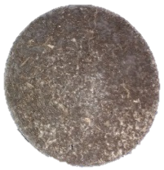
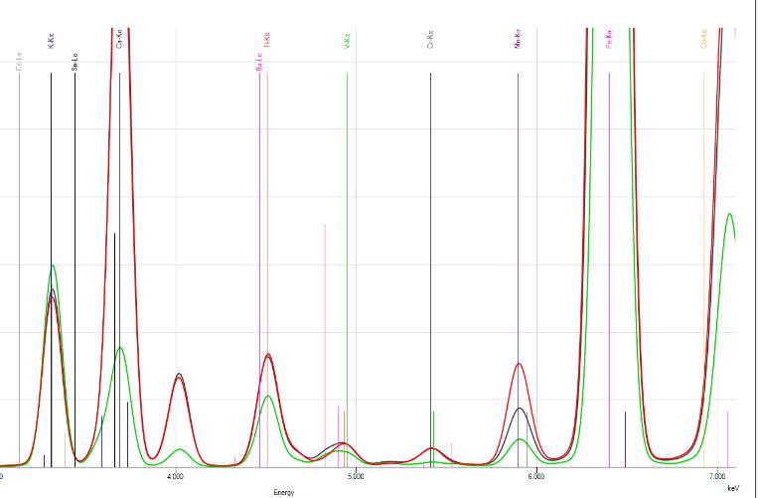


Introduction
Advantages
Minimal sample preparation
Rapid
Inexpensive
Portable
Challenges
Particle size effects
Surface irregularity
Matrix effects
Moisture effects
Objective
Improve accuracy and precision for trace elements and macronutrient analysis
sample
X-ray tube
Secondary target
XRF
detector
XRF Spectra

Slide 3
Materials and Methods
Sample preparation
Loose powder
Calibration study
Fundamental parameters (FP)
Matching library (ML) made up of 4 CRMs
Pressed pellet + wax
vs
Pressed pellet
XRF analysis of ISE samples
Cu
Cr
Pb
Fe
Al
Ca
Ni
Mn
S
Mg
Zn
P
ISE-International Soil Exchange
(reference samples for proficiency testing of labs)

Slide 4
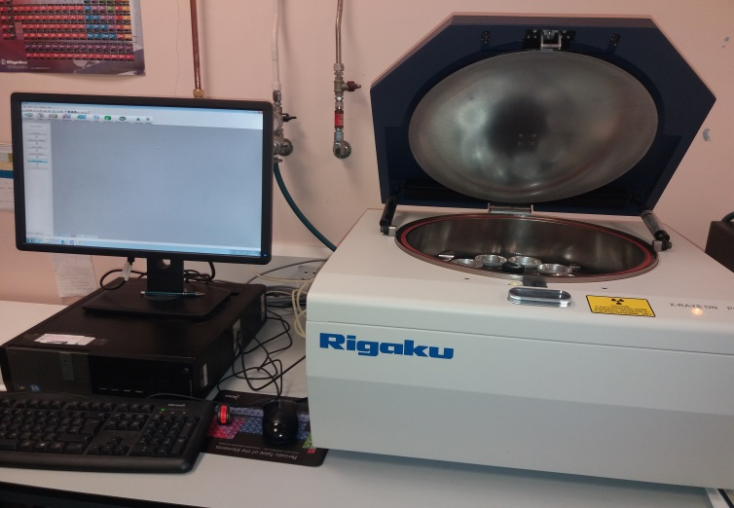
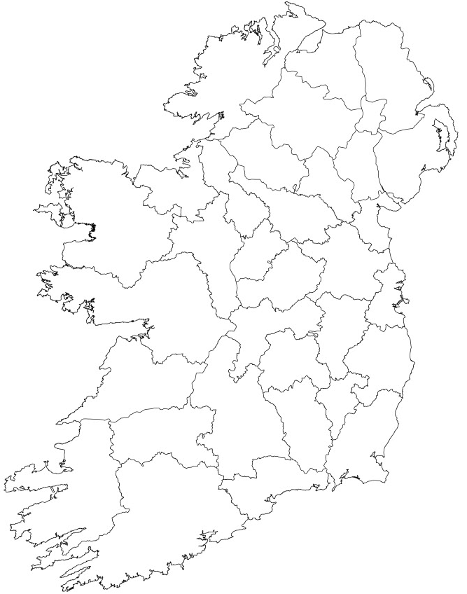
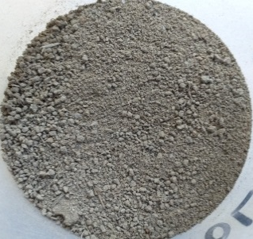
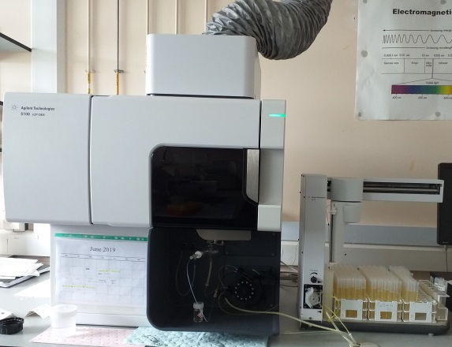
Materials & Methods
Pressed pellet with wax binder
Sampling sites
Energy-dispersive XRF
Aqua regia digestion
Agreement statistics
ICP-OES spectrometer

Slide 5
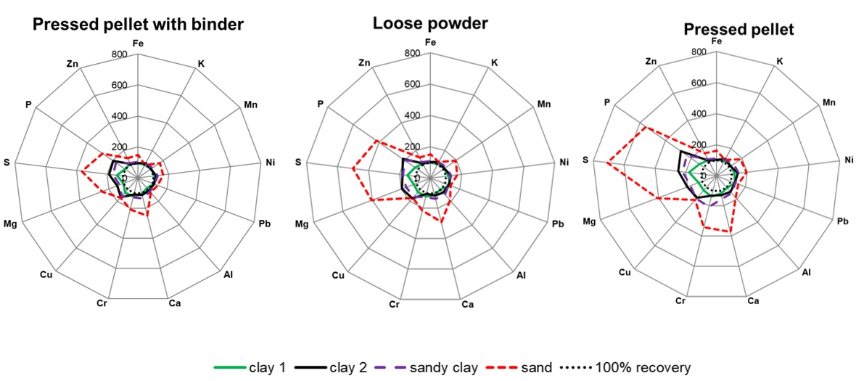
Results- Sample preparation comparison study

Slide 6
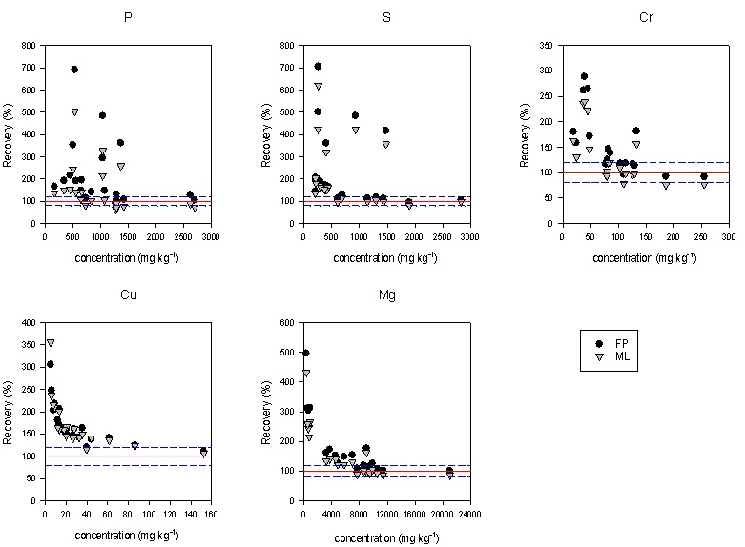
Results-XRF calibration study
FP- fundamental parameters
ML- matching library

Slide 7
Results- Comparison between XRF and ICP-OES
R ² >0.80
CCC>0.90
R ² >0.70
CCC<0.90>0.70
R ² <0.70
CCC<0.70
Ca
Zn
*Cu
Ni
Pb
Fe
Mn
Mg
S
P
Al
Cr
K
CCC-concordance correlation coefficient
* bias corrected for to improve agreement

Slide 8
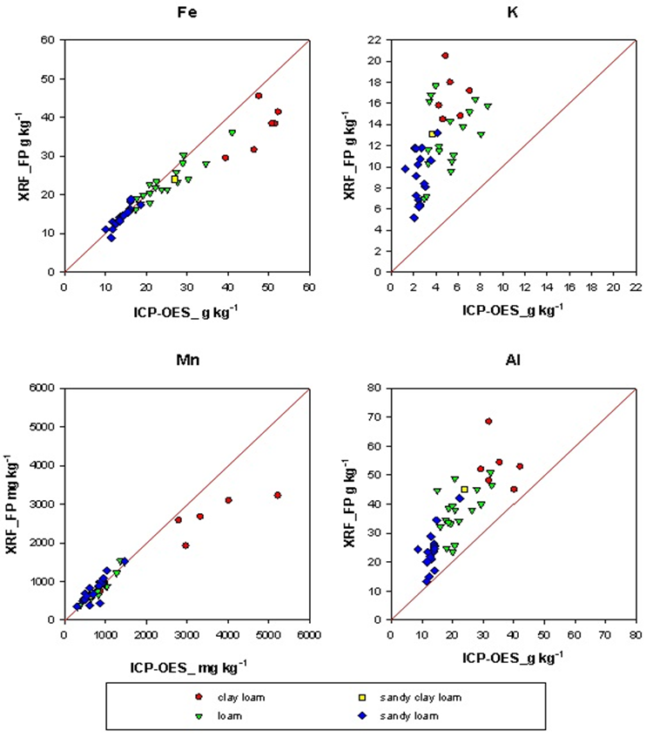
Observed differences between XRF and ICP-OES by soil texture

Slide 9
Conclusion
Pressed pellet with wax binder improves accuracy of XRF analysis
Matching library had varying effects on elements
XRF is more accurate for Al and K than aqua regia digestion with ICP-OES analysis
XRF can provide rapid determination of soil texture

Slide 10
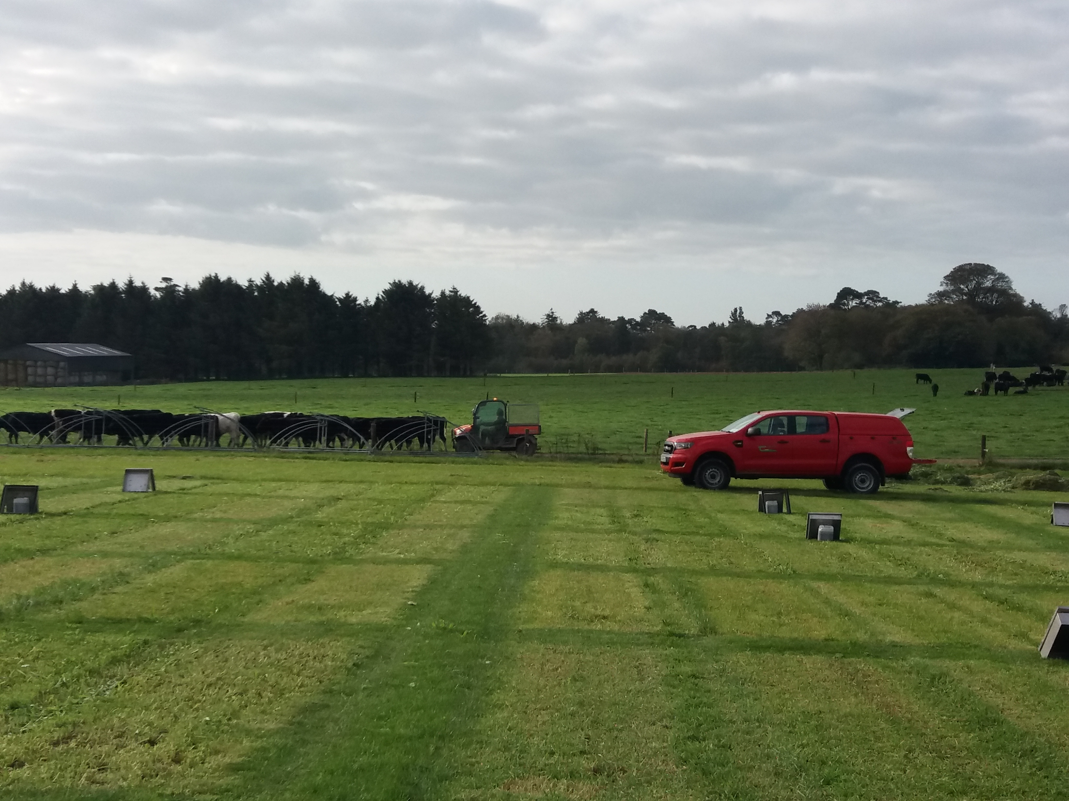

Acknowledgements
Linda Moloney Finn
Owen Frahill
Conor Nolan
Scott Rees

