Slide 1
Eastward Propagating Second Harmonic Poloidal Waves Triggered by Temporary Outward Gradient of Proton Phase Space Density: Van Allen Probe A Observation
Kazuhiro Yamamoto (Kyoto University), Masahito Nosé, Kunihiro Keika, David Hartley, Charles Smith, Robert MacDowall, Louis Lanzerotti, Donald Mitchell, Harlan Spence, Geoff Reeves, John Wygant, John Bonnell, and Satoshi Oimatsu
This study has been published as:
Yamamoto, K., Nosé, M., Keika, K., Hartley, D. P., Smith, C. W., MacDowall, R. J., et al. (2019). Eastward Propagating Second Harmonic Poloidal Waves Triggered by Temporary Outward Gradient of Proton Phase Space Density: Van Allen Probe A Observation. Journal of Geophysical Research: Space Physics, 124, 9904– 9923. https://doi.org/10.1029/2019JA027158
EGU ST2.7 session "Plasma waves, energetic particles and their interactions throughout planetary magnetospheres“, EGU2020-9575, Wed, 06 May, 14:00–18:00
Notes:
Please ask (stop) me at any time if you have any questions.

Slide 2
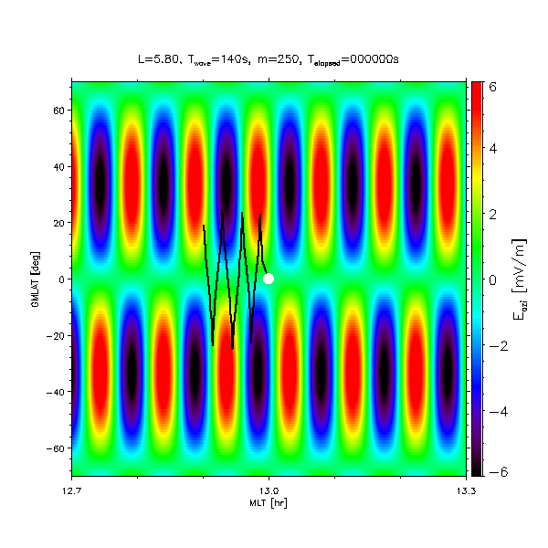
Introduction
N = ±1 resonance can take place for second (or even) harmonic waves.
Drift-bounce resonance is a possible mechanism of poloidal wave excitation in the inner magnetosphere (low β region).
Resonance condition
6
East
60
Trajectory of 11 keV proton
4
40
20
2
GMLAT (deg.)
0
Eazi (mV/m)
0
-20
-2
$$ω−mω_{d}(W,α)=Nω_{b}(W,α)$$
-40
$$m=\frac{2πR}{λ_{azi}}$$
-4
-60
ω: wave frequency, m: azimuthal wave number (m number), ω_{d}: drift frequency,
ω_{b}: bounce frequency, N: integer, W: resonant energy, α: resonant pitch angle
-6
West
12.7
13.0
13.3
$$λ_{azi}$$
MLT (hr)
Trajectory of a 11 keV proton calculated from test particle simulation in the dipole magnetic field.

Slide 3
Introduction
Previous study
Many studies have shown that poloidal ULF waves can be excited by ring current protons through drift-bounce resonance when the distribution of resonance particles is unstable (df/dW > 0).
energy gradient
radial gradient
$$\frac{df}{dW}={\left(\frac{∂f}{∂W}\right)}_{M,L}+\frac{dL}{dW}{\left(\frac{∂f}{∂L}\right)}_{M,W}$$
$$\frac{∂f}{∂W}>0$$
f : phase space density, M: magnetic moment
Southwood et al. (1969)
Takahashi et al. (2018)
Purpose of this study
What makes the particle distributions unstable? (scenario of the wave excitation [e.g., Engebretson et al., 1992; Dai et al., 2015])
We are interested in dynamics of the particle distributions.

Slide 4
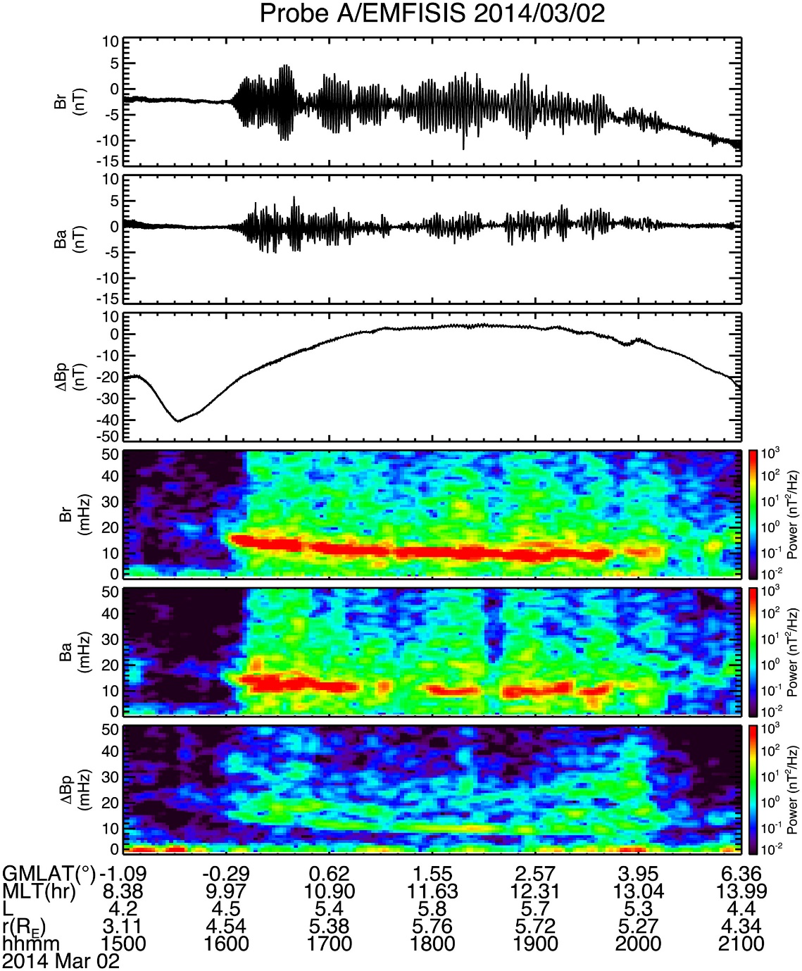
Introduction
Poloidal B
Long-lasting poloidal ULF waves have attracted many researchers.
However, each wave packet in one event has not been investigated.
Toroidal B
many wave packets
unstable
distributions
??
Purpose of this study
We examine the correspondence between wave packets and the particle distribution.
Oimatsu et al. (2018)
Notes:
This slide shows another consideration about the time variations of the distribution function.

Slide 5
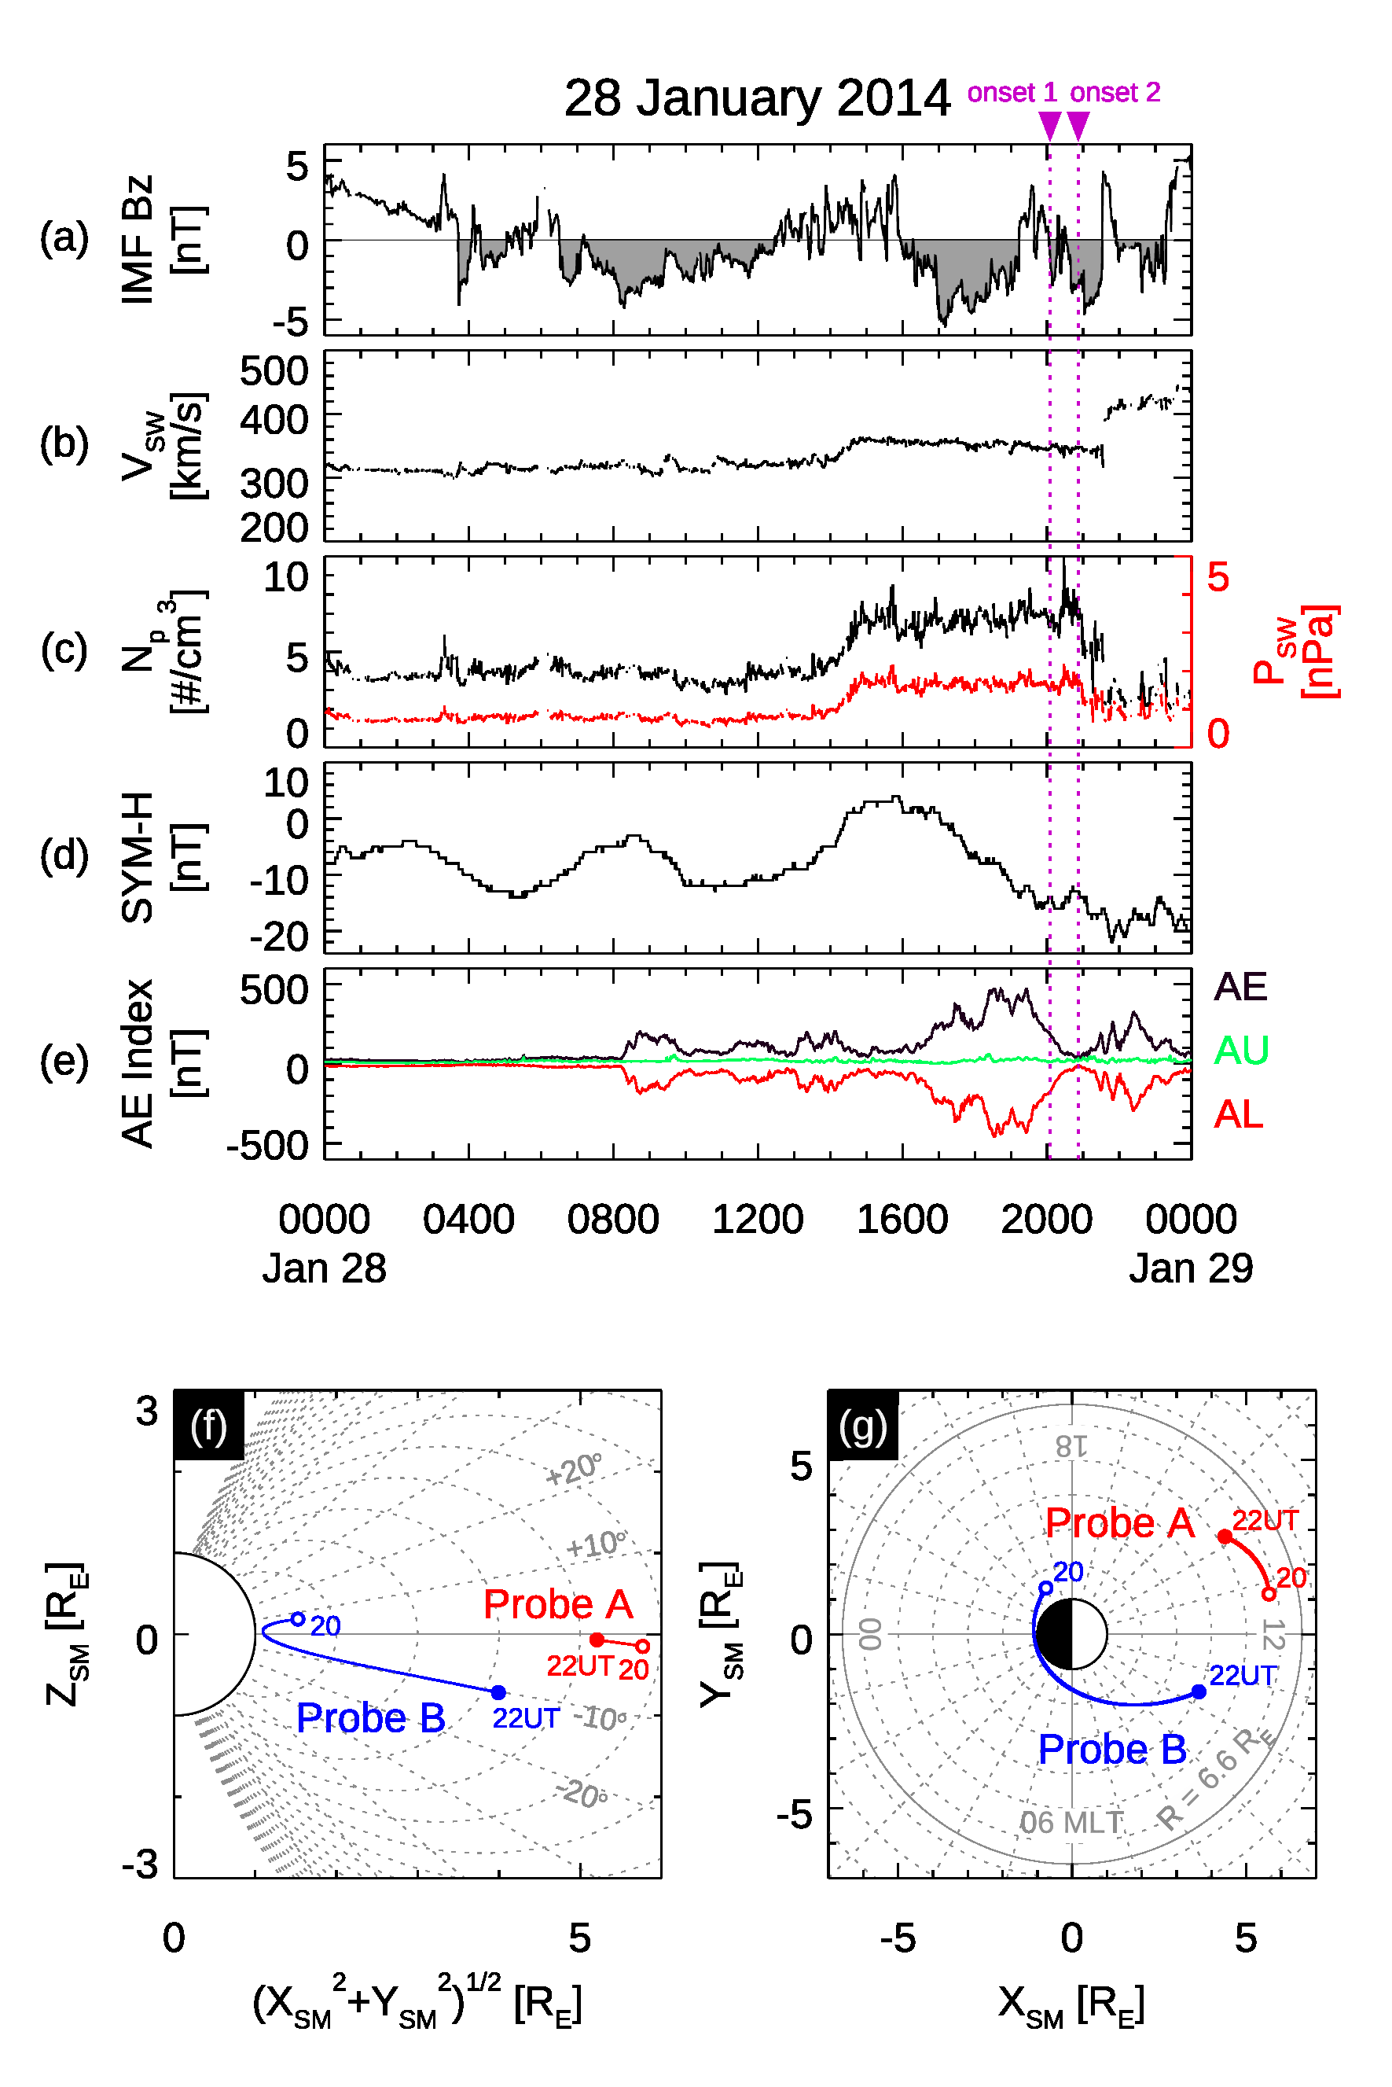
Observation
Probe A observed poloidal Pc 4 (f ~ 7 mHz) waves on 28th January 2014.
Recovery phase of the moderate substorm around 19 UT (a sharp drop of the AE index).
In the noon sector near the magnetic equator.
The solar wind speed and dynamic pressure are at low level.
not externally driven waves
Notes:
We used Van Allen Probes data on January 28th 2014.
Poloidal ULF waves were detected by probe A at the verical lines, during the recovery phase of the moderate substorm.
Probe A was passing the equatorial region on the dayside.

Slide 6
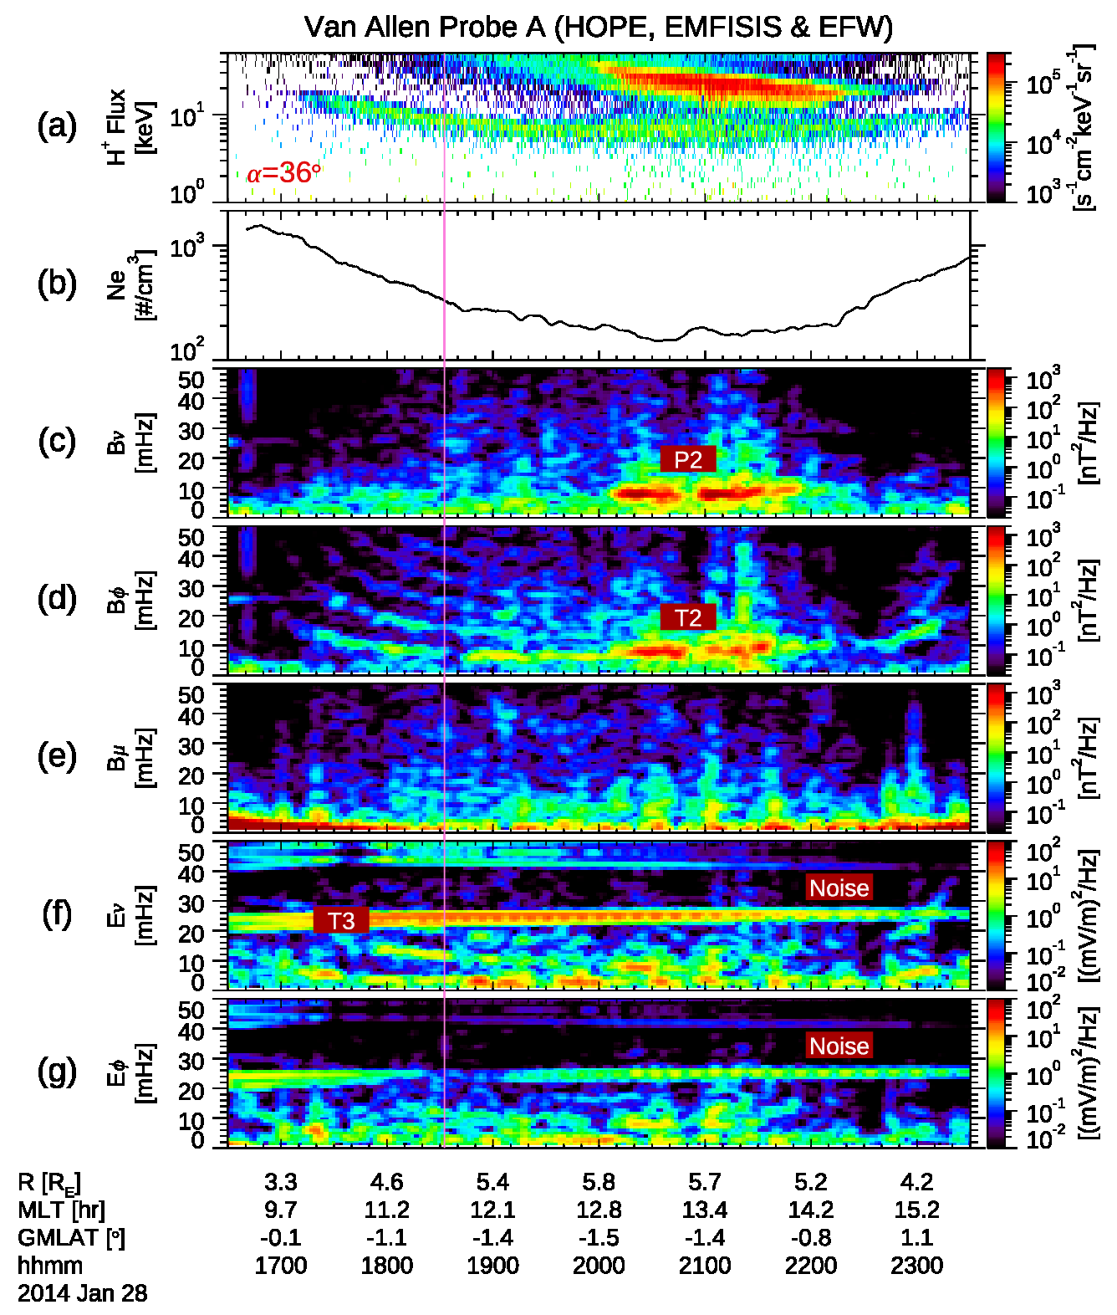
Overview
Injected protons in the high electron density region (Ne > 100 cm⁻³).
Second harmonic poloidal mode waves during 20-22 UT.
Multi-harmonic toroidal mode waves before and after the poloidal wave onsets.
Poloidal B
Toroidal B
Parallel B
Poloidal E
Toroidal E
Notes:
The top panel shows protons injected by the substorm observed by HOPE.
The electron density was very high, greater than 100 per cubic centimeters.

Slide 7
Wave amplitude and frequency
even mode
northern ionosphere
The magnetic field and electric field amplitude indicates that these waves are even mode waves.
V
V ~ 0
E = - (V×B) ~ 0 at equator
magnetic field line
equator
V
From the harmonic emission of toroidal mode waves, the poloidal mode waves correspond to second harmonic waves.
southern ionosphere

Slide 8
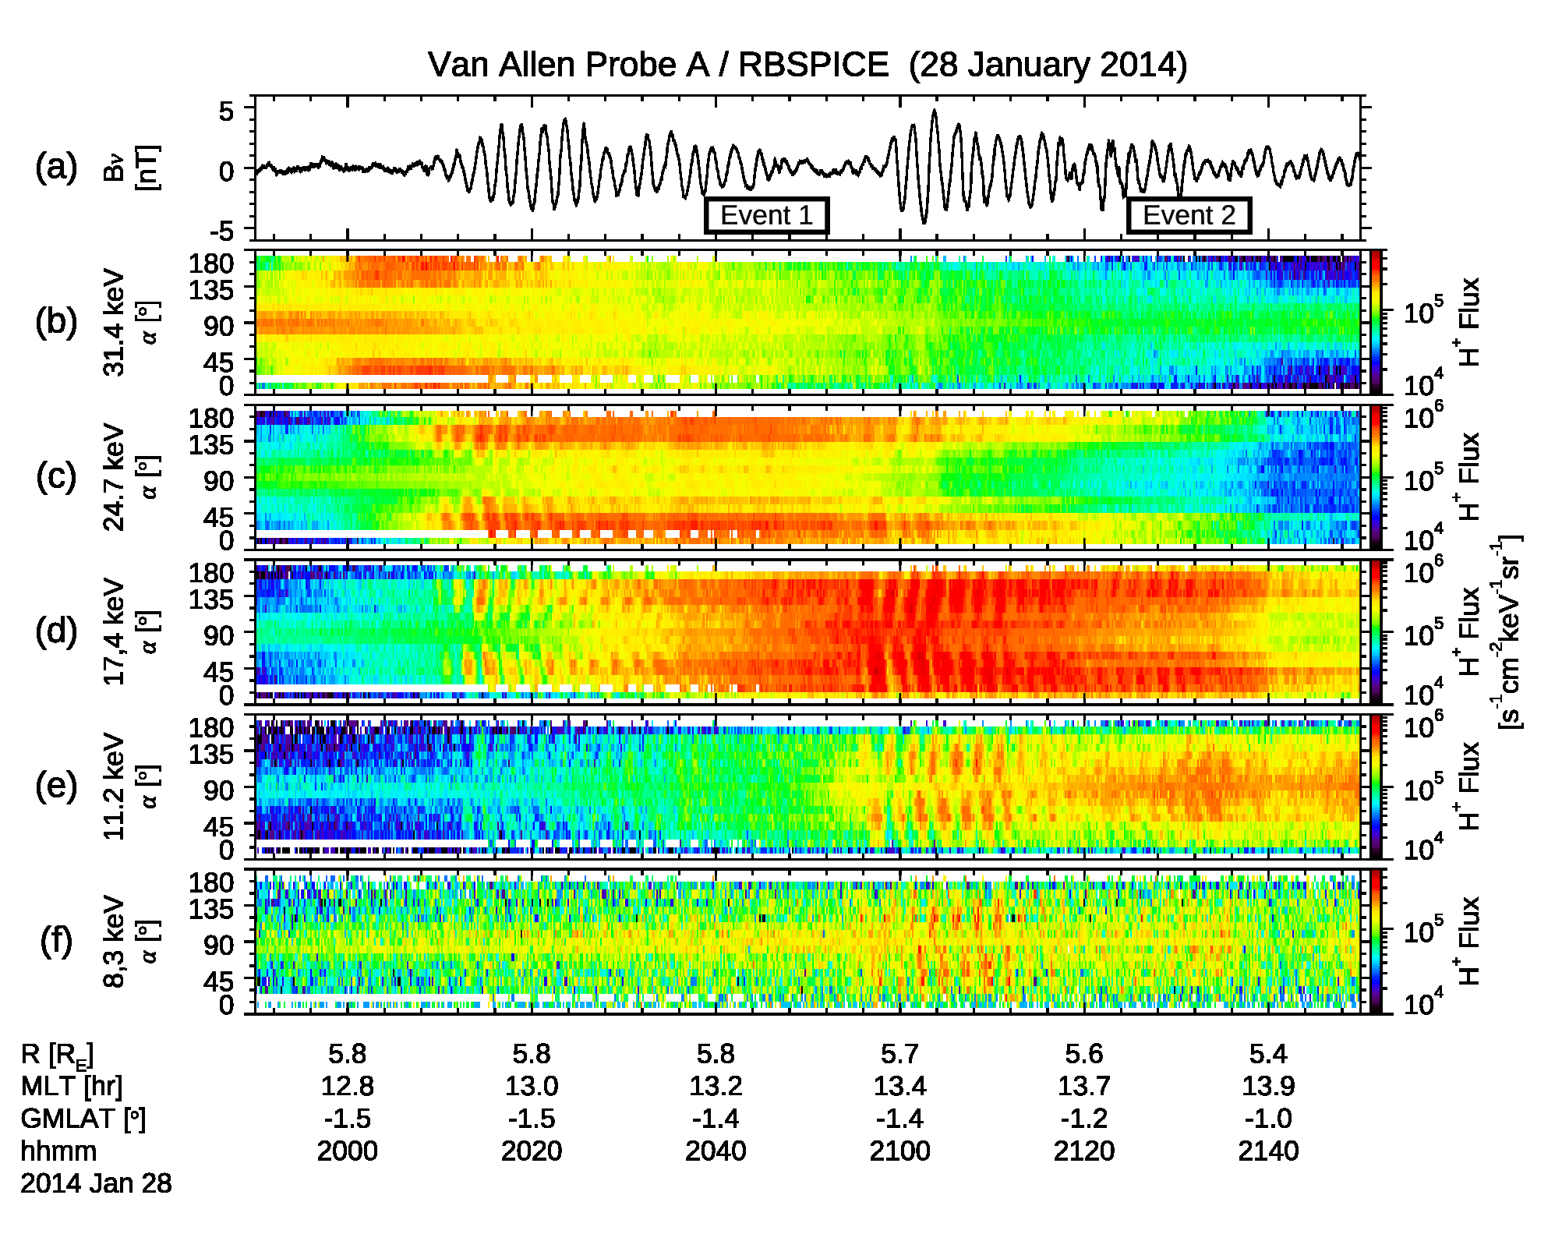
Pitch angle and energy dependence of H⁺ flux oscillations
Poloidal B
The wave form of the magnetic field and pitch angle distributions of the injected protons observed by RBSPICE.
Proton fluxes oscillated with a same frequency as the magnetic field oscillations.
The energy dispersion of flux enhancement and butterfly distributions suggest that these protons are injected by a substorm.
Notes:
This figure shows the wave form of the magnetic field and pitch angle distributions of the injected protons observed by RBSPICE.
Proton fluxes oscillated with a same frequency as the magnetic field oscillations.
The butterfly distribution suggests these protons are injected by the substorm.

Slide 9
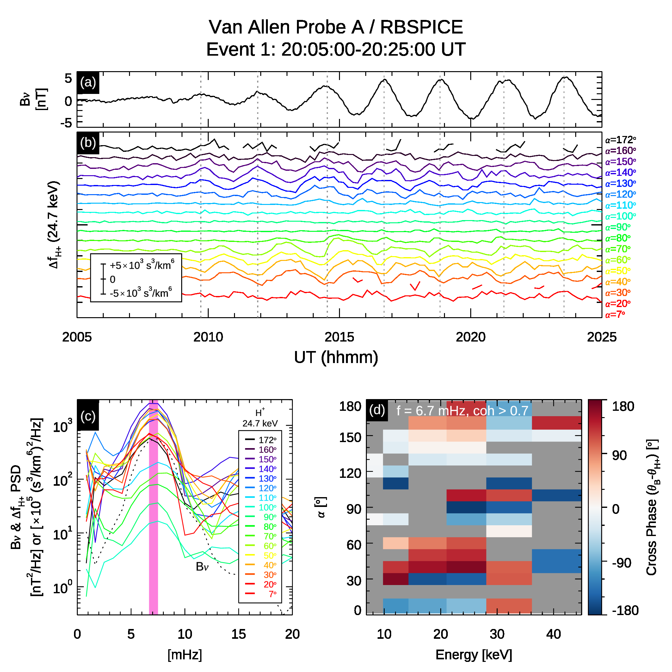
According to Southwood & Kivelson (1981); Takahashi et al. (1990), resonant particles oscillate in phase or out of phase with the magnetic field.
We performed cross phase analysis and found resonance pitch angles at ~ 40°/140°.
Notes:
We performed cross phase analysis to obtain the phase difference between the magnetic field and the proton phase space density.
According to …
Therefore, the resonance pitch angle are estimated to be around 40/140 degree.

Slide 10
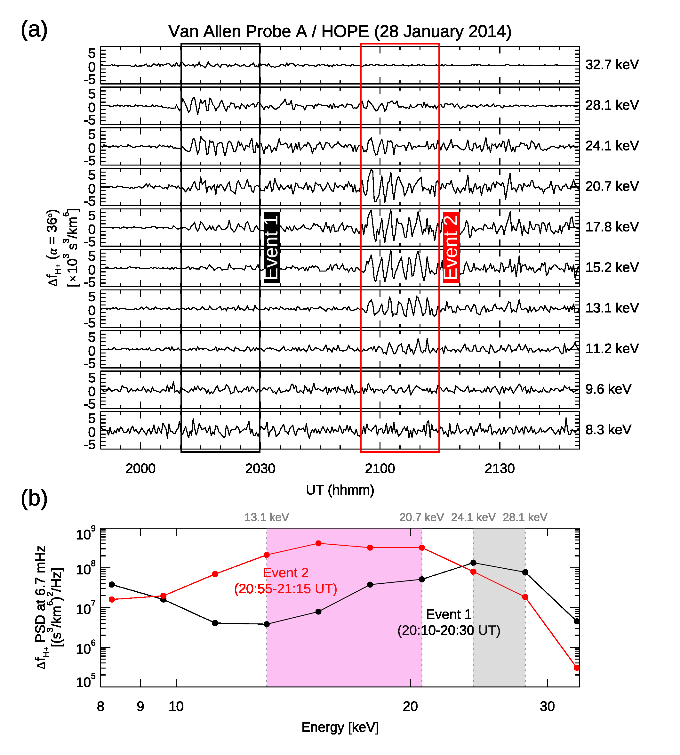
Energy dependence of the oscillations of proton phase space density is examined from the HOPE instrument.
We found that proton phase space density at 24.1-28.1 (13.1-20.7) keV oscillated significantly in event 1 (2), respectively.
Corresponding to the energy of newly injected particles.
Notes:
Using HOPE data, we also examined energy dependence of the oscillations of proton phase space density.
We found proton phase space density…

Slide 11
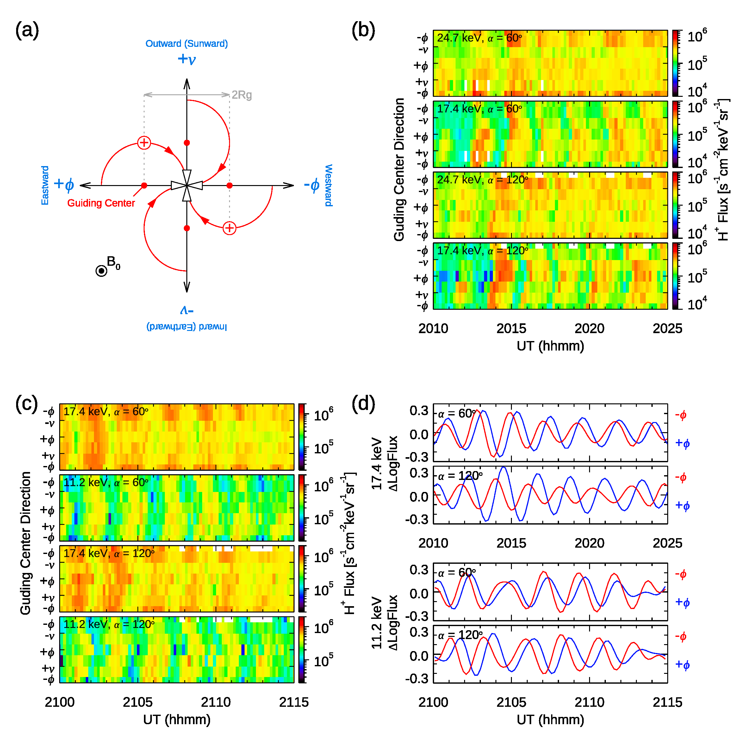
Estimation of m number
We estimated the azimuthal wave number (m number) and radial gradient of the proton phase space density by using ion sounding technique.
The estimated values are ~220 and ~260 for events 1 and 2, respectively.
Notes:
Finally, we estimated the azimuthal wave number by using ion sounding technique.
Figure (a) presents a schematic description of the ion sounding technique.
Because energetic protons have a finite Larmor radius, the protons convery the information of phase space density at a distance of the Larmor radius.
Thus we have virtually have two stations of particle measurement.

Slide 12
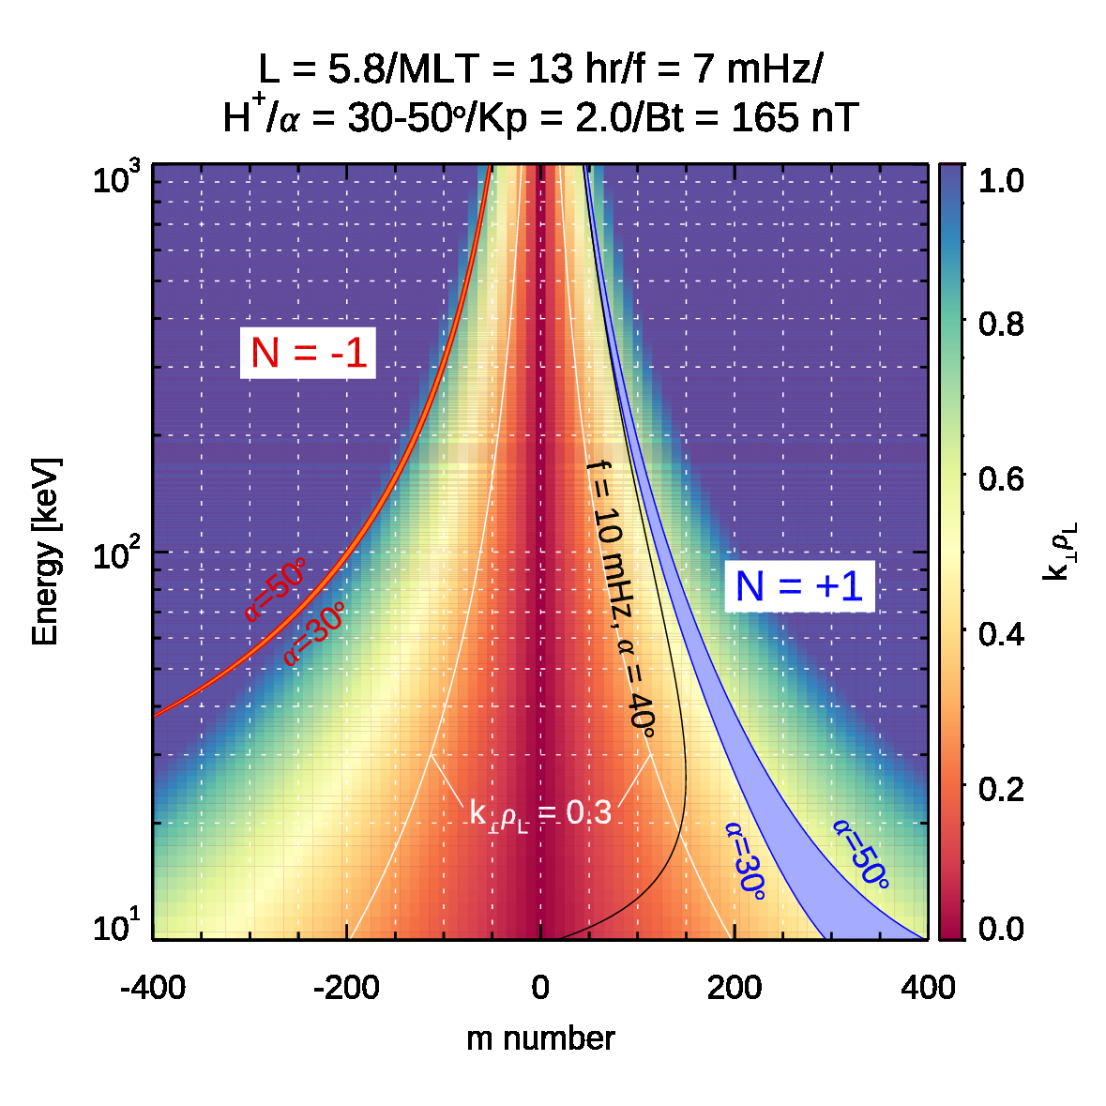
Discussion
Resonance condition of drift bounce resonance
$$ω−mω_{d}(W,α)=Nω_{b}(W,α)$$
most unstable at k⊥ρ_{L} ~ 0.5 (e.g., Chen & Hasegawa, 1988;1991; Dettrick et al., 2003)
We calculated the energy of N = +1 resonance using bounce and drift frequencies in the dipole field.
The resonance energy (10-30 keV) for the estimated m number of 220 -260 matches the energy where proton flux oscillation amplitudes were large.
Ne > 100 cm⁻³
higher energy ⇔ large pitch angle
Ne ~ 40 cm⁻³
eastward propagation (m > 0)

Slide 13
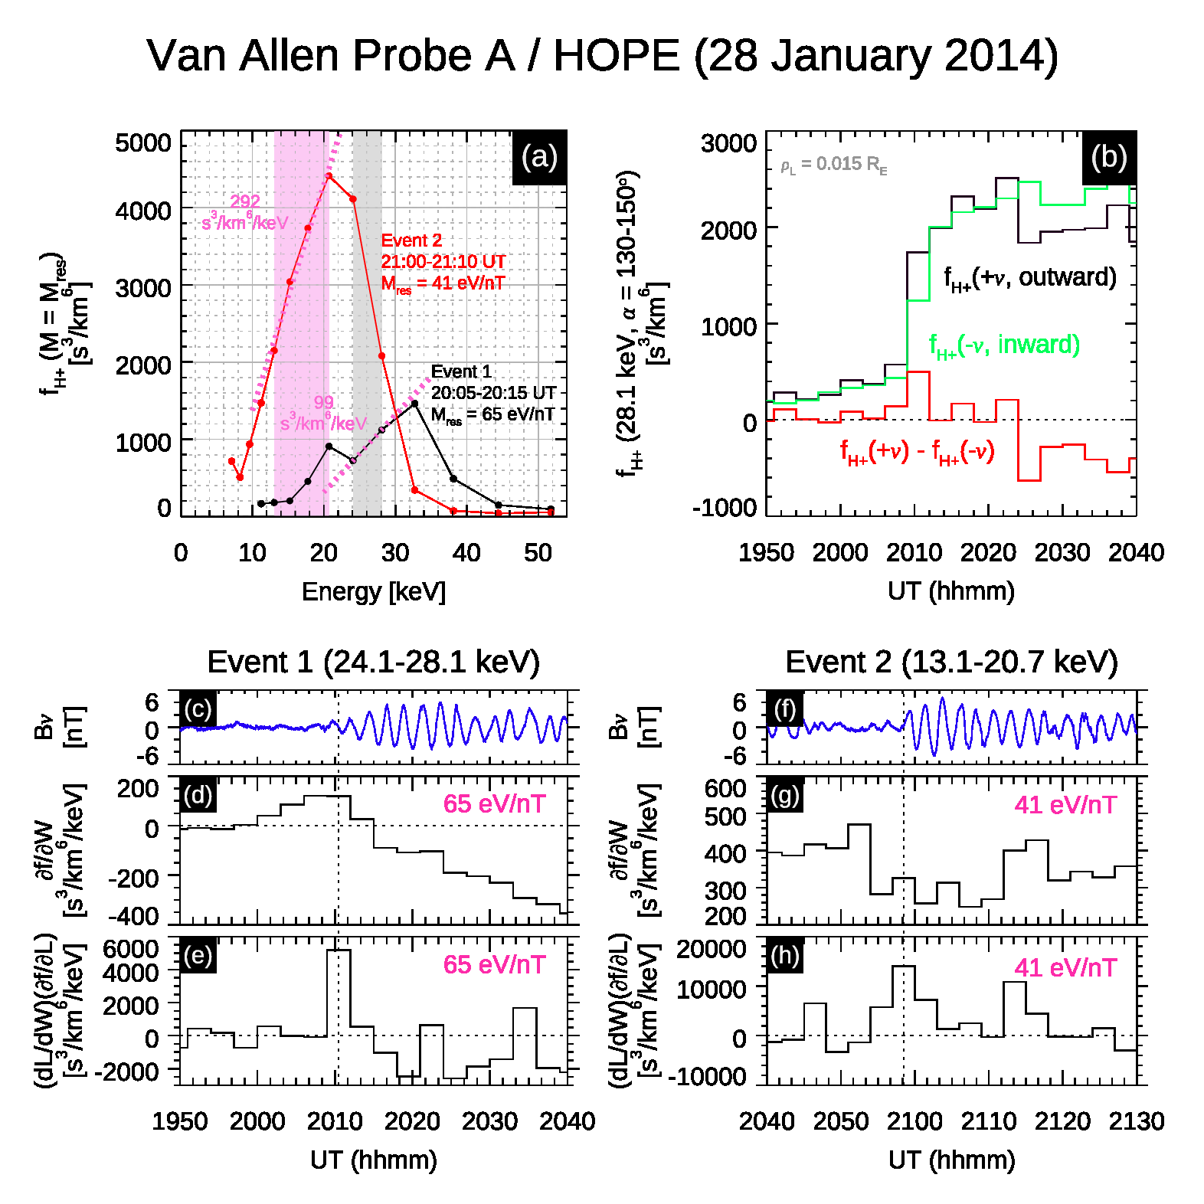
Destabilization by a steep outward gradient
We estimated df/dW and compared with the wave packets.
Contribution of the radial gradient is greater than that of energy gradient.
The transient intensification of ∂f/∂L seems to correspond to each wave packet onset.
$$\frac{∂f}{∂W}>0$$
$$\frac{∂f}{∂W}>0$$
$$\frac{∂f}{∂L}>0$$
$$\frac{∂f}{∂L}>0$$

Slide 14
Kp = 2-2+ (in given events)
consistent
$$Ratio=\frac{J(α=18−54°, 126−162°)}{J(α=72−108°)} −1$$
Mauk & MacIlwain (1974)
Location and timing of the substorm injection
We traced backward the protons with butterfly distributions by calculating the drift velocity.
The trajectory of the protons converges around 18-21 UT, suggesting the protons are injected on the dusk side.

Slide 15
Effect of cold electron density
We suggest that
the substorm injection provides resonance particles and
the geomagnetic storm makes the plasma environment satisfy unstable condition (k⊥ρ_{L} ~ 0.5) by increasing the cold electron density to > 100 cm⁻³.

Slide 16
Conclusions
Eastward propagating second harmonic poloidal waves with high m number were detected by Van Allen Probe A around the magnetic equator in the noon sector.
These waves are excited twice by double intensification of radial gradient of the proton phase space density due to substorm injection.
Dynamics of the plasmasphere also controls the poloidal wave excitation through the change of the local eigen-frequency of the waves.
A schematic description of the excitation of the second harmonic poloidal Pc 4 waves.

