Slide 1
Development of a Fast Solar Tracker Enabling Atmospheric Direct Sun Remote Sensing Applications on Different Moving Platforms
Ralph Kleinschek¹, Julian Kostinek², Philip Holzbeck¹, Marvin Knapp¹, Andreas Luther², Frank Hase³, and André Butz¹
¹Institute of Environmental Physics, Heidelberg University, Heidelberg, Germany
²Deutsches Zentrum für Luft- und Raumfahrt (DLR), Institut für Physik der Atmosphäre, Oberpfaffenhofen, Germany
³Karlsruhe Institute of Technology (KIT), Institute of Meteorology and Climate Research (IMK-ASF), Karlsruhe, Germany
We present a stand-alone solar tracker for direct-sunlight observations
Active tracking of the sun with a feedback loop of 100 Hz allows tracking from moving platforms
The solar tracker provides a pointing accuracy below 0.05° (≈1/10 sun diameter)
The device supports direct sunlight via two glass fibre cables
tracker
instrument

Slide 2
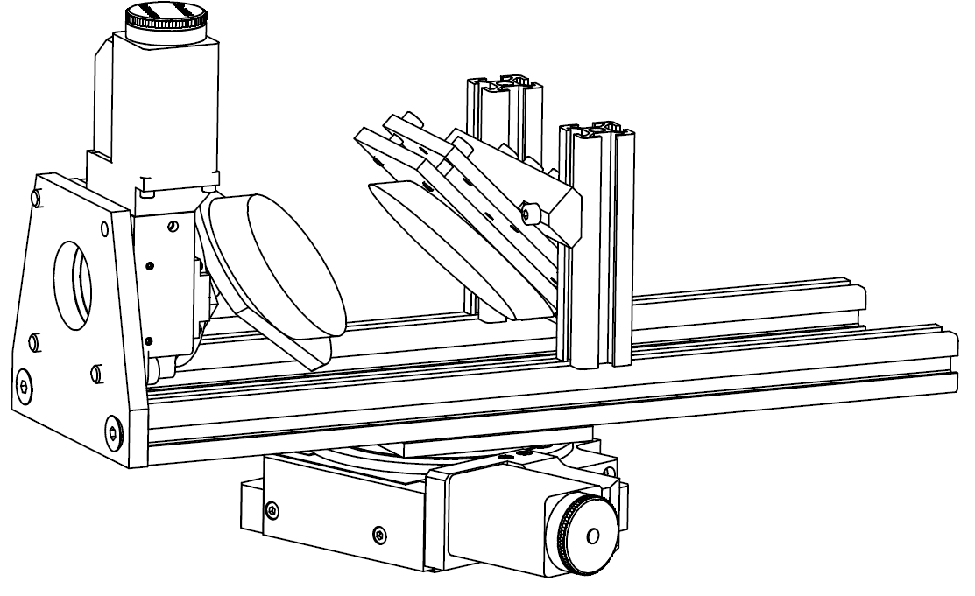
Two step tracking of the sun
Step 1: Coarse tracking
Step 2: Fine tracking
The fine tracking uses a mirror assembly on two perpendicular rotation stages. The suns projections is centered on a target on a screen. The mirror positions are updated with 100 Hz using the camera image.
adjustable
mirrors
Fish lens camera (FoV 185°) attatched to the tracker observes sky
Routine calculates relative position of sun according to tracking system
Finds coarse sun position (±3°) at sky
Fine tracking takes over as soon as the solar disk is within its field of view
Picture of the camera observing the projection on the screen. If the projection moves away from the target position, the mirrors are adjusted.
[Gisi, 2012]
camera
lens
screen

Slide 3
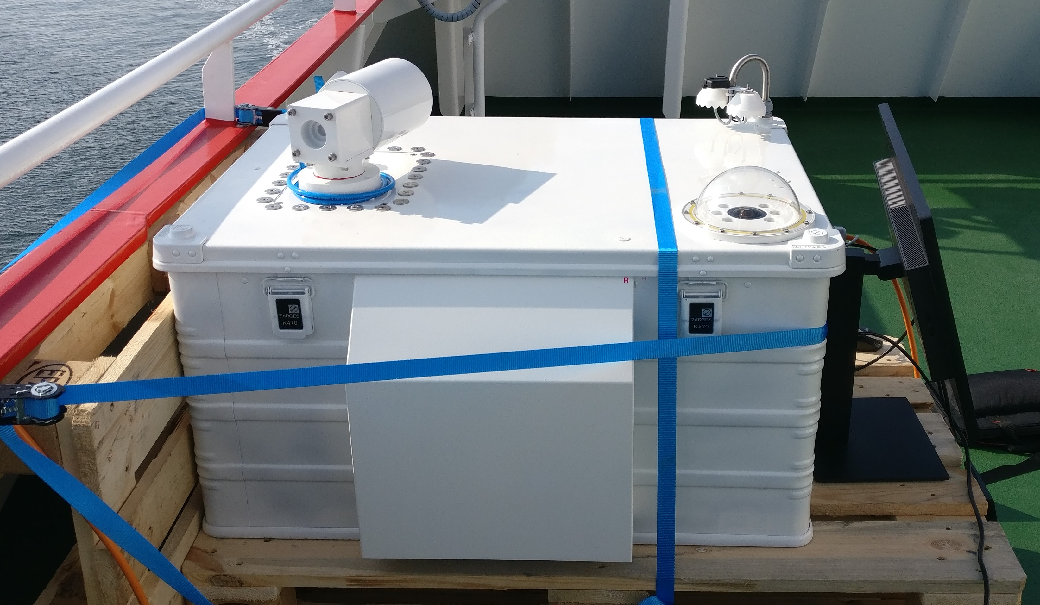
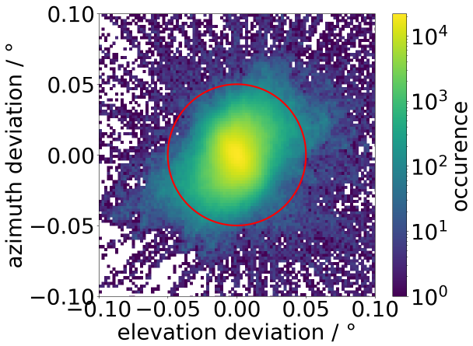
Performance during field campaign
A preliminary version of the device was tested on the Measuring Ocean References (MORE-2) campaign in June 2019. The instrument performed direct-sunlight observations from the German research vessel Sonne, while the solar tracker compensated the ships movements in real time.
preliminary
The deployed instrument. The solar tracker was inside a protective housing (circled) to avoid damage by precipitation and sea spray.
This figure shows how often the preliminary solar tracker satisfied the precision requirement of 0.05°. Under good weather conditions (figure), this is the case for more than 99% of the time. The campaign average is 79%.

Slide 4
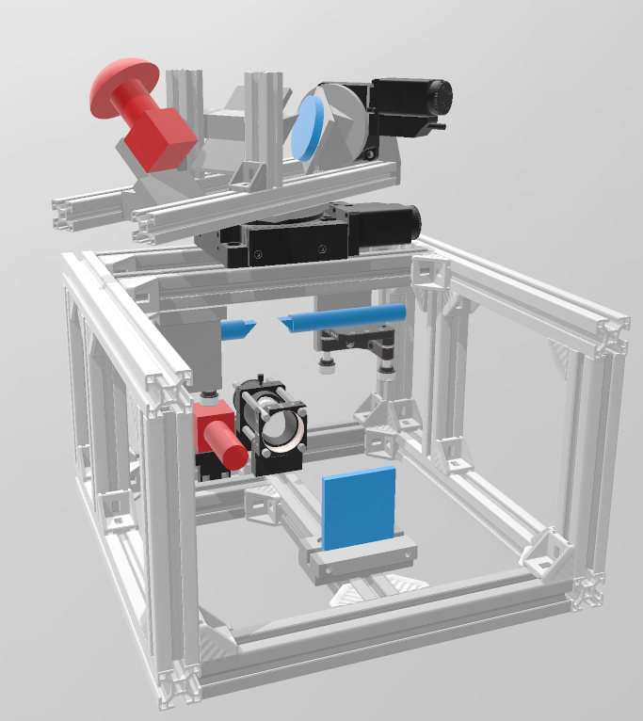
Current version of the solar tracker for deployment on a high altitude balloon
We improved the solar tracker further, increasing its tracking velocity and developing a stand-alone design to allow the use with a variety of spectrometers. We plan to use it on a high-altitude balloon during the TotalBrO campaign in 2021.
Model of the tracker. We show cameras in red and optical parts in blue. Two beam-splitter decouple light for augmented instruments.
Lab-test on a moving platform
(< 2 °/s) shows 99.8% of the deviations are smaller than 0.05°, and 27.2% smaller than 0.005°.
Picture of the stand-alone solar tracker (300x300x400 mm; 12 kg)

