Slide 1
Crustal structure of the Basque-Cantabrian Zone (N Spain) from seismic noise and receiver functions
Andres Olivar-Castaño*, Marco Pilz, David Pedreira, Javier A. Pulgar, Alba Diaz-González, Juan Manuel González-Cortina
*olivar@geol.uniovi.es
EGU 2020

Slide 2
The Basque-Cantabrian Zone (BCZ)
The BCZ is a thick Mesozoic basin with a complex 3D geometry inverted & incorporated into the Pyrenean-Cantabrian belt in North-Iberia
The crustal structure of the area is very complex, as evidenced by the presence of high-velocity bodies, deep transfer structures, and sharply-varying Moho depths (e.g. Pedreira et al., 2003, Quitana et al., 2015).

Slide 3
Data
Data used in this study was recorded by two temporary seismic networks: SISCAN, deployed between 2014 and 2018; and MISTERIOS, deployed between 2016-2017
Total 60 broadband stations; not all of them were operated simultaneously.
Average interstation distance of ~30 km

Slide 4
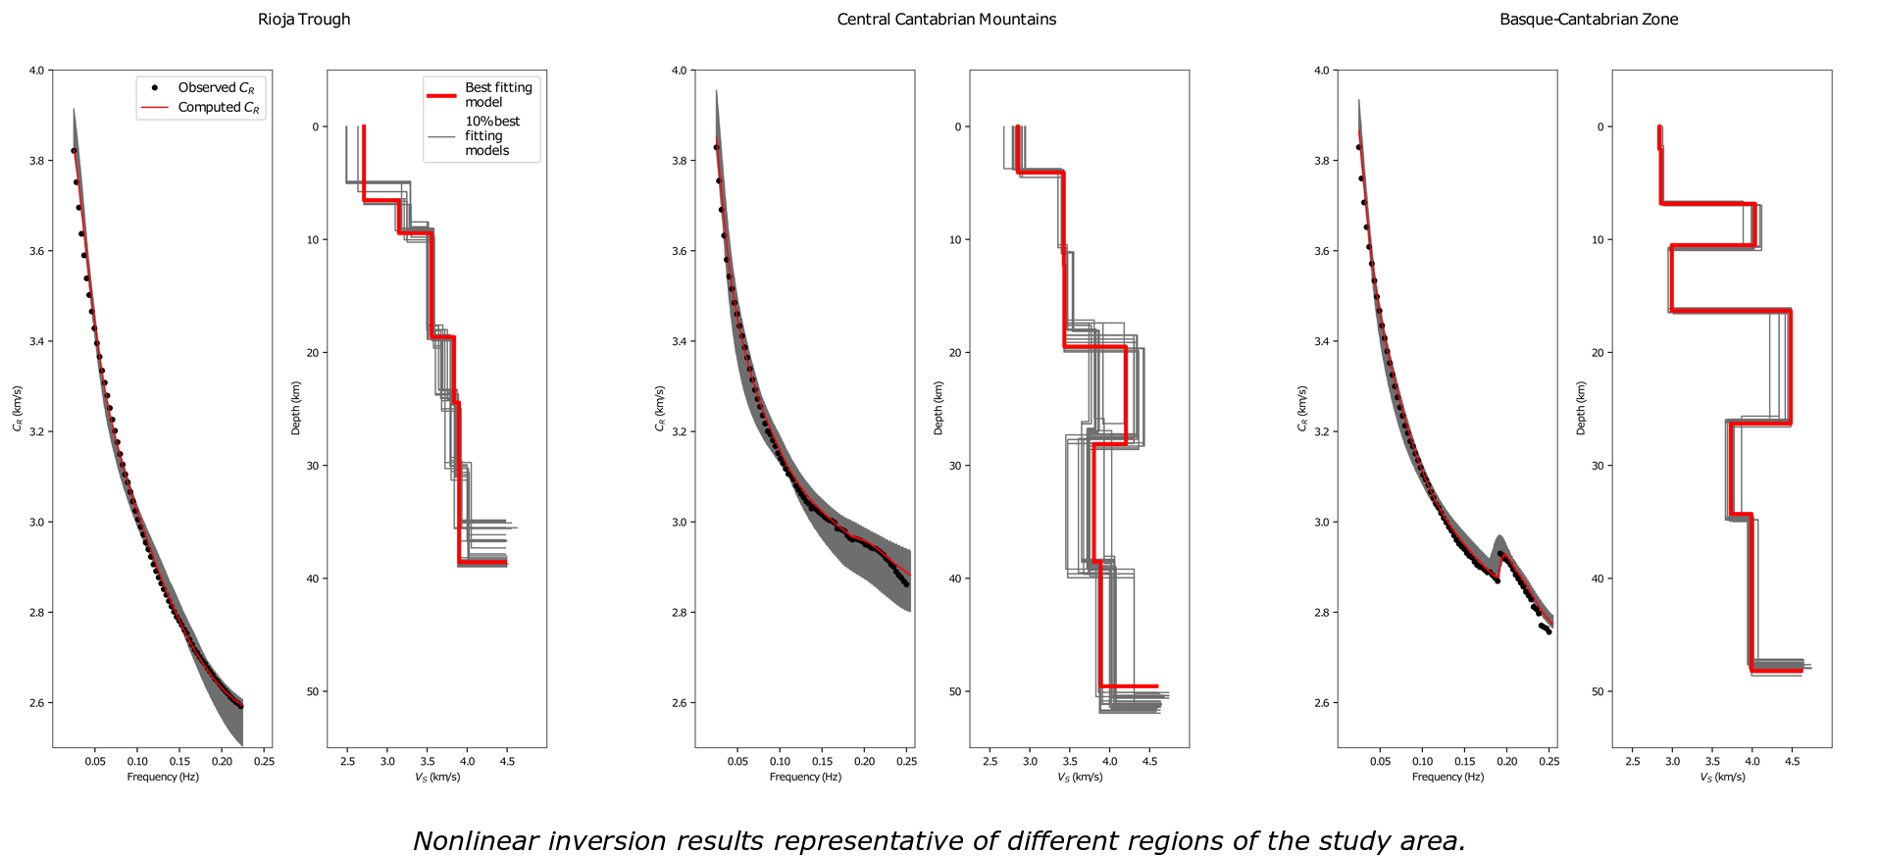
Seismic Noise Tomography
Cross-correlations of the vertical component were computed and stacked for each station pair.
Rayleigh phase velocities were measured from the stacked cross-correlations. These measurements were used to compute phase velocity maps for periods of 4-40 s.
A regularly-spaced grid was defined over the phase velocity maps, and a non-linear inversion was carried out at each node to determine the 1D shear-wave velocity structure. In the forward modelling, the fundamental mode as well as higher modes of propagation are accounted for.

Slide 5
Seismic Noise Tomography
The 1D shear-wave velocity models were linearly interpolated to create a 3D model.
Results support the conclusions from previous geophysical studies (e.g. Pedreira et al. 2003, 2007)
Deep layers (i.e. Moho depths) are poorly constrained due to the increasing wavelengths.

Slide 6
Receiver function analysis
In order to obtain more information about the deep crustal structure, P-wave receiver functions were collected for each station (LQT reference system) for earthquakes with epicentral distances in the range of 30º – 90º and M_{w} > 5.5
Earthquake recordings with low SNR were discarded. The number of receiver functions available at each location ranges between 24-100, approximately.
Receiver functions were stacked following the H-k stacking procedure (Zhu & Kanamori, 2000).
Overall, the results agree with existing knowledge: Moho depths are shown to be shallower in the western BCZ and to the south of the study area.
This part of our study is in an early stage.

Slide 7
References
Pedreira, D., Pulgar, J. A., Gallart, J., & Díaz, J. (2003). Seismic evidence of Alpine737crustal thickening and wedging from the western Pyrenees to the Cantabrian738Mountains (north Iberia).Journal of Geophysical Research,108, B42204. doi:73910.1029/2001JB001667
Pedreira, D., Pulgar, J. A., Gallart, J., & Torné, M.(2007).Three-dimensional741gravity and magnetic modeling of crustal indentation and wedging in the west-742ern Pyrenees-Cantabrian Mountains.Journal of Geophysical Research,112,743B12405. doi: 10.1029/2007JB005021
Quintana, L., Pulgar, J. A. & Alonso, J. L. (2015). Displacement transfer from borders to interior of a plate: A crustal transect of Iberia. Tectonophysics, 663, 378-398, doi: 10.1016/j.tecto.2015.08.046
Zhu, L. & Kanamori, H. (2000). Moho depth variation in southern California from teleseismic receiver functions. Journal of Geophysical Research 105, B2, 2969-2980

