Slide 1
Session: “New frontiers of multiscale monitoring, analysis, modeling and decisional support (DSS) of environmental systems (8 May 2020)”
Using explanatory crop models to help decision support system in controlled environment agriculture (CEA)
Chiara Amitrano *, Giovanni Battista Chirico, Stefania De Pascale,
Yousseph Rouphael, Veronica De Micco
University of Naples Federico II, Department of Agricultural Sciences, Portici (NA), Italy
*chiara.amitrano@unina.it

Slide 2
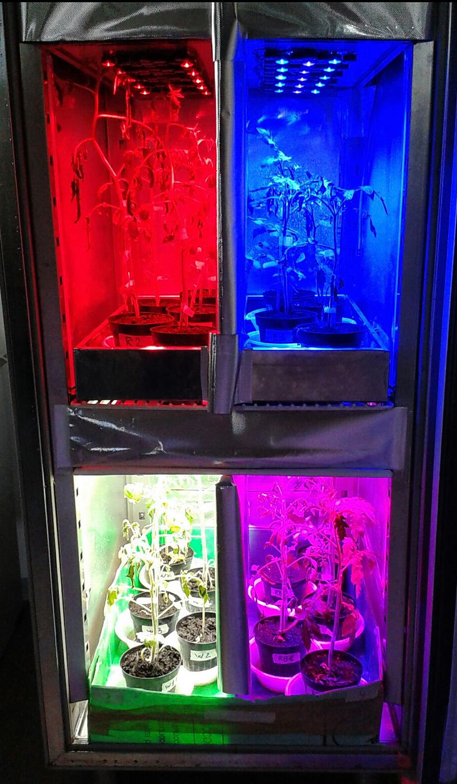
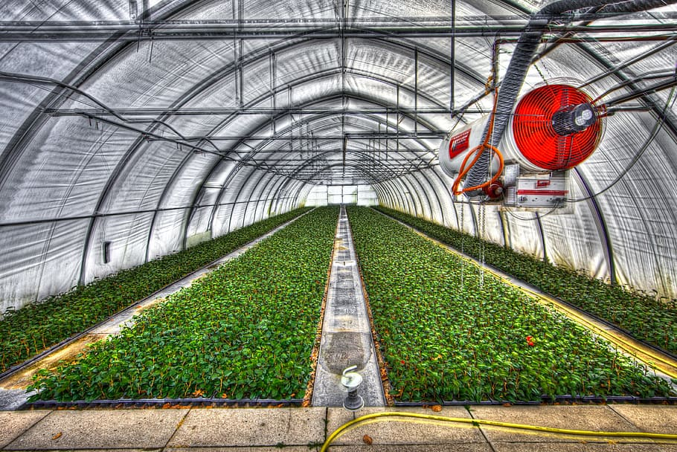
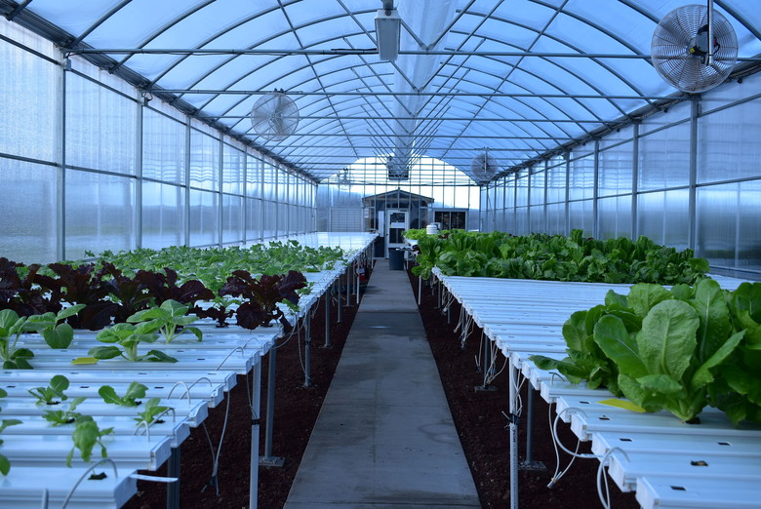
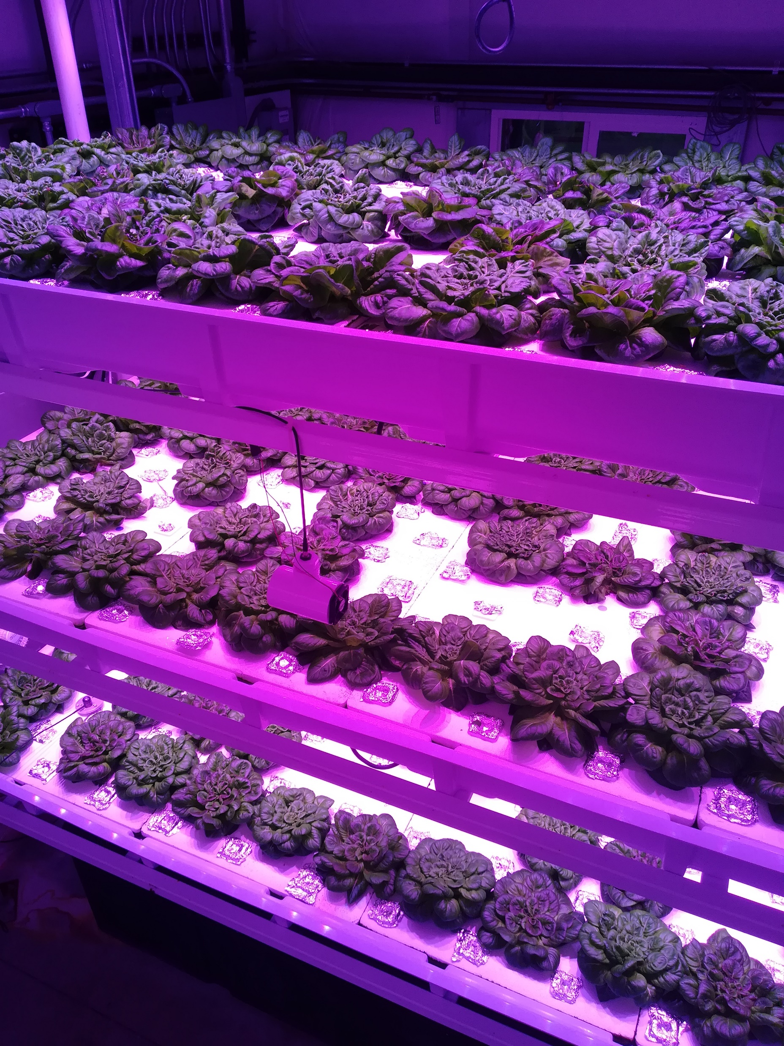
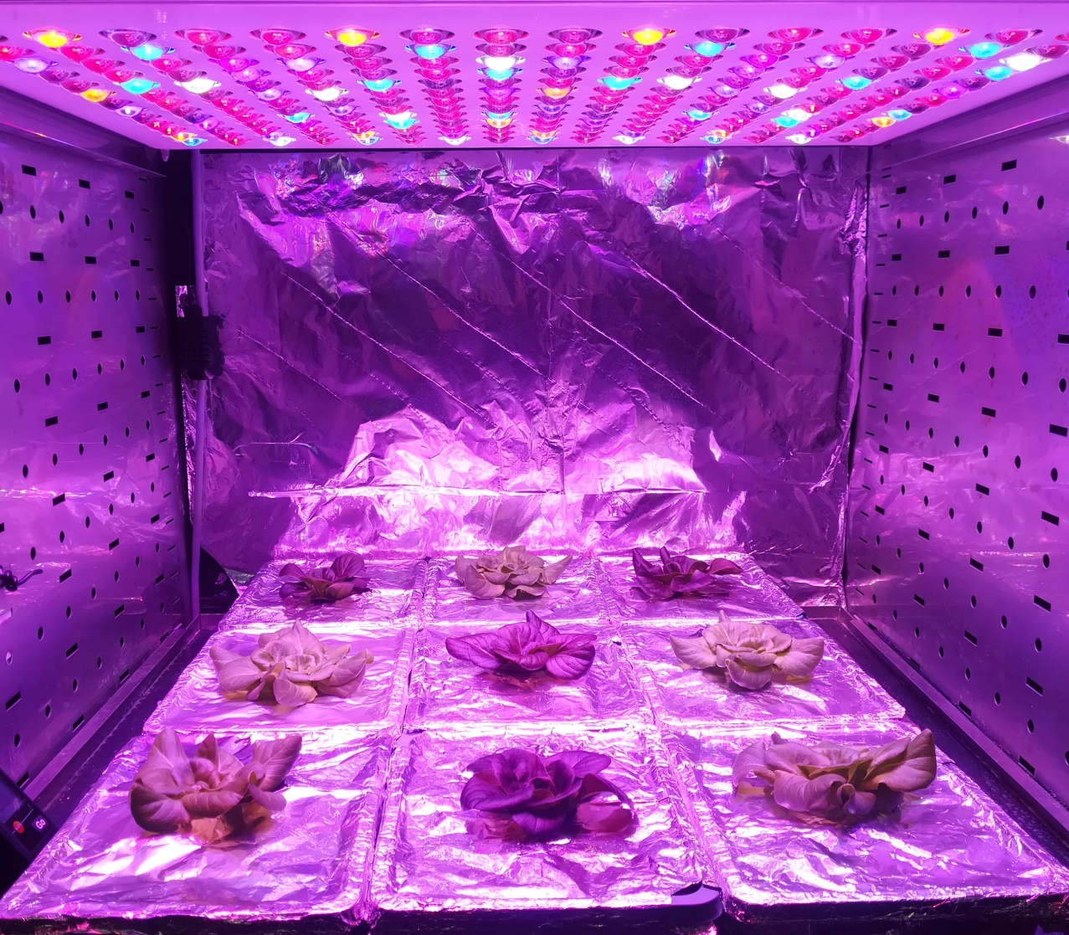
Background
Examples of CEA systems:
In controlled environment agriculture (CEA), computer technology is becoming an integral part in the production. Different sensors in CEA are used to monitor environmental parameters and activate environmental control.
Proximal sensors and plant phenotyping can help farmers in the crop management. However, these kinds of tools are often expensive or inaccessible for stakeholders.
The application of these tools to small-scale cultivation trials, could provide data for the implementation of mathematical models capable of predicting changes possibly happening during the cultivation.
These models could then be applied at larger scales, as extensive farm production, and be used to help in the cultivation management.

Slide 3
Aim
Experimental set-up
In the present study, we applied an Energy cascade model (MEC) to green- and red-leaf lettuce grown in a climatic chamber under low VPD (nominal condition) and high VPD (off-nominal condition).
We validated the model against experimental data to predict how possible variations in the cultivation factors impact plant performance, especially regarding daily biomass accumulation, photosynthesis and evapotranspiration.
Nominal Condition:
Low VPD
0.6 kPa
Off-Nominal Condition:
High VPD
1.7 kPa
Green and red-leaf Lactuca sativa L. ‘Salanova’
Two different VPDs were achieved by keeping the temperature at 24°C and changing the RH.
The lighting system in both conditions was an RGB red panel, with a light intensity of 315 µmol m⁻²s⁻¹ and 12 H photoperiod.

Slide 4
The MEC model algorithm
Parameter | Definition | Value | Source
H | Photoperiod | 12 | Experimental data
A_{MAX} | Maximum fraction of PPF absorbed by the canopy | 0.04 | Experimental data
PPF | Photosynthetic photon flux | 315 | Experimental data
*CUE_{MAX_green} | Maximum carbon use efficiency | 0.65 | Experimental data
CUE_{MAX_red} |  | 0.67
CUE_{MAX_offN_green} |  | 0.35
CUE_{MAX_offN_red} |  | 0.67
*CQY_{MAX_green} | Maximum canopy quantum yield | 0.70 | Experimental data
CQY_{MAX_red} |  | 0.72
CQY_{MAX_offN_green} |  | 0.68
CQY_{MAX_offN_red} |  | 0.69
t_{A} | Time at canopy Closure | 8 | Experimental data
t_{M} | Time of harvesting | 28 | Experimental data
t_{E} | Onset of edible biomass | 1 | Jones et al., 2000
BCF | Biomass carbon fraction | 0.4 | Jones et al., 2000
XFRT | fraction of DCG allocated to edible biomass | 0.95 | Jones et al., 2000
OPF | Oxygen production fraction | 1.08 | Jones et al., 2000
g_{A} | Aerodynamic conductance for water vapour transfer | 2.5 | Cavazzoni, 2003
The net photosynthesis (P_{N}) µmol CO2 m⁻² s⁻¹
P_{N} = (24-H) / 24 + H ∙ CUE / 24∙PG
Where P_{G} is the gross photosynthesis:
P_{G} = A ∙ CQY ∙ PPFD
The stomatal conductance (g_{S})
g_{S} = 1.717 · T – 19.96 – 10.54 · VPD · P_{N} / [CO₂]
Total edible biomass (TEB) gm⁻²:
TEB=$\int_{TE}^{TM}{XFTR ∙ CGR ∙ dt}$
The daily canopy transpiration (DTR)
DTR = 3600∙H∙ (M_{WW}/ ρ_{W}) ∙ g_{c} ∙ (VPD/P_{ATM})

Slide 5
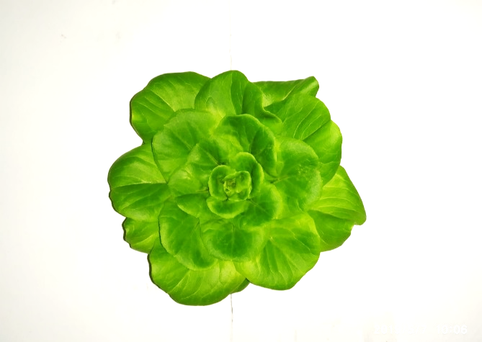
Results
Data predicted by the model and experimental data are indicated in the figures as:
• Model_green (green lettuce under nominal condition);
• Model_red (red lettuce under nominal condition);
• Model_offN_green (green lettuce under off-nominal condition);
• Model_offN_red (red lettuce under off-nominal condition)
• Exp_green, (green lettuce under nominal condition);
• Exp_red, (green lettuce under nominal condition);
• Exp_offN_green, (green lettuce under off-nominal condition);
•Exp_offN_red, (green lettuce under off-nominal condition).
Amitrano, C., Chirico, G. B., De Pascale, S., Rouphael, Y., & De Micco, V. (2019, October). Application of a MEC model for the irrigation control in green and red-leaved lettuce in precision indoor cultivation. In 2019 IEEE International Workshop on Metrology for Agriculture and Forestry (MetroAgriFor) (pp. 196-201). IEEE.

Slide 6
Results
Total Edible Biomass (gm⁻²)
Daily Transpiration (Lm⁻²)
Amitrano, C., Chirico, G. B., De Pascale, S., Rouphael, Y., & De Micco, V. (2019, October). Application of a MEC model for the irrigation control in green and red-leaved lettuce in precision indoor cultivation. In 2019 IEEE International Workshop on Metrology for Agriculture and Forestry (MetroAgriFor) (pp. 196-201). IEEE.

Slide 7
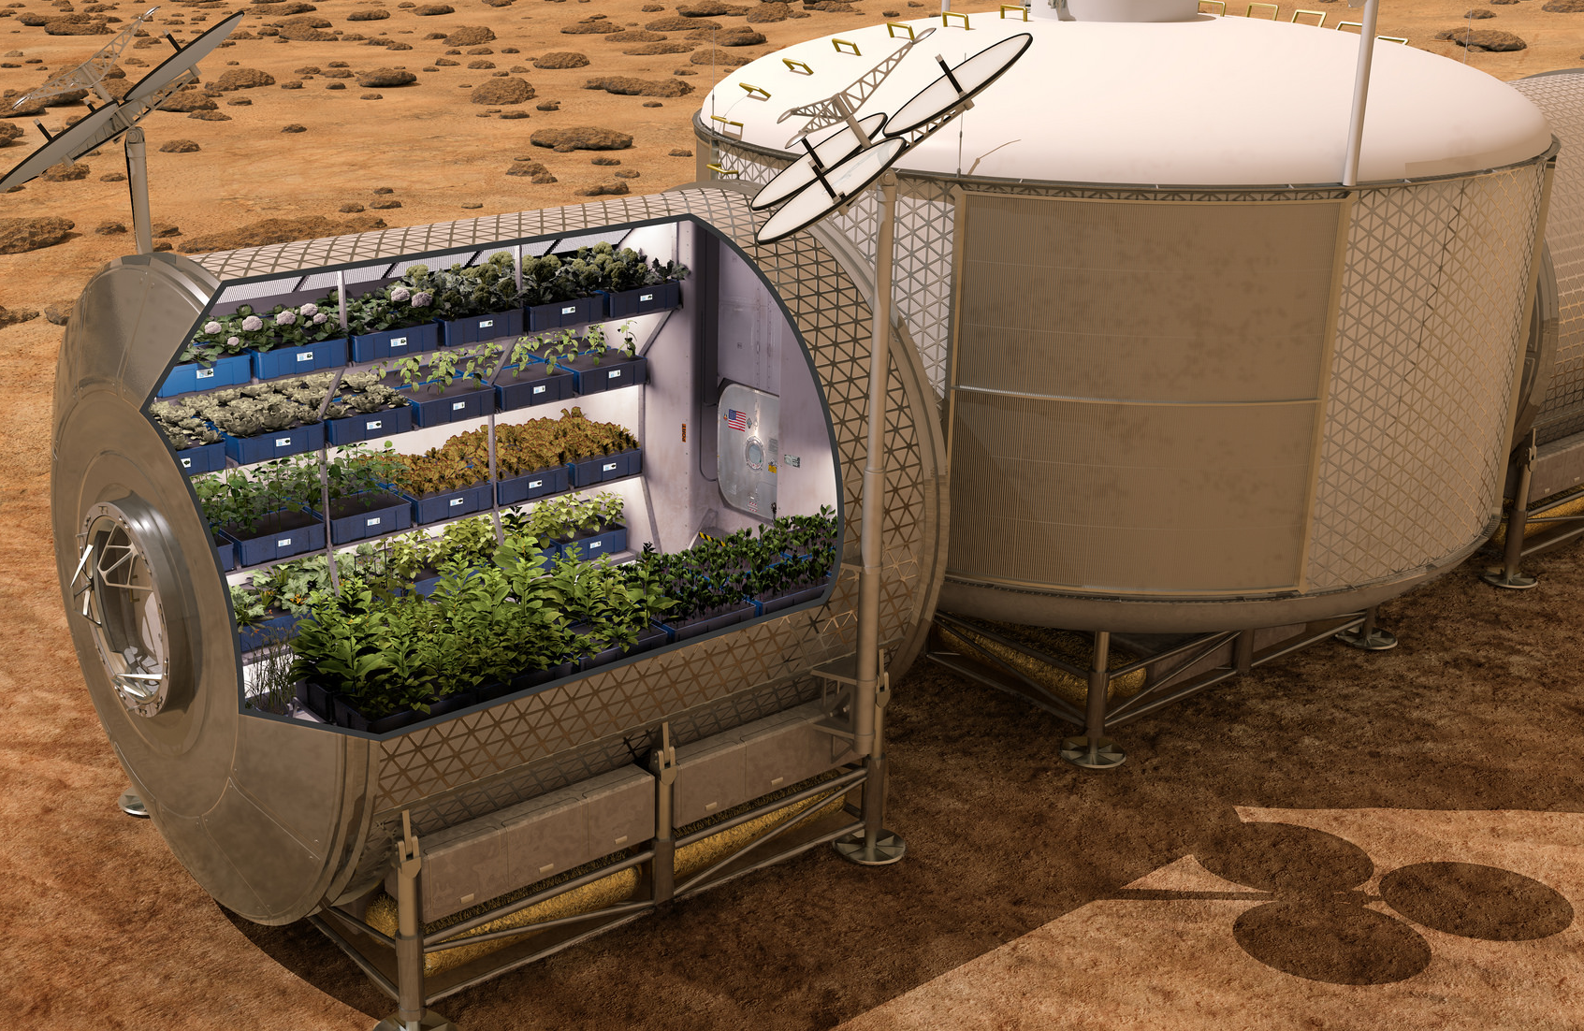
Conclusions
In the light of the above results, the MEC model reasonably predicts edible biomass, stomatal conductance and net photosynthesis in both green and red ‘Salanova’ lettuce under nominal and off-nominal conditions. To increase the functionality of the model a further step will be to specific parameters that will consider the possible intrinsic morpho-physiological variability of plants developed under off-nominal conditions
Take-home messages
Explanatory models are promising tool for forecasting growth variations caused by anomalies in the environmental control.
These models can also contribute to manage crop production throughout the year and to cultivate in extreme environments and/or under climate change scenario.

Slide 8
Stay Safe,
Stay Home !
Chiara Amitrano, Giovanni Battista Chirico, Stefania De Pascale,
Yousseph Rouphael, Veronica De Micco
University of Naples Federico II, Department of Agricultural Sciences, Portici(NA), Italy

