Slide 1
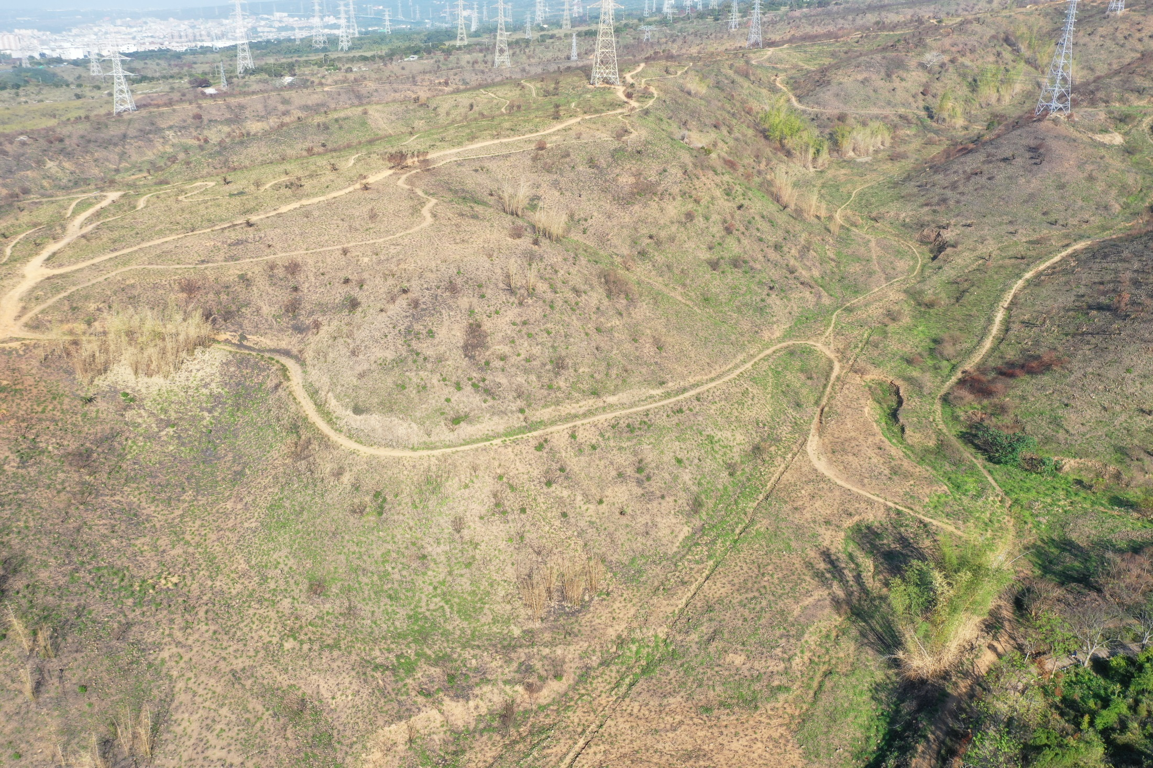
A study of wildfire risk using environmental indicators
Shao-Wei Wu Chao-Yuan Lin

Slide 2
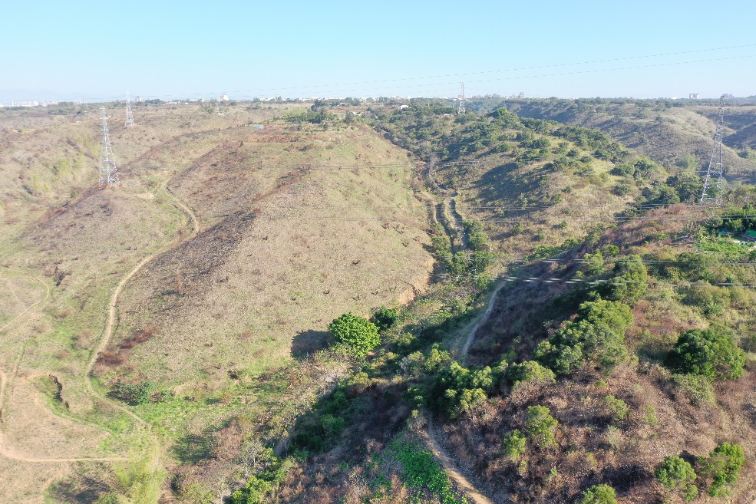
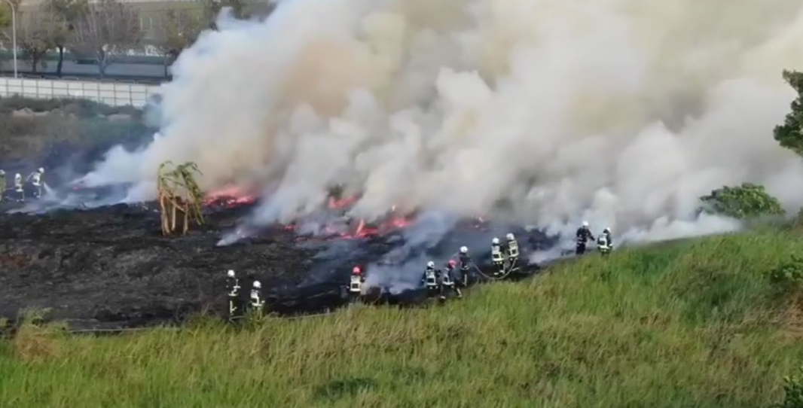
Introduction
Dadu Plateau is located on the outskirts of a densely populated city. According to the Taichung Fire Department’s 2013-2017 statistics, there are more than 400 wildfires a year$.$
Frequent wildfires reduce forest area and hinder plant succession, which may reduce water storage capacity of Dadu Plateau and can easily lead to flooding during heavy rains (Cho, 2017).
Established a model for estimating the spatial distribution of wildfire risk at the mostly occurring period .
(Zhang,2018)

Slide 3
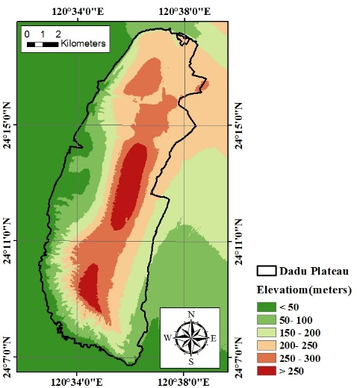
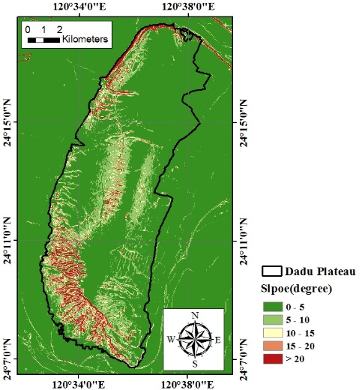
Study Area
Location: Dadu Plateau is located in central Taiwan (120°32′ E −120°40′ E, 24°6′ N-24°20′ N).
Rainfall: The average monthly rainfall is about 47.5mm and 182.5mm for the dry duration (October to the following March) and wet duration (April to September)
Soil: The soil is laterite with the properties of acidity is not suitable for cultivation due to low productivity and lack of irrigation facilities .
Vegetation: Guinea grass, which is a fire-adaptive species with tiller ability and can survive well on acidic and barren soils (Lin, 2000).
(a) Geographical map
(b) Geographical map 2
(c) Elevation map
(d) Slope map

Slide 4
Study Materials
The spatial and temporal distribution of wildfire risk was analyzed using data from 2013 to 2017. Meteorological data is extracted from the annual weather report to calculate the monthly Evenoffˊs Moisture Coefficient (EMC). Satellite images are derived from USGU, SPOT and Google Earth to extract relevant environmental indices, land cover categories to calculate the likelihood of wildfires. Fire cases provided by the Fire bureau are used for model validation
Name | Source | Year | Resolution | Purpose
Satellite images | Center for Space and Remote Sensing Research | 2013-2017 | 6m | Environment Index
 | United States Geological Survey | 2001-2017 | 30m | Environment Index
 | Google Earth | 2015-2017 | 30cm | Accuracy analysis
Meteorological data | Central Weather Bureau | 2013-2017 | Daily data | Environment Index
Wildfire report record | Fire Bureau | 2013-2017 | Daily data | Wildfire analysis
Farmland cover imageries | Agricultural Research Institute | 2016-2017 | 25cm | crop analysis
DEM | Department of Land Administration | 2003-2005 | 5m | Watershed Division

Slide 5
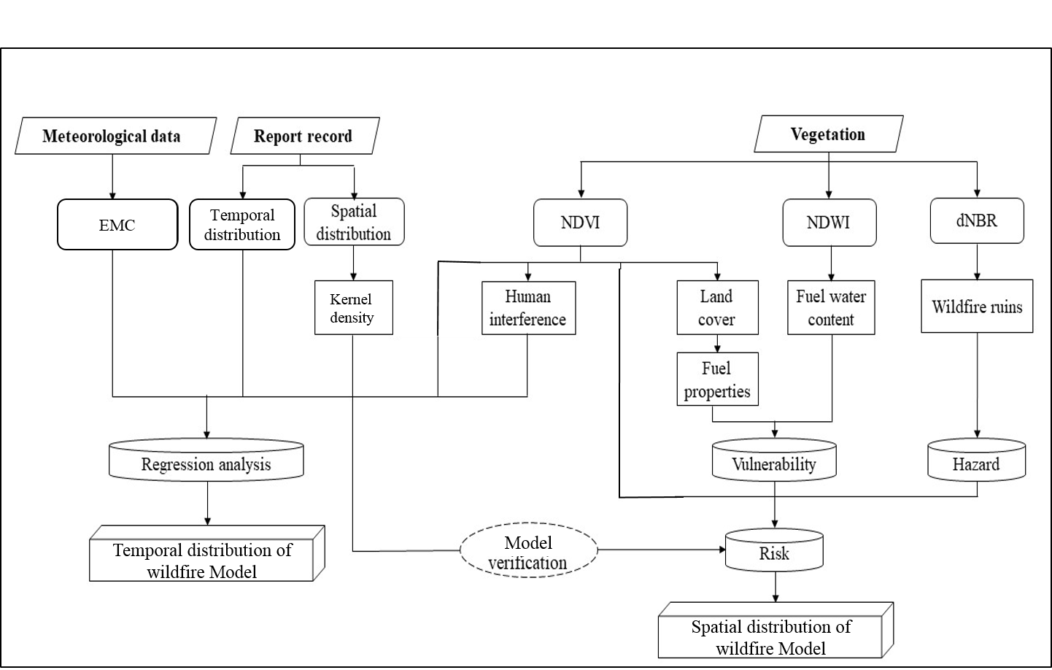
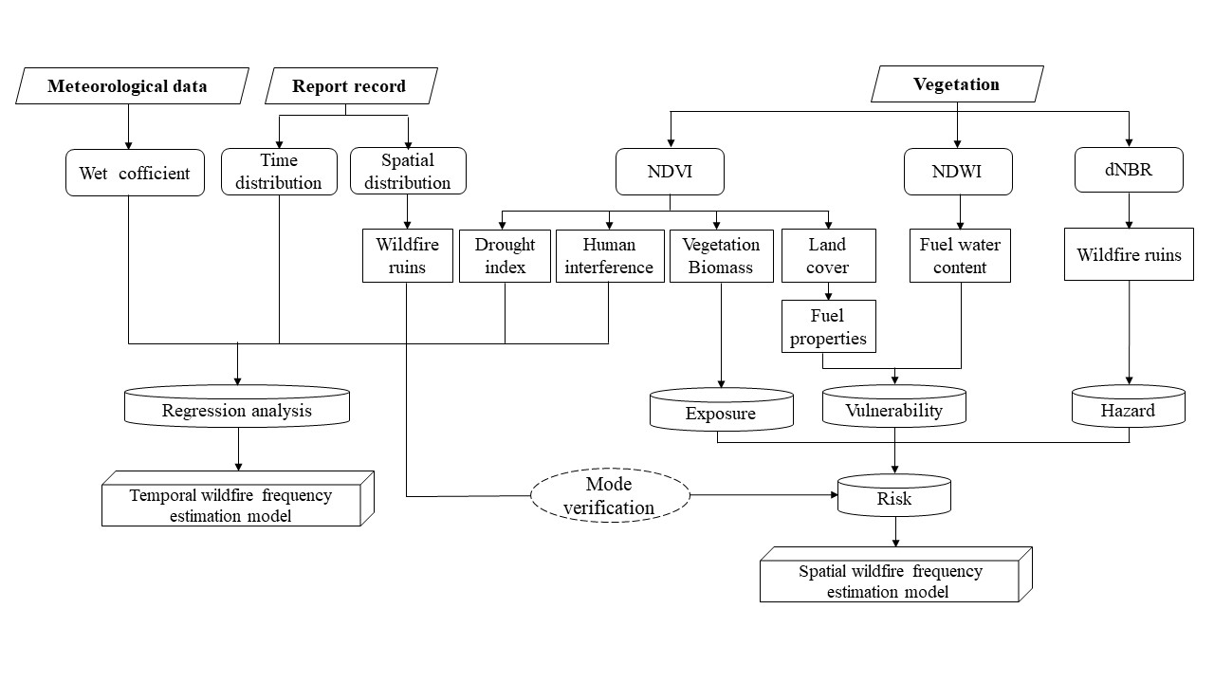
Flow chart
EMC
Temporal
distribution
Kernel
density
Temporal distribution of wildfire Model
Model
Spatial distribution of wildfire Model

Slide 6
Methods
Risk-based model of wildfire occurrence
Wildfires are often a combination of potential environmental factors and external disturbances, such as persistent drought, excessive accumulation of flammable fuels, environmental humidity, man-made activity and development. In the theory of natural disaster risk assessment, wildfire risk assessment is widely and prominent. The Intergovernmental Panel on Climate Change (IPCC) risk analysis model (IPCC, 2007) was used to define wildfire risk based on the product of wildfire hazards and environmental vulnerability as follows:
The risk is the probability of wildfire occurrence, the hazard is the probability of ignition, and vulnerability is the flammability of surface fuels. The risk of wildfires will be discussed based on temporal and/or spatial distribution.
Risk
=
Hazard
*
Vulnerability

Slide 7
Methods
Land cover categories
Fuel property also affects the occurrence of wildfire, so the type of land cover is closely related to fire events. The study showed that (Zhuo,2017) the NDVI values ​​of the four land cover types in Dadu Plateau have significant differences in the dry season. Satellite image extraction NDVI, and is divided into four types through the ARCGIS 10 image unsupervised classification and inferred the land cover category of the sample area.
Information of selected satellite images
Year | Resolution
2016/11/07 | 6*6m(SPOT)
2016/12/13 | 6*6m(SPOT)
2017/01/11 | 6*6m(SPOT)

Slide 8
Methods
Temporal distribution of wildfire risk(1/4)
Evenoff’s Moisture Coefficient
EMC is one of the drought indices based on cumulative rainfall, temperature, and relative humidity and can be considered a composite index of atmospheric moisture content (Li, 1990; Yang and Sun, 1997). EMC of each station is calculated using monthly data, and then uses Thiessen's polygon approach to interpolate the research site’s EMC .
$EMC=\frac{R}{E_{0}}$ $E_{0}=0.0018{\left(25+T\right)}^{2}(100−r)$
T is the average temperature (℃); r is the mean relative humidity (%); R is accumulated rainfall (mm).
Thiessen's Polygon map

Slide 9
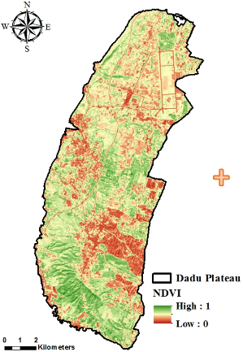
Methods
Temporal distribution of wildfire risk(2/4)
Normalized Difference Vegetation Index
NDVI changes are mainly influenced by environmental stresses such as soil moisture content, nutrient supply, tissue disease, farming behavior (Fiorucci et al., 2007). Using NDVI as an index of wildfire vulnerability in temporal and spatial distribution of wildfire risk (Fiorucci et al., 2007).
c
c
NDVI

Slide 10
Methods
Temporal distribution of wildfire risk(3/4)
Human influence
Changes in NDVI before and after wildfires were used to extract burned sites. High and low NDVI are divided from pre- and post-fire images using K-means analysis, and then the vegetation index change matrix is used to determine the burned site. NDVI variation levels remain unchanged or higher and are classified as non-fire zones, NDVI variations fall into a lower category and can be considered a burned site that can be used to validate wildfire risk models.
Variation matrix of vegetation index
 | ${NDVI}_{postfire}$Low | ${NDVI}_{postfire}$High
${NDVI}_{prefire}$Low | ▲ | ■
${NDVI}_{prefire}$High | ● | ▲
▲: unchanged ● : burned ■ :natural growth

Slide 11
Methods
Temporal distribution of wildfire risk (4/4)
Multiple Regression Analysis
Use multiple regression analysis to explore the relationship between temporal environmental indicators and wildfire frequency interpretation and prediction. Multiple regression analysis, input the monthly wildfire frequency data (wildfire report statistics), climate indicators (EMC), NDVI and human interference factors to establish the optimal time for stepwise regression The estimated mode of sexual wildfire potential. Under the multiple regression equation:
$Y_{i}=β_{0}+β_{1}X_{1}+β_{2}X_{2}+…+β_{i}X_{i}$+ε
$Y_{i}$is dependent variable，$X_{i}$is independent variable，$β_{0}$ is intercept，$β_{i}$is regression coefficient，ε is error term。

Slide 12
Methods
Spatial distribution of wildfire risk (1/3)
Fire hazard - dNBR
Hazards can be defined as the extent to which external forces affect natural disasters. Lightning and human activity are possible causes of wildfires, but are difficult to observe and quantify. In periodic wildfire conditions, the burning frequency of a place can be considered one of the fire hazard indices. Historic wildfire sites can be considered as ignition points and are most likely to catch fire in the future. Therefore, extraction of wildfire ruins is a fire hazard index that assesses fire risk at a particular location.
Normalized Burn Ratio (NBR) proposed by Lopez and Caselles in 1991 was applied to extract the burned sites from satellite images.
$$NBR = \frac{NIR−{SWIR}_{2}}{NIR+{SWIR}_{2}}$$

Slide 13
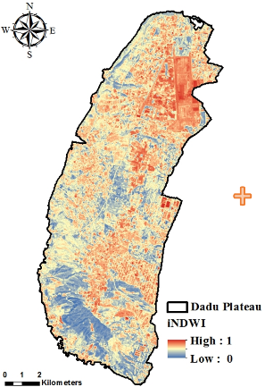
Methods
Spatial distribution of wildfire risk (2/3)
Fire Vulnerability-NDWI
Normalized Difference Water Index
Moisture content of plant tissue is a key factor affecting wildfire occurrence. NDWI has a higher sensitivity compared to NDVI for vegetation moisture content (Karamihalaki et al., 2016).
c
NDWI

Slide 14
Methods
Spatial distribution of wildfire risk (3/3)
Fire Vulnerability-Fuel property
Brown (1973) noted that grass is a light fuel characterized by rapid moisture loss of plant tissue and air supply flux, making it prone to ignition and fire spread, but combustion usually does not last long. However, heavy fuel for wood is not easy to burn because tissue moisture loss is not easy, but after ignition, it burns more and lasts longer.
Values of standardized fuel property (Brown (1973) )
Fuel property | value
light | 1
heavy | 0.5
No fuel | 0

Slide 15
Results and Discussions
Land cover categories(1/3)
100 points were randomly sampled according to each type of land cover and the kappa coefficient calculation result was 0.60 with moderate consistency. The result of the error matrix shows that most of the agricultural land is misjudged as non-vegetable land, which causes the overall accuracy to be reduced; the grassland and forest land classification results are good.
Classification data code | Reference data code
 | Non-vegetation | Agriculture | Grass | Forest
Non-vegetation | 81 | 14 | 0 | 1
Agriculture | 45 | 35 | 10 | 10
Grass | 3 | 7 | 80 | 12
Forest | 0 | 4 | 12 | 86

Slide 16
Results and Discussions
Land cover categories(2/3)
In order to improve the classification of agriculture land and non-vegetation, refer to the local agricultural production characteristics, the larger standard deviation of NDVI before and after harvesting were extracted to get the true agriculture land.
Agriculture
Non-agriculture
Before harvesting
After harvesting
Exraction of agriculture land

Slide 17
Results and Discussions
Land cover categories(3/3)
After correction of agriculture land classifcation, the overall accuracy is improved by 20%, achieving a high degree of consistency (kappa=0.81).
Cultivation seasons of main crops
Classification data code | Reference data code
 | Non-vegetation | Agriculture | Grass | Forest
Non-vegetation | 90 | 6 | 4 | 0
Agriculture | 10 | 75 | 14 | 1
Grass | 1 | 1 | 83 | 12
Forest | 0 | 2 | 12 | 89

Slide 18
Results and Discussions
Temporal distribution of wildfire risk(1/2)
Cloudless satellite images of each month from 2001 to 2017 were selected to calculate average NDVI coupled with the other indices​​(EMC, Human interference) as independent variables and wildfire frequency as dependent variable to establish temporal wildfire frequency model.
Month | 1 | 2 | 3 | 4 | 5 | 6 | 7 | 8 | 9 | 10 | 11 | 12
EMC | 0.71 | 0.32 | 0.87 | 1.2 | 3.77 | 2.66 | 1.82 | 2.73 | 0.62 | 0.15 | 0.22 | 0.41
NDVI | 0.18 | 0.13 | 0.11 | 0.20 | 0.27 | 0.25 | 0.34 | 0.23 | 0.34 | 0.23 | 0.20 | 0.17
Human interference | 0 | 0 | 1 | 1 | 0.36 | 0.36 | 0.36 | 0.36 | 0.36 | 0 | 0 | 0
Wildfire frequency | 48 | 56 | 116 | 91 | 19 | 11 | 16 | 18 | 28 | 54 | 58 | 62

Slide 19
Results and Discussions
Temporal distribution of wildfire risk(2/2)
Temporal distribution model of wildfire risk can be derived as follows, and show that the study area is a high-risk vulnerable to wildfire in March and April .
Multiple Regression Analysis
Mode verification
Model | Multiple regression | $$R^{2}$$
Model 1 | $Y$= -331.686$N$+121.164 | 0.509
Model 2 | $Y$= -322.121$N$+36.405$P$+107.558 | 0.720*
Model 3 | $Y$= -224.373$N$+50.813$P$-14.441$E$ | 0.908***
Estimated value
observed value
N = NDVI； P=Human influence area (𝑚2)； E =EMC；
Y= Frequency of wildfires occurrence

Slide 20
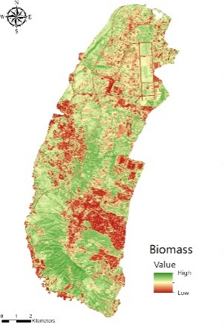
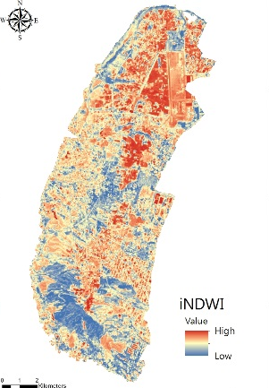
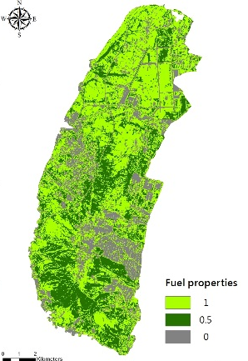
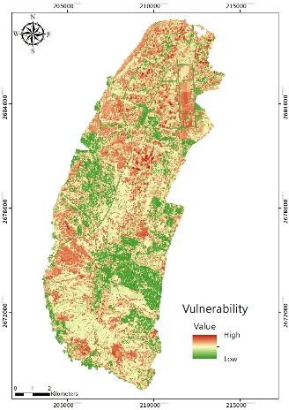
Results and Discussions
Spatial distribution of wildfire risk (1/4)
The spatial distribution of wildfire vulnerability can be displayed using related environment indicators extracted from satellite images taken at high-risk wildfire (March and April).
+
+
=
NDVI
NDVI
iNDWI
Fuel property
Wildfire vulnerability

Slide 21
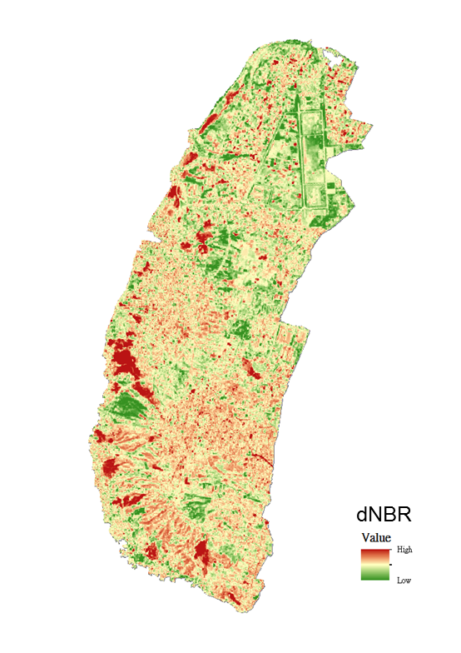
Results and Discussions
Spatial distribution of wildfire risk (2/4)
Using three years of high-risk wildfires (March and April), satellite images taken before and after the fire extracted dNBR and overlayed the dNBR indicator for three years as a measure of wildfire hazard.
+
+
=
2014 dNBR
2015 dNBR
2017 dNBR
Wildfire hazard

Slide 22
Results and Discussions
Spatial distribution of wildfire risk (3/4)
After calculating the vulnerability and hazard of wildfires, the two are multiplied (risk analysis) to obtain wildfire risk map.
Wildfire vulnerability
Wildfire hazard
Wildfire risk

Slide 23
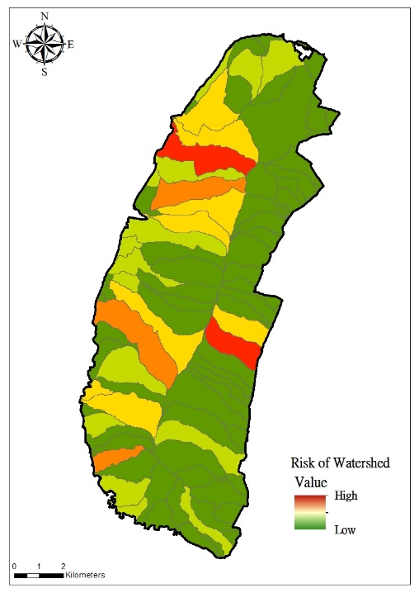
Results and Discussions
Spatial distribution of wildfire risk (4/4)
In order to understand the accuracy of the spatial wildfire risk model and using 100 hectares of watershed zoning as a validation analysis unit, the risk value of each partition and classified into ten levels were calculated using K-means cluster. The relationship of kernel density (calculated from wildfire report positions) and partition risk were used to verify the model’s accuracy.
partition risk
kernel density

Slide 24
Conclusion
It is of great significance to predict the hot spot of wildfire disaster with the risk concept model. The accuracy of the classification can be improved by about 20% if the local crop cultivation season can be taken into account in the ground cover category classification. Temporal wildfire risk model shows that drought makes the environment prone to wildfires between October and April, while the risk of wildfires increased significantly under human influence from March to April, with a highly explanatory 91% of the temporal wildfire risk model through meteorological factors, NDVI and man-made influences. In the case of periodic wildfires, the past common wildfire location is regarded as the most likely wildfire area in the future, as a hazard indicator to establish a highly accurate wildfire risk model for the reference of related authorities.

