Slide 1
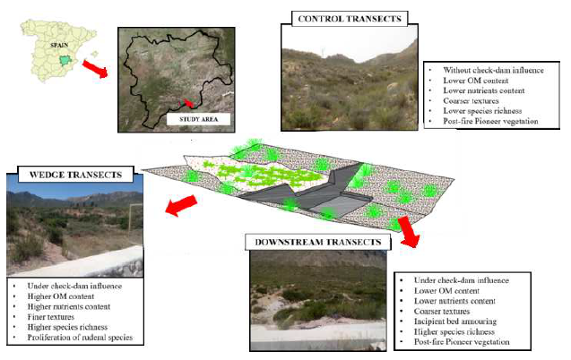
EGU2020-9921 | Displays | SSS2.9/GM4.12/HS13.30
Check dams effects on plant and soil interface immediately after wildfire
Bruno Timóteo Rodrigues, Manuel Esteban Lucas-Borja, Demetrio Antonio Zema, and Yang Yu
Email: ManuelEsteban.Lucas@uclm.es
1.- Introduction.
Mediterranean basins and their ecosystems have been traditionally affected by wildfires. After a wildfire, in Semi-arid Mediterranean areas, check-dam construction in channels is widespread as an emergency action to avoid soil erosion. The ways that these structures affect to channels’ geomorphological and edaphic characteristics or vegetation dynamics, have been widely studied. In relation to vegetation however, the majority of studies have been conducted in mountain torrents. Our approach focuses on how ephemeral streams’ vegetation, is affected locally by check-dam construction in the years following a wildfire. Vegetation and soil samplings were carried out in 17 check dams throughout a semiarid area in SE Spain, which was affected by a wildfire in 2012
2.- Aims.
The lack of studies carried out in ephemeral Mediterranean channels, and the need to gain a better understanding of how human activities affect the normal functioning of these valuable ecosystems, both encouraged us to conduct the present study, whose main objectives were to evaluate:
i.- The local effect of check-dam construction on post-fire vegetation recovering.
ii- Check-dam effects on plant alpha diversity and richness.
iii.-How soil characteristics and vegetation interact under check-dams influence.

