Slide 1







Space-weighted seismic attenuation
multi-frequency tomography at
Deception Island volcano (Antartica)
Roberto Guardo*, L. De Siena, A. Caselli, J. Prudencio, G. Ventura.
Notes:
How can we improve our understanding of volcanoes using seismic tomography techniques….

Slide 2
Index
Theory and Method
Analysis
Results
Discussions
Outlooks

Slide 3

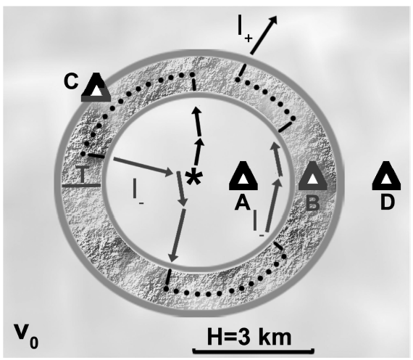
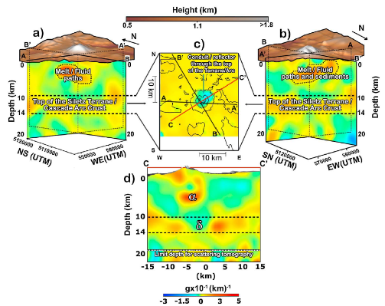
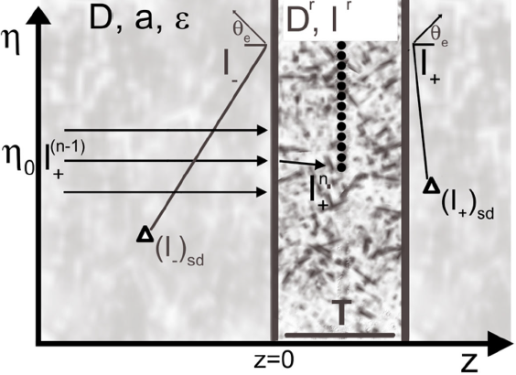
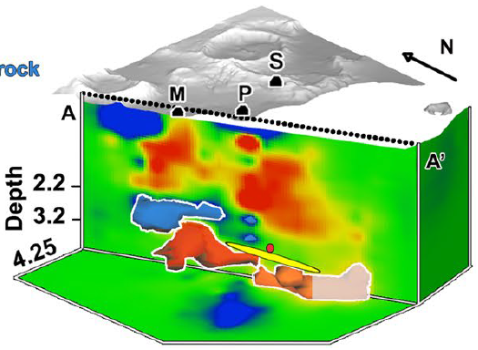
Theory 1/
THEORY 1/2
1
The “framework”: building forward models with Radiative
Transfer Theory
Seismic attenuation tomography in volcanoes
The “Japanese School” energy variations in the heterogeneous Earth
Mount St. Helens
Campi Flegrei
Notes:
Starting from the Japanese School that explain the energy variation in the heterogeneous Earth allow us to build a forward model with Radiative Transfer Theory driving through the seismic attenuation tomography in volcanoes, two examples: MSH and CF…

Slide 4
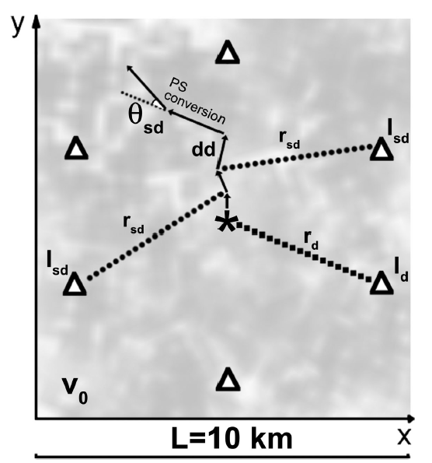
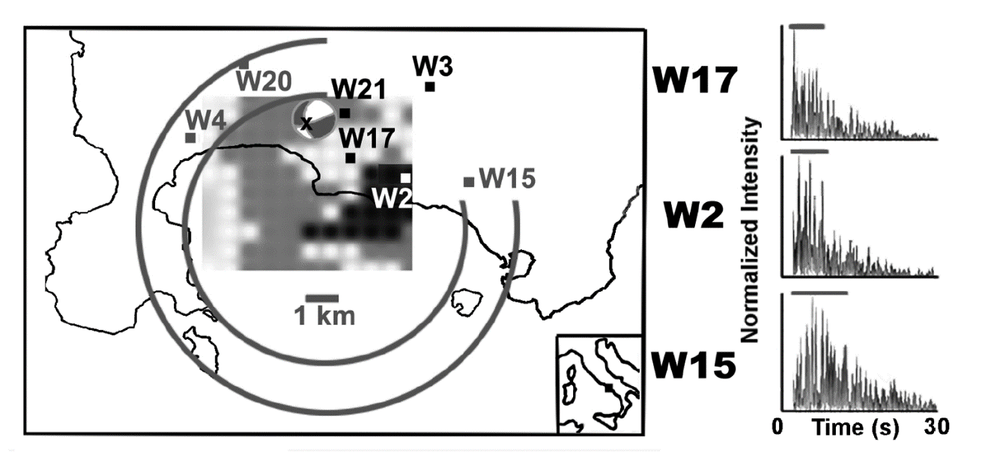
Theory 2/
THEORY 2/2
Applying the theory of radiative transfer, sensitivity kernels can be obtained by modeling scattering intensities at different lapse times;
Use coda-wave ”scattered” information;
Absorption + scattering → Coda Quality Factor (Qc);
Qc is measured from the decay of coda intensity versus lapse time.
Does not work at all frequencies and scales at the same way:
we need results in different frequency bands.
Notes:
Sensitivity kernels can be obtained by modeling scattering intensities at different lapse times with the theory of radiative transfer.
Using the radiative transfer theory, sensitivity kernels can be obtained by modeling scattering intensities at different lapse time.

Slide 5
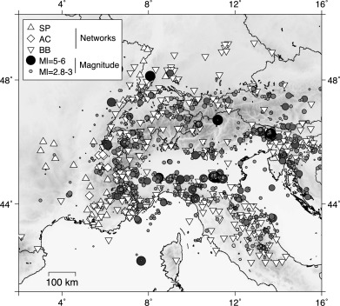
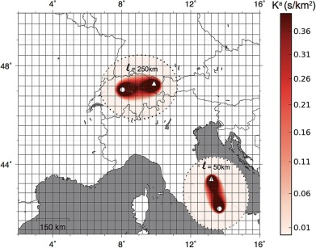
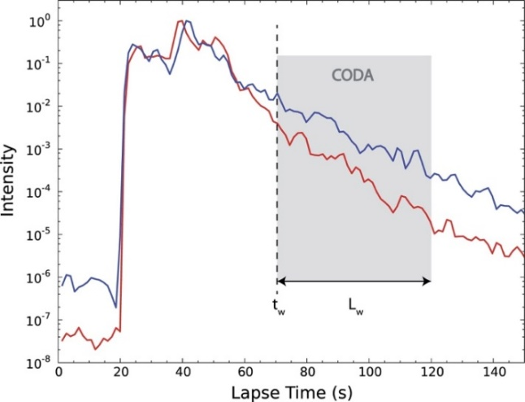
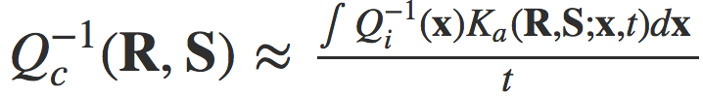
METHOD 1/3
Sensitivity kernels for coda imaging: regional/continental scales
(Mayor et al. 2016)
Linear relation between
the spatial variation of the inelastic quality factor Qi(x) and Qc:
For the same level of perturbation, a localized scattering anomaly will affect the shape of the coda at rather short lapse time in comparison to an absorption anomaly. Furthermore, in a medium with homogeneous scattering properties, the average spatial sensitivity to scattering decays by a factor t faster than the average spatial sensitivity to absorption.
At sufficiently long lapse-time in the coda (typically of the order of 2 to 4 mean free times) the slope of the coda decay is mostly affected by absorption anomalies.
“Ka”, the absorption sensitivity kernel, which depends on the position of the source (S) and receiver (R) and the lapse-time t in the coda.
Notes:
Mayor et al.. Develop a linear relation between . . . . Introducing the absorption sensitivity kernel which depends…..

Slide 6
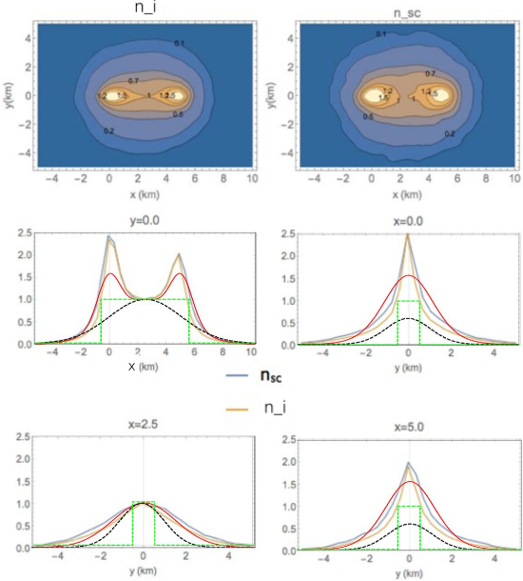
METHOD 2/3
Kernels-based imaging in volcanoes
(Del Pezzo et al. 2016)
Inhomogeneous scattering properties of volcanoes to map shape and dimensions of hot reservoirs and plumbing systems.
The forward model is built with Monte Carlo simulations of Radiative Transfer Theory equations.
Sensitivity is generally maximum at source and receiver, with wider illumination than in ray-dependent tomography.
Notes:
While DelPezzo et al. 2016 used the inhomogeneous scattering at Deception Island...

Slide 7
METHOD 3/3
Kernels-based imaging in volcanoes (inversion model)
(De Siena et al. 2017)
The main assumption is that total coda attenuation is caused by the medium comprising the inversion grid;
The weighting functions provide the rows of the inversion matrix at the nodes after normalization for the total weight relative to the source-receiver pair;
The output is generated from the contribution of all nodes of the grid to the single-station Qc measurement
Notes:
Finally De Siena et al. 2017 used a kernel-based imaging trough an inversion model (at Campi Flegrei)

Slide 8
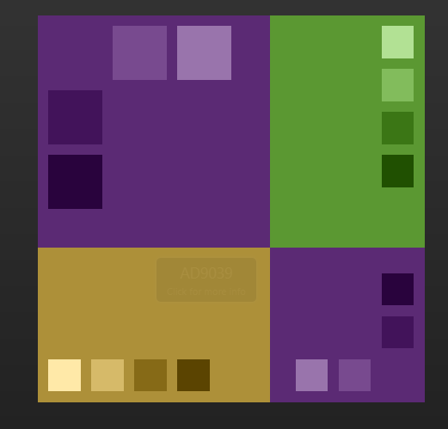
DATA ANALYSIS
✓
TOMODEC, January 2005;
2-D and 3-D velocity tomography (Ben-Zvi et al. 2009; Zandomeneghi et al. 2009; García-Yeguas et al. 2011; Luzón et al. 2011);
Intrinsic and scattering seismic attenuation (a.k.a. Gaussian kernels)
(Prudencio et al. 2013);
Kernels-based imaging in volcanoes (without inversion)
(Del Pezzo et al. 2016).
✗
✗
Notes:
We need to analyse those traces whose envelope can be described by the radiative transfer theory

Slide 9
DATA ANALYSIS
Zeros percentage;
Mean amplitude Noise windows;
Mean signal amplitude;
Signal to Noise ratio;
Mean amplitude Coda windows;
Mean amplitude max power;
Mean frequencies at max power;
Cross-correlation mean values;
Sum of the ampl. values > 500;
Amplitude “jumps”;
Mean Correlation coefficients;
Deviation Standard STA/LTA;
Zeros percentage;
Mean amplitude Noise windows;
Mean signal amplitude;
Signal to Noise ratio;
Mean amplitude Coda windows;
Mean amplitude max power;
Mean frequencies at max power;
Cross-correlation mean values;
Sum of the ampl. values > 500;
Amplitude “jumps”;
Mean Correlation coefficients;
Deviation Standard STA/LTA.
Zeros percentage;
Mean amplitude Noise windows;
Mean signal amplitude;
Signal to Noise ratio;
Mean amplitude Coda windows;
Zeros percentage;
Mean amplitude Noise windows;
Mean signal amplitude;
Signal to Noise ratio;
Zeros percentage;
Mean amplitude Noise windows;
Mean signal amplitude;
Zeros percentage;
Mean amplitude Noise windows;
Zeros percentage;
Zeros percentage;
Mean amplitude Noise windows;
Mean signal amplitude;
Signal to Noise ratio;
Mean amplitude Coda windows;
Mean amplitude max power;
Mean frequencies at max power;
Cross-correlation mean values;
Sum of the ampl. values > 500;
Amplitude “jumps”;
Mean Correlation coefficients;
Deviation Standard STA/LTA;
Zeros percentage;
Mean amplitude Noise windows;
Mean signal amplitude;
Signal to Noise ratio;
Mean amplitude Coda windows;
Mean amplitude max power;
Mean frequencies at max power;
Cross-correlation mean values;
Sum of the ampl. values > 500;
Amplitude “jumps”;
Mean Correlation coefficients;
Deviation Standard STA/LTA.
Notes:
So we need to “clean” the dataset

Slide 10
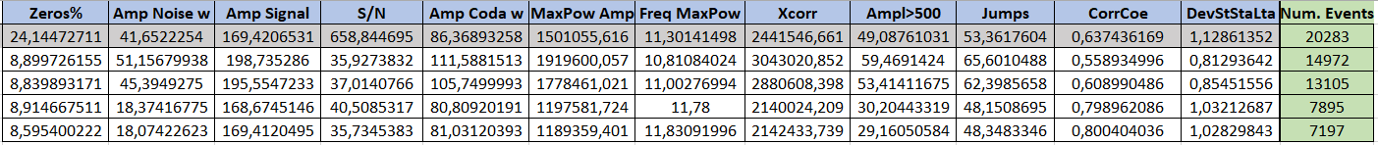
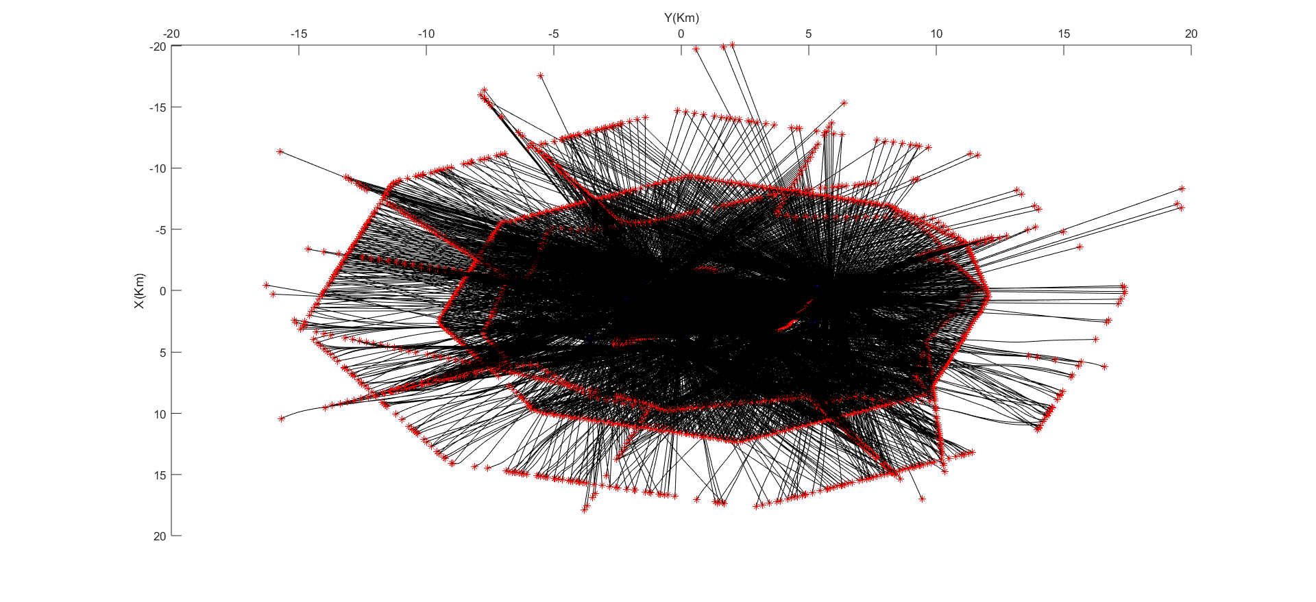
DATA ANALYSIS
Iteration 4 → “Bad station”
Iteration 3 → “Correlation coefficients ≤ 0.6”
Iteration 2 → “Max Amplitude > 6s”
Iteration 1 → “Zeros > 40%”
20283 → 7197
Filtering in five frequency bands, centered at 6 , 9 , 12 , 15 and 18 Hz;
4 seconds of Coda windows (starting from the main peak);
Grid resolution of 1 and 2 km.
Notes:
From 4 iterations we obtainded

Slide 11
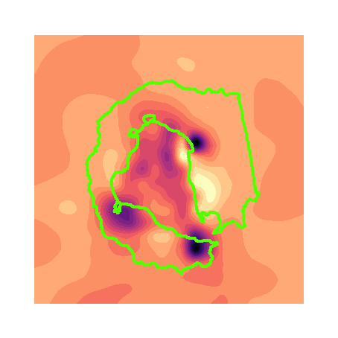
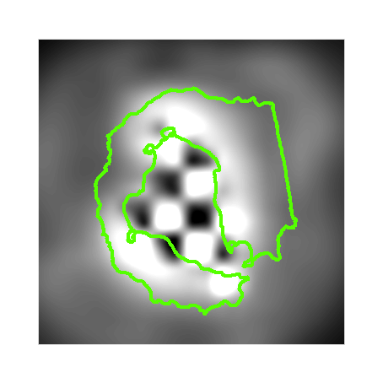
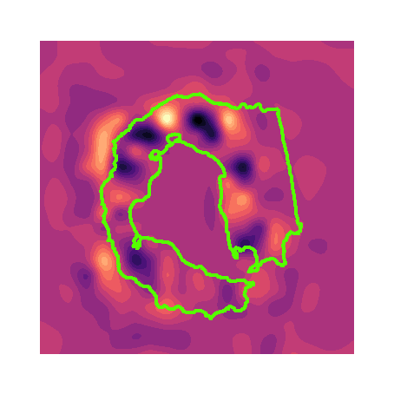
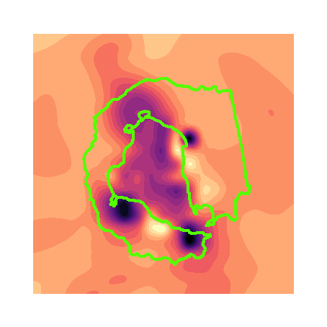
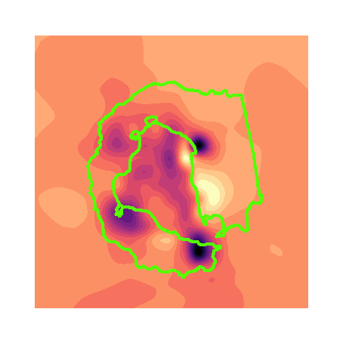
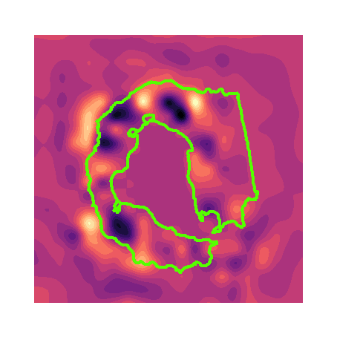
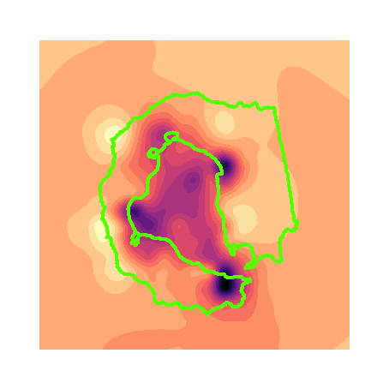
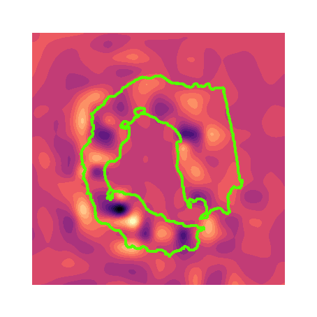
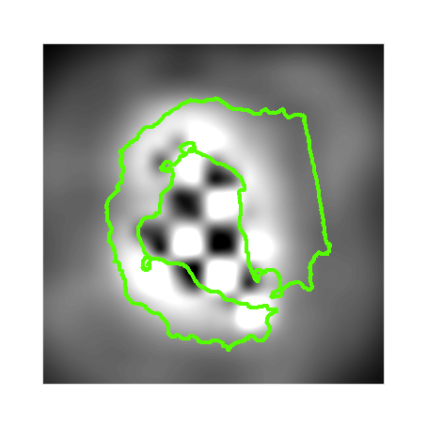
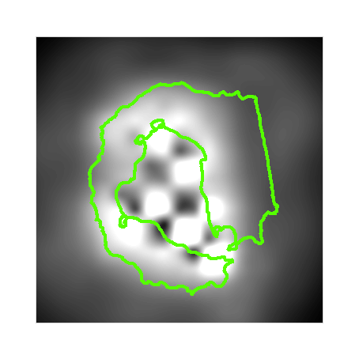
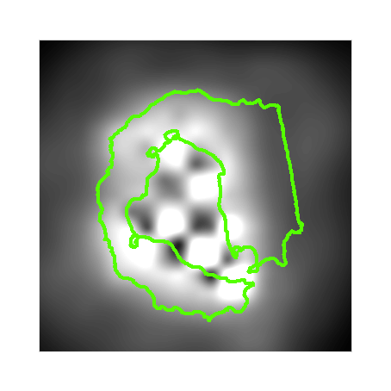
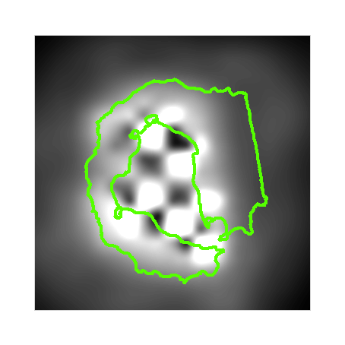
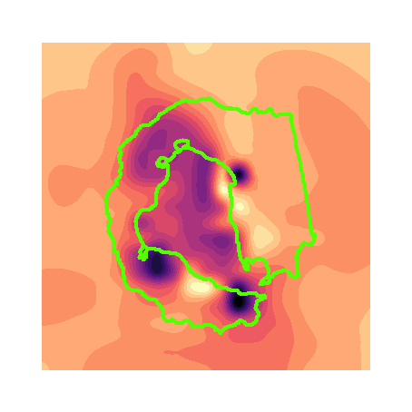
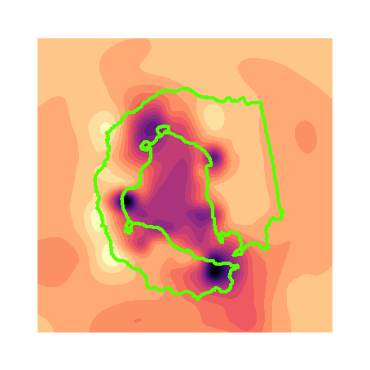
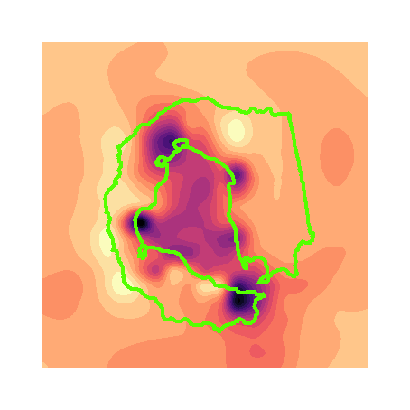
RESULTS
(1km resolution)
Iteration: 4 (last one)
Iteration: 3
Iteration: 2
Iteration: 1
Original dataset
6 Hz
15 Hz

Slide 12
RESULTS (1km res.)
Original dataset
Iteration: 4
6 Hz
15 Hz

Slide 13
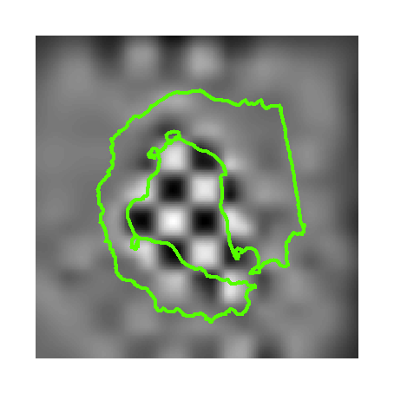
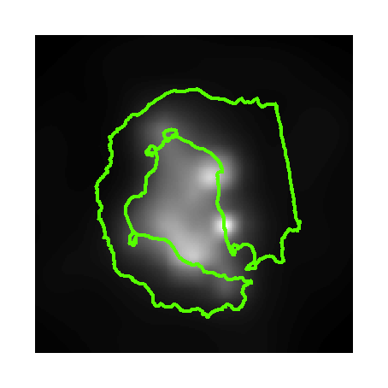
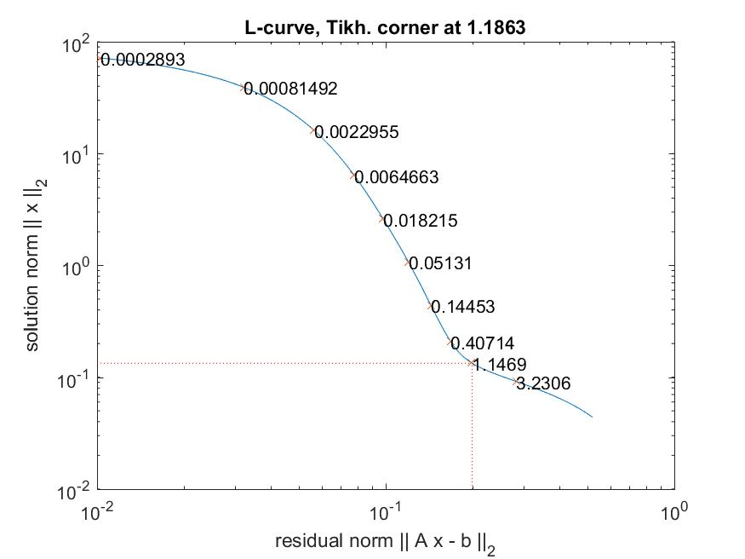
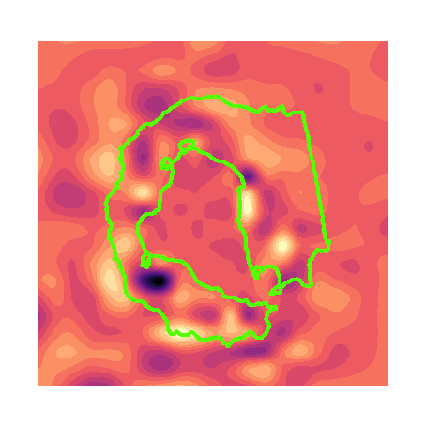
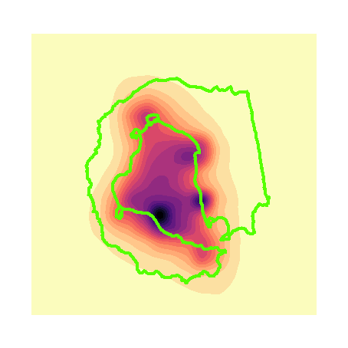
Tikhonov reg. (1km res. – 15 Hz)
0.118
11.8

Slide 14
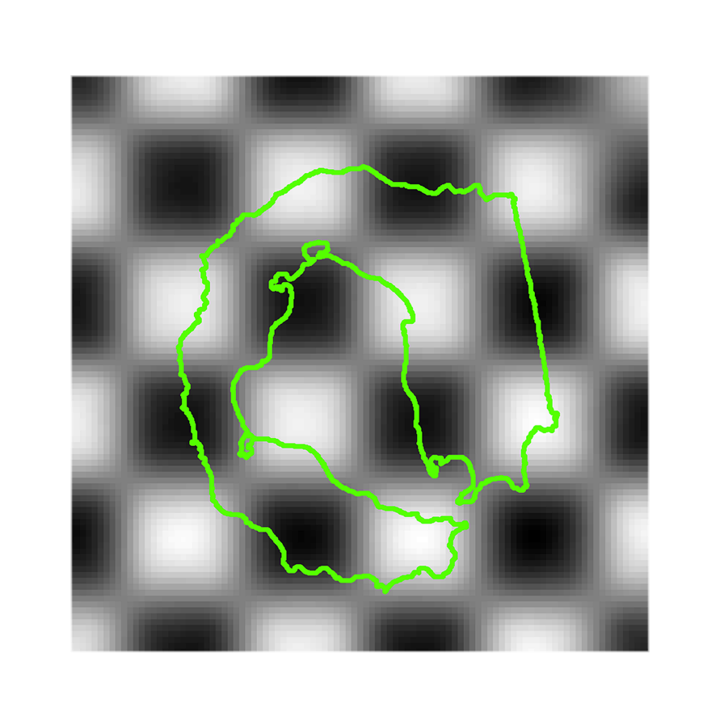
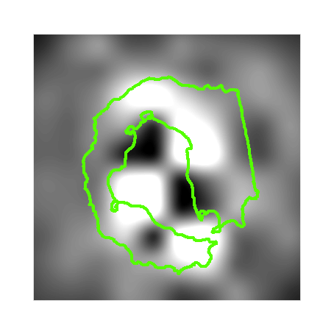
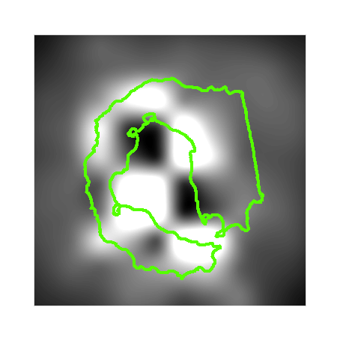
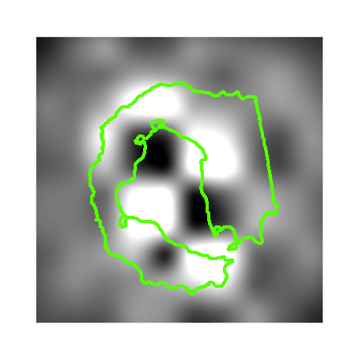
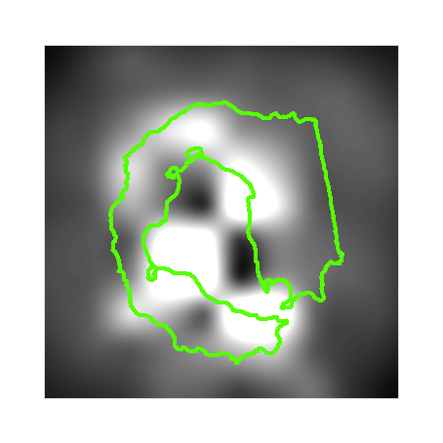
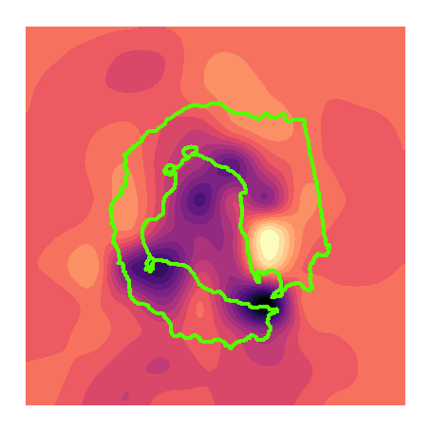
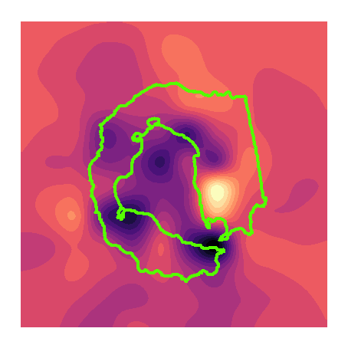
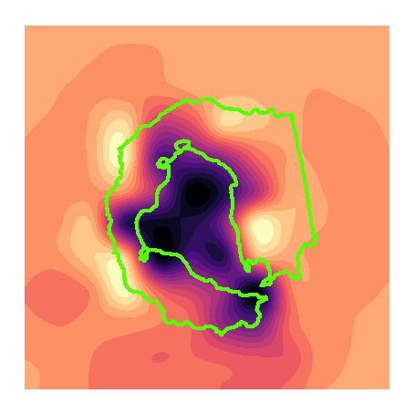
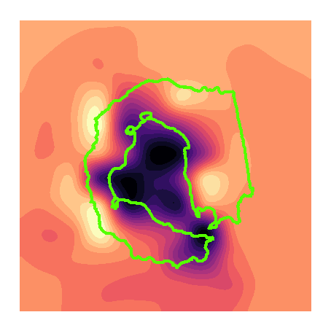
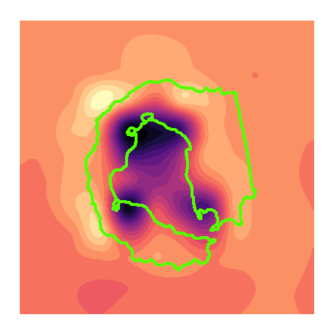
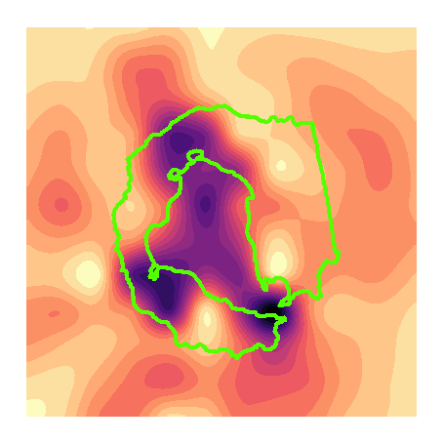
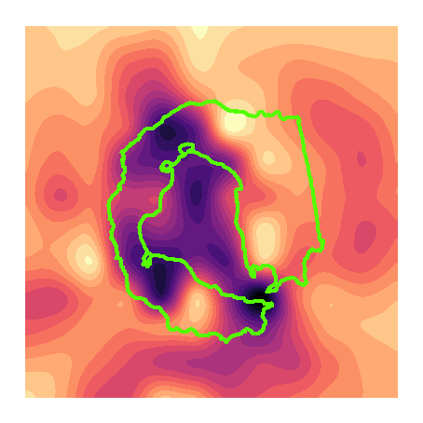
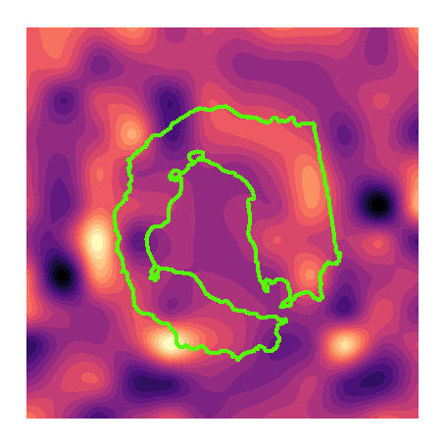
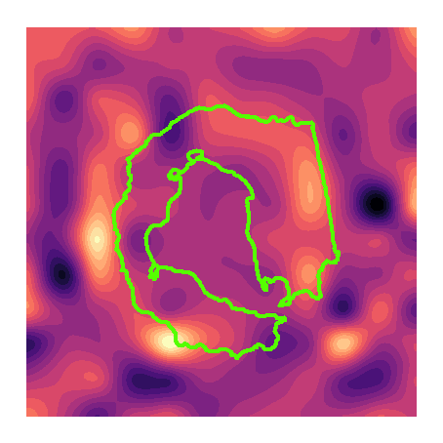
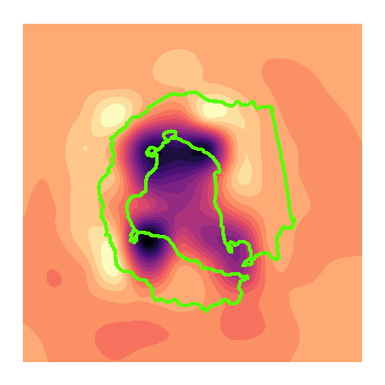
RESULTS
(2km resolution)
Iteration: 4 (last one)
Iteration: 3
Iteration: 2
Iteration: 1
Original dataset
6 Hz
15 Hz

Slide 15
RESULTS (2km res.)
Original dataset
Iteration: 4
6 Hz
15 Hz

Slide 16
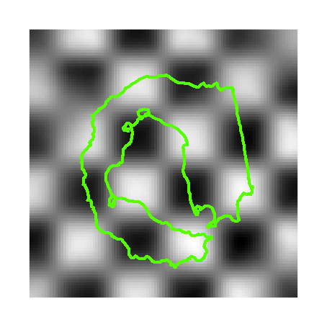




Tikhonov reg. (2km res. – 15 Hz)
0.155
15.5

Slide 17


Aa# = High attenuation
Ba# = Low attenuation
We consider the high attenuation areas as rocks caracterized by hot fluids or magmatic batches and the low attenuation ones as cooling magmatic body.

Slide 18
Aa# = High attenuation
Ba# = Low attenuation
We consider the high attenuation areas as rocks caracterized by hot fluids or magmatic batches and the low attenuation ones as cooling magmatic body.

Slide 19
DISCUSSIONS
Comparison with previous studies:
Geology
Tectonics
Geochemistry
Geophysics
Volcanic hazard

Slide 20

Comparison with previous geological studies
Hawkes et al. 1961 – Fig. 3
Volcanic centres of the «pre-caldera» group.
Notes:
Those centres have a spatial correlation lower than 2 km with each High attenuation areas.

Slide 21

Hawkes et al. 1961 – Fig. 6
Volcanic centres of the «Neptune bellow» group.

Slide 22

Geyer et al. 2019 – Fig. 1B
Location of the last eruptive centres
Notes:
The eruptive centres realated to the eruption of the 1967, 1969 and 1970 are mainly located in the Aa1 and in the noth extension of the high attenuation anomaly in the inner bay.

Slide 23

Comparison with previous tectonics studies
Paredes et al. 2006 – Fig. 4
Spatial distribution of morpholineaments and tectonic zoning.
Notes:
The intermediate grey indicates areas with fumaroles activity, coincident with the Heigh attenuation areas

Slide 24

Lopes et al. 2015 – Fig. 4
Main structural alignments that control the morphology
Notes:
The NNW-SSE high attenuation trend at 15 Hz match the same structural trend...

Slide 25

Lopes et al. 2015 – Fig. 4
Main structural alignments that control the morphology
Notes:
While a 2km resolution and 6Hz (deeper) it is possible to highlight a NNE-SSE trend coincidents with the tectonics regional structures.

Slide 26

Comparison with previous geochemical studies
Somoza et al. 2004 – Fig. 8
As and Mn distribution

Slide 27

Rey et al. 2002 – Fig. 5.5
Distribution of fumarolic areas.

Slide 28

Comparison with previous geophysical studies
Berrocoso et al. 2008 – Fig. 10
Deformation processes during 91/00 (NNW-SSE) and 02/03 (NE-SW)
Notes:
Extensional process follows the NW-SE direction (Fracture Hero Zone direction) and compressive process follows the Bransfield Rift extensional direction

Slide 29

Catalan et al. 2014 – Fig. 4a
Positive magnetic anomaly close by the Low Attenuation area (Ba1)

Slide 30
Zandomeneghi et al. 2009 – Fig. 6
Velocity tomography model (1km depth)

Slide 31


Qi
Qs
Prudencio et al. 2013
The high attenuation areas (yellow to red) matches our anomalies.

Slide 32
Del Pezzo et al. 2016
Middle-point weighting functions to the single-station measurements
Notes:
Frequency-dependent 2-D model calculated applying the middle-point weighting functions to the single-station measurements

Slide 33
DISCUSSIONS
Comparison with previous volcanic hazard studies
Bartolini et al. 2014 – Fig. 1A
Simplified regional tectonic map.

Slide 34
DISCUSSIONS
Bartolini et al. 2014 – Fig. 1B

Slide 35
DISCUSSIONS
Bartolini et al. 2014 – Fig. 7
Susceptibility map of future eruptions calculated with QVAST

Slide 36
DISCUSSIONS
Bartolini et al. 2014 – Fig. 12
Qualitative hazard map

Slide 37

Berrocoso et al. 2006 – Fig. 5.10-6
Map of natural hazards
Notes:
(Museo Nacional de Ciencias Naturales, Dep. Volcanología)

Slide 38

Smellie et al. 2002 – Fig. 6.3
Suggested escape route. The extraction point H (SE) spatially matches the high attenuation area Aa3.

Slide 39
OUTLOOKS (1)
at Deception Island Volcano
4D analysis;
Repeat the analysis using different Coda Windows;
Repeat the analysis using different Coda Windows;
4D analysis;
Comparison with other available data e.g.:
  Magnetic anomaly data (Catalán et al. 2014);
  Temperature anomaly (Berrocoso et al. 2018).
OUTLOOKS (2)
Method application
Apply to other volcanoes the aforementioned combination between Qc-Kernel and GIS analysis;
Apply the dataset cleaning procedure to other
big and high-dimensional data.

Slide 40

Thanks
For the
Attention

