Slide 1
High-resolution soil moisture retrieval using a Neural Network approach from Sentinel-1 SAR data
Qi Gao¹, Maria Jose Escorihuela¹, Nemesio Rodriguez-Fernandez², Olivier Merlin² and Mehrez Zribi²
¹isardSAT, ² CESBIO

Slide 2
Outline
1 Study Area and Database
1.1 Study Area
1.2 Database
2 Methodology
Neural Network
3 Results
3.1
4 Conclusions

Slide 3
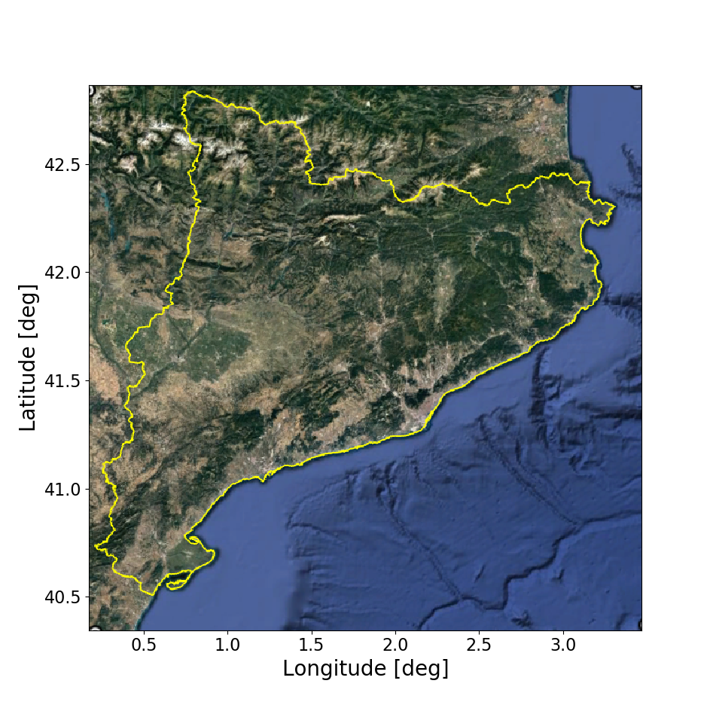
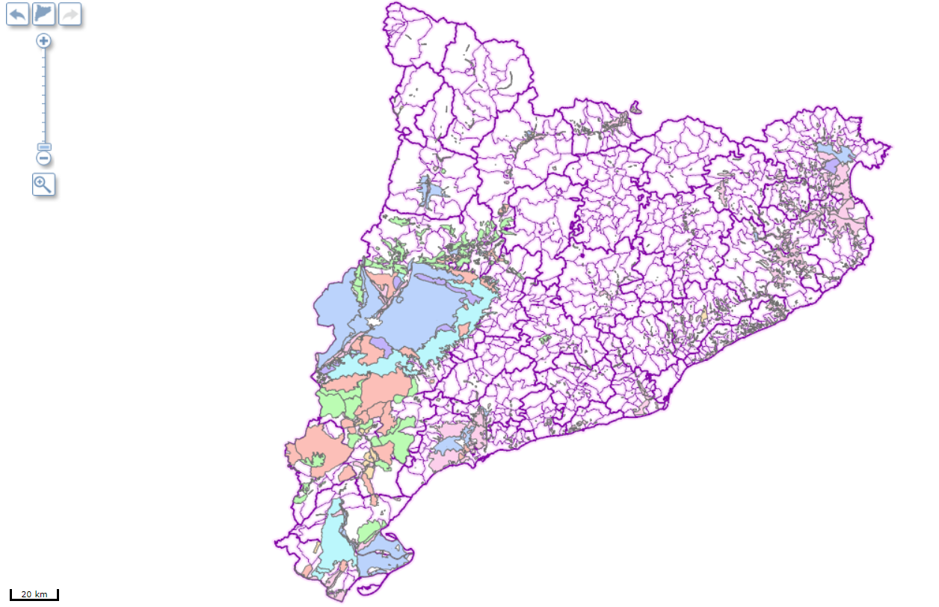
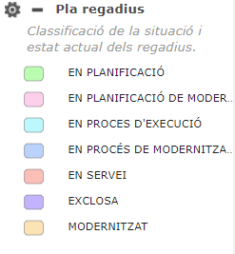
1 Study Area and Data Base
Study area: Catalonia

Slide 4
Datasets
Satellite data
VV + VH
track 30/110
SMAP
A: April 03, 2014
B: April 22, 2016
C-SAR
12 days, 10 m
40 km soil moisture
SMOS_NRT
40 km Near Real Time soil moisture
NDVI
A: June 23, 2015
B: March 7, 2017
Multi Spectral Instrument
10 days, 10 m
DISPATCH SM
1km downscale soil moisture

Slide 5
Datasets
Land cover:
CCI (Climate Change Initiative) land cover: 300m resolution
SIGPAC land cover: at field scale
Crop type
SIGPAC crop type: wheat, corn, etc.
Irrigation index
CCI land cover
SIGPAC
DEM
SIGPAC: Geographic Information System for Agricultural Parcels

Slide 6
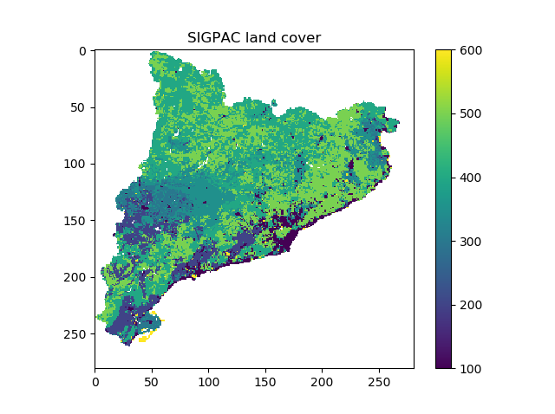
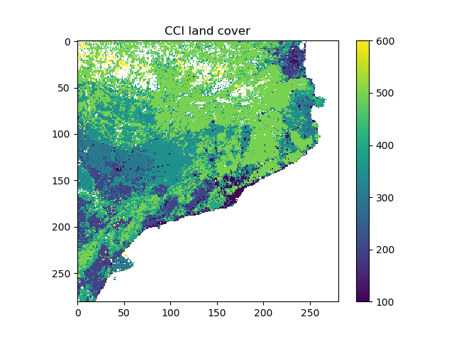
Datasets

Slide 7
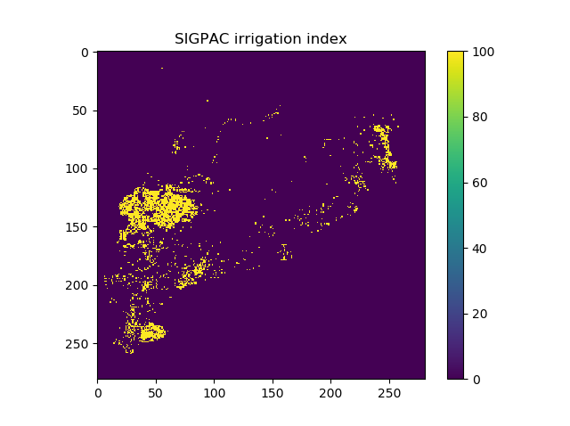
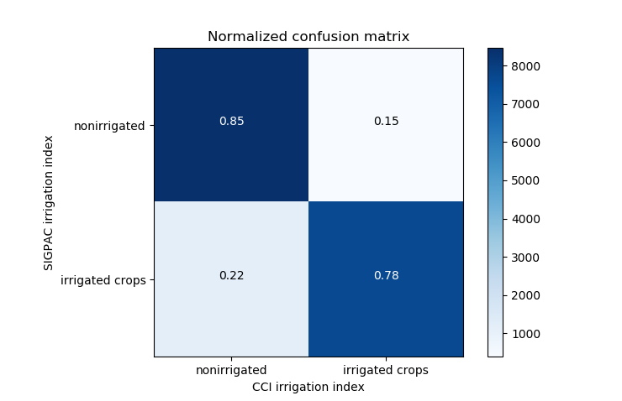
Datasets

Slide 8
Datasets
Indexes for VV and VH
Index 1
Index 2
$$I_{1}=\frac{\left(σ_{i}^{0}−σ_{min}^{0}\right)}{(σ_{max}^{0}−σ_{min}^{0})}$$
$$I_{2}={SM}_{min}+\left({SM}_{max}−{SM}_{min}\right)∗I_{1}$$

Slide 9
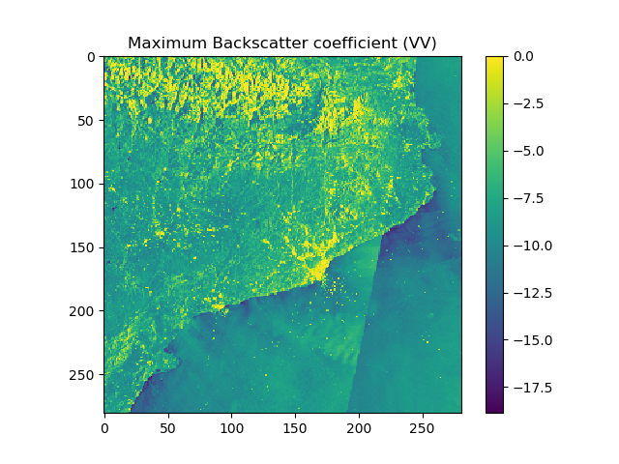
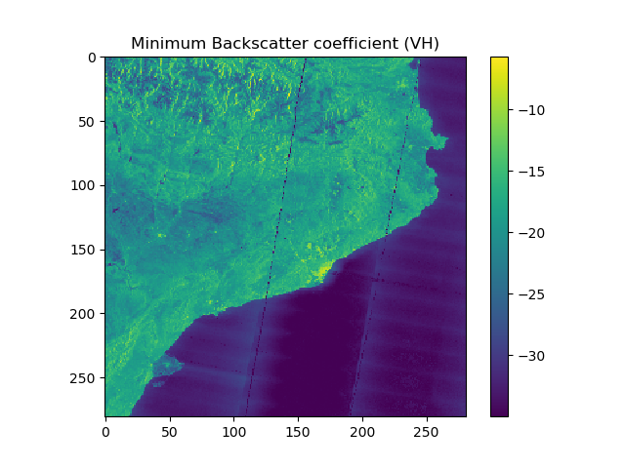
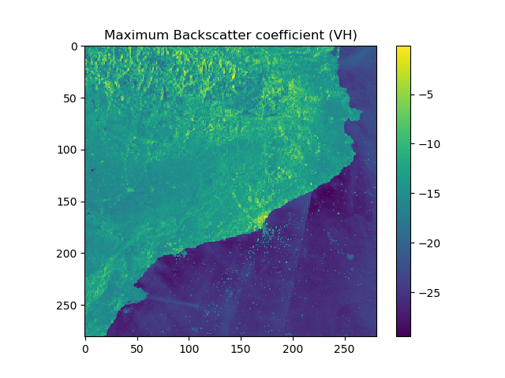

Slide 10
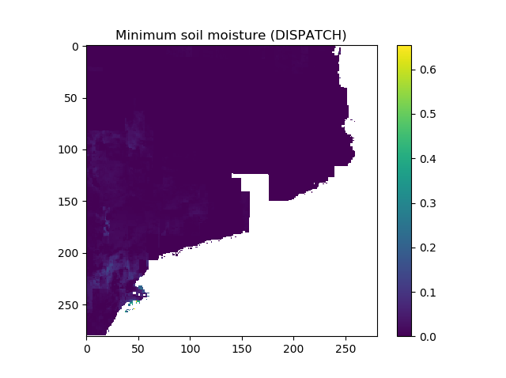
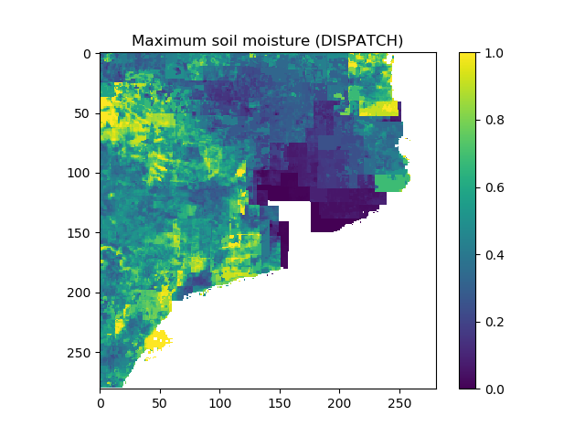
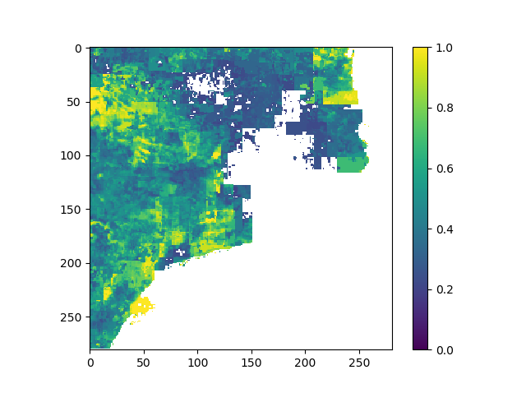
RFI removal →
SM_max<0.2

Slide 11
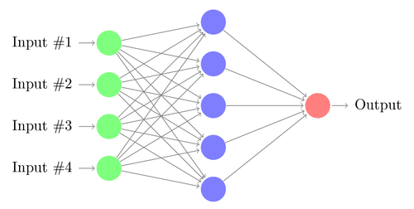
Methodology
Neural Network (Matlab toolbox)
Training target: DISPATCH soil moisture
Feed-Forward
Back-Propagation

Slide 13
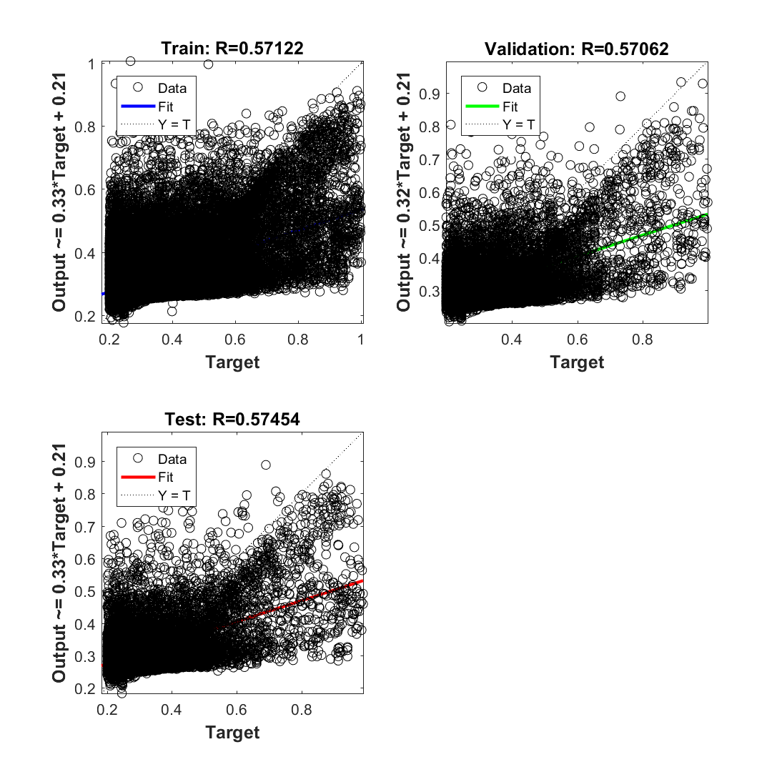
Results
Input: Index1, Index2, SMAP
Target: DISPATCH
Input: Index1, Index2, SMAP, NDVI
Target: DISPATCH

Slide 14
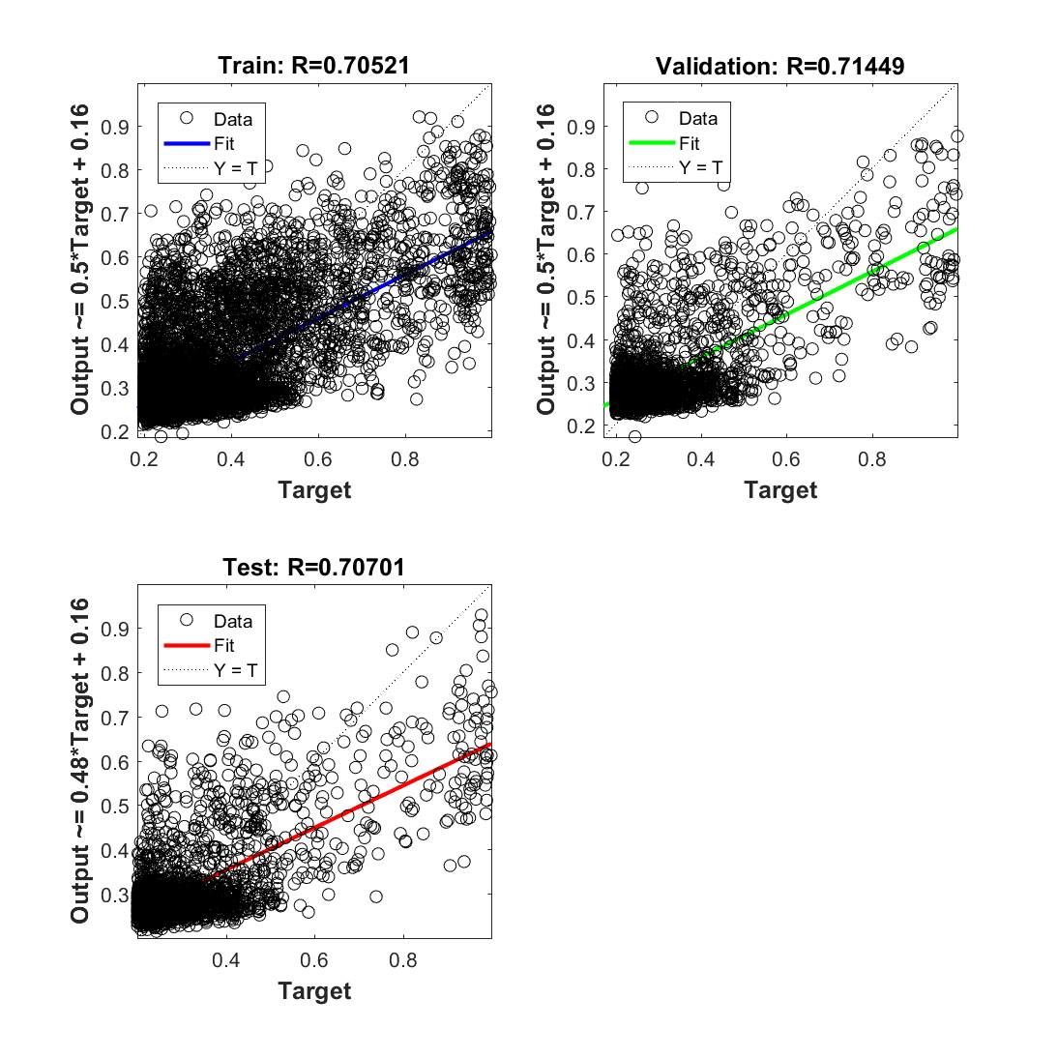
Results for different land cover
Input: Index1, Index2, SMAP
Target: DISPATCH
Only for cropland
CCI
SIGPAC

Slide 15
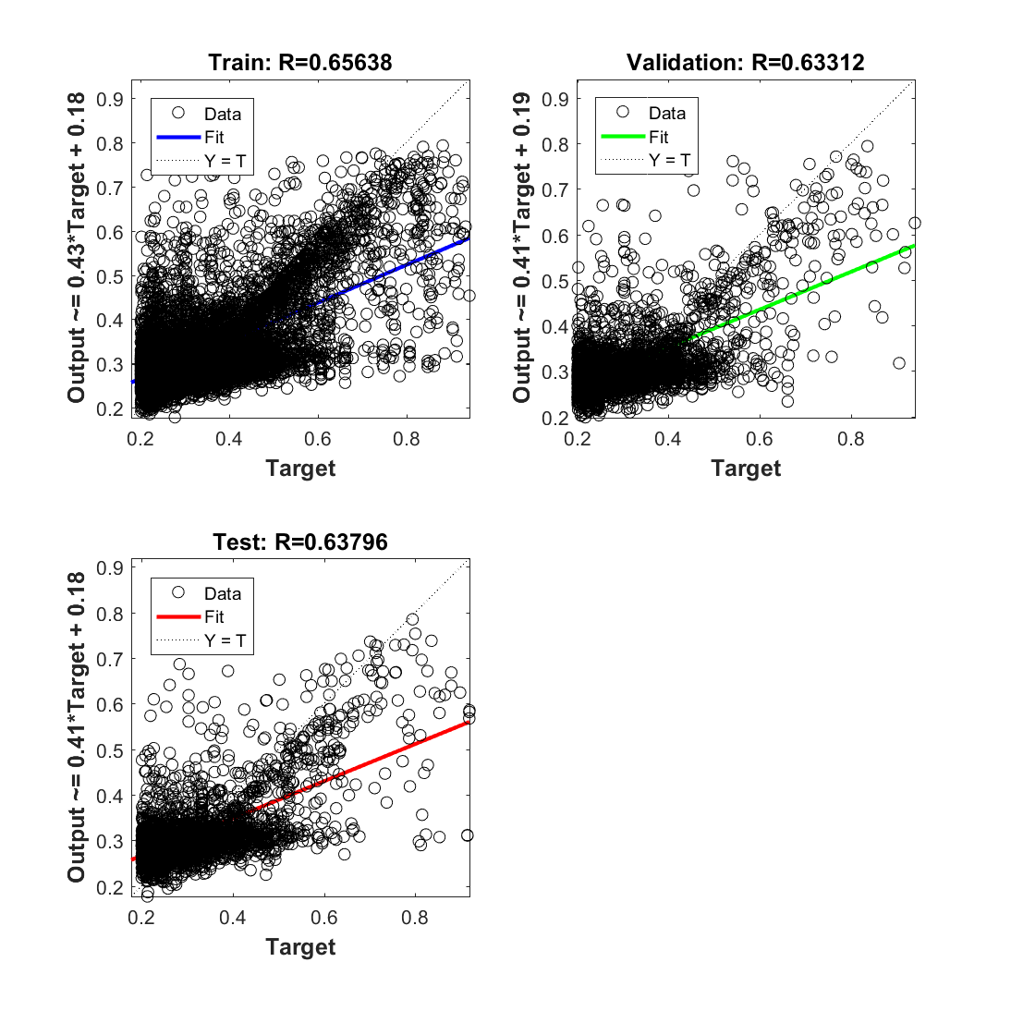
Results for different land cover
Input: Index1, Index2, SMAP
Target: DISPATCH
Only for forest
CCI
SIGPAC

Slide 16
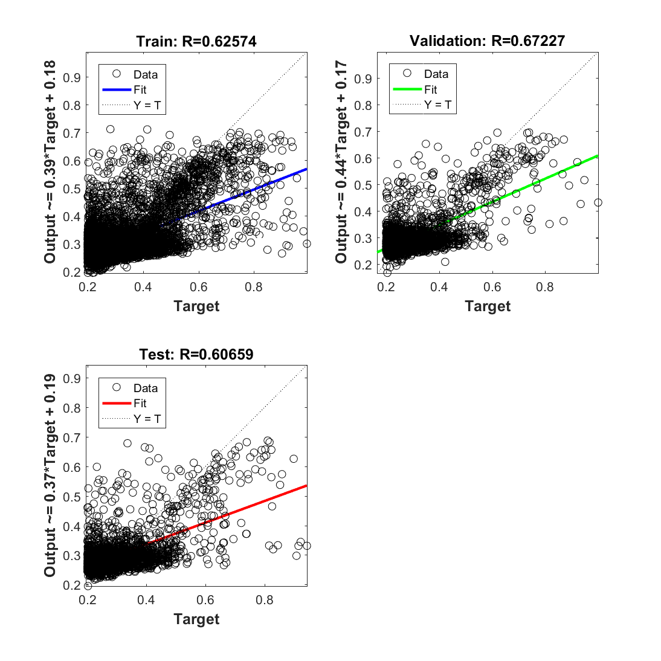
Results for different land cover
Input: Index1, Index2, SMAP
Target: DISPATCH
Cereal
Corn

Slide 17
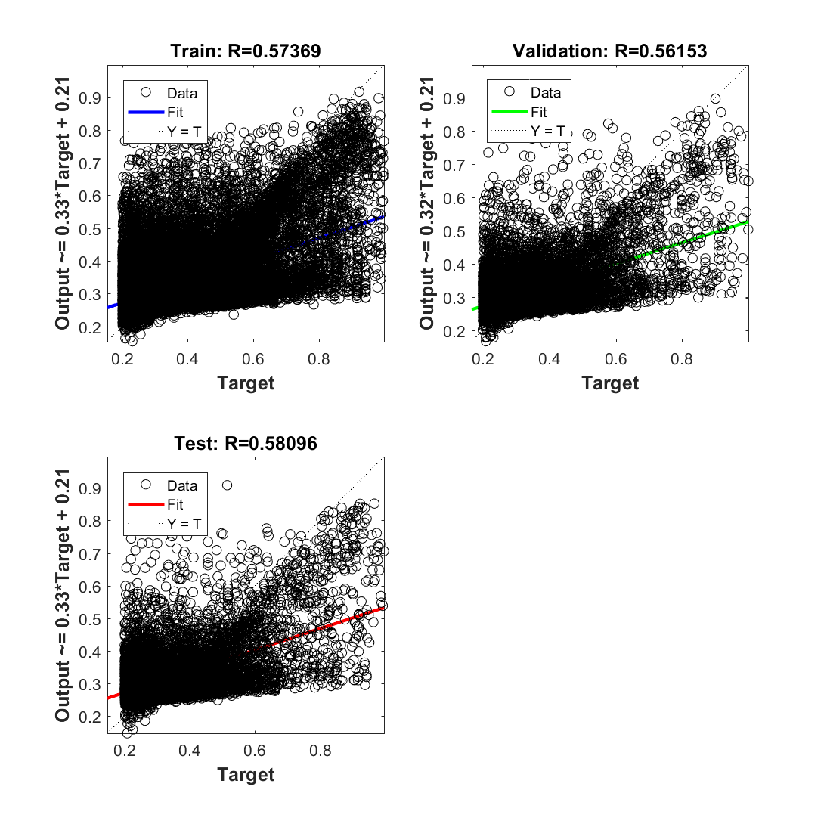
Results for different land cover
Input: Index1, Index2, SMAP
Target: DISPATCH
Irrigated
Non-irrigated

Slide 18
Conclusions
Results depend on the inputs
With NDVI the correlation coefficient R is slightly higher
Results depend on data filtering
For cropland SIGPAC gives a higher R than CCI (0.71 vs 0.65)
Separate corn and wheat didn’t improve the results
Irrigation fields have a slightly higher correlation R=0.72
Results heavily depend on the land cover, better filtering of data is needed.

