Slide 1

Welcome to EGU 2020 Sharing Geoscience Online
#shareEGU20
Cryosphere change impacts on marine
ecosystems and biogeochemical cycling
Live online discussion: 07 May 16:15-18:00
BG4/CL4/OS3 Cryosphere change impacts on marine ecosystems and biogeochemical cycling
Introduction slides by M Hopwood, S Ribeiro, H C Ng and L Tedesco

Slide 2
Decreasing sea-ice coverage, increasing permafrost-derived inputs and increasing ice sheet and glacier discharge will continue to affect high latitude environments in the coming decades under all future climate scenarios. Such changes at the interface between the ocean and the cryosphere raise questions about the downstream effects in marine ecosystems, as increased meltwater discharge is likely to impact not only coastal hydrology but also biogeochemistry, sediment transport and ecosystem services such as fisheries and carbon sequestration. However, the impact of increasing melt on fjord and coastal environments is poorly constrained, impacting our ability to make predictions regarding the consequences of future climate change. In order to understand the effect of changing cryosphere-derived inputs on high latitude fjords and marine coastal environments, knowledge concerning the physical and biochemical perturbations occurring in the sea ice and water column and the structure, function and resilience of affected ecosystems must be integrated. In this session we explicitly welcome cross-disciplinary attempts to understand how far reaching the effects of sea-ice, permafrost derived material and glacial changes are on marine biogeochemistry, productivity, biodiversity, and ecosystem services.
In the following slides, we highlight why we think this is a critical area for research,
BG4/CL4/OS3 Cryosphere change impacts on marine ecosystems and biogeochemical cycling
Introduction slides by M Hopwood, S Ribeiro, H C Ng and L Tedesco

Slide 3
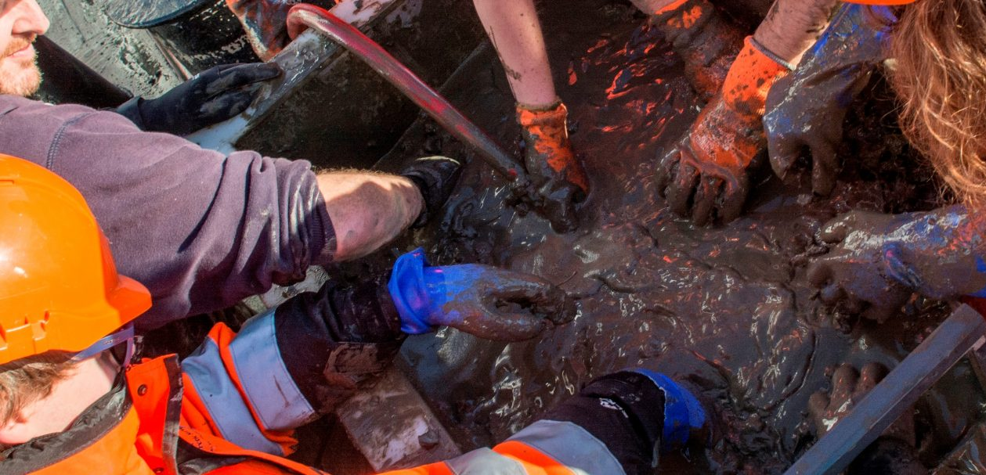

Biogeochemical processes (diagenesis) in the sediments play a key role in remobilising nutrient silicon and iron back into the overlying water column. There remains significant gaps in knowledge of such benthic nutrient flux in the polar region. Benthic supply of silicon and iron might become increasingly important with decreasing sea ice extent, especially in regions subject to shelf-break upwelling (Randelhoff and Sundfjord, 2018, https://doi.org/10.5194/os-14-293-2018), which could provide a pathway for the benthic nutrient flux to reach the surface ocean and be utilised by the planktonic ecosystems.
Changing Arctic Ocean Seafloor project
BG4/CL4/OS3 Cryosphere change impacts on marine ecosystems and biogeochemical cycling
Introduction slides by M Hopwood, S Ribeiro, H C Ng and L Tedesco

Slide 4
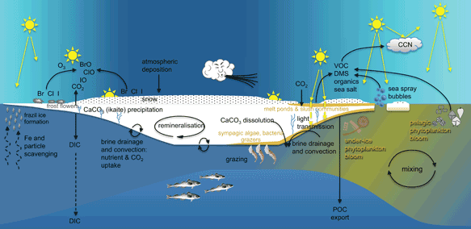
Sea ice biogeochemical processes: impact the underlying seawater and remote water masses through effects on marine productivity, nutrient stocks, and releases of brine and meltwater
Affect the atmospheric composition by controlling air-sea fluxes of gases and aerosols with the potential for significant climate feedbacks through direct and indirect (cloud) forcing mechanisms
Terrestrial processes can impact sea-ice and ocean processes by transporting nutrients and carbon via riverine input and coastal erosion
Higher trophic levels of polar ecosystems are dependent on sea ice.
Indigenous communities in the Arctic are affected by changes in sea-ice biogeochemistry through cascading ecosystem effects
Changes in sea-ice structure and integrity will themselves impact the use of sea ice for cultural purposes and transportation.
Concept sea-ice – ocean – terrestrial interaction
Modied from Steiner and Stefels (Elementa, 2017)
BG4/CL4/OS3 Cryosphere change impacts on marine ecosystems and biogeochemical cycling
Introduction slides by M Hopwood, S Ribeiro, H C Ng and L Tedesco

Slide 5
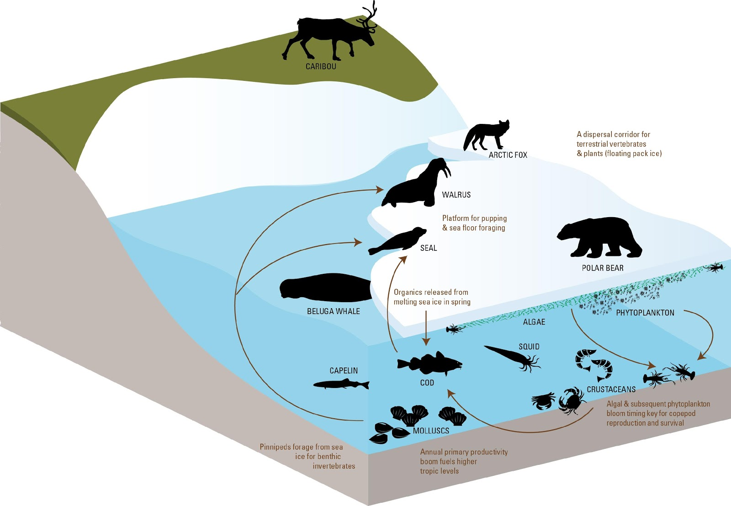
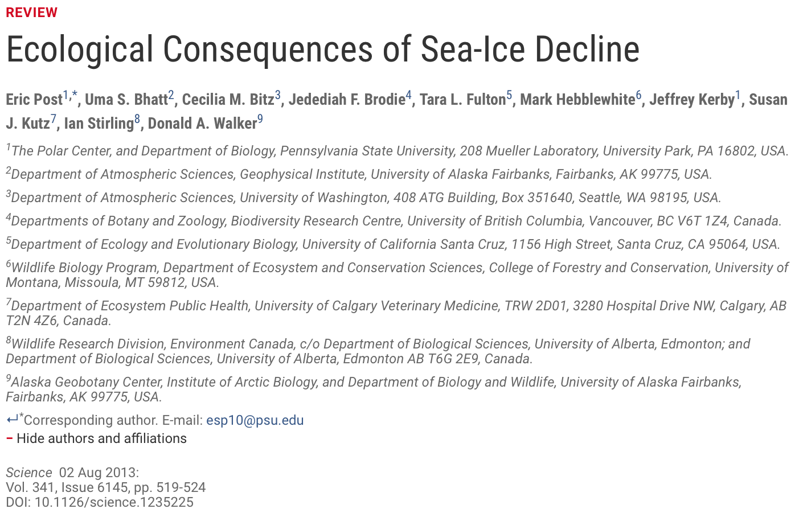
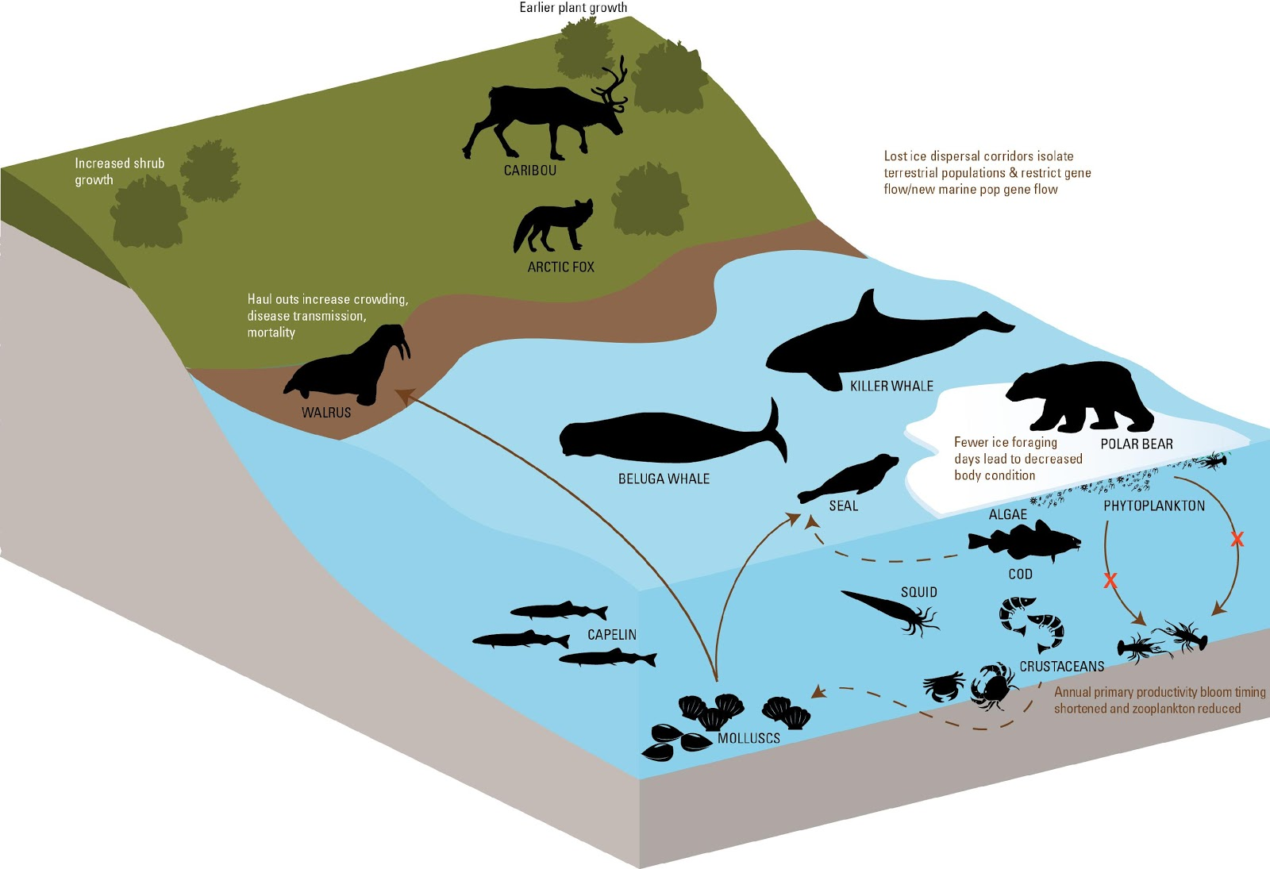
Modified from Post et al (Science, 2013)
Ecological consequences of Arctic sea ice decline:
Greening on land and earlier plant growth
Loss of critical habitat – reduction in population or possibly moving to land
Change to a less nutritious diet
Arrival of new species
BG4/CL4/OS3 Cryosphere change impacts on marine ecosystems and biogeochemical cycling
Introduction slides by M Hopwood, S Ribeiro, H C Ng and L Tedesco

Slide 6
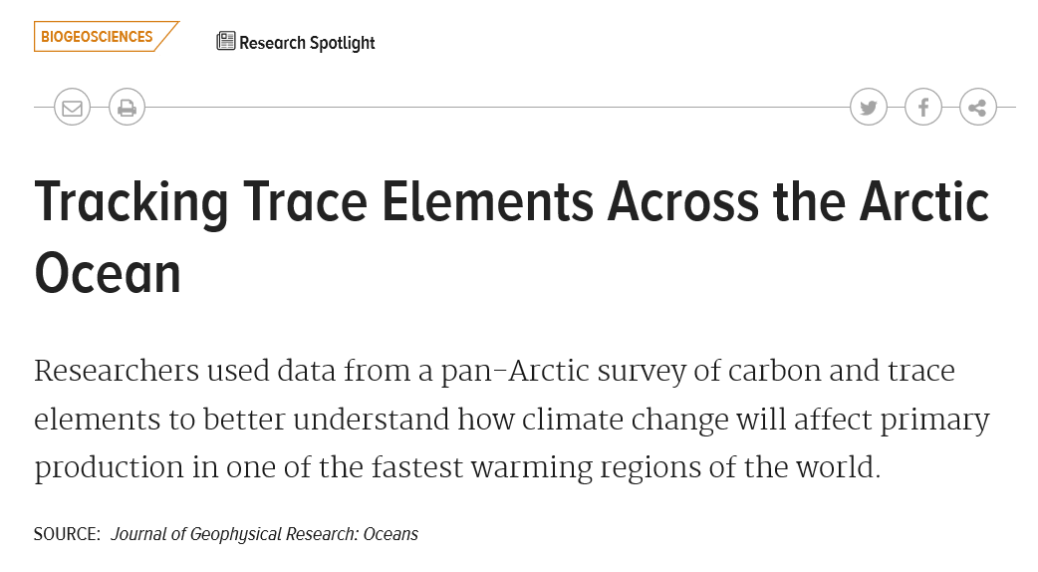
The Transpolar Drift is emerging as a major biogeochemical feature of the Arctic transferring a broad range of shelf-derived material across the Arctic and potentially into the high latitude North Atlantic. Key questions are how shifts in future sea-ice dynamics will effect the current, its biogeochemical signature and biological effects. (Charrette et al., JGR Oceans, 2020, https://agupubs.onlinelibrary.wiley.com/doi/abs/10.1029/2019JC015920)
BG4/CL4/OS3 Cryosphere change impacts on marine ecosystems and biogeochemical cycling
Introduction slides by M Hopwood, S Ribeiro, H C Ng and L Tedesco

Slide 7
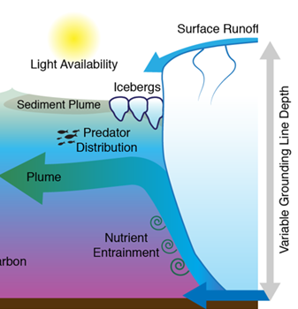
Around Greenland and Antarctica, much uncertainty concerns the fate and effects on increasing discharge from the Ice Sheet into the ocean. We know that glacier discharge plumes are responsible for driving mixing of heat, salinity and nutrients downstream of glacier termini. But how these plumes will respond in the future to the combined effects of terminus retreat and increasing discharge remains challenging to predict (de Andrés et al., The Cryosphere Discussions, 2020, www.the-cryosphere-discuss.net/tc-2019-264/).
Concept glacier plume
BG4/CL4/OS3 Cryosphere change impacts on marine ecosystems and biogeochemical cycling
Introduction slides by M Hopwood, S Ribeiro, H C Ng and L Tedesco

Slide 8
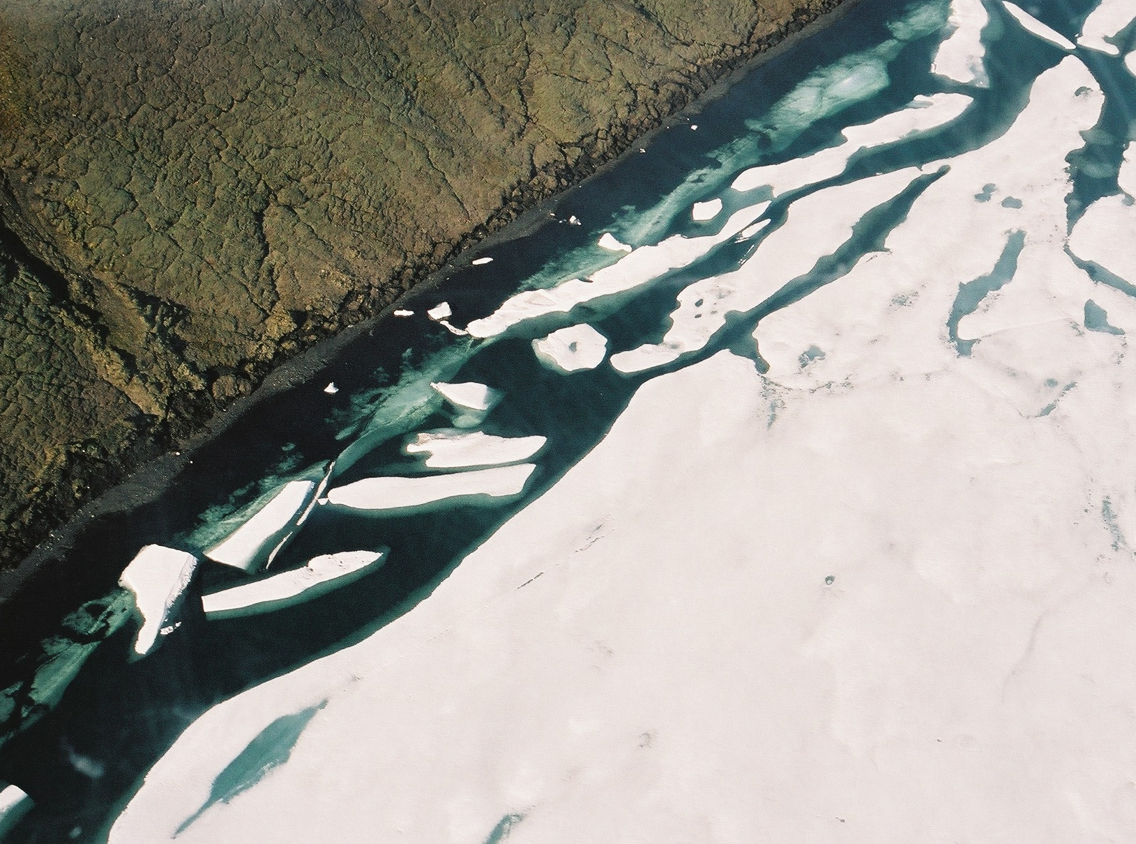
Despite its importance to the global climate system and the need for long-term quantitative data (pre-observational period) for future projections, sea ice is a relatively difficult parameter to reconstruct from the palaeo record. This is because most biogenic proxies commonly used for sea ice reconstructions are only indirectly associated with sea ice.
Novel approaches are emerging, including sedimentary ancient DNA of obligate sea ice organisms (de Schepper et al., 2019, ISME J 13, 2566–2577), and highly-branched isoprenoid (HBIs) lipid biomarkers. The latter include HBIs produced by obligate sea ice diatoms (IP₂₅, IPSO₂₅) and open-water phytoplankton (HBI III, HBI IV) that can be used together to reconstruct seasonal spring sea ice and the seasonal sea ice edge (Belt, 2018, Org. Geochem. 125, 277–298).
Disregarding these advances, the confident use of biogenic indicators for palaeo sea ice reconstructions relies on an in-depth understanding of organism-proxy relationships, present-day proxy distributions vis-á-vis measured environmental parameters, as well as rigorous testing of, and comparison between, proxies (Limoges et al., 2018, J. Geophys. Res. Biogeosci., 123, 760–786).
BG4/CL4/OS3 Cryosphere change impacts on marine ecosystems and biogeochemical cycling
Introduction slides by M Hopwood, S Ribeiro, H C Ng and L Tedesco

Slide 9
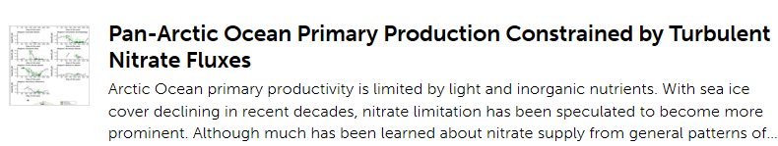
Some relatively large effects of increased freshening on the ocean are definitely under-studied. Arctic freshening and the resulting increase in ocean stratification exerts a strong influence on nutrient dynamics and thereby marine primary production. Recent work increases our ability to quantify the reduction in nutrient supply that occurs as increasing volumes of discharge are released into the Arctic.
(Randelhoff et al., 2020, www.frontiersin.org/articles/10.3389/fmars.2020.00150/full)
Arctic river water and meltwater alike are known to perturb the carbonate system and negatively affect shell-forming organisms by amplifying ocean acidification. Due to low alkalinity, and a pCO₂ under-saturation that arises when meltwater mixes with saline water, meltwater is particularly corrosive promoting ocean acidification, but also creating a large pCO₂ sink in glacier-estuaries.
(Meire et al., Biogeosciences, 2015, https://www.biogeosciences.net/12/2347/2015/)
BG4/CL4/OS3 Cryosphere change impacts on marine ecosystems and biogeochemical cycling
Introduction slides by M Hopwood, S Ribeiro, H C Ng and L Tedesco

Slide 10
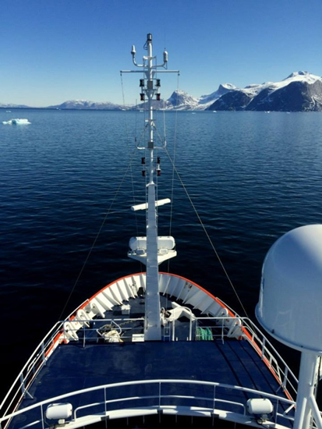
Whilst productivity in Arctic glacier fjords varies markedly, averages from present datasets suggest glacier fjords are at the unproductive end of the Arctic. Clear differences in productivity do however arise between land- and marine- terminating glaciers (Meire et al., Glob. Chang. Biol., 2017, https://onlinelibrary.wiley.com/doi/full/10.1111/gcb.13801)
Generally, the transition from marine- to land- terminating glacier-fjord systems is expected to induce changes in turbidity, light availability and the mixing of nutrients into surface waters that combined will negatively affect marine primary producers. Kongsfjorden in Svalbard is a well-studied system poised to make such a transition in the next few decades
(Torsvik et al., Estuar. Coast. Shelf Sci., 2019, www.sciencedirect.com/science/article/abs/pii/S0272771418308837)
Interesting contrasts between Arctic and Antarctic glacier-fjord systems are beginning to emerge. Future work may address why some Antarctic glacier-fjord systems have extremely high productivity compared to any well documented Arctic case studies (Mascioni et al., Polar Biol., 2019, https://link.springer.com/article/10.1007/s00300-019-02564-7).
BG4/CL4/OS3 Cryosphere change impacts on marine ecosystems and biogeochemical cycling
Introduction slides by M Hopwood, S Ribeiro, H C Ng and L Tedesco

Slide 11
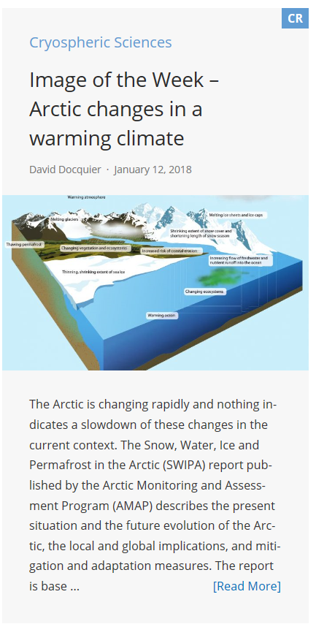
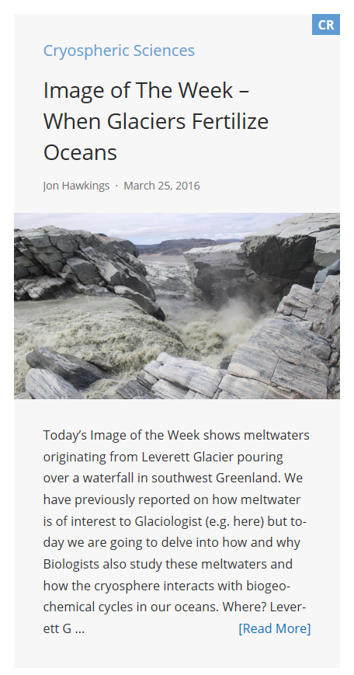
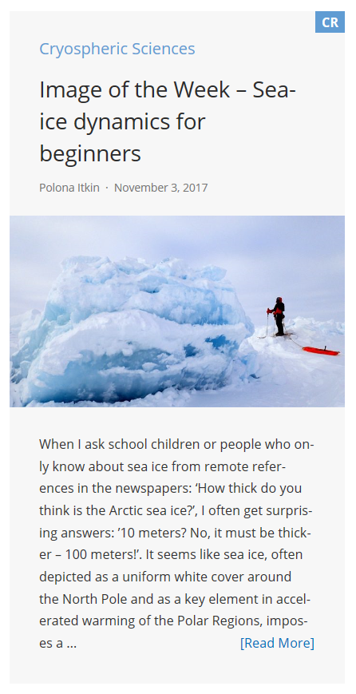
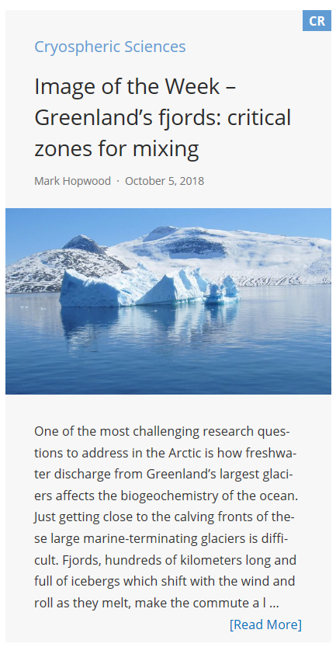
Further reading:
BG4/CL4/OS3 Cryosphere change impacts on marine ecosystems and biogeochemical cycling
Introduction slides by M Hopwood, S Ribeiro, H C Ng and L Tedesco

