Slide 1

Soils and the Critical Zone: carbon, resilience, and change
Convener: Chris McCloskey
Co-conveners: Emily Dowdeswell-Downey, Dan Evans, Victoria Janes-Bassett
SSS5.8 | Mon, 04 May, 14:00–15:45

Slide 2
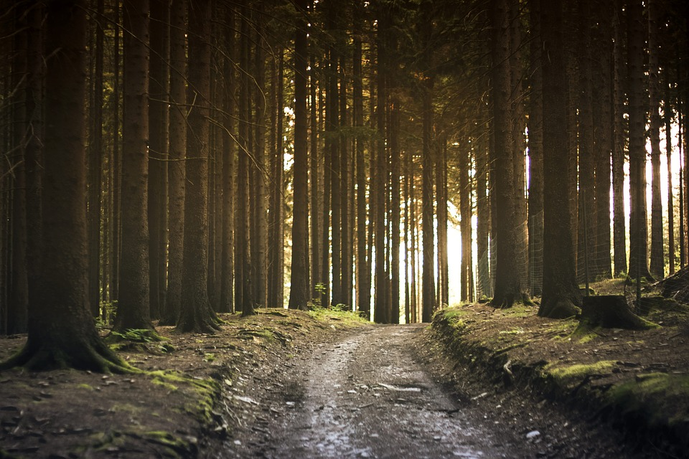
Chris McCloskey
Cranfield University, UK
PhD Researcher
Interests: plant-soil interactions, soil C dynamics, rhizosphere processes
c.mccloskey@cranfield.ac.uk
Emily Dowdeswell-Downey
Cranfield University, UK
PhD Researcher
Interests: soil erosion, climate change, microbial responses
e.dowdeswell@cranfield.ac.uk
Dan Evans
Lancaster University, UK
PhD Researcher
Interests: Soil formation, soil erosion, soil sustainability
d.evans3@lancaster.ac.uk
Victoria Janes-Bassett
Lancaster University, UK
Research Associate
Interests: Environmental modelling, biogeochemical cycling and land use
v.janes@lancaster.ac.uk
@CS_McCloskey
@EDowdeswell
@DanEvansol
@torijanes

Slide 3

Session overview
Soils represent a major terrestrial carbon store and fulfil a variety of functions from which the environment and humankind benefit. Soils processes operate and interact across the Critical Zone: the near-surface terrestrial layer extending from the bedrock through to the lower atmosphere. Multiple external pressures may result in changes to soil functioning, and we need a good understanding of how soils respond at a range of spatial and temporal scales.
The storage, stability, and cycling of carbon is fundamental to the resilience of soil systems. It is essential that we consider the role of carbon in all soil systems, from the microbial and aggregate scale to the catchment and the whole land surface, in order to better understand the interconnectivity between rocks, soils, plants, and the atmosphere. This is particularly important as soils are facing multiple perturbations, ranging from rapid shifts in land use and management to degradation and long-term environmental and climatic change. To maintain soil functions we need to develop further knowledge of how resistant soils are to these changes, alongside if, and how, they recover.
This session will consider terrestrial carbon pools and dynamics, and explore soil resilience at any, or multiple scales. We welcome contributions that consider processes within and between different elements of the Critical Zone, alongside innovative methods of quantifying and investigating change. Early career researchers are strongly encouraged to apply, and we seek submissions considering empirical, modelling, or meta-analytical approaches.

Slide 4

How this session will work
Thank you again for submitting your abstracts to this EGU session. Despite the prevailing circumstances we hope it will be possible to have a stimulating session centred around our shared research interests through the EGU “sharing geosciences online” format.
Displays
Please note all abstracts have been assigned the same format of display for shareEGU. We encourage you to upload a presentation in advance for discussion during the session. Presentations could take the form of (for example) a single slide poster-style presentation, or a short set of slides guiding readers through your research, but please bear in mind the time allocated for each display is limited. Details for uploading presentations can be found here: https://egu2020.eu/sharing_geoscience_online/presentation_upload_recipe.html
If you do not intend to upload a display please let us know at c.mccloskey@cranfield.ac.uk to help us plan the session.
Online session
Based on approximately 20 participants, we estimate about 5 minutes per display – although we may have more time depending on how many of us are available to attend the chat, and we expect time for extra questions at the end.
To get discussion of your display started, please prepare four highlights about your research in advance, to paste into the chat at the relevant point. These should cover:
• What is the main scientific question that your paper addresses?
• What is novel, important and timely about your work?
• What are your key findings?
• What is your main conclusion?
To get discussions started quickly we need to keep things concise, so please limit each highlight to at most 25 words. Following this there will be an opportunity for those attending to ask questions and start a discussion based upon your research.
If you have any questions please don’t hesitate the session convenors.

Slide 5
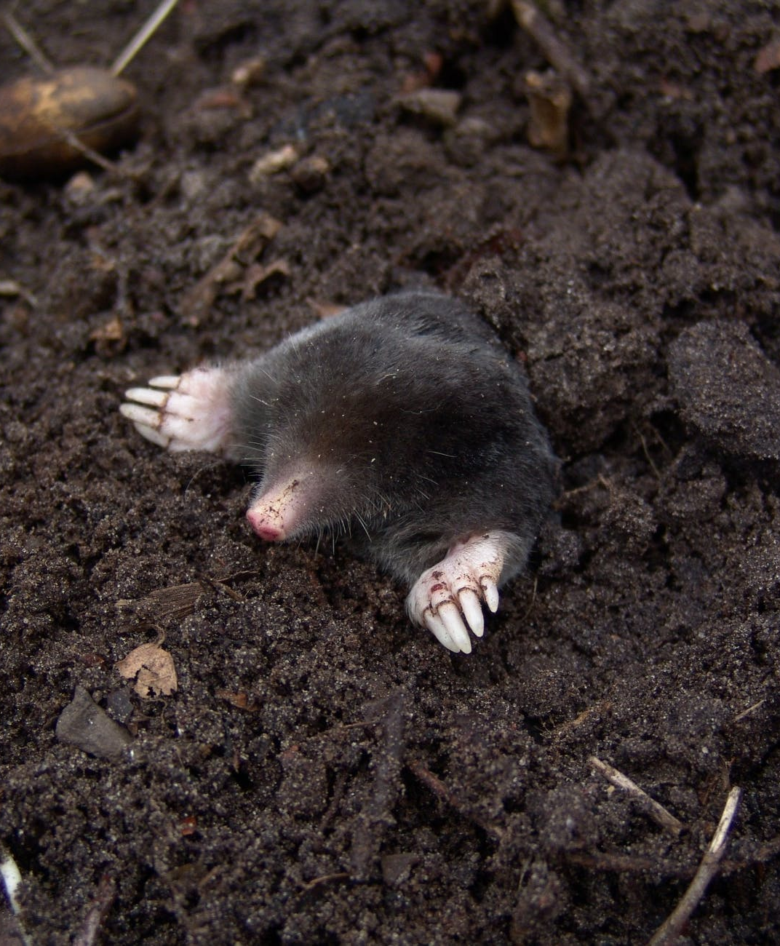
Running order
14.00 | Introduction
14.05 | Nathaniel Looker
14.10 | Anna Zielonka
14.15 | Stefano Manzoni
14.20 | Fiona Tang
14.25 | Alix Vidal
14.30 | Aditi Sengupta
14.35 | Jessica Davies
14.40 | Roisin O’Riordan
14.45 | Elin Ristorp Aas
14.50 | Mariam El-Amine
14.55 | Ilaria Baneschi
15.00 | John Quinton
15.05 | James Stockdale
15.10 | Han Chen
15.15 | Maria Timofeeva
15.20 | Anurag Kumar
15.25 | Carlos Alberto Quesada
15.30 | Yang Guo
15.35 | Cristina Ariza Carricondo
15.40 | Leysan Fattakhova
15.45 | Close

