Slide 1
SSS12.9 Digging the Future? Unearthing the power of soil science to address global challenges
#EGUDiggingTheFuture
#shareEGU20
Martha Ledger^{ECS} - University of Nottingham, UK
Session Conveners: Jessica Potts^{ECS} , John Beale^{ECS}, Harry Harvey^{ECS}, Corina Lees^{ECS}, Phil Haygarth
Chairperson: Jessica Potts^{ECS}

Slide 2
Soils are the cornerstone of Earth system regulation, and of our existence.
The nexus of the biosphere, hydrosphere, atmosphere, geosphere.
The great regulator of Earth’s climate.
Responsible for storage, filtering and regulation of water sources.
Host to a range of biological communities.
They provide the water and nutrients to feed and fuel our planet.

Slide 3
By 2050…
The world’s population will have reached 9 billion.
Food production must be doubled to sustain population growth… and with half of the resources we have today.
Pressure on our soils is immense, and the pressure is only set to increase.
How can the needs of people and the environment be met under such increasingly challenging circumstances?

Slide 4
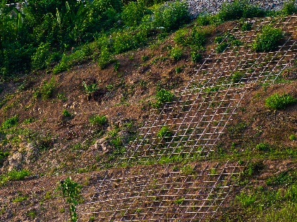
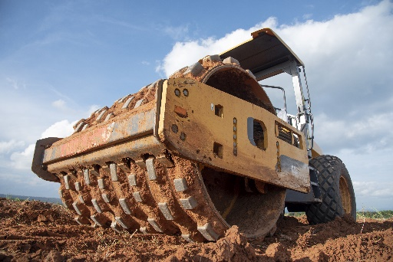
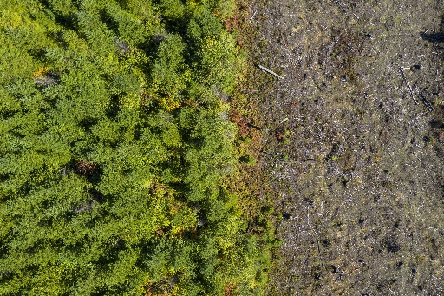
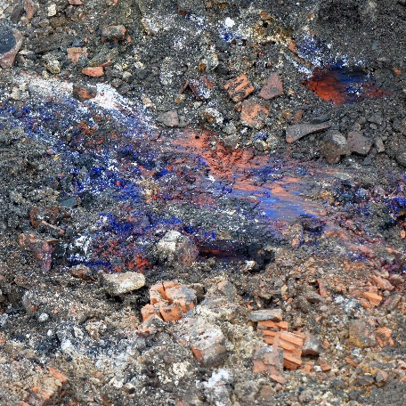
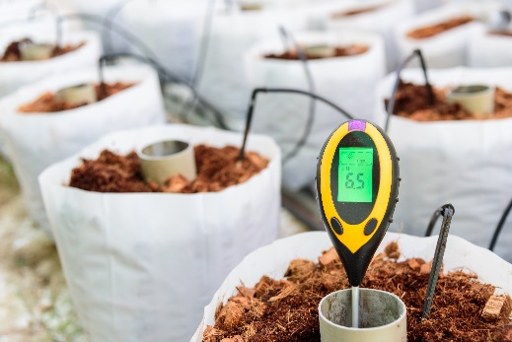
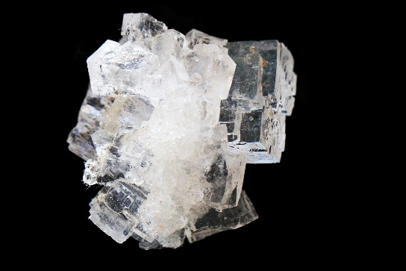
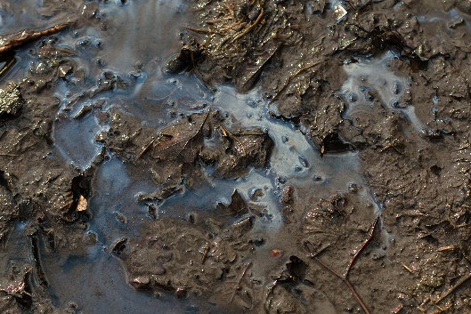
Threats to soil function
Soil compaction
Soil organic carbon loss
Soil contamination
Soil erosion
Loss of soil biodiversity
Salinization
Waterlogging
Nutrient imbalance
Soil acidification

Slide 5
This session, we showcase a variety of approaches and methods towards advancing soil science understanding.
Importance of, threats to and optimal management of organic and mineral soils
Microbiological indicators of soil function and characteristics
Optimising soils for sustainable extra-terrestrial agriculture
Requirements of our soils for the future – can these requirements be met?
We look forward to your contribution towards our discussion.

Slide 6
Live Session Details-
The general live chat will be structured as follows-
Displays will be discussed in display number order (outlined in following slides), and each display will be discussed for 5-7 minutes
Each presenting author is asked to prepare a 1-3 sentence introduction in advance, and we kindly ask that attendees do not post in the chat during this time
Following this introduction, we will take questions from attendees. Please begin questions with @”authorname” when asking questions. We would ask that attendees be mindful of the group discussion format and to time their questions appropriately to keep the discussion flowing and easy to follow.
Finally, we would like to make everyone aware that interactive discussion can take place before and after the conclusion of our live chat by engaging with the display comments at https://meetingorganizer.copernicus.org/EGU2020/displays/35118

Slide 7
D2292 |Determining regional scale carbon losses from tropical peatlands using ISBAS-InSAR
Martha Ledger, Sofie Sjögersten, Andrew Sowter, David Large, Chris Evans, and Keith Morrison
D2293 | Life cycle assessment of horticultural production on UK lowland peat soils Benjamin Freeman, David Styles, Christopher Evans, David Chadwick, and David Jones
D2294 | Effects of crop residue on carbon dioxide, methane and nitrous oxide emissions on cultivated peat soils
Samuel Musarika, Davey Jones, Dave Chadwick, Niall McNamara, and Chris Evans
D2295 | Life, but not as we know it: exploring RNA viral diversity in soils through viromics
Luke Hillary, Evelien Adriaenssens, Davey Jones, and James McDonald
D2296 | Highlight | Characterisation of Martian soil simulant MMS-1 in mixture with green compost for future sustainable space agriculture
Paola Adamo, Simona Vingiani, Mario Palladino, Christophe El-Nakhel, Luigi G. Duri, Antonio Pannico, Youssef Rouphael, Stefania De Pascale, and Antonio G. Caporale
D2297 | Effects of land use change and grazing on soil carbon dynamics in the semi arid Chaco, Argentina
Rose Durcan, Mariana Rufino, Nick Ostle, Natalia Banegas, and Emilce Viruel
D2298 | The influence of soil fertility on carbon cycling and storage in temperate tree bioenergy crops
Leigh-Anne Kemp
D2299 | Anaerobic Digestate Fraction and Nutrient Stoichiometry Significantly Influence the Carbon Cycle in Grassland Soils
Marta Cattin, Marc Stutter, Alfonso Lag-Brotons, Phil Wadley, Kirk T. Semple, Chris Parry, and Ben W.J. Surridge
D2300 | Regional Characterisation of Soils from Ground, Air and Space (withdrawn)
Uwe Meyer, Michaela Frei, and Elke Fries
D2301 |The utilisation of Amino methyl phosphonic acid by soil micro-organisms as a phosphorus nutrient source
Anchen Kehler, Martin Blackwell, Phil Haygarth, and Federica Tamburini
D2302 | Soil Microbial Indicators of Alkane Flux around a Natural Gas Seep
Thomas Bott, Simon Gregory, George Shaw, and Barbara Palumbo-Roe
D2303 | Phosphorus chemical changes under soils over a period of agricultural intensification
Andrew Tweedie, Philip M. Haygarth, Anthony Edwards, Allan Lilly, Nikki Baggaley, and Marc Stutter
D2304 | Exploring nitrogen losses from urine patches between upland and lowland grazing systems
Danielle Hunt, David Jones, Laura Cardenas, and David Chadwick
D2305 | Geochemical fingerprinting of lemon juices and cultivation soils for authentication and traceability of geographical provenience
Luigi Ruggiero, Maria Chiara Fontanella, Carmine Amalfitano, Gian Maria Beone, Claudio Di Vaio, and Paola Adamo
D2306 | Sediment origins across the terrestrial-aquatic continuum: climate threat mitigation and promotion of water quality
Katy Wiltshire, Toby Waine, Bob Grabowski, Miriam Glendell, Steve Addy, Nikki Baggaley, Barry Thornton, Jeroen Meersmans, and Fiona Napier

