Slide 1
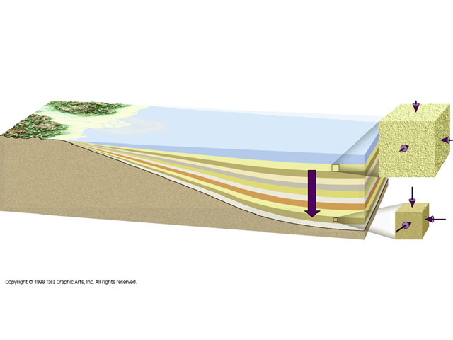


Temperature in Sedimentary Basins
Conveners: Andrea Schito, Silvia Omodeo Salè, Sveva Corrado, David Muirhead, Marta Gasparrini
EGU 2020 session TS 1.1

Slide 2
Topic of the session
Welcome to TS 1.1 session “Temperature in sedimentary basins”.
The aim of this session is to present an overview on the latest thermal modelling approaches including carbonate thermo-chronometry, organic matter and clay minerals thermal maturity and new numerical approaches applied on sedimentary basin developed in different geodynamic settings.
Presentations will last 5 minutes + 5 minutes for questions and have been ordered to group similar techniques and basins’ geodynamical affinities.

Slide 3
Schedule of the session
Attendance time: Wednesday, 06 May 10:45–12:30
- Presentation (10:45-10:55)
Metamorphosed Permian vertebrate fossils: geochemistry and mineralogy of “white” sharks – Presented by Anthea Arns (10:55 – 11:05)
Repurposing Britain’s Coal Measures: insight from seismic and borehole-based mapping and geothermal modelling – Presented by Louis Howell (11:05 – 11:15)
A Pyrenean-like model for the Variscan belt in NW Africa : insights from thermometry- based Raman spectroscopy study in the Khenifra Basin – Presented by Remì Leprêtre (11:15 – 11:25)
Sedimentological features and thermal maturity signature of the upper Triassic Streppenosa and Noto Formations, source rocks in the Hyblean Plateau (SE Sicily, Italy) - Presented by Rosanna Maniscalco (11:25 – 11:35)

Slide 4
Schedule of the session
Structural styles of the External Rif and Flysch Domain (Rif belt, northern Morocco) through thermal maturity and structural data – Presented by Achraf Atouabat (11:35 – 11:45)
Middle Miocene onset of thrusting along the basal décollement of the Jura Mountains: Evidence from carbonate U-Pb dating and clumped isotope thermometry – Presented by Nathan Looser (11:45 – 11:55)
Joint application of fluid inclusion and clumped isotope (Δ⁴⁷) thermometry to burial carbonate cements from Upper Triassic reservoirs of the Paris Basin – Presented by Natalia Vergara (11:55 – 12:05)
Quantifying the Effects of Salt Structures on Source Rocks Thermal Evolution of the Marine Sedimentary Basins – Presented by Shaowen Liu (12:05 – 12:15)
A Bayesian approach for thermal history reconstruction in basin modeling – Presented by Andrea Licciardi (12:15 – 12:25)
General Discussion

