Slide 1
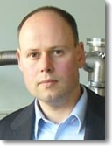
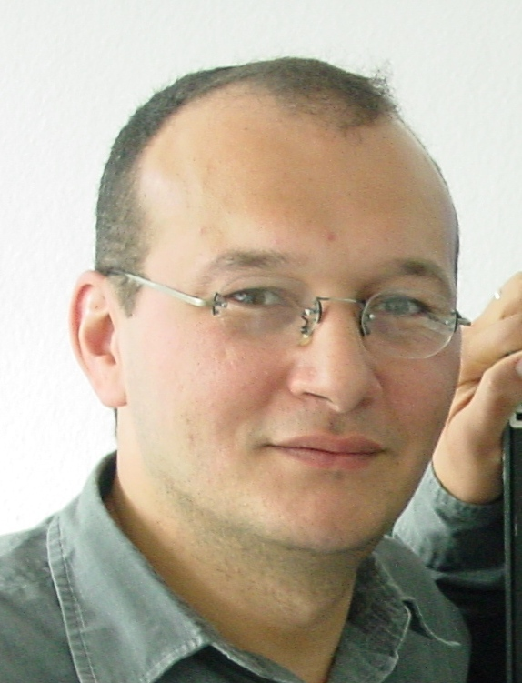
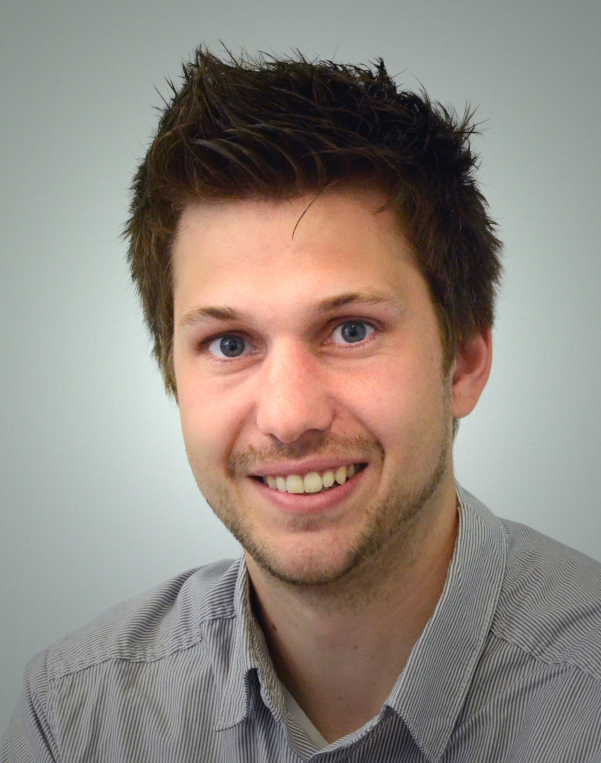
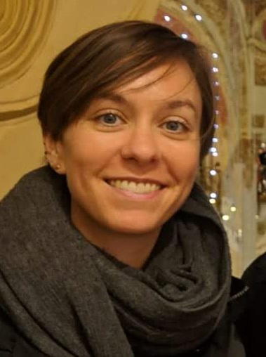
AS1.32 : Atmospheric Ice Clouds Observations and Modelling
Session Date:
Tuesday, 05 May,
14:00–15:45
Conveners:
Hinrich Grothe
A. Abdelmonem
Christian Rolf
Odran Sourdeval
Sylvia Sullivan

Slide 2
AS1.32 : Atmospheric Ice Clouds Observations and Modelling
Session general guideline
Important notes:
The link to the chat room becomes active 15 minutes prior to scheduled session start and disappears 30 minutes after the scheduled end of the session.
There will be no live audio or video streaming!
Presenting authors are asked to upload their Display (presentation) material very soon (latest 24 hours before the start of the session).
Audience are encouraged to view presentations and Abstracts in advance and prepare their questions. Please prepare questions in advance (to copy-and-paste).
During the live session we will encourage community interactions, first in the form of Q&A from the audience on each display content followed by a dedicated time (about 30 min) for open discussions on overarching topics.
Presenters are asked to initiate their short Q&A time by submitting a Short Summary of their display. Please prepare short summary in advance (to copy-and-paste)
Presentations will be discussed in the order of appearance displayed in the program.
2

Slide 3
AS1.32 : Atmospheric Ice Clouds Observations and Modelling
Session general guideline
Session Progress :
The chairman will start the session with welcoming audience
The chairman will ask the first presenter to share his/her Short Summary*.
The first presenter will copy-and-paste his pre-written short summery about his display
The chairman will write: “Questions?”
Audiences who have questions should write: “Q request”
The chairman selects one and writes: “Nickname”
Nickname should write his/her question.
Presenter should answer
Nickname may comment on the answer or say “Thanks”
If there is more than one Q request, chairman will select a second Nickname.
Steps 7 to 9 will be repeated for the second Nickname.
The chairman will ask the second presenter to share his/her short summary.
Steps 3 to 11 will be repeated for the second presenters
Steps 2-13 will be repeated for the next presenter until the last Display.
If some time is left, more questions can be discussed as follow: Steps 4 to 9 will be repeated for open questions. In this case each Nickname should start his question with the Name of the targeted presenter.
Please always wait for the chairman instructions.
Write your comments only after the chairman approve.

Slide 4
AS1.32 : Atmospheric Ice Clouds Observations and Modelling
Session general guideline
Notes on Display “Short Summary”:
Short Summary should have max. 1000 characters (including spaces).
Start with title, motivation, technique, findings and then conclusions. You may also upload image with the chat.
Example:
“A spectroscopic view of mineral aerosol surface aging under atmospheric conditions: Atmospheric mineral aerosols have direct and indirect influence on the climate system. They may age under natural atmospheric conditions. This has a large impact on the ice nucleation (IN) ability of the aerosol particles and hence climate system. We use nonlinear optical spectroscopy to investigate IN processes on the molecular level. We found that silica surface ages in aqueous solution. The aging is accelerated by successive freeze-melt cycles next to the surface. Aging altered the temperature dependence of the water structure next to the surface and correspondingly the IN ability of the surface. The reason is a disruption of the equilibrium at the surface due to dissolution and re-adsorption of dissolution products.”

Slide 5
AS1.32 : Atmospheric Ice Clouds Observations and Modelling
Session general guideline
Useful links:
Session programme and the link to the chat room
https://meetingorganizer.copernicus.org/EGU2020/session/36929
Session Displays (Abstracts/presentations)
https://meetingorganizer.copernicus.org/EGU2020/session/36929
To prepare and upload your presentation materials
https://egu2020.eu/sharing_geoscience_online/presentation_upload_recipe.html
Live text chat guide
https://youtu.be/xTCPKDmgSVw

