Slide 1
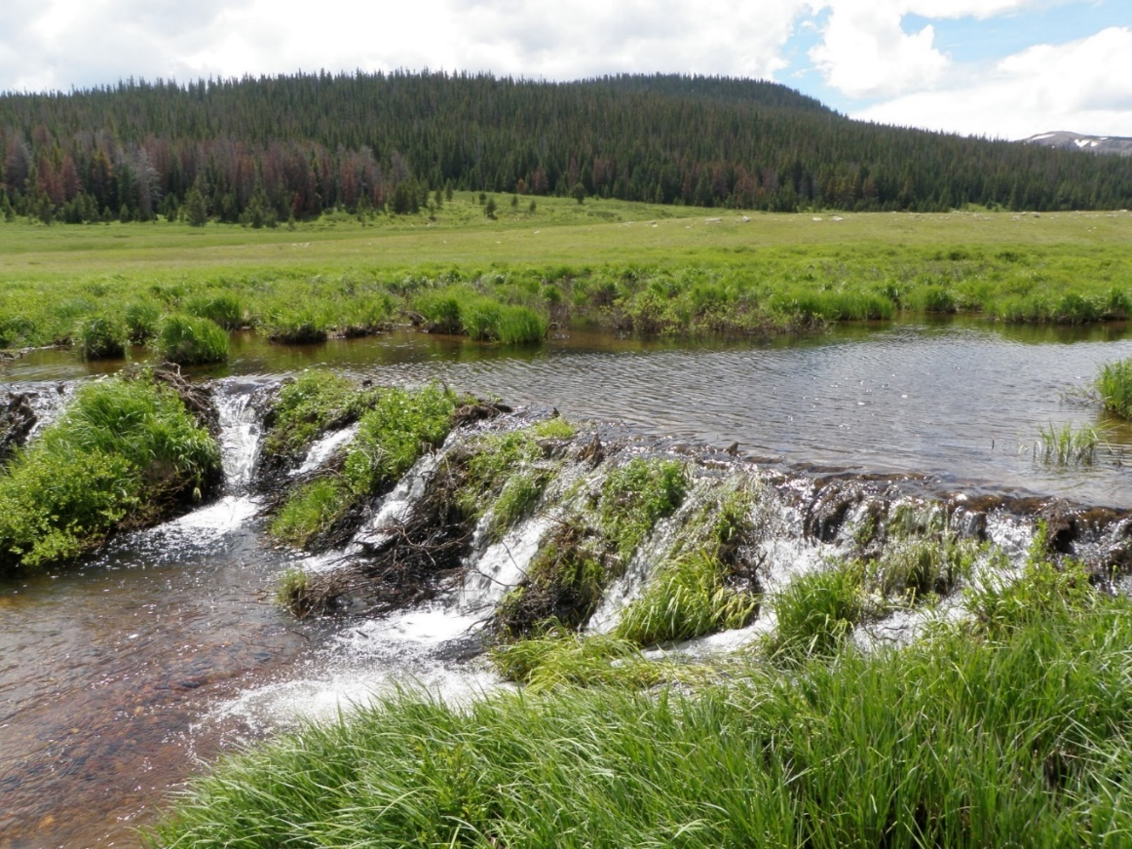
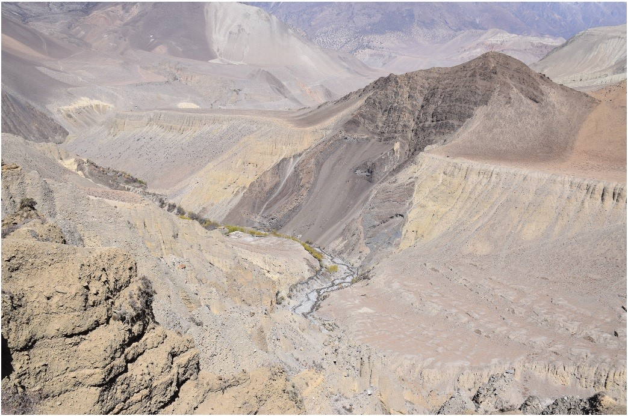
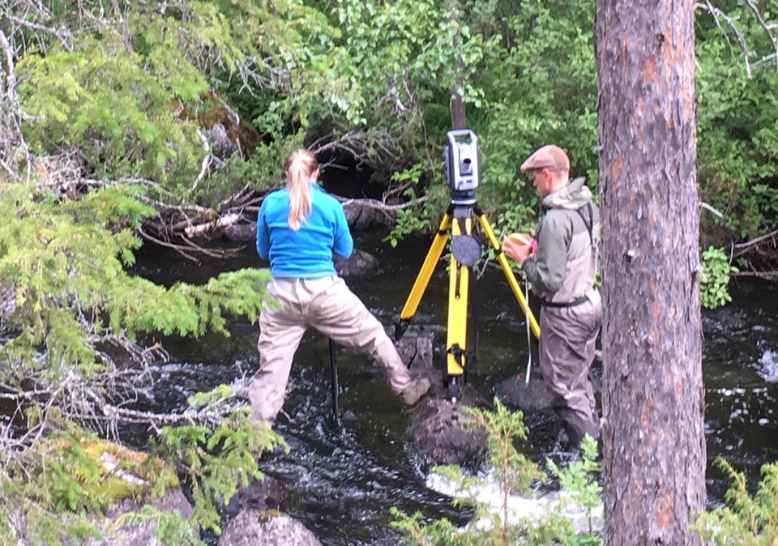
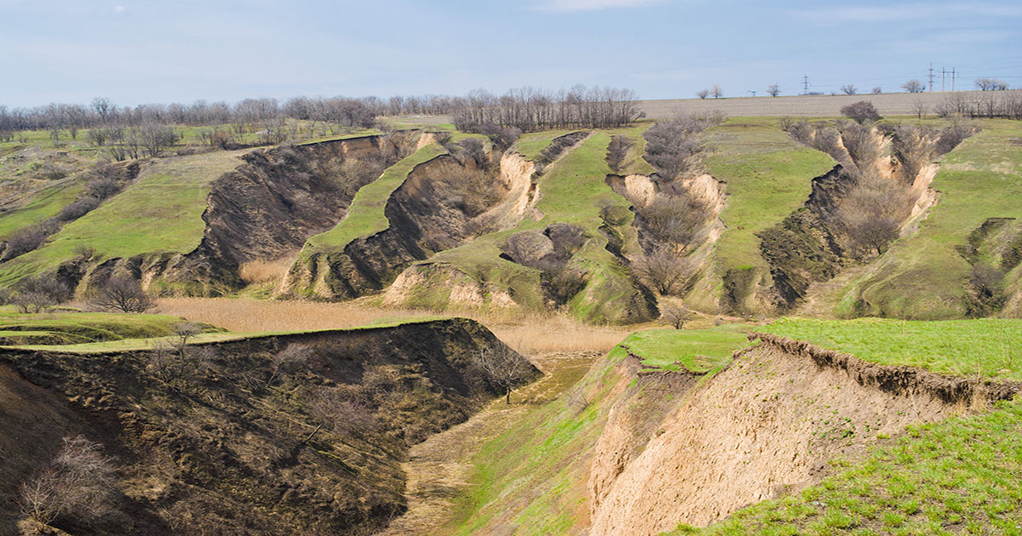
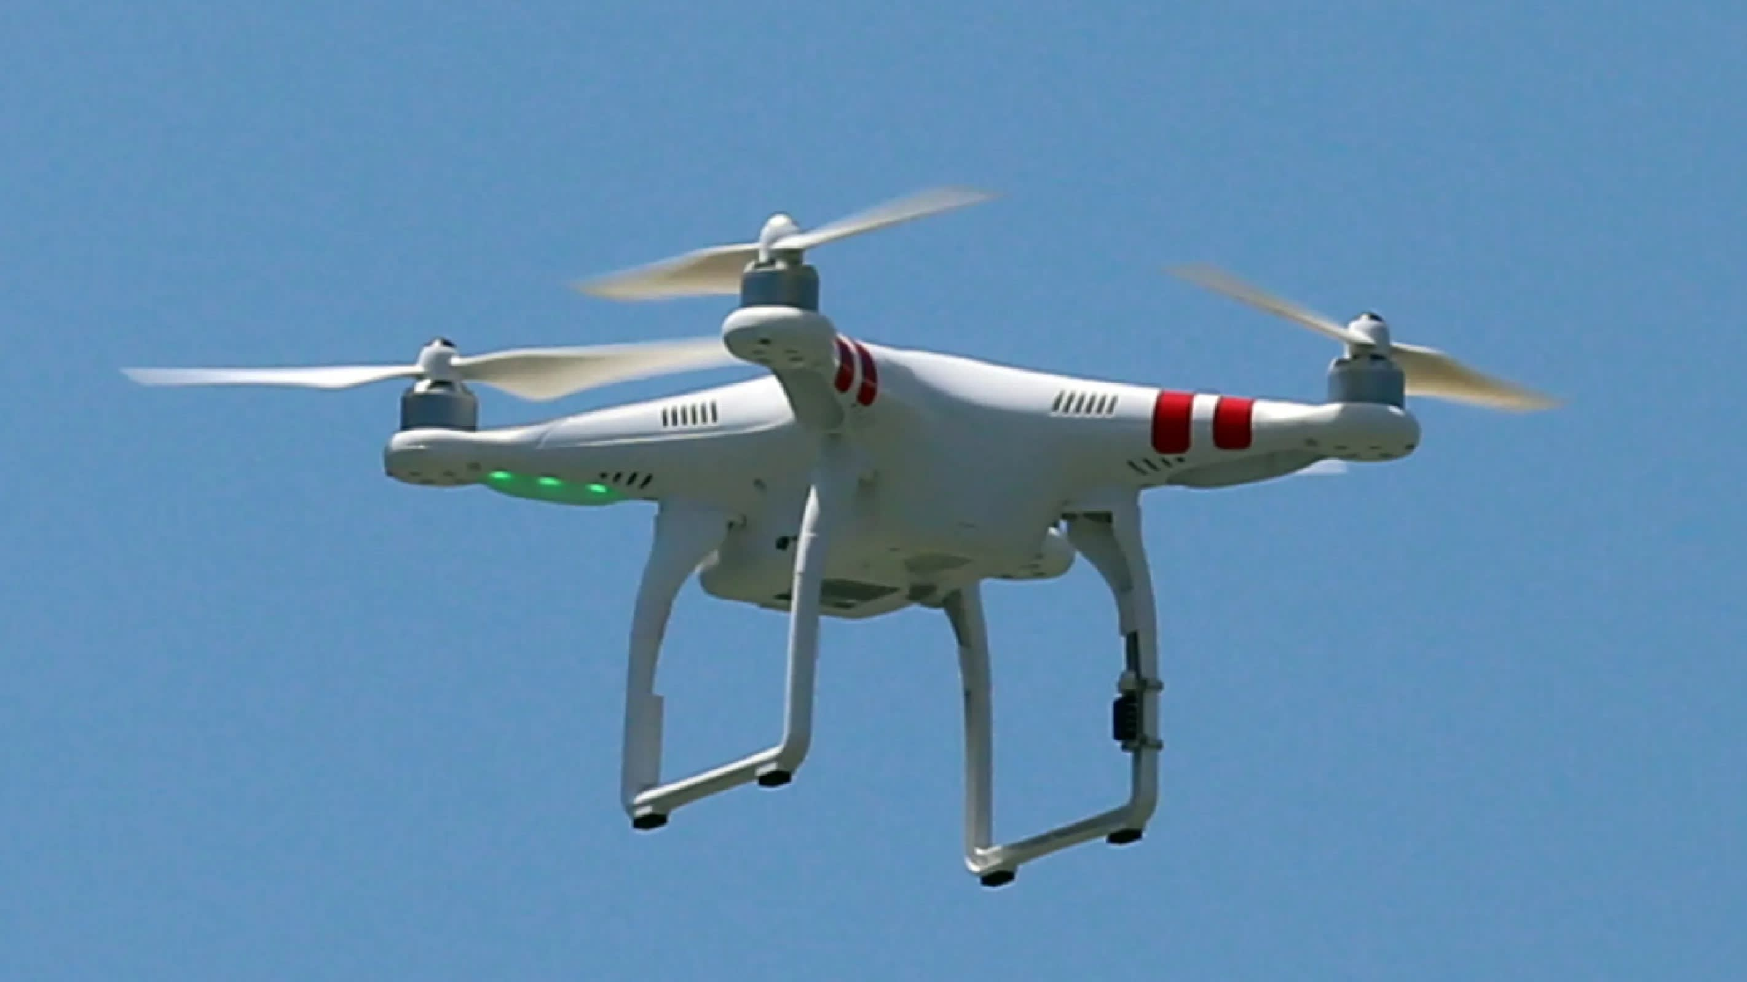
GM 3.6 (Dis)connectivity in hydro-geomorphic systems: emerging concepts and their applications
Conveners: Ronald Pöppl, Lina Polvi Sjöberg, Laura Turnbull, Manuel López-Vicente, Jantiene Baartman, Lovisa Eirell, Anthony Parsons
co-sponsored by IAG
Concepts (examples)
Environments
Methods (examples)
„natural“
measurement
modelling
Fryirs et al., 2007
Keesstra et al., 2018
Photo: L. Polvi Sjöberg
Poeppl et al. 2017
Photo: R. Sjöberg
Photo: R. Sjöberg
Poeppl et al. 2019
„anthropogenic“
indices
remote sensing
Poeppl and Parsons, 2018
Bracken et al., 2015
Photo: L. Polvi Sjöberg
https://youmatter.world/en/definition/soil-erosion-degradation-definition/
Schopper et al., 2019
https://asia.nikkei.com/Politics/International-relations/Japan-Coast-Guard-to-eliminate-Chinese-drones
WHEN?
HOW?
CONTACT (CHAT MODERATION)
Wed. 06 May 16:15–18:00
Chat discussion (Sharing Geoscience
Online)
ronald.poeppl@univie.ac.at lina.polvi@umu.se
Session abstract: https://meetingorganizer.copernicus.org/EGU2020/session/37501

Slide 2
GM 3.6 (Dis)connectivity in hydro-geomorphic systems: emerging concepts and their applications
Conveners: Ronald Pöppl, Lina Polvi Sjöberg, Laura Turnbull, Manuel López-Vicente, Jantiene Baartman, Lovisa Eirell, Anthony Parsons
co-sponsored by IAG
CHAT PROGRAMME
General introduction by the conveners (“setting the context”) – 5 min
2) ‘Mentimeter’ poll (conveners, authors, audience) – 5 min
3) Displays (max. 7 min per display):
Invited “speakers” first (Gordon Grant, Ellen Wohl, Rebekah Levine)
Then following the order as shown in the official EGU session programme (shown in panel to the right of chat window)
Procedure: Each display will be announced by the session moderators asking the “speakers” to post key messages related to their display material. Then the audience is kindly asked to post questions/statements for discussion.
4) Concluding remarks (conveners) – 5 min
WHEN?
HOW?
CONTACT (CHAT MODERATION)
Wed. 06 May 16:15–18:00
Chat discussion (Sharing Geoscience
Online)
ronald.poeppl@univie.ac.at lina.polvi@umu.se
Session abstract: https://meetingorganizer.copernicus.org/EGU2020/session/37501

