Slide 1
GI4.6/CL5.26/HS13.4/NH8.14 Session Summary Progresses and gaps on monitoring of snow and its components at the local-, regional to global scale and its applications to support weather, hydrological and climate science, as well as monitoring of natural hazards
Convener: Ali Nadir Arslan
Co-conveners: Leena Leppänen, Carlo De Michele, Jürgen Helmert

Slide 2
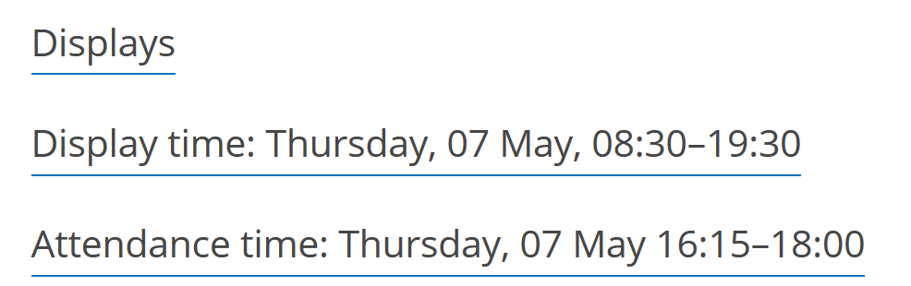

Slide 3
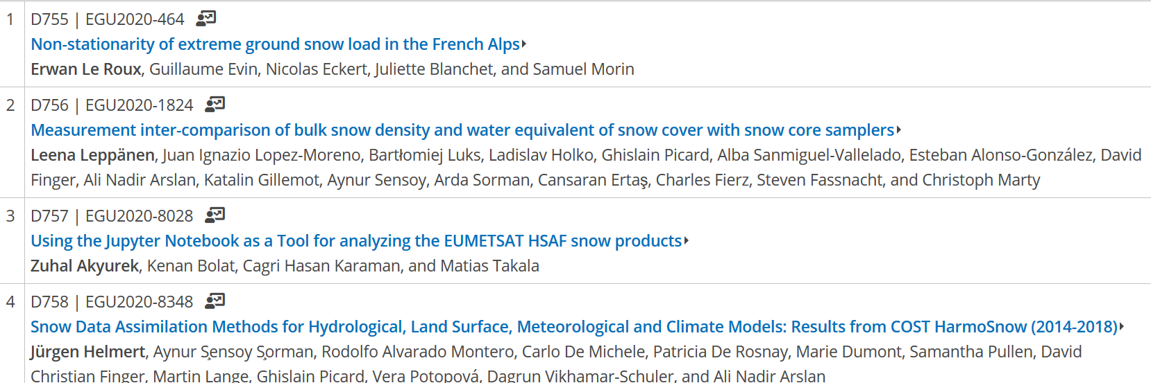
SCHEDULE:
16:15 Session Introduction by Chair
16:25 – 16:49 - Presentations

Slide 4
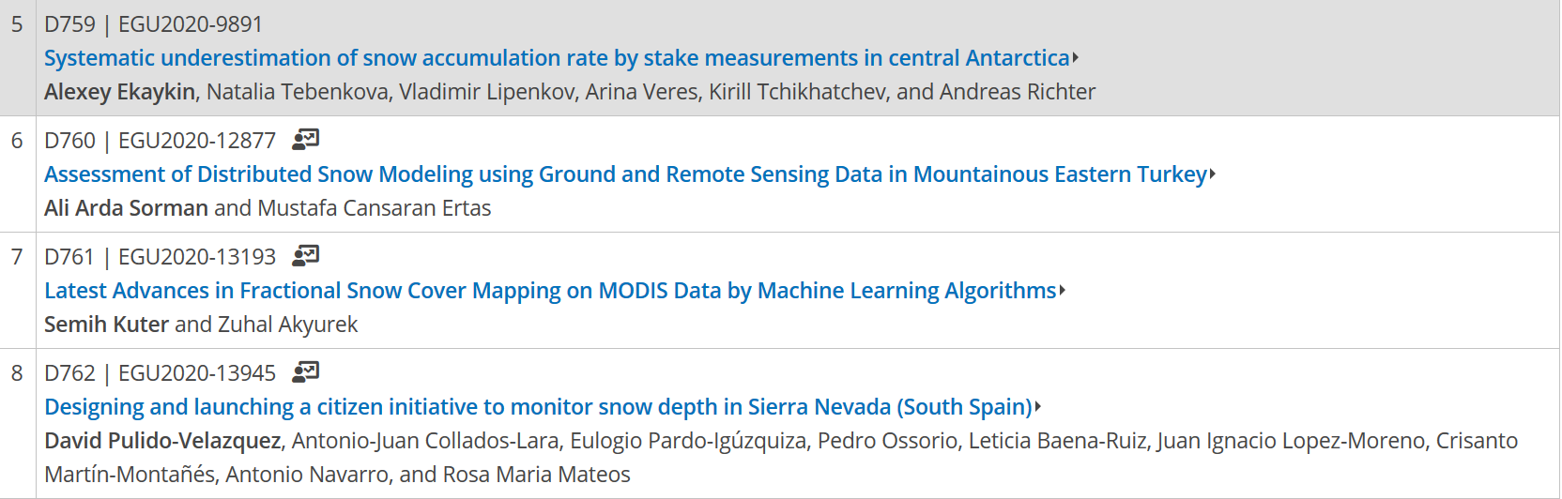
SCHEDULE:
16:49 – 17:13 - Presentations

Slide 5
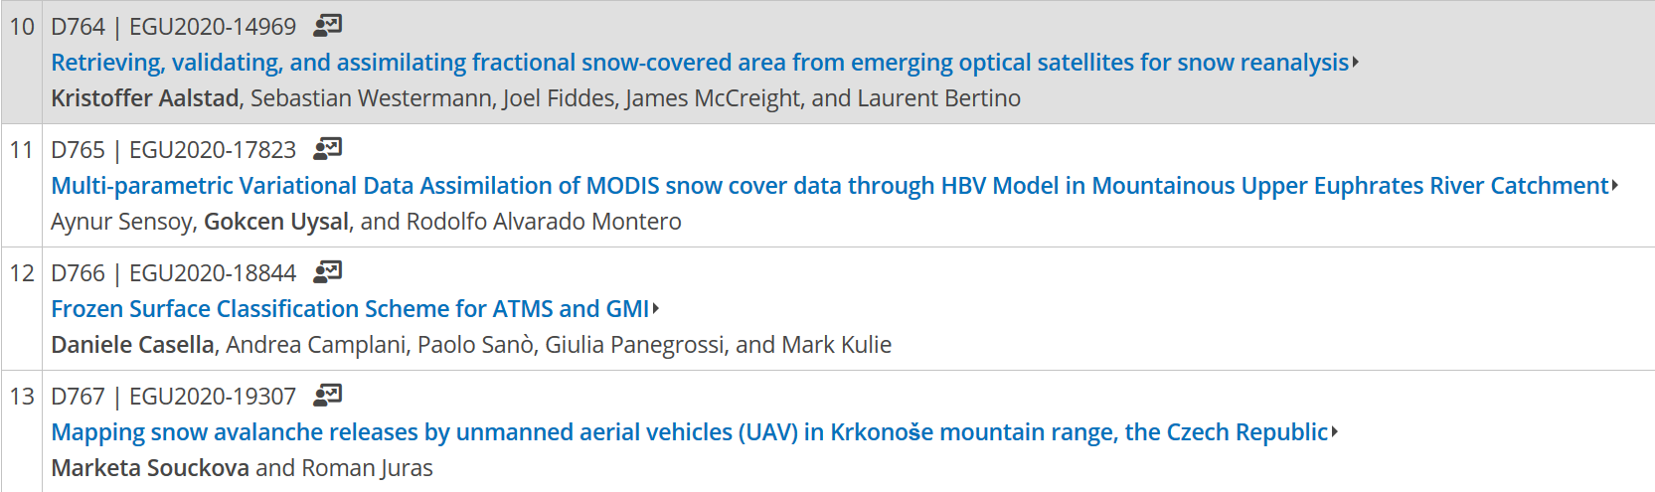
SCHEDULE:
17:13 – 17:37 - Presentations

Slide 6
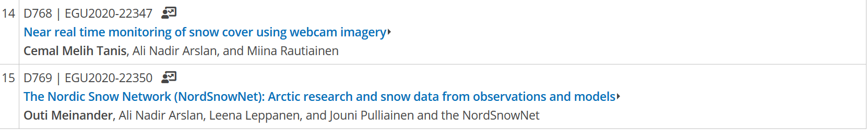
SCHEDULE:
17:37 – 17:49 – Presentations
17:49 – 18:00 – FINAL REMARKS

