Slide 1

Enhanced ESA-NASA Cooperation in Earth Observation
EGU On-line Townhall Meeting, 5 May 2020
Sandra Cauffman, NASA Earth Science Division
Maurice Borgeaud, ESA Earth Observation Programmes

Slide 2








Agenda
EGU On-line Townhall Meeting TM4
Enhanced ESA-NASA Cooperation in Earth Observation
19h00 Introduction by NASA and ESA Co-chairs Borgeaud/Cauffman
19h05 Sub-Group 1: Mission and Technology Neeck/Silvestrin
19h15 Sub-Group 2: Cal/Val and Field Campaigns Kaye/Davidson
19h25 Sub-Group 3: Ground segment and data Murphy/Hanowski
19h35 Joint projects and way forward Cauffman/Borgeaud
19h40 Discussions
ESA UNCLASSIFIED – For Official Use
European Space Agency

Slide 3
Background
The National Aeronautics and Space Administration (NASA) and the European Space Agency (ESA) signed on 7 September 2010 a formal Earth Science and Observation Framework for Cooperation
This led to the establishment of a joint NASA-ESA Earth Science Joint Program Planning Group (JPPG) to formalize and enhance cooperation in the areas of Earth observation/science and climate change
Three Sub-Groups (SG) established under the JPPG:
SG-1: Mission and Technology
SG-2: Cal/Val and Field Campaigns
SG-3: Ground segment and data
The JPPG reports annually to ESA/NASA executive top management
ESA UNCLASSIFIED – For Official Use
European Space Agency

Slide 4
Objectives
Present update on NASA and ESA Earth Observation (EO) programmes
Assess collaboration plans and progress
Receive and discuss Subgroup reports
Identify key strategic issues for coordination, within and across the Subgroups
Enable face-to-face, iterative subgroup planning
Discuss new opportunities
Ensure maximum integration and complementarity of the ESA-NASA EO programmes
ESA UNCLASSIFIED – For Official Use
European Space Agency

Slide 5
SG1: Mission & Technology Pierluigi Silvestrin (ESA) Steven Neeck (NASA)

Slide 6
SG-1:Mission & Technology
To identify, evaluate, and initiate as appropriate a broad suite of collaboration opportunities ranging from
Coordination in the operation of future missions
Shared interests in technology and instrument development
Identification of major new missions that could only be addressed with substantial collaboration
Collaboration/Coordination activities:
Mission identification & selection, coordination during early phases
Technology developments (e.g. ESTO)
Special areas, e.g. future Copernicus and mass change / gravity missions
Convoy/constellation management and planning
Decadal Survey
Ensuring mutual representation in science teams for early phases
ESA UNCLASSIFIED – For Official Use
European Space Agency
Notes:
ESTO: Earth Science Technology Office – NASA
NOTE THAT AN TEM HAS BEEN SLIGHTLY MODIFIED, FROM “OTHER AREAS” TO “SPECIAL AREAS”

Slide 7
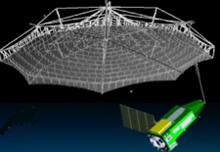
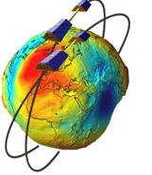
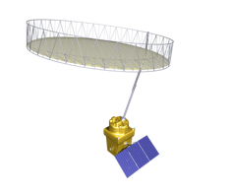
SG-1:Mission & Technology
Some recent activities
Collaboration on Mass Change Designated Observable / Next-Gen Gravity Mission studies
Sentinel-6 mission collaboration
NASA/JPL support for ESA BIOMASS antenna reflector development
Collaboration on Copernicus Polar Ice and Snow Topography (CRISTAL) and Copernicus Imaging Microwave Radiometer (CIMR) mission studies and other potential future Sentinels, e.g. synergies of US Decadal Survey and new European missions using hyperspectral (SBG, CHIME), thermal (SBG, LSTM) and radar (SDC, ROSE-L) imaging data
Cross-participation in Mission Advisory Groups and Science Teams
Regular exchanges on EO constellation operation methods
Support to EU - US dialogue on architectures of Copernicus Optical Imaging (eg Sentinel-2 NG) and Sustainable Land Imaging System (Landsat NeXT)
-
ESA UNCLASSIFIED – For Official Use
European Space Agency

Slide 8
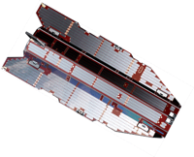
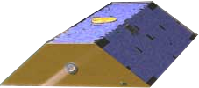
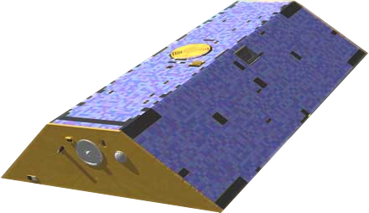
Highlights on: Joint Future Constellation for Mass Change / Gravity Monitoring at High Resolution
Past observations
Continuity of
observations
Enhanced continuity of observations
NASA
Mass Change
Designated Observable
/ Next-Gen Gravity Mission
MCDO/NGGM
GRACE
GRACE−FO
US/DE
US/DE
2002
2009
2013
2017
2018
2023
~2028
GOCE
ESA
Start of sustained observations at higher spatial & temporal resolution
Notes:
NASA & ESA are discussing scenarios for establishing a joint constellation by aligning the ongoing NASA Mass Change Designated Observable (MCDO) and the preparatory activities for Phase-A (early 2021) of Next Generation Gravity Mission (NGGM) in ESA. The agencies have agreed to cooperate towards preparing User and Mission Requirement Documents and defining support science study activities.

Slide 9
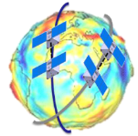
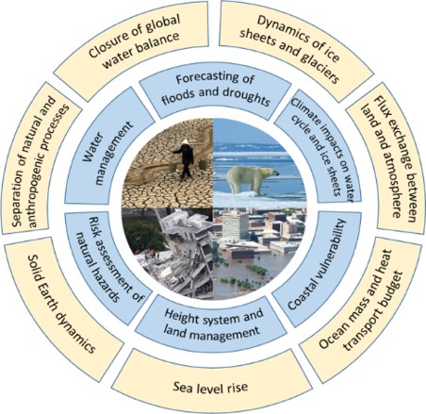
Mass Change: the unique cross-cutting variable
Implicitly assumed as available information for multiple Copernicus services (land/hydrology, climate, marine, emergency)
Provides also the global context at mid- and long-term for all water related elements in atmosphere, land, ocean, ice, solid earth, hence for climate
Crucial for many water cycle related ECVs as defined by GCOS
Unique in providing ground water information essential for
water management and droughts/floods
Immediate opportunities for a joint cross-cutting mission
(MCDO-NGGM) based on a constellation in international
cooperation
ESA-NASA Ad-hoc Joint Science Study Team (AJSST) established to consolidate science & application needs and mission requirements

Slide 10



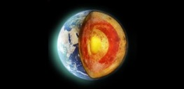
Thematic fields and signals
Hydrology
Ground water storage
Soil moisture & surface water storage
Extreme events warning (e.g. drought, flood)
Water balance closure
Global change impact on water cycle
Cryosphere
Cryosphere mass balance
Global and regional sea level
Global isostatic adjustment (GIA)
Mass changes of ice sheet and glaciers
Emergency applications (e.g. meltwater flooding)
Oceanography
Sea-level rise
Ocean bottom pressure
ACC and AMOC variability
Tidal models
Heat and mass observations
Ocean circulation models
Solid Earth
Natural hazards
Evolution of Earth’s crust under external or internal forcings
Natural resources exploitation
Deep interior properties and dynamics
Notes:
Additional notes from AJSST members: Please, write your full name and comments here.

Slide 11
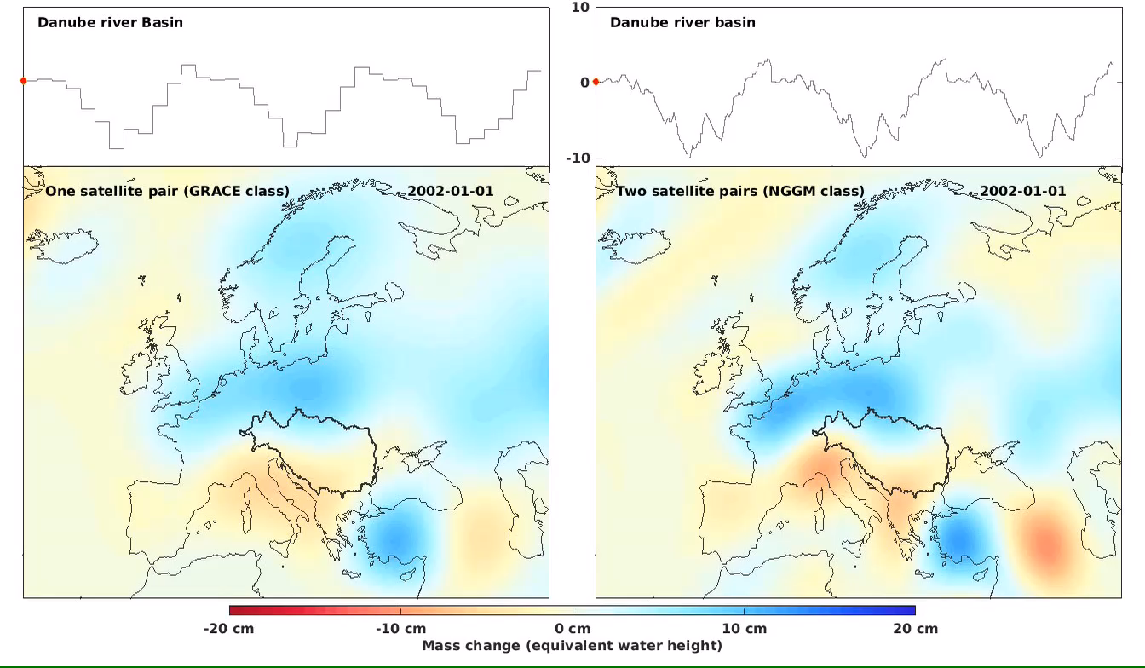
Example of simulation results over Europe
30 days “GRACE” type
3 days double pair

Slide 12
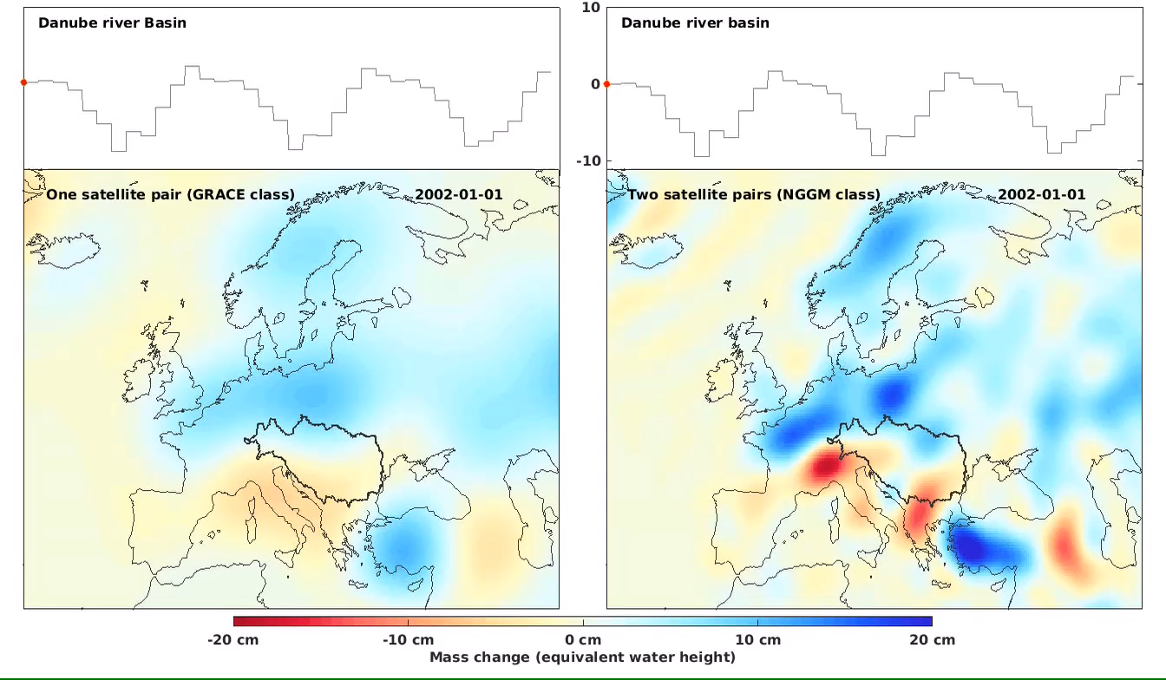
Example of simulation results over Europe
30 days “GRACE” type
30 days double pair

Slide 13
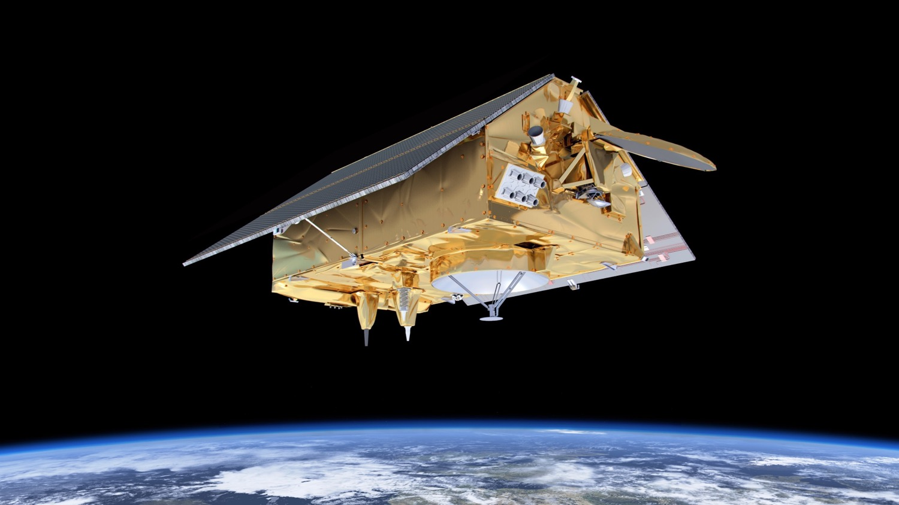

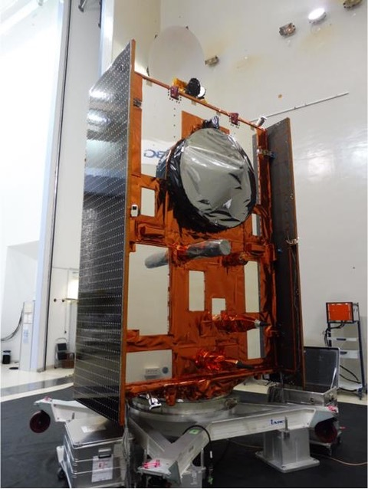


Sentinel-6 Michael Freilich
Launch in 2020
Radar altimetry from non-sun-synchronous orbit (h=1336 km, I=66°) with 10 day repeat cycle
Instruments: SAR altimeter, climate-quality microwave radiometer, precise orbit determination and radio-occultation receivers

Slide 14
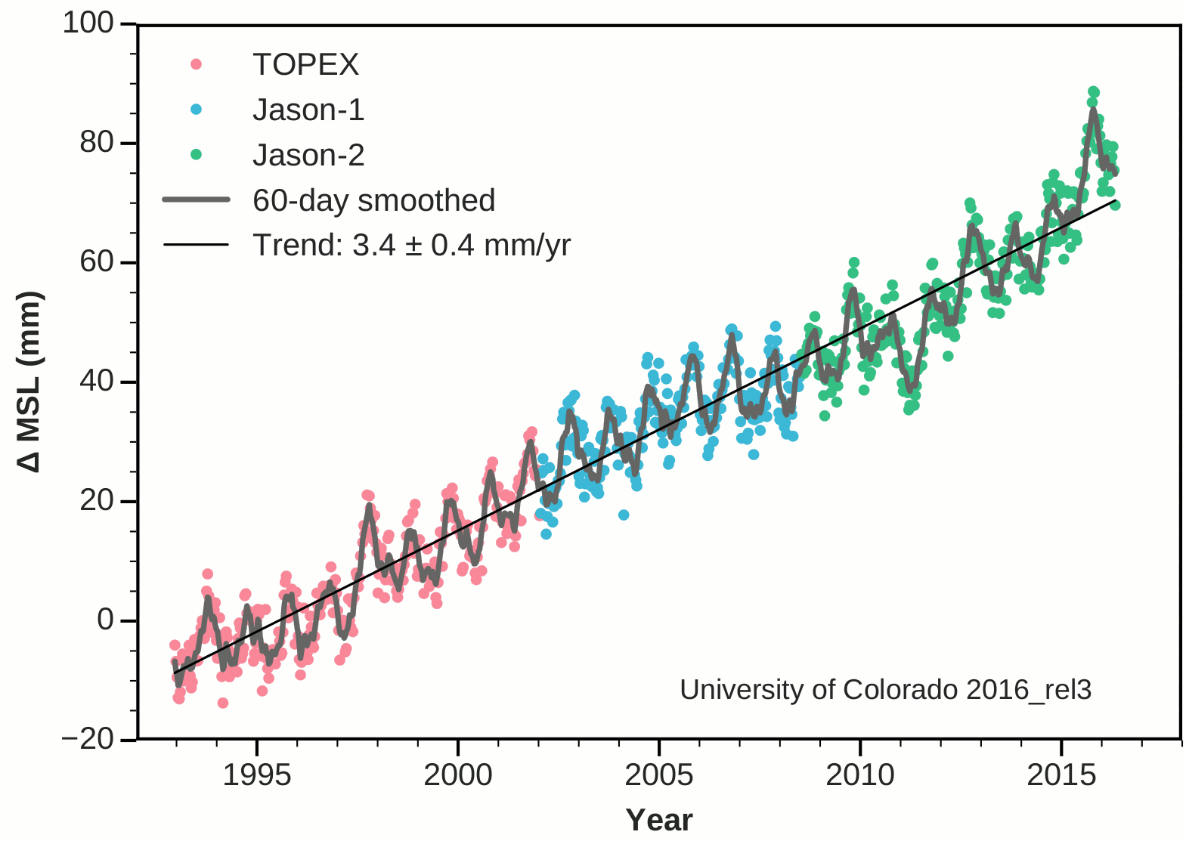
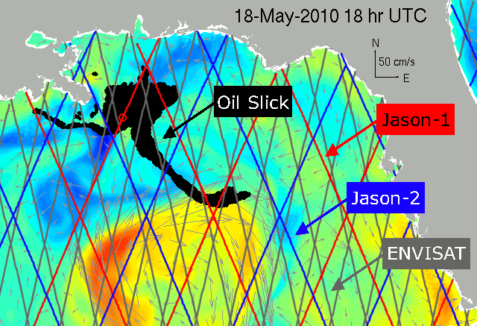
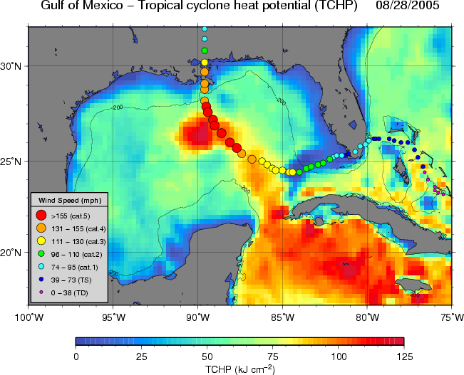
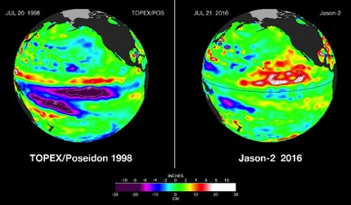
Sentinel-6 Main Science Objectives
Globally Averaged Sea Level Rise
Near Real Time Surface Currents
Continue the time series of global and regional sea level change
Seasonal, inter-annual and decadal ocean variability
Coastal variability and its impact on ecosystems
Ocean weather-operational oceanography
Surface wave forecasting and evaluation
Hurricane intensity forecasting
Ocean Heat Content & Tropical Cyclones
El Nino/La Nina monitoring

Slide 15
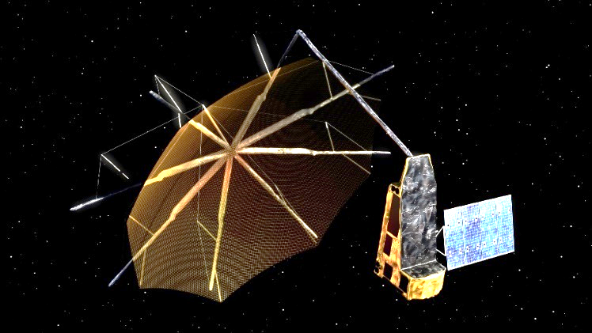
NASA support for ESA Biomass Reflector development
Provides NASA/JPL expertise, to assist the ESA Biomass project’s Large Deployable Reflector (LDR) procurement, development, integration and test, and risk assessment throughout implementation.
Cooperative activity from contractor selection through LDR deployment and checkout
Joint ESA and NASA/JPL team overseeing LDR build at Harris Corporation in Florida
Mission Objective - Take stock of the biomass in the world’s forests and monitor its evolution
Single satellite/single payload mission
P-band (435 MHz) Synthetic Aperture Radar (SAR), 6 MHz bandwidth
12 m diameter deployable reflector
Full polarimetric SAR
Multi-pass interferometry
Sun-synchronous 666 km orbit
1250 kg - VEGA launch
5 years lifetime
LRD –Q4 2022

Slide 16
SG2: Calibration/Validation and Field Campaigns Malcolm Davidson (ESA) Mark Drinkwater (ESA) Jack Kaye (NASA)

Slide 17
SG-2: Calibration/Validation and
Field Campaigns
Objectives:
Coordinated Cal/Val field work for current, future, or potential ESA & NASA satellite missions
Focused coordination on data utilization and integration that requires participation from both ESA and NASA satellite and research communities
Share results and build connections that can further community understanding and participation in activities
Collaboration/Coordination activities:
Provide for laboratory calibration of relevant sensors
Provide opportunities for one party’s instrument to fly aboard the other’s platform
Provide for jointly implemented airborne field work (e.g., both parties bring platforms to same place)
Provide for coincident under flight of one party’s satellite as part of other’s campaign
ESA UNCLASSIFIED – For Official Use
European Space Agency

Slide 18
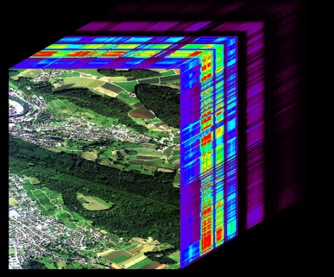
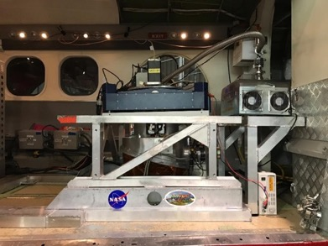
Some highlights from recent and upcoming activities
Pursuing opportunities provided by new missions and associated science
Preparation for new Copernicus High Priority Copernicus Missions (HPCM) has led to large-scale collaboration on two pan-European campaigns
European Hyperspectral Campaign 2018 and SBG-CHIME 2020 (now 2021)
European Hyperspectral Thermal Emission Campaign 2018 and 2019 (Net-Sense)
Launch of Aeolus mission has led to dedicated activities (underflights) including joint field campaigns in 2020 (now delayed to 2021)
Continued collaboration on Pandonia Global Network (PGN) and focused activities on S5p cal/val
Continued collaboration on FLEX & Ecosystem Science incl. potential 2021 French Guyana campaign
Enabling new innovative EO science
Collect more systematically science output of joint campaign activities e.g. scientific publication lists for FLEX, AfriSAR
MAPS (Methane Arctic Permafrost Study) coordinated effort
New science opportunities through CryoSat-2 orbit alignment with IceSat-2
ESA observer in NiSAR SDT/NASA observers in Earth Explorer and HPCM MAGs
Cross-cutting elements with other subgroups
AfriSAR campaign data integrated in MAAP developments (Subgroup 3)
AVIRIS-NG Image Cube
HyTES TIR Airborne Instrument
Notes:
Added PGN
Need to add LPS Session summary slide from Jack

Slide 19
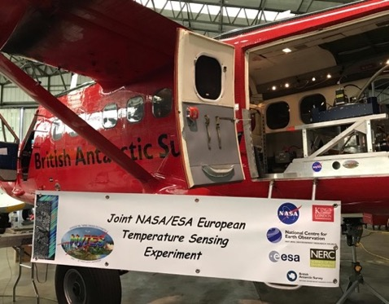
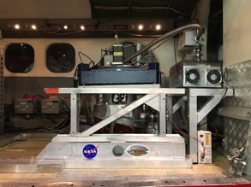

Hyperspectral Thermal Emission Spectrometer (HyTES) 2019-2020 European Campaign (1)
Multi-sensor, multi-mission & insitu campaign in support of ESA FLEX mission & Sentinel-3 calval
Observe instrumented agricultural targets in Italy and the UK
Observations with airborne HyPLANT fluorescence imaging sensor
Observe geo-thermal targets near Grosetto, Italy
Underfly ECOSTRESS, ASTER, Landsat and Sentinel 3 satellite
Provide pathfinder data for future ESA Copernicus expansion TIR mission (LSTM)
Observe controlled-burn fire target and smoke plume in Italy.
Multiple passes from ignition till completion.
Produce quicklook L1A radiance images daily in the field
Process to L1B and L2 surface temperature and emissivity at JPL
Produce L3 products for select scenes
Prepare for follow-on campaign in 2020 (now delayed to 2021)
HyTES in BAS Twin Otter
HyTES Instrument

Slide 20
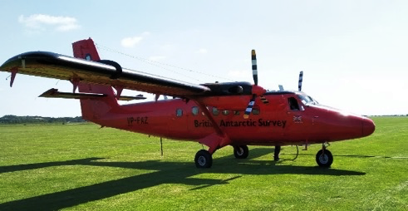
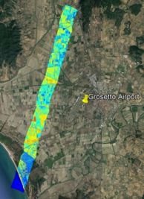
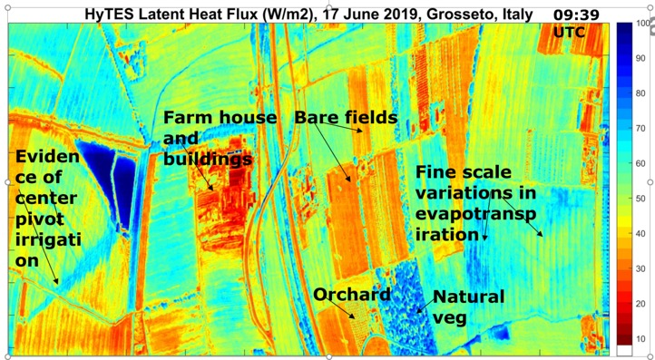
Hyperspectral Thermal Emission Spectrometer (HyTES) 2019-2020 European Campaign (2)
Objectives:
Document the predictive power of LST and other remote sensing parameters for early detection of drought stress in vegetation.
Quantify the foreseen error limits per pixel, per land use class and at European field scale
Quantify sensitivity of mission to systematic and random errors separately
Timeline:
Space Act Agreement in Place 05/01/19
Ship to UK 05/17/19
Install in BAS Aircraft 06/14/19
Transit to Italy 06/16/19
Campaign in Grosetto/Siena 6/16-6/25
Return to UK 06/27/19
UK Flights 6/28-6/30
All data processed to L2 03/20/20

Slide 21
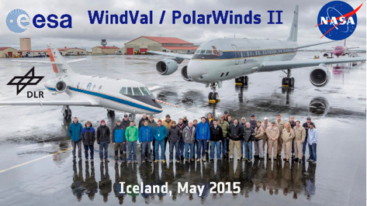
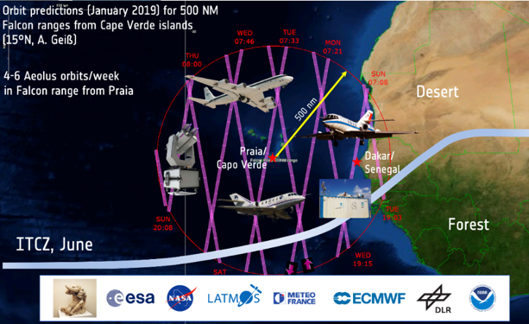
Joint 2020 Tropical ESA and NASA Aeolus Validation and Science Campaign (postponed to 2021)
Building on the Windval-I/Polarwinds-II campaign in 2015, NASA CPEX 2017 campaign and upgraded NASA DAWN lidar instrument & test flights in 2019
Objective to provide correlative observation between Aeolus and the airborne wind lidar instruments supporting Aeolus Validation, including Aeolus response calibration and observations over varying albedos
Focus on tropical wind systems (e.g., Easterly Waves, ITCZ), aerosols, (e.g., Sahara dust), tropical clouds systems, convection and organisation
Campaign from Cape Verde for the specific investigation of the Saharan Air Layer (SAL), African Easterly Waves and Jets (AEJ), Tropical Easterly Jet (TEJ, 10 km), deep convection in ITCZ
International collaboration DLR Falcon-20, NASA DC-8 and additional aircraft with (wind) lidar payloads and in-situ instruments, and ground based measurements activities with strong aerosol component
Intensive field campaign period several weeks within mid-June to mid-August 2021
19/20 nodal syc Scenario

Slide 22
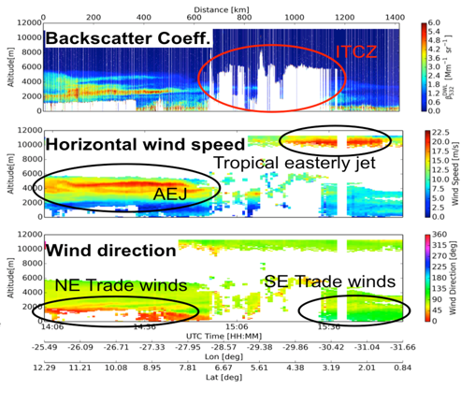
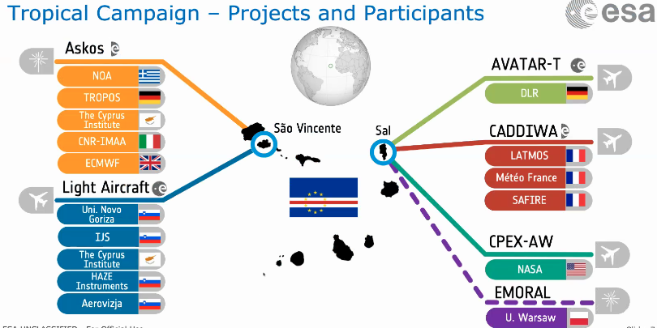
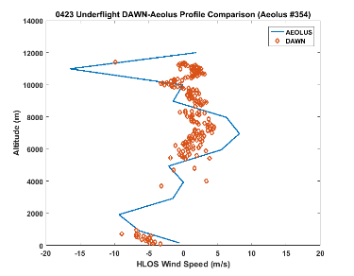
CPEX-AW as Part of ESA Tropical Campaign (now 2021)
NASA Contribution: Convective Processes Experiment-Aerosols & Winds (CPEX-AW)
Confirmed Instruments on NASA’s DC-8 Aircraft:
DAWN: (Doppler Aerosol WiNd lidar)
HALO: (High Altitude Lidar Observatory)
Dropsondes:
APR-3: (Airborne Precipitation & Cloud Radar 3rd Gen.)
HAMSR: (High Altitude Monolithic Microwave integrated Circuit (MMIC) Sounding Radiometer)
DAWN Projected Onto Aeolus Line of Sight Wind and Compared With Aeolus LOS

Slide 23
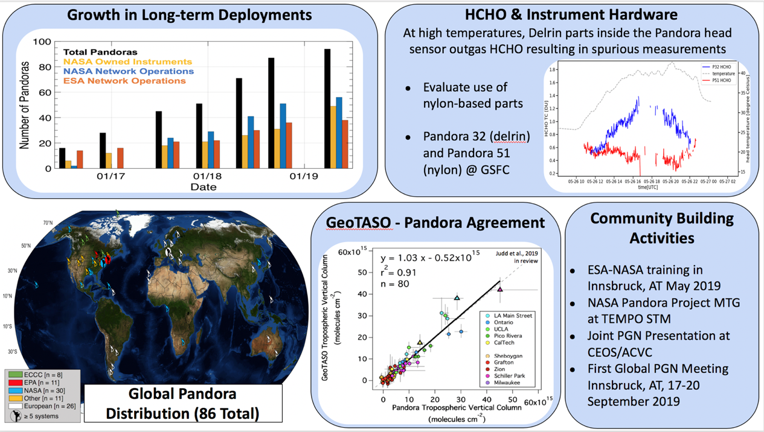
ESA/NASA Pandonia Global Network

Slide 24
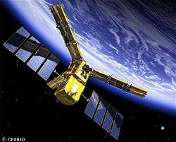
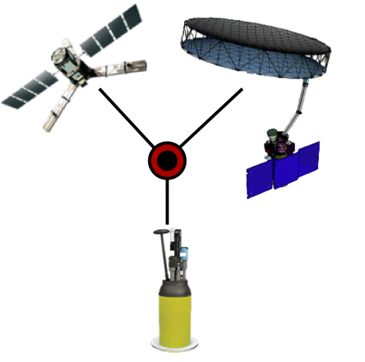
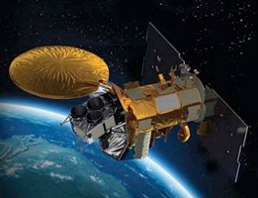
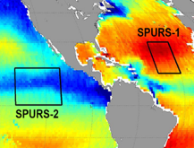

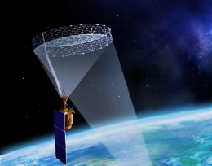

Joint Satellite Salinity Validation & Exploitation Platform
Goal: Enhance validation & exploitation of satellite salinity data across ESA & NASA missions by combining expertise to provide a common validation framework & interactive analysis tools for studying salinity processes in key dynamic regimes.
Multi-mission
Contributions
Collaboration
SMOS
Recent Progress:
Announcement: OceanObs’19, September 2019
Identified consistent criteria for match-up between satellite & in-situ salinity measurements (endorsed by NASA OSST).
Developed a process study page for NASA SPURS-2 field campaign region, being integrated into the platform together with SPURS-2 in situ data.
Triple-point collocation analysis code for uncertainty estimation is being tested; rudimentary implementation into the platform soon.
Future Plan:
Implement satellite & in-situ data match-up using criteria developed.
Develop a process study page for NASA SPURS field campaign region and incorporate SPURS data into the platform.
Mature triple-point collocation analysis tool.
Develop interactive data analysis using Jupyter Notebook.
triple
point
co-
location
analysis
tool
Aquarius
NASA Field Programs
SMAP
SMAP
notebook
Integration
with
interactive
analysis
Notes:
Triple point collocation analysis is an analysis tool for inversely estimating the uncertainties of three independent datasets (e.g., 2 satellites and 1 in-situ) on the spatial scales of satellite measurements.
The collaboration paves the way for producing multi-mission salinity synthesis products and developing requirements for potential Sentinel-like future ESA-NASA salinity missions (e.g., CIMR)

Slide 25
SG-3:Ground Segments and Data Henri Laur (ESA) Kevin Murphy (NASA)

Slide 26
SG-3:Ground Segments and Data
Objectives:
Exchange basic information on ESA and NASA Earth Observation missions and suborbital campaigns and related Ground Segments and Data
Identify key strategic issues for coordination with Ground Segments and Mission Data
Develop and implement opportunities for joint activities on Ground Segments and Mission Data
Collaboration/Coordination activities:
Data exchange: MERIS & MODIS, SEASAT & ERS, Sentinel data
Technical interfaces: ESA-NASA technical operating agreement for Copernicus data, co-developed CEOS OpenSearch common standard, open source cloud architecture
Joint projects: Joint Mission Algorithm and Analysis Platform (Joint MAAP)
ESA UNCLASSIFIED – For Official Use
European Space Agency

Slide 27
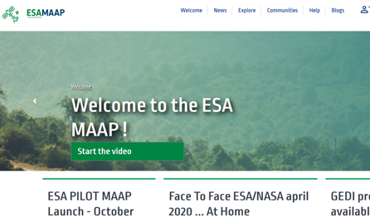
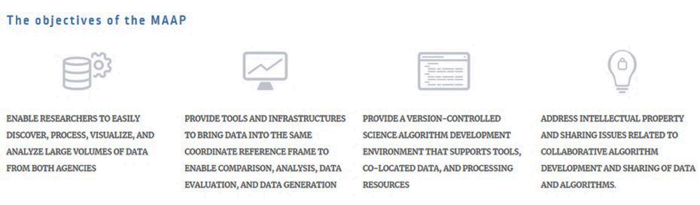
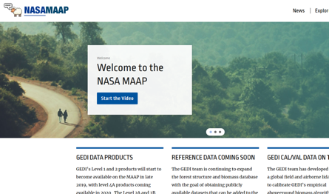
ESA/NASA Joint Program Planning Group SubGroup-3: Ground Segments and Data
Some recent activities
MAAP for Biosphere
The ESA-NASA Joint Multi-Mission Algorithm and Analysis Platform (MAAP) is a collaborative project focused on improving the understanding of aboveground terrestrial carbon dynamics.
The MAAP will provide a common platform with computing capabilities co-located with data and tools related to the ESA BIOMASS mission and the NASA GEDI and NISAR missions.
Opening in early 2021
ESA UNCLASSIFIED – For Official Use
European Space Agency

Slide 28
ESA/NASA Joint Program Planning Group SubGroup-3: Ground Segments and Data
Some recent activities
Coordinated evaluation of Third Party mission data
ESA and NASA recognize the potential of new space companies for providing unique EO capabilities. The global research and application communities should have access to and be able to trust these products.
NASA and ESA:
Coordinate respective independent evaluations performed by each agency,
Develop non-binding best practices on evaluation, identify common guard rails for comparison of data,
Coordinate on data licenses for data purchased and related issues for facilitating data use.
ESA UNCLASSIFIED – For Official Use
European Space Agency

Slide 29
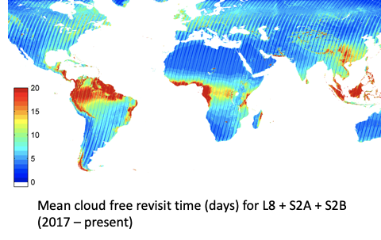
ESA/NASA Joint Program Planning Group SubGroup-3: Ground Segments and Data
Some recent activities
Harmonized Landsat Sentinel-2 product
Goal: For NASA to produce a global gridded 30-meter resolution surface reflectance data from Landsat-8 and Sentinel-2 missions.
This paves the road for a stronger collaboration on future US Landsat missions and European Next-Generation Sentinel-2 missions.
ESA UNCLASSIFIED – For Official Use
European Space Agency

Slide 30
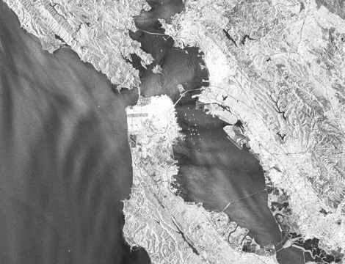
ESA/NASA Joint Program Planning Group SubGroup-3: Ground Segments and Data
Some other activities
Sentinel data mirroring in US (with European Commission and ESA)
NASA SMAP mission contribution to ESA SMOS Salinity Mission Exploitation Platform
ESA CryoSat orbit adaptation to NASA ICESat-2 orbit pattern over polar regions to increase synergy between the 2 missions (planned in 2020)
EO data stewardship: → Common approach on EO data preservation content, → Co-developed CEOS OpenSearch Best Practices as a common standard for interoperability of catalogues
Sentinel-1
San Francisco
(27 April 2020)
Copyright: Contains modified Copernicus Sentinel data (2020)
ESA UNCLASSIFIED – For Official Use
European Space Agency

Slide 31

IMBIE: Ice Sheet Mass Balance
Inter-comparison Exercise
New IMBIE Greenland assessment
seven-fold increase in ice loss rate since 1990s
3.8 trillion tonnes lost between 1992-2018
already 10.6mm contribution to global sea level rise
rate of loss tracks IPCC high-end climate warming scenario, which predicts an additional 7cm of sea level rise by 2100
an extra 40 million people at risk of coastal flooding
"Mass balance of the Greenland Ice Sheet from 1992 to 2018”, Andrew Shepherd, Erik Ivins, etal, Nature, 2019
ESA UNCLASSIFIED – For Official Use
European Space Agency
Notes:
***UNDER EMBARGO UNTIL 17:00 CET, 10 December 2019***
Tomorrow [December 10] the Ice Sheet Mass Balance Inter-comparison Exercise (IMBIE) - supported by ESA’s Climate Change Initiative and its Science for Society Programme - will release the most complete and assessment of Greenland ice sheet in the journal Nature.
The assessment shows:
- Greenland ice sheet is losing mass seven times faster than in the 1990s.
Greenland lost 3.8 trillion tonnes of ice between 1992 and 2018 – enough to push up global average sea level by 10.6mm. From 33 billion/tonnes per year in 1990s TO 254 billion tonnes per year in the last decade.
IMPORTANTLY, the rate of loss over the study period tracks the IPCC high-end climate warming scenario, which predicts an additional 7cm of global average sea level rise. This puts an additional 40 million people at risk of coastal flooding by the end of the century.
The IPCC’s central climate warming scenario predicts that global sea levels by 2100 could put put 360 million people at risk of annual coastal flooding. The additional contribution based on the IMBIE findings suggests 400 million people will be affected
IMBIE is:
a major international collaboration supported by ESA and NASA
compared and combined data from 11 satellites - including ESA’s ERS-1, ERS-2, Envisat and Cryosat-2 missions and the Copernicus Sentinel-1 and Sentinel-2 missions
Data used to monitor changes in the ice sheet’s volume, flow and gravity.
Aims to condense historic and contemporary understanding and estimates into a single estimate of the Greenland’s net gain or loss of ice, known as mass balance.

Slide 32
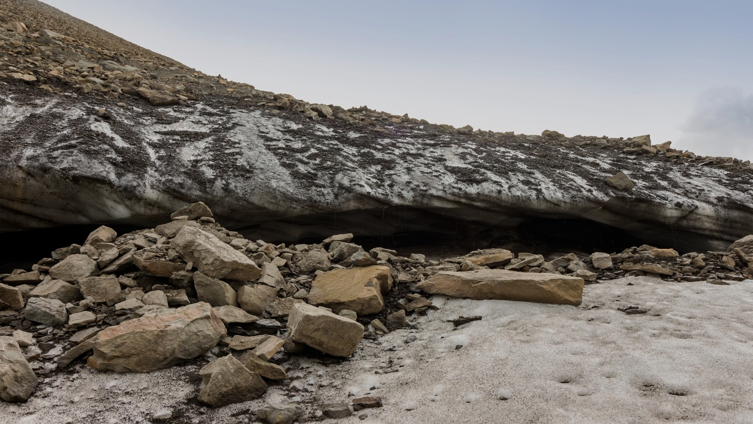

Arctic Methane Challenge
To estimate and understand the magnitude and dynamic evolution
of Arctic methane emissions
Joint community initiative
Foster scientific collaboration and networking across the Atlantic
Enhance current EO capabilities, methods, products and science
Deliver a community response to one of the main scientific challenges of the next decade
Contact:
Diego Fernandez Prieto | ESA Chip Miller | NASA
ESA UNCLASSIFIED – For Official Use
European Space Agency
Notes:
Joint community initiative to investigate the linkages between permafrost degradation and Arctic methane emissions
Foster scientific collaboration and networking across the Atlantic to enhance current EO capabilities, methods, products and science
To deliver a community response to one of the main scientific challenges of the next decade: Estimate and understand the magnitude and dynamic evolution of the Arctic methane release to the atmosphere

Slide 33
International Cooperation during COVID-19
International cooperation will involve joint utilisation of data from ESA and NASA EO missions and coordinated observations, scientific work and joint presentation of results
Cooperation extended to JAXA and use of data from JAXA EO missions
Topics include impact of the lockdown on air quality and climate change (e.g. NO2 and CO2) and on monitoring the economic impacts on land (e.g. factories and transport infrastructure)
Promote the use of EO data as a means to provide focus on human interactions in the environment and to support the integration of socioeconomic and earth science data.
Cooperation involves short-term actions (e.g. preparation of a Joint Dashboard with EO-based results) and longer-term scientific cooperation
ESA UNCLASSIFIED – For Official Use
European Space Agency
Notes:
JAXA
JAXA has proposed to ESA on the 2 April to cooperate on EO Applications and COVID-19
Initial discussion planned on possible joint use of ESA and JAXA missions and data
JAXA could provide GOSAT-2 CO₂ data, ALOS 2 data and, possibly other satellite capabilities
Meeting with JAXA is planned on 14 April
NASA
Meeting between NASA Administrator Jim Brindestine and ESA DG was organised on 3 april (with D-EOP)
NASA Administrator underlined that this pandemic is an opportunity to observe and monitor the Earth System and noted the reduction of NO2 level.
It was agreed to organise a dedicated meeting between the Associate Administrator Thomas Zurbuchen and Josef Aschbacher to discuss potential coordination and cooperation on EO and COVID-19
Cooperation could involve possible joint utilisation of data from ESA and NASA missions, coordinated observations, impact of forecasts, cloud formation etc.
Meeting with NASA is planned on 14 April.

Slide 34
Conclusions and Way Forward
ESA-NASA JPPG cooperation started in 2010 and fully operational
Demonstrated valuable results (Joint preparation of missions, IMBIE, Sentinel 6 ”Michael Freilich”, joint campaigns & under-flights, preparation for common data exploitation)
Foster the scientific international collaboration between US and Europe
Ensure maximum integration and complementarity of the ESA-NASA EO programmes (e.g. NASA Decadal Survey, ESA EOEP/FutureEO, Copernicus)
ESA UNCLASSIFIED – For Official Use
European Space Agency
Notes:
JAXA
JAXA has proposed to ESA on the 2 April to cooperate on EO Applications and COVID-19
Initial discussion planned on possible joint use of ESA and JAXA missions and data
JAXA could provide GOSAT-2 CO₂ data, ALOS 2 data and, possibly other satellite capabilities
Meeting with JAXA is planned on 14 April
NASA
Meeting between NASA Administrator Jim Brindestine and ESA DG was organised on 3 april (with D-EOP)
NASA Administrator underlined that this pandemic is an opportunity to observe and monitor the Earth System and noted the reduction of NO2 level.
It was agreed to organise a dedicated meeting between the Associate Administrator Thomas Zurbuchen and Josef Aschbacher to discuss potential coordination and cooperation on EO and COVID-19
Cooperation could involve possible joint utilisation of data from ESA and NASA missions, coordinated observations, impact of forecasts, cloud formation etc.
Meeting with NASA is planned on 14 April.

