Slide 1
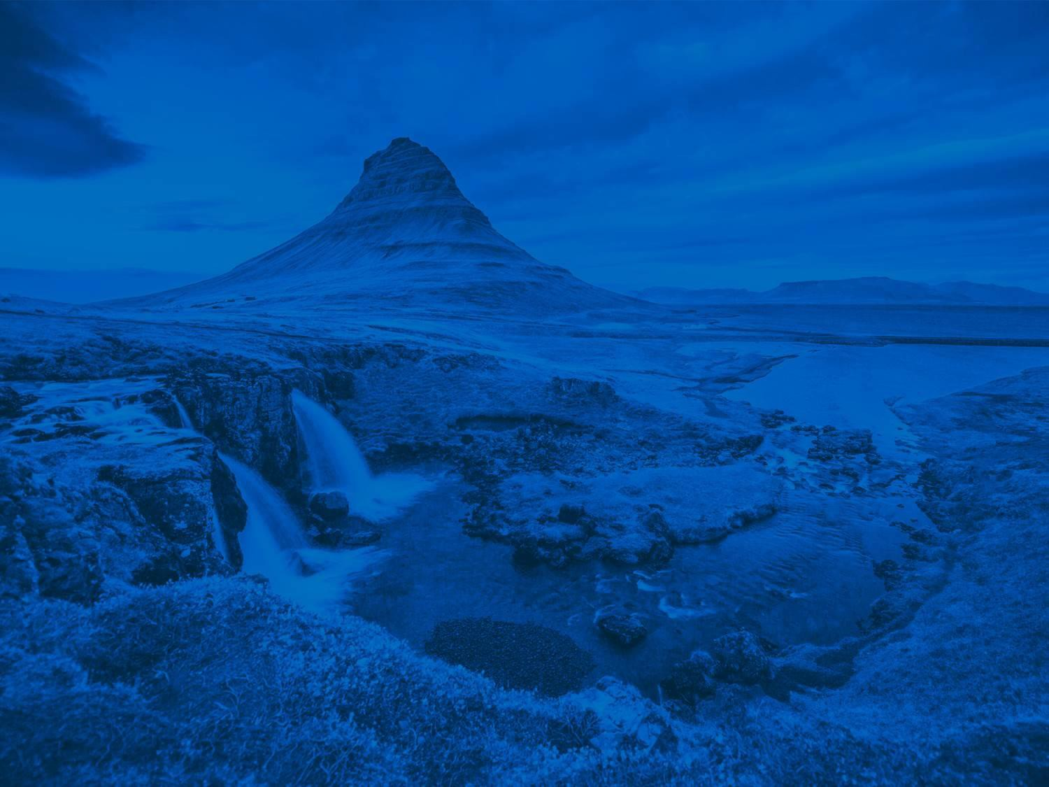

EMRP Division Meeting
Fabio Florindo, Eric Font, Sergio Vinciguerra, George Balasis and Anita Di Chiara
Sharing Geosciences online
Wed, 06 May,
12:45–13:45 (chat)
Meetings | Publications | Outreach | www.egu.eu

Slide 2

AGENDA
Approval of the Agenda
Division President elections
Report on the Activities of EGU and the Division
#shareEGU20 & EMRP
EMRP Medal Committees, Medallists, Awards
Division Officers
Early Career Scientists Activities
EGU Publications
Any other business

Slide 3
AGENDA
Approval of the Agenda
Division President elections
Report on the Activities of EGU and the Division
#shareEGU20 & EMRP
EMRP Medal Committees, Medallists, Awards
Division Officers
Early Career Scientists Activities
EGU Publications
Any other business

Slide 4
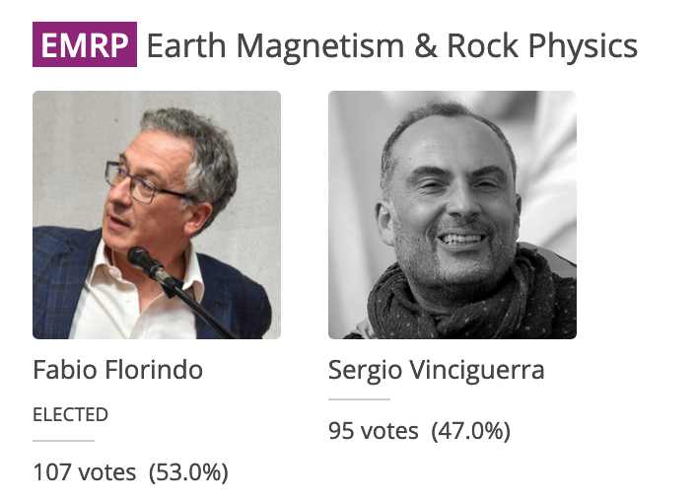
2. Division President elections
Elections in Autumn 2019
EMRP President : there were two candidates
Fabio Florindo elected for the second term.
He will serve as Division President for the term 2021–2023.
_______________
New EGU president: Helen M. Glaves
will become
- Vice president at the GA 2020
- EGU president at the GA 2021

Slide 5
AGENDA
Approval of the Agenda
Division President elections
Report on the Activities of EGU and the Division
#shareEGU20 & EMRP
EMRP Medal Committees, Medallists, Awards
Division Officers
Early Career Scientists Activities
EGU Publications
Any other business

Slide 6
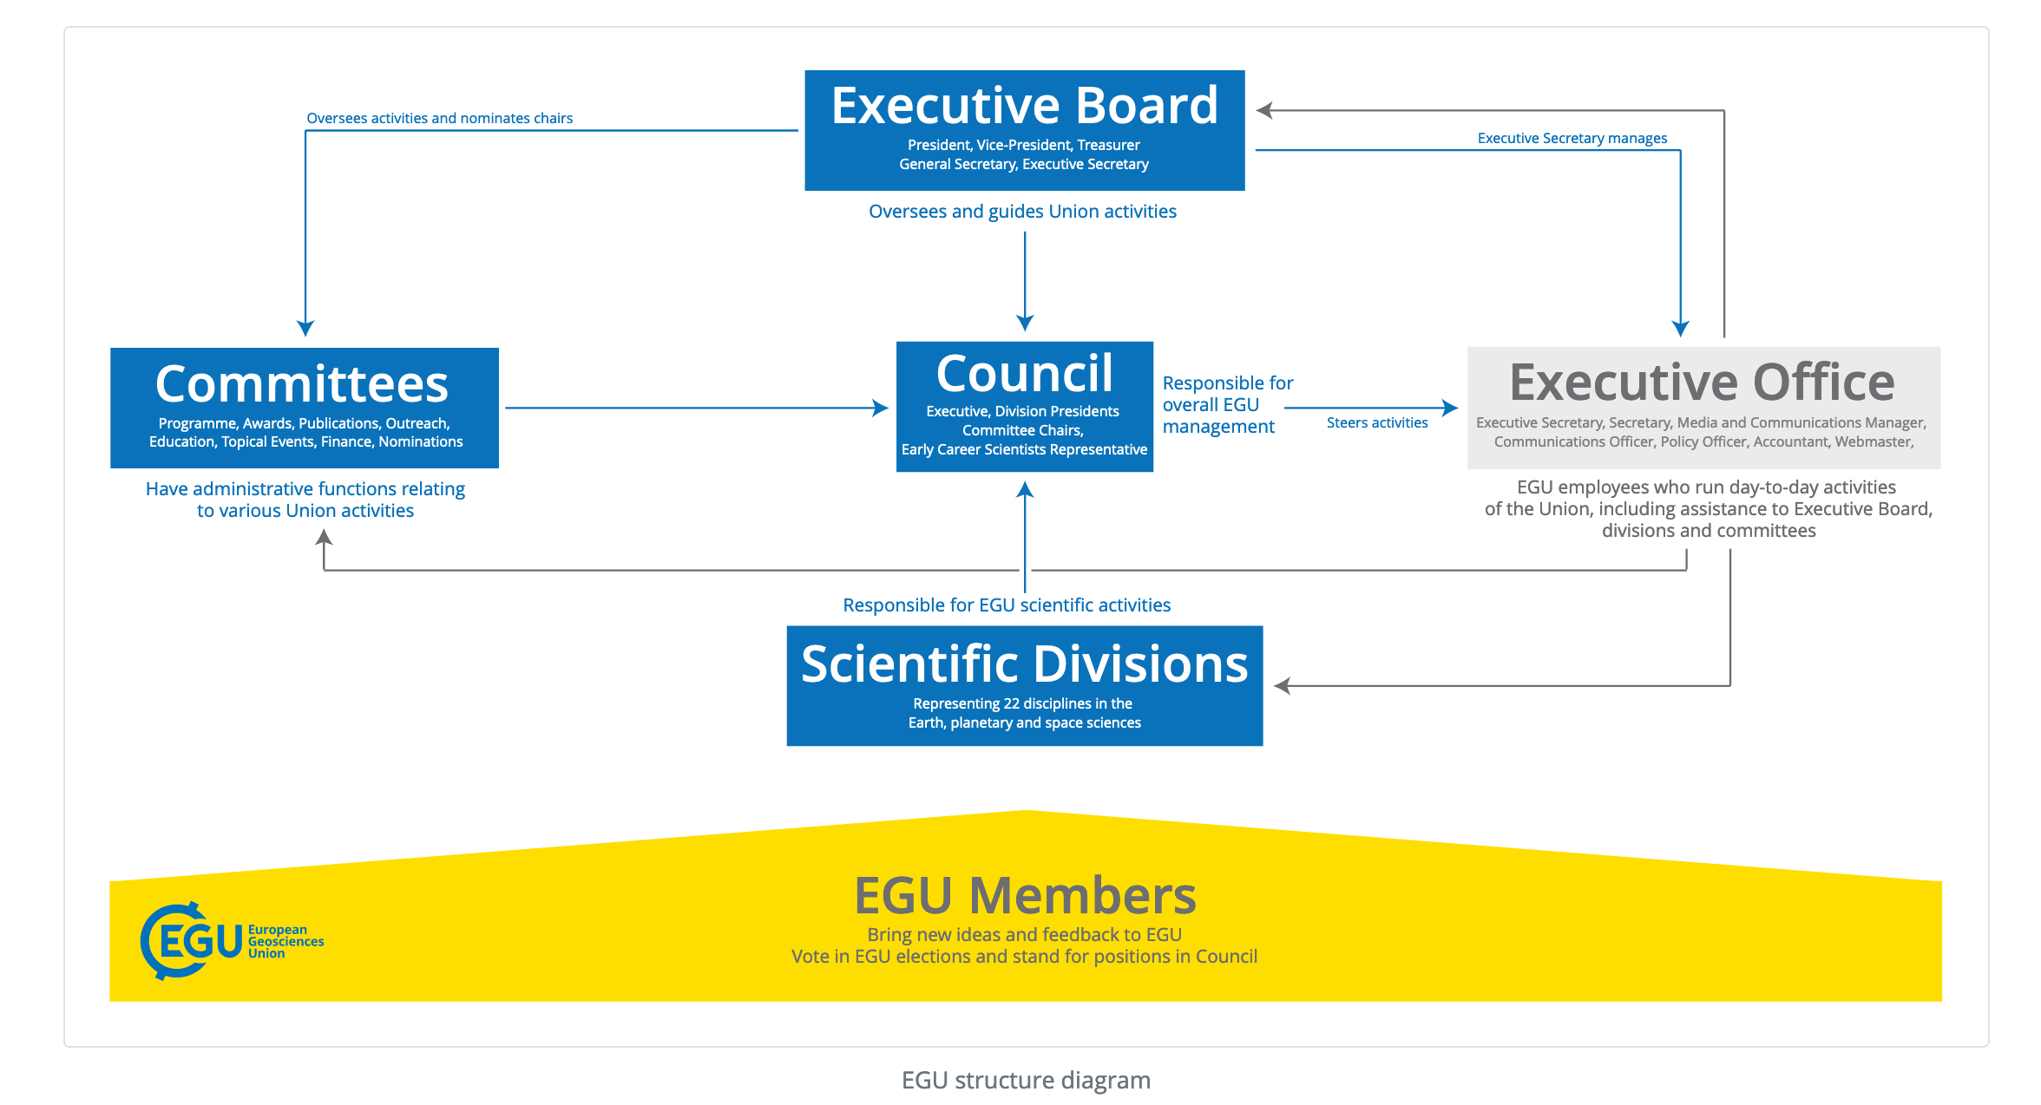
3. Report on EGU and Division Activities

Slide 7
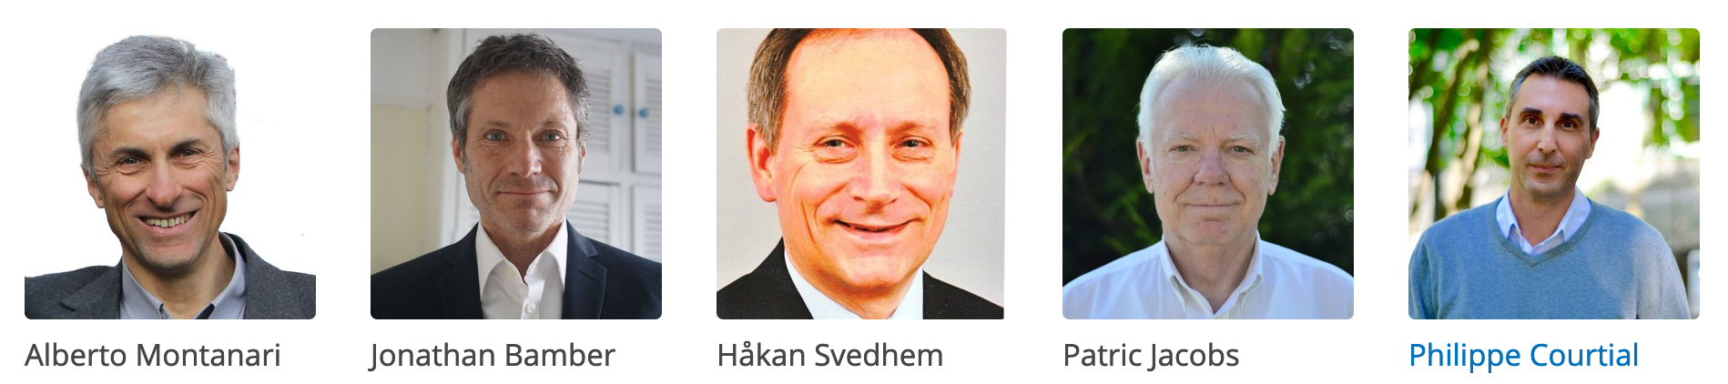
3. Report on EGU and Division Activities
EGU Executive Board
EGU President: Alberto Montanari
Vice-President: Jonathan Bamber
General Secretary : Håkan Svedhen
Treasurer: Patric Jacobs
Executive Secretary: Philippe Courtial

Slide 8
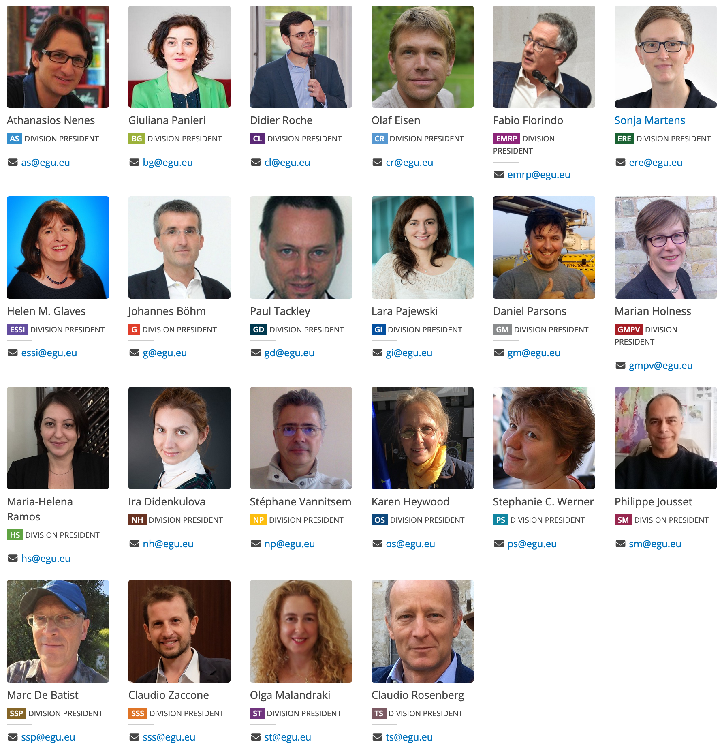
3. Report on EGU and Division Activities
EGU Union Council: Executive Board + Division Presidents (22)

Slide 9
Main EGU Activities
3. Report on EGU and Division Activities
General Assembly into #shareEGU20
Online chat vs sessions
Displays instead of Orals, posters and PICOs
Publications:
EGU Journals: 19 open access and peer reviewed journals
EGUsphere (https://www.egusphere.net/)

Slide 10
Main EGU Activities
3. Report on EGU and Division Activities
Awards (no OSPP prize this year and Medal lectures during #EGU21 (when we’ll have double)
Outreach and Education

Slide 11

Committees
3. Report on EGU and Division Activities
Awards Committee Chair: Özgür Karatekin (awards-medals@egu.eu)
Coordinates EGU medal committees and proposes medal recipients to the Council
Education Committee Chair: Chris King (education@egu.eu)
Coordinates the EGU activities related to secondary and tertiary education
Finance Committee Chair: Patric Jacobs (treasurer@egu.eu)
Coordinates EGU finances and proposes budget to the Council
Nominations Committee
Oversees the various nomination processes related to EGU elections and awards and medals
Outreach Committee Chair: Mioara Mandea (outreach@egu.eu)
Coordinates outreach activities as stipulated by By-Laws 1.5 and 1.6
Programme Committee Chair: Susanne Buiter (programme-committee@egu.eu)
Coordinates the scientific programme of the General Assemblies including travel support
Publications Committee Hubert H.G. Savenije (publications@egu.eu)
Coordinates the EGU journals and other publications
Topical Events Committee Jürg Schweizer (topical-events@egu.eu)
Coordinates activities related to topical meetings, conference series, workshops and training schools

Slide 12
Meetings, Medals & Early Career Scientists
3. Report on EGU and Division Activities
Meetings Calendar
A hub of information on conferences and workshops in the geosciences at www.egu.eu/meetings/calendar. You can also post your meeting
Awards & Medals
Awards & medals nominations for the year 2021 are currently open. The deadline for submissions is 15 June http://www.egu.eu/awards-medals
Early Career Scientists
Early Career Scientist [ECS] can find out how to get involved in the Union & benefit from our ECS resources at www.egu.eu/ecs
Jobs
The EGU offers a platform for job seekers to find vacancies in the Earth, planetary and space sciences at www.egu.eu/jobs. Add yours, or look for a new position

Slide 13
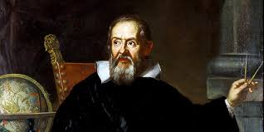
EGU Galileo conferences e co-sponsored Meetings
EGU Galileo Conferences
The EGU Galileo Conferences address well-focused cutting-edge topics at the frontier of geosciences research. The conferences are informal: the state-of-the-art is outlined in keynote presentations designed to trigger in-depth discussion of important aspects of the conference topic. EGU provides full organisational support to the EGU Galileo Conferences, thereby allowing organising committees to focus on the scientific aspects of the conference.
Submission periods are usually from 1. December until end of February of the following year (4 months in total)
EGU Co-Sponsored Meetings
The EGU meetings programme is dedicated to the pursuit of progress in all areas of the Earth, planetary and space sciences through the co-sponsoring of a number meetings. We strive for excellence in the organisation and running of conference series, topical meetings, workshops, training schools and external meetings for the benefit of all scientists. We pay special attention to the needs of early career researchers, and help organisers achieve financial stability, visibility, and/or access to a larger target community.
Details here: https://www.egu.eu/meetings/support-request/
Submission periods are usually from 1. June – 15. August every year
https://www.egu.eu/meetings/

Slide 14
AGENDA
Approval of the Agenda
Division President elections
Report on the Activities of EGU and the Division
#shareEGU20 & EMRP
EMRP Medal Committees, Medallists, Awards
Division Officers
Early Career Scientists Activities
EGU Publications
Any other business

Slide 15
4. #shareEGU20 & EMRP
Sharing Geoscience Online: New concept
Online? Yes! Because it is EGU’s responsibility to help minimise the impact of COVID-19 on scientific research and collaboration
Pilot experiment (we would like feedback!)
Free registration

Slide 16
4. #shareEGU20 & EMRP
Sharing Geoscience Online in a nutshell
Our concept of Sharing Geoscience allows:
Authors to upload presentation materials and receive feedback on those from 1 April to 31 May 2020)
Conveners, authors and attendees to discuss abstracts, presentation materials and open questions during a live, text-based chat (4 – 8 May)
Everyone to participate in Union Symposia, Great Debates, Short Courses, Networking, Division Meetings, #shareEGUart, Photo Competition and more
EGU to gather experience with online activities and use these in plans for reducing the environmental impact of the General Assembly

Slide 17
4. #shareEGU20 & EMRP
Sharing Geoscience Online: New concept in very short time
16 March: Start developing concept for online activities
19 March: Cancelled physical General Assembly
23 March: First Sharing Geoscience Online webpages
31 March: All presentations turned to displays, rescheduled sessions to blocks of 30 displays
1 April: Open for upload of presentation materials and commenting & First FAQ page live
6 April: Webinar
8 April: SC plan
16 April: Open for upload of session materials & Division Meetings scheduled
21 April: ‘how-to-use-the chat’ pages
28 April: Chat video and test chat channels per programme group

Slide 18
4. #shareEGU20 & EMRP
Code of Conduct
Participation in EGU2020: Sharing Geoscience Online implies agreement to EGU's Code of Conduct, https://www.egu.eu/about/code-of-conduct/
The Code of Conduct is flagged when uploading materials, when commenting, when entering the chat
Violations or concerns to be reported to conduct@egu.eu

Slide 19

4. #shareEGU20 & EMRP
GA2020 statistics (as of 27 April 2020, 08:30)
18,052 abstracts in programme | +11.1% relative to 2019
702 unique scientific sessions
440 out of 702 scientific sessions are co-organized (62.7%)
6/88 short courses online
1,135 presentation materials uploaded
82 comments to uploaded presentation materials received

Slide 20
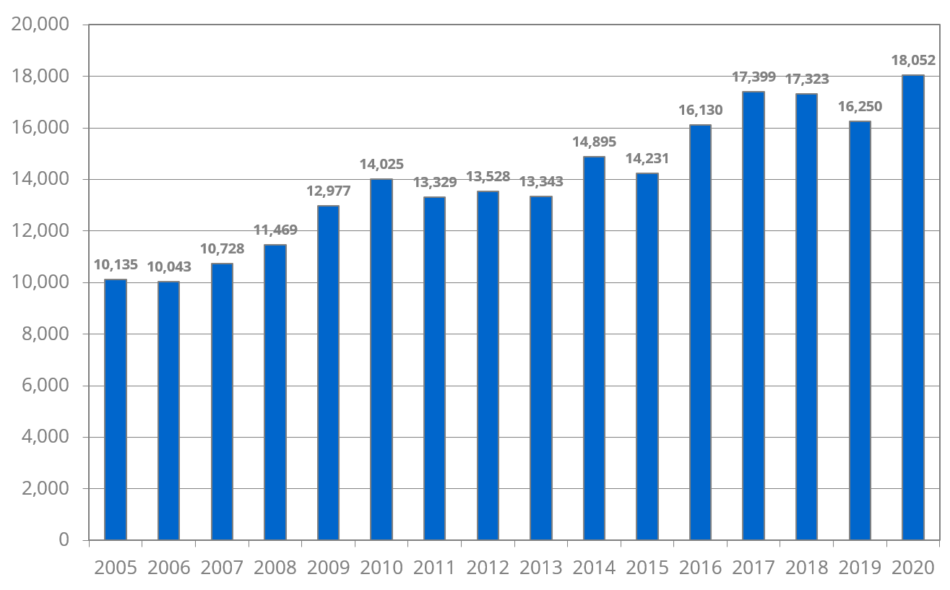
4. #shareEGU20 & EMRP
Abstracts in programme 2005 – 2020
a
c
b
2018: withdrawal of no-show abstracts
2019: one first-author abstract rule
2020: Physical GA cancelled 19 March; part of the GA brought online

Slide 21
4. #shareEGU20 & EMRP
EMRP abstracts 2020: 277 (+54%)
(9 lead sessions)
EMRP abstracts 2020: 868 (+8%)
(23 co-organiz sessions)
EMRP abstracts 2019: 180
(lead sessions)
EMRP abstracts 2019: 800
(co-organiz sessions)

Slide 22
Communication Activities at the General Assembly
4. #shareEGU20 & EMRP
EGU Today
Daily newsletter highlighting scientific sessions, short courses and other activities at the Assembly
Blogs
GeoLog, the EGU Blog Network & EGU Division Blogs will be sharing great sessions, research, interviews
Follow them at geolog.egu.eu and blogs.egu.eu
Social Media
Sessions will be advertised on Twitter (@EuroGeosciences) and Facebook (European Geosciences Union)
For behind the scenes access to the conference follow us on Instagram (@EuroGeosciences)
Participants can ask questions & keep updated by following #shareEGU20 and #shareEGU_emrp

Slide 23
AGENDA
Approval of the Agenda
Division President elections
Report on the Activities of EGU and the Division
#shareEGU20 & EMRP
EMRP Medal Committees, Medallists, Awards
Division Officers
Early Career Scientists Activities
EGU Publications
Any other business

Slide 24

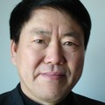
5. EMRP Medal Committees, Medallists, Awards
EMRP has two medals: Petrus Peregrinus and Louis Néel
EGU Petrus Peregrinus MEDAL
Established by the Division on EMRP in recognition of the scientific achievements of Petrus Peregrinus, to be awarded for outstanding scientific contributions in the field of geomagnetism, planetary magnetism and palaeomagnetism.
Medal Lecture: Postponed to 2021
The 2020 Medal is awarded to Prof. Rixiang Zhu for his outstanding accomplishments in magnetism and paleomagnetism and his extraordinary support of the scientific community.
COngratulATIONS!

Slide 25
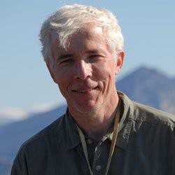
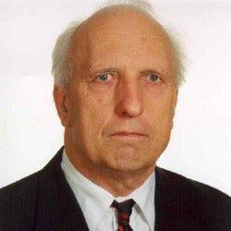
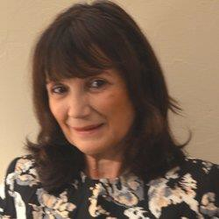
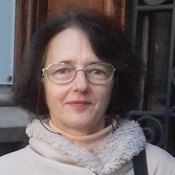
5. EMRP Medal Committees, Medallists, Awards
EGU Petrus Peregrinus MEDAL committee
Chair: John Tarduno,
Members: Agris Gailitis (terms end),
Mioara Mandea,
Catherine Kissel
Jonathan Aurnou (new member)

Slide 26

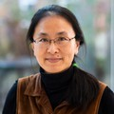
5. EMRP Medal Committees, Medallists, Awards
EGU Louis Néel MEDAL
Established by the Division on EMRP in recognition of the scientific achievements of Louis Eugene Felix Néel, who shared the 1970 Nobel Prize of Physics for his fundamental research and discoveries concerning antiferromagnetism. This medal is reserved for individuals in recognition of outstanding achievements in rock magnetism and rock physics.
Medal lecture : Postponed to 2021
The 2020 Louis Néel Medal is awarded to Wenlu Zhu for her exceptional contributions to understanding coupling between fluids and rock deformation and in recognition of her role in promoting women in science and rock physics globally.
COngratulATIONS!

Slide 27
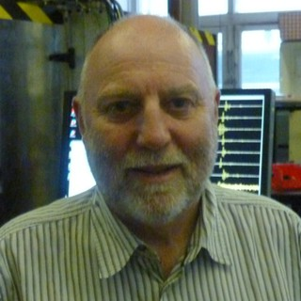
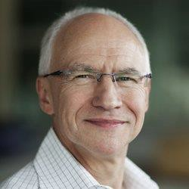
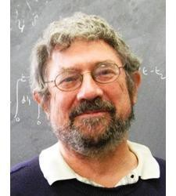
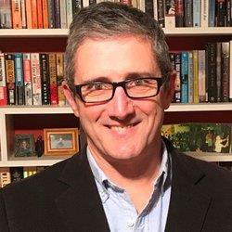
5. EMRP Medal Committees, Medallists, Awards
EGU Louis Néel medal committee
Chair: Philip Meredith
Members: Christopher J. Spiers, J. Michael Kosterlitz, and Chris Marone

Slide 28
5. EMRP Medal Committees, Medallists, Awards
New rules form the Awards Committee
EGU Council Meeting 13-14 Feb 2020
The following divisions medals are to be given
every two years only:
Earth and Space Science Informatics (ESSI)
Solar-Terrestrial Sciences (ST)
Earth Magnetism & Rock Physics (EMRP)
Planetary and Solar System Sciences (PS) already does this
________________

Slide 29
5. EMRP Medal Committees, Medallists, Awards
We start with the Petrus Peregrinus medal
to be assigned in 2021
Detailed guidelines for Union medals, Union awards, Union travel awards, Division medals and awards at www.egu.eu/awards-medals
Deadline for proposing candidates for 2020 is
15 June 2020 (awards.medals@egu.eu)

Slide 30
Early Career Scientists Awards
5. EMRP Medal Committees, Medallists, Awards
Union award
Arne Richter Award for Outstanding Early Career Scientists
(formerly Outstanding Young Scientist Awards)
Division award
Division Outstanding Early Career Scientists Award
General Assembly award
Outstanding Early Career Scientist Poster & PICO (OSPP) Awards (unfortunately this year will not be possible but will resume from next year)

Slide 31

5. EMRP Medal Committees, Medallists, Awards
Outstanding Student Poster & PICO Award 2019
3-4 OSPP Judges for each poster/PICO
OSSP is awarded to Leonie Pick for the PICO entitled:
"Historical geomagnetic storm drivers determined exclusively from ground-based magnetometer measurements”
(Pick, L.; Effenberger, F.; Zhelavskaya, I.; Korte, M.)
Leonie Pick

Slide 32
AGENDA
Approval of the Agenda
Division President elections
Report on the Activities of EGU and the Division
#shareEGU20 & EMRP
EMRP Medal Committees, Medallists, Awards
Division Officers
Early Career Scientists Activities
EGU Publications
Any other business

Slide 33
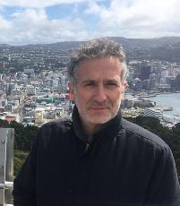

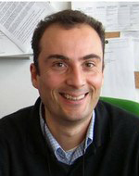
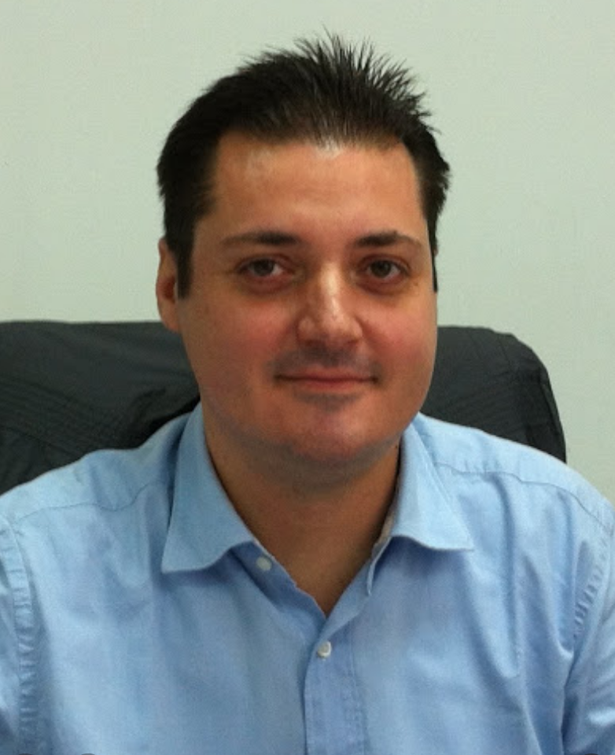
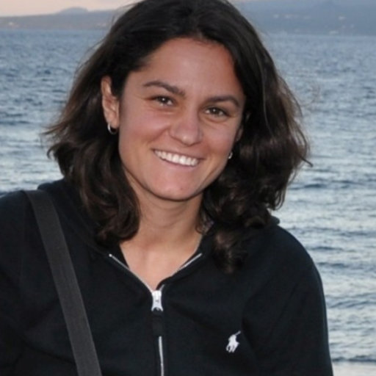
Present EMRP Division officers (2019-2020)
President:
Fabio Florindo
INGV (Italy)
Vice-Presidents:
Eric Font
Univ. Lisbon (Portugal)
Sergio Vinciguerra
Univ. of Turin (Italy)
Secretary: George Balasis
ECS Representative: Anita Di Chiara
NOA (Greece)
INGV (Italy) and SIO
ECS= Early Career Scientists

Slide 34
AGENDA
Approval of the Agenda
Division President elections
Report on the Activities of EGU and the Division
#shareEGU20 & EMRP
EMRP Medal Committees, Medallists, Awards
Division Officers
Early Career Scientists Activities
EGU Publications
Any other business

Slide 35
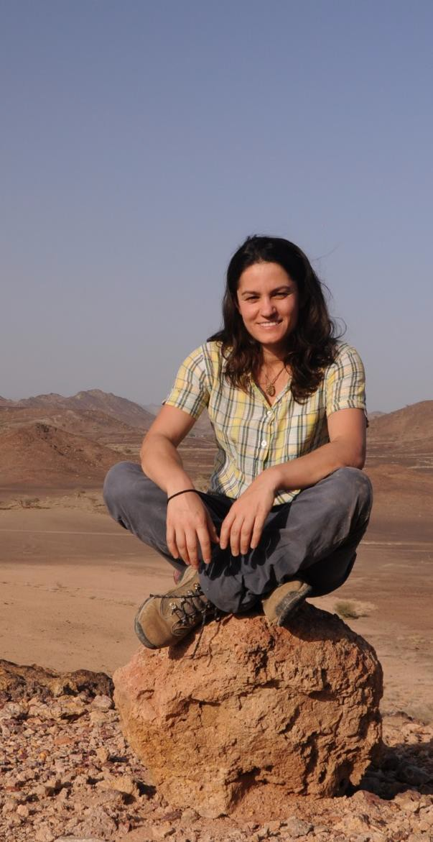
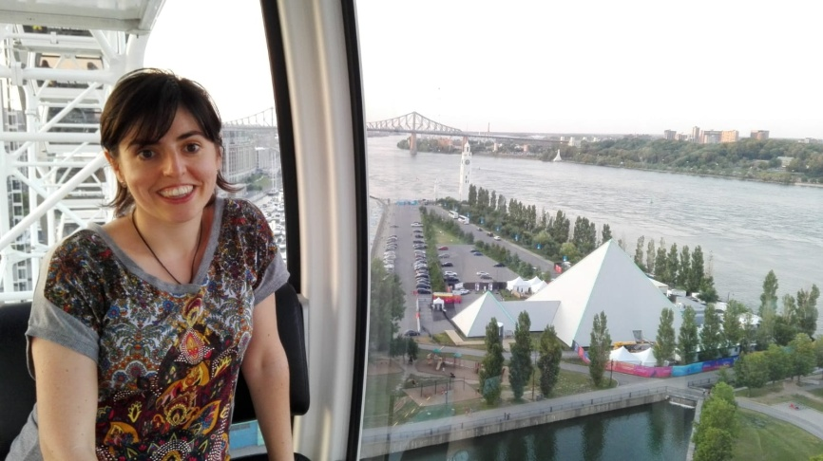
7. Early Career Scientists Activities
EMRP ECS Representative
Dr. Anita Di Chiara (current Early Career Scientists –ECS- Representative)
If agreed, Dr. Saioa Arquero Campuzano will take over for 2020-2022
Email ecs-emrp@egu.eu or emrp@egu.eu
Twitter: @EGU_EMRP
Facebook: EGU_EMRP

Slide 36


7. Early Career Scientists Activities
ECS activities during #shareEGU and beyond
Virtual Networking event (on Monday evening)
EGU Pride on Friday (see program)
New Equality Diversity and Inclusion group
FOR EGU 2021
Suggest Short Courses and encourage ECS to participate to activities across the year
(contact the ECS Rep for more info)
Follow our activities and make suggestions on: ecs-emrp@egu.eu
EMRP social media:
@EGU_EMRP
EGU Earth Magnetism & Rock Physics Divisions

Slide 37
AGENDA
Approval of the Agenda
Division President elections
Report on the Activities of EGU and the Division
#shareEGU20 & EMRP
EMRP Medal Committees, Medallists, Awards
Division Officers
Early Career Scientists Activities
EGU Publications
Any other business

Slide 38
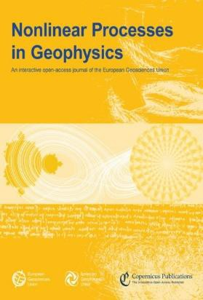




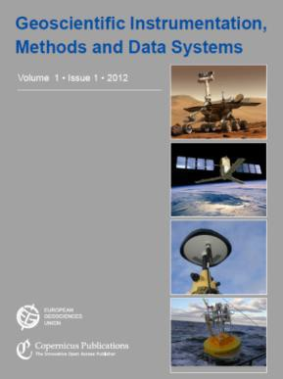
19 Open Access Journals

Slide 39
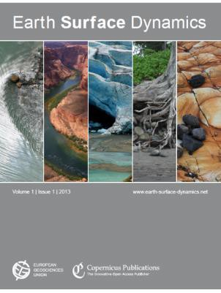


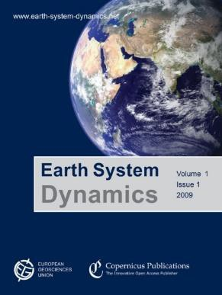


19 Open Access Journals
zz
x

Slide 40

EGUSphere
The EGU interactive community platform
https://www.egusphere.net
A new online platform designed to increase visibility and boost discussion and collaboration within the Earth, planetary, and space science community.
EGUsphere will serve as a central repository for the abstracts and presentations from the Union's annual General Assembly and other meetings, with the opportunity to engage in virtual discussions.
In the coming months, additional capabilities will offer geoscientists the options to publish standard preprints as well as preprints that are being peer reviewed through the innovative, open-access process that EGU has pioneered.

Slide 41
AGENDA
Approval of the Agenda
Division President elections
Report on the Activities of EGU and the Division
#shareEGU20 & EMRP
EMRP Medal Committees, Medallists, Awards
Division Officers
Early Career Scientists Activities
EGU Publications
Any other business

Slide 42
Call for Programme for EGU 2021
EGU 2021 Programme - https://www.egu2021.eu
Vienna, 25–30 April 2021
Programme to be prepared by October 2020
Diversity amongst conveners (from 2 to 5 conveners, each person may convene not more than 3 sessions)
No duplication/overlap among sessions
Encourage poster only/PICO sessions
Try to cover emerging topics
Encourage interdisciplinarity
Involve more Early Career Scientists and consider gender diversity
Sessions <20 papers: merged/poster only/PICO
Sessions <5 papers deleted automatically
PICO sessions 15 or multiples (http://egu2018.eu/pico.html)

Slide 43
9. Call for Programme for EGU 2021
Guidelines:
No solicited presentations by conveners: “Authors (first and co-authors) should not have a solicited presentation in a session they (co-)convene. (Co)-conveners should not be presenting author, and are discouraged from being co-author, on oral presentations in a session they convene.”
1 abstract rule: “Authors are allowed as first author to submit either one regular abstract plus one abstract solicited by a convener, or two solicited abstracts.”
Number of conveners on a session: At session submission minimum 2 – maximum 5
Number of convenerships as a recommendation: 1 as main convener, maximum 3 (co-)convenerships total

Slide 44
GA 2021 timeline (working version)
1 – 19 Jun 2020 | Sub-programme structure (call-for-skeleton)
24 Jun – 15 Aug 2020 | Public call for Great Debates and Union Symposia
24 Jun – 11 Sep 2020 | Public call-for-sessions, incl Short Courses
16 Sep – 14 Oct 2020 | Session programme finalization
14 Oct 2020 - not fixed | PC Meeting (online)
1 Dec 2020 | Support application deadline
13 Jan 2021 | Abstract submission deadline

Slide 45

2020/21 EGU Governance Review
Governance Review Panel:
Toby Rhodes (Independent Chair)
Ulrich Pöschl (Publications Committee Member, AS)
Raffaele Albano (outgoing ECS Representative, NH)
Susanne Buiter (outgoing Programme Committee Chair, TS)
Claudia Jesus Rydin (Chair, Equalities & Diversity Working Group)
Katja Fennel (Chair, Publications Committee, BG, OS)
Helen Glaves (outgoing Division President, ESSI)
Dan Parsons (Division President, GM)
Giuliana Panieri (outgoing Division President, BG)
Chris King (Chair of Education Committee)
Philippe Courtial (EGU Executive Secretary)
Email: governancereview@egu.eu
EGU2020: Sharing Geoscience Online | May 2020
Meetings | Publications | Outreach | www.egu.eu

Slide 46
EGU Governance Review: Objectives
A governance review is an opportunity for the EGU to reflect on its governance arrangements in order to best serve the current and future needs of the organisation, the members, the scientific community and global concerns.
In particular, the governance review will:
determine whether the governance processes and structures of the EGU are fit for purpose
make recommendations for any changes to better serve the current and future needs of the EGU and its members
Objectives of the EGU Governance Review
To review the governance processes and structures of the EGU, and make recommendations for any changes to enable the organisation:
to best deliver its Mission and Vision
to best serve the current and future needs of the organisation and its members;
to ensure EGU structures deliver appropriate scientific and professional diversity and representation amongst EGU committees and boards
Terms of Reference: The full EGU Governance Review Terms of Reference is available to download here

Slide 47
EGU Governance Review Scope: Timescales & Contact
Timescales
The Governance panel will convene in late May 2020, and conduct their review over the following 9-12 months.
The Governance Review will produce an interim report to the EGU Council in October 2020, and a final report with recommendations in January 2021.
The Governance Review will report to EGU members at the 2021 EGU General Assembly. If any changes to EGU governance require EGU Members to vote, this will take place at the EGU General Assembly.
Implementation of any agreed governance changes will take place following the 2021 EGU general assembly

Slide 48
EGU Governance Review Scope: EGU Member Input
EGU members may input their views to the Governance Review via their divisional representatives on EGU Council
EGU members may also contact the Governance Review Panel directly via email at:
governancereview@egu.eu

Slide 49
Feedback
As EGU is a bottom-up organization
Any feedback on how to improve:
next EGU 2021 General Assembly
Division activities and networking
Is more than welcome!
Please send and email to emrp@egu.eu

Slide 50
Enjoy Sharing Geoscience
Online!

