Slide 1
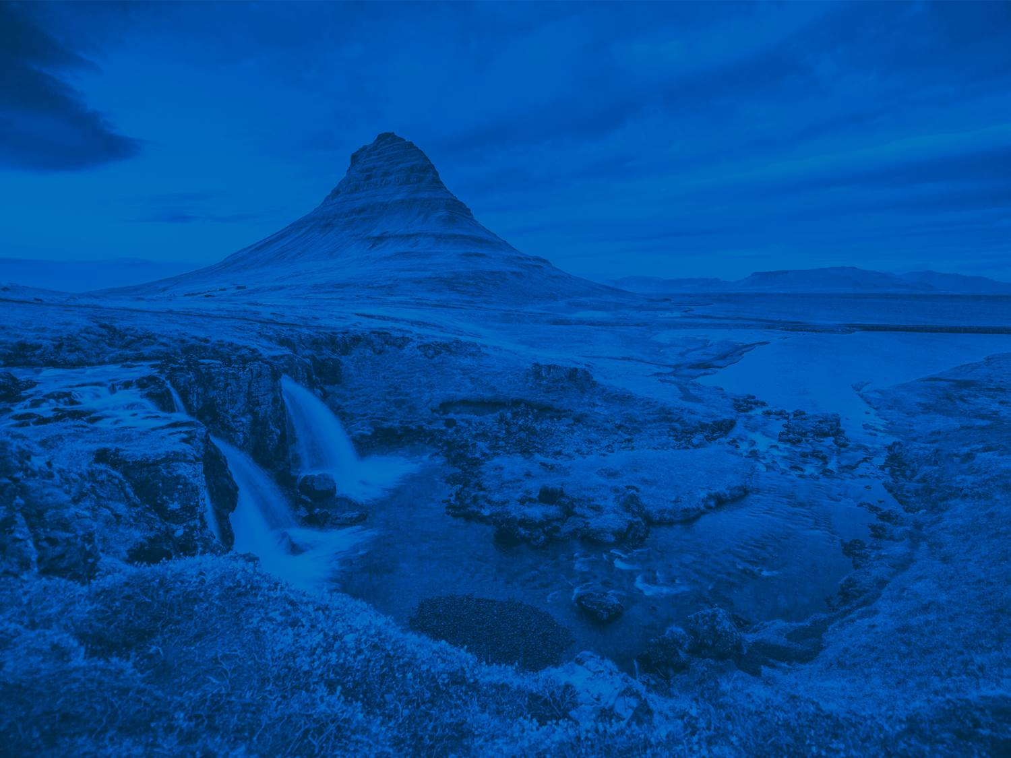

ESSI Division Meeting
7 May 2020
12:45-13:45
Helen Glaves
Meetings | Publications | Outreach | www.egu.eu
Notes:
Welcome to the ESSI Division Meeting materials!
This meeting will be run via a chat session so please post your questions comments between 12:45 and 13:45 on Thursday, 7 May 2020. Alternatively, you can contact the ESSI Division President by email at essi@egu.eu
Thank you for your continued support of EGU and the ESSI Division
We hope you find this material informative and useful

Slide 2
GA2020 statistics (at 27 April 2020)
18,052 abstracts in programme | +11.1% relative to 2019
702 unique scientific sessions
440 out of 702 scientific sessions are co-organized (62.7%), thereof 37 ITS
6 out of the 88 planned short courses now online
1,135 presentation materials uploaded
82 comments to uploaded presentation materials received

Slide 3
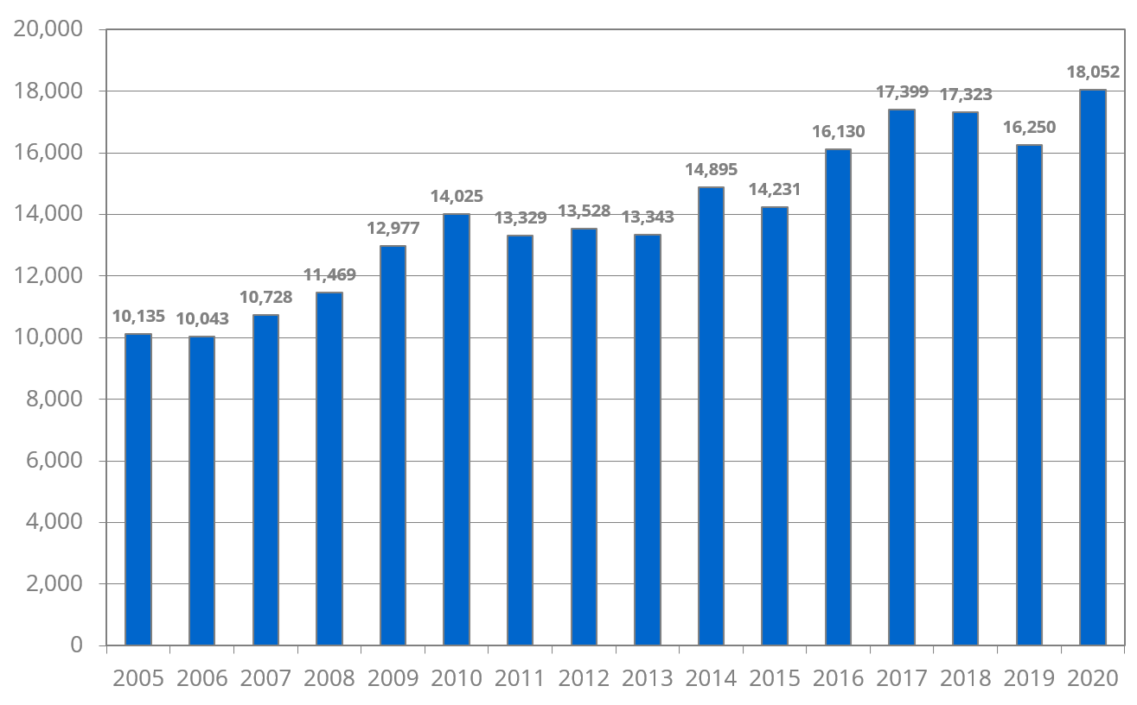
Abstracts in the programme 2005 – 2020
a
c
b
2018: withdrawal of no-show abstracts
2019: one first-author abstract rule
2020: physical GA cancelled 19 March; part of the GA moved online

Slide 4
Sharing Geoscience Online: New concept
Online? Yes! Because it is EGU’s responsibility to help minimise the impact of COVID-19 on scientific research and collaboration
Pilot experiment (we would like feedback!)
Free registration
Our considerations:
    Science submitted to the General Assembly 2020 can be presented and shared
    All authors and conveners can participate, across different time zones
    Sharing Geoscience Online is accessible (in terms of bandwidth, for anyone with hearing or visual difficulties)
    The concept works for all presentation types: oral, poster and PICO

Slide 5
Sharing Geoscience Online in a nutshell
Our concept of Sharing Geoscience allows:
Authors to upload presentation materials and receive feedback on those from 1 April to 31 May 2020)
Conveners, authors and attendees to discuss abstracts, presentation materials and submit questions during a dedicated live, text-based chat session (4 – 8 May)
Everyone to participate in Union Symposia, Great Debates, Short Courses, Networking, Division Meetings, #shareEGUart, Photo Competition, Data Help Desk and more
EGU to gather experience with online activities and use these in plans for reducing the environmental impact of the General Assembly

Slide 6
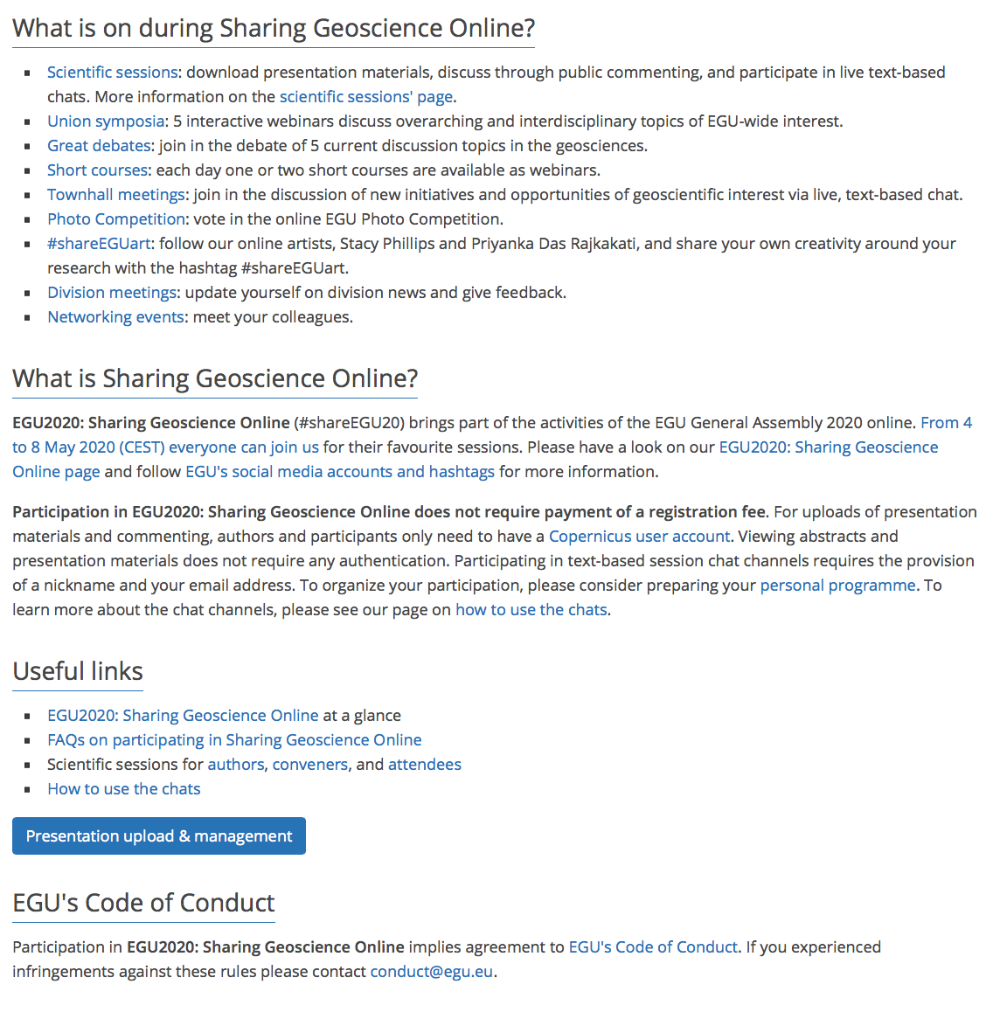

www.egu2020.eu
Notes:
More information on the EGU website at www.egu2020.eu

Slide 7


Notes:
The Data Help Desk is coming to EGU for the first time this year thanks to the ESSI community. It has been a fixture at a number of large geoscience conferences including the AGU Fall Meeting for a several years now. Run by volunteers, the Data Help Desk provides researchers with the opportunities to ask a range of experts their data related questions, as well as learning new data management skills, and trying new tools and techniques.
This year the Data Help Desk has gone virtual. You can send your questions via Twitter using the hashtag #DataHelpDesk but please also add the SGO hashtag #shareEGU20
The Data Help Desk is a joint initiative between EGU, AGU ESIP and Earthcube

Slide 8
Code of Conduct
Participation in EGU2020: Sharing Geoscience Online implies agreement to EGU's Code of Conduct, https://www.egu.eu/about/code-of-conduct/
The Code of Conduct is flagged when uploading materials, when commenting, when entering the chat
Violations or concerns to be reported to conduct@egu.eu
Notes:
All participants in EGU 2020: Sharing Geoscience Online must adhere to the EGU Conduct of Conduct. Any incidents that breach this code can be reported to the EGU Person of Trust via the email address conduct@egu.eu

Slide 9
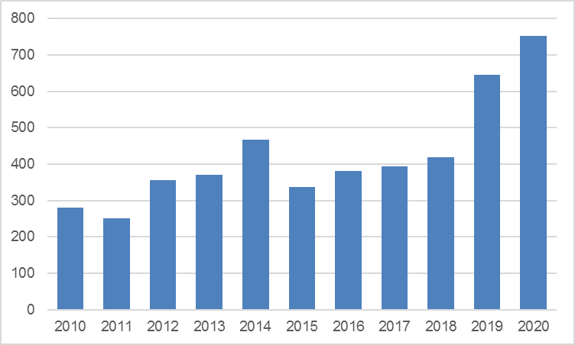
Contributions in ESSI (2010 – 2020)
EGU Abstracts: 18,052
ESSI abstracts: 724
Notes:
646 abstracts (2019) v 724 abstracts (2020)
Increase of 12%

Slide 10
ESSI programme in numbers
ESSI sessions: 12 Co-organised: 19 Total: 31
ESSI 1: Community-driven challenges and solutions dealing with Informatics
  Sessions: 12 Displays: 41 (245)
  (3 division-led / 7 co-organised / 2 short courses)
ESSI 2: Infrastructures across the Earth and Space Sciences
  Sessions: 17 Displays: 86 (358)
  (5 division-led/ 9 co-organised / 3 short courses)
ESSI 3: Open Science 2.0 Informatics for Earth and Space Sciences
  Sessions: 4 Displays: 70 (70)
  (4 division-led)
ESSI 4: Visualization for scientific discovery and communication
  Sessions: 3 Displays: 0 (51)
  (3 co-organised)
Notes:
ESSI sessions 12 (15 in 2019)
Co-organised: 19 (20 in 2019)
ESSI presentations per subprogram group. Figures in brackets = total for subprogram group (both ESSI led and co-organised)

Slide 11
ESSI Division Structure: Subprograms
ESSI 1: Community-driven challenges and solutions dealing with Informatics
  Kerstin Lehnert
  Dirk Fleischer
ESSI 2: Infrastructures across the Earth and Space Sciences
  Horst Schwichtenberg
  Wim Som de Cerff
  Paolo Mazzetti
ESSI 3: Open Science 2.0 Informatics for Earth and Space Sciences
  Vacant (Proposed: Kirsten Elger)
  Pierre Philippe Mathieu
ESSI 4: Visualization for scientific discovery and communication
  Jon Blower
  Mohan Ramamurthy
ESSI 5: General contributions
Notes:
The ESSI sub-programme groups forms part of the ESSI Division stucture (see https://www.egu.eu/essi/structure/ for full details)
ESSI subprograms: 4 in final program for the GA
ESSI 5: only available during call for astracts. All abstracts from this sub-program group are reallocated to other sessions. Provided to allow authors to submit and abstract to the ESSI sessions where
Each subprogram is convened by a minimum of two representatives

Slide 12
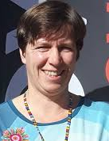
ESSI Division Structure: Subprograms
ESSI 1: Community-driven challenges and solutions dealing with Informatics
  Kerstin Lehnert
  Dirk Fleischer
ESSI 2: Infrastructures across the Earth and Space Sciences
  Horst Schwichtenberg
  Wim Som de Cerff
  Paolo Mazzetti
ESSI 3: Open Science 2.0 Informatics for Earth and Space Sciences
  Vacant (Proposed: Kirsten Elger)
  Pierre Philippe Mathieu
ESSI 4: Visualization for scientific discovery and communication
  Jon Blower
  Mohan Ramamurthy
ESSI 5: General contributions
Dr Kirsten Elger is proposed as
co-convener for sub-program group ESSI3
Any objections to the ESSI Division President
(Email: essi@egu.eu)
Before 22 May 2020
Notes:
ESSI 3 currently has a vacancy.
Dr. Kirsten Elger is nominated for this position.
Any objections should be forwarded to ESSI Division President (email address: essi@egu.eu) before 22 May 2020)

Slide 13
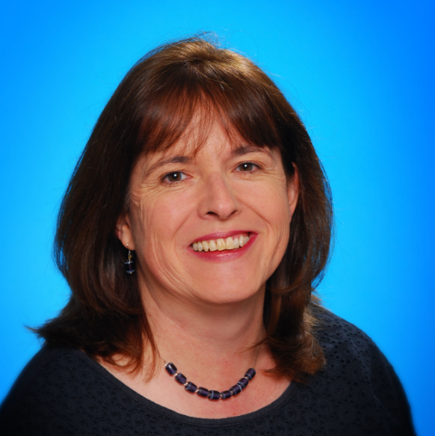
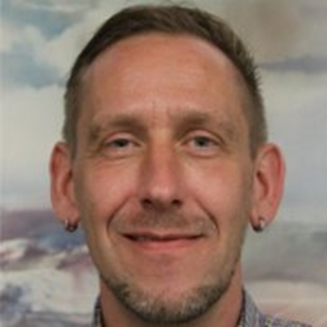
ESSI Division Structure: Leadership
Helen Glaves
ESSI Division President
Elected: 2017 – 2019
Re-elected: 2019 - 2021
Jens Klump
Division President Elect
Division President 2020 – 2023
Notes:
Helen Glaves: transitioning to EGU Vice President at next EGU Plenary (May 2020)
Dr. Jens Klump: taking over as ESSI Division President one year early and will therefore serve a three year term

Slide 14
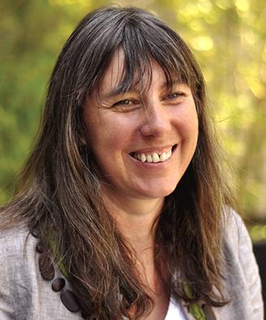
ESSI Division Structure: Leadership
Professor Jane Hart is proposed as
ESSI Deputy Division President
Any objections to the ESSI Division President
(Email: essi@egu.eu)
Before 22 May 2020
Helen Glaves
ESSI Division President
Elected: 2017 – 2019
Re-elected: 2019 - 2021
Jens Klump
Division President Elect
Division President 2020 – 2023
Notes:
A vacancy now exists for Deputy Division President: Professor Jane Hart is nominated for this position
Any objections should be forwarded to ESSI Division President (email address: essi@egu.eu) before 22 May 2020)

Slide 15
ESSI Division President: next election
Next EGU election (Divisions): November 2021
Successful candidate: deputy president from EGU GA 2022 (1 year)
Assumes role of Division President at EGU GA 2023 (2 years)
All EGU members are eligible
Division President can only stand once for re-election (usually 4 years in total)
Call for candidates opens June 2021

Slide 16
ESSI Division Structure: Science Officers
Meteorology and Climatology | Reinhard Budich
Space | Vacant (Pier Giorgio Marchetti)
Geochemistry | Kerstin Lehnert
Oceanography | Antonio Novellino
Liaison AGU ESSI Section | Peter Fox
Science Officers should promote sub-programmes and encourage their colleagues to organize sessions for the GA
Any new volunteers?
Notes:
ESSI also has 5 science officers
There is currently a vacancy for the Space science officer becasue Dr. Marchetti has stepped down. Volunteers for this role should contact the ESSI Division President (email: essi@egu.eu)
The current sope of the individual science areas is relatively limited and doesn’t fully encompass the different geoscience domains. Proposal to expand geochemistry to include geology? Please provide your comments on this suggestion.

Slide 17
ESSI Early Career Scientist (ECS) Representative
Early Career Scientist: EGU member receiving highest degree (BSc MSc or PhD) in last 7 years
Early Career Scientist representatives are a crucial link between the EGU and the young scientist community
Each division can have an Early Career Scientist representative
ESSI ECS: one candidate nominated
Notes:
Each Division has an Early Career Scientist (ECS) representative
NB: ECS classification can be extended to take into account any parental leave
ESSI currently has a vacancy for this role

Slide 18
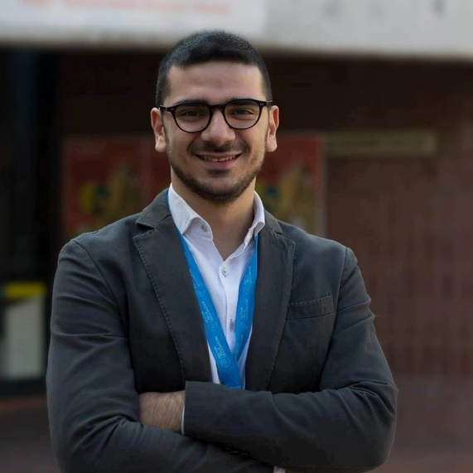
Federico Amato
Dr. Federico Amato is proposed as
ESSI ECS Representative
Any objections to the ESSI Division President
(Email: essi@egu.eu)
Before 22 May 2020
Ph.D. in Innovation and Sustainable Development Engineering
Currently Postdoctoral Research Fellow in Environmental Data Mining at the University of Lausanne
Short bio
My research interest is the study of the interaction between spatial and temporal components of environmental and geographical phenomena, and their consequences in terms of spatial planning and urban geography. My recent work has focused on the analysis of land use dynamics and its relationship with climate, pollution, natural hazards and other social/economic phenomena. I collaborate with the Italian association “Liberascienza” to support their science communication activities.
Motivation
The ESSI division is growing, and so is the number of ECS in it. I expect to contribute to construct a clear portrait of ECS needs and expectation, helping to develop activities that can support the promotion of their research, a wider comprehension of the Division and General Assembly structure, and the creation of a real community that keeps in touch throughout the entire year and not only during the general assembly.
Notes:
Dr Federico Amato is nominated as the new ECS representative for the ESSI DIvision
Any objections should be forwarded to ESSI Division President (email address: essi@egu.eu) before 22 May 2020)

Slide 19
Federico Amato
Ph.D. in Innovation and Sustainable Development Engineering
Currently Postdoctoral Research Fellow in Environmental Data Mining at the University of Lausanne
Short bio
My research interest is the study of the interaction between spatial and temporal components of environmental and geographical phenomena, and their consequences in terms of spatial planning and urban geography. My recent work has focused on the analysis of land use dynamics and its relationship with climate, pollution, natural hazards and other social/economic phenomena. I collaborate with the Italian association “Liberascienza” to support their science communication activities.
Motivation
The ESSI division is growing, and so is the number of ECS in it. I expect to contribute to construct a clear portrait of ECS needs and expectation, helping to develop activities that can support the promotion of their research, a wider comprehension of the Division and General Assembly structure, and the creation of a real community that keeps in touch throughout the entire year and not only during the general assembly.
Notes:
Dr. Amato has provided a short bio and his motivation for wanting this role that is shown here.

Slide 20
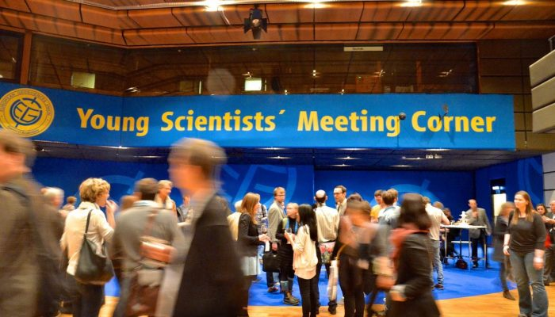
ECS participation in the ESSI Division
Abstracts tagged as ECS:
  ESSI 368 / 724 (51%)
  EGU 9625 / 18,052 (53%)
We need more:
ESSI ECS oral presentations
ESSI ECS conveners/chairs
EGU guideline specifically encourages
  ECS Session chairs
  2 oral presentations by ECS per time block
Notes:
ECS- don’t forget to identify yourself when submitting an abstract

Slide 21
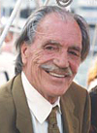
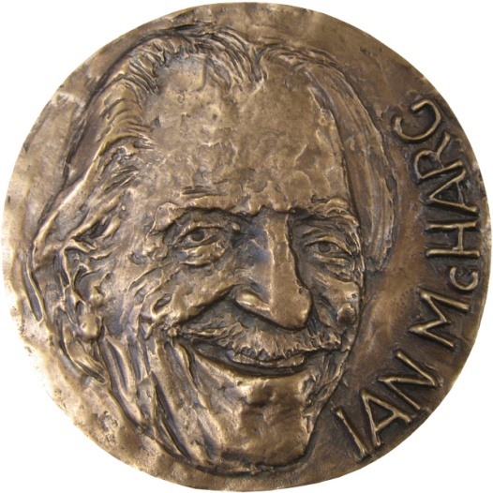
ESSI Awards: Ian McHarg Medal
ESSI Division Medal
Awarded for distinguished research in Information Technology applied to the Earth and space sciences.
In recognition of the scientific achievements of Ian McHarg
  a pioneer of the concept of ecological planning
  provided the basic concepts of Geographic Information Systems (GIS)
https://www.egu.eu/awards-medals/portrait-ian-mcharg/

Slide 22
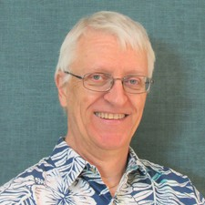

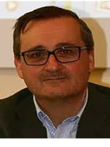
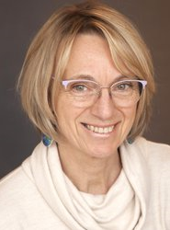
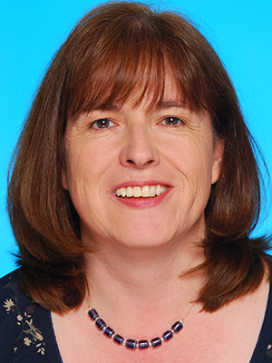



ESSI Awards: Our medallists
2020
Paul Wessel
2019
2018
2016
2013
2012
2011
Stefano Nativi
Kerstin Lehnert
Helen Glaves
Alessandro Annoni
Peter Fox
Monique Petitdidier
Notes:
Congratulations to Dr Paul Wessel the 2020 recipient of the Ian McHarg Medal (see https://www.egu.eu/awards-medals/ian-mcharg/2020/paul-wessel/ for full details)
Presentation of the actual award including Dr. Wessels medal lecture has been deferred until 2021

Slide 23
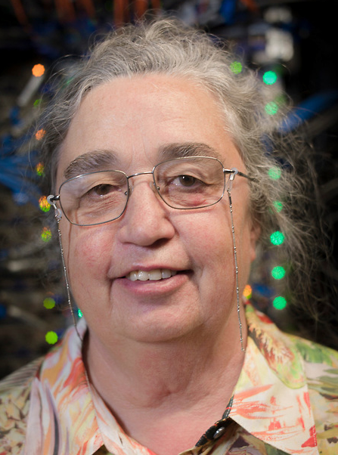
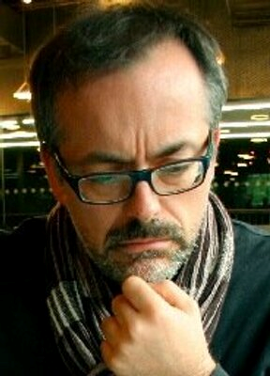
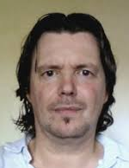

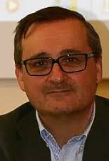

Ian McHarg Medal committee
Lesley Wyborn (chair)
Paolo Diviacco
Paolo Mazzetti
Kerstin Lehnert
Stefano Nativi
Paul Wessell
Notes:
ESSI Medal Committee composition. Members can only serve for four years and one person must rotate off every year. We thank Dr.Joan Maso who is stepping down from the ESSI Medal Committee having reached the maximum term for membership of this committee.
The new medallist is usually invited to join the committee. This year Dr. Paul Wessel is joining the committee as this year’s recipient of the Ian McHarg Medal

Slide 24
Ian McHarg Medal committee
Medal Committee approval
Any objections to the ESSI Division President
(Email: essi@egu.eu)
Before 22 May 2020
Lesley Wyborn (chair)
Paolo Diviacco
Paolo Mazzetti
Kerstin Lehnert
Stefano Nativi
Paul Wessell
Notes:
The medal committee needs ot be approved by the ESSI Division.

Slide 25

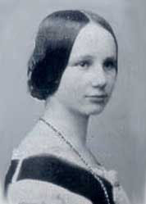
Proposed change: McHarg – Lovelace Medal
Format change - biennial starting 2021
Expand scope
  include technological advances e.g. software development
  new approaches e.g. promoting open science
Renamed to support diversity in EGU/ESSI and highlight new format
Notes:
Ada Lovelace: English mathematician and writer, chiefly known for her work on Charles Babbage's proposed mechanical general-purpose computer, the Analytical Engine.
Proposal to be circulated to ESSI members by email for feedback by the end of May.. Proposal to be tabled at next Council meeting for approval.

Slide 26
ESSI Awards: Outstanding Student
Poster and PICO (OSPP)
Satisfy one of the following criteria:
  current undergraduate (e.g. BSc) or postgraduate
  (e.g. MSc, PhD) student
  recent undergraduate or postgraduate student presenting their thesis work.
First author and personally presenting the poster or PICO at the conference
Self nomination during abstract submission
Judges (3 per submission) needed
ESSI OSPP coordinator : ECS representative
https://www.egu.eu/awards-medals/ospp-award/
Notes:
Each year each Division confers the OSPP award for the best student poster or PICO. The recipient is selected from those nominated.

Slide 27
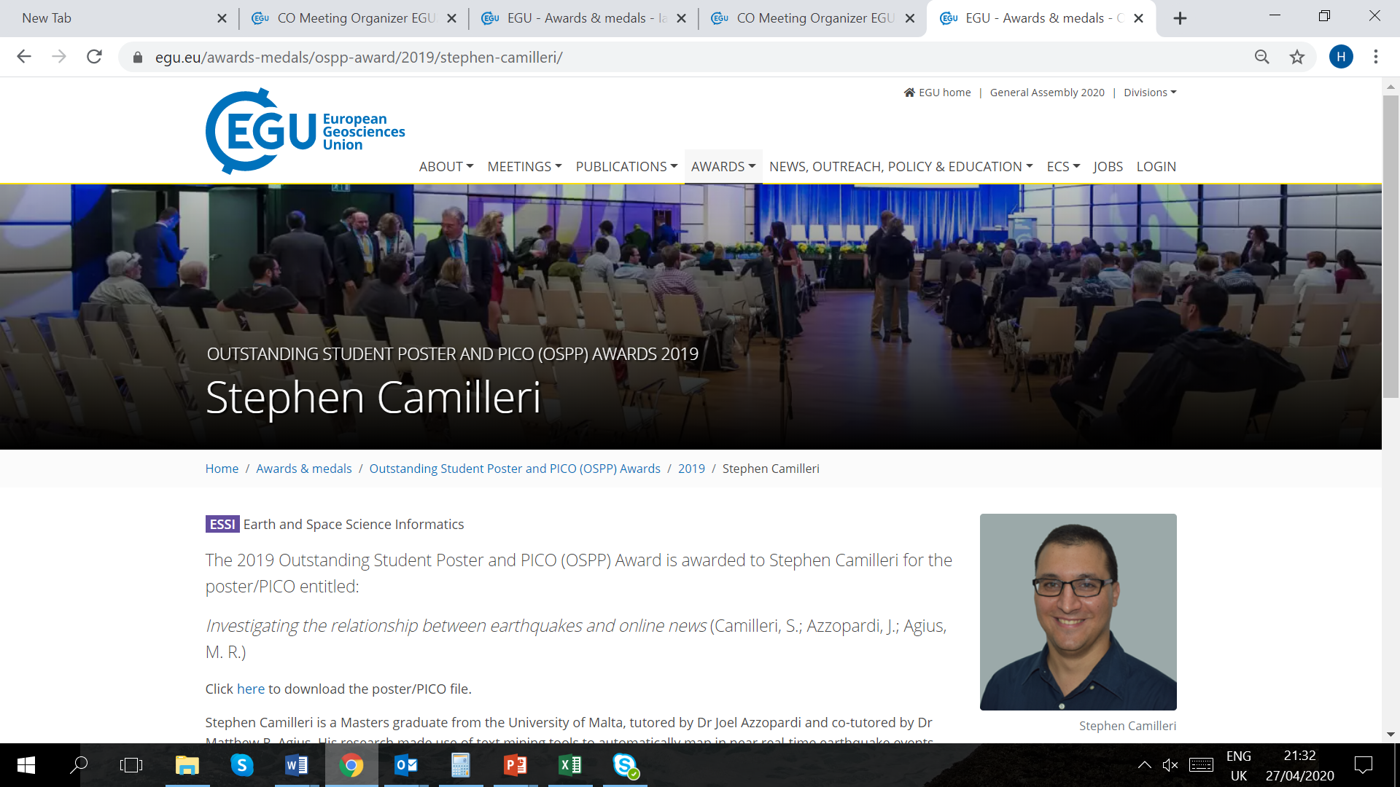
OSPP - Outstanding Student
Poster and PICO Award
EGU2019-15196 Investigating the relationship between earthquakes and online news
Stephen Camilleri, Joel Azzopardi, and Matthew R. Agius
University of Malta
Notes:
Congratulations to this year’s awardee is Dr. Stephen Camilleri from the University of Malta

Slide 28

OECS
ESSI has never selected a recipient
Only EGU Division not to have given the OECS award !!!
Notes:
Recognises scientific achievements in the field of ESSI made by an early career scientist.
Nomination is by letter and CV submitted to the Division President. Eligible candidates are evaluated by the division president, who the forwards the most outstanding candidate to the Chair of EGU’s Awards Committee for the award to be confirmed by the EGU Awards Committee.
ESSI has never made this award!!

Slide 29
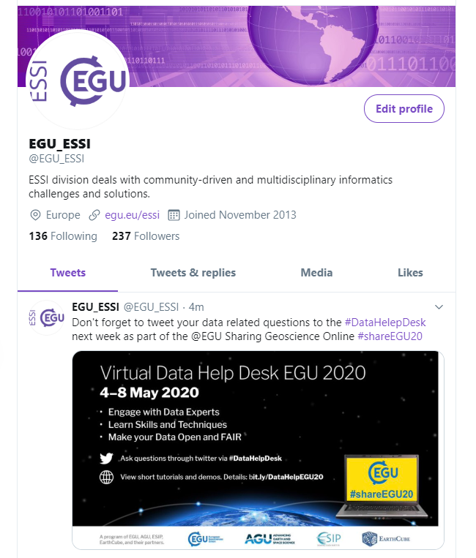


@EGU_ESSI
ESSI on social media

Slide 30
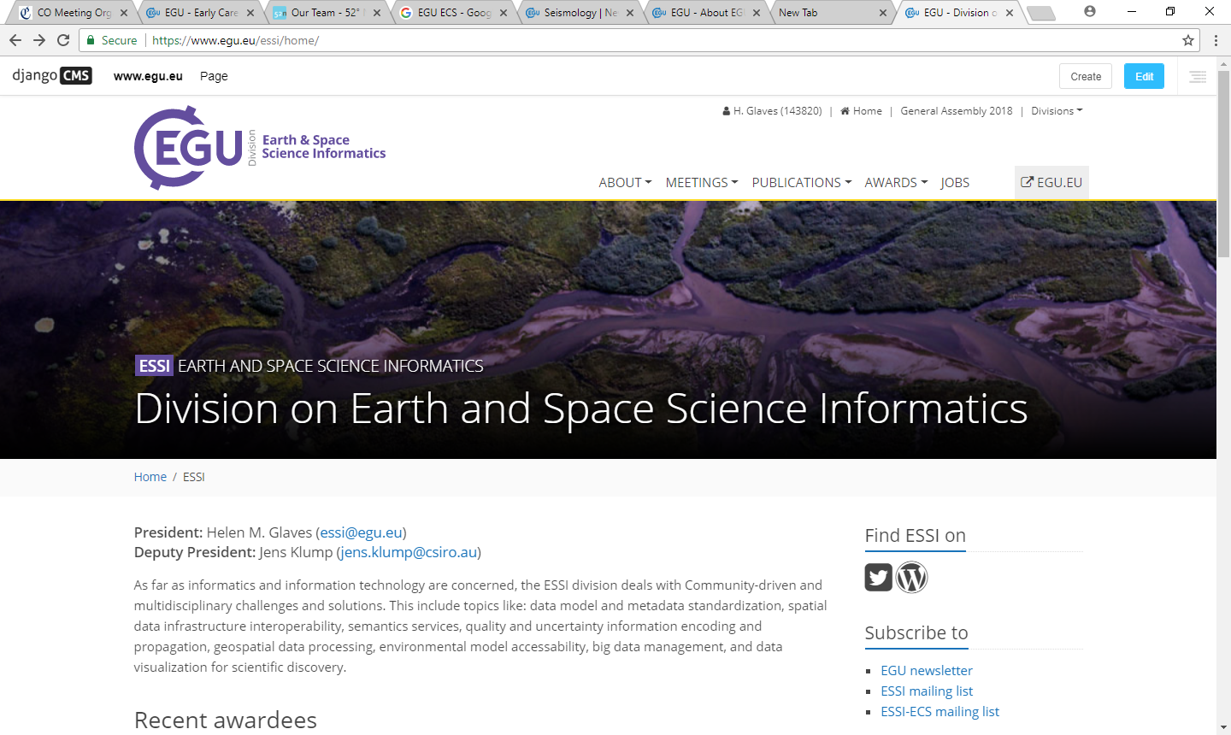
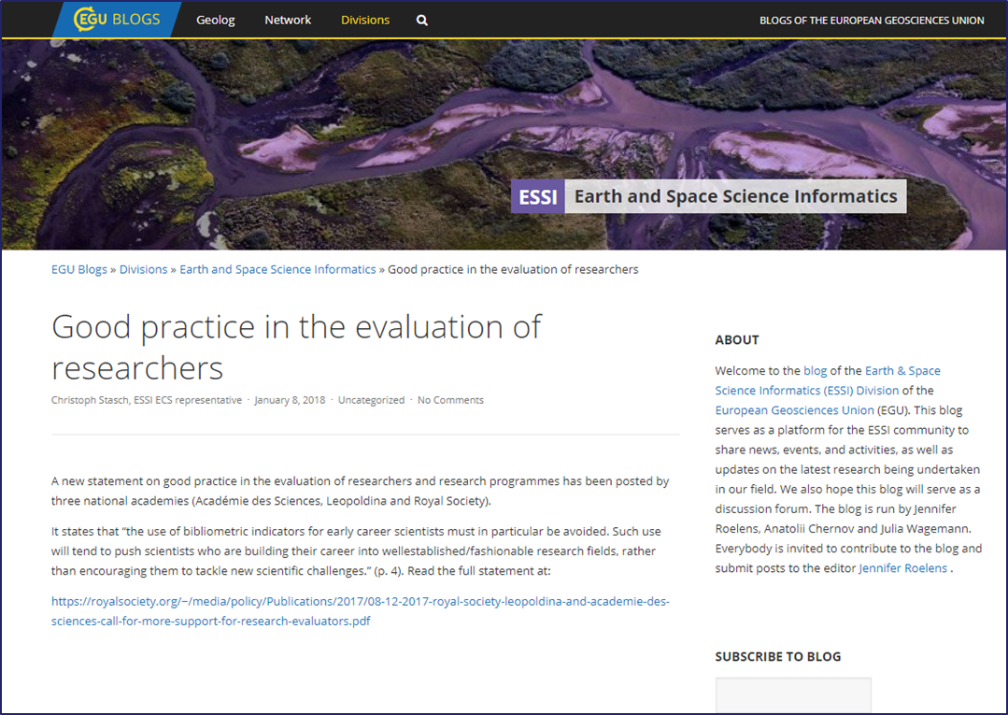
ESSI web pages and blog
Notes:
ESSI web pages and blog: provide information about the Division
Blog: platform for the ESSI community to share news, events, and activities, as well as updates on the latest research being undertaken in our field.
Relatively under used. Need content to be submitted by community

Slide 31


essi@egu.eu
Notes:
Thank you for taking the time to look at this presentation
Earth and Space Science Informatics (ESSI) is one of a small number of transversal divisions in EGU, and it has relevance for researchers active in many of the other EGU Divisions. The EGU ESSI Division continues to grow as shown by the increasing number of abstracts that are received for the sessions convened during the GA. We hope you will continue to support and contribute to the ESSI Division.
Thank you for being part of EGU2020: Sharing Geoscience Online, and we hope to see you in Vienna next year!!

