Slide 1

Detection and mitigation of ionospheric artifacts in
the azimuth ground displacements through
the SAOCOM-1 L-band SAR data exploitation

Slide 2
SIGNAL PROPAGATION THROUGH THE ATMOSPHERE
Satellite SAR systems are generally located at an altitude between 500 and 1000 km above the Earth's surface.
The transmitted and received signals interact with two main layers of the atmosphere:
Troposphere: it is an electrically neutral layer, consisting of gases (nitrogen and oxygen) and vapor water.
Ionosphere: it is an electrically charged layer, containing ions and electrons.
A sketch of the observation geometry of the SAR system when traveling through the atmosphere.
The troposphere behaves as a nondispersive medium:
The ionosphere behaves as a dispersive medium:
all frequency components propagate at the same speed;
frequency components propagate with different speeds;
the refractive index is independent of frequency.
the refractive index depends on frequency.

Slide 3
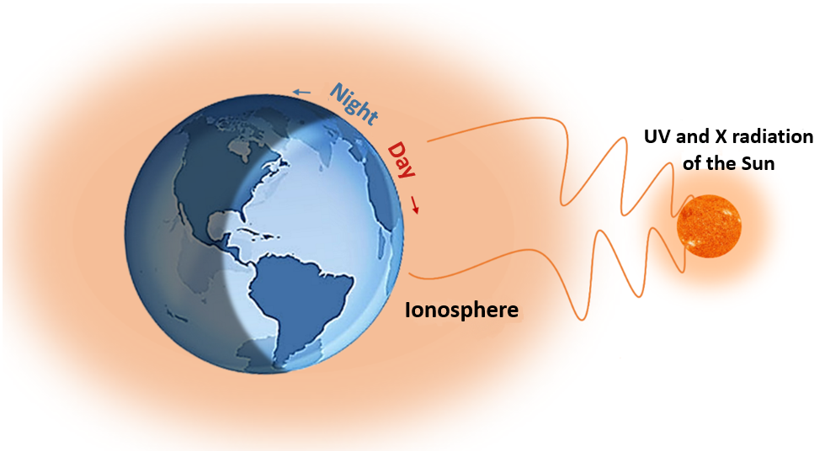
IONOSPHERE
The ionosphere is the layer of the atmosphere between 60 and 1000 km above the Earth's surface. It is made up of free electrons, ions, and neutral particles.
The ionosphere is a highly dynamic medium that varies in space and time and is closely correlated with solar activity.
The density of electrons in the ionosphere changes dramatically from the local daytime to night-time, reaching the maximum in the early afternoon and gradually decreasing after midnight.
The ionospheric activity is more stable during the day than at night. For this reason, the ascending SAR images are more easily affected by the ionospheric variations than the descending images.

Slide 4
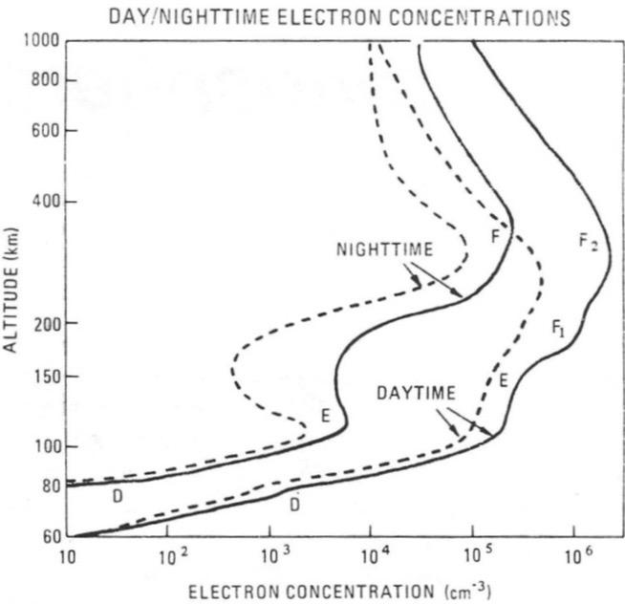
PHYSICAL MECHANISM OF THE IONOSPHERE
The electron density profile of the ionosphere changes with altitude and typically has the absolute maximum at about 250 km of altitude. This allows conventionally dividing the ionosphere into two large regions called:
topside ionosphere: beyond the absolute maximum of electronic density;
bottomside ionosphere: below that maximum.
Due to the presence of relative maxima in the electronic density profile, the bottomside ionosphere can be conversely divided into three other regions, commonly referred to as D, E, and F layers.
The F region is conventionally divided into the F1 and F2 layers based on the two maxima in the electron density profile during the day.
At night, the F1 and F2 layers of the ionosphere combine to form a single F layer.

Slide 5

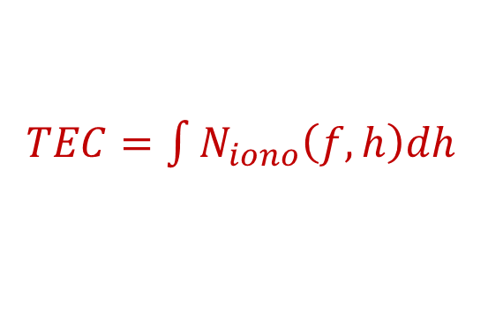
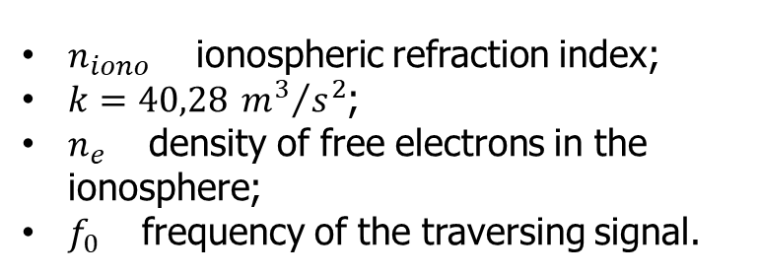
TOTAL ELECTRON CONTENT (TEC)
The influence of the ionosphere on signals traversing it is determined by the ionospheric refractivity:
$n_{iono}$ ionospheric refraction index;
$k=40,28 {m^{3}}/{s^{2}}$;
$n_{e}$ density of free electrons in the ionosphere;
$f_{0}$ frequency of the traversing signal.
$$N_{iono}=\left(n_{iono}−1\right){10}^{6}≈−k{10}^{6}\frac{n_{e}}{f_{0}^{2}}$$
where
The magnitude of ionospheric effects increases with increasing solar activity (defines $n_{e}$) and is most significant at lower frequencies.
All the ionospheric effects are a function of the so-called Total Electron Content (TEC )
$TEC=\int{N_{iono}\left(f,h\right)dh}$
This quantity is measured in Total Electron Content Unit (TECu), with 1 TECu = ${10}^{16}$ electrons/$m^{2}$.

Slide 6
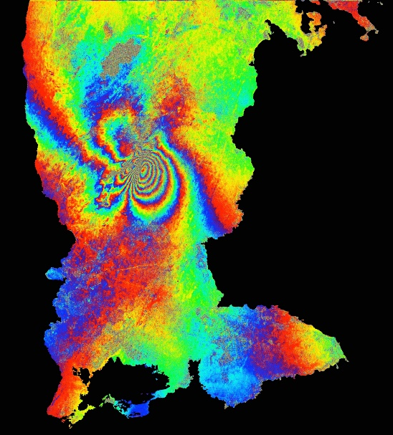
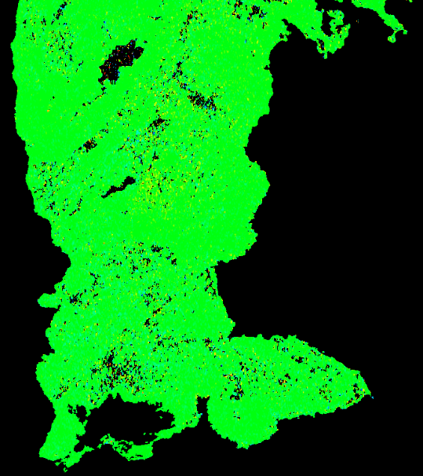
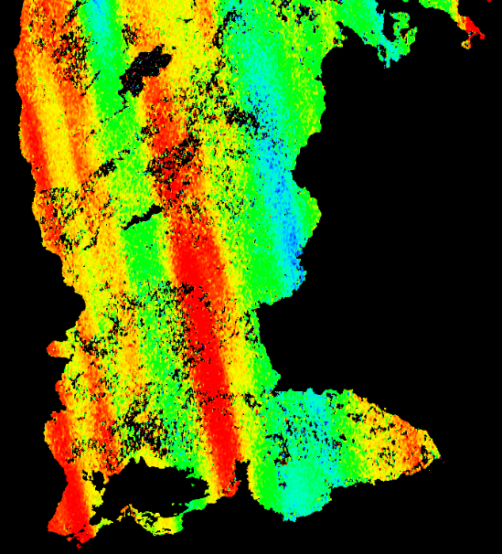

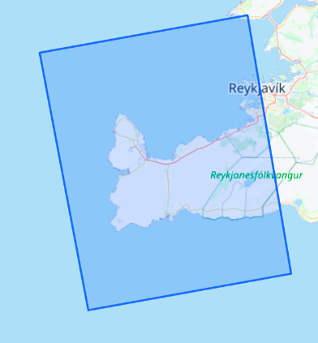
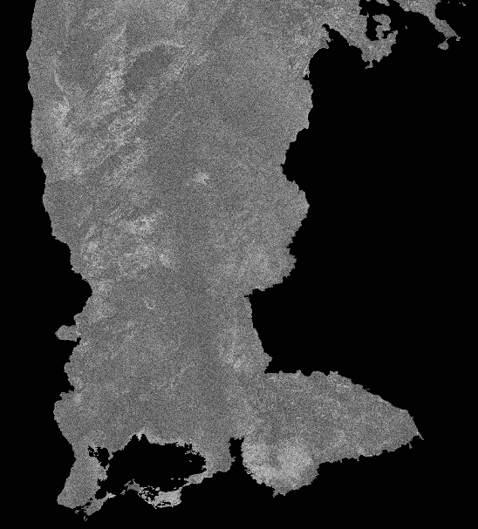
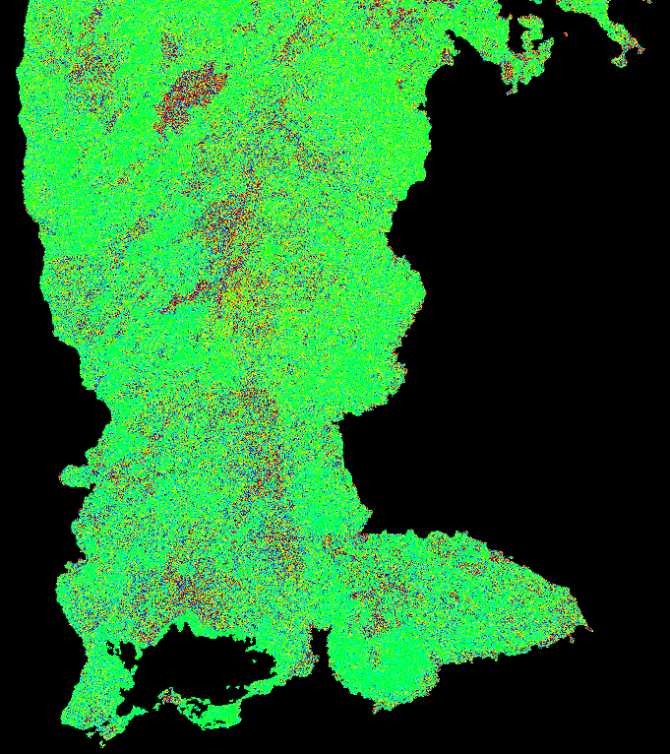
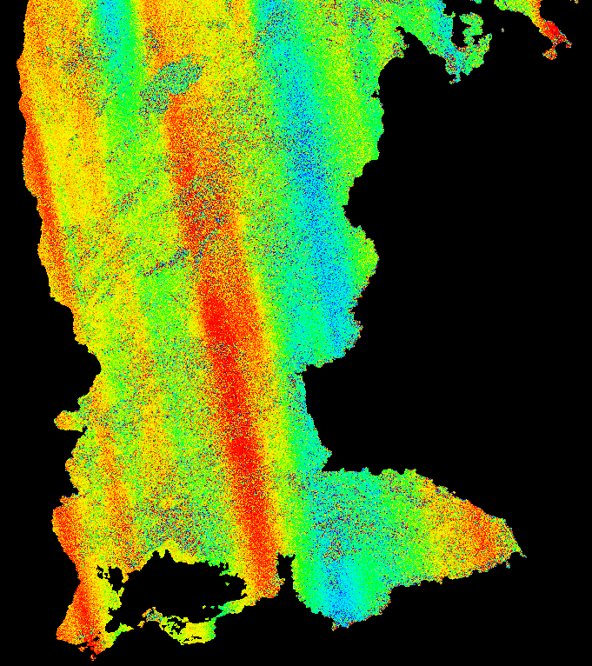

CASE STUDY OUTCOMES: Litli-Hrútur eruption-Iceland
Differential Interferogram
Slant Range POT
Azimuth POT
-π
[rad]
π
-250
[cm]
250
SAOCOM-L1A-ASC-S6
azimuth
range
Interferometric Coherence
Split-Spectrum
MAI
range
azimuth
18062023SAB_05082023SAA
-π/2
[rad]
π/2
Acquisition time: 07:05 UTC
0
1

Slide 7
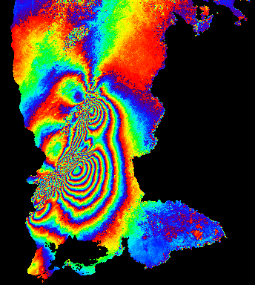
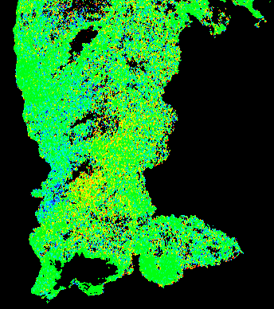
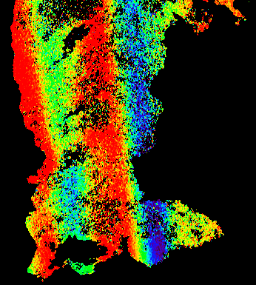
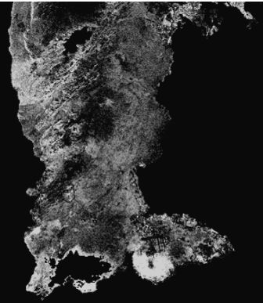
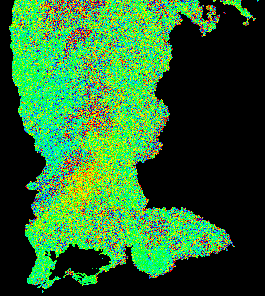
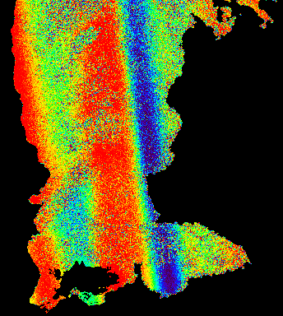
CASE STUDY OUTCOMES: Litli-Hrútur eruption-Iceland
Differential Interferogram
Slant Range POT
Azimuth POT
-π
[rad]
π
-250
[cm]
250
SAOCOM-L1A-ASC-S6
azimuth
range
Interferometric Coherence
Split-Spectrum
MAI
range
azimuth
18062023SAB_19122023SAA
-π/2
[rad]
π/2
Acquisition time: 07:05 UTC
0
1

Slide 8
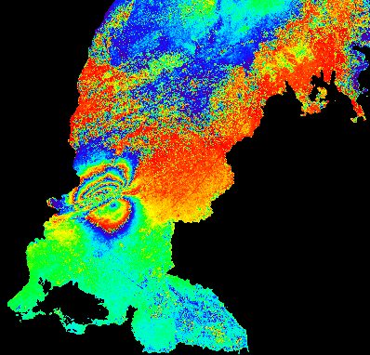
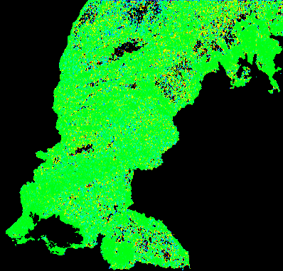
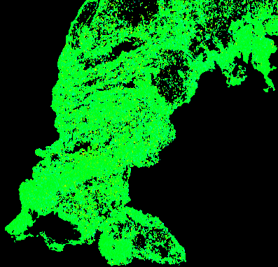
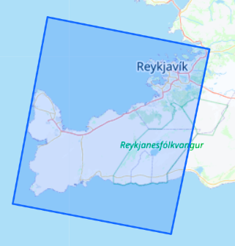
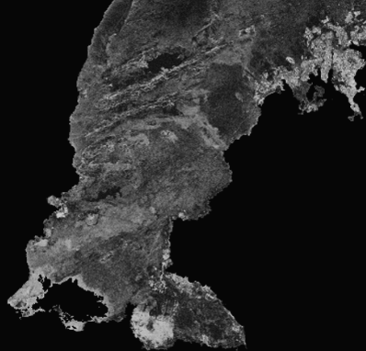
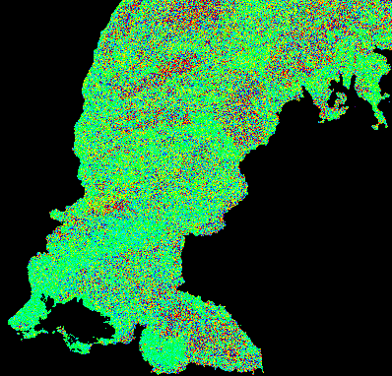
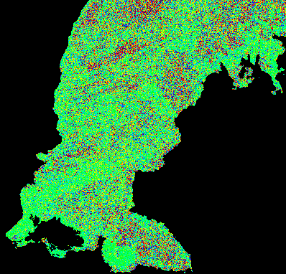
CASE STUDY OUTCOMES: Litli-Hrútur eruption-Iceland
Differential Interferogram
Slant Range POT
Azimuth POT
-π
[rad]
π
-250
[cm]
250
SAOCOM-L1A-DESC-S5
range
azimuth
azimuth
range
Interferometric Coherence
Split-Spectrum
MAI
07122023SAA_08012024SAA
-π/2
[rad]
π/2
Acquisition time: 19:50 UTC
0
1

Slide 9
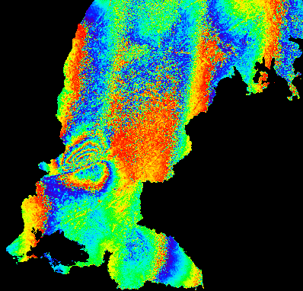
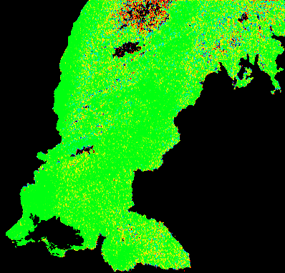
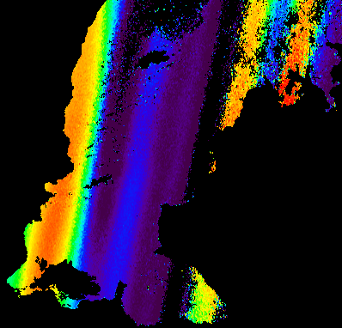
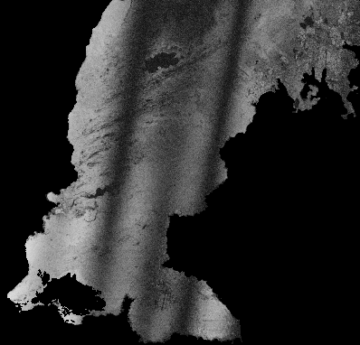
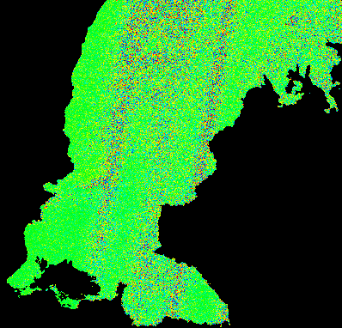
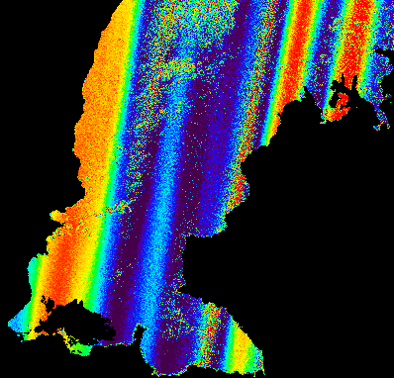
CASE STUDY OUTCOMES: Litli-Hrútur eruption-Iceland
Differential Interferogram
Slant Range POT
Azimuth POT
-π
π
-10
[m]
10
[rad]
SAOCOM-L1A-DESC-S5
range
azimuth
azimuth
range
Interferometric Coherence
Split-Spectrum
MAI
15122023SAB_08012024SAA
-π/2
[rad]
π/2
Acquisition time: 19:50 UTC
0
1

Slide 10
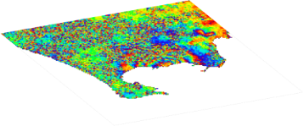
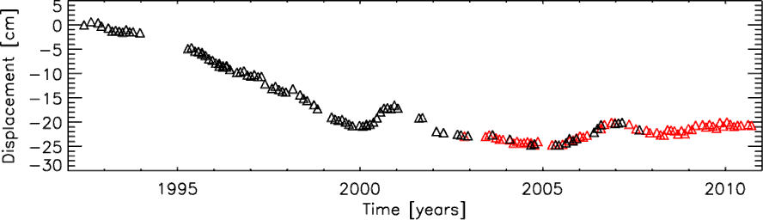
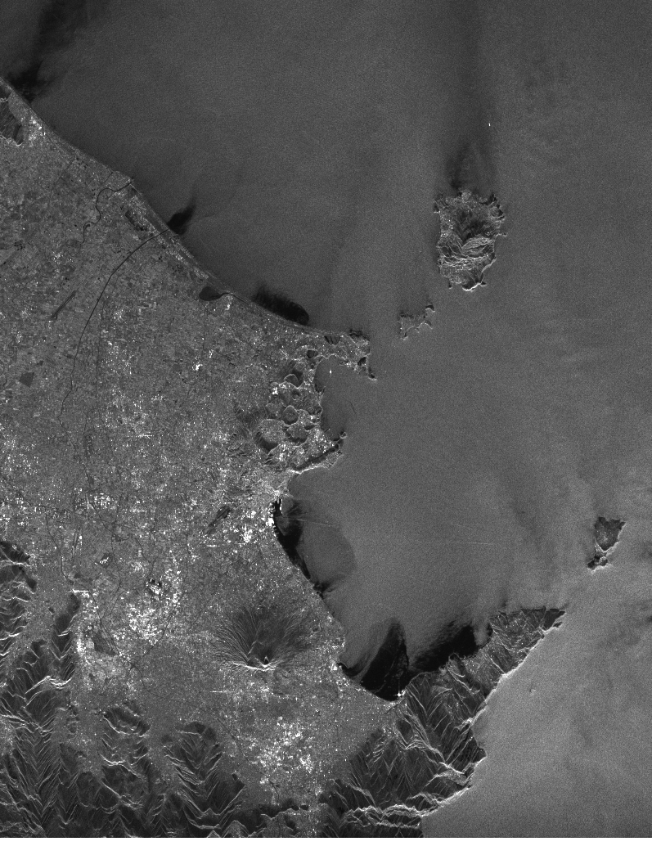
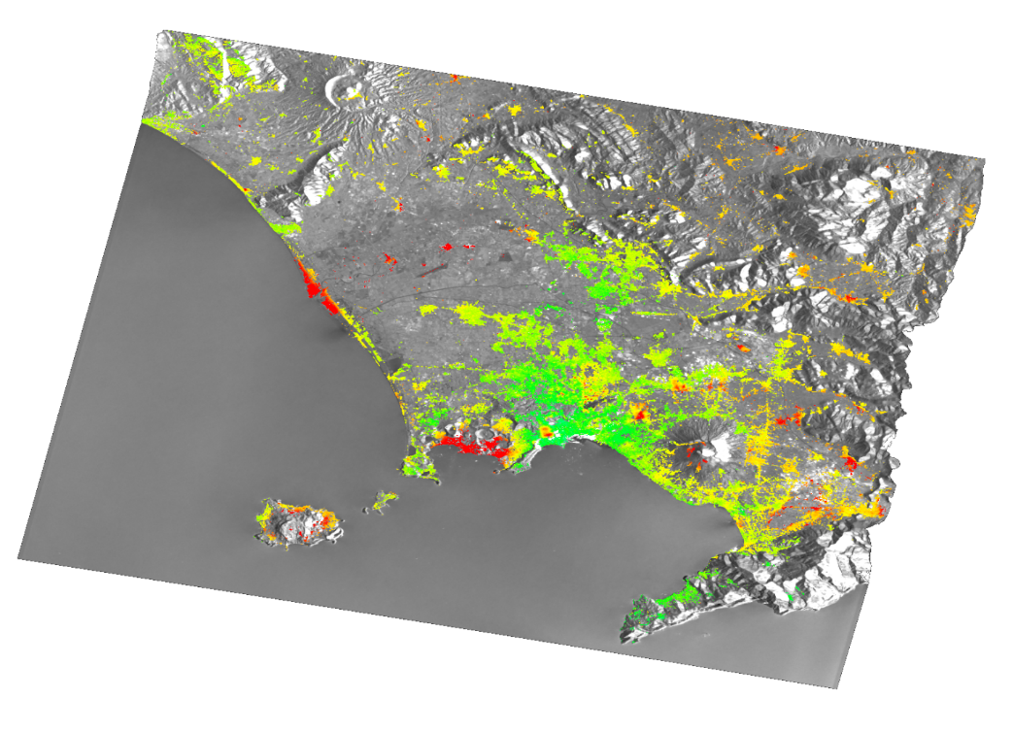

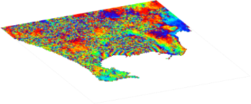
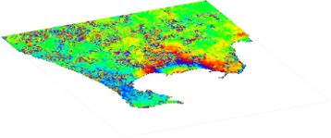
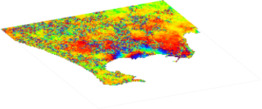
SMALL BASELINE SUBSET (SBAS) APPROACH
SAR Images
SB Interferograms
ERS/ENVISAT images (1992 – 2010)
Δ ERS
Δ ENVISAT
Mean deformation velocity
[cm/yr]
<- 0.5
> 0.5
time
Ischia
Campi Flegrei
Mt. Vesuvio
Berardino et al., 2002, IEEE Trans. Geosci. Remote Sens.
Pepe et al., 2005, IEEE Trans. Geosci. Remote Sens.

Slide 11
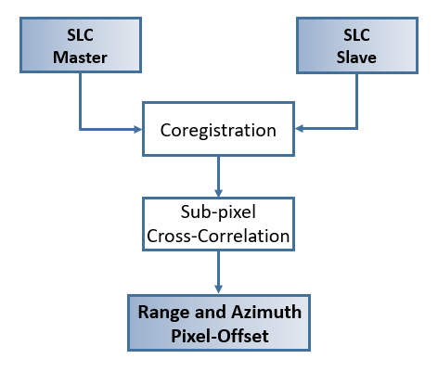
PIXEL OFFSET TRACKING (POT) TECHNIQUE
The POT technique is useful in scenarios where DInSAR might fail, such as detecting surface deformation from high-magnitude earthquakes.
The POT technique typically achieves surface displacement accuracies of around 1/10 of the pixel size.
The advantage of using the POT technique is that it provides two-dimensional displacement information in both the radar azimuth and slant-range directions.

Slide 12
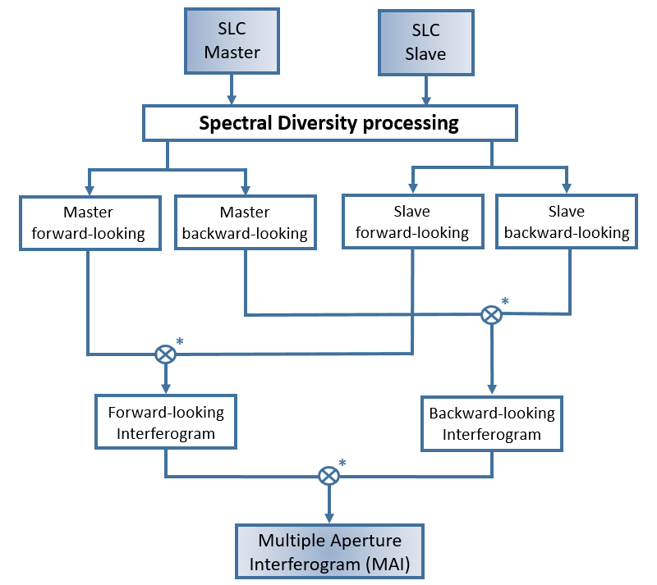
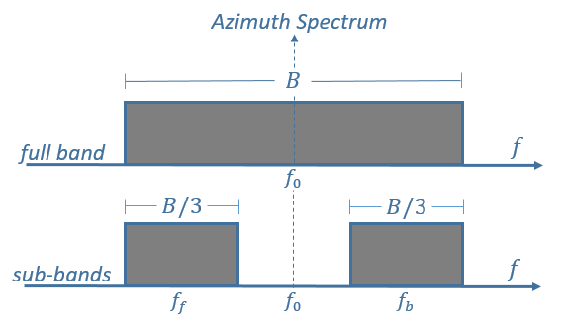
MULTIPLE APERTURE INTERFEROMETRY (MAI) TECHNIQUE
In the MAI technique, the azimuth beamwidth is split into forward and backward looks.
The symbol * denotes a complex conjugate multiplication

Slide 13
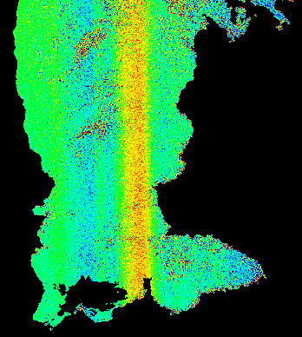
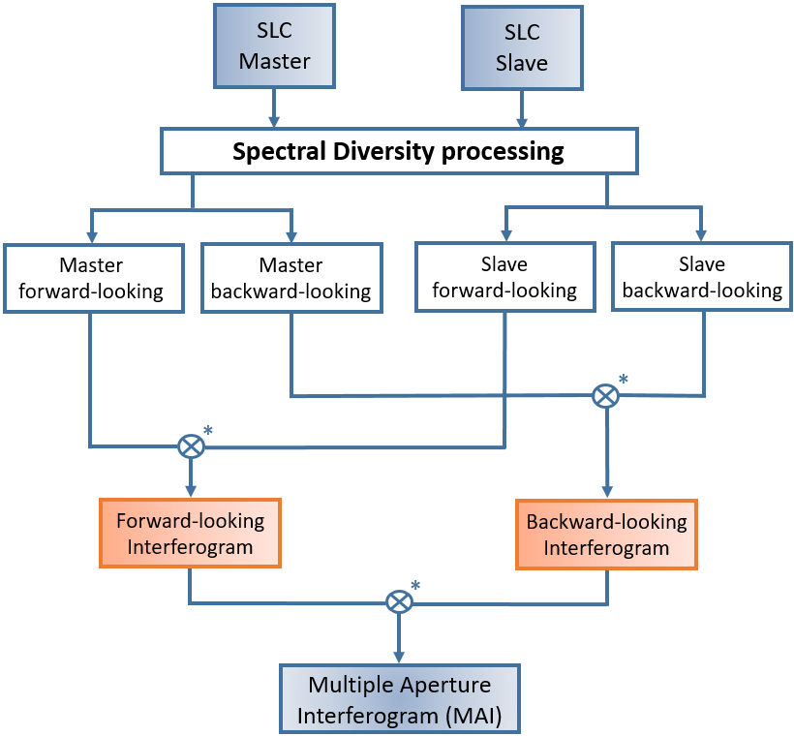


PAIRING OF ADJACENT SUB-BANDS
15 Sub-Bands
$$B_{az}$$
…
$$f$$
azimuth
range

Slide 14
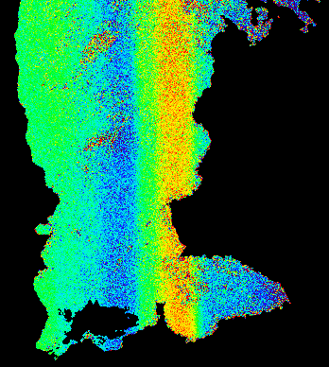
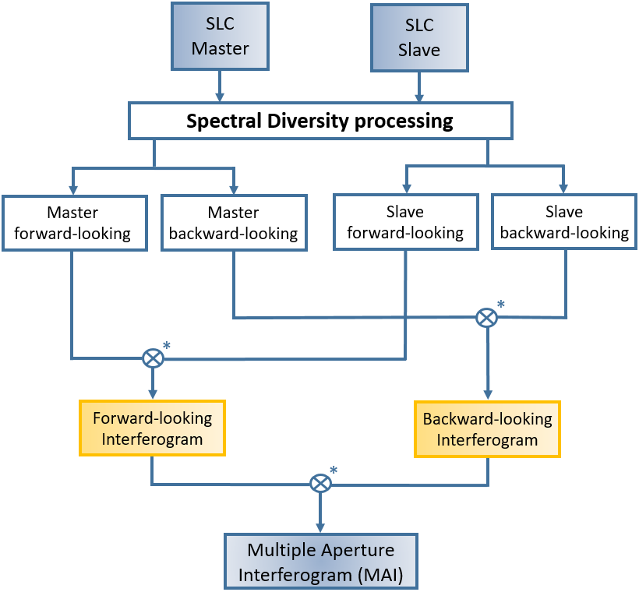
PAIRING OF ADJACENT SUB-BANDS
15 Sub-Bands
$$B_{az}$$
…
…
$$f$$
azimuth
range

Slide 15
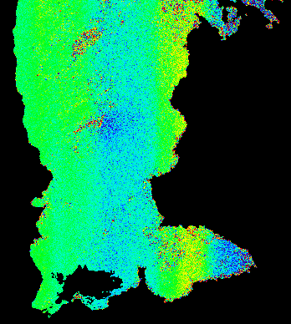
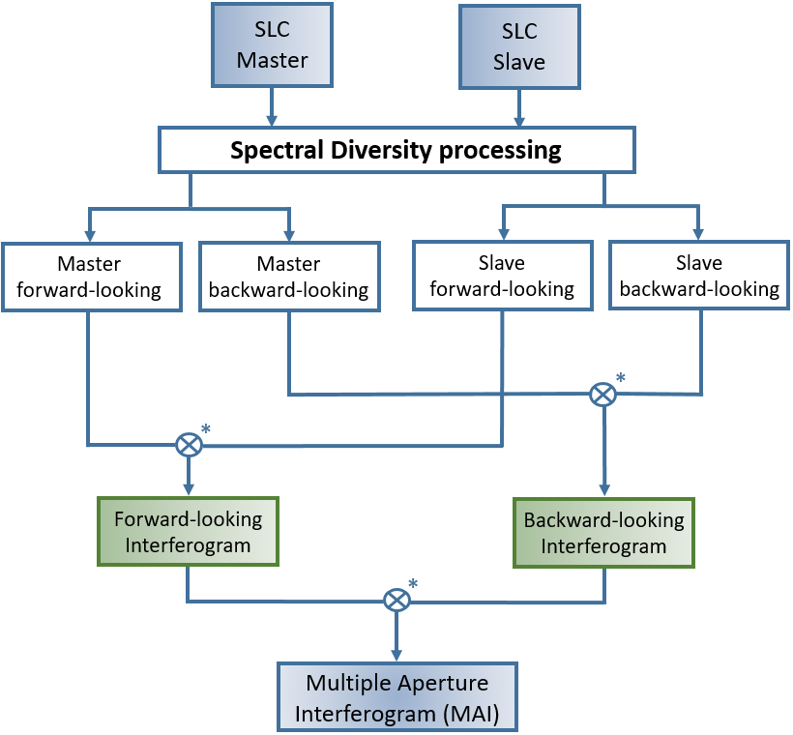
PAIRING OF ADJACENT SUB-BANDS
15 Sub-Bands
$$B_{az}$$
…
…
…
$$f$$
azimuth
range

Slide 16
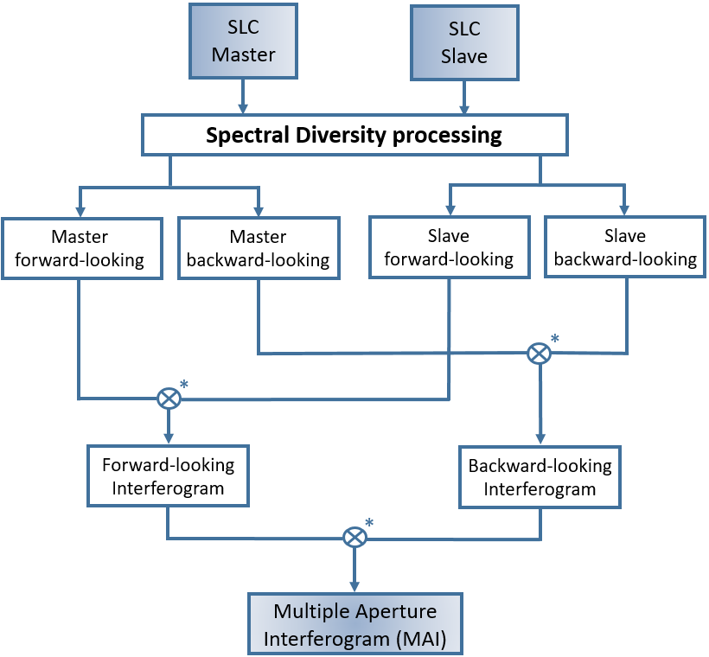
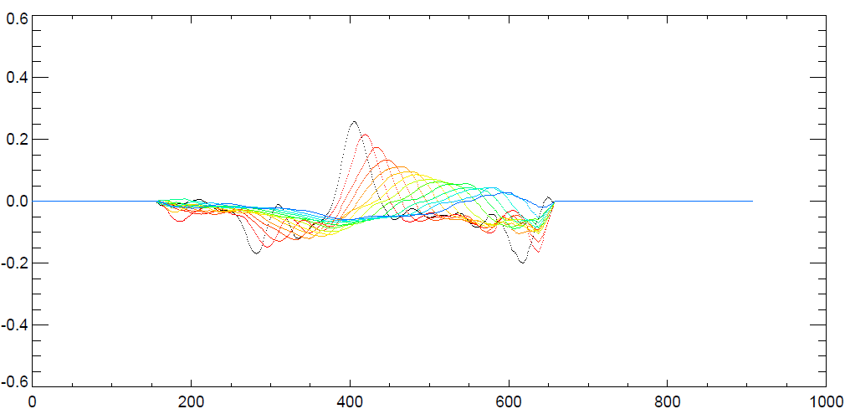
PAIRING OF ADJACENT SUB-BANDS
15 Sub-Bands
$$B_{az}$$
…
…
…
…
$$f$$
azimuth
range
Average
Amplitude
Azimuth

Slide 17
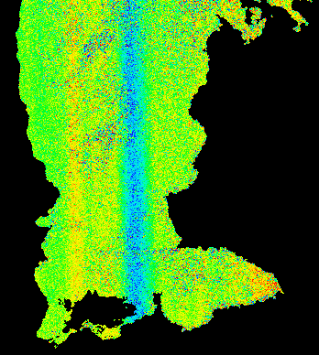
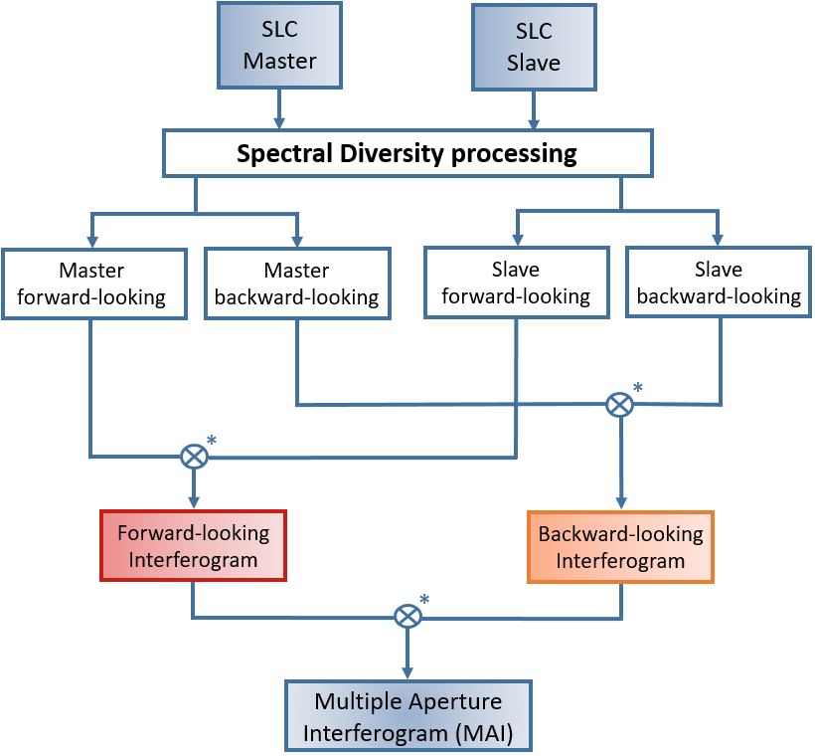


INCREASING ANGULAR DIVERSITY
15 Sub-Bands
$$B_{az}$$
…
$$f$$
azimuth
range

Slide 18


INCREASING ANGULAR DIVERSITY
15 Sub-Bands
$$B_{az}$$
…
…
$$f$$
azimuth
range

Slide 19


INCREASING ANGULAR DIVERSITY
15 Sub-Bands
$$B_{az}$$
…
…
…
$$f$$
azimuth
range

Slide 20



INCREASING ANGULAR DIVERSITY
15 Sub-Bands
$$B_{az}$$
…
…
…
…
$$f$$
azimuth
range
Average
Amplitude
Azimuth

