Slide 1

Entire Atmosphere Global model (EAGLE): development, first version and preliminary results
Timofei V. Sukhodolov^{1,2,3}, Fedor S. Bessarab¹, Nicolay V. Chirik¹, Bernd Funke⁴, Maxim V. Klimenko¹, Vladimir V. Klimenko¹, Yuriy N. Korenkov¹, Dmitry V. Kulyamin^{1,5}, Katharina Meraner⁶, Hauke Schmidt⁶, Pavel A. Vasiliev¹, Irina E. Zakharenkova¹, and Eugene V. Rozanov^{1,2,3}
¹West Department of Pushkov Institute of Terrestrial Magnetism, Ionosphere and Radio Wave Propagation RAS, Kaliningrad, Russia
²Physikalisch-Meteorologisches Observatorium, World Radiation Center, Davos, Switzerland
³Institute for Atmospheric and Climate Science, ETH Zurich, Zurich, Switzerland
⁴Instituto de Astrofısica de Andalucia, CSIC, Granada, Spain
⁵Research Computing Center, Lomonosov Moscow State University, Moscow, Russia
⁶Max Planck Institute for Meteorology, Hamburg, Germany

Slide 2
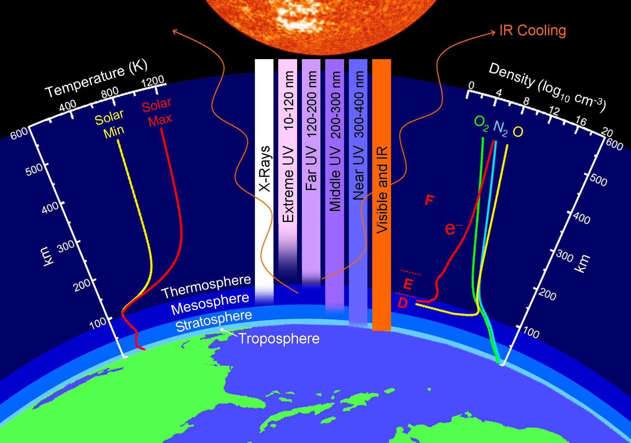
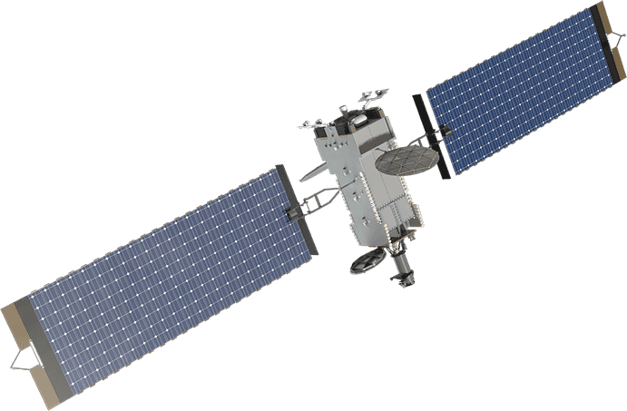
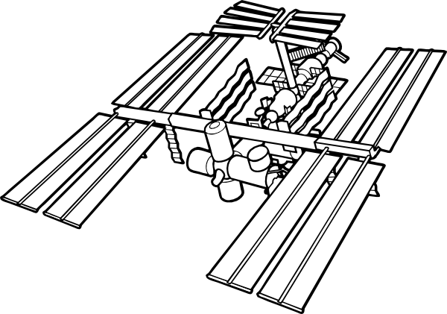




Structure of the Atmosphere
Why do we care?
Credit: John Emmert/Naval Research Lab
Upper atmosphere
SPACE WEATHER
80-90 km
WEATHER, CLIMATE
Middle/lower atmosphere
Everything is coupled!

Slide 3
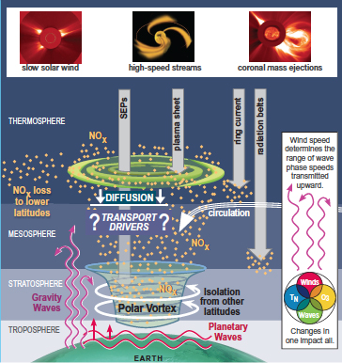
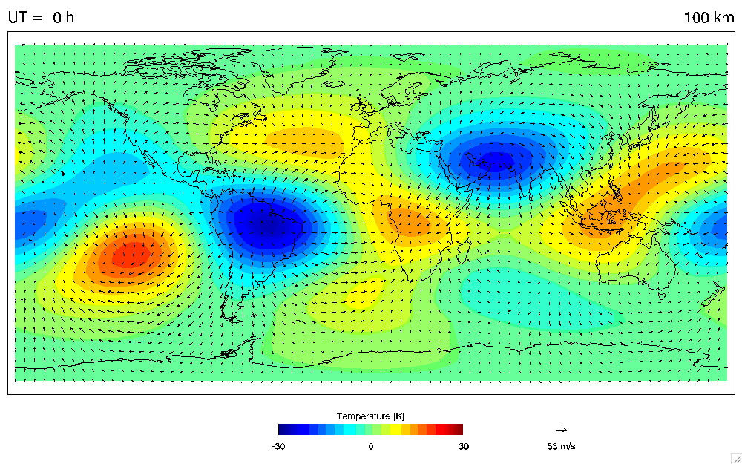
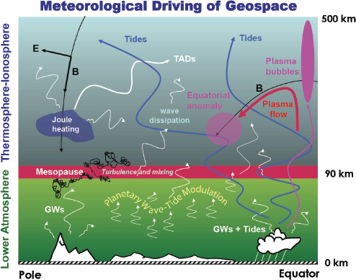
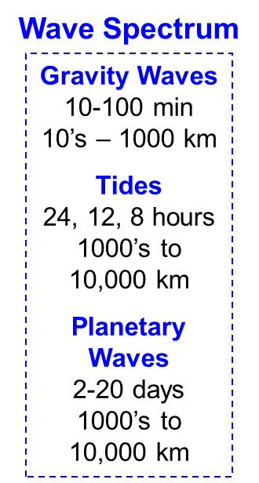
Interaction between the “lower/middle atmosphere” and the “upper atmosphere”
Courtesy of Jeffrey M. Forbes, University of Colorado, Boulder, and David Fritts, Colorado Research Associates.
Courtesy of Cora E. Randall, University of Colorado, Boulder; Janet U. Kozyra, University of Michigan, Ann Arbor; and Scott M. Bailey, Virginia Institute of Technology
Ozone destruction by NO_{x}
Propagation and dissipation of atmospheric waves

Slide 4
Our models
EAGLE
HAMMONIA
GSMTIP
ERA-Interim
nudging
Stratospheric
aerosols
Solar
irradiance
GHG/
ODS
Lower
Boundary conditions
D, E, F1 Ionosphere
80-175 km
Mostly molecular ions, electrons
Ion-involved reactions
Ion, electron/neutral interactions
Thermosphere
80-520 km, L30
5˚-5˚
Neutral chemistry
Neutral dynamics
Physics & Dynamics
0-180(280) km, L119
1.9˚-1.9˚, T63
Column physics
Tracer transport
Chemistry
48 species
107 neutral reactions
46 photolysis reactions
18 ion-involved reactions
Solar EUV
Auroral precipitation/
Field-aligned current
Electric
field
F2 Ionosphere, Protonosphere
175-100000 km
Mostly atomic ions, electrons
Quasihydrodynamics
Sea ice
Sea temperature
Land use
Ionization rates (MA)
Ionization rates (UA)
Entire Atmosphere Global Model

Slide 5
Coupling interface
HAMMONIA + GSMTIP = EAGLE (Entire Atmosphere Global Model)
Parameter | CCM HAMMONIA | GSM TIP
Vertical coordinates | σ-levels | Heights
Horizontal space | Spectral | Grid point
Horizontal resolution | 1.9˚-1.9˚ | 5˚-5˚
Horizontal grid | Geographic | Geomagnetic
Dynamical timestep | 3 min | 1 min
Parallelized | Yes | No
Vertical domain | 0-200 km | 80-500 km
Shared data | Temperature, densities, winds | Ionization rates, Ion drag, Joule heating
?
?
?
1,2,3,4,n
HAMMONIA
GSMTIP
1 timestep
i/o
3 timesteps
1 model month = 3 real days on 64 processors with hourly output

Slide 6
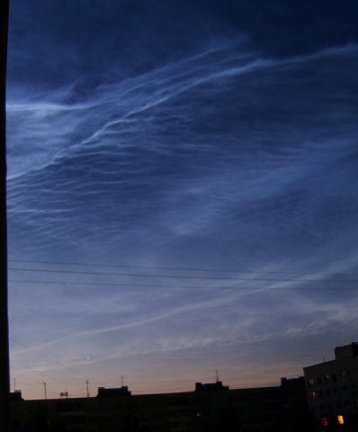
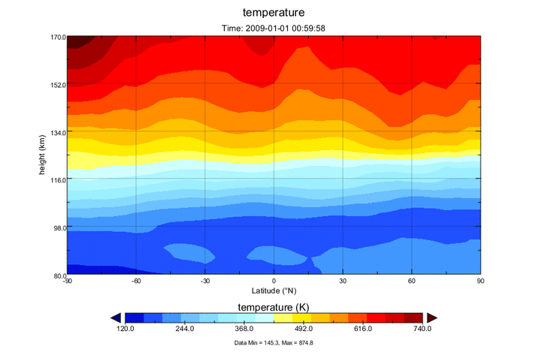
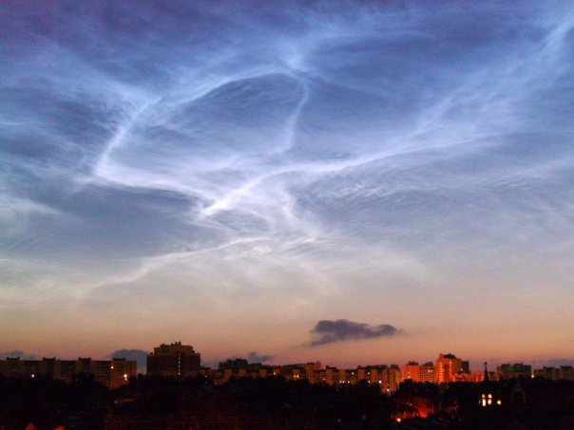
Where to couple?
January 2009 temperature

Slide 7
Where to couple?
January 2009 zonal wind
EAGLE 120 km run
UARS satellite
Zonal wind, m/s

Slide 8
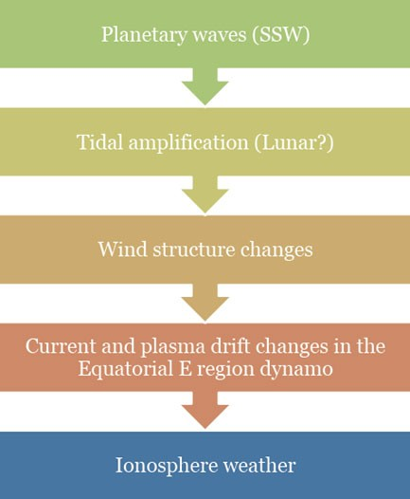
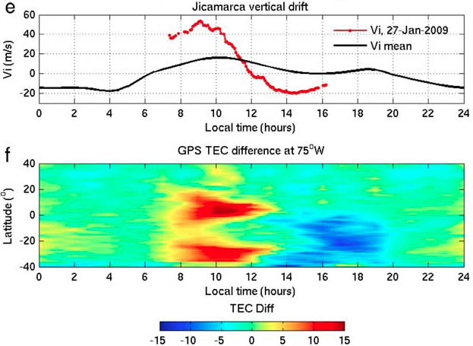
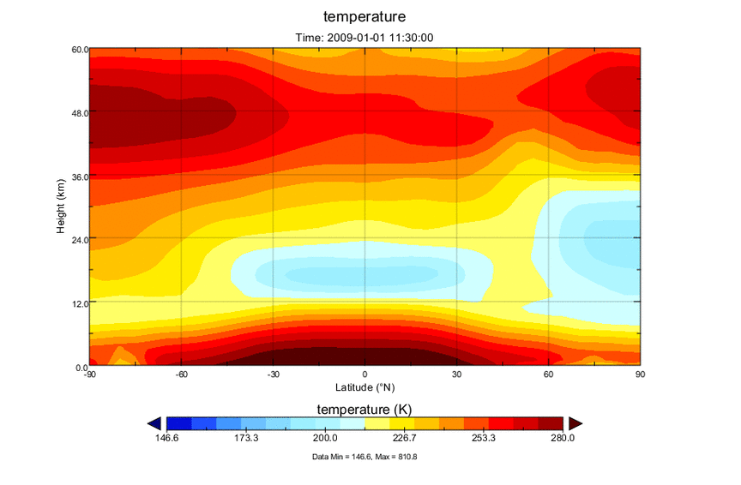
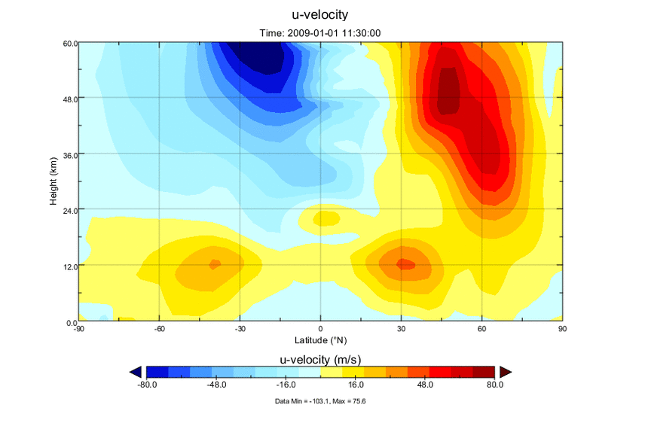
Sudden stratospheric warming
(Chau et al., 2010,2012 JGR; Goncharenko et al., 2010 JGR)

Slide 9
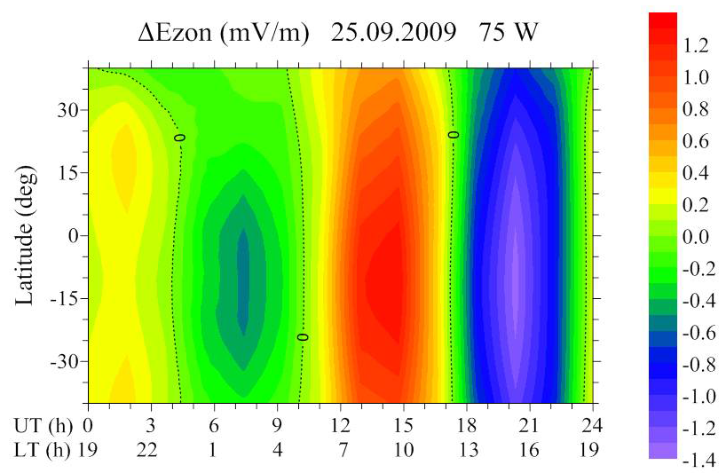
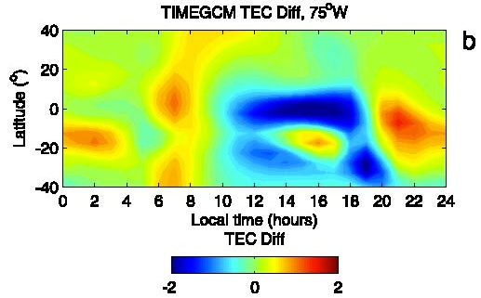
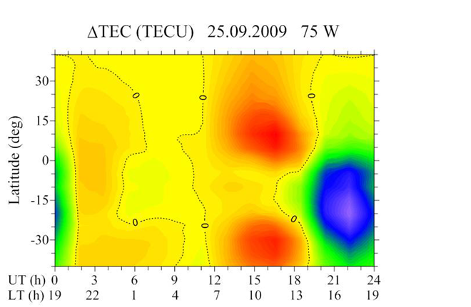
Previous attempts
Thermosphere Ionosphere Mesosphere Electrodynamics General Circulation Model (TIMEGCM) (30 – 600 km)
Liu et al., 2002, 2005, 2010; Yamashita et al., 2010
GSMTIP (Klimenko et al., 2015)
The zonal electric field is the main driver for low-latitude ionospheric response to sudden stratospheric warming

Slide 10
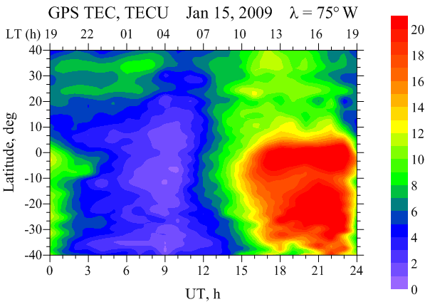
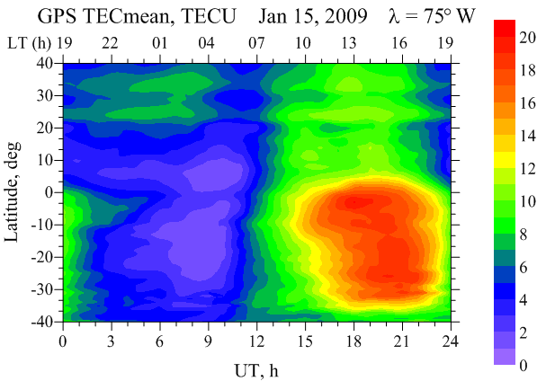
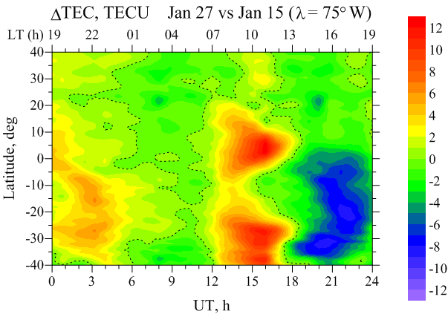
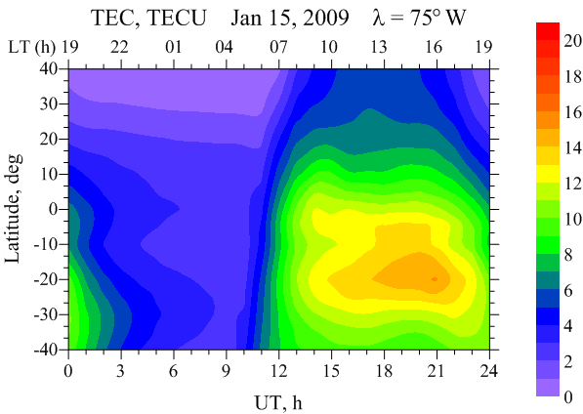
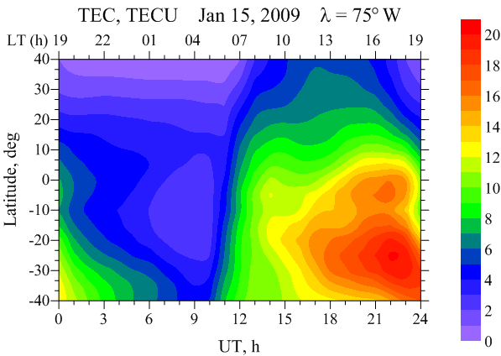
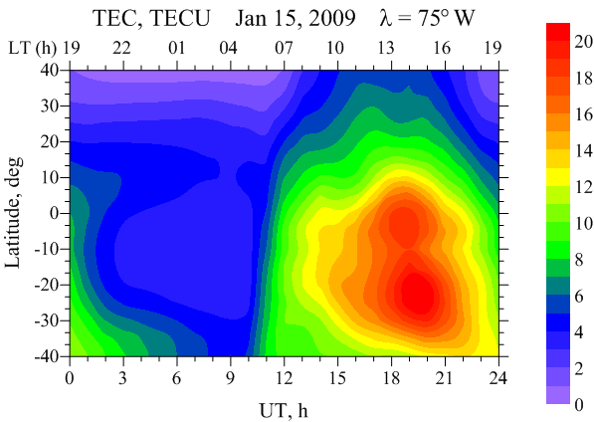
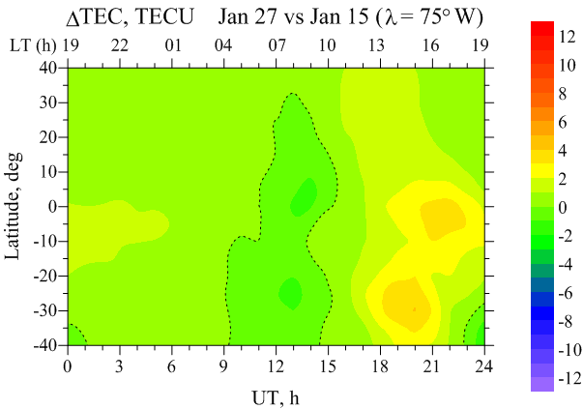
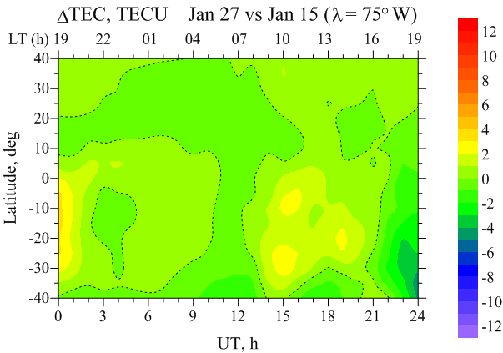
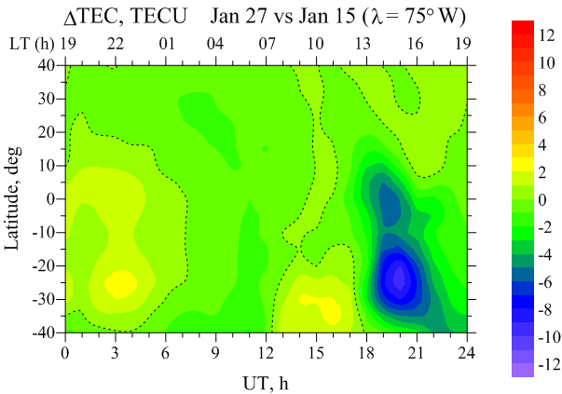
New SSW results
80 km
100 km
120 km

Slide 11
Overview
Now
New model is stably running
Mean state and some features are already well reproduced
Soon
Deep comparison against observations is needed (SABER, TIMED, MIPAS, UARS)
Remaining coupling questions
GMDD model description paper
Later
SSW effects
SPE effects
Solar variability effects
Much more….

Slide 12
Thank you!

