Slide 1
Local-scale wind speed features captured by seasonal forecasts
Jaume Ramon, Ll. Lledó, P-A. Bretonnière, M. Samsó and F-J. Doblas-Reyes
06/09/2021
EMS Annual Meeting 2021

Slide 2
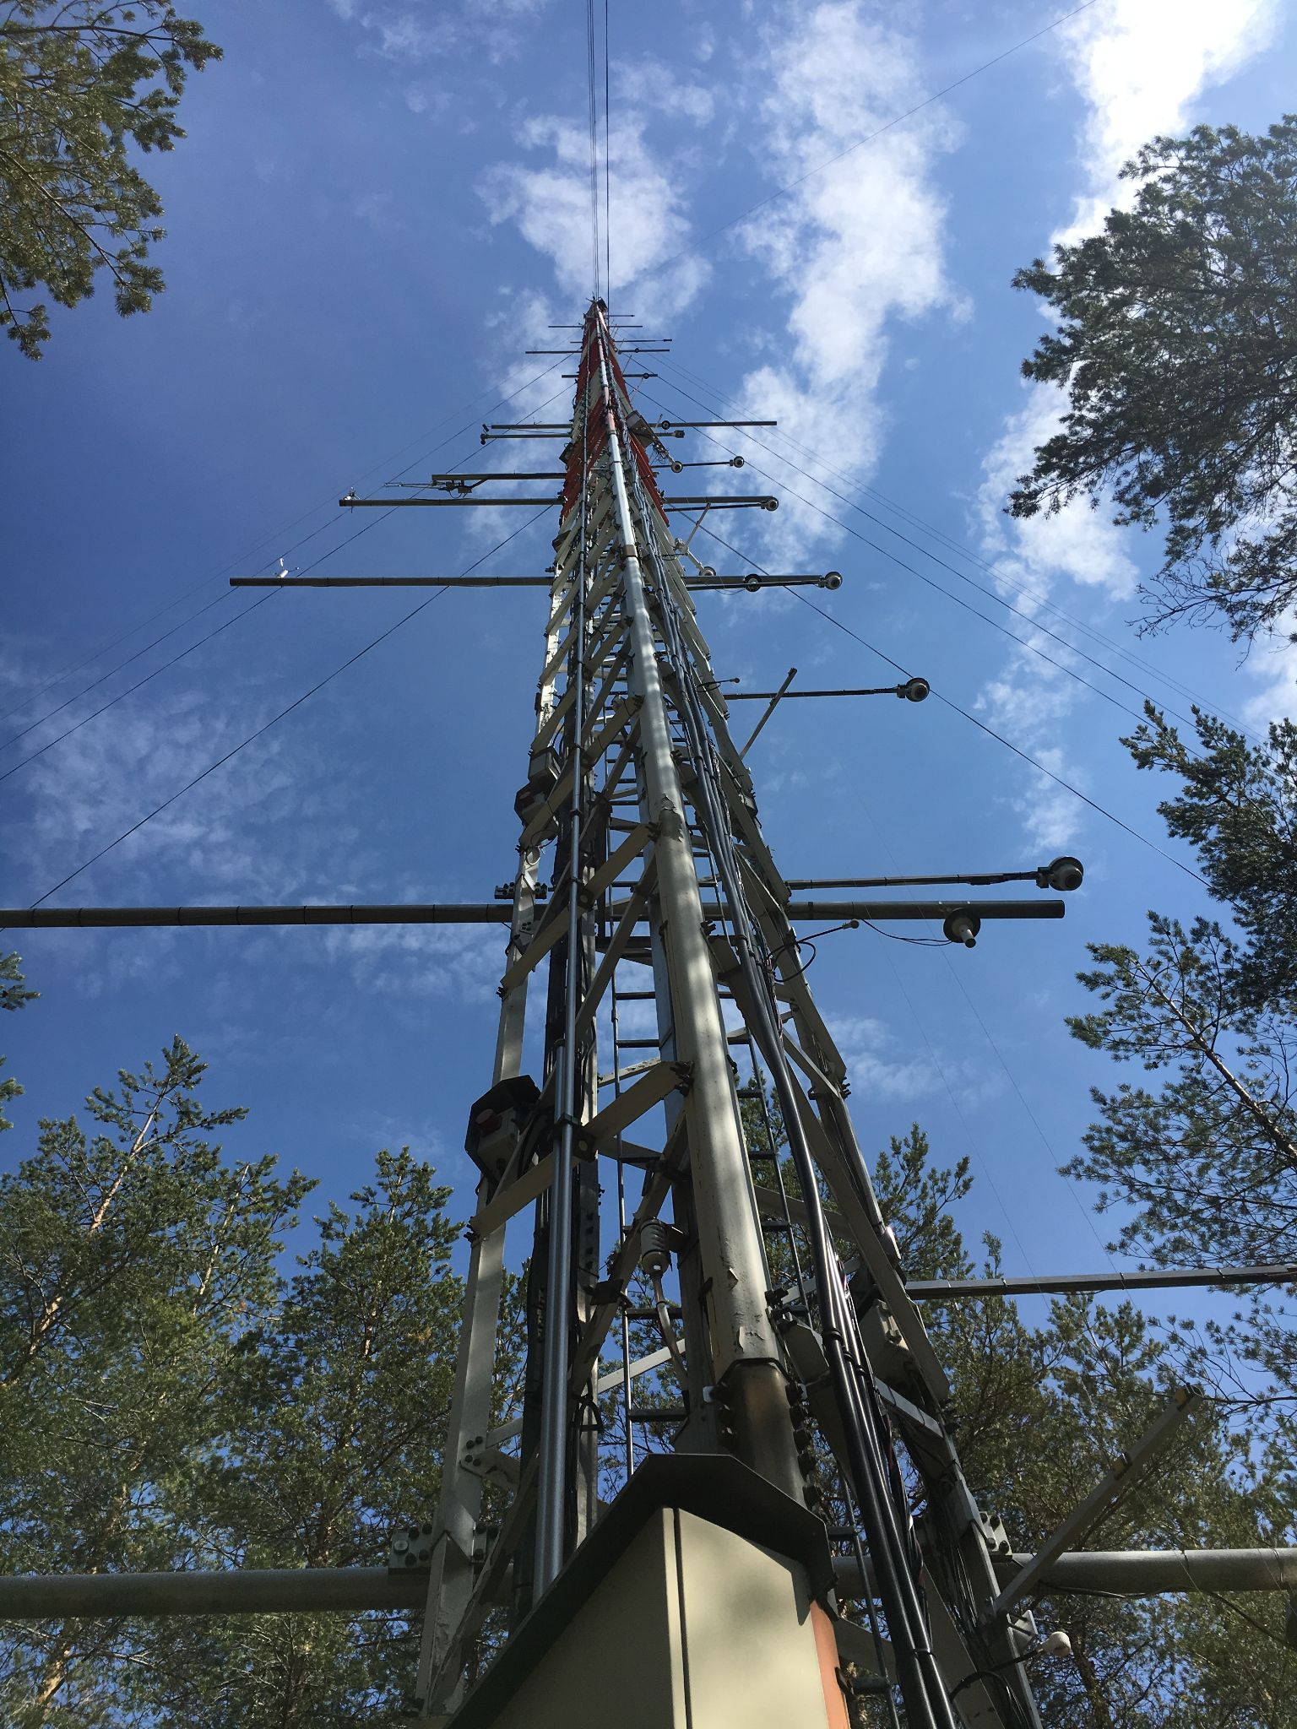
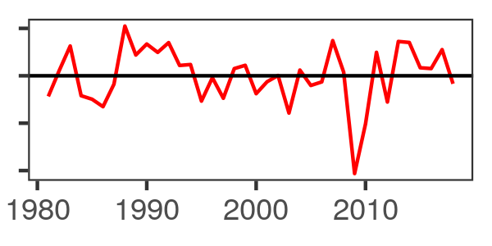
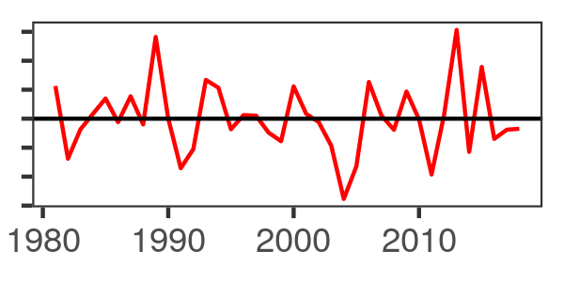
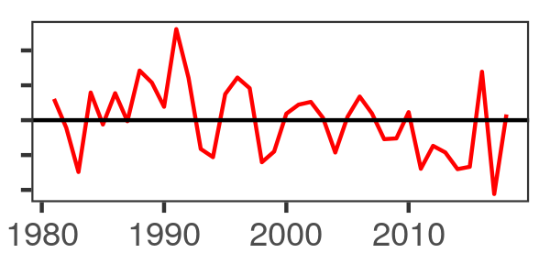
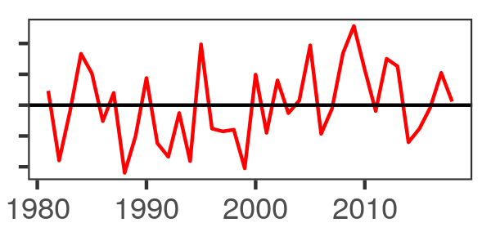
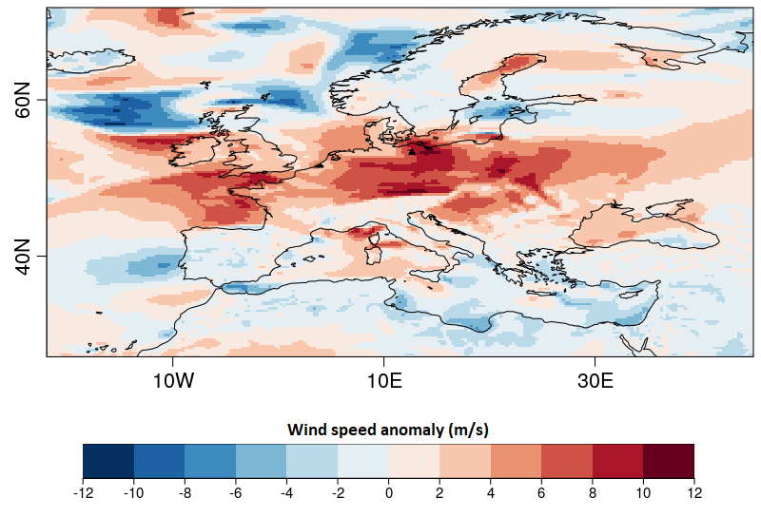
Hybrid Forecasts - Statistical Downscaling
near-surface
wind speed
Indices of the four main Euro-Atlantic Teleconnections
~
+
+
+
tall meteorological towers
reanalyses
1980
1990
2000
2010
observations - training (perfect prognosis)
forecasts and observations - validation
J. Ramon et al. (2021). A perfect prognosis downscaling methodology for seasonal prediction of local-scale wind speeds.
doi:10.1088/1748-9326/abe491

Slide 3
Hybrid vs Dynamical Forecasts: are they better?
Conclusions:
Hybrid predictions outperform the dynamical forecasts at the local scale:
Prediction | CRPSS
Dynamical prediction (without bias-correction) | -4.215
Dynamical prediction (bias-corrected) | -0.046
Hybrid prediction | 0.001
Better
Worse
Data: Puijo tower, Finland
Hybrid predictions show their added value at the furthest forecast horizons, where dynamical predictions barely show skill.
Hybrid predictions also show skill at the local scale. A very simple multi-linear regression can capture local wind effects.
Hybrid predictions are easily interpretable because they use information of the general atmospheric circulation, i.e. Euro-Atlantic Teleconnections.
Target season: winter (DJF)
Skill score: CRPSS
Seasonal prediction system: SEAS5 (ECMWF)
Dots: statistically significant (Diebold-Mariano test)
J. Ramon et al. (2021). A perfect prognosis downscaling methodology for seasonal prediction of local-scale wind speeds.
doi:10.1088/1748-9326/abe491

