Slide 1
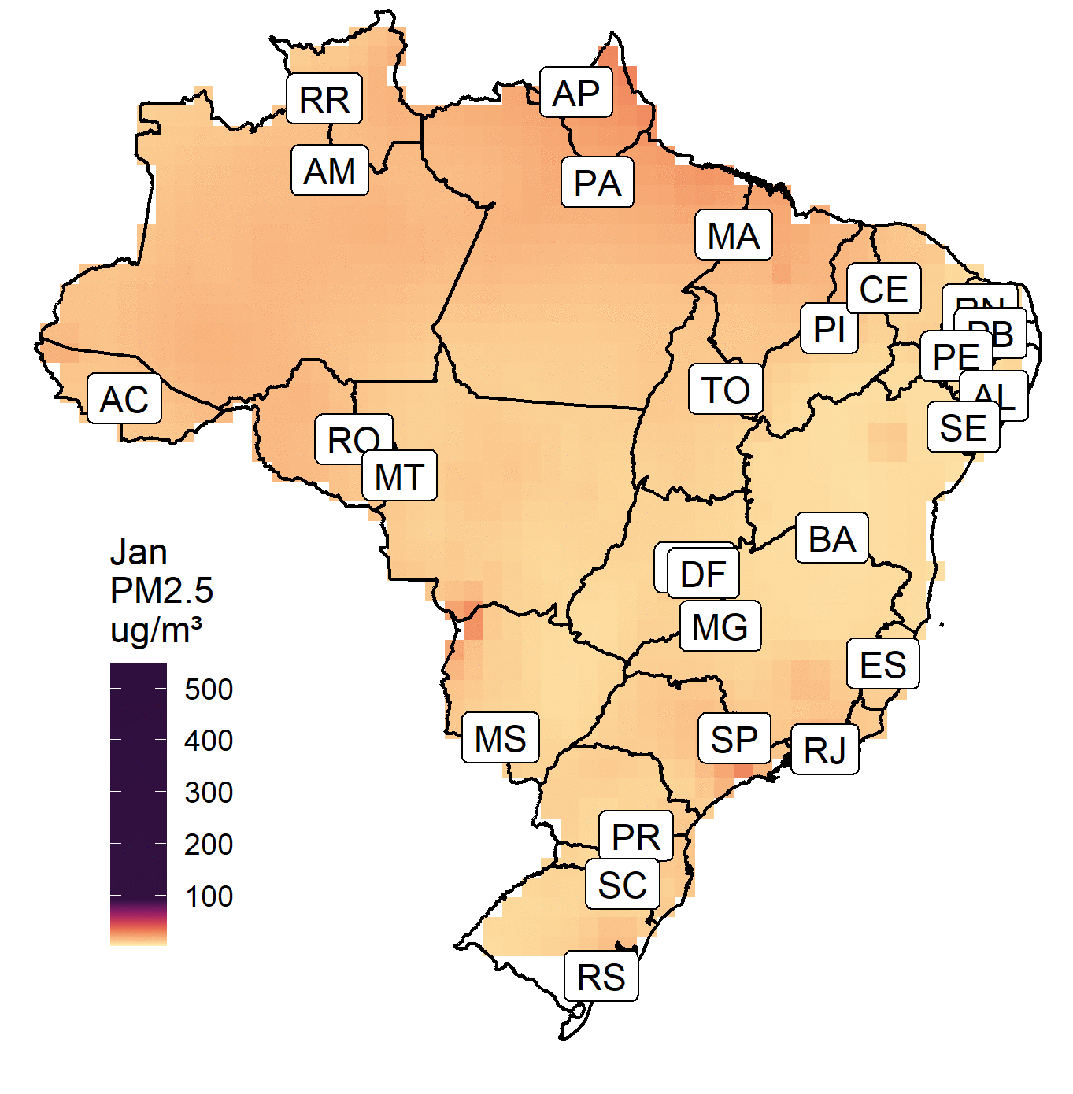
Association between COVID-19, mobility and environment in Brazil Brazilian capitals
Sergio Ibarra-Espinosa
Edmilson Dias de Freitas
Departamento de Ciências Atmosféricas
Universidade de São Paulo
Sergio.ibarra@usp.br

Slide 2
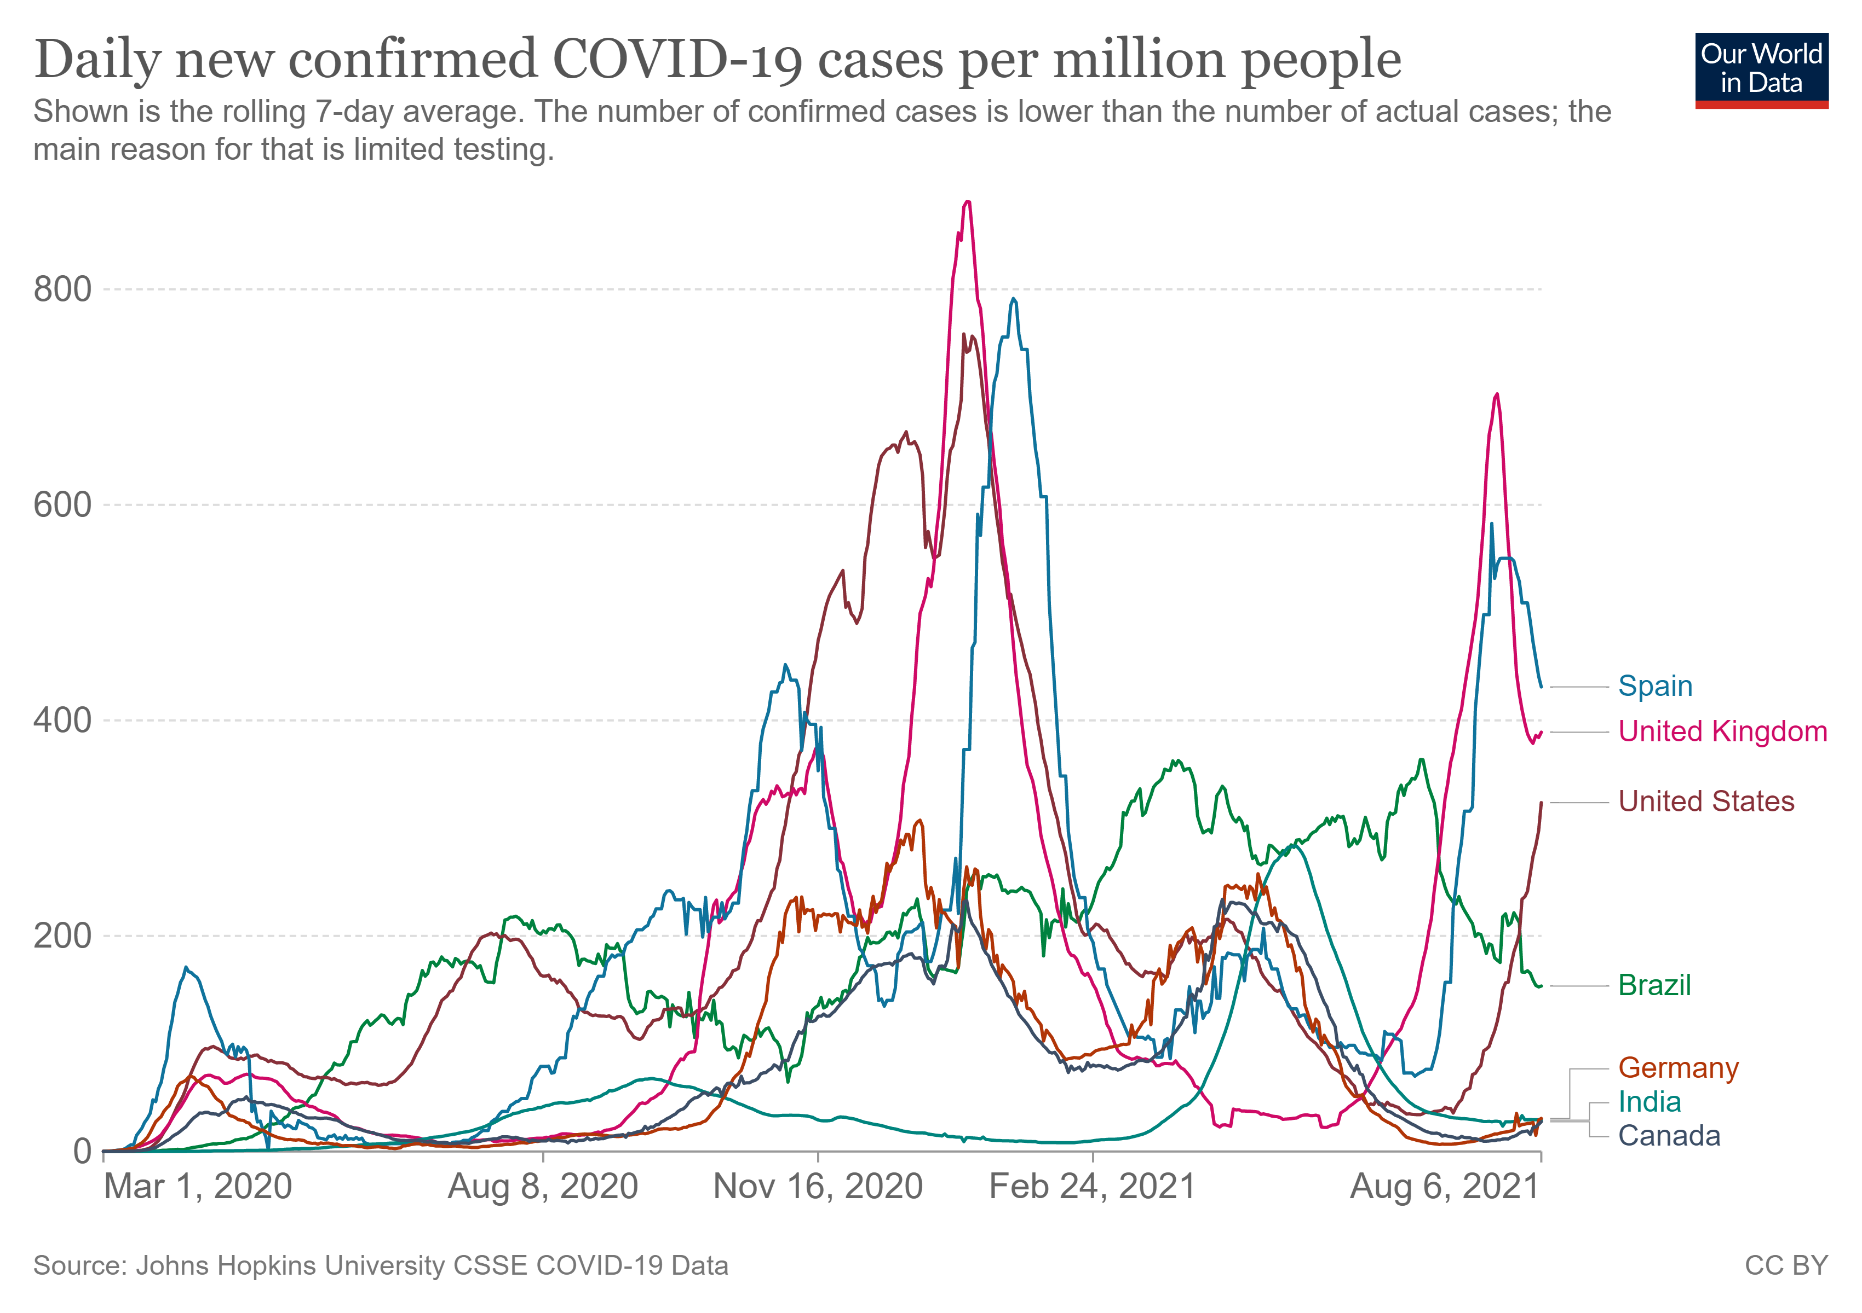
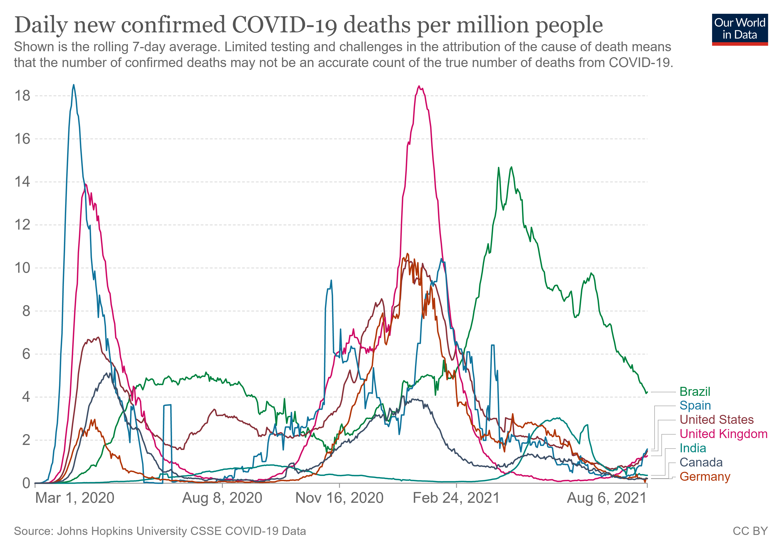
Introduction
152 CASES/million people Rolling 7-day average
4.17 CASES/million people Rolling 7-day average

Slide 3
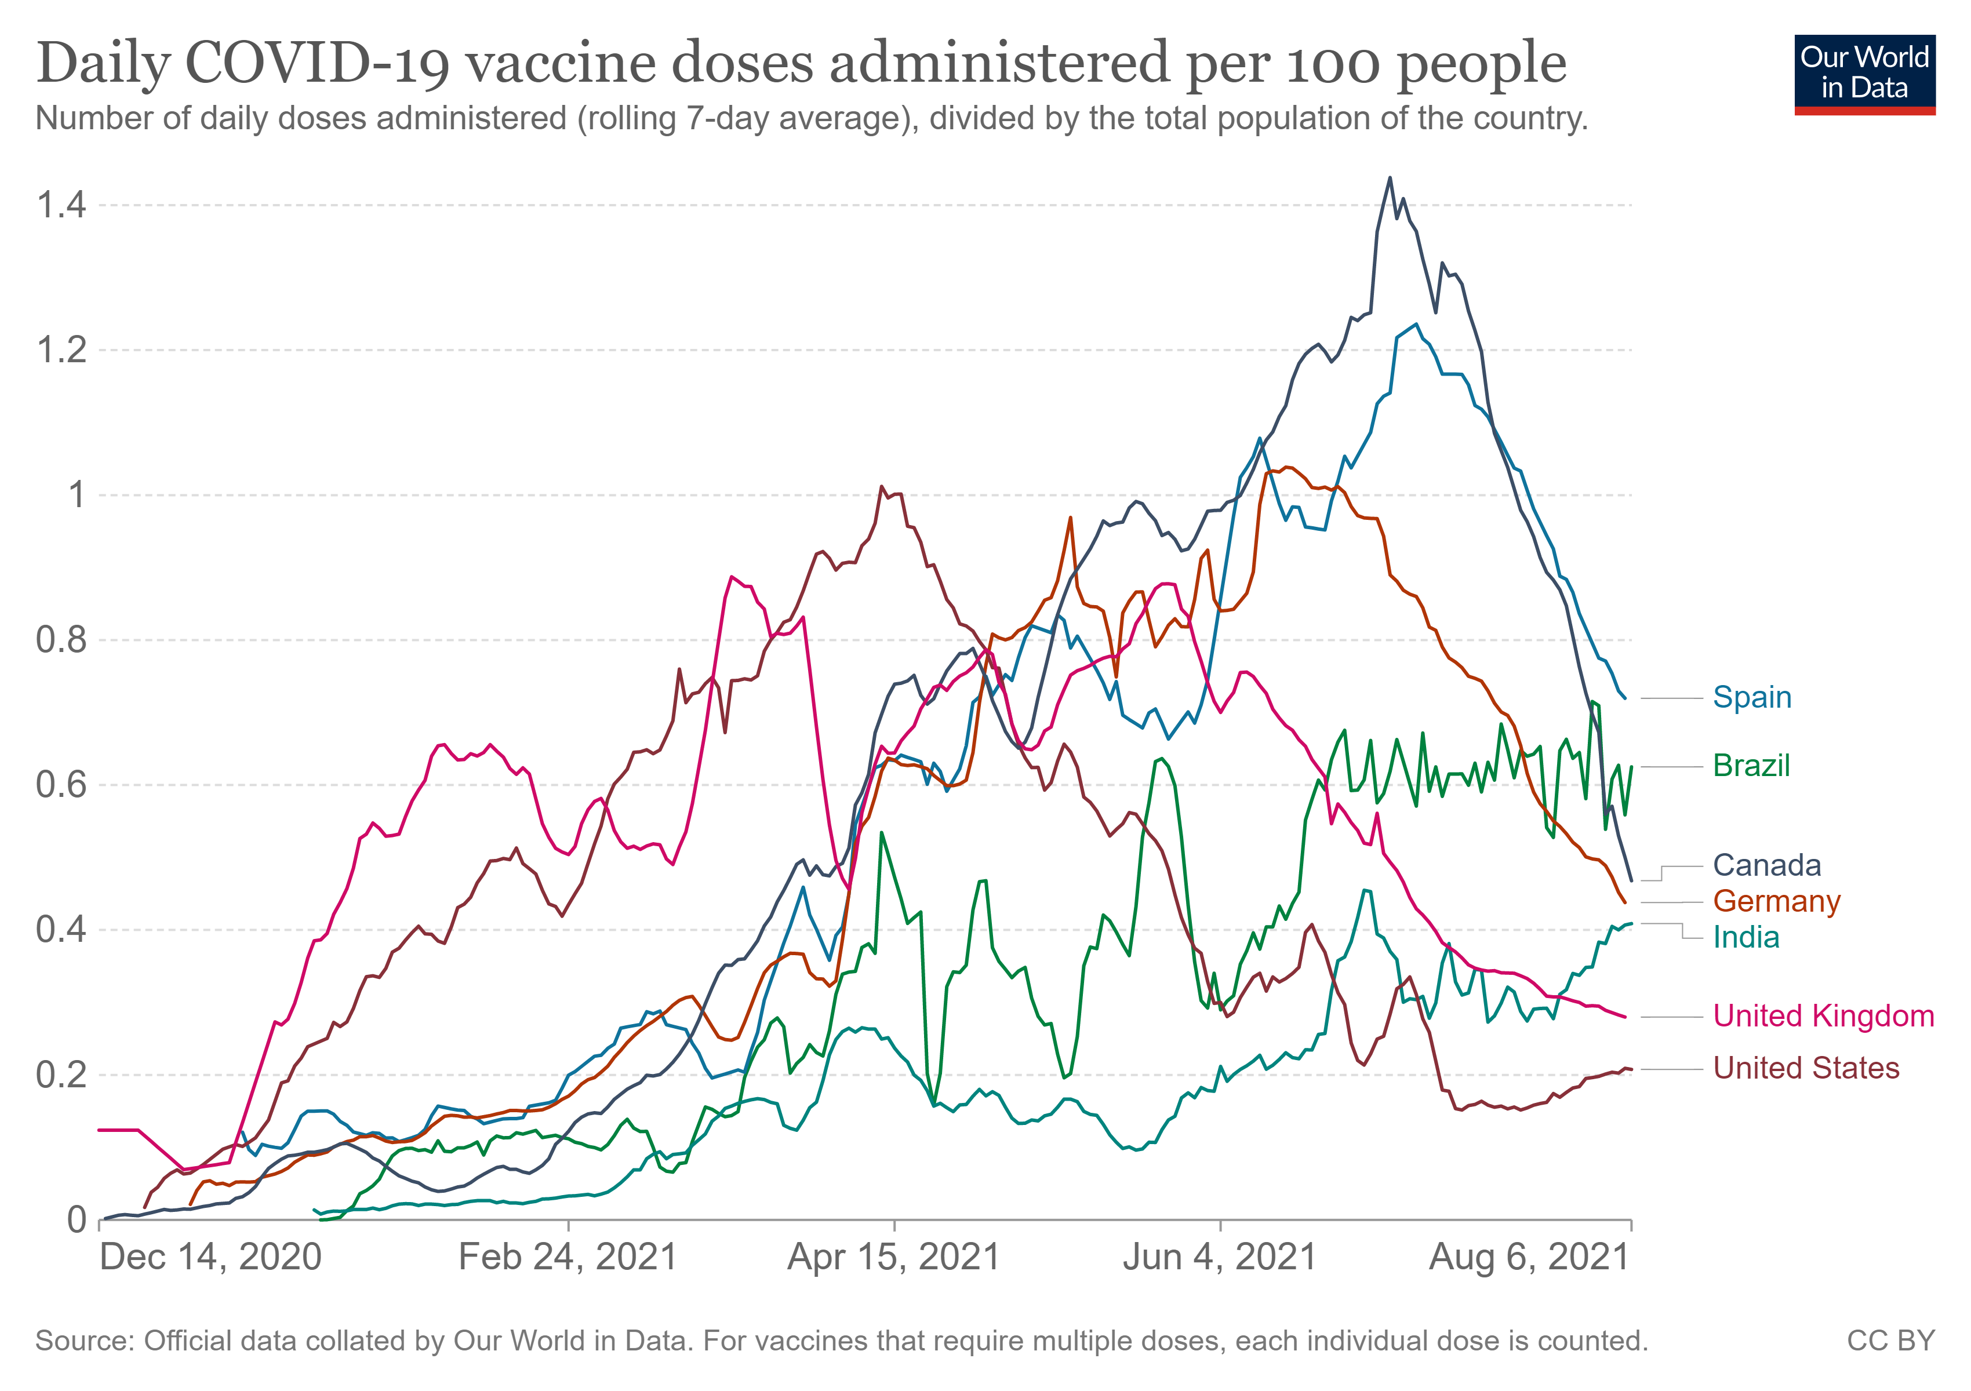
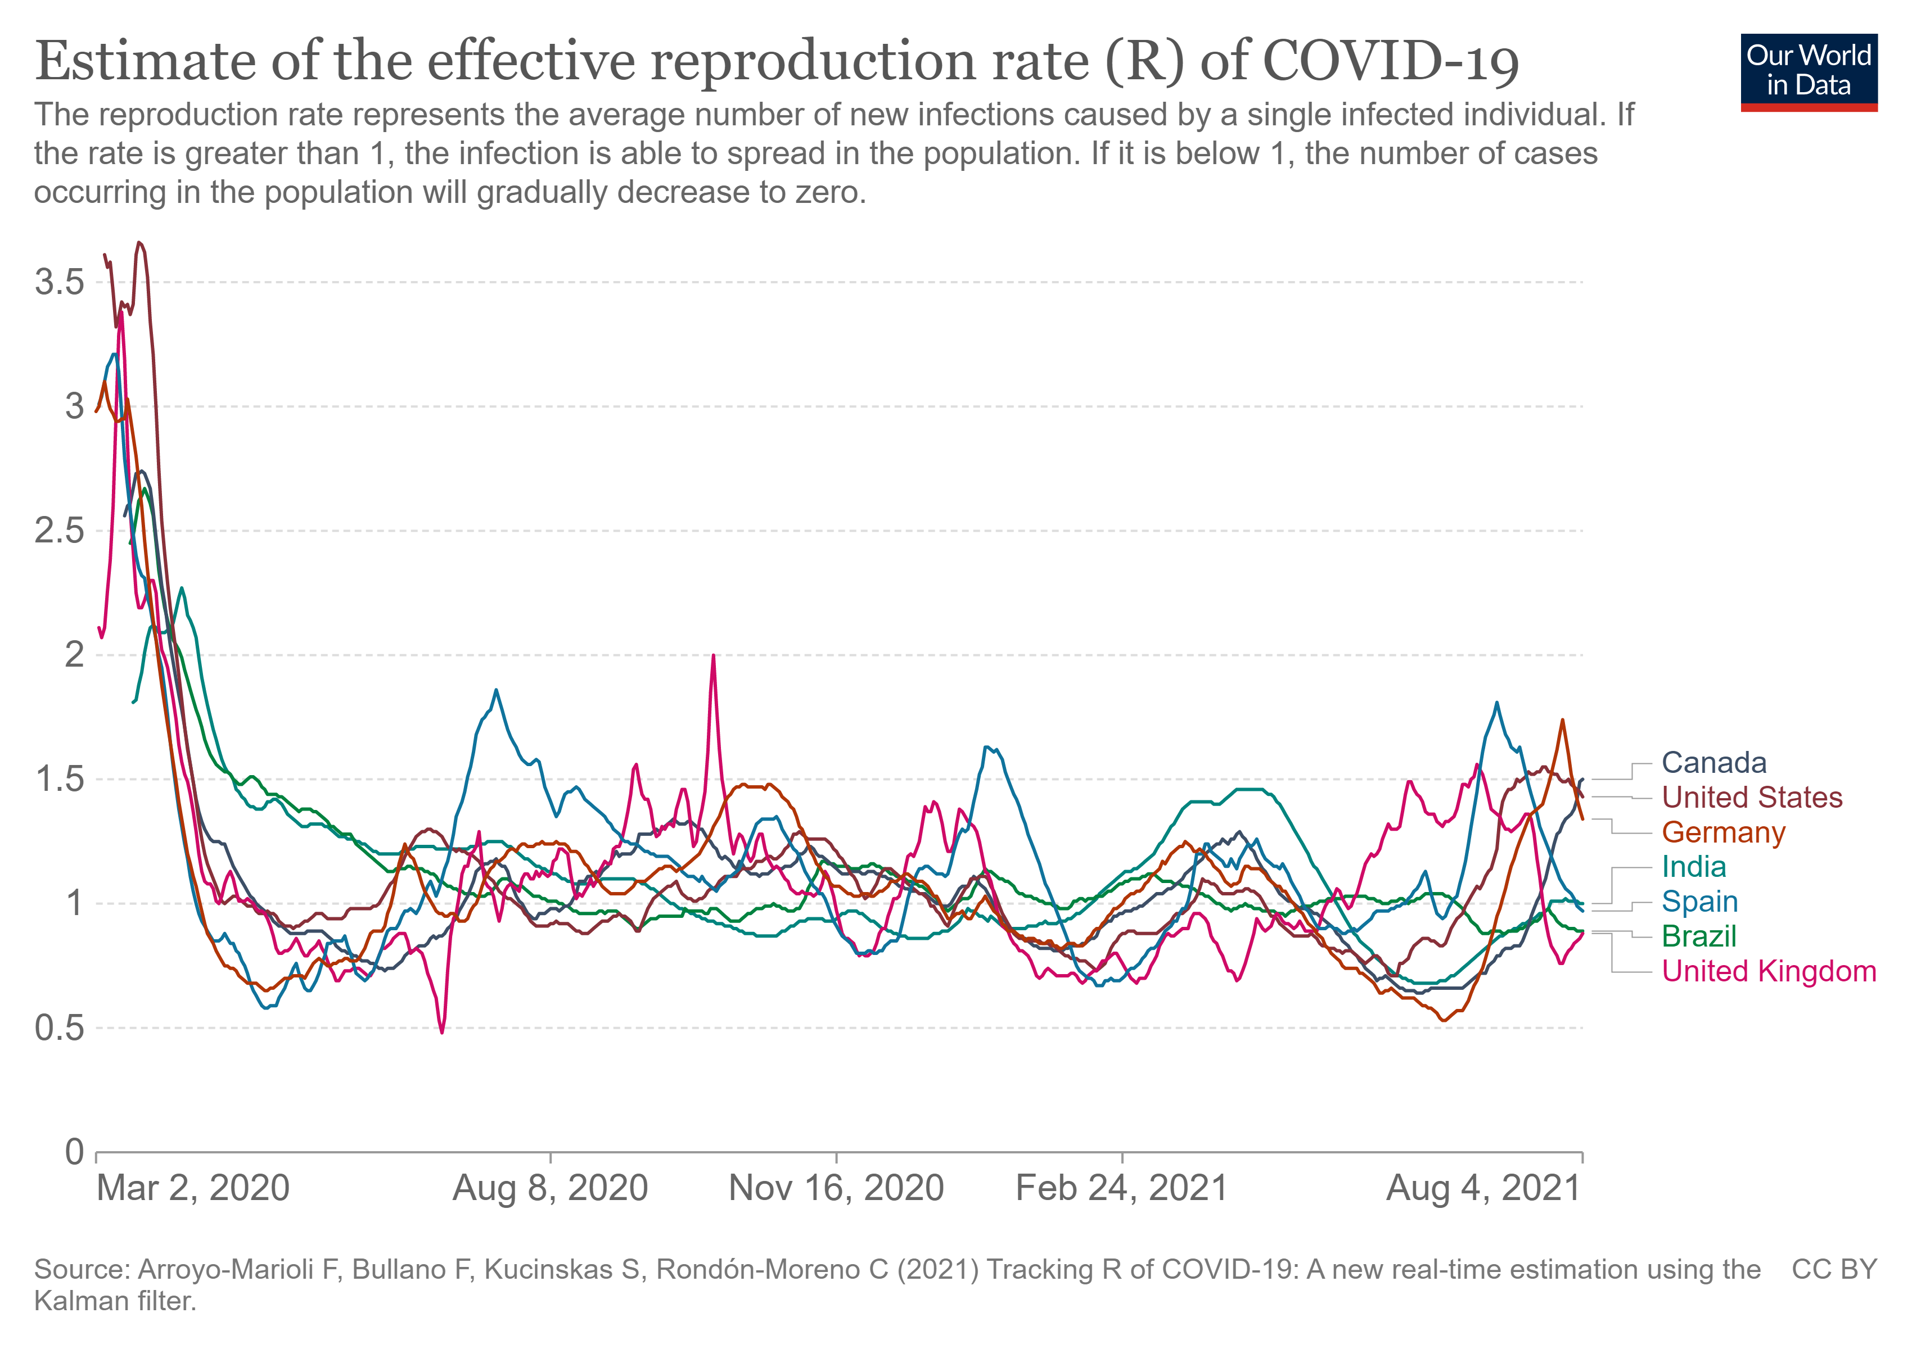
Introduction
0.56 CASES/100 PEOPLE
RR 0.89

Slide 4
Data: COVID19 in Brazil (https://covid.saude.gov.br/)

Slide 5
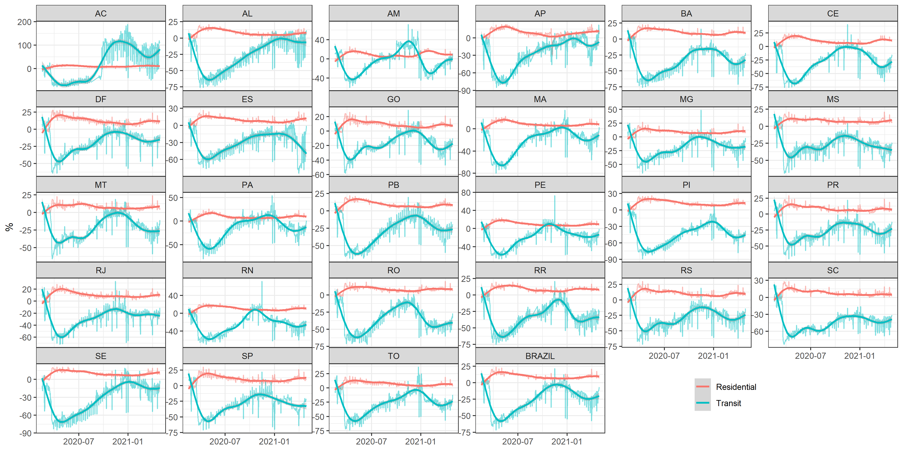
MOBILITY in Brazil (https://www.google.com/covid19/mobility/)
2020-01-01 - 2021-04-30

Slide 6
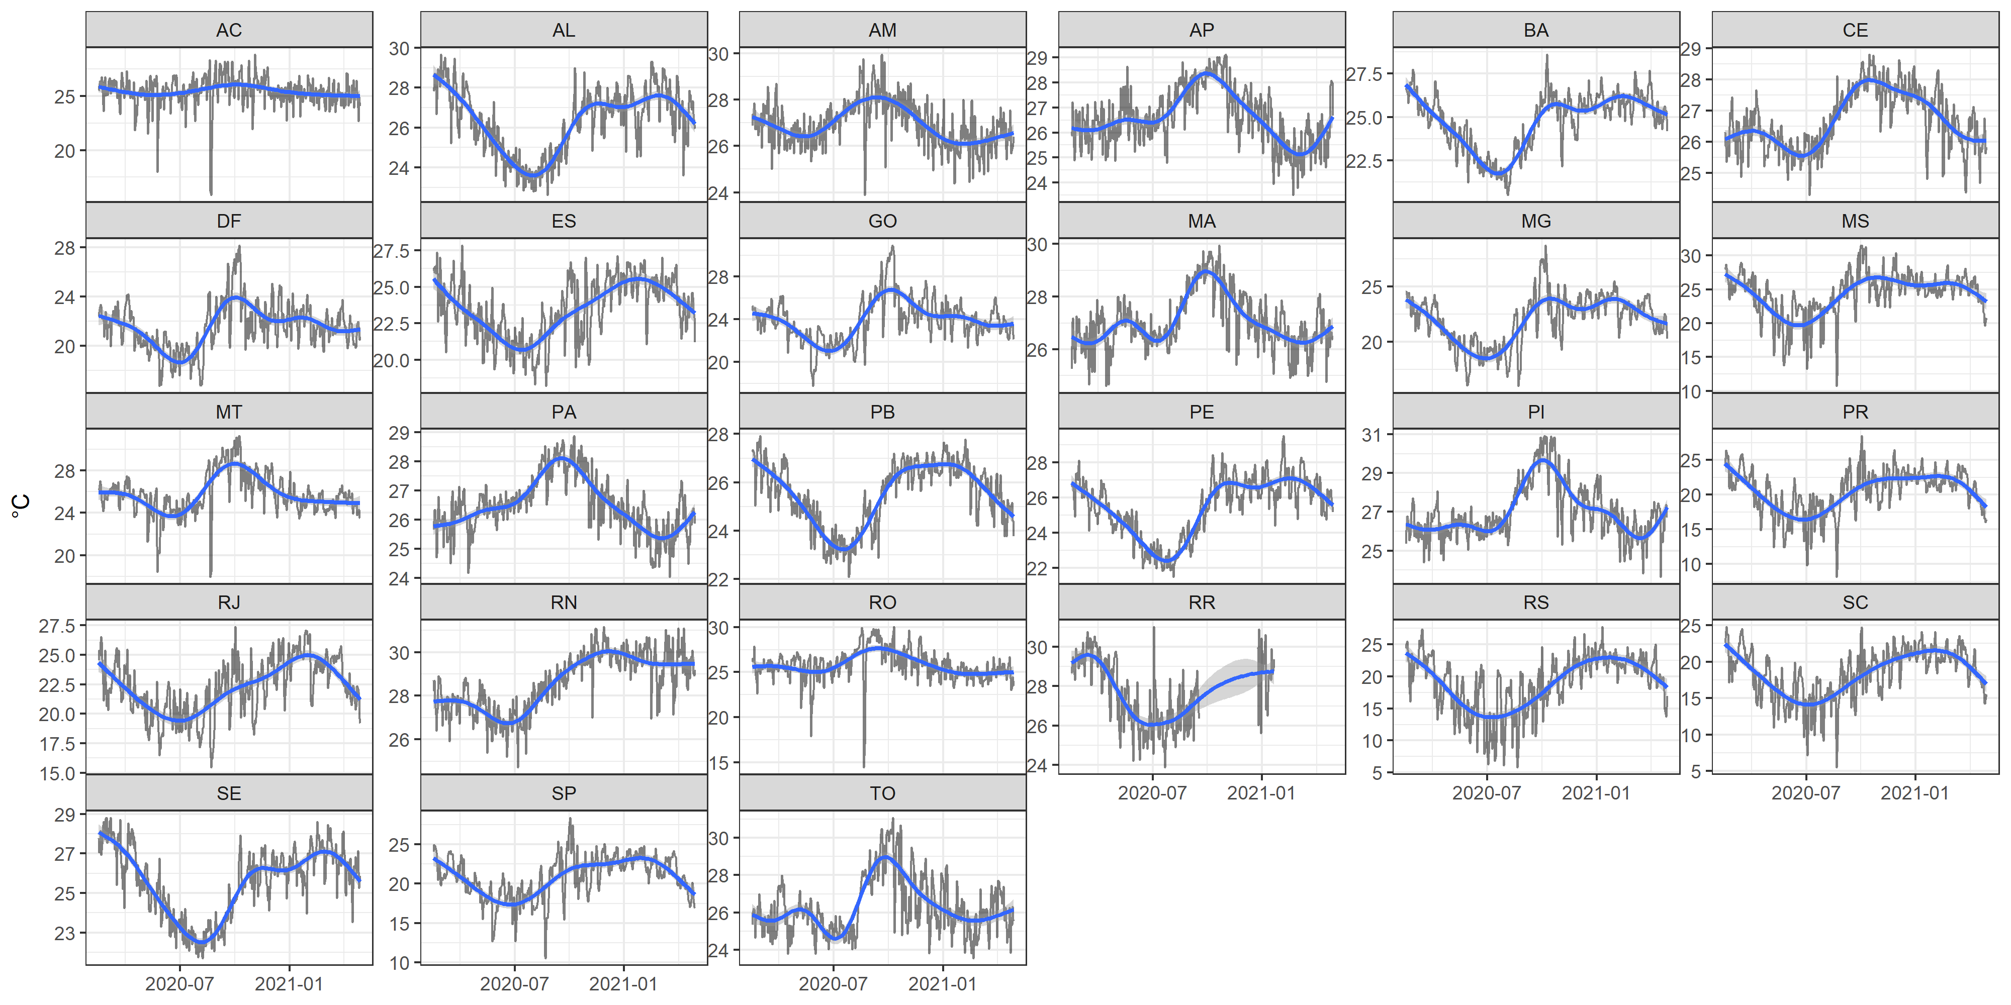
METEOROLOGY Brazil (https://portal.inmet.gov.br/)
Daily mean temperture (°C)
2020-01-01 - 2021-04-30

Slide 7
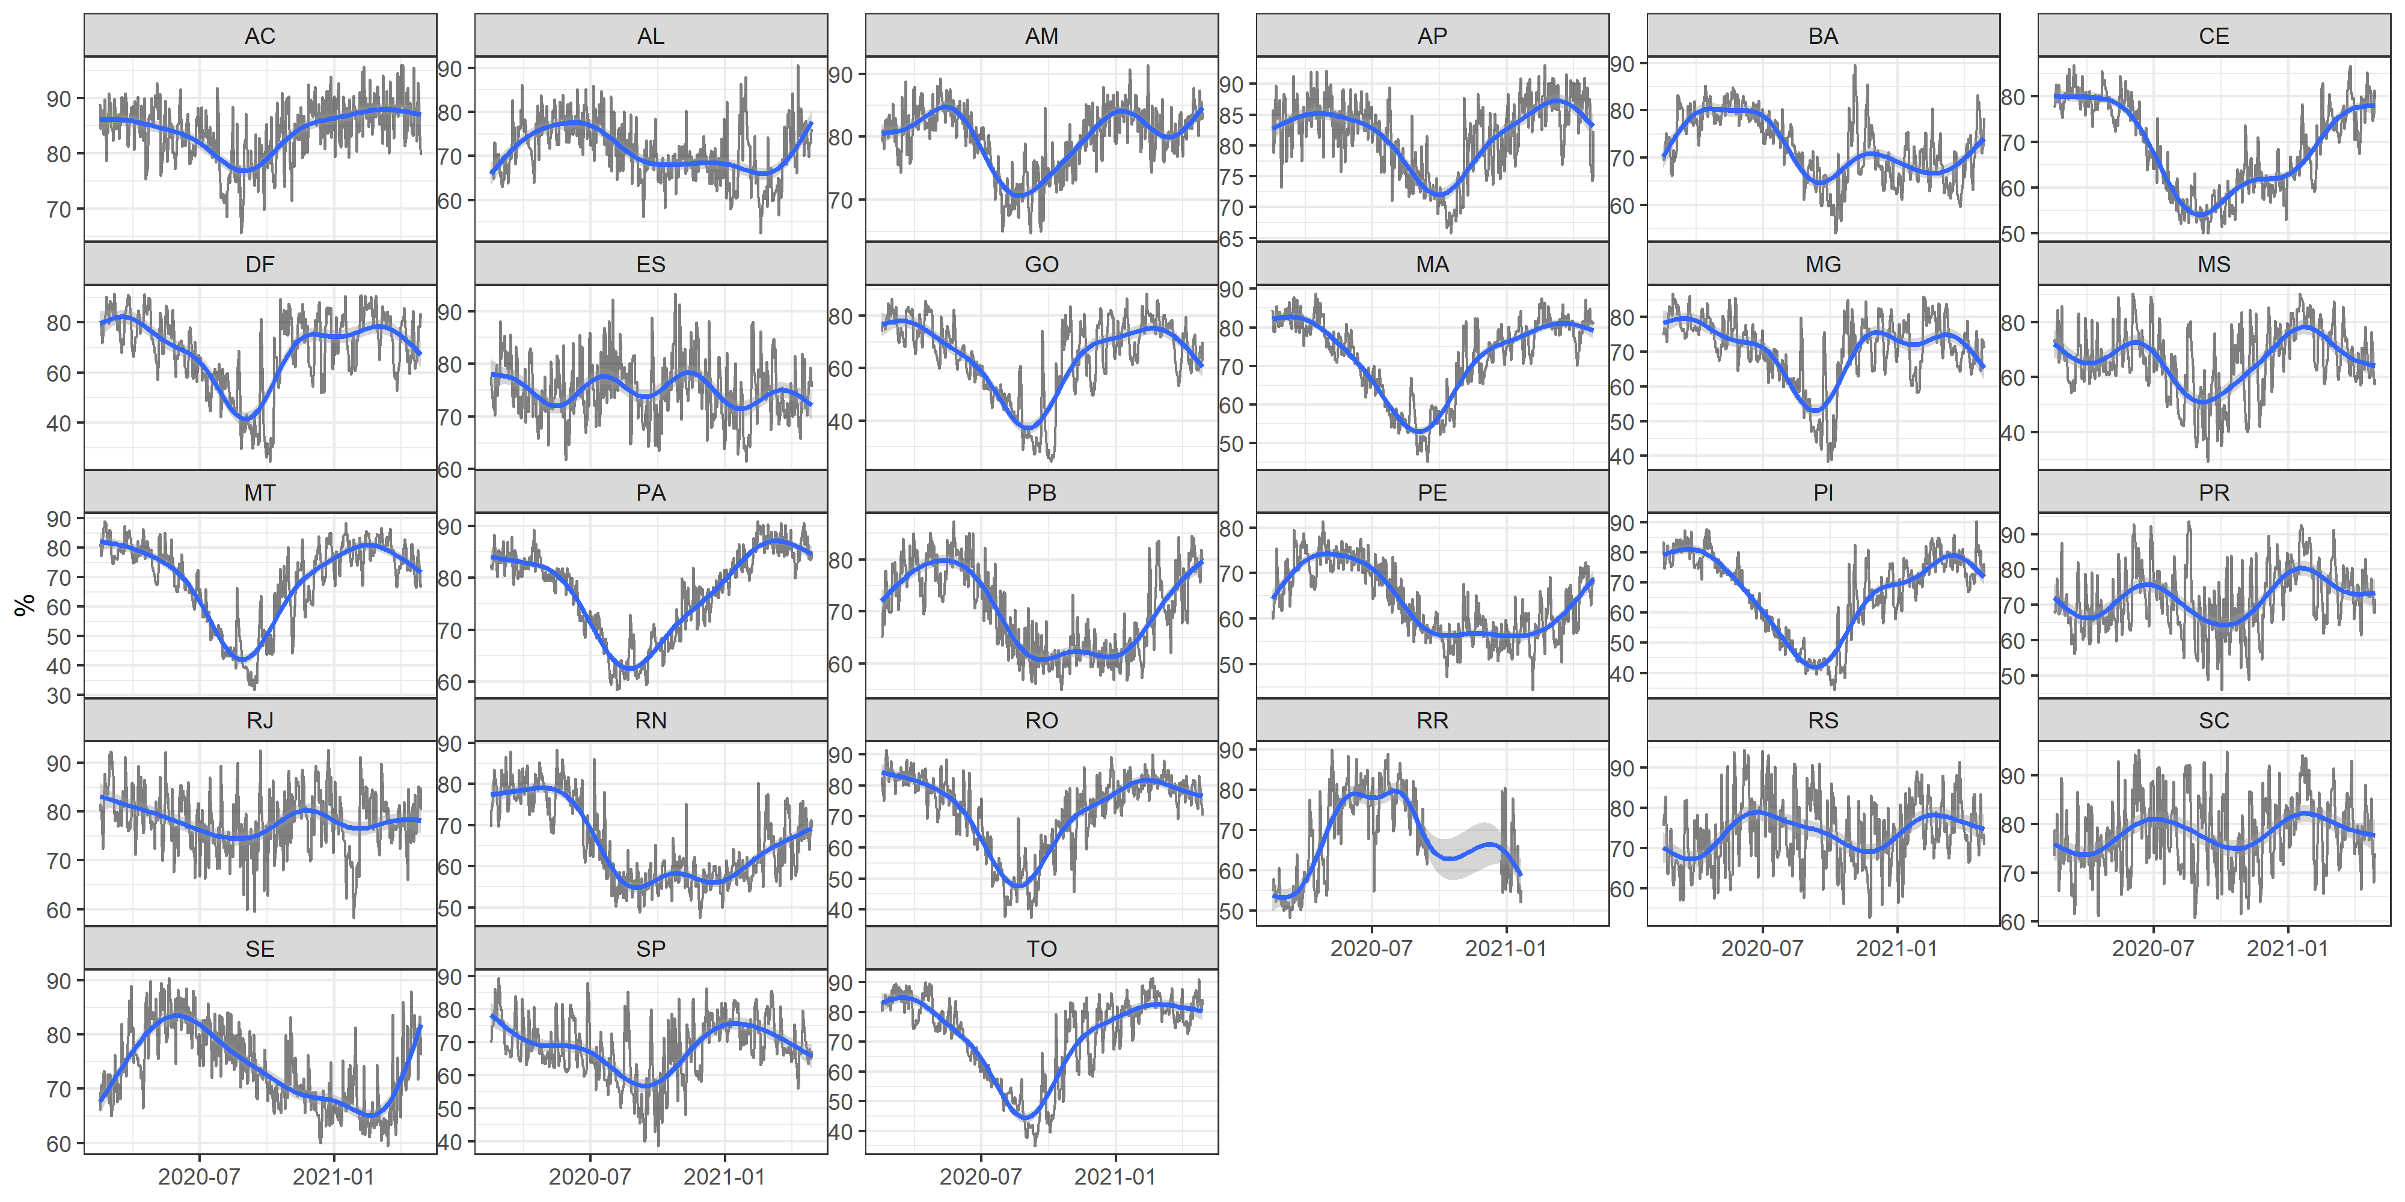
METEOROLOGY Brazil (https://portal.inmet.gov.br/)
Daily mean relative humidity (%)
2020-01-01 - 2021-04-30

Slide 8
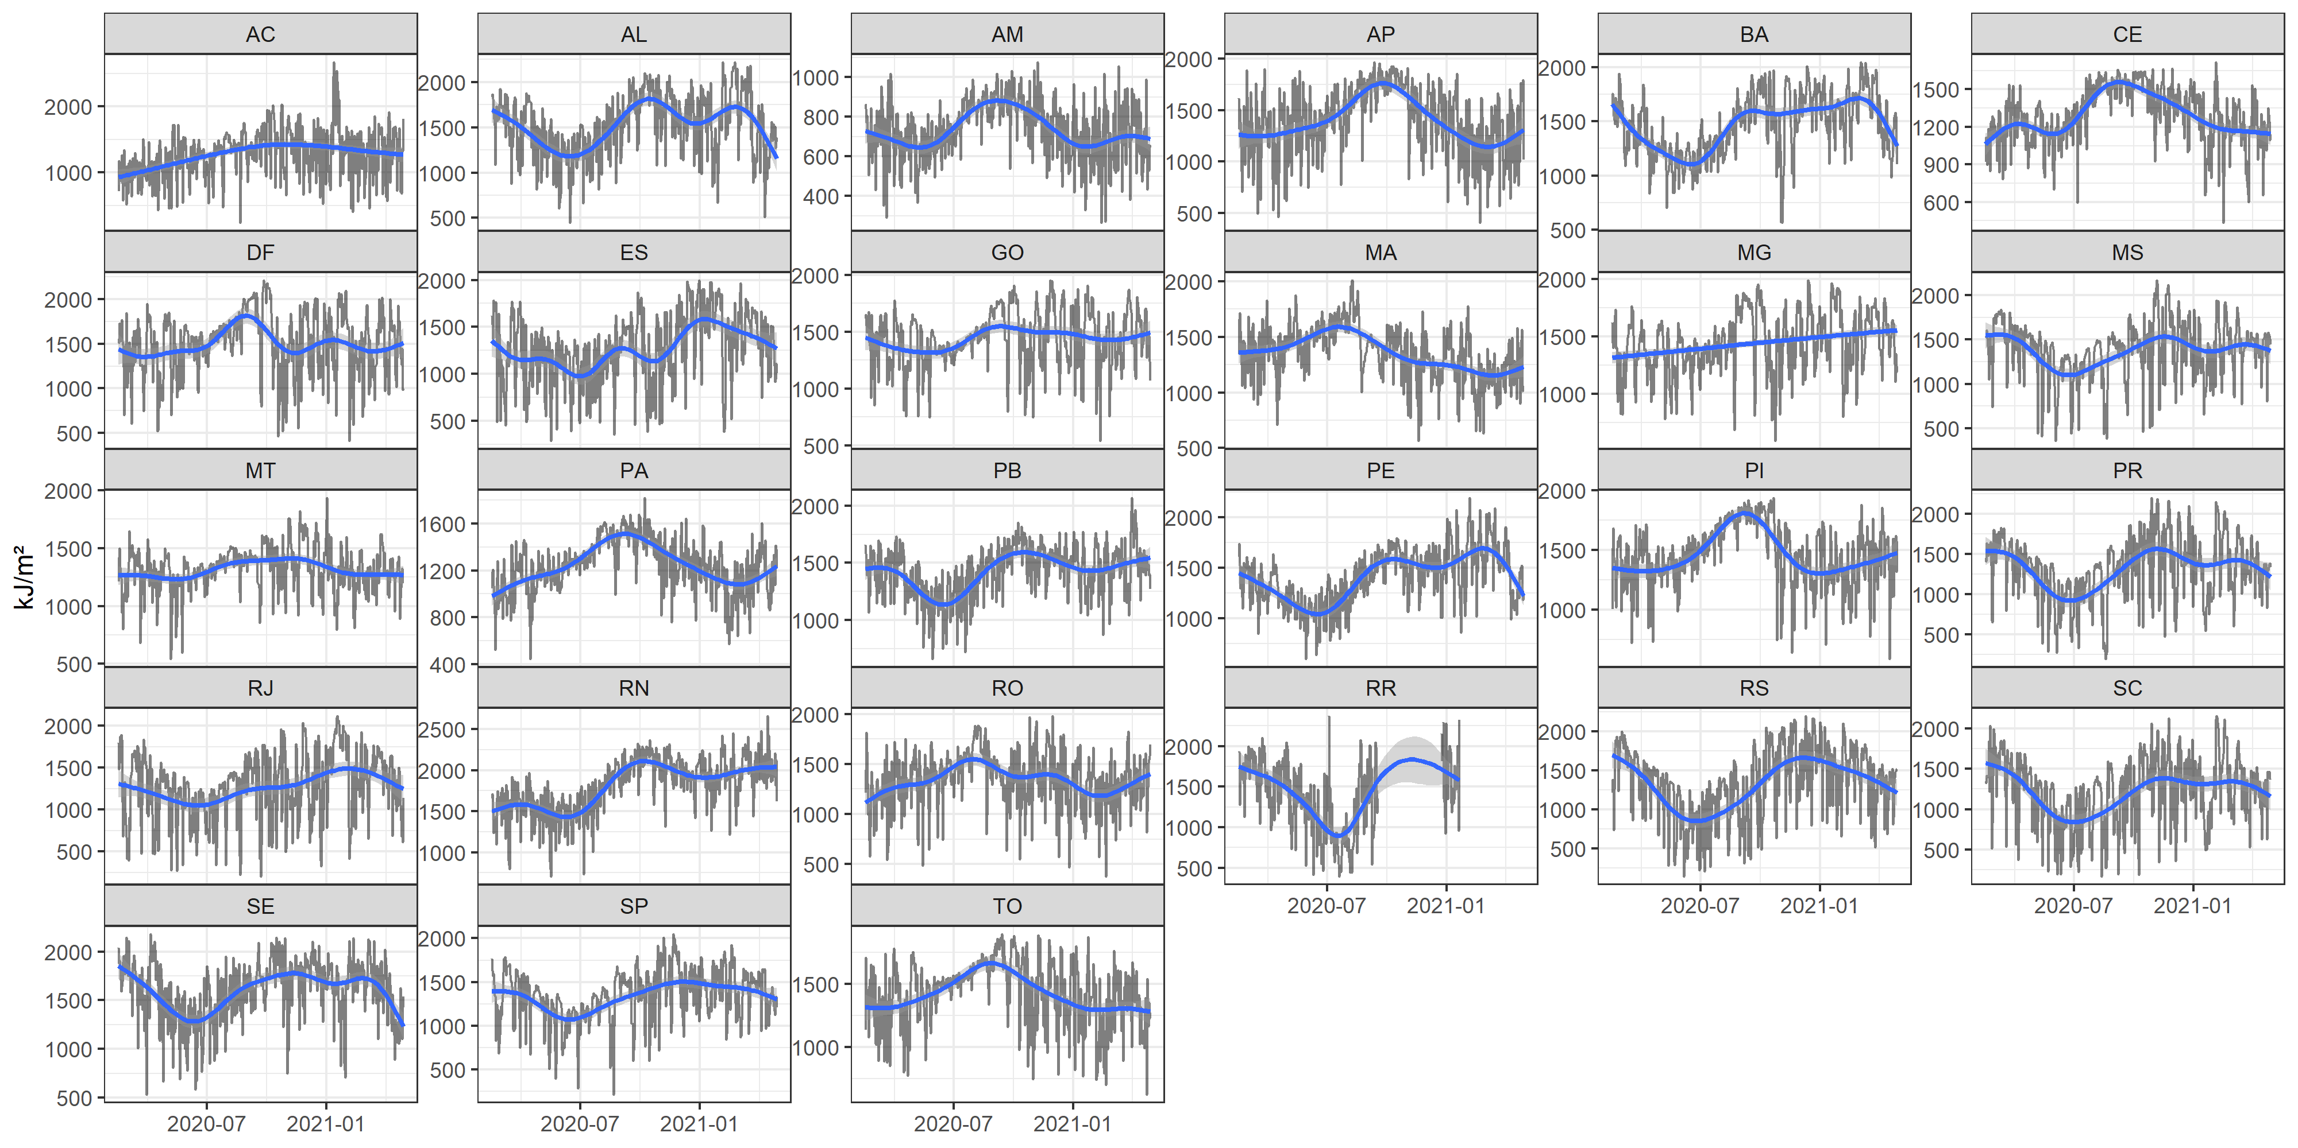
METEOROLOGY Brazil (https://portal.inmet.gov.br/)
Daily mean global radiation (kJ/m²)
2020-01-01 - 2021-04-30

Slide 9
Atmospheric composition – Monthly mean 2020
EAC4 (ECMWF Atmospheric Composition Reanalysis 4)

Slide 10
Methodology
Environmental data: EAC4 2020-01-01 – 2020-12-31
$$log\left(u_{i}\right)=β_{0}+β_{1}∗RMI_{m,n}+s\left(PM_{{2.5}_{m}}\right)+s\left(O_{3_{m}}\right)+s\left(RH_{m}\right)+s\left(temp_{m}\right)+s\left(time\right)+s\left(dow\right)+s\left(moy\right)+s(season)$$
Meteorology data: INMET 2020-01-01 – 2021-04-30
$$log\left(u_{i}\right)=β_{0}+β_{1}∗RMI_{m,n}+s\left(RH_{m}\right)+s\left(temp_{m}\right)+s\left({rad}_{m}\right)+s\left(time\right)+s\left(dow\right)+s\left(moy\right)+s(season)$$
$RH_{m}$ moving average of mean daily relative humidity by moving average m
${temp}_{m}$ moving average of mean daily celsius temperature
PM2.5: moving average of mean daily Particulate matter with aerodynamical diameter with less or equal of 2.5 um
O3: moving average of mean daily surface ozone.
Dow: day of the week
Moy: month of the year
Season: 4-months number for dec-feb, mar-may, jun-aug, sep-nov.
$u_{i}$ COVID-19 by distribution i
$β_{0}$ coefficient intercept
$β_{1}$ coefficient mobility
S: spline
RMI: Mobility
Rad: global radiation

Slide 11
Methodology
Environmental data EAC4
PM_{2.5}
O₃
Temperature
Relative humidity
2020-03-23 -2020-12-31
Effects of mobility considering
Residential Mobility (Isolation)
Public transportation mobility
COVID-19
Cases and deaths
Quase poisson and Negtive Binomial
Environmental data INMET
Temperature
Relative humidity,
Global radiation
2020-03-23 -2021-03-30
Effects of mobility considering
Residential Mobility (Isolation)
Public transportation mobility
COVID-19
Cases and deaths
Quase poisson and Negtive Binomial

Slide 12
Methodology basis
Dominici F, McDermott A, Hastie TJ. 2004. Improved semiparametric time series models of air pollution and mortality. J Am Stat Assoc 99: 938–948.
Peng RD, Dominici F. 2008. Statistical methods for environmental epidemiology with R. R a case study air Pollut Heal.
Wood S. 2017. Generalized Additive Models: An Introduction with R. Chapman and Hall/CRC.
Zeileis A, Kleiber C, Jackman S. 2008. Regression Models for Count Data in R. J Stat Software, Artic 27:1–25; doi:10.18637/jss.v027.i08

Slide 13
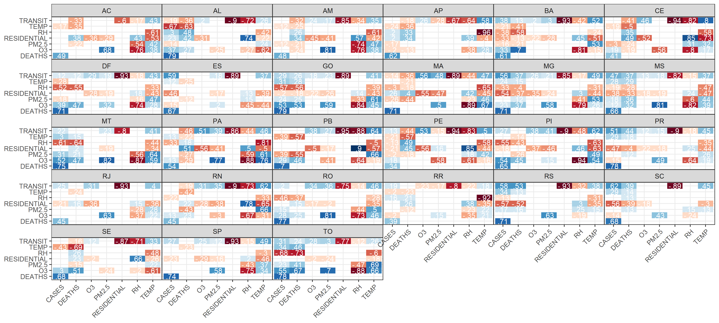
Results – correlations eac4 (p<0.05)
2020-03-27 - 2020-12-31

Slide 14
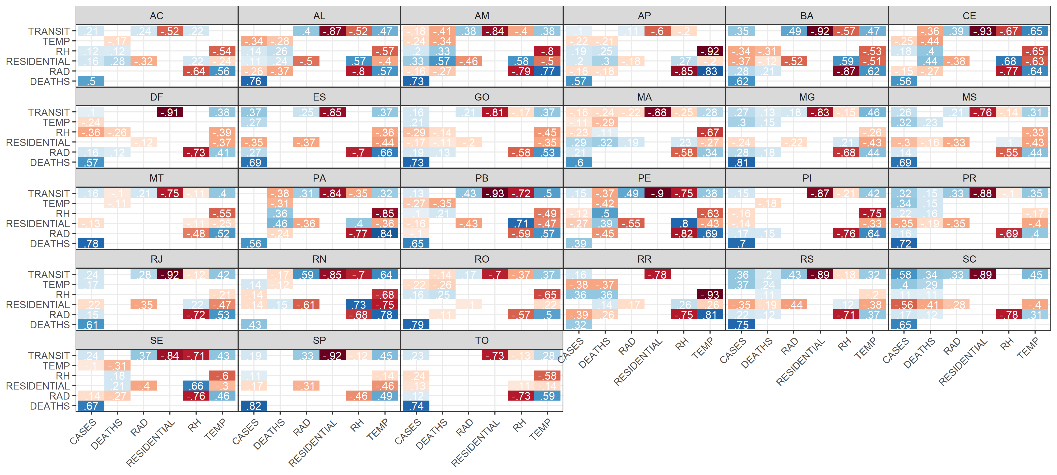
Results – correlations INMET (p<0.05)
2020-03-27 - 2021-04-30

Slide 15
Results – Association Residential – COVID19

Slide 16
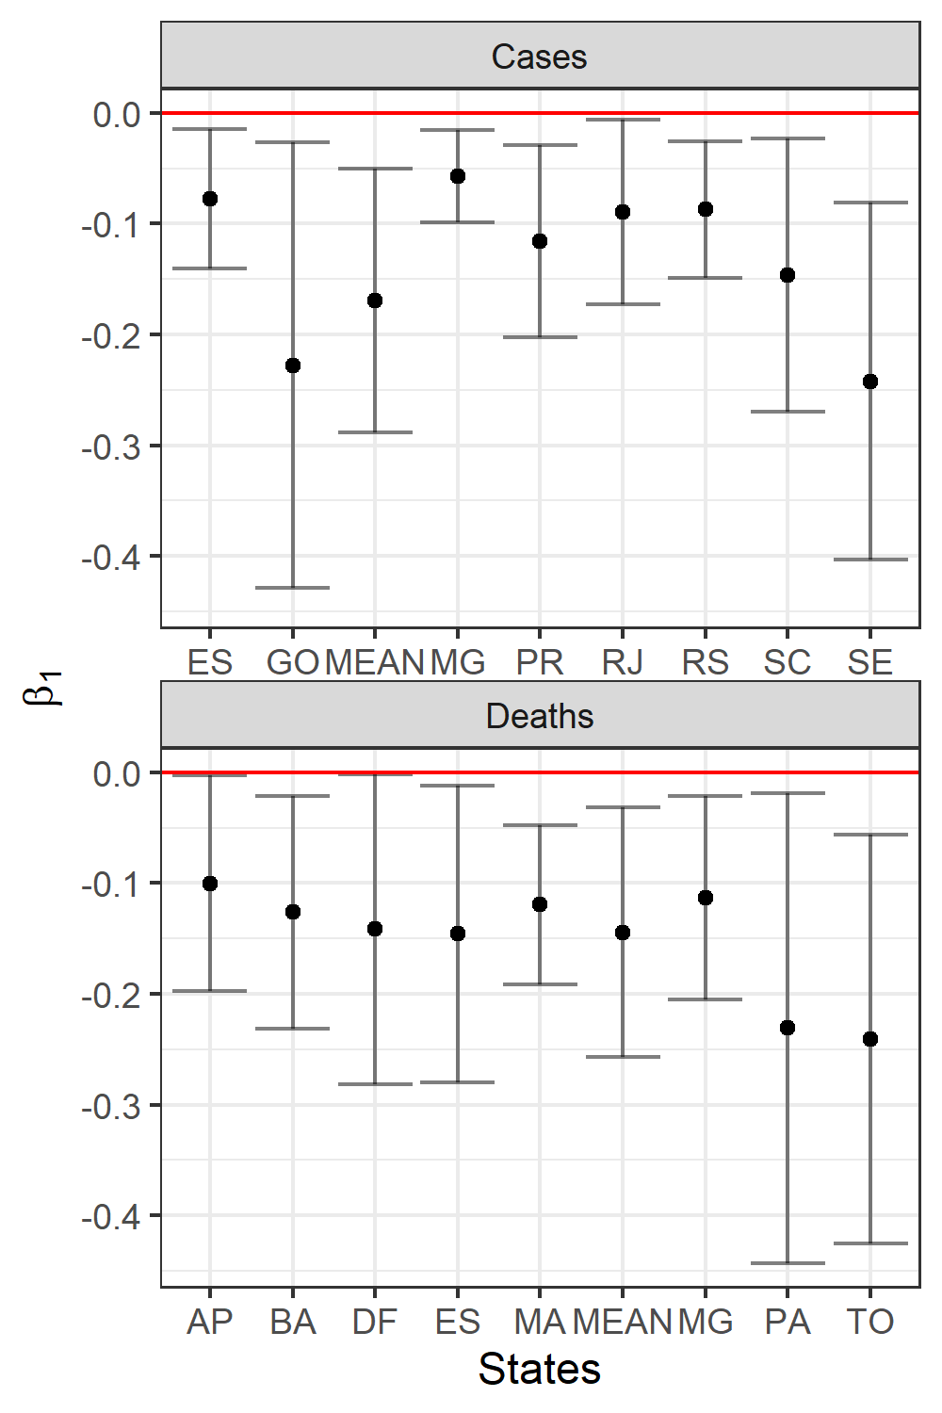
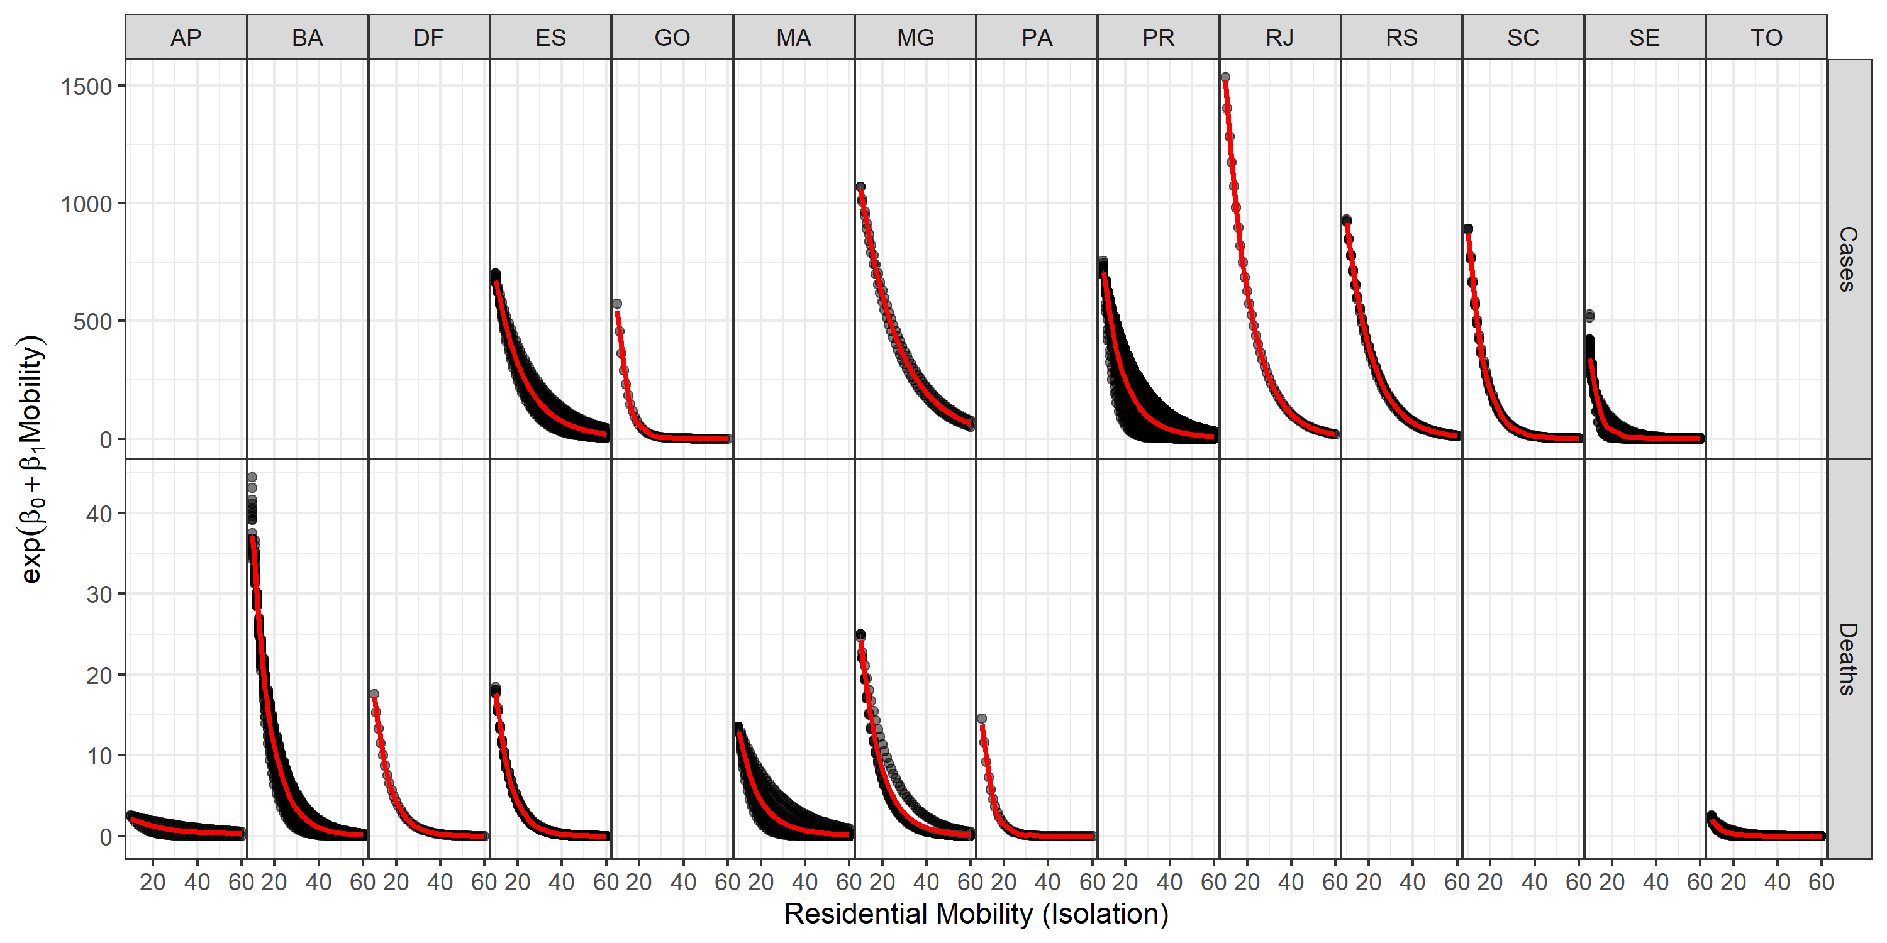
Results – Association Residential – COVID19

Slide 17
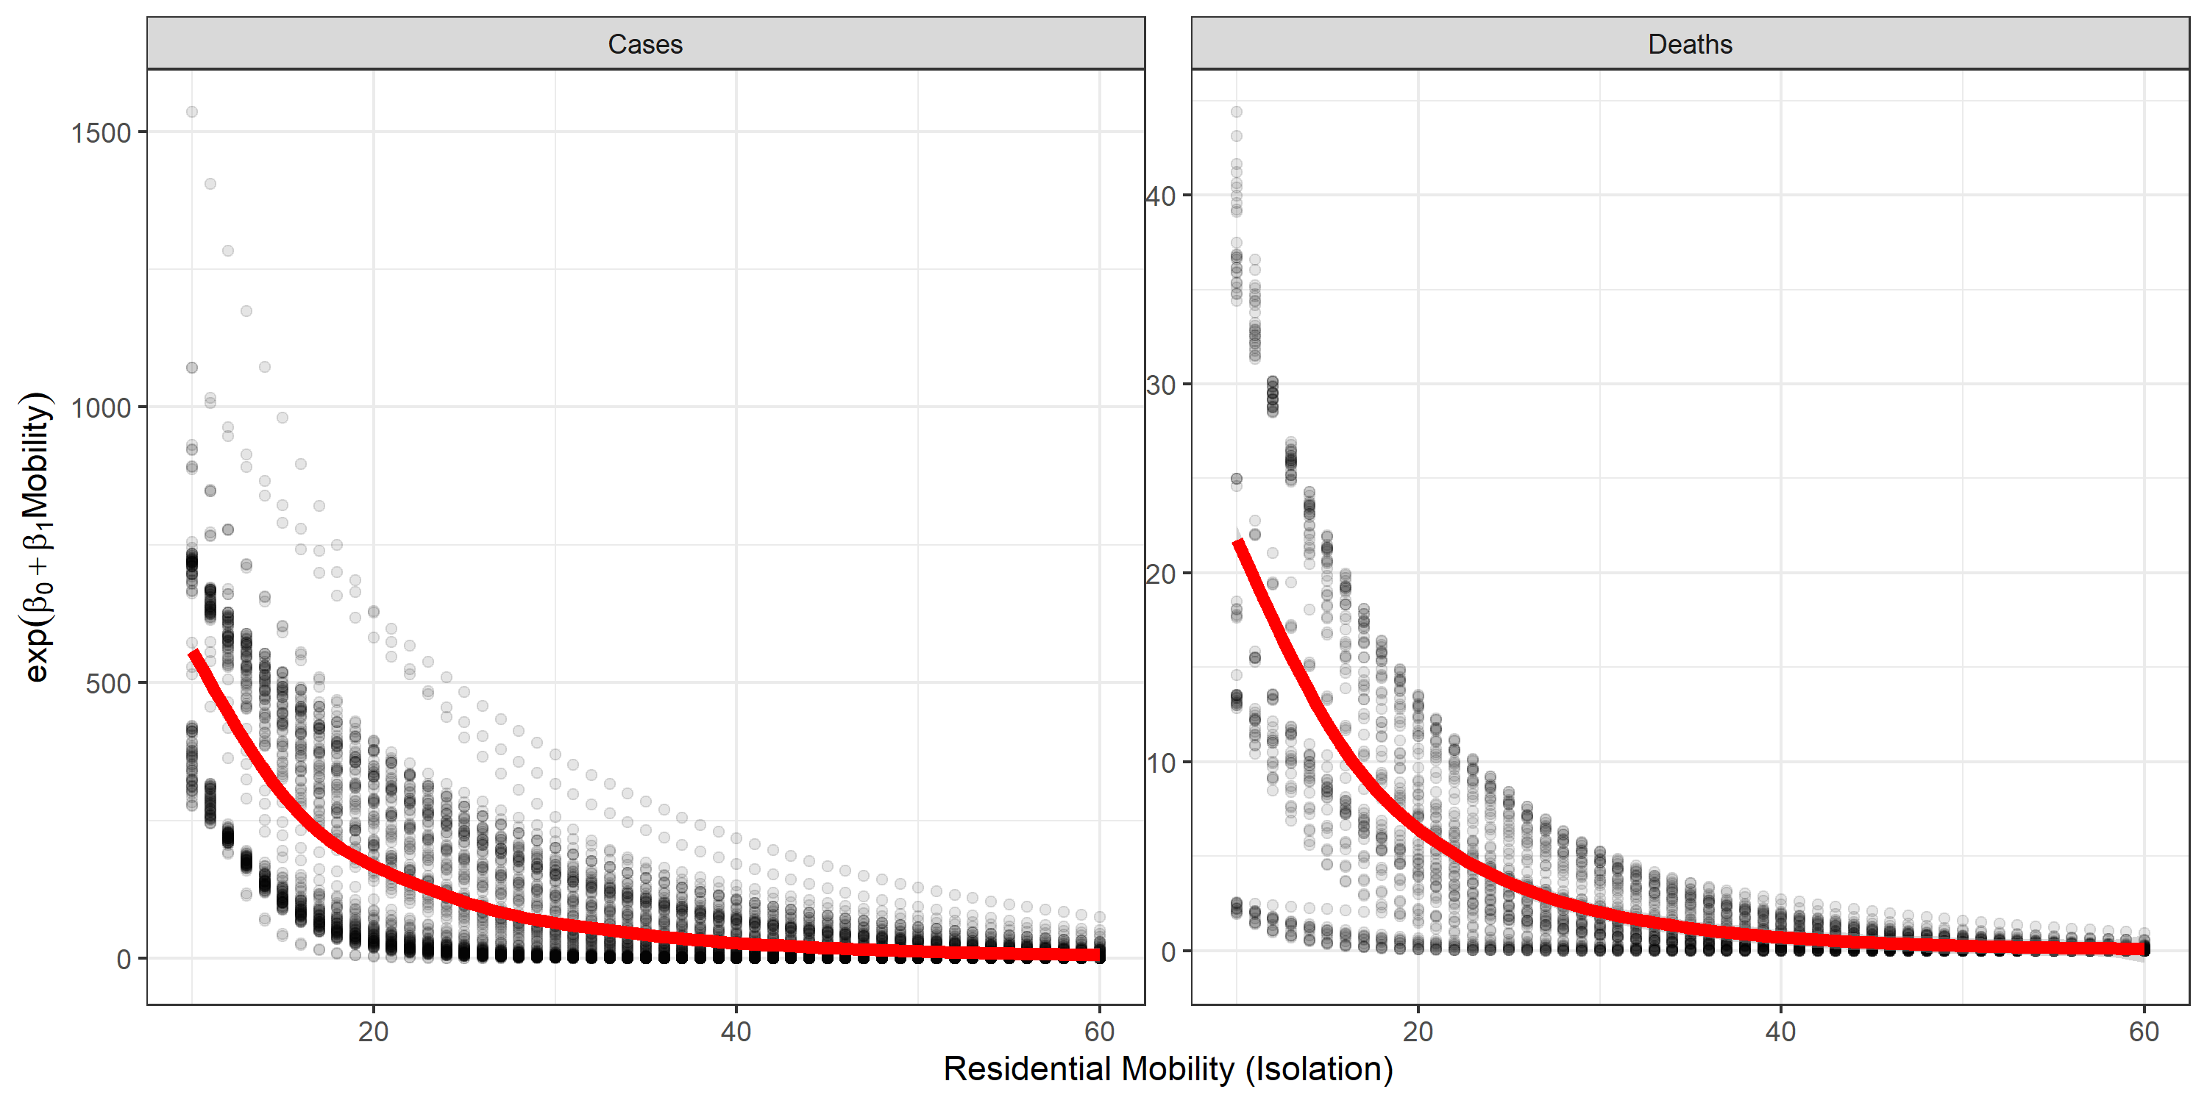
Results – Association Residential – COVID19
Mean: 575.99
(CI 95%: 96.28 – 11933.18)
Mean: 22.38
(CI 95%: 2.74 - 158.03)
Mean: 18.98
(CI 95%: 0.76 – 2446.26)
Mean: 0.40
(CI 95%: 0.00 – 128.66)

Slide 18
Results – Association TRANSIT – COVID19

Slide 19
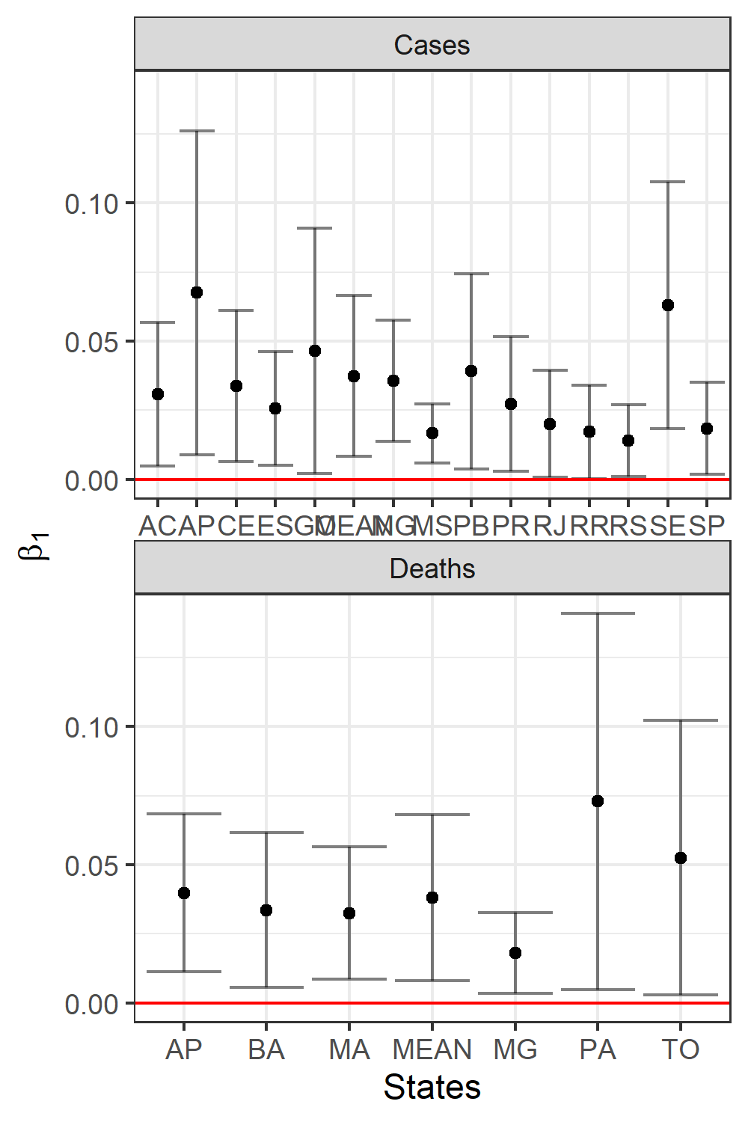
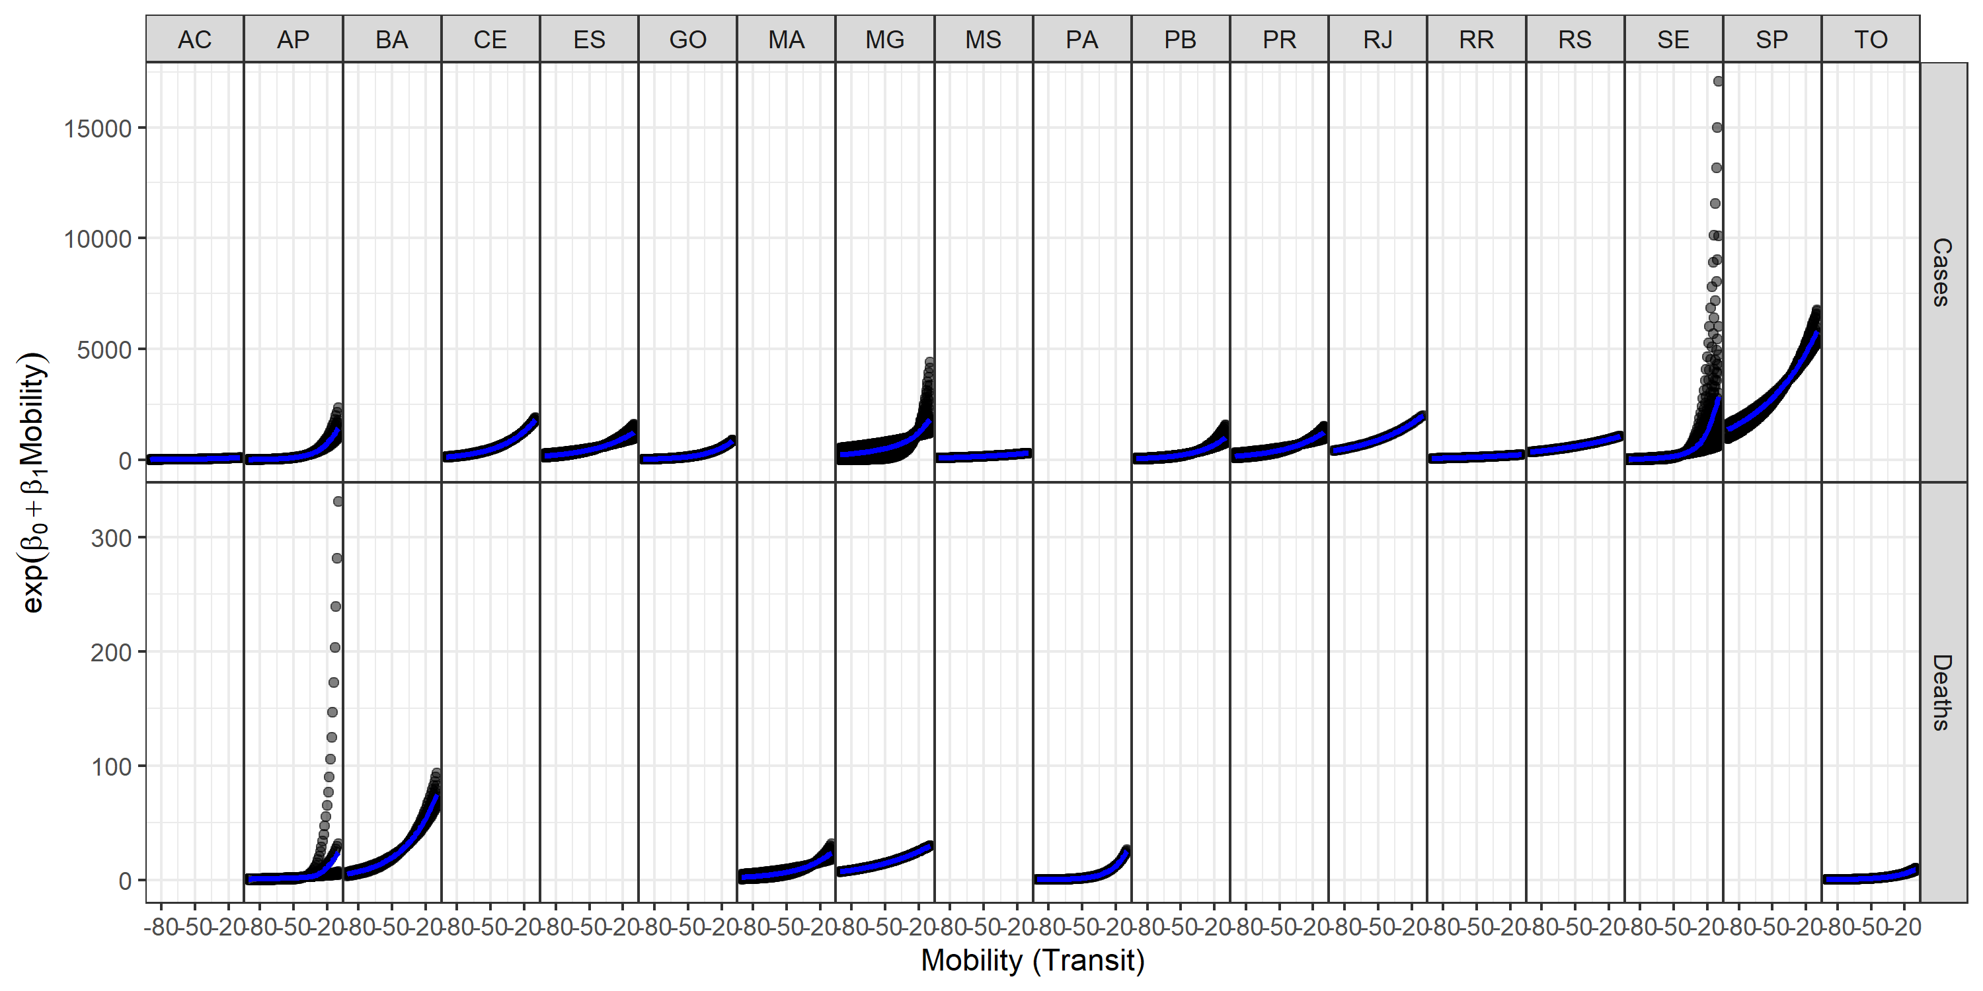
Results – Association Transit – COVID19

Slide 20
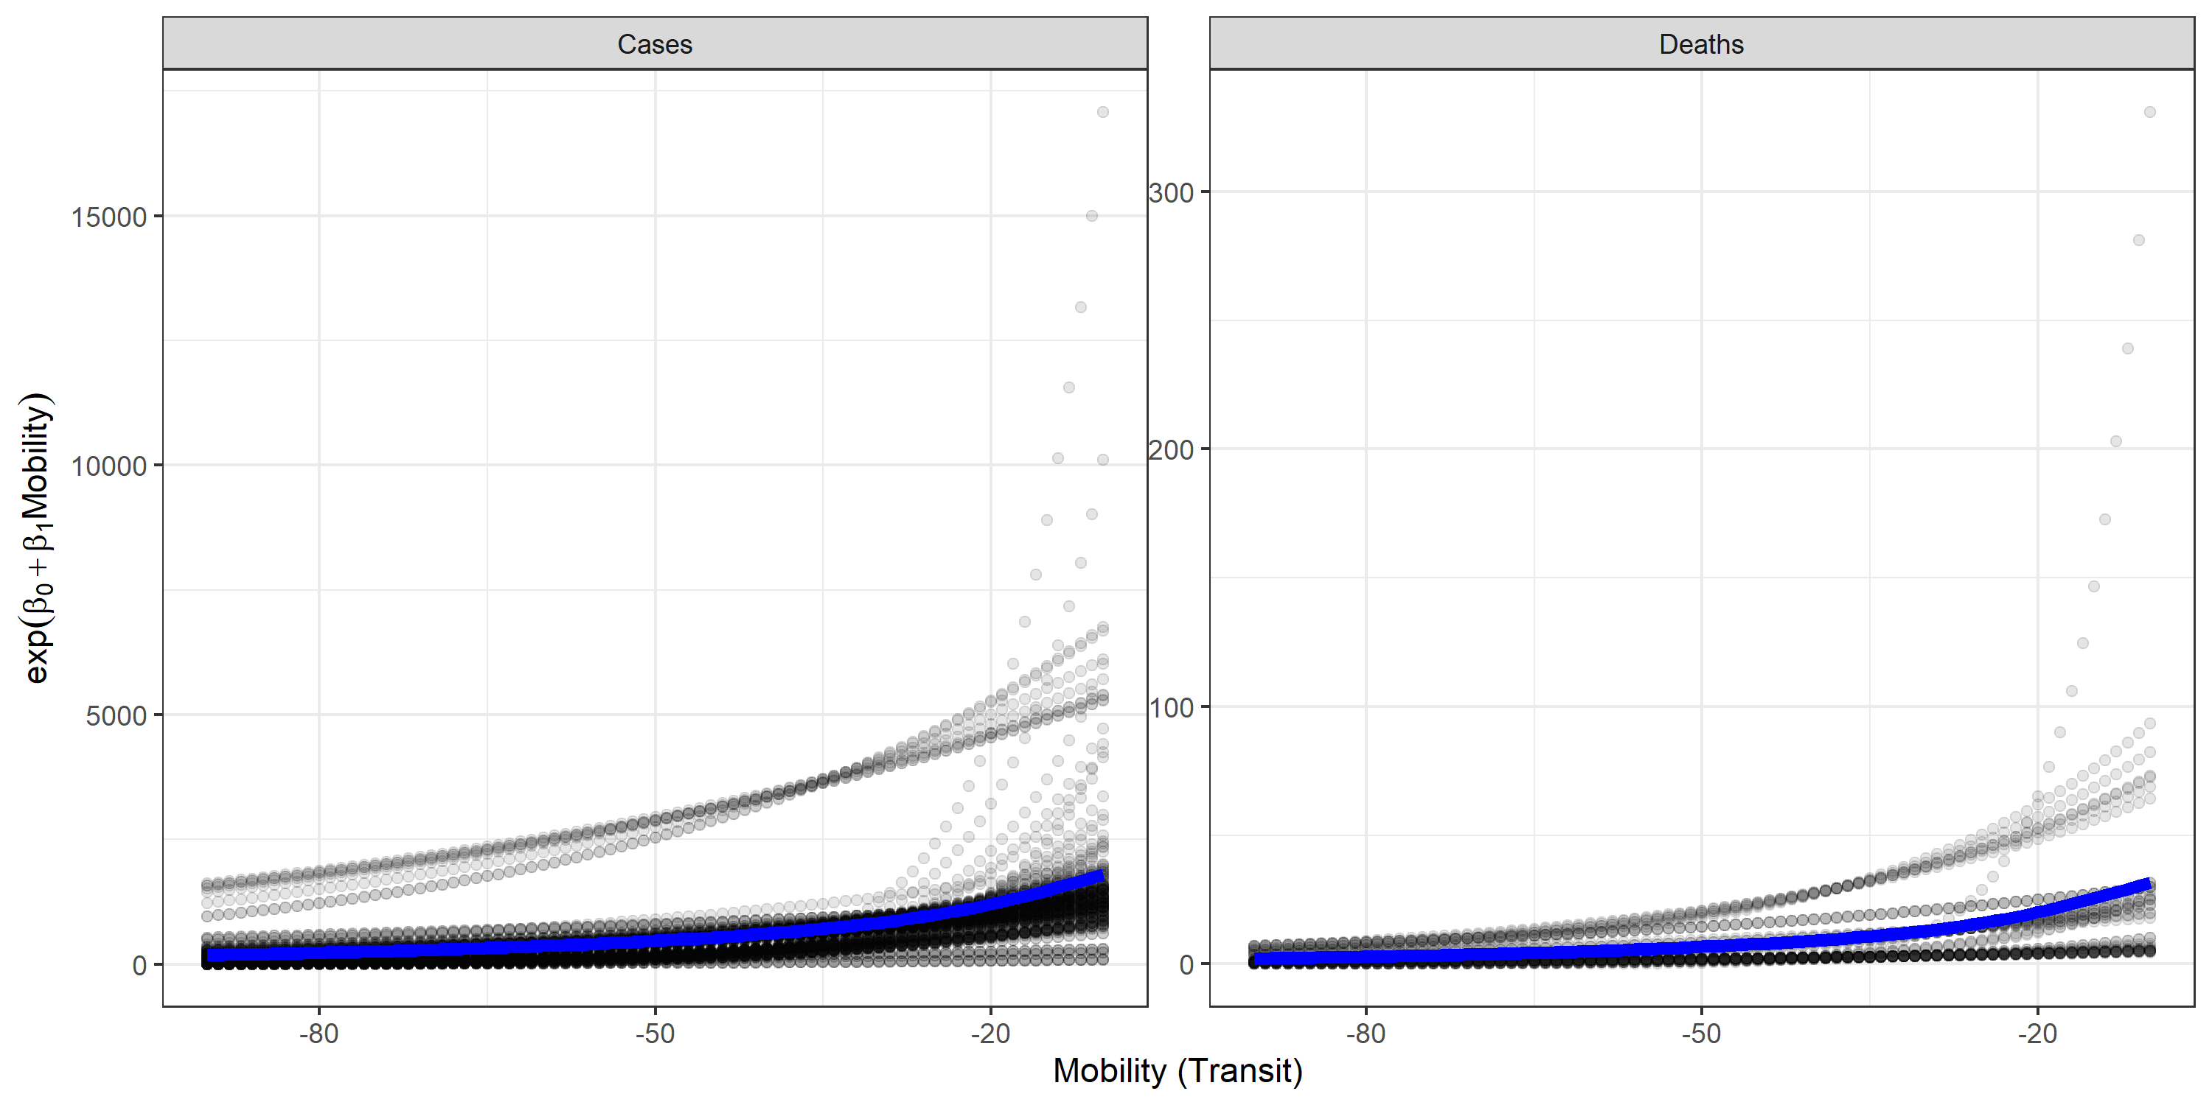
Results – Association TRANSIT – COVID19
Mean: 190.48
(CI 95%: 71.39 – 623.18)
Mean: 2.18
(CI 95%: 0.64 – 8.70)
Mean: 622.24
(CI 95%: 522.08 – 771.18)
Mean: 9.27
(CI 95%: 7.96 – 11.47)

Slide 21
Results – Association Residential – COVID19
INMET

Slide 22
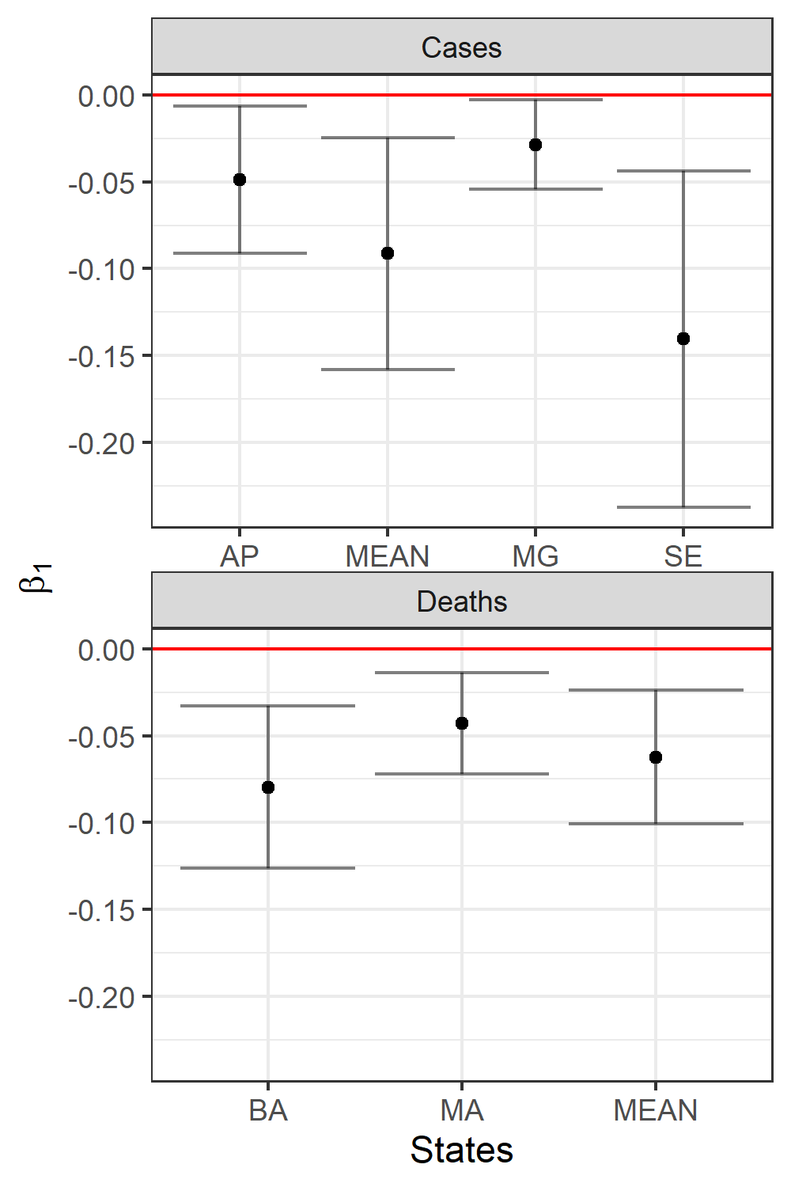
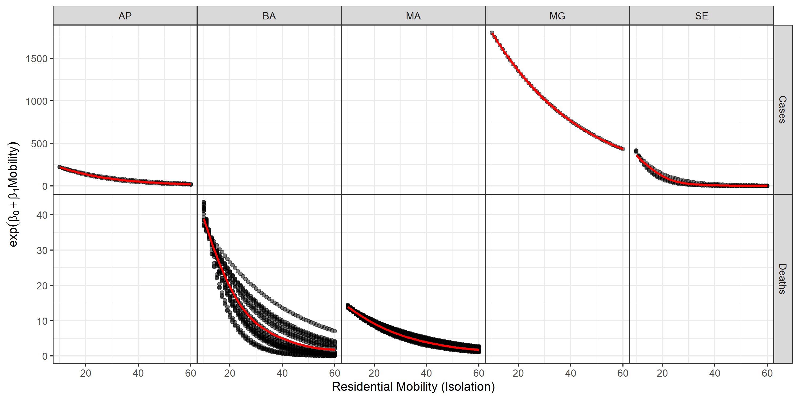
Results – Association Residential – COVID19
INMET

Slide 23
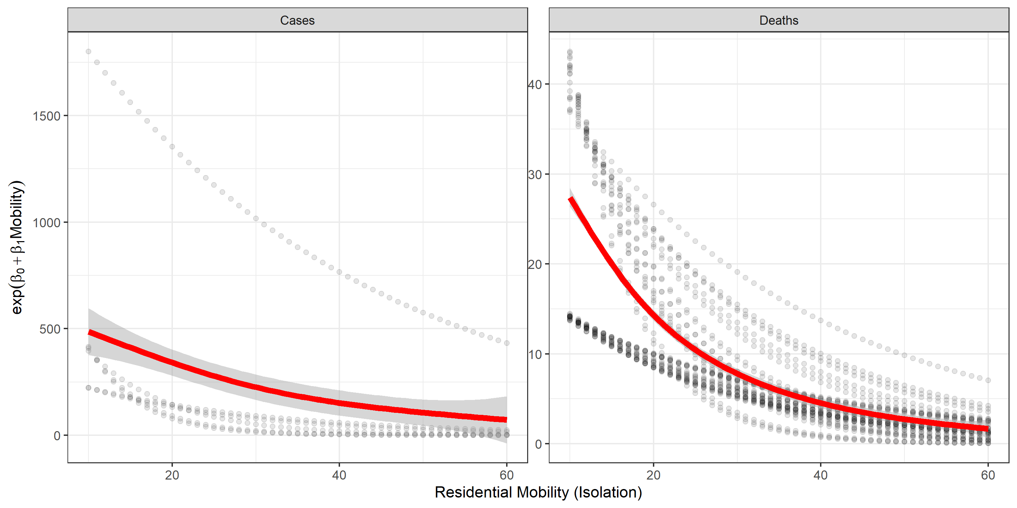
Results – Association Residential – COVID19
INMET
Mean: 577.10
(CI 95%: 28.04 – 6980.67)
Mean: 28.04
(CI 95%: 11.87- 69.81)
Mean: 126.49
(CI 95%: 27.91– 1010.20)
Mean: 3.50
(CI 95%: 0.54 – 28.94)

Slide 24
Results – Association TRANSIT – COVID19
INMET

Slide 25
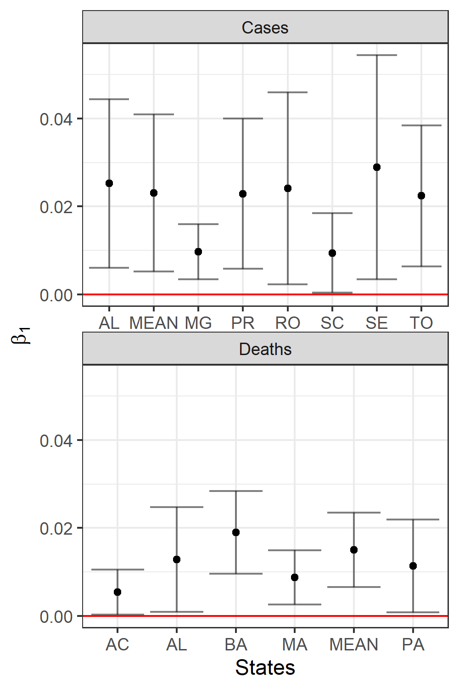
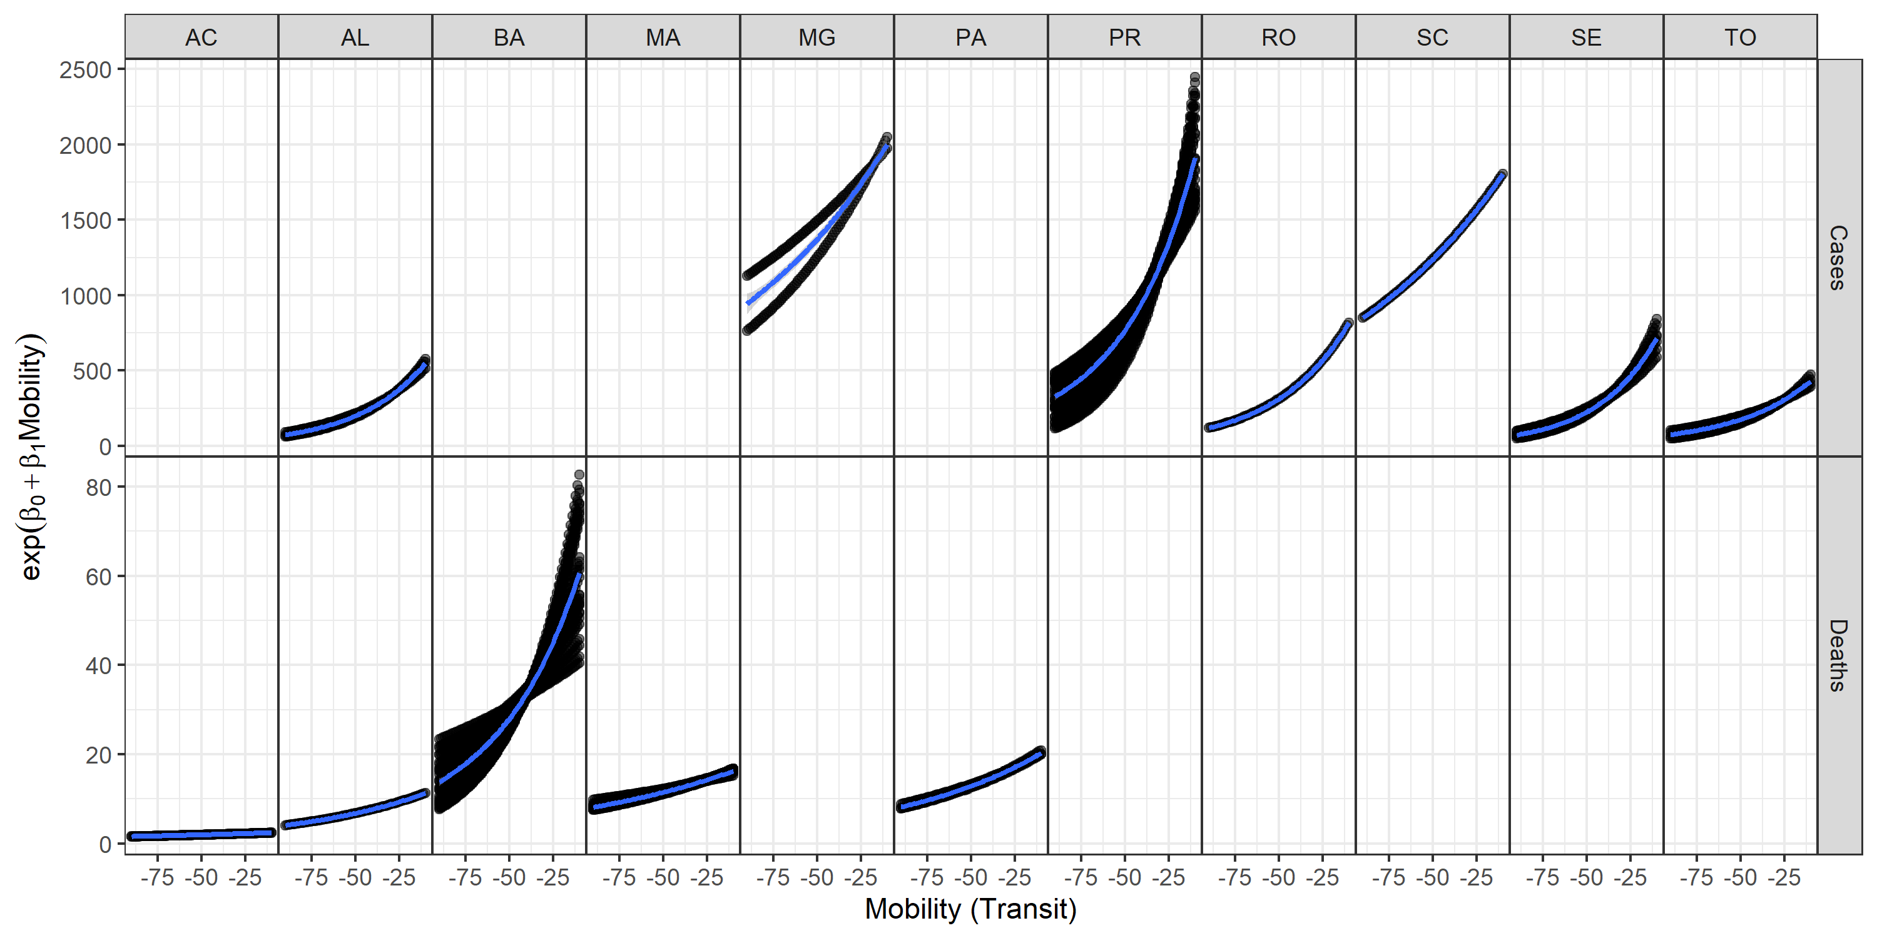
Results – Association Transit – COVID19
INMET

Slide 26
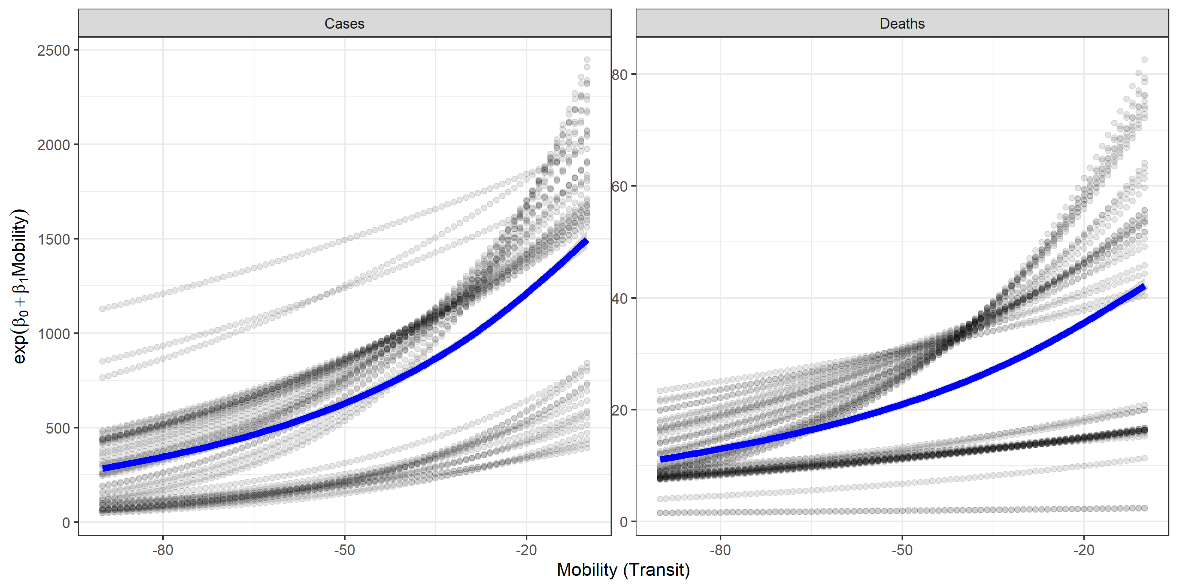
Results – Association TRANSIT – COVID19
INMET
Mean: 286.16
(CI 95%: 123.66 – 746.72)
Mean: 11.18
(CI 95%: 6.97 – 18.27)
Mean: 777.69
(CI 95%: 647.89 – 939.53)
Mean: 24.88
(CI 95%: 23.54 – 26.35)

Slide 27
Results – Association Residential – COVID19
We found significant associations between residential mobility and COVID19
When there is more isolation, less COVID19 and vice-versa
Using state averages decreasethe magnitude of the impact.
Future research should relate smaller regions, such as municipalities or cities
Normally, these type of analyses covers a longer time span.
Dispite the difficulties, our results show the evidence of the effect of isolation on COVID19

Slide 28
Results – Association TRANSIT – COVID19
We found significant associations between transit mobility and COVID19
When there is more transit use, more COVID19 and vice-versa
Data from INMET suggest that transit increases more COVID-19 than staying out of home. This makes sense since using public transportation mean more agglomeration the transit system, than staying out of home, per se. Data from EAC4 shows similar pattern. However, both results shows more deaths with less general isolation.
Only environmental factors used in this study do not explain the magnitude of spread of COVID-19.

Slide 29
Results – Association TRANSIT – COVID19
Using data from EAC4 we found more states with significant associations. This might be because independen variables are averaged over all the extention for each state, while data from INMET are station surface measurement sites, which may represent more local fenomena.
More research will be done to search associations between air pollution and COVID-19
Thanks
sergio.ibarra@usp.br

Slide 30
Association between COVID-19, mobility and environment in Brazil Brazilian capitals
Sergio Ibarra-Espinosa
Edmilson Dias de Freitas
Departamento de Ciências Atmosféricas
Universidade de São Paulo
Sergio.ibarra@usp.br

Slide 31
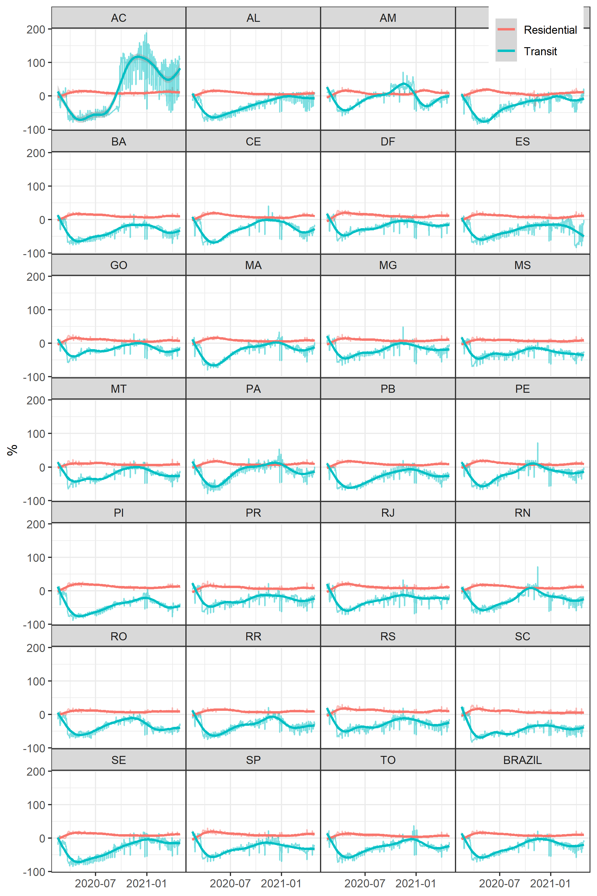
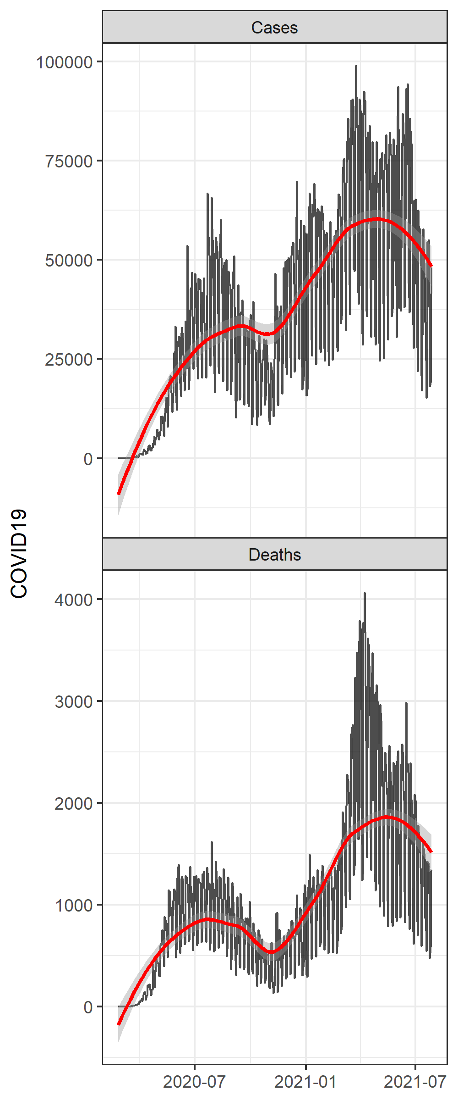
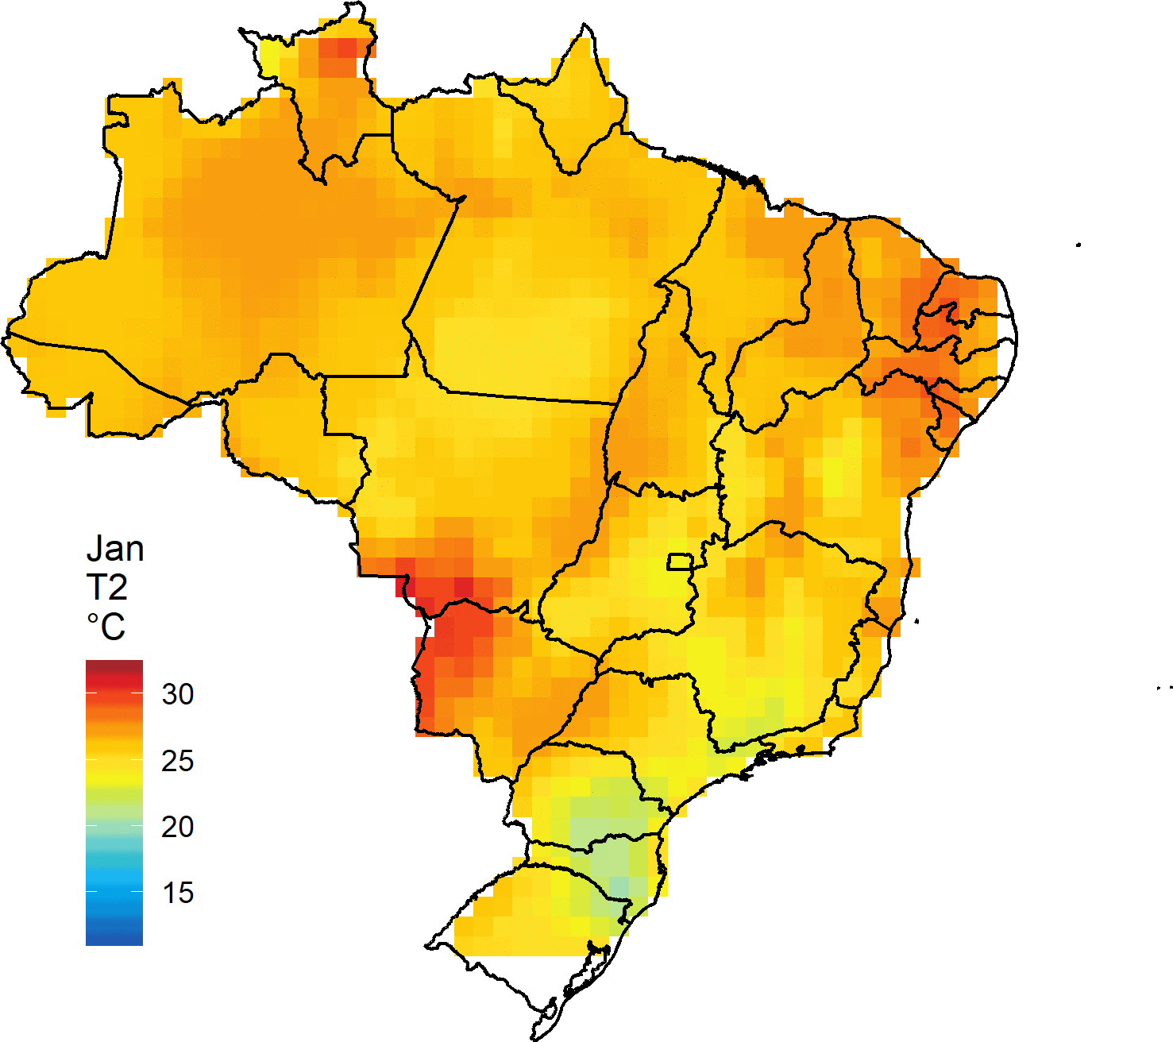
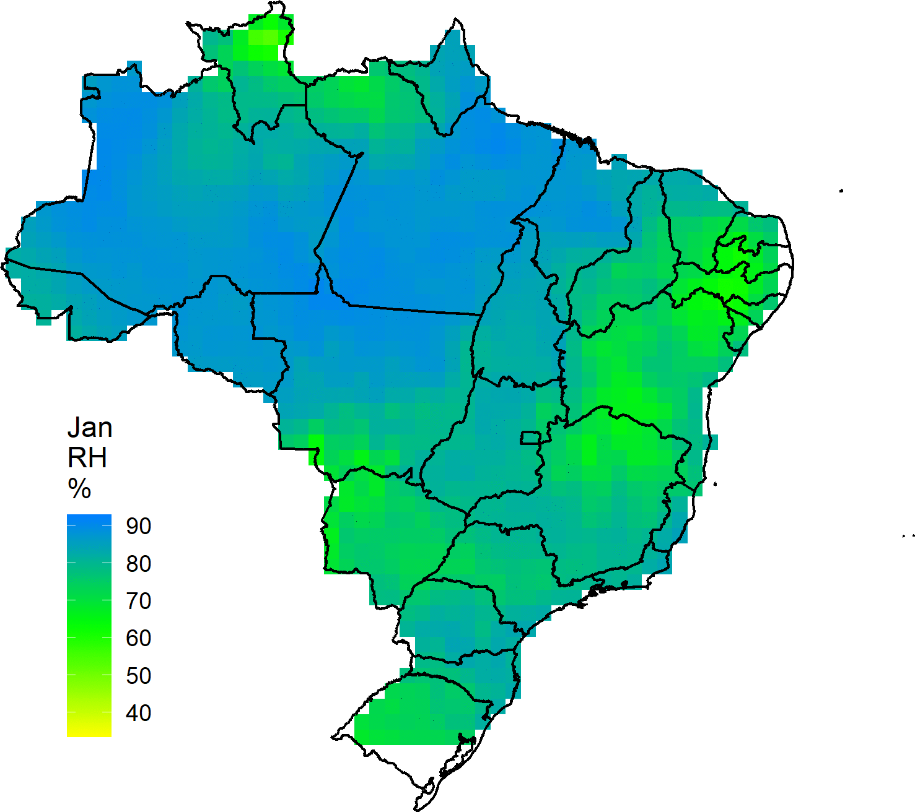
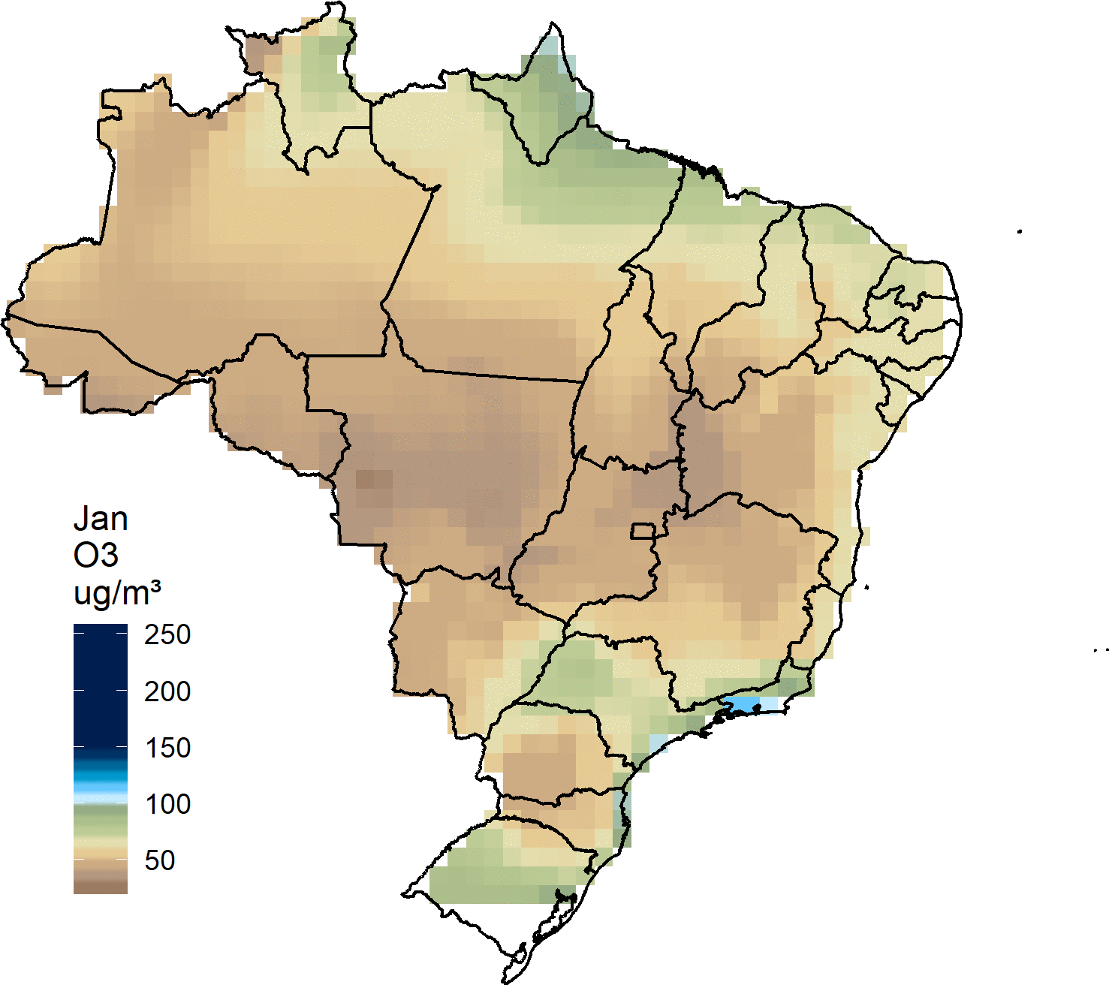
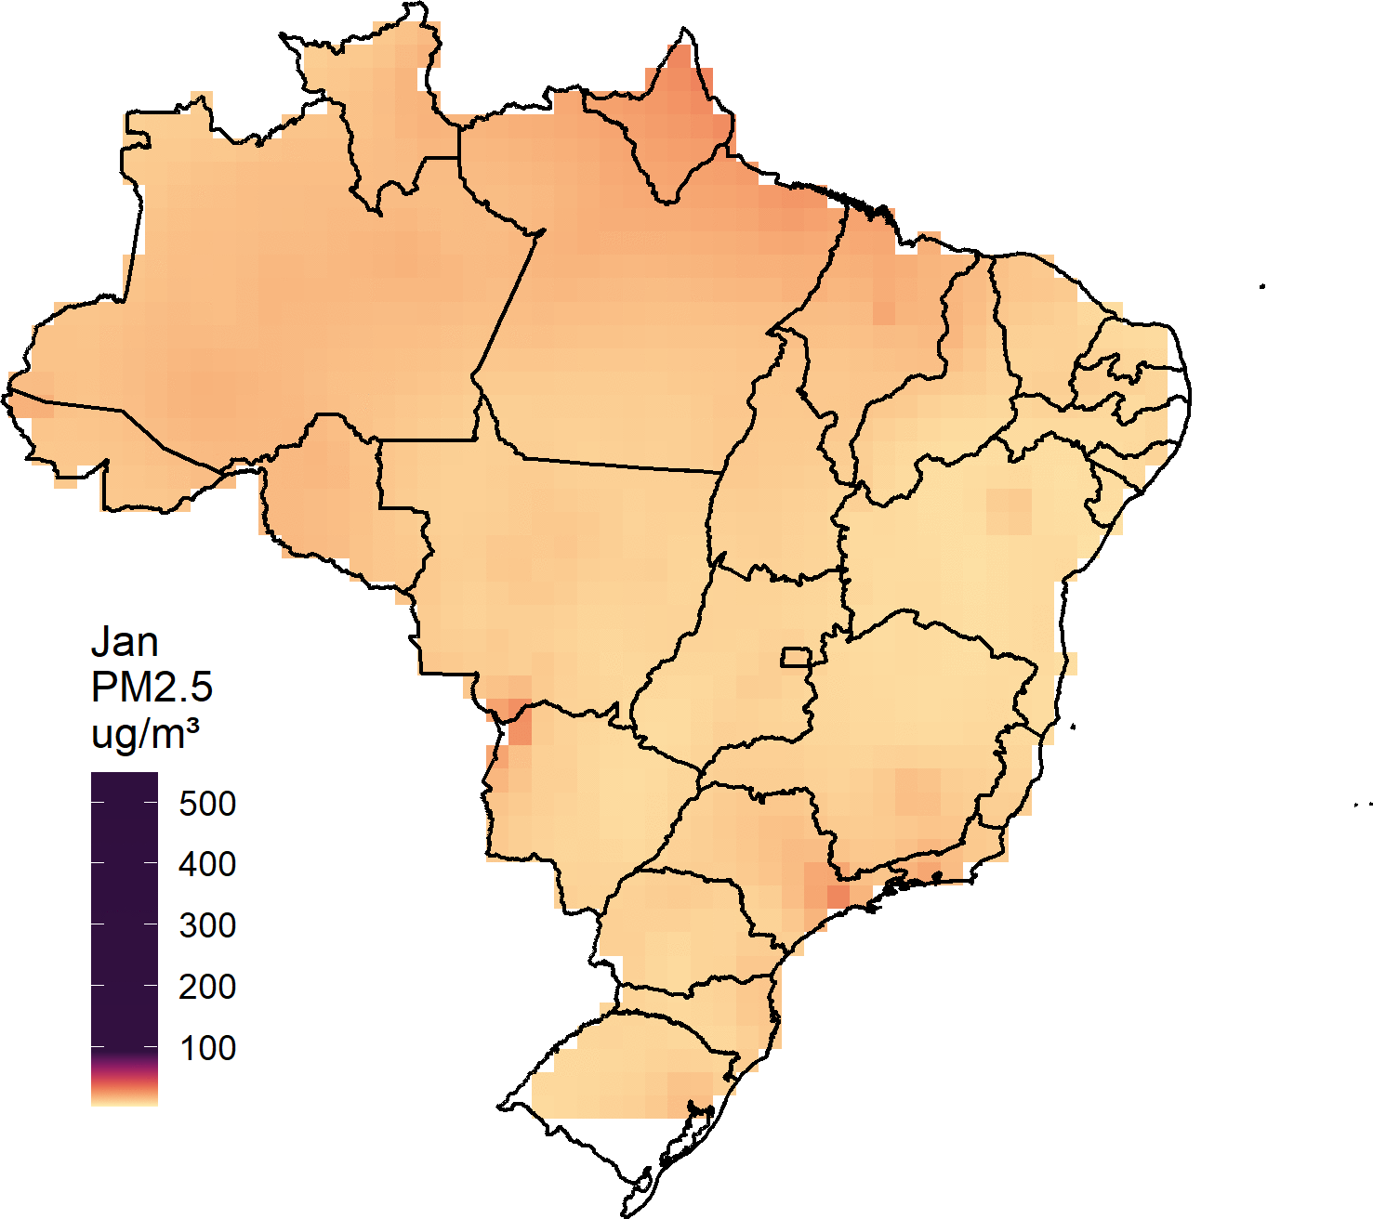
MOBILITY and Environment in Brazil

Slide 32
Results – Association mobility – COVID19
EAC4
EAC4
MOBI = 10. Mean: 575.99
(CI 95%: 96.28 – 11933.18)
MOBI = 10. Mean: 22.38
(CI 95%: 2.74 - 158.03)
MOBI = -90. Mean: 190.48
(CI 95%: 71.39 – 623.18)
MOBI = -90. Mean: 2.18
(CI 95%: 0.64 – 8.70)
MOBI = 45. Mean: 0.40
(CI 95%: 0.00 – 128.66)
MOBI = -40. Mean: 622.24
(CI 95%: 522.08 – 771.18)
MOBI = -40. Mean: 9.27
(CI 95%: 7.96 – 11.47)
MOBI = 45. Mean: 18.98
(CI 95%: 0.76 – 2446.26)
INMET
INMET
MOBI = 10. Mean: 577.10
(CI 95%: 28.04 – 6980.67)
MOBI = 10. Mean: 28.04
(CI 95%: 11.87- 69.81)
MOBI = -90. Mean: 286.16
(CI 95%: 123.66 – 746.72)
MOBI = -90. Mean: 11.18
(CI 95%: 6.97 – 18.27)
MOBI= 45. Mean: 3.50
(CI 95%: 0.54 – 28.94)
MOBI = -40. Mean: 777.69
(CI 95%: 647.89 – 939.53)
MOBI = 45. Mean: 126.49
(CI 95%: 27.91– 1010.20)
MOBI = -40. Mean: 24.88
(CI 95%: 23.54 – 26.35)

