Slide 1
Using Value Chain Approaches to Evaluate the End-to-End Warning System
Beth Ebert (BOM), David Hoffmann (WMO), Carla Mooney (BOM)
EMS, 10 September 2021

Slide 2
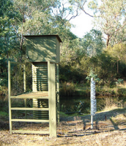
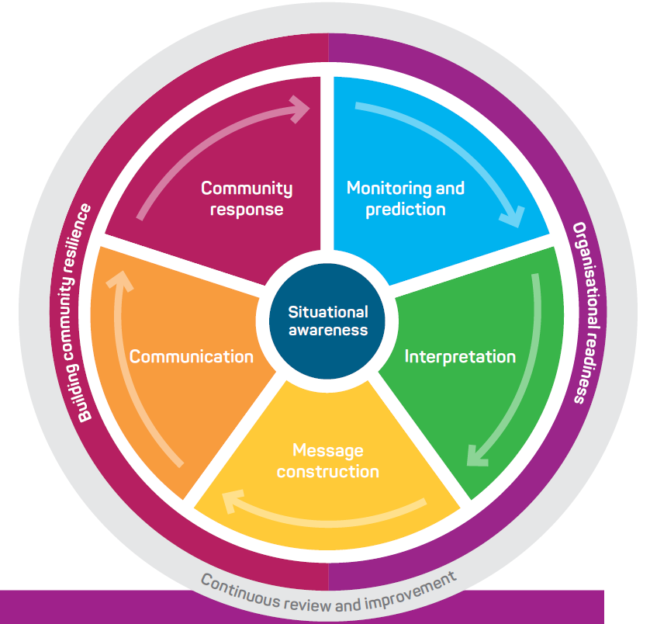
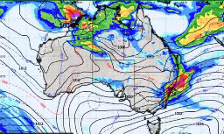
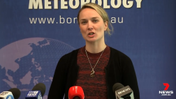
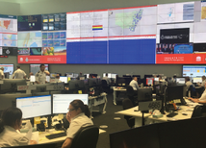
Australia’s Total Warning System
How can we understand and improve our forecast and warning chain?
How can we target and measure improvements?
What investment would bring the greatest benefit?
What can we learn from past events?
What does international best practice look like?
Notes:
There are a lot of different components to producing a warning, involving many different people and skill sets. It’s important that it all fits together well and that the information flows effectively through the system.
There are many questions we might ask in order to help improve our warning systems and their effectiveness.

Slide 3
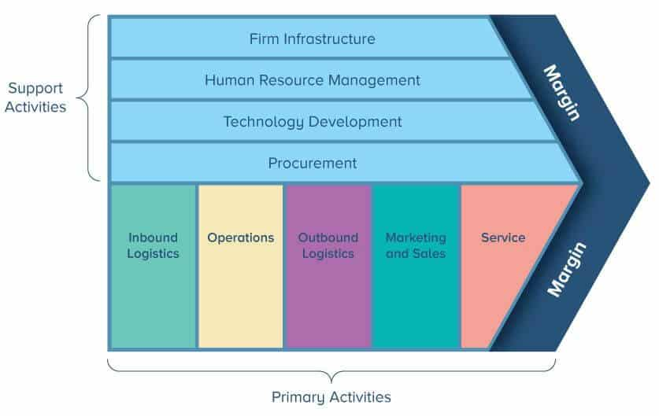
What is a Value Chain?
Source: https://www.smartsheet.com/value-chain-model
Economic value chain developed by Porter (1985)
Hydro-meteorological value chain:
A tool for characterising and evaluating value (information) in a hydro-met information process with the aim to reduce costs/damages from hydro-met events and increase value for the end-user
Many other value chains & networks exist!
Lazo et al., 2009, Primer on Economics for National Meteorological and Hydrological Services
Notes:
Porter’s economic value chain doesn’t apply all that well to services (or to many industries nowadays)

Slide 4
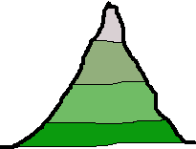
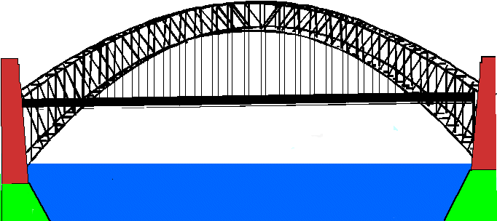
HIWeather value chain for warnings
Weather Forecast
Hazard Forecast
Warning
Observations
Decision
Impact Forecast
Golding et al., 2019
Sensor Technology
Weather Modelling
Ocean, Land Surface & Pollution Modelling
Social, Economic & Health Modelling
Communication Science: Messages & Media
Behavioural Psychology
Each stakeholder adds value through tools, experience, other information sources
📈
Each stakeholder has their own set of objectives, resources and constraints that can limit the value
📉

Slide 5
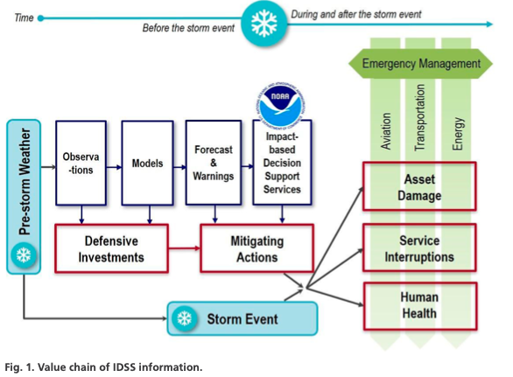
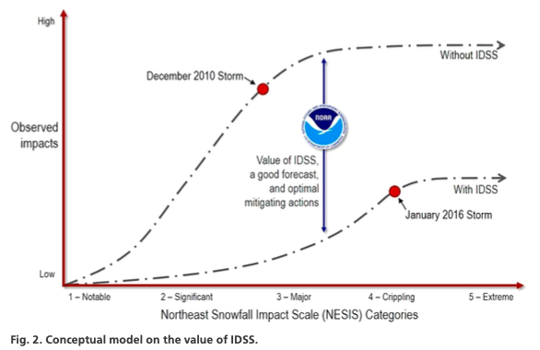
Value chain example – economic value of improving a forecasting system
Reducing socioeconomic impacts of winter storms by implementing an Impact-Based Decision Support Services (Lazo et al., BAMS, 2020)
Integrating social-science and economics analysis to assess and improve impact-based decision support services (IDSS)
Implementation of IDSS reduced costs by over $107 million in aviation and energy sector combined and reduced recovery time by 5 days for ground transportation
Notes:
In this recent example the effectiveness of the warning system for winter storms was examined before and after improvements were made to make the warning system, to try to estimate the economic value of those improvements.

Slide 6
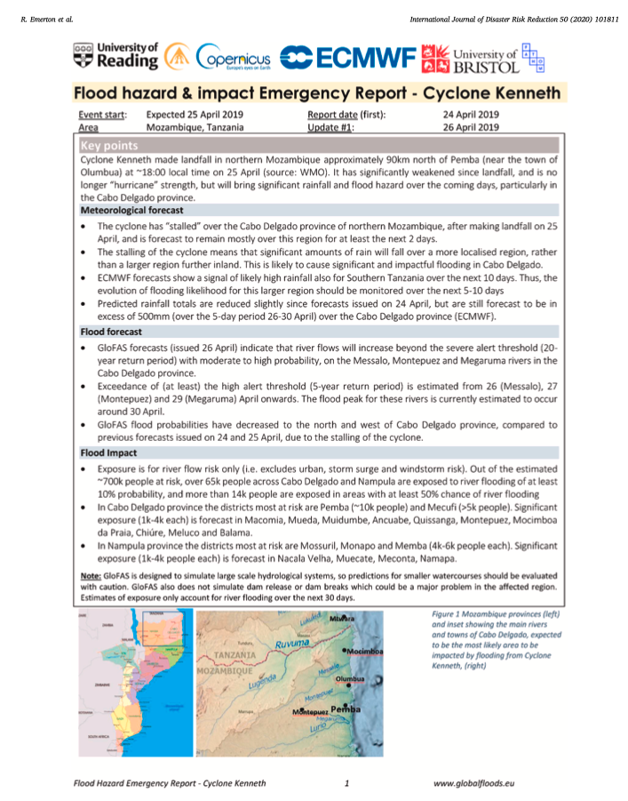
Value chain example – learning from high impact weather events
Evaluation of cyclone flood forecast for international humanitarian preparedness and response (Emerton et al., IJDRR, 2020)
Probabilistic real-time flood forecast and risk bulletins to improve communication of hazard risk information to decision-makers and stakeholders
Considerable loss of life from cyclones in Mozambique in 2019 due to significant gaps and weaknesses in the accuracy of the (flood) warnings and an overall emergency preparedness, response and coordination with a limited understanding of risk
Notes:
Forecast-based Financing is another application. In this example the authors took a critical look at the performance of all elements of the end-to-end warning chain for Cyclones Kenneth and Idai in Mozambique. Analysed the lessons learned.

Slide 7
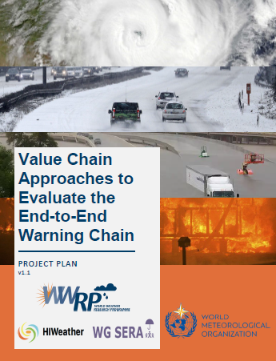
WWRP Value Chain project
Research to improve the effectiveness of the warning chain

Slide 8
Exploring value chain approaches
Value chain approach(es) to use
Is there a “best” value chain approach to use or should more than one be applied?
What methods best support meta-analysis?
Measuring the value chain
What metrics can be used?
Where can these metrics be used within the value chain?
How can we measure or evaluate intangible aspects of the value chain?
What methods can be used to capture metric uncertainty?

Slide 9
Exploring warning chains for hazardous events
Predictability & processes
Multi-scale modelling of hazards
Human impacts, vulnerability & risk
Communication
User-oriented evaluation
What contributed to the severity of the event, e.g. pre-conditioning?
How did multiple NWP models perform?
What are the reasons for good/poor performance?
What diagnostic tools would assist?
How did the characteristics of the prediction models (spatial resolution, update frequency, ensemble size, coupling, DA, etc.) affect predictive ability?
What obs data were used as model input, nowcasts and verification, e.g. non-traditional data?
What vulnerabilities and exposures were important in producing the impacts?
What socioeconomic data were used to assess risk?
Were impacts predicted (i.e. impact-based forecast or impact forecast) and how?
How did users make decisions (thresholds)?
Which providers issued communications and to which users?
What was the nature of the content (text, graphics, general vs tailored)?
Were there absent or failed communications?
How was uncertainty conveyed?
How did error/ uncertainty propagate through the warning chain?
Did users have access to quality information?
How much value was added/lost along the warning chain/network?
What were the strongest and weakest links?

Slide 10
High impact events of interest since the project started
Texas cold snap February 2021
Eastern Australian floods March 2021
Gansu ultramarathon disaster May 2021
Hurricane Ida, USA August 2021
Pacific Northwest heat wave June 2021
Western European floods July 2021

Slide 11
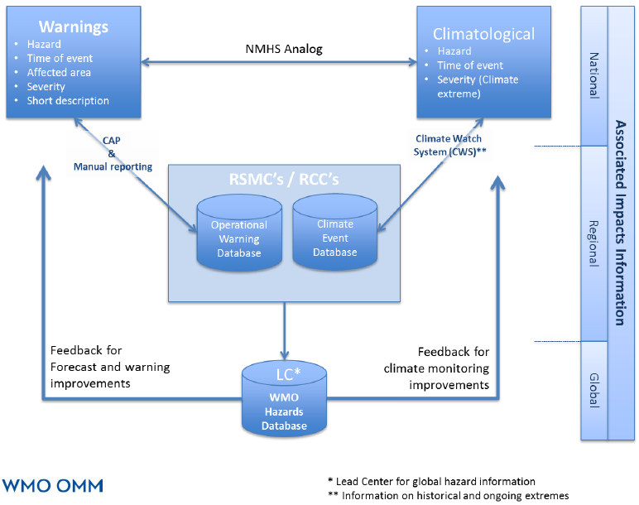
Leveraging and extending existing databases
Emergency Events Database
SHELDUS
ECMWF Severe Event Catalogue
Disaster Information Management System
… and more …
WMO Catalogue of Hazardous Events

Slide 12
Progress so far
Kicked off November 2020, extends through 2024
International multidisciplinary project team
Project plan published, seeking funding opportunities & collaborators
Glossary of terminology
Value Chain Framework outlined, literature review in progress
Case study data template in development
Workshops on Citizen Science and Australian flood event
Take our short survey at https://forms.office.com/r/fF2pKq9XEn
Value chain as an analysis approach
Hazardous event case studies to support analysis of the end-to-end warning chain
Contact:
Beth Ebert (chair) beth.ebert@bom.gov.au
More information:
http://hiweather.net/Lists/130.html
HIWeather newsletter
HIWeather YouTube channel
Notes:
The Value Chain project hopes to help researchers and practitioners to
Use the value chain as an analysis approach to understand and improve their forecast and warning chains, and to be able to measure how effective the different parts are working; and then
Review other warning chains for other high impact weather events to understand what has worked well, by accessing data of past events and knowing what data to collect and put in.

