Slide 1
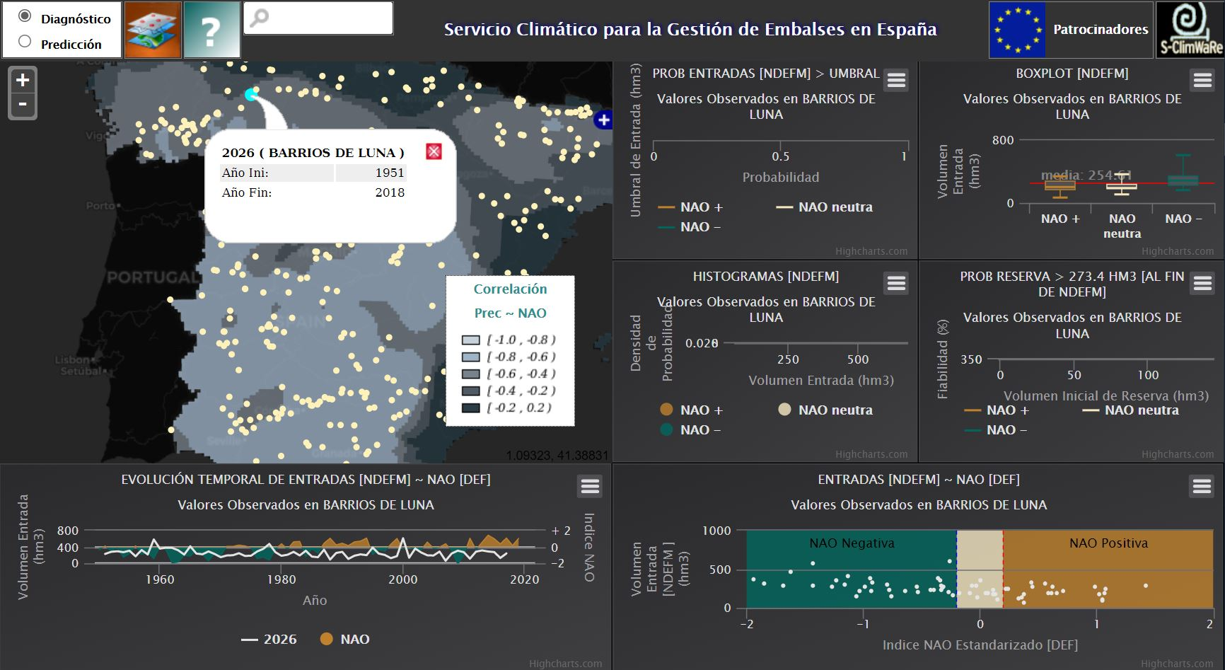
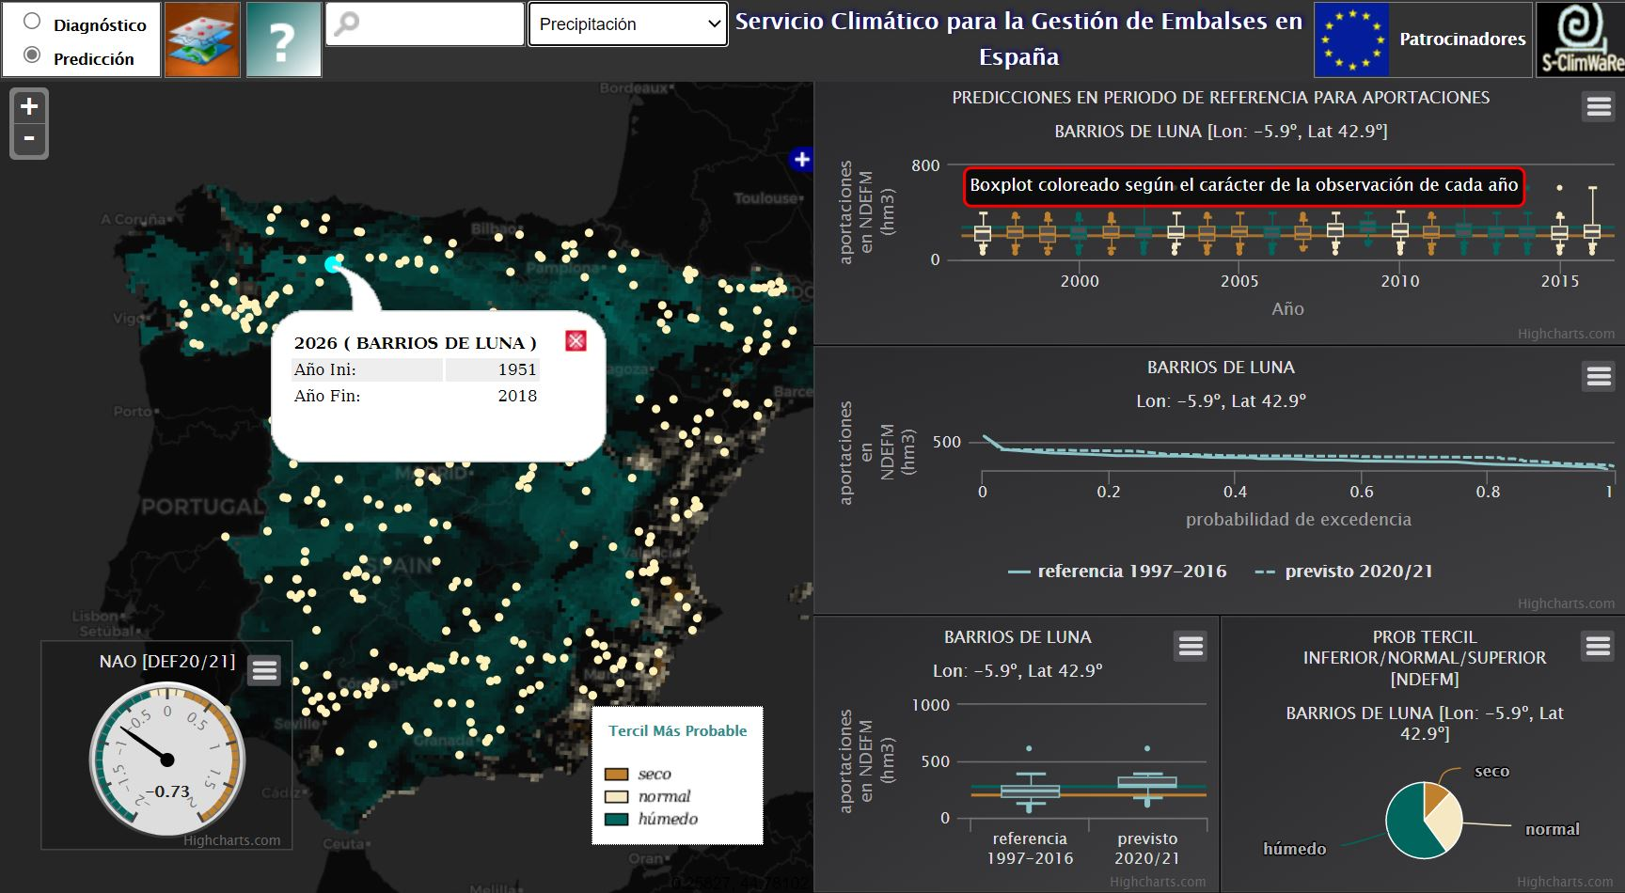
Upgrade of a climate service tailored to water reservoirs management
E. Sánchez-García¹, I. Abia¹, M. Domínguez¹, J. Voces¹, J.C. Sánchez¹,
B. Navascués¹, E. Rodríguez-Camino¹, M.N. Garrido¹, M.C. García²,
F. Pastor², M. Dimas³, L. Barranco³, C. Ruiz Del Portal⁴
¹ Agencia Estatal de Meteorología (AEMET), Spain
² Dirección General del Agua (D.G. Water), Spain
³ Centro de Estudios Hidrográficos – CEDEX, Spain
⁴ Confederación Hidrográfica del Miño-Sil, Spain
Contact: E. Sánchez-García (esanchezg@aemet.es)
OPEN ACCESS:
https://www.aemet.es/es/serviciosclimaticos
variable select
Exploring, for any water reservoir or grid point over continental Spain, the existing hydrological variability and hazard linked to climate variability.
Seasonal predictions for November to March accumulated water reservoir inflow, precipitation, snow and temperature. Probabilistic forecasts and its skill were jointly displayed in the web tool.
EMS Annual Meeting 2021 online | 3–10 September 2021

Slide 2
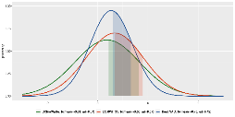
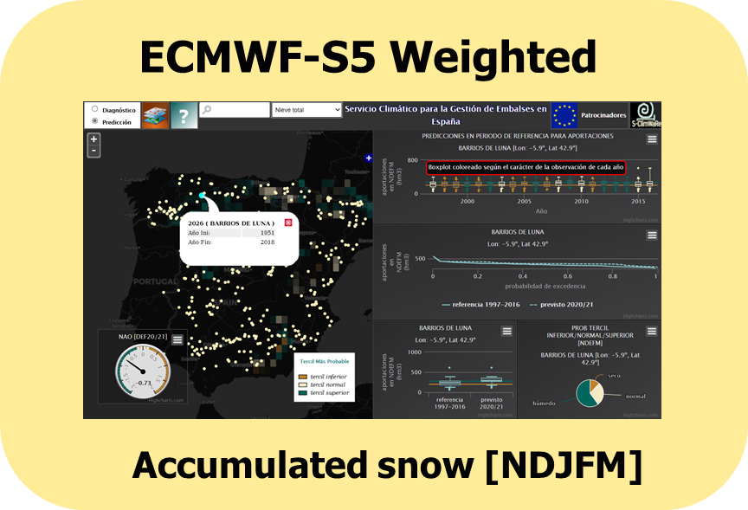
CSTools R package:
cran.r-project.org/web/packages/CSTools
S-ClimWaRe
AEMET Empirical model
Water reservoir inflow
ECMWF-S5
ECMWF-S5
Using two functions from the MEDSCOPE Toolbox for Climate Forecasts postprocessing:
Downscaling
Weighting
Snow
Resolution 25 km
WEB TOOL
Precipitation
ECMWF-S5-D
Temperature
Resolution 5 km
EMS Annual Meeting 2021 online | 3–10 September 2021

