Slide 1
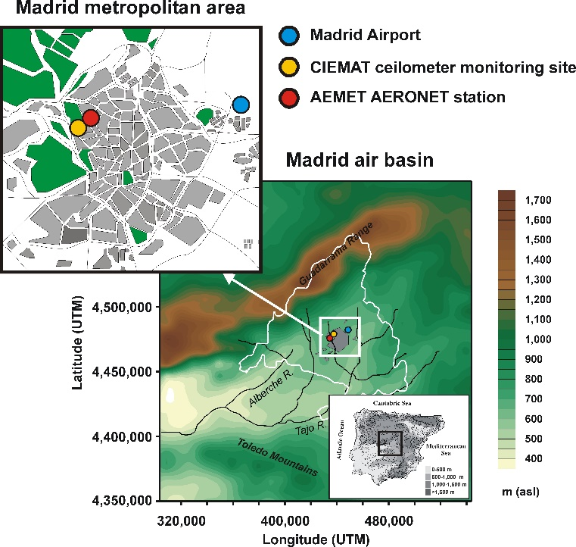
Assessment of the planetary boundary layer height by means of machine learning techniques using ceilometer signals
Rubén Barragán (ruben.barragan@ciemat.es), Francisco Molero, Begoña Artíñano
Department of Environment, Centro de Investigaciones Energéticas, Medioambientales y Tecnológicas (CIEMAT)
Introduction & Main objective
Anthropogenic aerosols deteriorate air quality increasing public health risk → their characterization is mandatory in atmosphere studies.
These aerosols are mostly concentrated within the PBL, from the surface up to a variable height → presence of a temperature inversion / radiation emitted by the surface.
The ceilometer CHM15k-Nimbus, deployed in the MDR-CIEMAT ACTRIS station collocated with the meteo station, provides continuous aerosol vertical profiles with good spatial resolution.
The main objective of this work is the assessment of the PBLH by means of machine learning techniques using ceilometer signals.
Site & Instrumentation
Figure 1. Location of MDR-CIEMAT ACTRIS station (adapted from Barragan et al., 2020)
ABLH (black dots) and MLH (red dots) are estimated from ceilo signals using the STRATfinder algorithm → provides diary boundary layer configuration at 1 min resol (10 min in this work) → determining optimized path between 2 points minimizing a cost function (Kotthaus et al., 2020)*.
This study estimates PBL heights from simple data, therefore because of its simplicity, the acceptance of continuous values and the little data preparation required, a regression tree analysis is used to predict PBL heights (Table 1):
Table 1. Response and predictors used to feed the model
Type | Instrument | Variable
Response | Ceilometer (STRATfinder) | ABLH
 |  | MLH
Predictors | Copernicus | LST
 | CIEMAT Meteo station | Rain Flag
 |  | Upper/Lower T
 |  | T gradient
 |  | Rel. Humidity
 |  | Wind speed
 |  | Pressure
 | Pyranometer | Solar fraction
Figure 2. Colormap of ceilometer attenuated backscatter Black and red dots stand for the ABLH and MLH estimated using the STRATfinder algorithm. For the sake of clarity only the period between 14th and 17th July is shown
*Kotthaus, S.; Haeffelin, M.; Drouin, M.-A.; Dupont, J.-C.; Grimmond, S.; Haefele, A.; Hervo, M.; Poltera, Y.; Wiegner, M. Tailored Algorithms for the Detection of the Atmospheric Boundary Layer Height from Common Automatic Lidars and Ceilometers (ALC). Remote Sens. 2020, 12, 3259. https://doi.org/10.3390/rs12193259

Slide 2
Results (II)
Methodology
Estimation of ABLH and MLH by means of the STRATfinder algorithm:
349 days analyzed (17 days without ceilometer data during 2020)
An ABLH and MLH point every 10 minutes
Download predictors data from the CIEMAT meteo station and Copernicus
As Copernicus provides LST hourly data, same LST value is used for the 6 ten-minutes packages of each hour
Only days with presence of convective boundary layer are taken into account (ABLH=MLH)
Predictors and responses in the correct format are used to feed the regression tree model:
Tree of depth 25
80% of data randomly selected to test de model
14179 values analyzed (27.5% of the total)
Test and train datasets have showed a good correlation with the response data. Figure 4 shows that Train and Test predictions and response data are superimposed
Figure 4. Train and test datasets predictions compared to the response data for the period between 14th and 17th July 2020
Finally Figure 5 shows the importance of every predictor used. The lower temperature measured by the meteo station is clearly the most important variable when 2020 is analyzed, followed by the pressure, solar fraction and RH that show similar importance
Results (I)
In this section, the results of the regression tree model are summarized:
Table 2. Mean absolute error (MAE), root mean square error (rmse) & correlation coefficient (R²) estimates for the regression tree model in 2020
 | mae | rmse | R²
Test dataset | 107.77 | 217.27 | 0.93107
Train dataset | 186.82 | 344.37 | 0.82618
Figure 5. Importance of the different predictors in the regression tree model
Conclusions
The regression tree model presents good results as confirm the high R² values found (0.93 and 0.82 for the Train and Test dataset respectively)
The model shows good results with simple data that no need of data processing
PBL heights can be estimated with good results using just meteo station and satellite data for long datasets (whole 2020)
Temperature is the key parameter to estimate the convective boundary layer
RH is one of the main key predictors because present a temporal evolution very similar to the MLH estimated by STRATfinder but opposite → decrease while MLH increase, keep low values while MLH stays stable and increase when MLH decrease during nighttime
Figure 3. Linear fit of between predicted and actual MLH with 95% prediction interval for the train (left) and test (right) datasets

