Slide 1
Statistical Analysis and Case Study of the Evaporation Duct over South China Sea
Jou Ping Hou, Mong-Ling Chiao
Department of Environmental Information and Engineering,
Chung Cheng Institute of Technology, National Defense University, Taoyuan, Taiwan

Slide 2
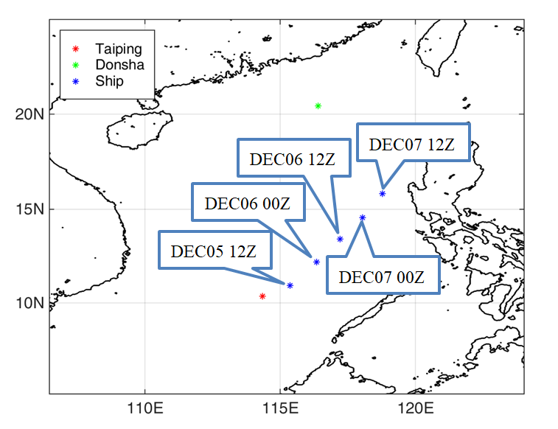
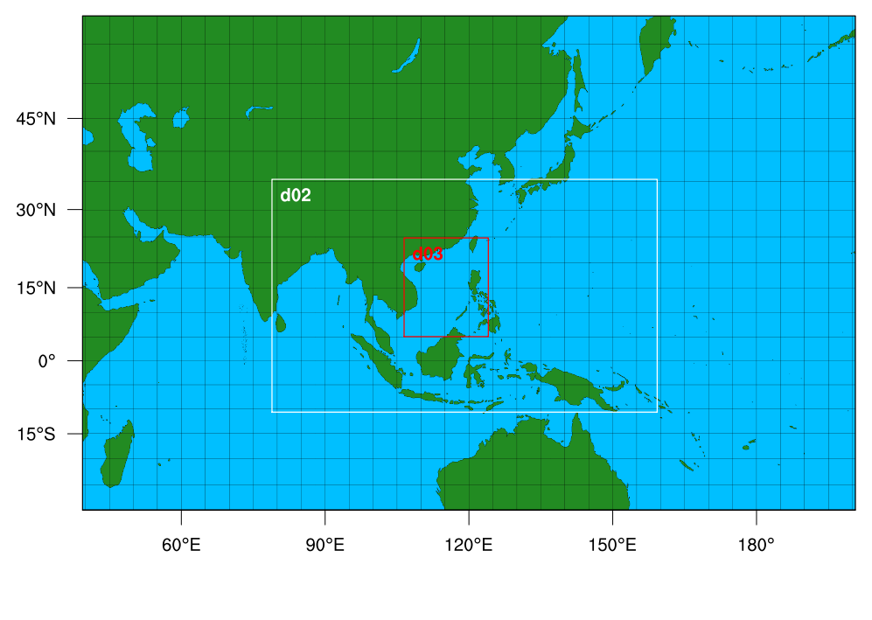
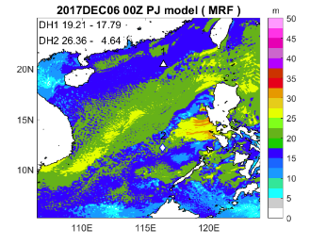
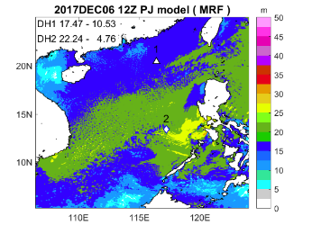
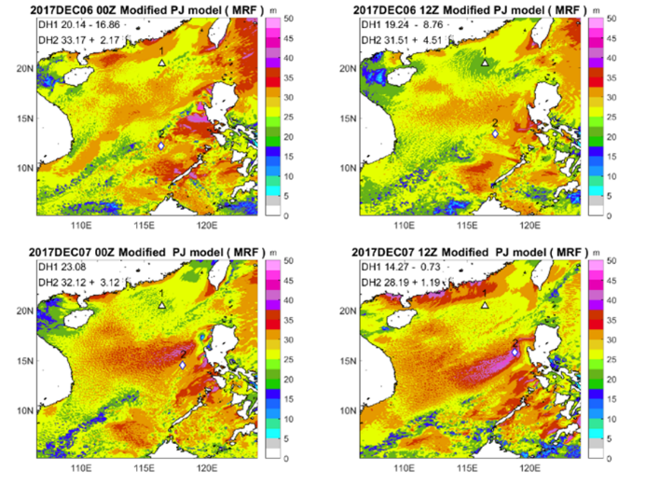
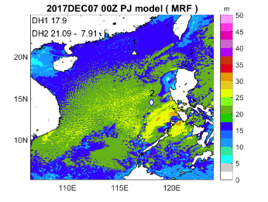
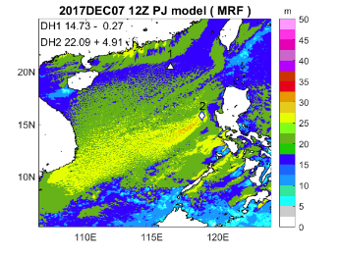
Route of R/V O.R.1 in the South China Sea Two-Island Monsoon Experiment (SCSTIMX) in 2017
WRF configuration:
Positions of domain 3 (d03) with 3-km resolution
Accuracy of M-P-J model is better than P-J model.
Item | Evaporation duct Height(m)
Forecast | 12hrs | 24hrs | 48hrs
R/V O.R.1 | 31 m | 27 m | 27 m
P-J | 26.36 m | 22.24 m | 22.09 m
Modified P-J | 33.17 m | 31.51 m | 28.19 m
Paulus-Jeske model
Modified P-J model

