Slide 1
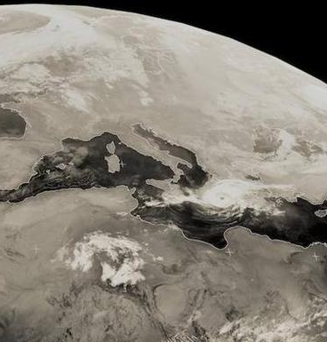
USE OF HIGH RESOLUTION COUPLED MODELS FOR FUTURE CLIMATE PROJECTIONS OF MEDICANES
Jesús Gutiérrez Fernández (jesus.gfernandez@uclm.es)
Juan Jesús González Alemán
Alba de la Vara
Miguel Angel Gaertner Valdepeñas.
Salvatore Pascale
Hiroyuki Murakami
Gabriel A. Vecchi
William Cabos
Dmitry V. Sein
Universidad de Ciencias Ambientales

Slide 2
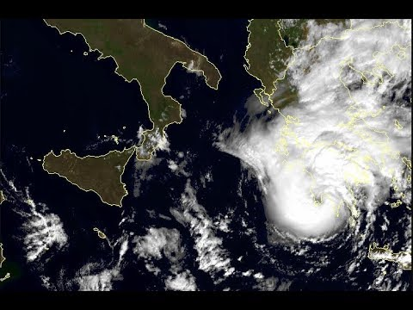
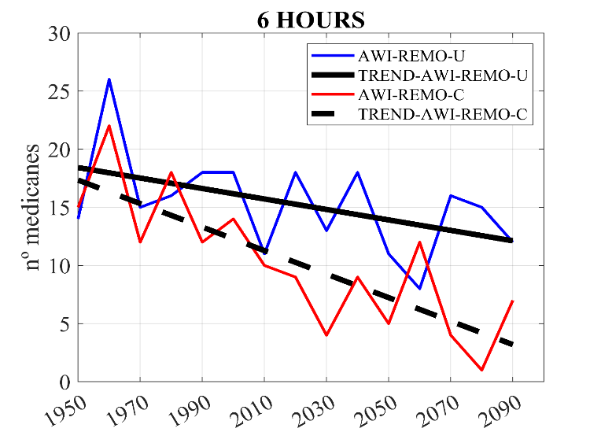
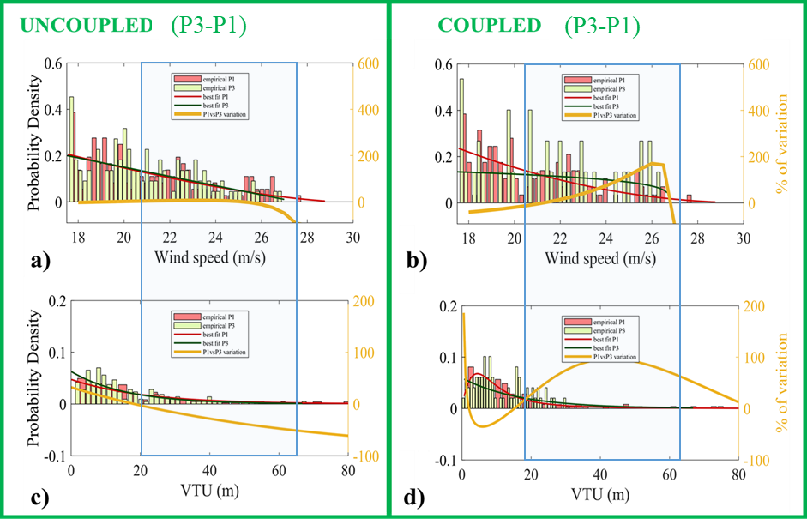
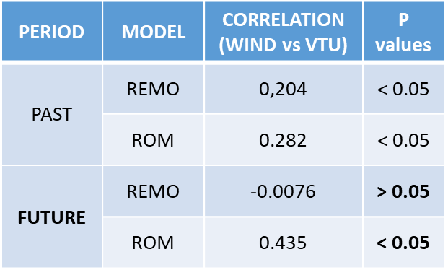
USE OF HIGH RESOLUTION COUPLED MODELS FOR FUTURE CLIMATE PROJECTIONS OF MEDICANES
REMO: UNCOUPLED MODEL
ROM: COUPLED MODEL
P1 = 1951-2000
P3 = 2050-2100
In future climate → Medicane changes.
Coupled run→ VTU ↑ → Max wind↑→ higher intensity
Uncoupled run → VTU ↓ → Max wind↓ → less intensity
RESULTS: FRECUENCY AND INTENSITY MEDICANES.
Trend (1950-2099) → ROM → -1,1 med/dec
→ REMO → 0.45 med/dec

