Slide 1
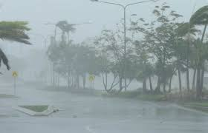
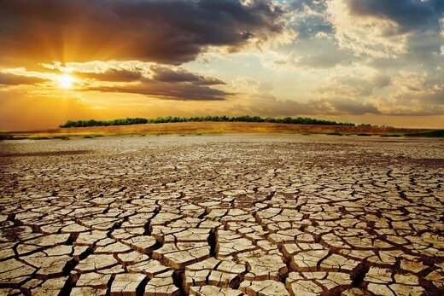
Long-term trends of precipitation in Europe in different datasets
Radan HUTH^{1,2}, Václav VÍT¹
¹ Faculty of Science, Charles University, Praha, Czechia
² Institute of Atmospheric Physics, Czech Academy of Sciences, Praha, Czechia

Slide 2
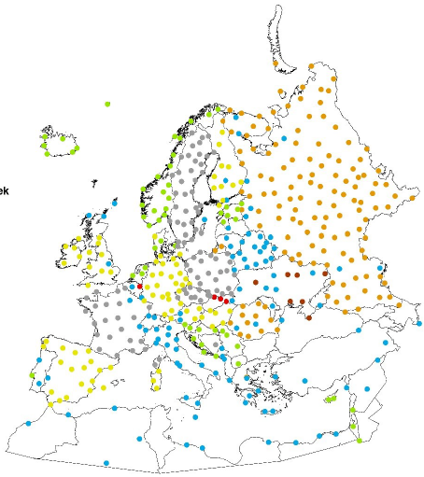
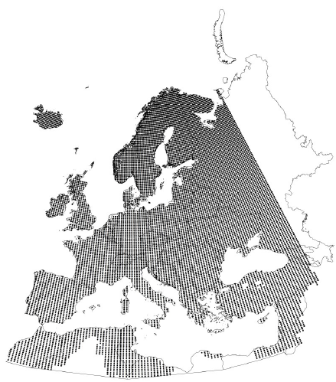
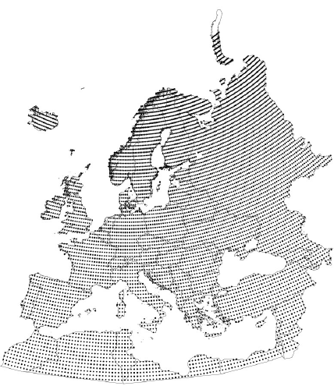
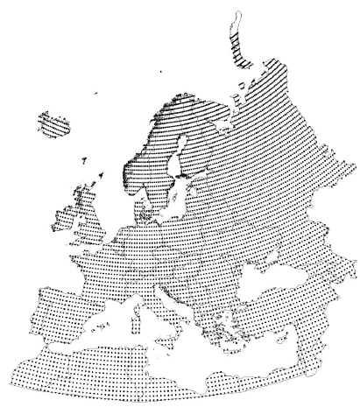
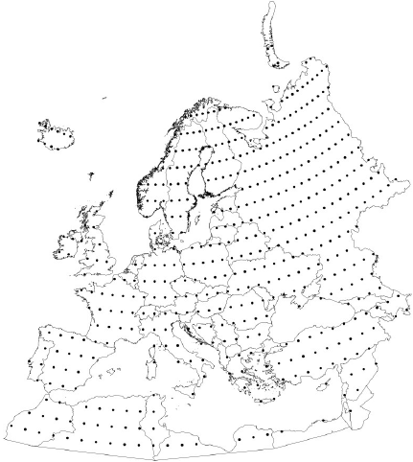
Data
daily precipitation
1961-2011
datasets
observed
ECA & D (507 stations)
gridded
E-OBS (10,402 gridpoints)
CRU TS v. 4.03 (7,678 gridpoints)
reanalyses
JRA-55 (6,559 gridpoints)
NCEP/NCAR (610 gridpoints)

Slide 3
Methods
seasonal precipitation totals (DJF, MAM, …)
Theill-Sen regression (median of pairwise slopes)
significance of trends: Mann-Kendall test
significance of difference of trends: Fisher test for correlation coefficients

Slide 4
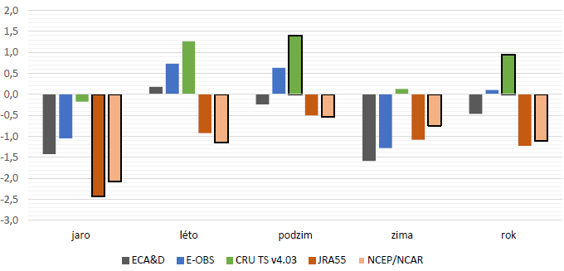
spatial mean relative trend (% / 10 yr)
spring
summer
autumn
winter
annual
both reanalyses: strongest drying trend except winter
CRU TS: strongest wetting

Slide 5
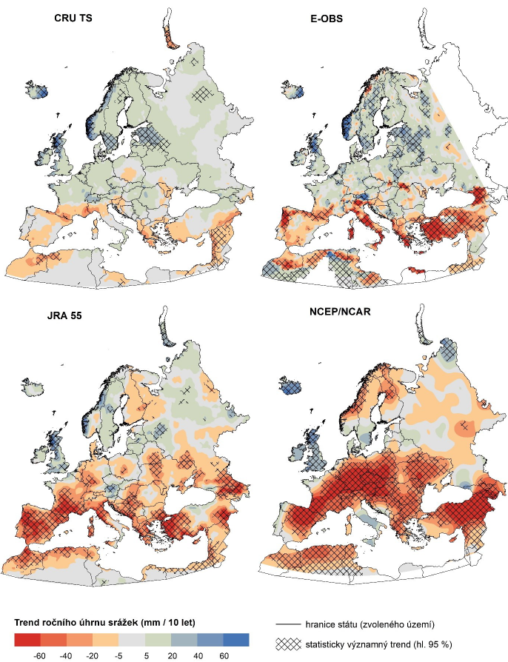
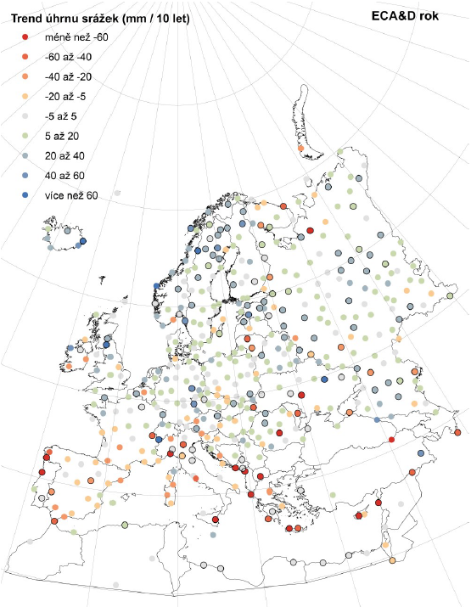
precip trend, mm / 10 yr, 1961-2011
ANNUAL

Slide 6
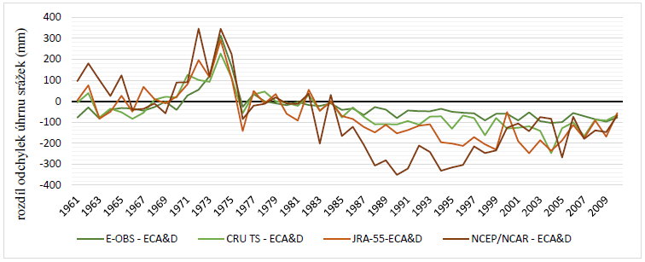
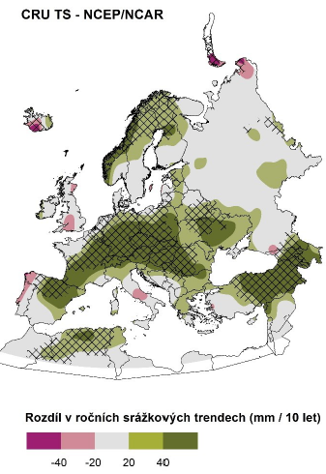
ANNUAL
Sodankylä: diff. from ECA&D
difference CRU TS – NCEP/NCAR
(mm / 10 yr)

Slide 7
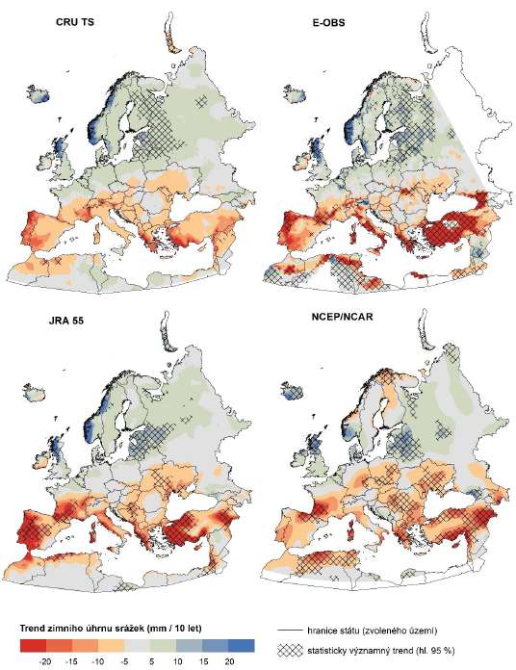
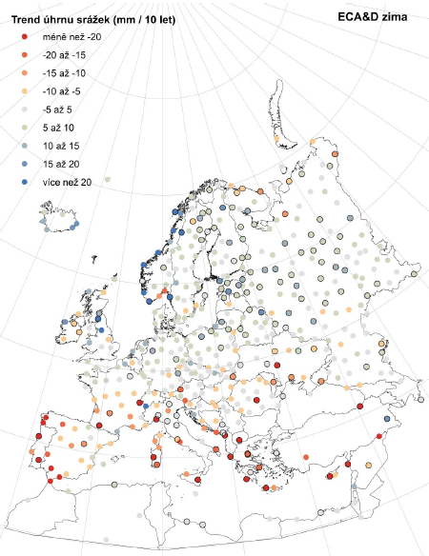
precip trend, mm / 10 yr, 1961-2011
WINTER

Slide 8
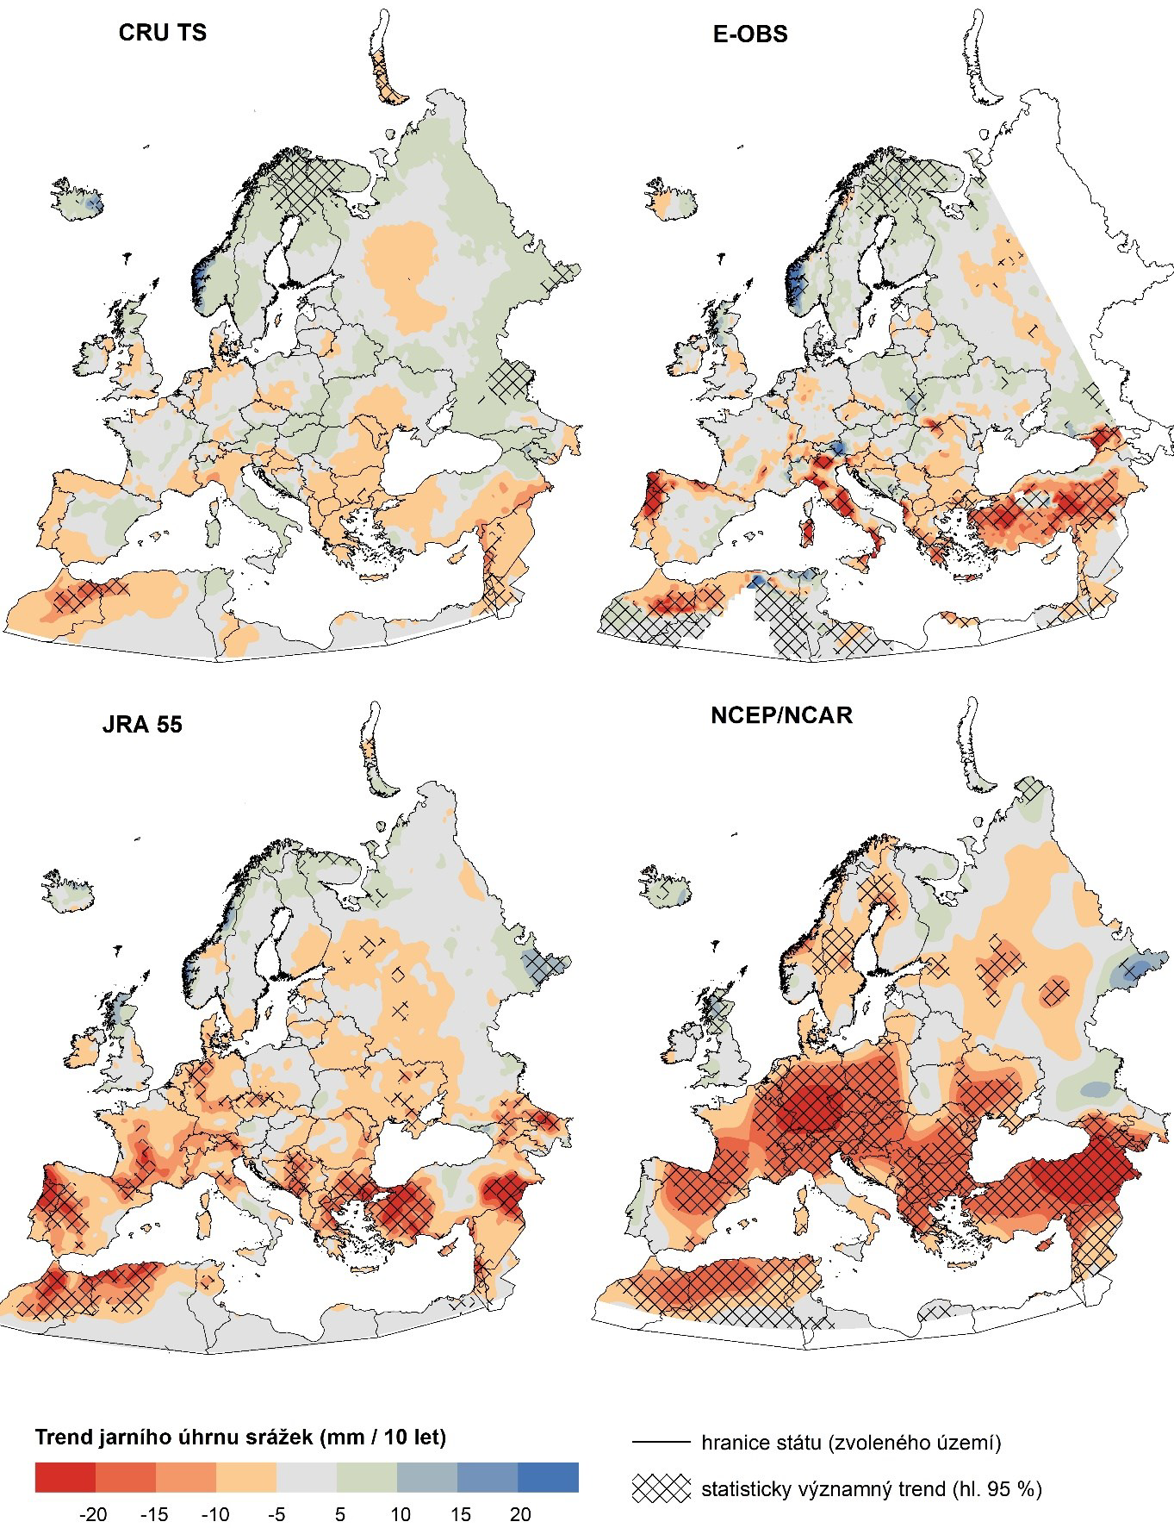
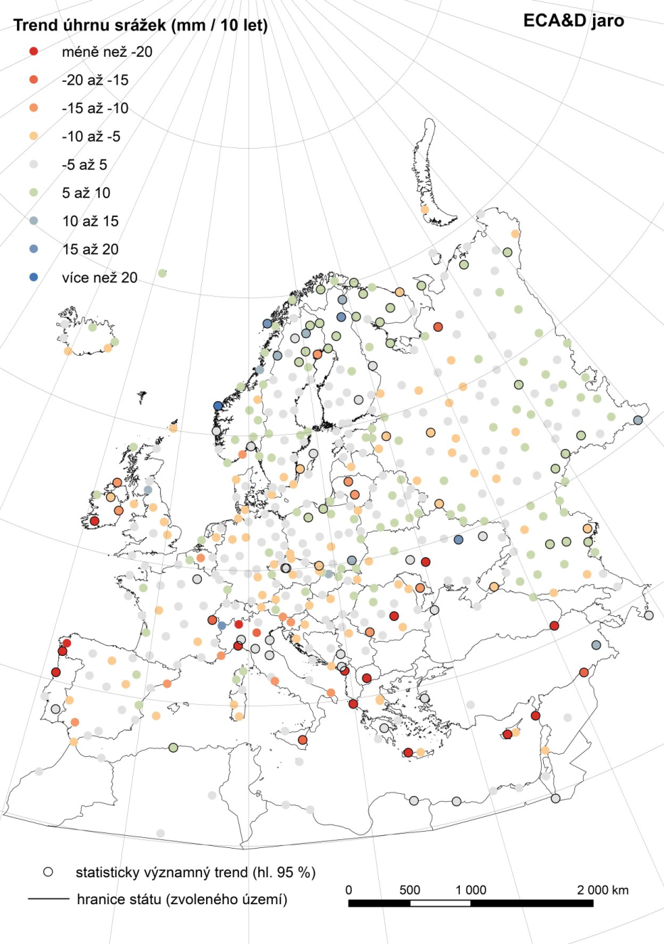
precip trend, mm / 10 yr, 1961-2011
SPRING

Slide 9
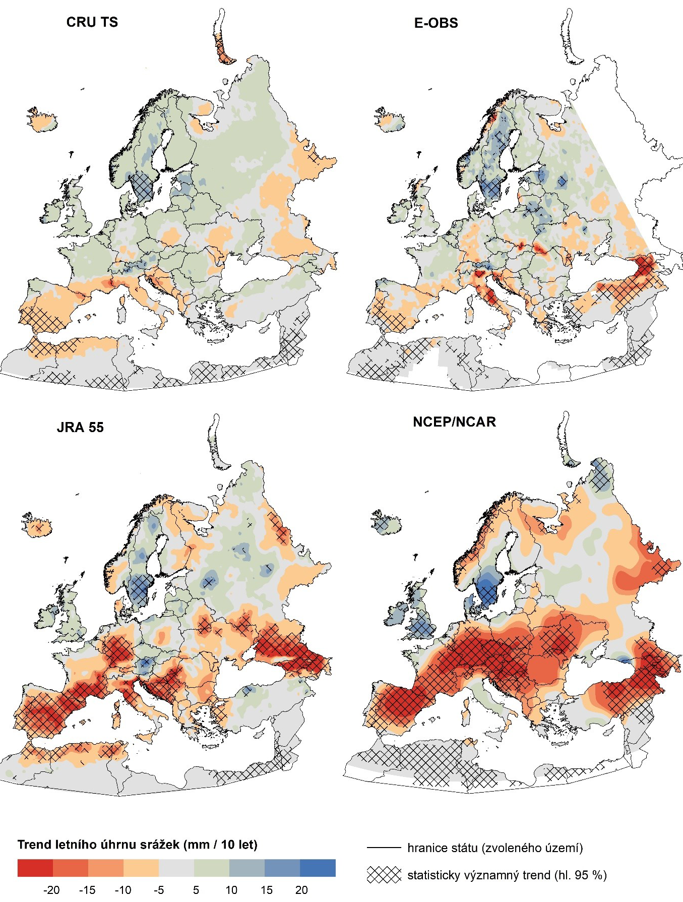
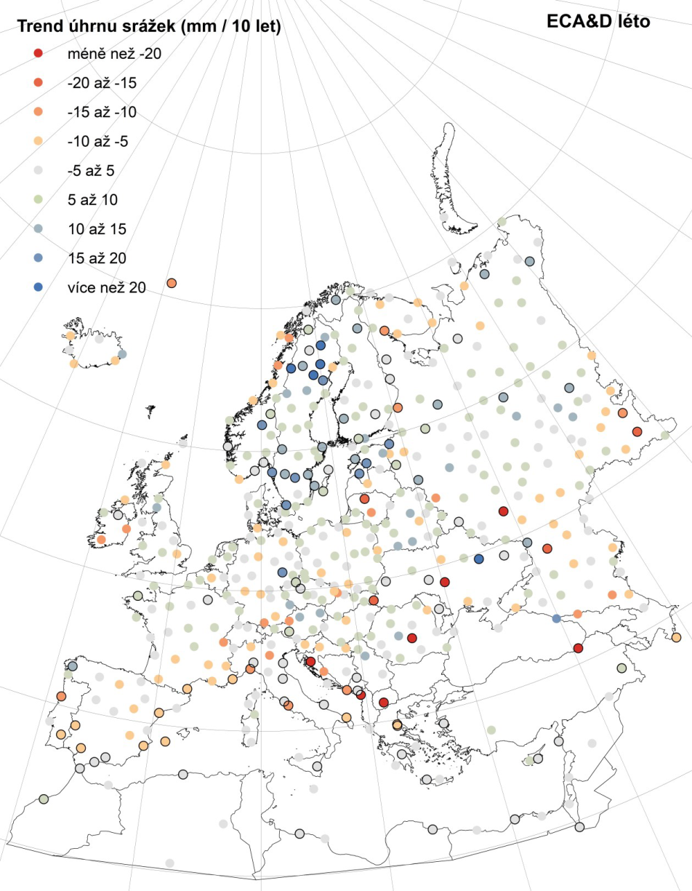
precip trend, mm / 10 yr, 1961-2011
SUMMER

Slide 10
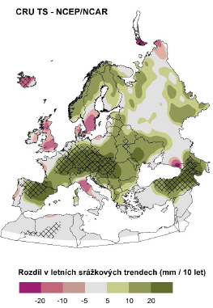
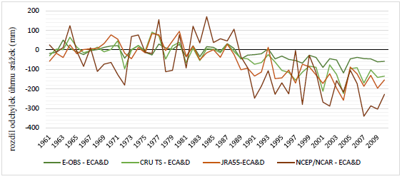
SUMMER
Poltava: diff. from ECA&D
difference CRU TS – NCEP/NCAR
(mm / 10 yr)

Slide 11
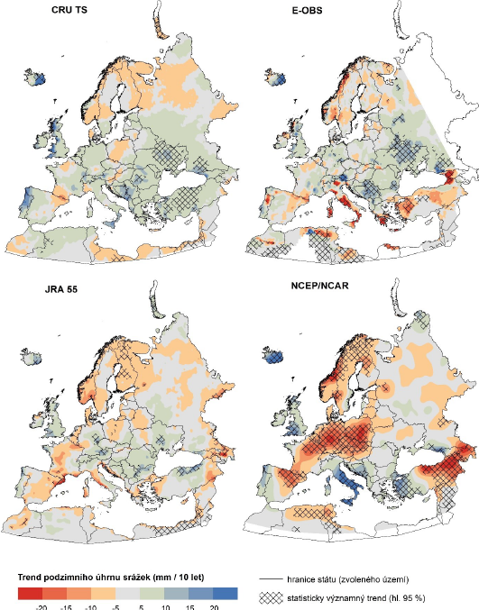
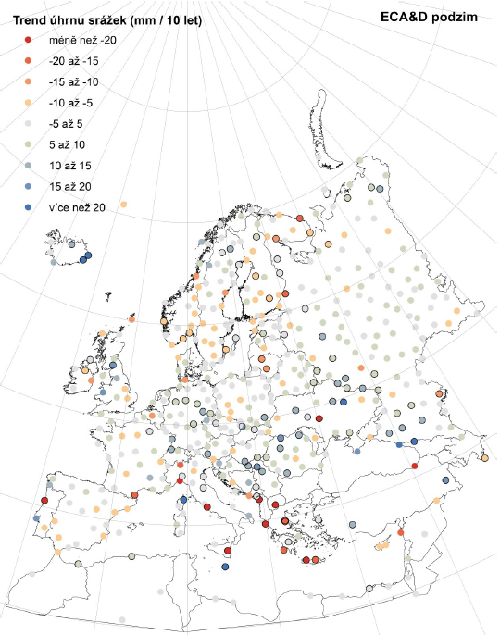
precip trend, mm / 10 yr, 1961-2011
AUTUMN

Slide 12
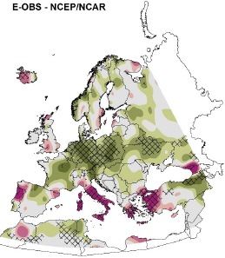
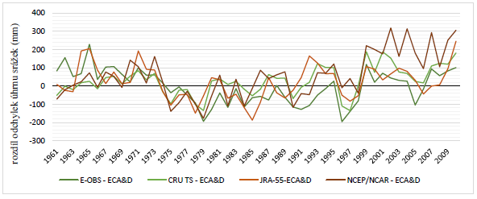
AUTUMN
Roma-Ciampino: diff. from ECA&D

Slide 13
Final questions (instead of answers☺)
Which database provides correct trends?
impossible to say; each database has its own potential drawbacks
Potential drawbacks
station data
inhomogeneities
measurement errors (unlikely to have much effect)
gridded data
inhomogeneity of stations entering interpolation
time-varying sets of stations used for interpolation
reanalyses
time-varying datasets entering assimilation (e.g., satellites only from 1979)
time-varying data quality
model imperfections / errors

Slide 14
Final questions & remarks
detailed local / regional analysis may
identify specific drawbacks of individual databases
point to wrong / correct (worst / best) database(s) in each specific case
wrong / correct (good / bad) database(s) vary regionally and seasonally
is excessive drying typical for all reanalyses? ➔ more reanalyses (possibly also surface-input) should be examined
general conclusion: trend analysis based on a single database may be misleading

