Slide 1
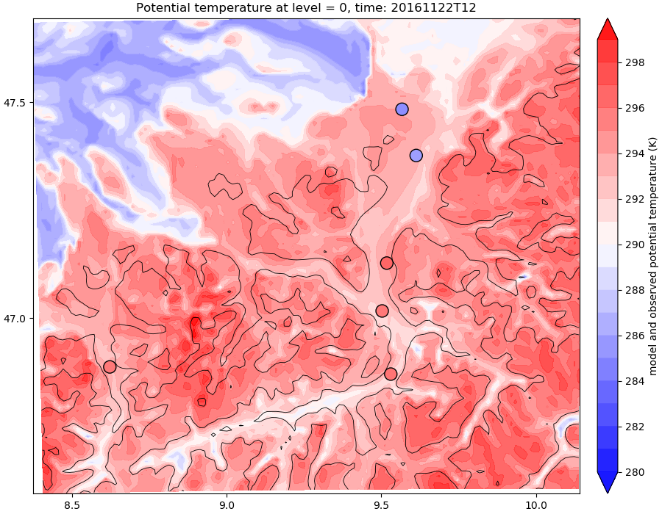
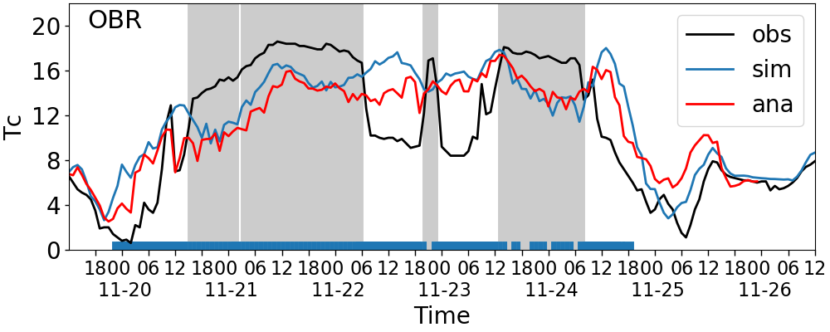
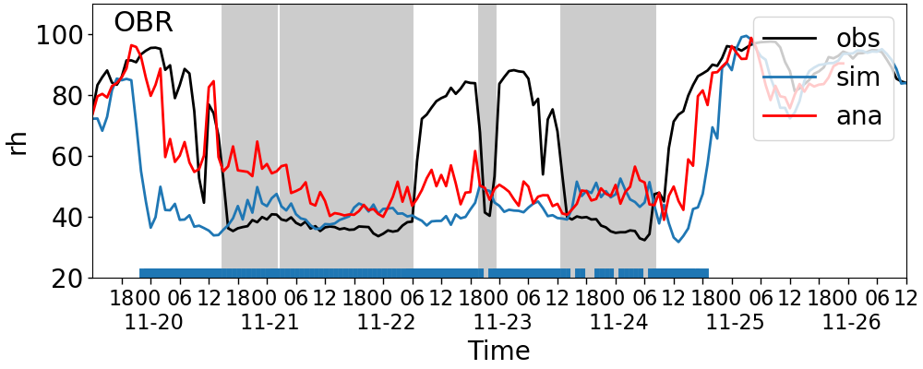
Evaluation of near-surface characteristics of Foehn in COSMO-1
Yue Tian, Juerg Schmidli, Julian Quimbayo-Duarte
Institute for Atmospheric and Environmental Sciences (IAU), Goethe University Frankfurt, Germany
Motivation: Anecdotal evidences of model biases and causes from forecasters’ experience and master theses
Goal: to verify and document the model biases, and to test on the possible causes
Example: case in Nov 2016
2016-11-22 12:00
OBR

Slide 2
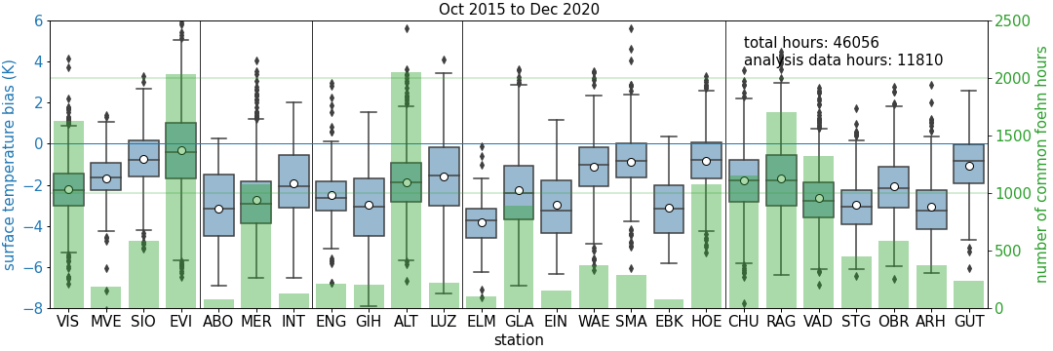
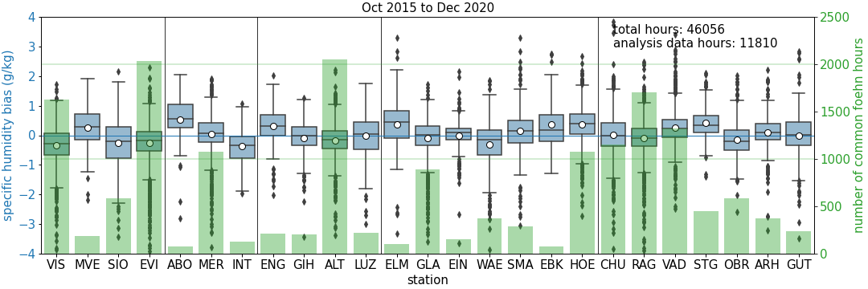
Evaluation of near-surface characteristics of Foehn in COSMO-1
Yue Tian, Juerg Schmidli, Julian Quimbayo-Duarte
Institute for Atmospheric and Environmental Sciences (IAU), Goethe University Frankfurt, Germany
Figure: Model biases in surface temperature (top) and specific humidity (bottom) during common foehn hours from Oct 2015 to Dec 2020
Further sensitivity tests:
Land-surface processes (skin layer, bare soil evaporation, resistance for surface heat fluxes)
Horizontal shear production in TKE
COSMO-550m

