Slide 1
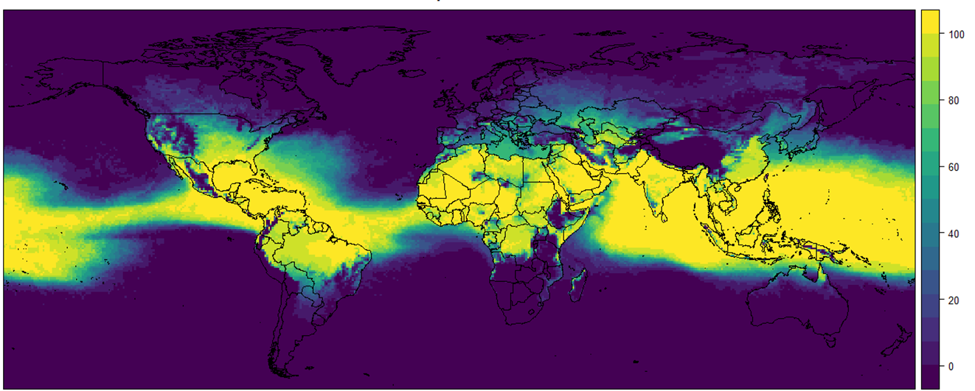
PhD Researcher at University of Reading and seconded to Ecmwf as an analyst
Daily Maximum exposure time in days from the 1st June 2021 to the 18th August 2021

Slide 2
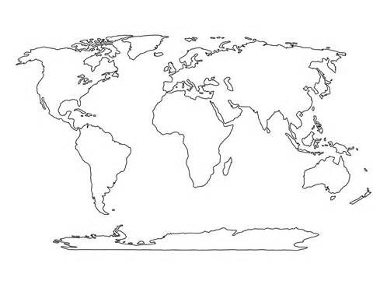
WHAT ARE
Heatwaves?
“When a location records a period of at least three consecutive days with maximum temperatures meeting or exceeding a heatwave temperature threshold”
Monday
Tuesday
Average
Wednesday
Thursday
Friday
Saturday
Sunday
There is no universal definition for
Heatwaves
(WMO,2015)
WMO,2015;McCarthy,2019
(McCarthy et al., 2019)

Slide 3
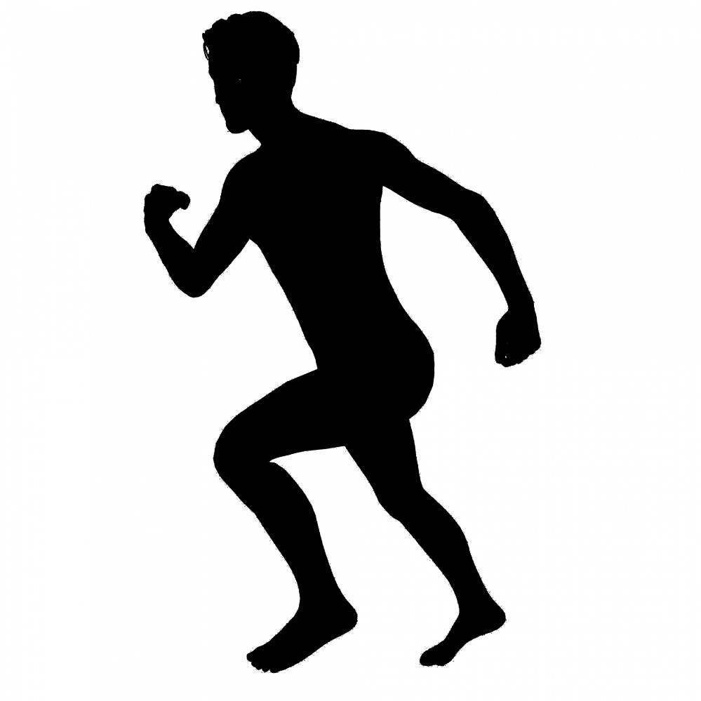
WHAT IS
Heat Stress?
Body heat
Build up of body heat as a result of activity and or external environment
(McGregor et al 2018)
McGregor, 2018

Slide 4
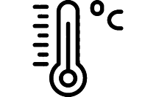
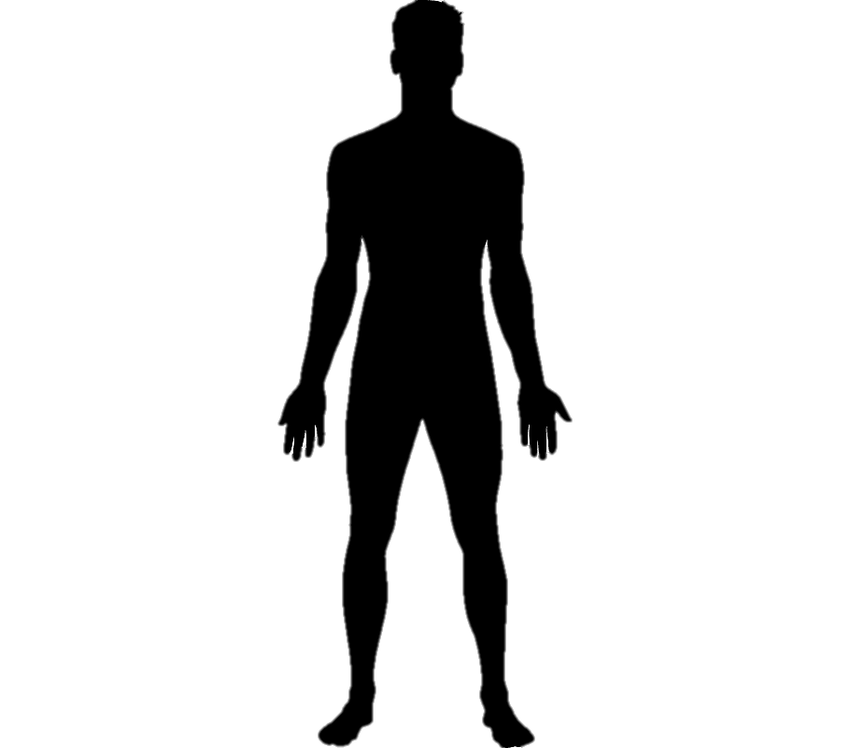
THE UTCI
A thermal comfort index
2m Temperature
Wind Speed
Universal
Thermal
Climate Index (UTCI)
Mean Radiant
Temperature
%
Dew Point Temperature
Polynomial function of a body model
Based on a white European male walking
(Di Napoli et al 2021,2019,2018)
Di Napoli, 2018,2019,2021

Slide 5
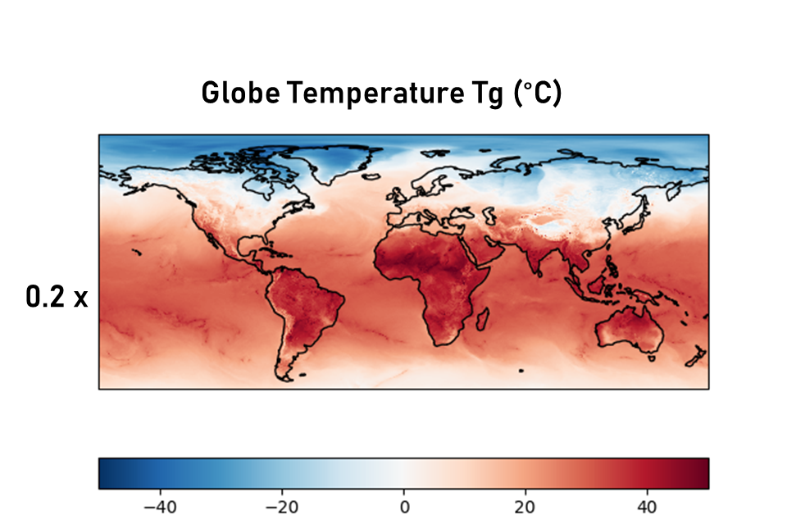
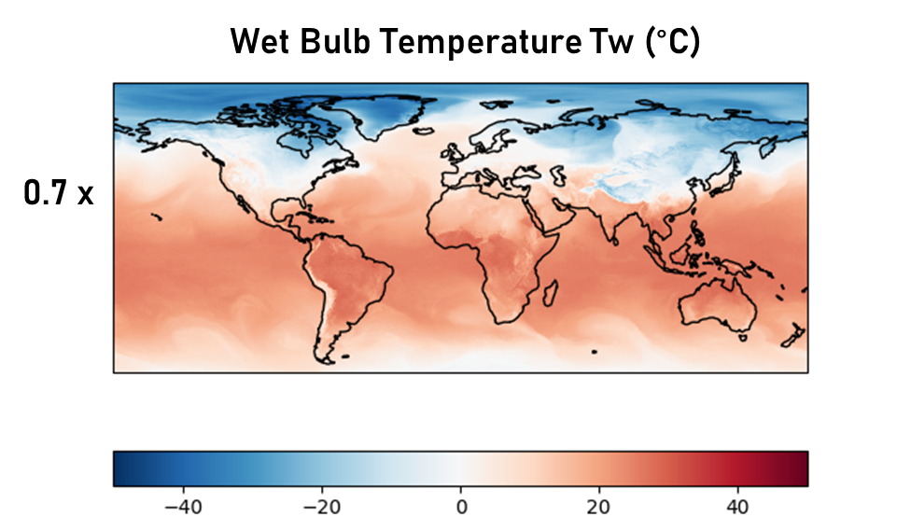
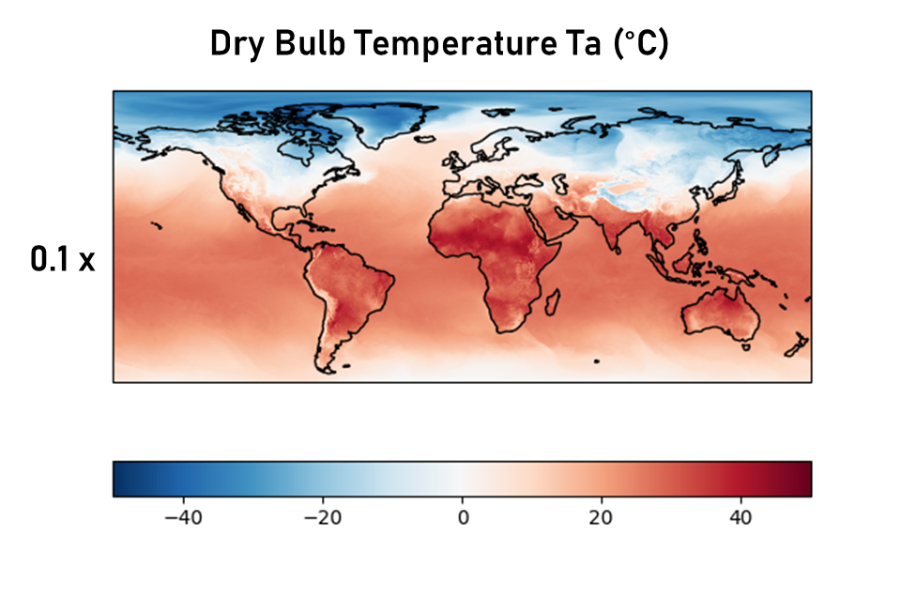
The Wet Bulb Globe Temperature
A heat stress index
Full method available in our python library
ERA5 Data from
1st March 2018
Stull 2011, Guo et al 2018

Slide 6
WHAT ARE
Heatwave impacts?
Raised morbidity (e.g. kidney disease and CSM)
Increase in hospital admissions.
Raised levels of mortality and suicide rates.
Overheating of buildings and urban heat island.
Reduction of some crop yields and food security challenges
Reduced levels of productivity
Delays on rail networks due to inadequate infrastructure.
Pressure on power grids from air con and overheating infrastructure.
Loss of livestock
Delays in planes being able to take off

Slide 7
Heat Stress at 12pm 22nd July
ECMWF forecast data for the UK heatwave that also was a heatwave in MENA region

Slide 8
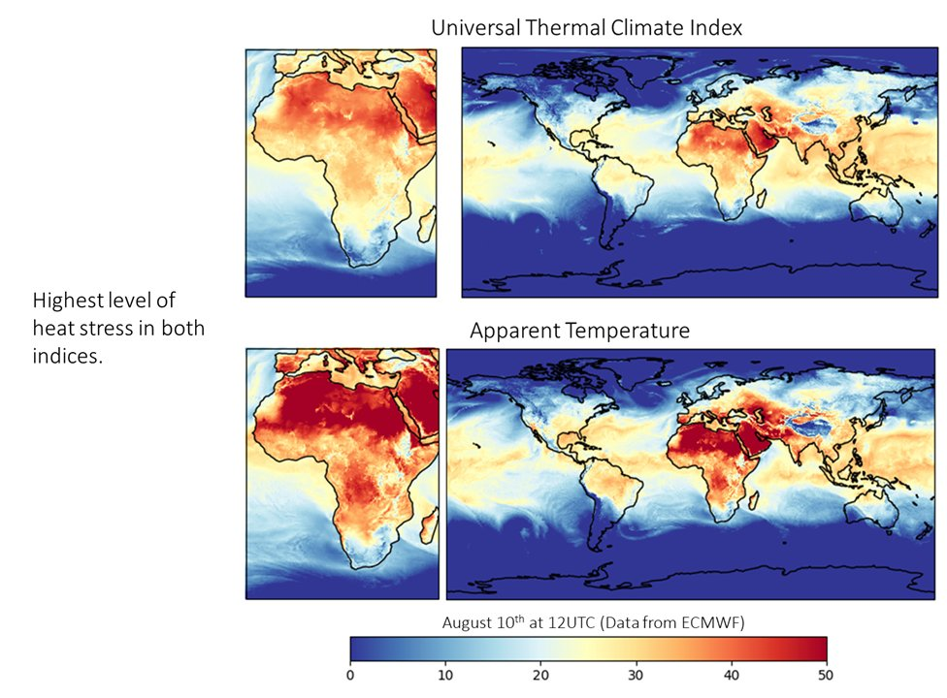
ECMWF Forecast Data for the Med heatwave in August
Heat Index that considers wind speed, relative humidity and temperature

Slide 9
People Impacted
From Extreme Heat Globally
Considering that 74% of the populated land surface is exposed to heat stress levels in the UTCI during August 2020, Vulnerable people are over 65s, pregnant women, under 5s, those with preexisting medical conditions and those who work outside.
Red Cross Climate Center 2020; Brimicombe et al 2021 under review

Slide 10
People Impacted
From Extreme Heat Globally
Same
Population
as the
Of the US, Brazil, Japan,
Russia, UK and France
Red Cross Climate Center 2020; Brimicombe et al 2021 under review

Slide 11
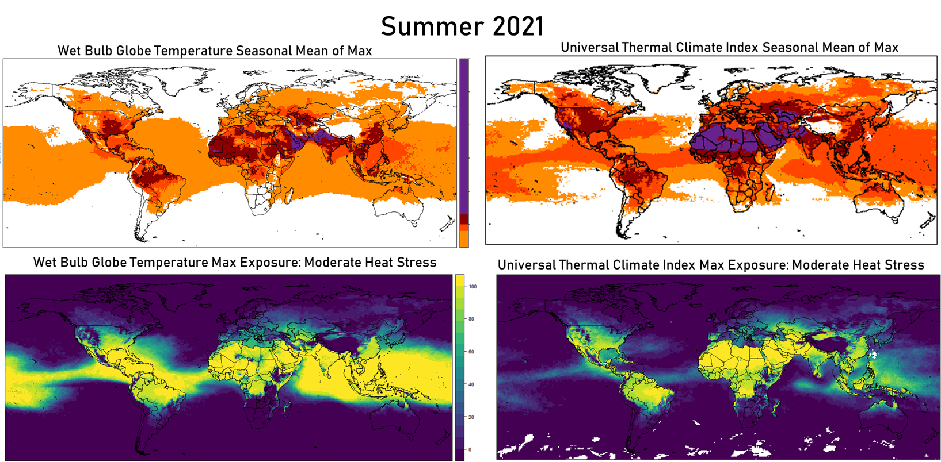
Heat Stress
This slide is the focus
of my lightning talk
Is Borderless
Purple highest level of heat stress
Exposure number of daily maximums that exceed moderate heat stress threshold over June 1st to August 18th 2021.

Slide 12
Feel free to get in touch if you have any questions or want to talk research.
Twitter: @ChloBrim
E-mail: c.r.brimicombe@pgr.reading.ac.uk

