Slide 1
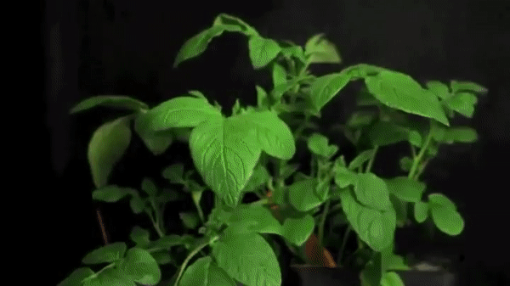
Implementing the modified potato blight risk forecasting model in Ireland
Late Potato Blight (Phytophthora infestans) is a fungal pathogen which has the potential to decimate potato crops if untreated
Blight has been forecasted in Ireland using the same model and methods since the 1950s, calibrated based on weather data and sparse meteorological spatial coverage at the time
Field based research (Cucak et al., 2019) proposed changes to the Old Irish Rules, and a change to the Effective Blight Hours to between 4 and 11 hours depending on regional susceptibility to blight outbreaks
 | Old Irish Rules | Modified Irish Rules
Humidity | 90% | 88%
Sporulation Duration | 12 hours | 10 hours
Temperature | 10°C | 12°C (potentially)
Due to the potential for catastrophic crop losses, commercial potato production relies entirely on prophylactic use of fungicides
This research was originally funded due to the need to reduce the spraying of pesticides and fungicides
EU regulations on fungicide use are becoming more stringent to reduce environmental damage and potential for mutation
Field analysis of pesticide applications using the New Irish Rules indicated that pesticide reductions of up to 58.7% were possible on average, without compromising disease control and yield (Cucak et al., 2021)
Phytophthora infestans (Late Blight) on potatoes

Slide 2
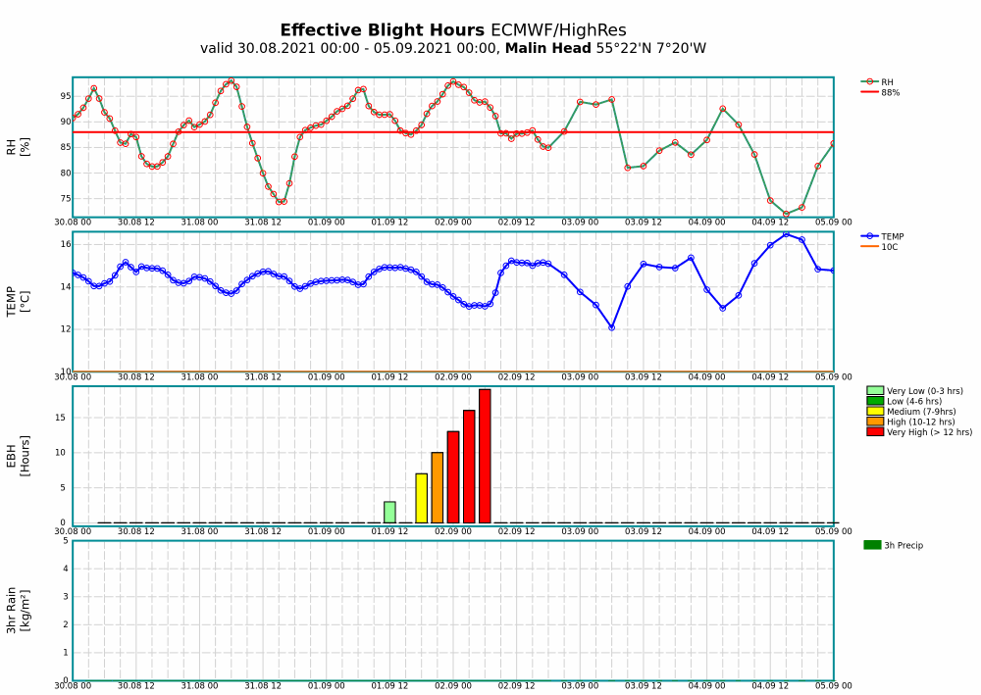
Modified Irish Rules Forecast (Implemented by Met Éireann)
Meteograms for each synoptic station location
Maps of blight risk based on Modified Irish Rules

