Slide 1
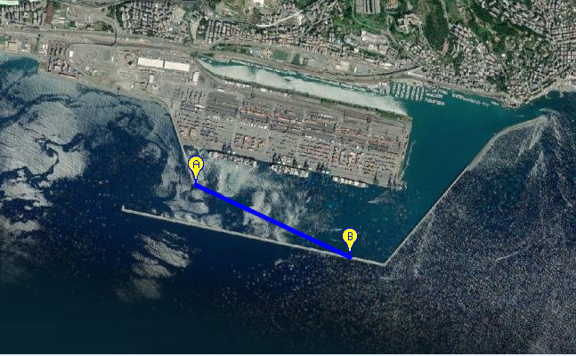
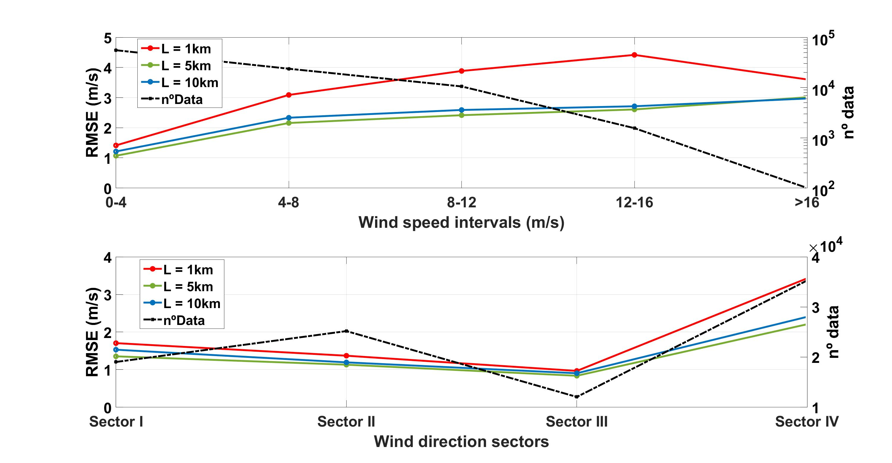
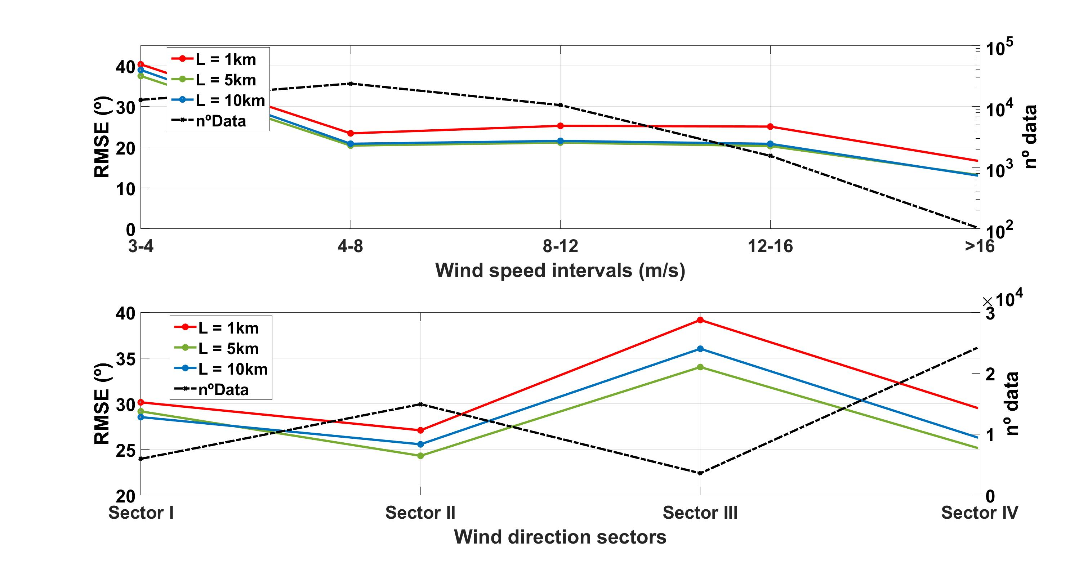
Comparison between the 2D wind fields retrieved by a scanning Doppler lidar and anemometric measurements
José Antonio Benavent-Oltra¹, Djordje Romanic^{1,2}, Milos Lompar³, and Massimiliano Burlando¹
Department of Civil, Chemical and Environmental Engineering, University of Genoa, Italy. 2. Department of Atmospheric and Oceanic Sciences, University Montréal, Canada. 3. Department of Meteorology, Republic Hydrometeorological Service of Serbia, Serbia
2D wind fields retrieved by SingleDop software using scanning Doppler lidar data are compared with anemometric measurements.
SingleDop is a software module based on the theoretical work described in Xu et al. (2006), which is intended to retrieve 2D low-level winds from either real or simulated Doppler radar data.
Wind Speed
Wind Direction
September 7th, 2021

Slide 2
Thunderstorm extraction
Analytic criterion:
$U_{max,10}≥18 m/s$
$G_{10}= {U_{max,10}}/{{\overline{U}}_{10}}≥1.5$
Subjective analysis of the signal extracted
Cross-checking with meteorological data (lightning occurrence, radar images)
subset of 13 events
(Nov 2019 – Jul 2020)
Conclusions
SingleDop shows a high potentiality to retrieve 2D Wind Fields using Doppler lidar measurements.
L = 5 km shows the best agreement with anemometer measurements both wind direction and velocity for all velocities and sectors. High linear correlations (R>0.9).
The agreement of wind velocity between SingleDop and anemometer data is better when wind vectors are aligned along the line-of-sight (Sectors I-III).
Doppler lidar and anemometer measurements have the same behaviour during thunderstorm events.
We will study and characterized the thunderstorm events using Doppler lidar data.
September 7th, 2021

