Slide 1
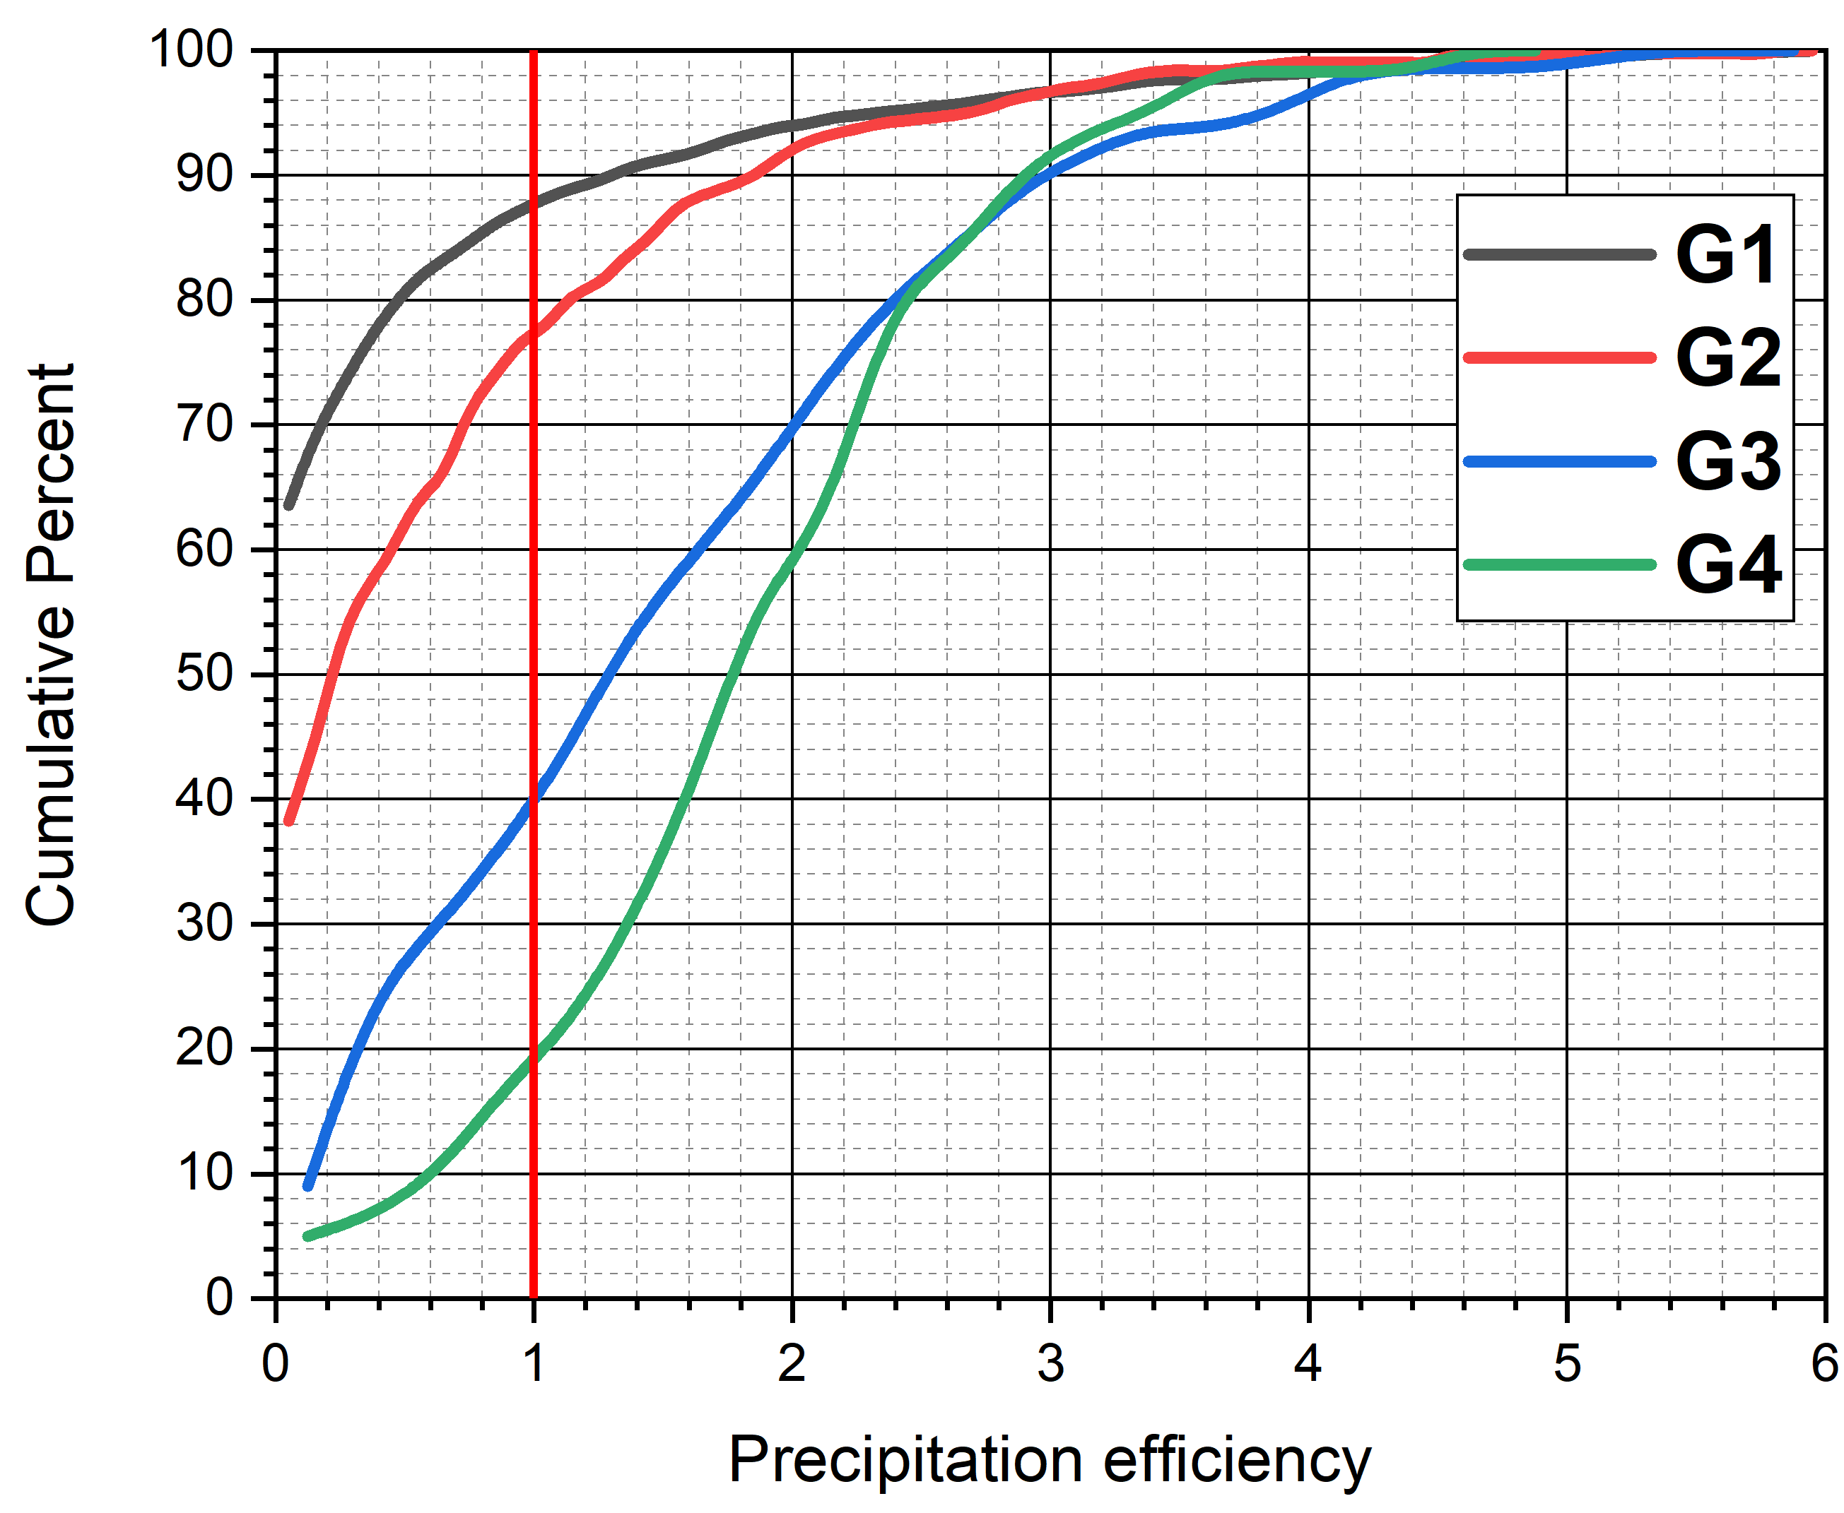
SAM-BM LES (SAM-Khairoutdinov, BM-Kogan)
Trade wind shallow cumulus clouds (RICO data)
Domain~ 52 km; 512x512x100 grid points
Dataset: 2031 clouds G1-G2 Small/Medium G3-G4 Large/Mature
G1
Precipitation efficiency
PE = PR/CR
PE >>1 for H > ~ 2.3 km
G2
G3
G4
PE

Slide 2
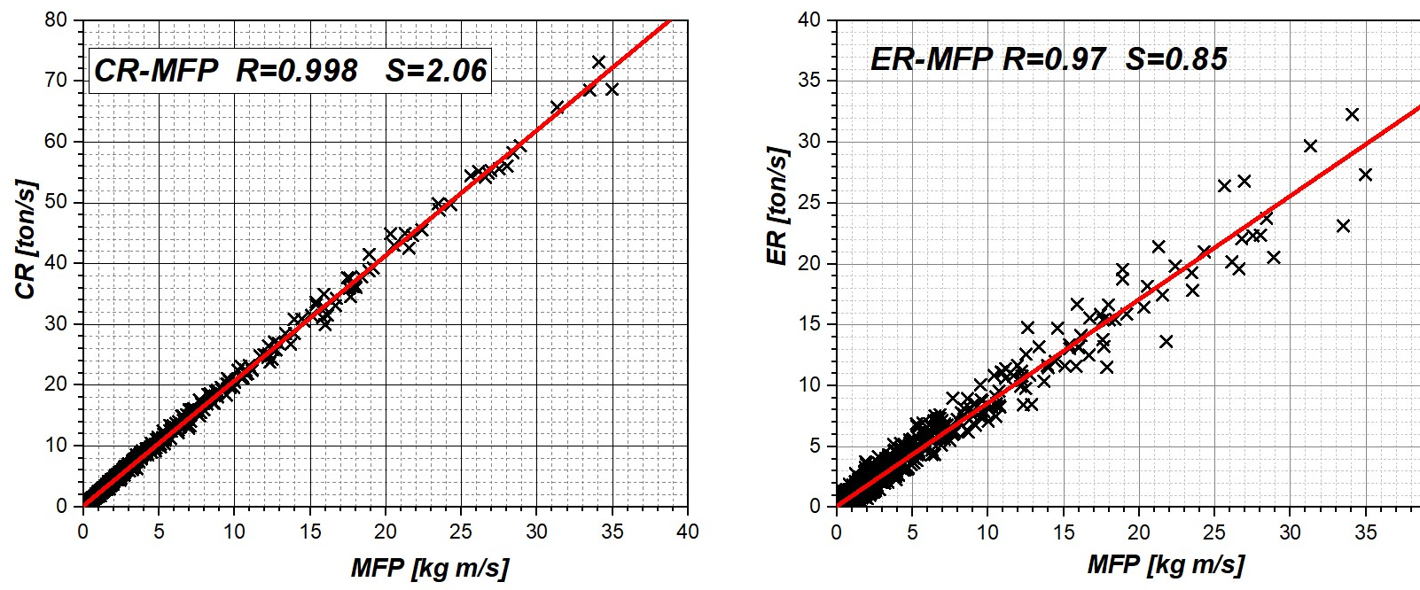
Condensation/Evaporation Rates (CR/ER) are linear functions of upward mass flus (MFP)
Questions: Email: ykogan@nwra.com

