Slide 1
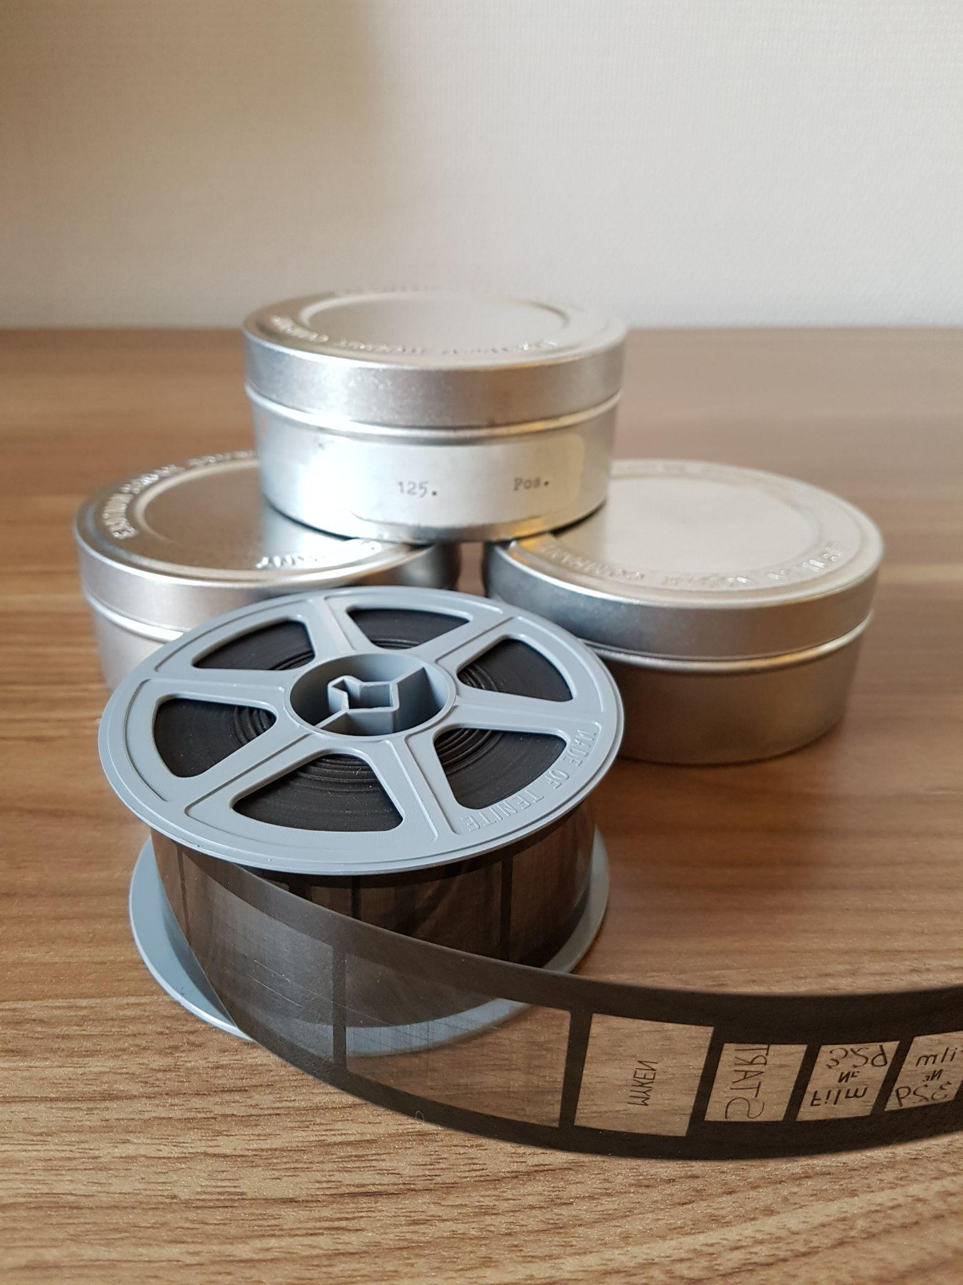
Data rescue and digitization through image recognition
~70 years (1860 - 1931)
~3.9 million images
Daily data, in monthly sheets
1, 2, 3, 4 or 6 sheets per image
Handwritten
Large variations in image quality

Slide 2
Data rescue and digitization through image recognition
Status
All stations identified (879), and connected to metadata
All years identified
Early experiments on reading actual data

