Slide 1
Sponsor:
Association between COVID-19 lockdown policies and air pollution with associated mortality reduction in Europe
Pierre Masselot
Research Fellow in Statistics and Environmental Epidemiology, LSHTM
Co-authors:
Rochelle Schneider, Ana M. Vicedo-Cabrera, Francesco Sera, Marta Blangiardo, Chiara Forlani, John Douros, Oriol Jorba, Mario Adani, Rostislav Kouznetsov, Florian Couvidat, Joaquim Arteta, Blandine Raux, Marc Guevara, Augustin Colette, Jérôme Barré,
Vincent-Henri Peuch
Antonio Gasparrini

Slide 2
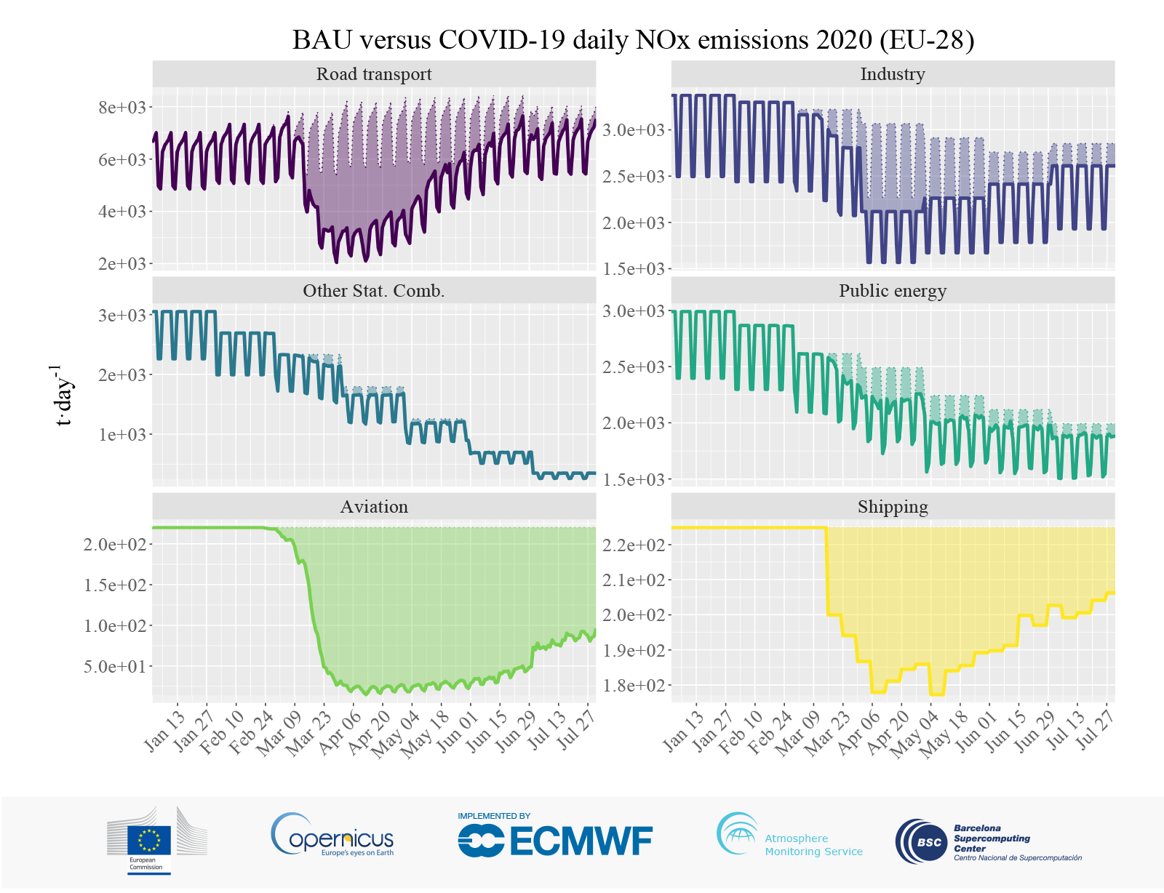
Decrease of NOx in Europe during COVID-19 first wave
Lockdown response during COVID-19 pandemic resulted in decreased emissions in Europe
Credit: Copernicus Atmosphere Monitoring Service/ECMWF/BSC.
1

Slide 3
Relating lockdown policies to AP decrease
Reduction of emissions reduction of Air pollution
Air pollution is a major cause of death in Europe
Study objective
Assess the impact of lockdown policies on AP reduction in 47 EU cities
Impact of overall lockdown
Impact of specific sub-policies
Avoided AP-related mortality
2

Slide 4
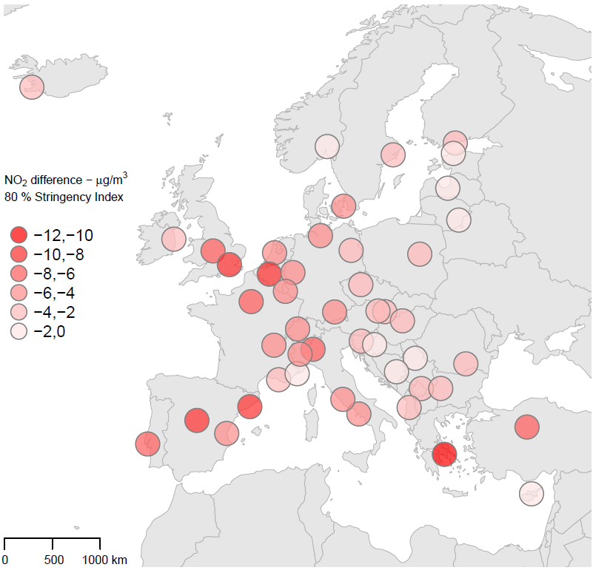
Time period, Scenarios, Study region, and Pollutants
Time-series
Lockdown policies
Air pollutants
2020
Overall: Stringency index
NO₂
PM_{2.5}
PM₁₀
O₃
Business-as-usual scenario
Study region
47 European
cities
Lockdown scenario
Containment and closure policies: 9 specific policies
Credit: CAMS - https://atmosphere.copernicus.eu
3

Slide 5
Lockdown – BAU scenarios - all 47 cities across Europe
NO₂
Lockdown
BAU
4

Slide 6
Lockdown – BAU scenarios - all 47 cities across Europe
O₃
5

Slide 7
Lockdown – BAU scenarios - all 47 cities across Europe
PM_{2.5}
PM₁₀
6

Slide 8
Statistical analysis
The statistical analysis follows three main steps:
1st Step: Association between Stringency Index and pollution difference
2nd Step: Impact of specific sub-policy measures (Close public transport / Stay at home requirements)
3rd Step: Estimating the excess deaths attributable to changes in air pollution levels
7

Slide 9
Statistical analysis
1st Step: Association between Stringency Index and pollution difference
Bayesian non-linear mixed-effects model
$$y_{it}=f\left(x_{it};β+b_{i}\right)+γz_{it}$$
$y_{i}$: daily pollutant difference for city $i$
$x_{i}$: daily Stringency Index for city $i$
$z_{i}$: confounding variables: day-of-week, greenness of city $i$ in 2014 and built-up area of city $i$ in 2015
Flexible spatial structure of city-specific function
95% credible intervals
Confounding
Fixed and city-specific nonlinear effect
NO₂
PM_{2.5}
O₃
PM₁₀
8

Slide 10
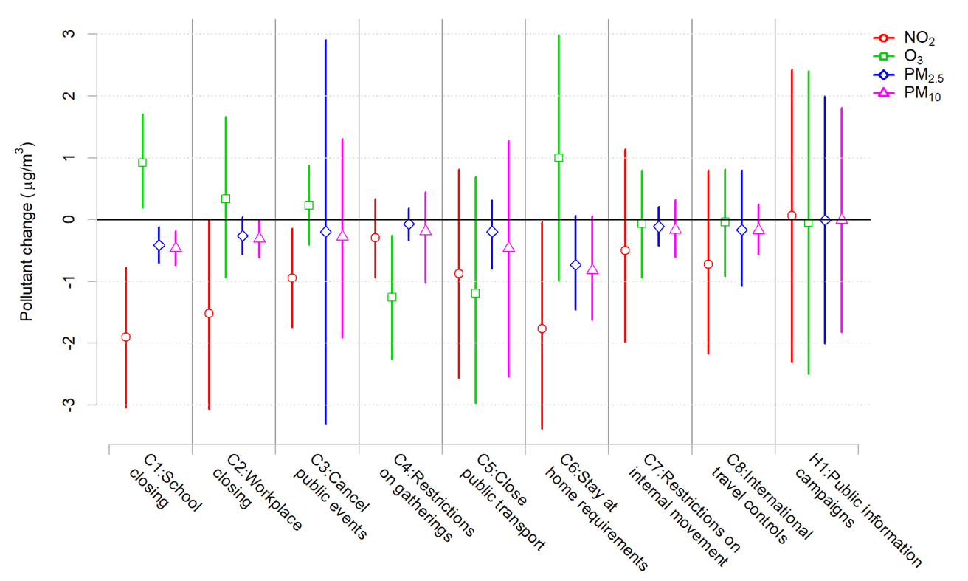
Statistical analysis
2nd Step: Impact of specific sub-policy measures
$$y_{it}=\left(α+a_{i} \right)x_{it}^{∗}+f(x_{it}^{}−x_{it}^{∗};β+b_i )+γz_{it}$$
$y_{it}$: daily pollutant difference for city $i$
$x_{it}$: daily Stringency Index for city $i$
$x_{it}^{∗}$: daily sub-policy indicator for city $i$
$z_{it}$: confounding variables: day-of-week, greenness of city $i$ in 2014 and built-up area of city $i$ in 2015
Included on Stringency Index
ID | Description
C1 | School closing
C2 | Workplace closing
C3 | Cancel public events
C4 | Restrictions on gathering
C5 | Close public transport
C6 | Stay at home requirements
C7 | Restriction on internal movement
C8 | International travel controls
H1 | Public information campaigns
9

Slide 11
Results: epidemiological analysis
Statistical analysis
3rd Step: Estimating the excess deaths attributable to changes in air pollution levels
Health impact assessment with the quantification of avoided deaths due to short-term exposure to air pollution.
Total number of avoided deaths of 486, 37, 175, and 134 for NO2, O3, PM2.5, and PM10 across the 46 cities
Paris (France) showed the highest number of avoided deaths for NO₂ and O3.
City | Country | Max SI | Excess Deaths NO2 | Excess Deaths O3 | Excess Deaths PM25 | Excess Deaths PM10
Paris | France | 87.96 | -69.2 (-84.2 ; -53.8) | 3.5 (2.4 ; 4.6) | -23.2 (-26.5 ; -20.4) | -17.4 (-19.3 ; -15.4)
Athens | Greece | 84.26 | -40.1 (-48.8 ; -31.2) | -0.7 (-1.0 ; -0.5) | -10.0 (-11.4 ; -8.8) | -7.8 (-8.7 ; -6.9)
Barcelona | Spain | 85.19 | -39.2 (-47.7 ; -30.5) | -1.2 (-1.6 ; -0.8) | -12.2 (-13.9 ; -10.7) | -9.3 (-10.3 ; -8.3)
Madrid | Spain | 85.19 | -38.8 (-47.2 ; -30.2) | -3.4 (-4.5 ; -2.3) | -7.7 (-8.7 ; -6.7) | -6.1 (-6.7 ; -5.4)
London | United Kingdom | 75.93 | -37.9 (-46.1 ; -29.5) | 4.9 (3.4 ; 6.5) | -13.9 (-15.8 ; -12.2) | -10.5 (-11.7 ; -9.3)
Milan | Italy | 93.52 | -36.7 (-44.7 ; -28.6) | -6.1 (-8.0 ; -4.1) | -18.1 (-20.6 ; -15.8) | -12.6 (-14.0 ; -11.2)
Naples | Italy | 93.52 | -29.9 (-36.4 ; -23.3) | -1.9 (-2.6 ; -1.3) | -8.2 (-9.4 ; -7.2) | -5.9 (-6.5 ; -5.2)
Lisbon | Portugal | 87.96 | -18.9 (-23.0 ; -14.7) | 0.3 (0.2 ; 0.4) | -11.4 (-13.1 ; -10.0) | -10.6 (-11.8 ; -9.4)
Rome | Italy | 93.52 | -18.4 (-22.4 ; -14.3) | -5.8 (-7.7 ; -4.0) | -6.8 (-7.7 ; -5.9) | -4.8 (-5.3 ; -4.3)
Turin | Italy | 93.52 | -13.3 (-16.2 ; -10.3) | -3.6 (-4.8 ; -2.5) | -6.8 (-7.8 ; -6.0) | -4.9 (-5.4 ; -4.3)
TOTAL |  | 100 | -485.5 (-590.9 ; -377.6) | -36.5 (-57.1 ; -16.0) | -174.6 (-199.0 ; -153.1) | -133.5 (-148.2 ; -118.3)
Top 10 cities
*ranking order is determined by NO2 deaths
* Negative values indicate avoided deaths
10

Slide 12
Thank you
Rochelle Schneider
rochelle.schneider@lshtm.ac.uk

Slide 13
Statistical analysis
1st Step: Association between Stringency Index and pollution difference
Pollutant specific scale
NO2
O3
PM_{2.5}
PM10
*80% SI is the SI-max mean from 47 cities

