Slide 1
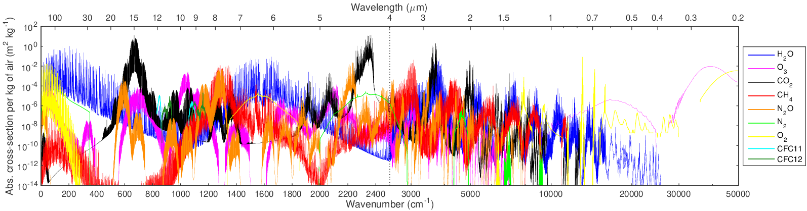
The full-spectrum correlated-k method
to accelerate radiative transfer in NWP models
Robin Hogan and Marco Matricardi
r.j.hogan@ecmwf.int
Absorption spectrum of nine gases at 100 hPa (Hogan & Matricardi 2020)

Slide 2
Overview
Can radiation schemes be faster and more accurate?
  Radiation often cited as most costly part of climate models, but NWP models can benefit from faster schemes too
  Some IPCC models use legacy codes that predict inaccurate greenhouse gas forcing (e.g. Soden et al. 2018)
The correlated k-distribution (CKD) method underpins most radiation schemes: it divides the spectrum into bands, each of which contains a number of k terms to represent the gas absorption spectrum
  Cost of entire radiation scheme proportional to total number of spectral intervals, but most current schemes give the user no control over this number, e.g. to optimize for climate or NWP, or perform accuracy-efficiency trade-off
The full-spectrum correlated-k (FSCK) method treats entire spectrum with a single band
  Proposed by Modest and Zhang (2002) for combustion; fast prototype atmospheric models in shortwave (Pawlak et al. 2004) and longwave (Hogan 2010), but the method needs rigorous online testing
This talk presents ecCKD, a tool for generating CKD gas optics schemes for specific applications
  Train and evaluate new schemes using line-by-line calculations from the Correlated K Distribution Model Intercomparison Project (CKDMIP), a 1-TB dataset (Hogan and Matricardi, GRL 2020)
  Demonstrate the FSCK method for the longwave, and a hybrid FSCK approach in the shortwave to handle spectrally varying cloud and surface absorption and reflection
  Performance in the ecRad radiation scheme both in the offline version, and online in the ECMWF model

Slide 3
Are we using our computer time wisely?
There is a trade-off between the temporal, spatial and spectral resolution of radiation, as well as the sophistication of the solver (e.g. 2 vs. 4 or more streams)
In 2017, ECMWF had lowest spatial & temporal resolution of 7 global NWP models
Met Office NWP model uses 3.7 times fewer spectral intervals than RRTMG!
RRTMG gas optics scheme
Hogan et al. (2017: ECMWF technical memo #816)

Slide 4
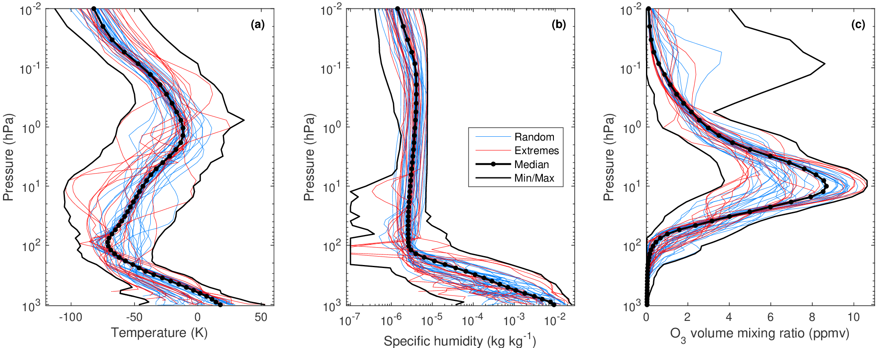
CKDMIP training and evaluation dataset (Hogan & Matricardi 2020)
CKDMIP motivation: to evaluate the various methods for generating gas optics schemes
100x 137-level profiles of T, q and O₃ from Eresmaa and McNally (2014)
34 greenhouse gas scenarios
1 TB dataset of the layer optical depth of 9 gases from LBLRTM
+12 further scenarios for studying gas overlap

Slide 5
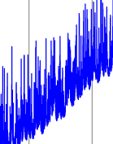
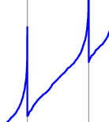
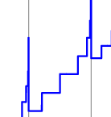
A new C++ tool to generate CKD models: ecCKD
Band
Generates a CKD model automatically (no hand tuning) from a few user-specified configuration parameters, including several novel steps
Reorder “median” spectrum of each gas in each user-defined band (fast) uniquely in order of the height of the peak heating/cooling rate
Partition the reordered spectrum for each gas, then merge gases
  Automatically choose number of intervals (“k terms” / “g points”) to ensure RMS heating-rate error associated with each is less than user-specified tolerance
  Equipartition algorithm ensures RMS error is the same for each interval
  Hypercube partition method (Hogan 2010) allows partitioned spectra of multiple gases to be combined optimally
  Compute Planck-function look-up table vs T for each spectral interval
Molar absorption of each gas/interval from CKDMIP Idealized dataset
Optimize molar absorptions to minimize errors in fluxes & heating rates
  Train on 50 CKDMIP Evaluation-1 profiles x 20 greenhouse gas scenarios
  Use C++ Adept automatic differentiation library (Hogan 2014) with L-BFGS minimizer to optimize 10⁵ look-up table coefficients
Molar absorption (k)

Slide 6
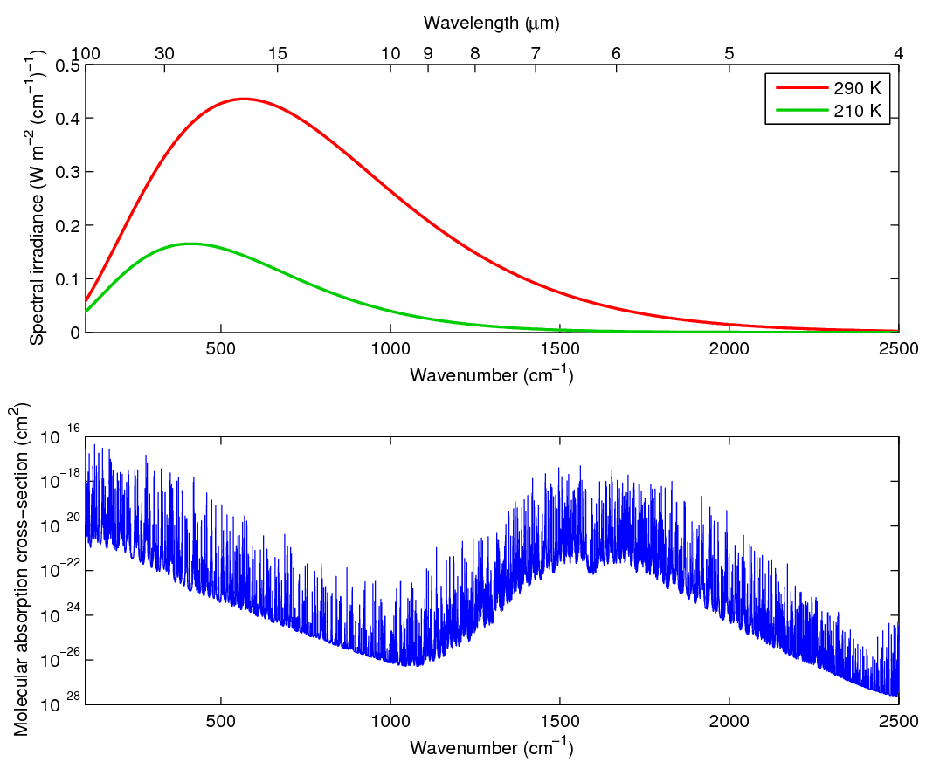
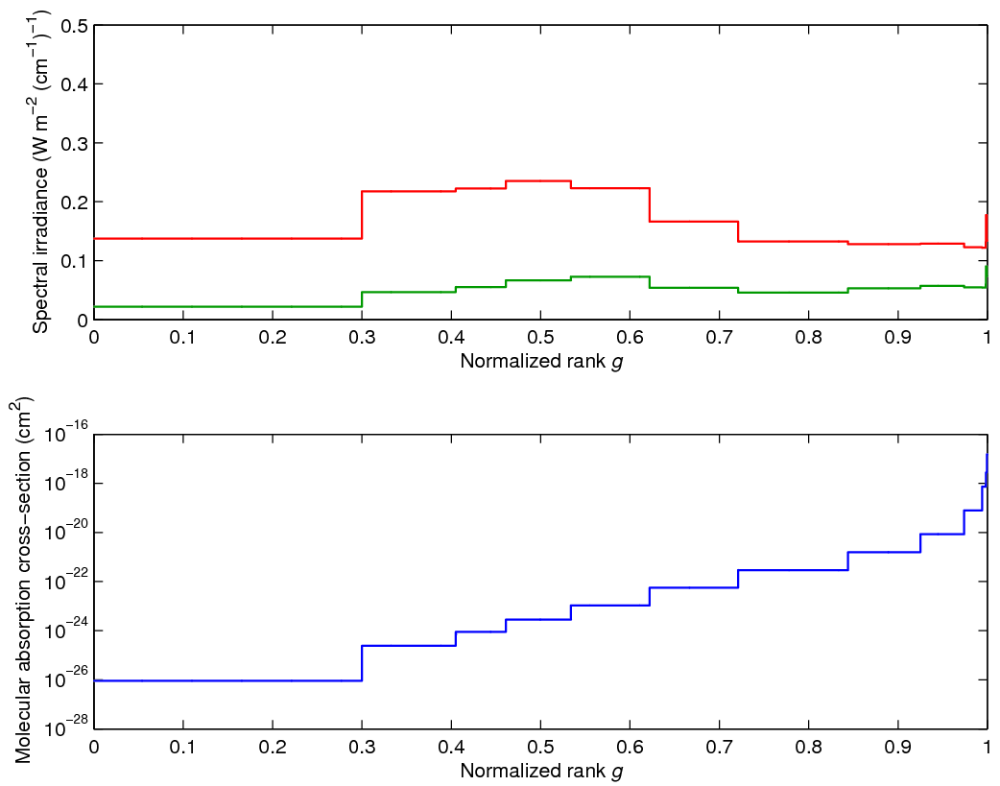
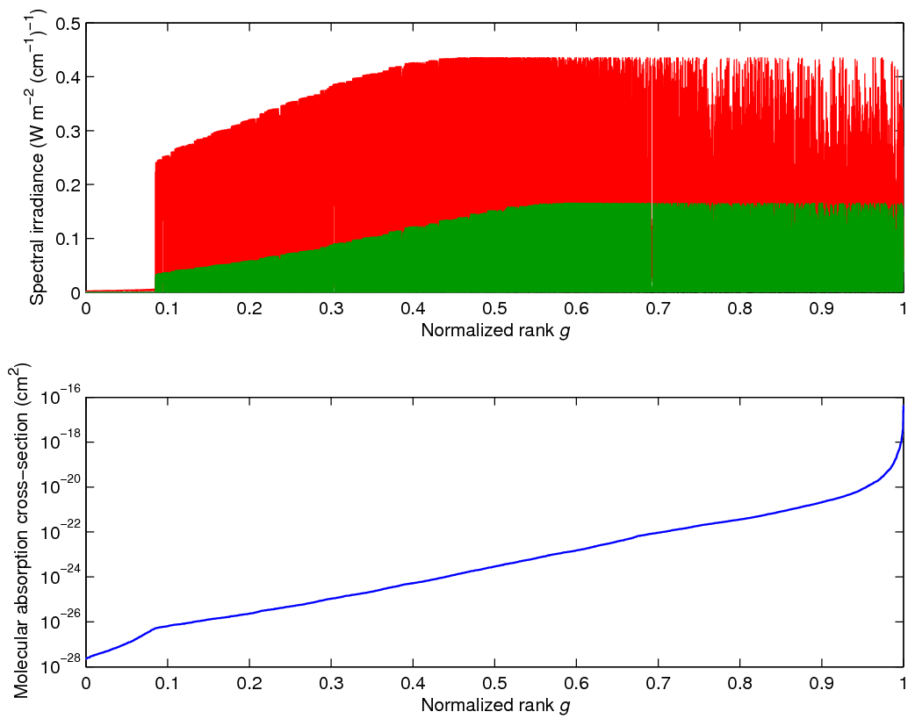
Full-spectrum correlated-k (FSCK) method
First applied to combusting gases by Modest and Zhang (2002)
Demonstrated for the atmosphere in the shortwave by Pawlak et al. (2004) and longwave by Hogan (2010)
Reorder the entire spectrum
Discretize such that the heating-rate error for each full-spectrum quadrature point equals some specified tolerance
Average the Planck function across the wavelengths contributing to each quadrature point
Water vapour spectrum Planck function

Slide 7
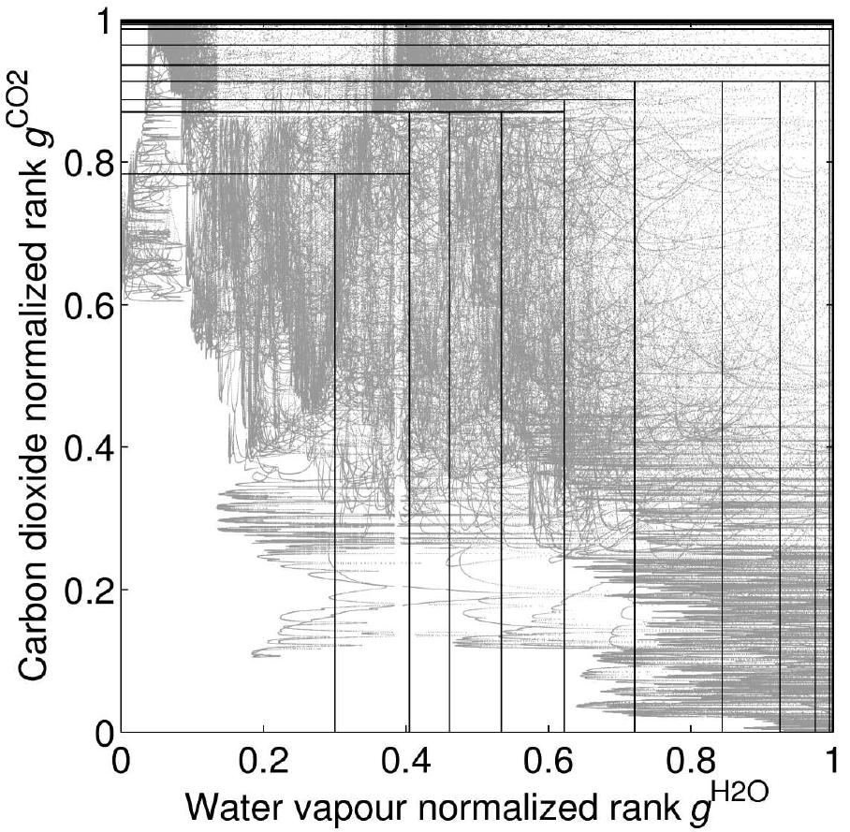
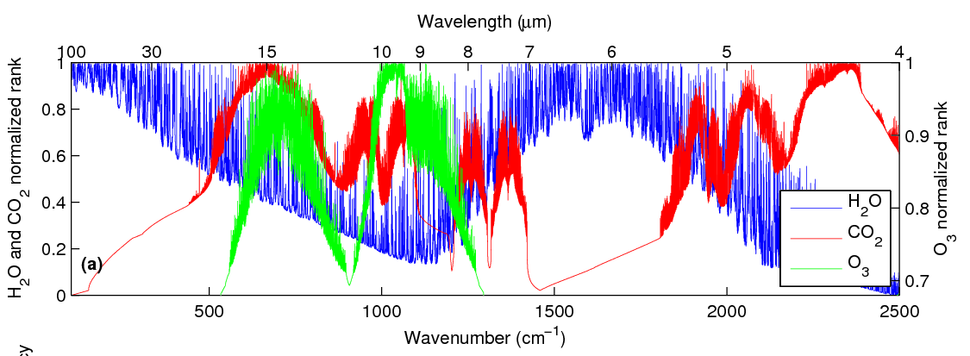
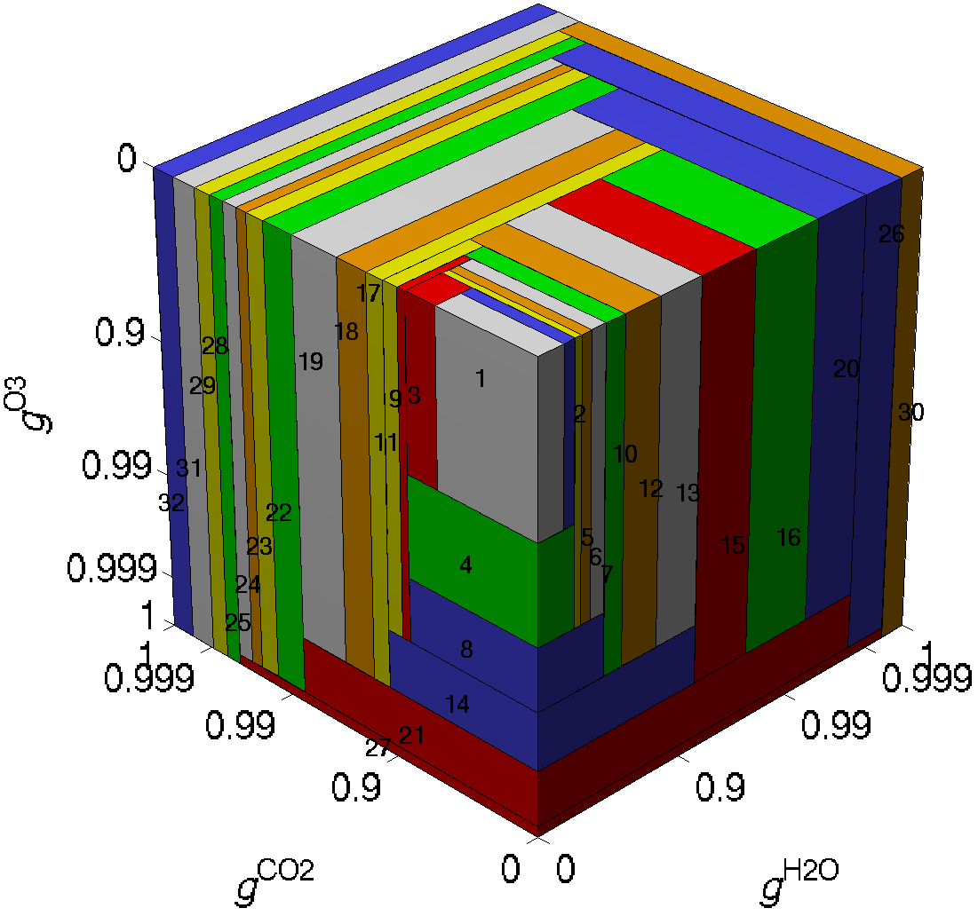
How can we treat overlapping gases?
CO₂
Consider first water vapour and carbon dioxide in the longwave spectrum, whose k distributions are to be discretized into around n_{H2O}=12 and n_{CO2}=12 k terms
Inefficient method would require n_{H2O}×n_{CO2}×n_{O3}=144 terms
But when H₂O is strong, no need to discretize CO₂ spectrum
Efficient method requires only n_{H2O}+n_{CO2}–1=23 terms
Works for any number of gases, e.g. with n_{O3}=5 ozone terms we require 27 rather than 720 terms for the gas mixture
H₂O

Slide 8
Two example FSCK models in the longwave
Each k term maps uniquely to specific spectral points as shown
Some k terms “specialize” in treating a specific gas, but all gases can contribute to the optical depth of all k terms
Planck function used by a k term is integral over those points
The user-specified error tolerance has been chosen so that models with 2^{n} terms are generated (e.g. 16 and 32) which is optimal for vector lengths on some computer architectures
  This is fewer than the 47-156 used in seven global NWP models surveyed by Hogan et al. (2017)
Cloud optical properties are averaged per k term
  Hypothesis to be tested: longwave cloud radiative effect is dominated by a fairly narrow part of the spectrum (the infrared window) and cloud optical properties vary only modestly in the longwave, so this does not lead to large errors
Increasing optical depth

Slide 9
Clear-sky evaluation: longwave
Evaluation against 50 independent line-by-line calculations (CKDMIP Evaluation-2 dataset) for present-day greenhouse gas concentrations
32-term model obviously more accurate than 16-term model
32-term model has similar accuracy to 140-term RRTMG model used at ECMWF (and elsewhere): potentially 4.4x faster
16-term model potentially suitable for TL/AD part of data assimilation cycle, which needs to be fast and is only run for 12 hours

Slide 10
Evaluation of instantaneous LW forcing by 5 main well-mixed greenhouse gases
Excellent performance on CKDMIP climate scenarios, including CO₂ concentrations from 180 ppmv (glacial maximum) to 2240 ppmv (8x preindustrial)
32-term model more accurate than 16-term model for CH₄ due to 2 rather than 1 specialized k terms
Surface forcing TOA forcing

Slide 11
Challenges for FSCK in the shortwave
Near-infrared: very large variations in absorption and scattering by clouds and the surface
Visible and ultraviolet: absorption and Rayleigh scattering vary monotonically with wavelength
Users want wavelength-specific products: RGB imagery, photosynthetically active radiation (PAR)…

Slide 12
Two “Hybrid FSCK” models in the shortwave
Optically thick parts of the near-IR: use FSCK since clouds and the surface not important
Optically thin parts of the near-IR: use several sub-bands coinciding with near-IR windows to resolve cloud and surface variations
Visible: impose red, green and blue bands for imagery (and PAR=R+G+B); ecCKD would otherwise partition them into a similar number of intervals but with less useful boundaries
Ultraviolet: let ecCKD partition automatically
R G B

Slide 13
Clear-sky evaluation: shortwave
16-term model less accurate than 32-term model in mesosphere due to 3 rather than 5 CO₂-specific terms
Small heating-rate bias in lower troposphere in 16-term model can lead to substantial warm bias due to long radiative timescales here (see later…)

Slide 14
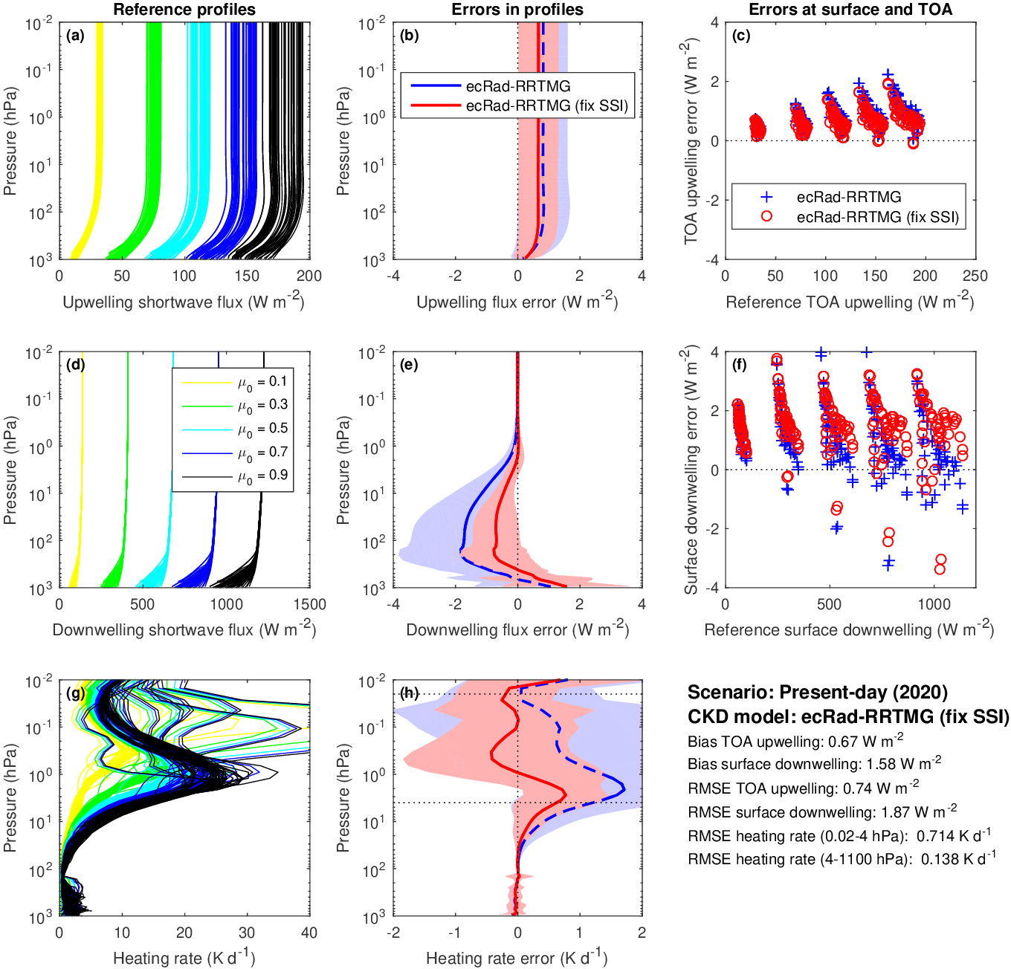
RRTMG-SW evaluation
112-term RRTMG model used at ECMWF (equivalent to RRTMG v3.9) has much larger errors in stratosphere heating rate due to older Kurucz solar spectrum with more ultraviolet
Scaling the solar energy in each band to match the latest spectrum improves performance, but appreciable biases remain in the upper stratosphere

Slide 15
Evaluation of ice cloud radiative effect (CRE) using line-by-line calculations
Longwave: both ecCKD models (and RRTMG) accurate to 0.3 W m⁻², even with FSCK method
Shortwave: ecCKD-32 and RRTMG have similar accuracy, validating use of sub-bands
But it is mportant to use “thick averaging” of cloud optical properties: attempt to get correct reflectance in optically thick limit (Edwards & Slingo 1996)
Current
New

Slide 16
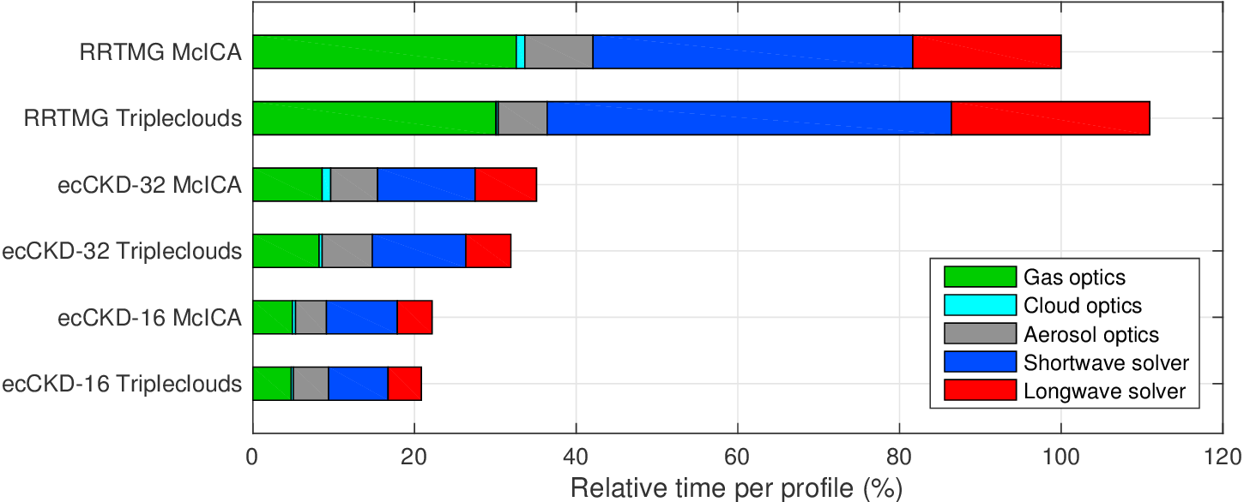
Computational cost in offline single-precision ecRad (Intel Xeon, gfortran)
IFS configuration
Noise-free solver
3.1x faster overall (3.9x fewer k terms)
4.9x faster overall (7.8x fewer k terms)
Cloud & aerosol optics now per k term not per band, so similar cost in RRTMG and ecCKD
Optimized noise-free Tripleclouds solver is now a little faster than McICA!

Slide 17
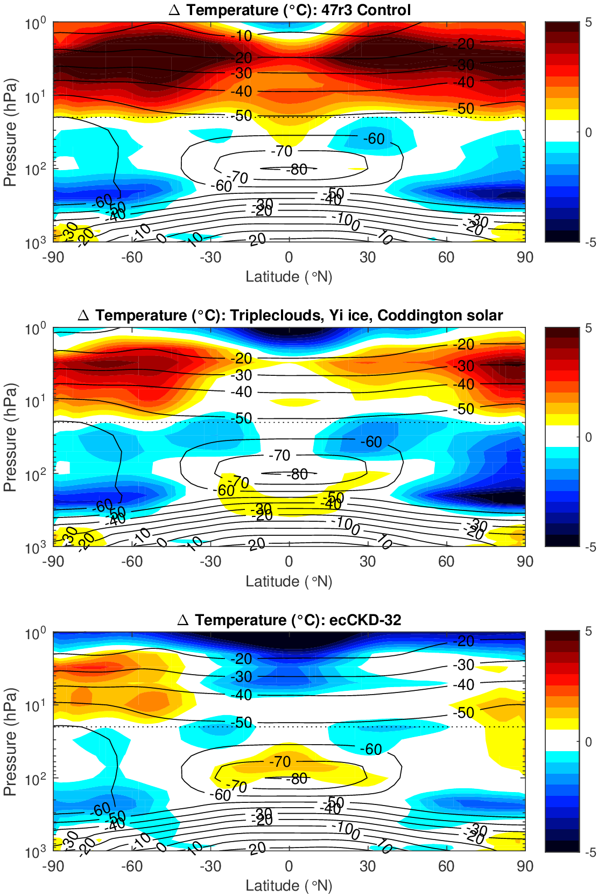
Change to temperature bias in “climate runs”
+6 K
4x 1-year 60-km (Tco199) free-running single-precision coupled simulations
Bias vs. ERA5 for p>20 hPa, vs. MLS otherwise
Pressure-dependence of temperature change corresponds to location of heating-rate biases in RRTMG versus line-by-line calculations reported by Hogan & Matricardi (2020)
Significant reduction to long-standing polar lower stratosphere cold bias!
-4 K
Revised solar spectrum and noise-free Tripleclouds solver
+4 K
-5 K
Gas optics changes only
+2 K
-2 K

Slide 18
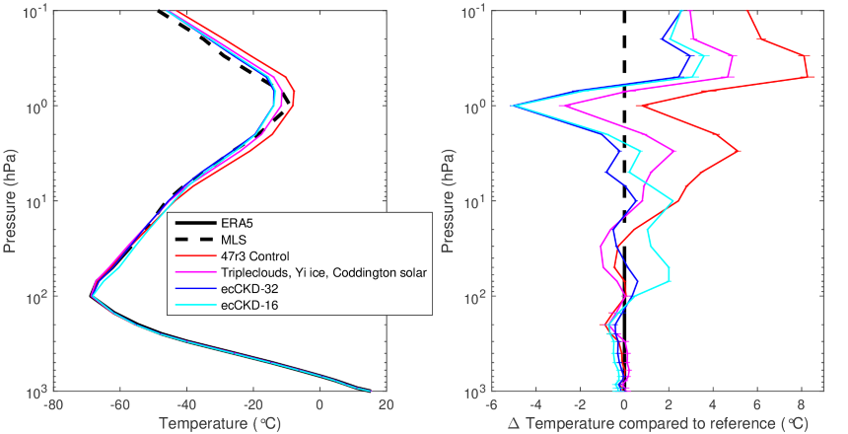
…or as a global-mean vertical profile
Stratospheric climate for ecCKD-32 significantly better than RRTMG control, even with revised solar spectrum (but other compensating errors may be present)
ecCKD-16 is 1.5 K warmer in the lower stratosphere than ecCKD-32, related to a heating rate bias of only 0.05 K/day and the long radiative timescale of ~30 days
Perhaps training should penalize heating-rate errors more strongly here?

Slide 19
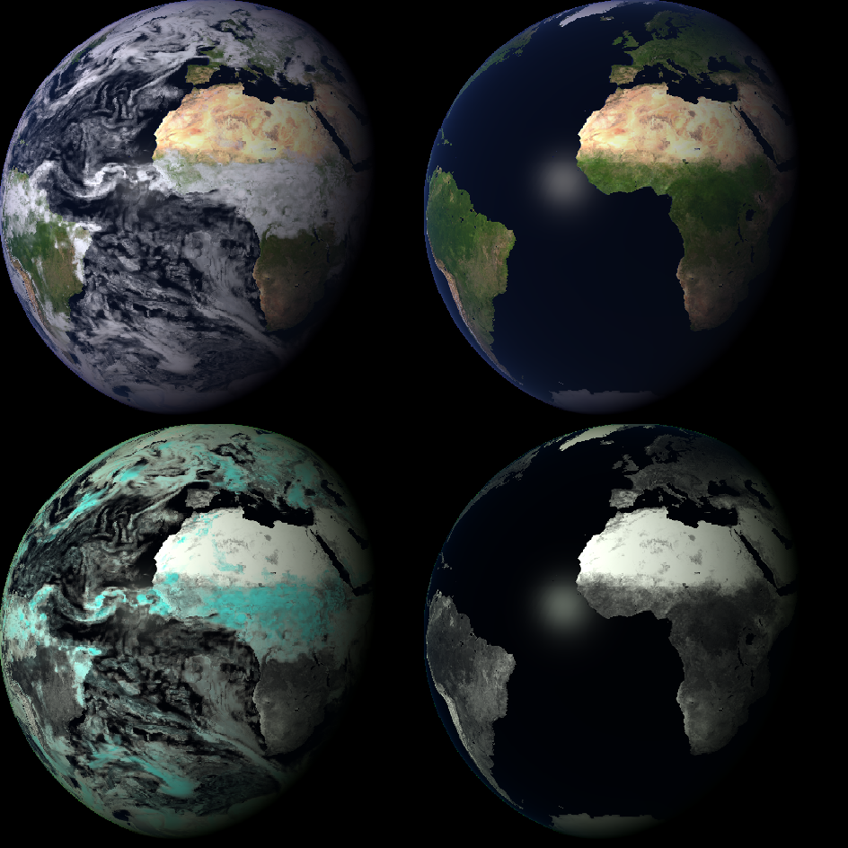
ecCKD in other contexts
Use ecCKD to generate a gas optics model for 8 MODIS spectral bands; ecRad ensures spectrally correct cloud properties
Simulations demonstrate the “FLOTSAM” solar radiance model to simulate geostationary imagery using ERA5 cloud fields
These simulations lack aerosols and we still need to plumb the phase-function information through to FLOTSAM
Bottom row shows EUMETSAT-like visualization where red is actually near-IR, highlighting strong ice-cloud absorption (surface albedo not yet correct)

Slide 20
Summary and next steps
The free ecCKD tool offers the ability to generate faster and more accurate gas optics models targeted at different applications, and which are simple enough (defined by a netCDF file) to be implemented in any radiation scheme, not just ecRad
Will shortly release ecCKD on GitHub and submit paper
Further testing and optimization aiming for operational implementation in IFS Cycle 49r1 (2023)
Can take advantage of cheaper scheme to improve radiation accuracy in ECMWF operations, e.g. more frequent calls or more accurate solver with more streams or 3D effects
Improved spectral detail in surface albedo scheme to generate online RGB imagery and other shortwave spectral diagnostics from forecasts
New gas optics models, e.g. to represent alternative water-vapour continuum models

