Slide 1
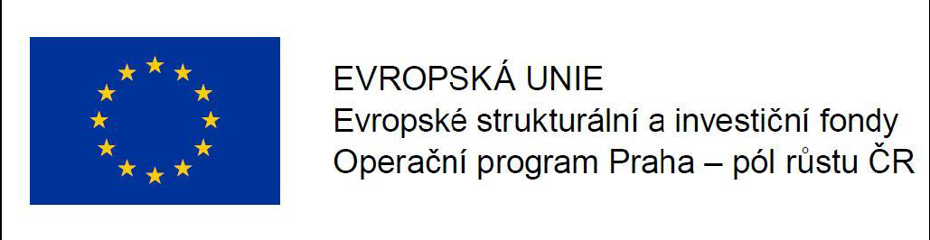
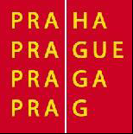
Urbanization in regional climate simulations – Project URBI PRAGENSI
Tomáš Halenka, Peter Huszár, Michal Belda, Jan Karlický, Tereza Nováková

Slide 2
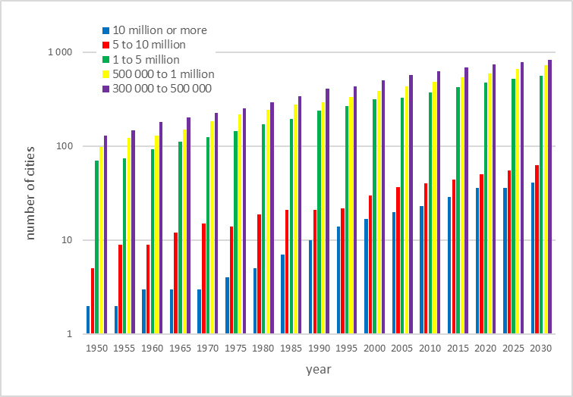
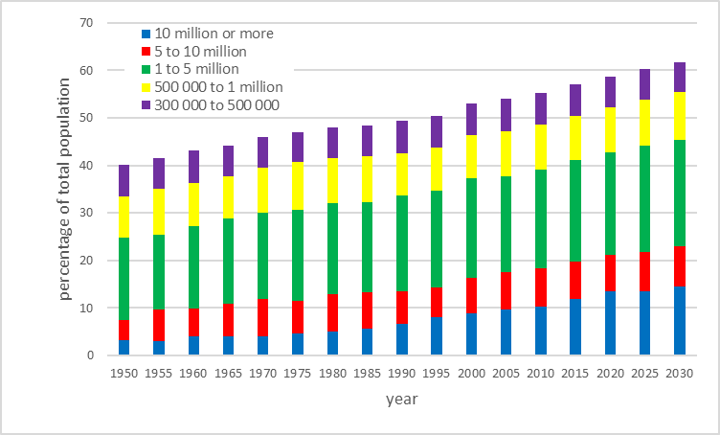
Motivation
World:
From 2009 - more than 50% of the world's population living in cities (UN, 2009)
Adaptation committee UN FCCC – $1.8 trillion investment in 2020-2030 benefit of $7.1 trillion, cities one of critical issues
Europe:
2008 - 73% of the population in cities
mid 21th century - 84%, representing a rise from 531 to 582 millions (UN, 2008)
in the Czech Republic, a similar change from 73.5% to 83% is projected by the Czech Statistical Office.
Clearly:
Quite many atmospheric effects on population through the urban environment
Especially thermal extreme weather effects like heat wave and air-quality threshold exeedances
Recent challenges in modeling of urban heat island ☆
Sustainable Cities and Society, Volume 19, 2015, 200–206
http://dx.doi.org/10.1016/j.scs.2015.04.001

Slide 3
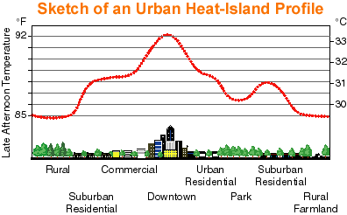
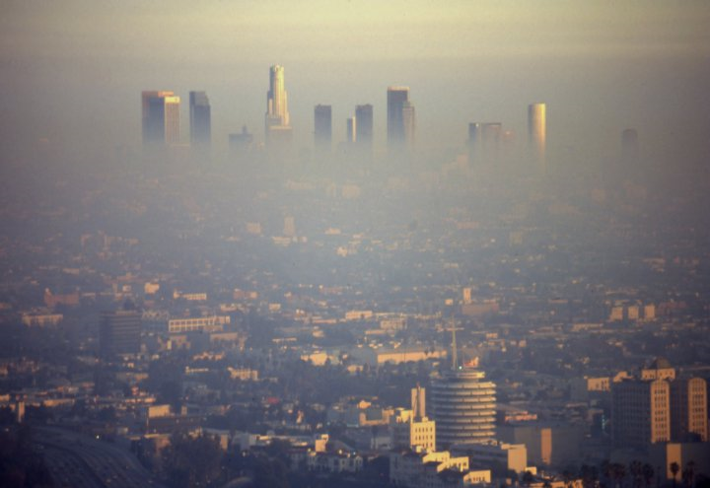
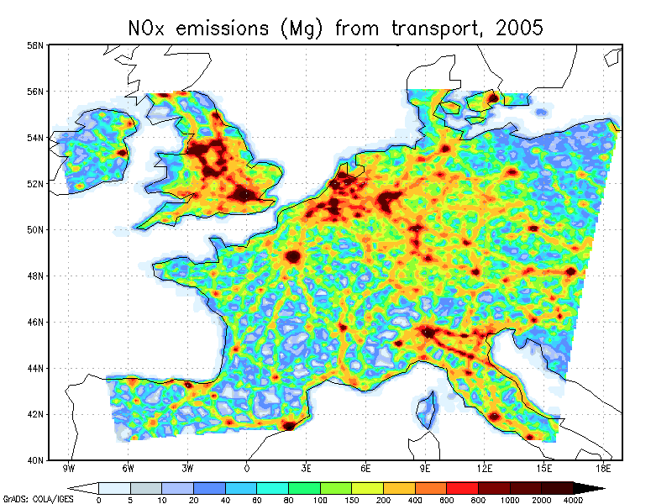
What we are talking about …
Solecki et al ., 2004
Los Angeles smog and California climate change policy
MEGAPOLI TNO NOx emissions [Mg], 2005 from transport (S7)

Slide 4
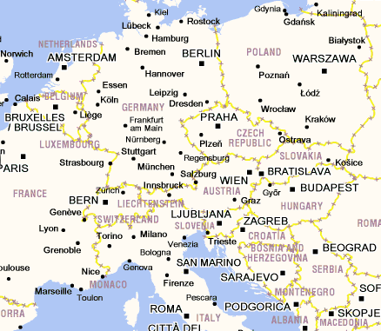


UHI Project - Development and Application of Mitigation and Adaptation Strategies and Measures for Counteracting the Global Urban Heat Island Phenomenon
Within framework of EC Operation Programme Central Europe (3CE292P3)
18 partners, coordinated by ARPA, Italy (Paolo Lauriola)
8 of the most relevant metropolitan areas and
Metropolitan European
Growth Areas (MEGAs) of
CE area

Slide 5
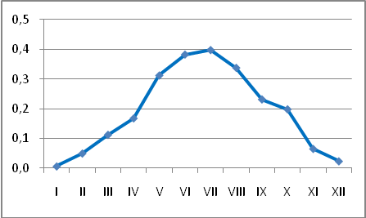
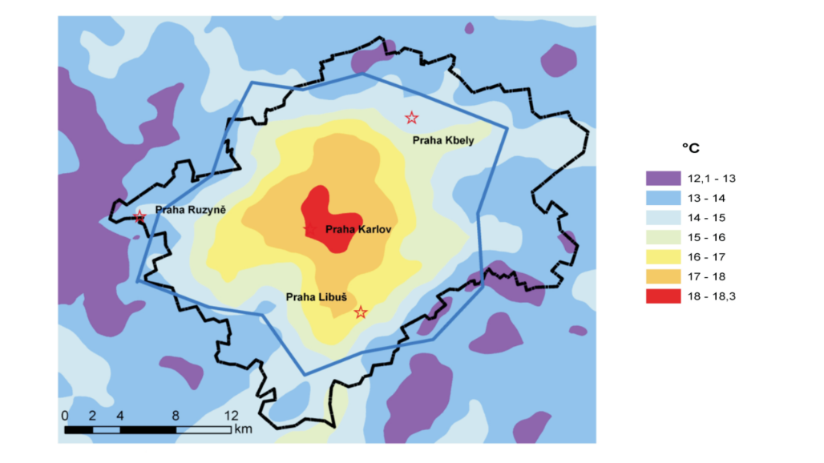
Prague heat island
period | I | II | III | IV | V | VI | VII | VIII | IX | X | XI | XII | YEAR
1961-2009 | 2,2 | 2,3 | 2,2 | 2,2 | 2,2 | 2,4 | 2,3 | 2,2 | 2,0 | 2,0 | 2,2 | 2,2 | 2,2
1961-1990 | 2,2 | 2,3 | 2,2 | 2,1 | 2,1 | 2,2 | 2,2 | 2,0 | 1,9 | 2,0 | 2,2 | 2,2 | 2,1
1991-2009 | 2,2 | 2,3 | 2,3 | 2,3 | 2,4 | 2,6 | 2,6 | 2,4 | 2,1 | 2,2 | 2,2 | 2,2 | 2,3
Difference new - standard | 0,01 | 0,05 | 0,11 | 0,17 | 0,31 | 0,38 | 0,40 | 0,34 | 0,23 | 0,20 | 0,07 | 0,02 | 0,19
Klementinum vs. Ruzyne
Pretel (2010)

Slide 6
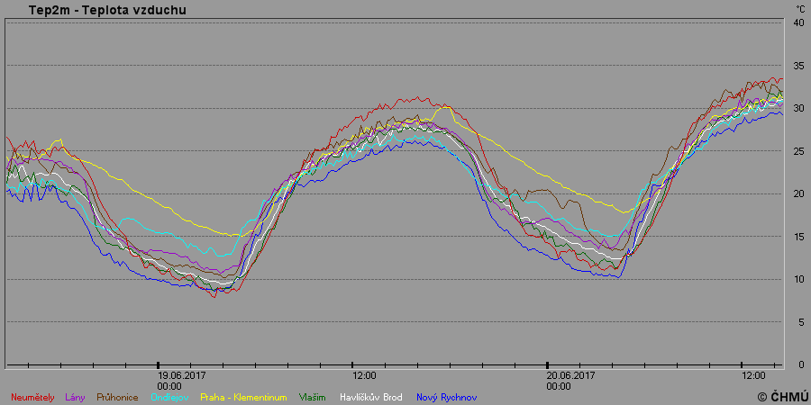
Example June 18-21, 2017

Slide 7
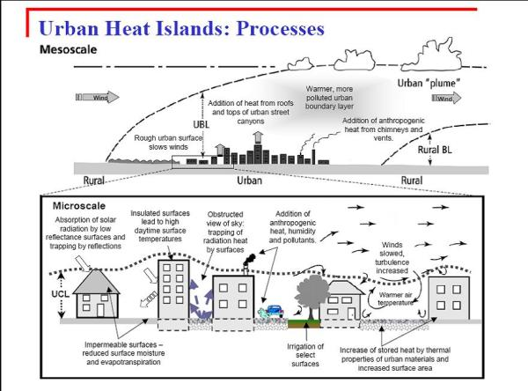
Atmospheric processes in urban canopy layer

Slide 8
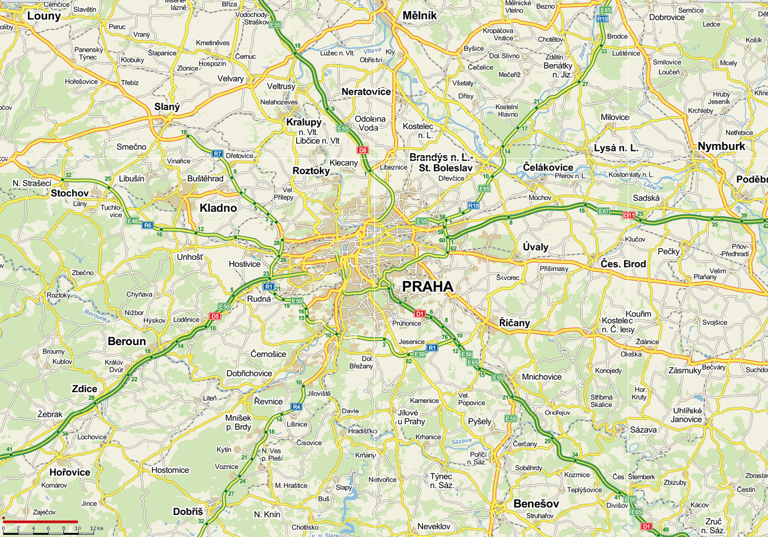
Why urban parameterizations
10 km x 10 km grid of regional climate model

Slide 9
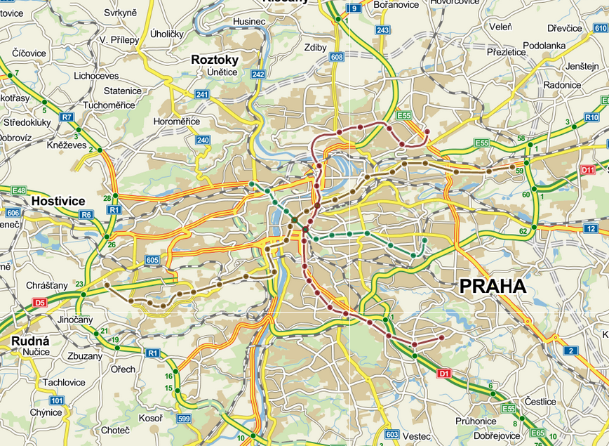

Even further in very high-resolution
Subgrid treatment
(2 km x 2 km)
1 km resolution for weather and air quality forecast in URBI PRAGENSI
10 km x 10 km grid of regional climate model

Slide 10
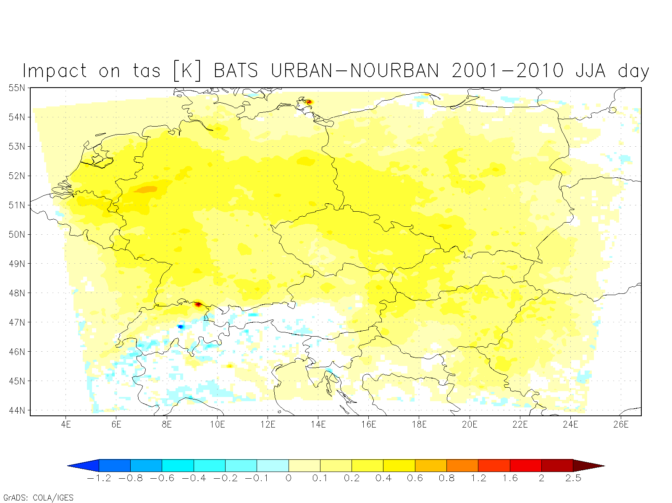
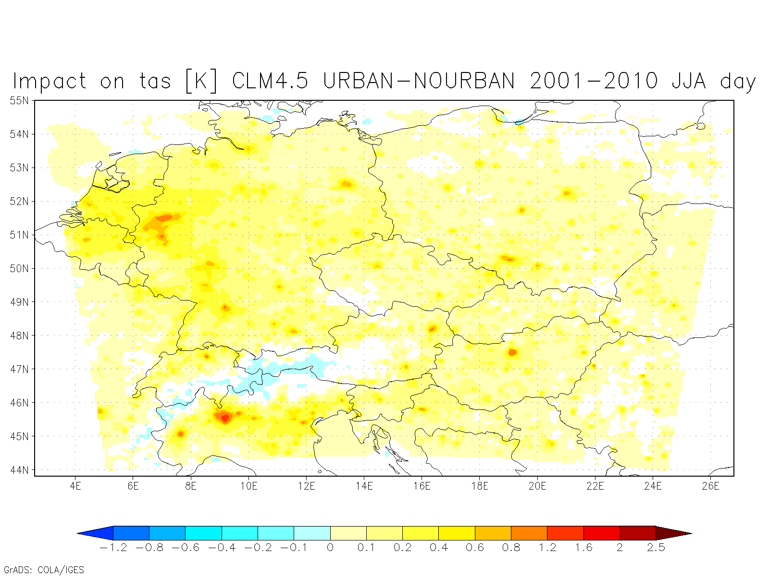
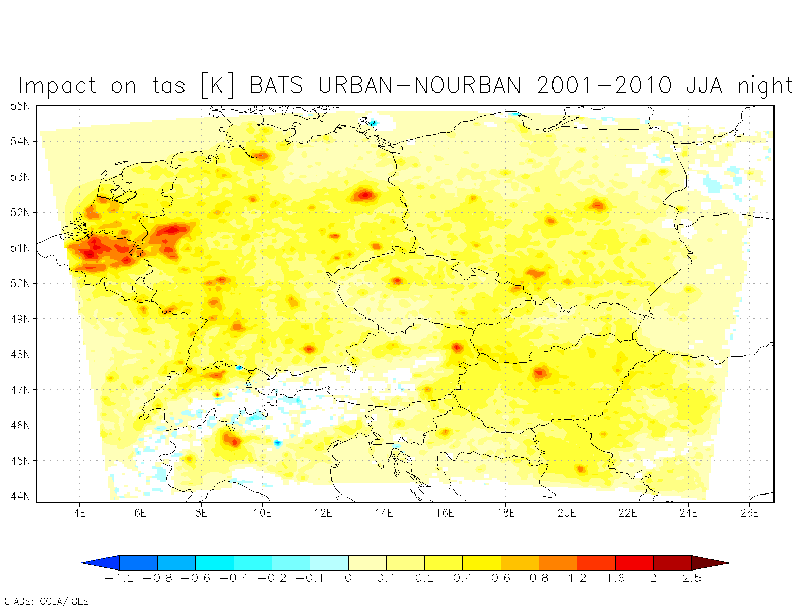
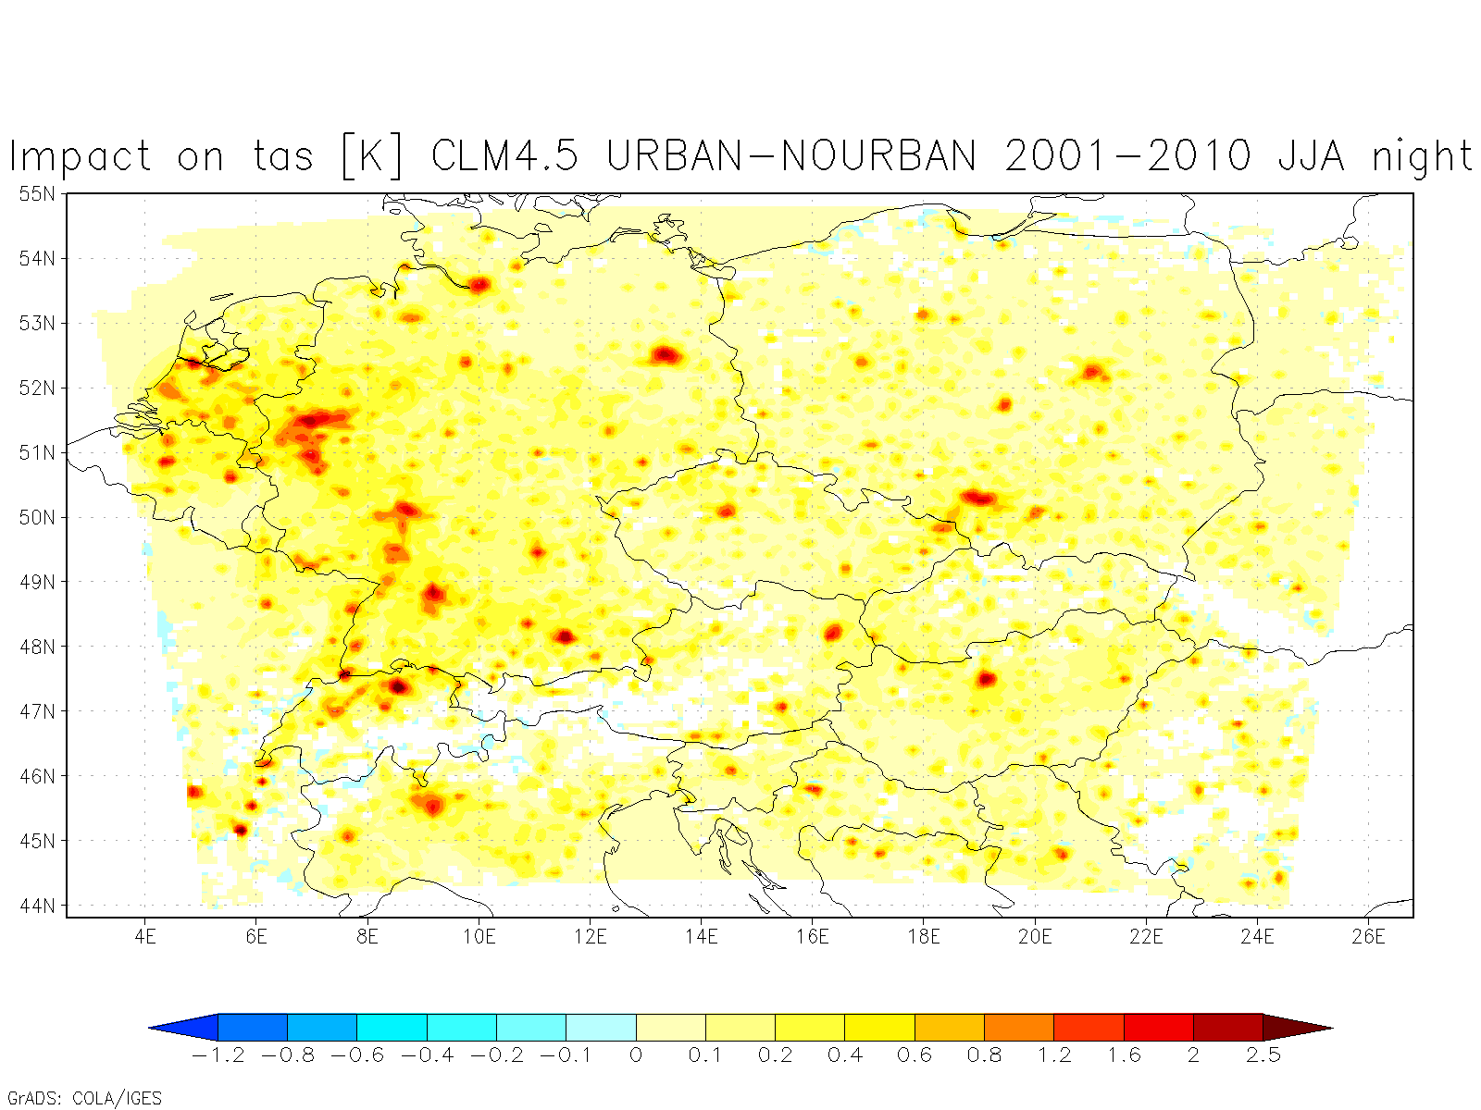
Near surface temperature RegCM4
summer
day
BATS/SLUCM
CLM4.5/CLMU
night
Huszar et al. (ACP, 2014)

Slide 11
Modeling atmospheric process in urban canopy
BULK – no special parameterization, but recognizing the land-use type (albedo, emissivity and other land surface parameterizations)
SLUCM – single-layer urban canopy model
MLUCM – multi-layer urban canopy model
BEP-BEM – building environment parameterization – building energy model
Tests in RegCM and WRF at 10 km resolution

Slide 12
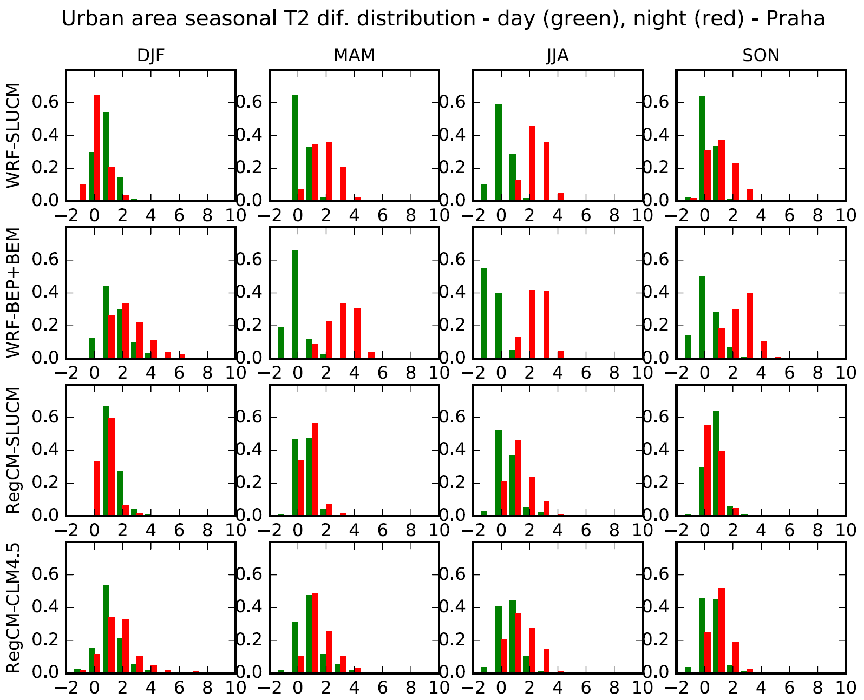
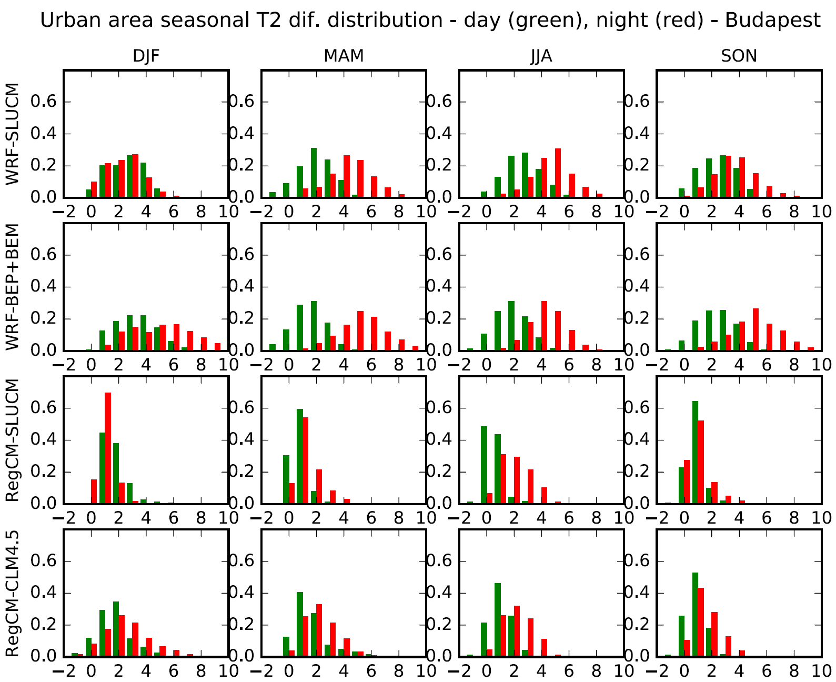
UHI intensity for Prague and Budapest (day vs. night)
Karlicky et al. (ACP, 2018)

Slide 13
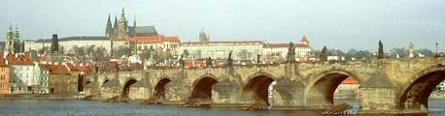
Project URBI PRAGENSI
Urbanization of weather forecast
Urbanization of air-quality forecast (connected to the above)
Urbanization of climate change scenarios, the tool for efficiency assessment of adaptation or mitigation measures in strategic development plans
Hot-spots simulations

Slide 14
Urbanization of weather forecast
• urbanized weather prediction based on very high resolution simulations (WRF, 1 km) with localised urban parameters for individual parts of the city
• to provide more detailed information for warnings, planning of the activities of population, planning of the services to adapt and mitigate the effects of urban heat island
• to provide the tool for the assessment of the potential of measures for adaptation and mitigation adopted in Strategic City Development Plan in selected case studies

Slide 15
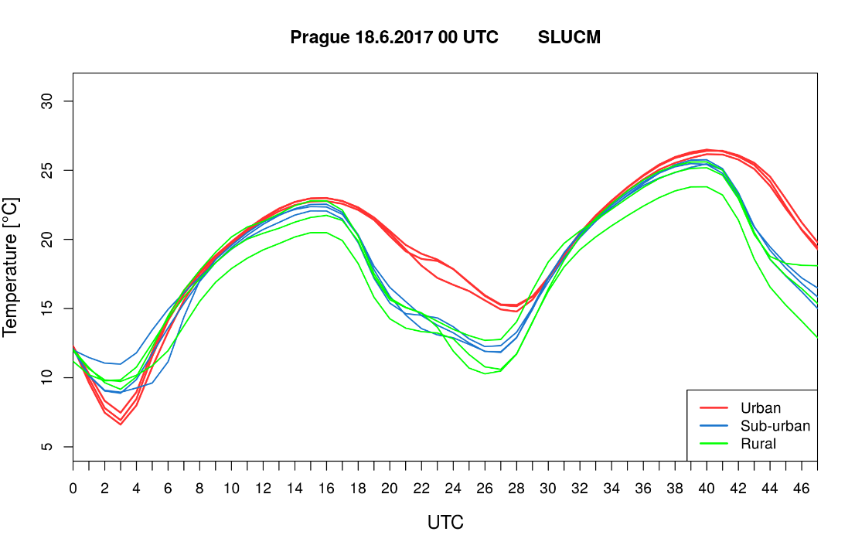
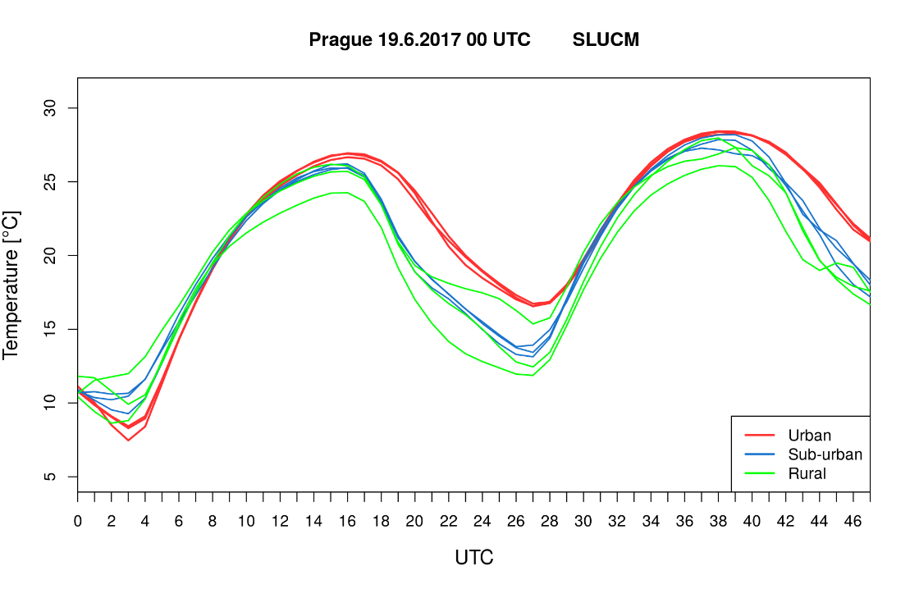
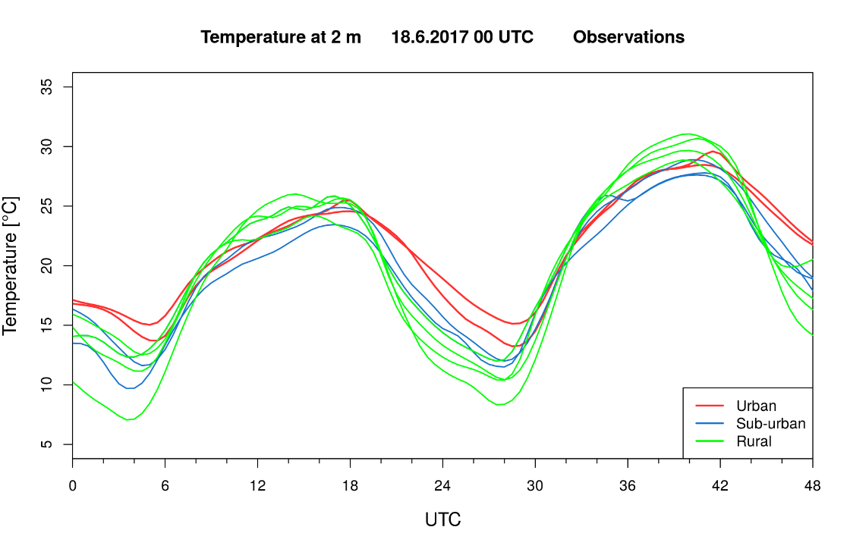
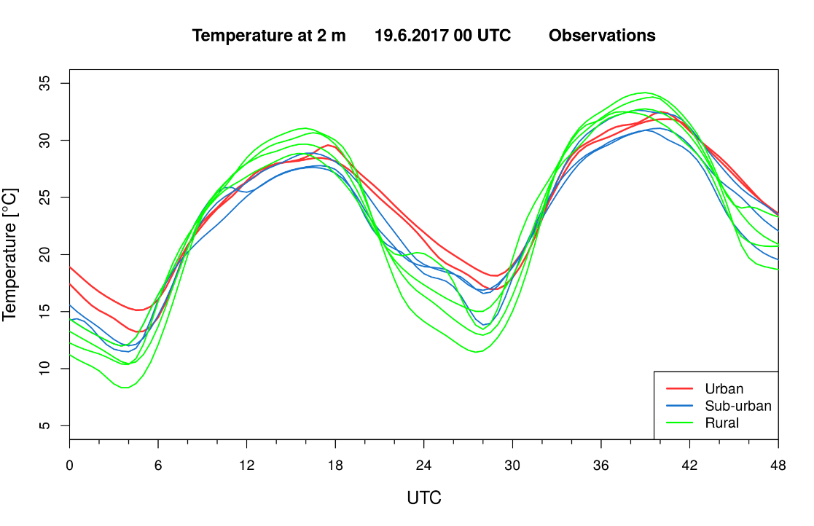
WRF forecast mode with SLUCM (3km)

Slide 16
Urbanization of air-quality forecast
• air quality prediction based on urbanized weather forecast (role of mixing layer height, wind velocity, temperature, etc) using coupled simulations of WRF and CTM in very high resolution simulations of 1 km with localised urban emissions
• to provide more detailed information for warnings, planning of the activities of population, planning of the services to adapt and mitigate the effects of urban environment
• to provide quasi-operationally the tool for the assessment of the potential of regulatory measures, esp. for transportation, for mitigation of concentration exceedances

Slide 17
PM2.5 urban effect (meteorological)
Observation
Temperature (°C)
Temperature (°C)
Huszar et al. ACP, 2018

Slide 18
Urbanization of climate change scenarios
• urbanization of climate change scenarios results from CMIP and EuroCORDEX available simulations
• urbanized simulations for dynamical downscaling of selected climate change scenarios simulations in very high resolution simulations (3 km) with localised urban parameters for individual parts of the city
• to provide the tool for the assessment of the potential of measures for adaptation and mitigation adopted in Strategic City Development Plan in long term perspective, together with air-quality issues

Slide 19
Conclusions
• Urban surfaces have significant impact on the meteorological conditions and climate in Central Europe, with increasing effects on population and up-to-date science can to catpture it
• Urban heat island effect clearly identified in simulations as well, mainly during summer and nighttime, especially significant under extreme weather like heat wave
• High-resolution achieved the city’s scale, no excuse to neglect it, localized simulations, weather prediction for cities, with extreme events for adaptation or mitigation options can be done
• Higher complexity parameterization necessary to capture the effects fully, which might be important e.g. for air-quality issues
Proof of concept and further more detailed assessment within the project URBI PRAGENSI, topic taken to CORDEX activity platform – planning FPS
Proof of concept

Slide 20
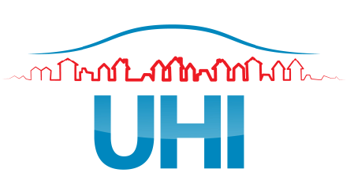
Acknowledgement
The work recently supported within OP-PPR URBI PRAGENSI - Urbanization of weather forecast, air quality prediction and climate scenarios for Prague CZ.07.1.02/0.0/0.0/16_040/0000383, OP-PPR project Proof of Concept UK, CZ.07.1.02/0.0/0.0/16_023/0000108, Ověření proveditelnosti a komerčního potenciálu výsledků výzkumu Univerzity Karlovy, started under support by UHI project “Development and Application of Mitigation and Adaptation Strategies and Measures for Counteracting the Global Urban Heat Island Phenomenon” within the framework of EC Operation Programme Central Europe (3CE292P3), using the previous development achieved under EC FP6 STREP CECILIA, later under support by EC FP7 Project MEGAPOLI (Megacities and regional hot-spots air quality and climate), grant agreement no.: 212520.
THANKS FOR YOUR ATTENTION !

