Slide 1
Leveraging machine learning to produce a cost effective national building height map of Ireland to create local climate zones
Eoghan Keany, Geoffrey Bessardon and Emily Gleeson

Slide 2
Motivation
compact midrise
compact high-rise
compact low-rise
Met Eireann has recently produced a land cover map of Ireland using machine learning based on the CORINE map.
Walsh et al. 2021 Using machine learning to produce a very high resolution land-cover map for Ireland https://doi.org/10.5194/asr-18-65-2021
Bessardon et al. Using machine learning to produce a very high-resolution land-cover map for Ireland and beyond, EMS Annual Meeting 2021, online, 6–10 Sep 2021, EMS2021-53, https://doi.org/10.5194/ems2021-53, 2021
To make this map operational CORINE urban labels have to be translated in local climate zones (Stewart, I.D. and Oke, T.R. (2012)) requiring information on building density and heights
Frantz et al. 2021 produced a map of building height using Sentinel-1 and Sentinel-2 time series for Germany
open low-rise
open midrise
open high-rise
sparsely built
large low-rise
lightweight low-rise
LCZ definition schematic from Stewart, I.D. and Oke, T.R. (2012)

Slide 3
Model and datasets
Dataset used
Model tested
Time series data from both Sentinel 1 and 2
Data from which we will predict building height
2012 building heights map only covers Dublin
Reference data to train our model
European Settlement Map 2015
Quality control to mask non building area in results
Ridge Regressior (similar to Frantz et al. 2021 )
Poisson XGBoost Regressor
Convolutional Neural Network
U-Net

Slide 4
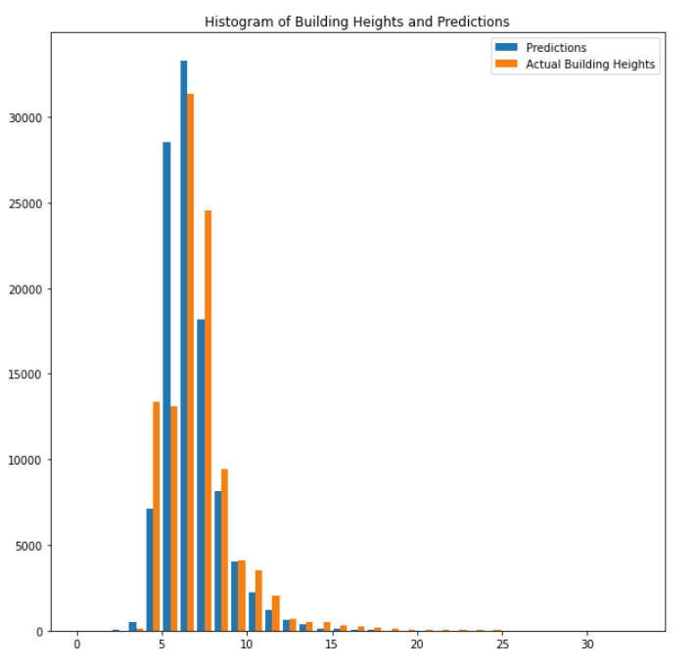
Results
CNN achieving the best results for RMSE, wRMSE, and Earth Mover’s distance but 10 times longer
XGBoost RMSE and wRMSE better than Ridge Regressor but Earth Mover’s distance is doubled
Ridge Regressor deemed to be the best compromise
Ridge Regressor does a good job but over predicts average building heights
Models performances table

Slide 5
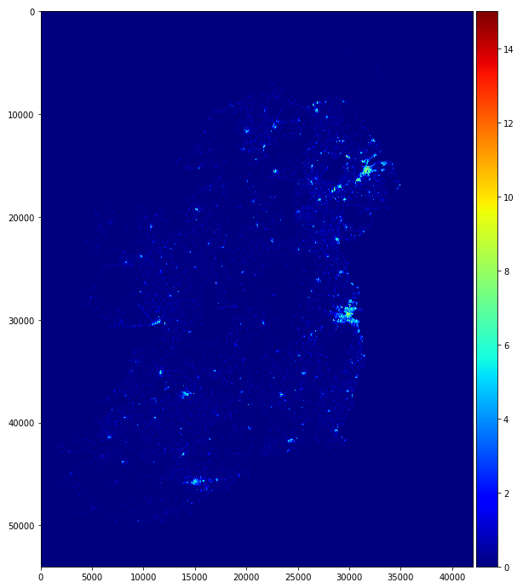
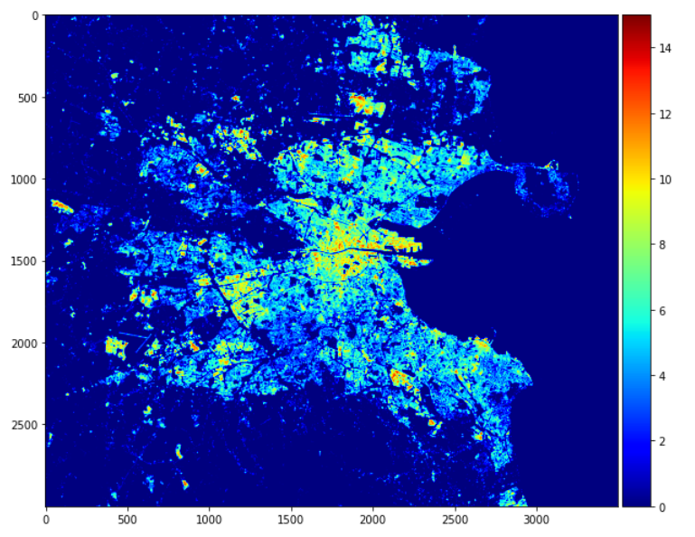
Conclusion
Entire Map
Dublin City
We produced a building height of Ireland using machine learning
This method relies on open-source dataset and as such can be reproduced
Next step using this new map to improve the LCZ classification in HARMONIE-AROME

