Slide 1
New profiling capability for operational ceilometer networks
M. Tuononen, R. Lehtinen, J. Kallio,
P. Tuominen, R. Roininen

Slide 2
Vaisala CL61 ceilometer with depolarization
Ice crystals
Melting layer
Falling precipitation
Liquid cloud droplets
Evolution of boundary layer

Slide 3
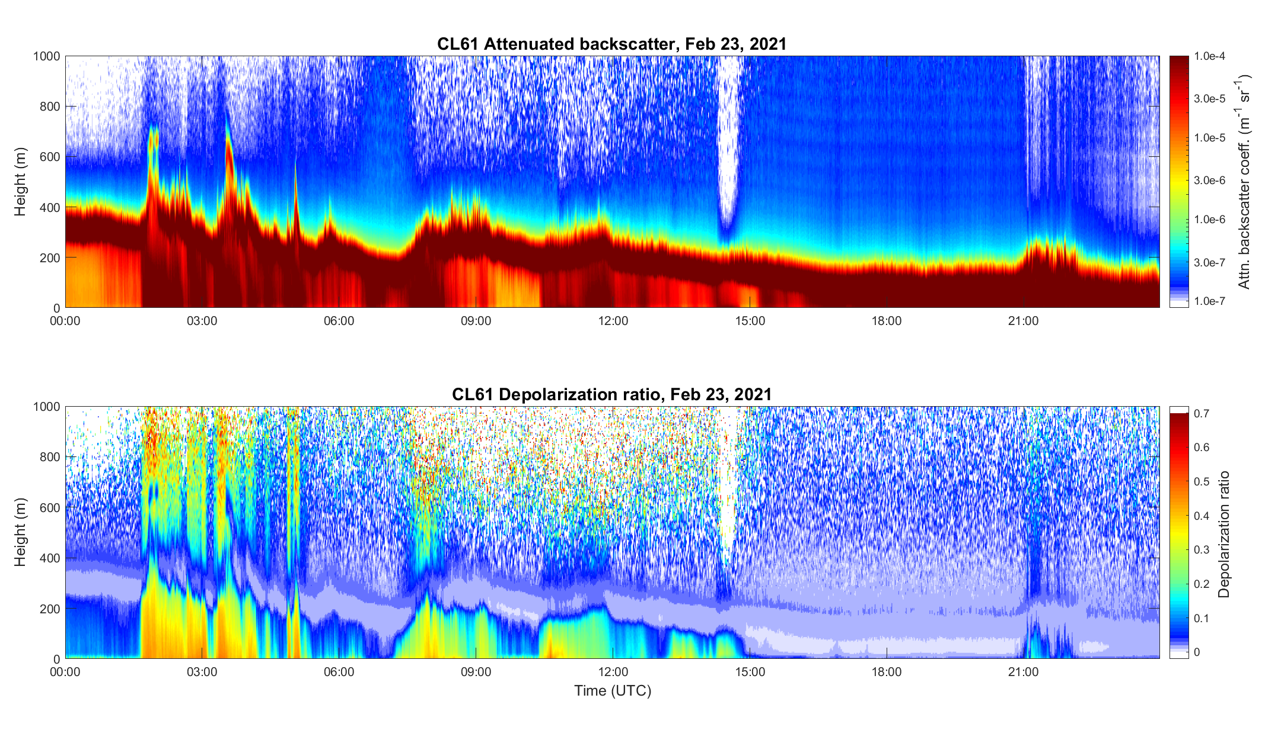
Forest fire smoke
Application case examples
Freezing rain

Slide 4
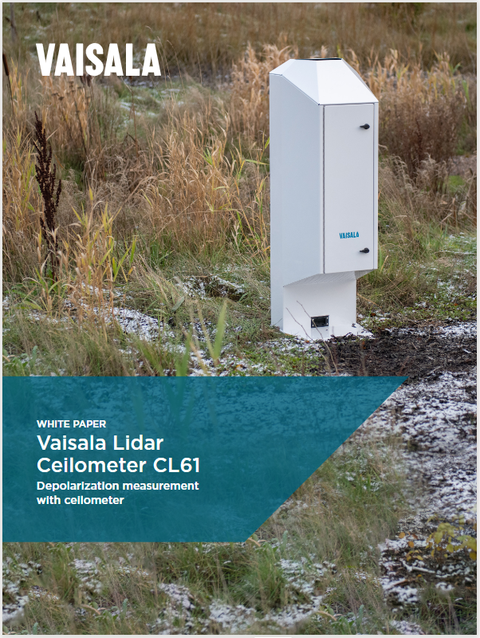
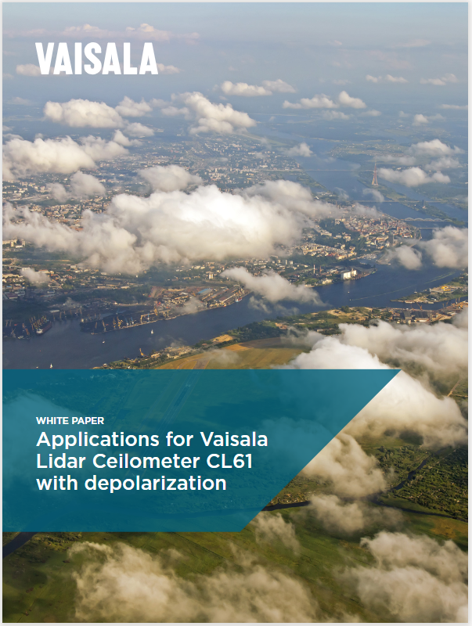
CL61 white papers

